Slide 1

CSCI 476: Computer Security
Cross Site Scripting (XSS) Attack (Part 1)
Reese Pearsall
Fall 2024
https://www.cs.montana.edu/pearsall/classes/fall2024/476/main.html

Slide 2
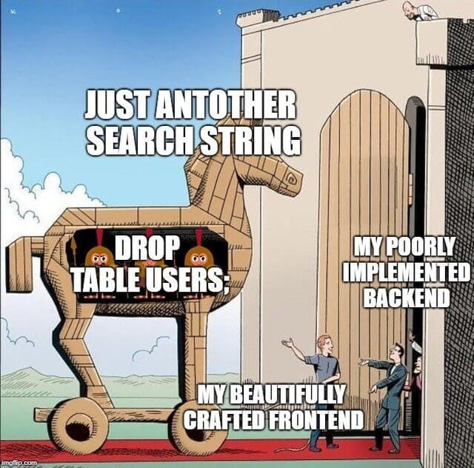
Announcement
Lab 3 (Buffer Overflow) Due tonight @ 11:59 PM
Lab 4 (SQL injections) Due Sunday 10/20 @ 11:59 PM

Slide 3


Slide 4
Lab 4

Slide 5
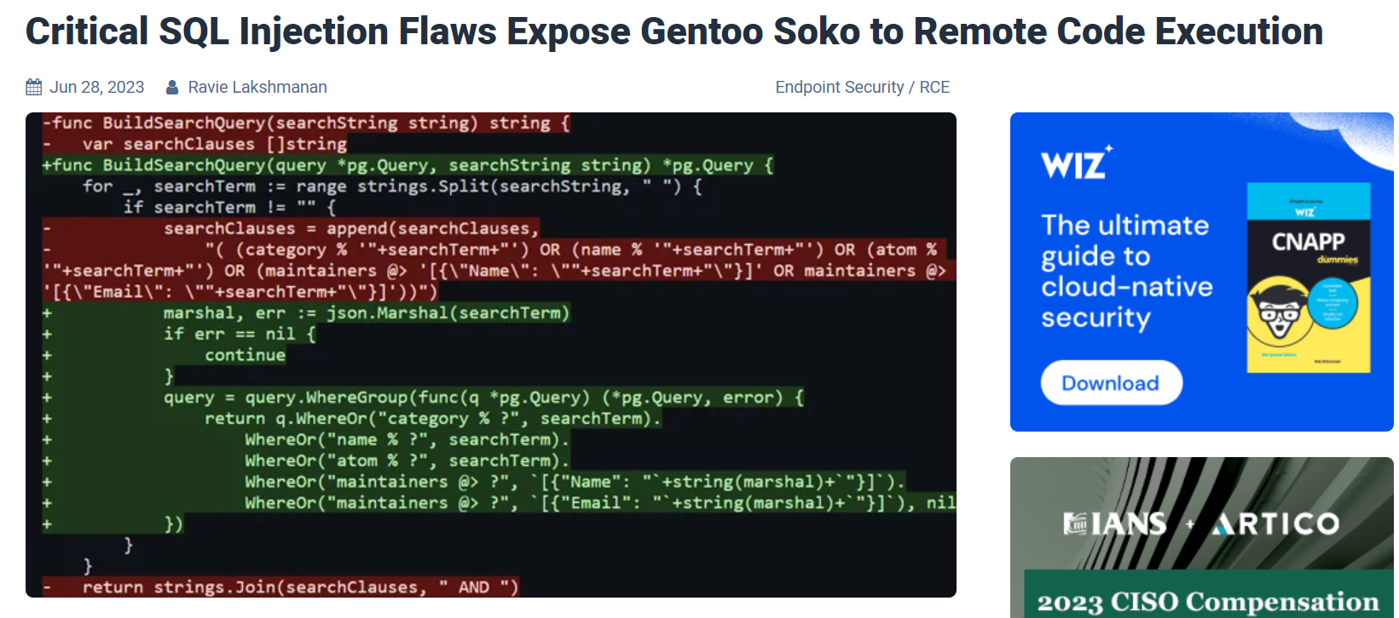
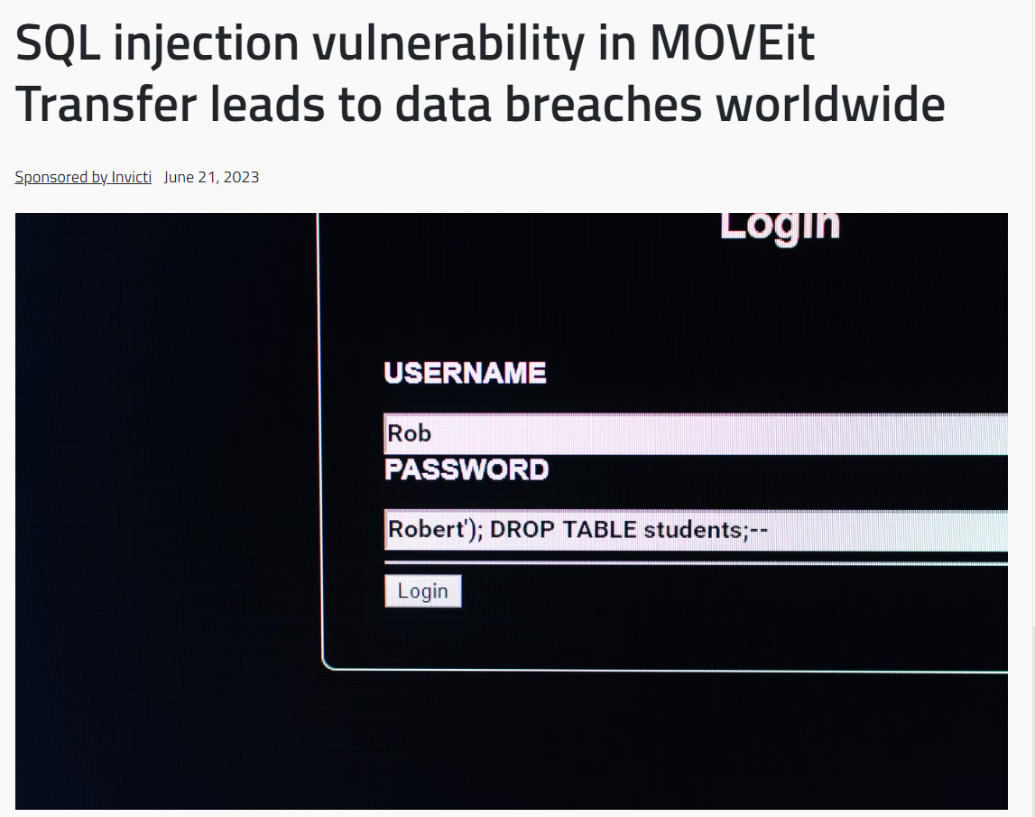
SQL Injection

Slide 6
Timeline and TODO
Software Security
Set- UID + Access Control
Shellshock
Buffer Overflow
Cryptography
Symmetric
Asymmetric
Hashing
August
December
Computer System Basics
Web + Network Security
SQL Injection
XSS Attack
TCP/IP Attacks
DNS Cache Poisoning
Special Topics,
Threat Modeling, Lessons Learned

Slide 7



The Internet
Brief Review of
Query parameters can be passed via URL or in an HTTP request
protocol://hostname[:port]/[path/]file[?color=red&type=suv]
Communication of the web:
URL
Client
Server
HTTP Request:
Format: Method, Headers, Body
Methods: GET, POST, HAD, UPDATE
Headers: Host, referrer, User-agent, Cookie…
HTTP Response:
Format: Status, Response Headers, Body
Status Codes: 2xx (successful), 3xx (redirect), 4xx (bad request), 5xx (server error)
Server-side functionality
Serve static resources (HTML, CSS, Images)
Serve dynamic Resources (PHP, Ruby, Java, Javascript…)
Query Databases
Relational (MySql)
Non-Relational (MongoDB)
Big Idea: Our input data gets passed to another host through URL parameters and an HTTP requests
Database

Slide 8
Our Attacks So far
Shellshock- We were able to execute operating system commands of our choosing (/bin/sh) on someone else’s server due to unsafe environment variable parsing
Buffer Overflow- We were able to execute arbitrary code by hijacking a program that unsafely writes data to the stack
SQL Injection- We were able to run our own arbitrary SQL queries due to unsafe user input handling
XSS – We are able to get someone else’s browser to execute our own JavaScript code

Slide 9
Our Attacks So far
Shellshock- We were able to execute operating system commands of our choosing (/bin/sh) on someone else’s server due to unsafe environment variable parsing
Buffer Overflow- We were able to execute arbitrary code by hijacking a program that unsafely writes data to the stack
SQL Injection- We were able to run our own arbitrary SQL queries due to unsafe user input handling
XSS – We are able to get someone else’s browser to execute our own JavaScript code due to unsafe input handling and unsafe web communication policies

Slide 10

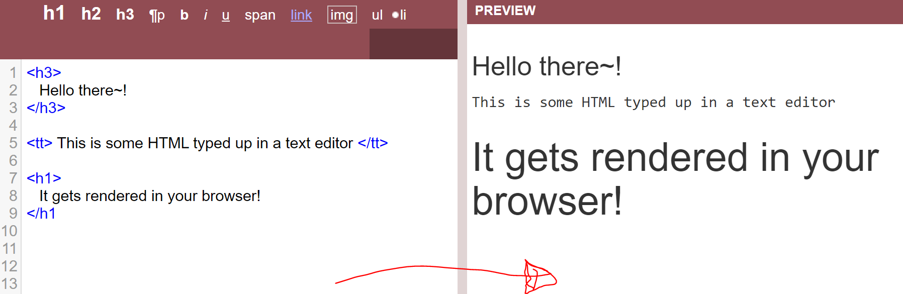
Javascript
Purpose of Javascript?
Static Content consists of mostly HTML + CSS

Slide 11
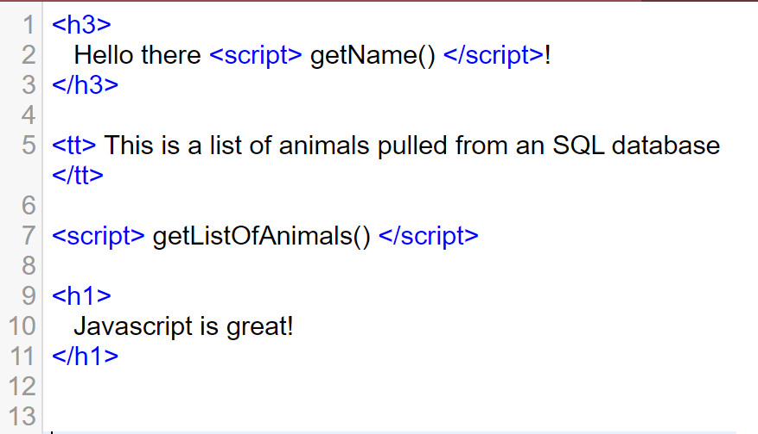
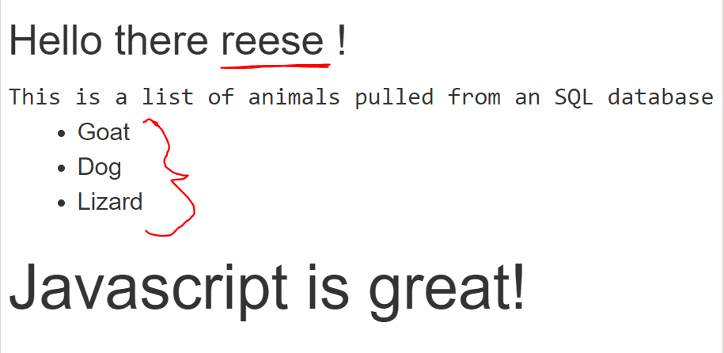
Javascript
Purpose of Javascript?
Javascript allows us to serve dynamic web content

Slide 12
<!DOCTYPE html>
<html>
<head>
<title> Javascript example</title>
</head>
<body>
<h2>JavaScript HTML Events</h2>
Enter your name: <input type="text" id="fname" onchange="upperCase()">
<p>When you leave the input field, a function is triggered which transforms the input text to upper case.</p>
<script>
function upperCase() {
alert("AHHHHHHHHHHHHHHH");
const x = document.getElementById("fname");
x.value = x.value.toUpperCase() + " pearsall";
}
</script>
</body>
</html>

Slide 13

It is very common for web pages to take in input from a user
Our input could be reflected in the HTML output, put into a SQL query, HTTP request etc
Instead of inputting normal text, we could input our own javascript

Slide 14

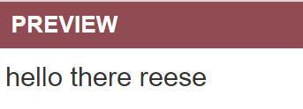
<p> Hello there $value </p>
reese
(html)

Slide 15
<p> Hello there $value </p>
http://unsafe-website.com?value=reese
(html)

Slide 16
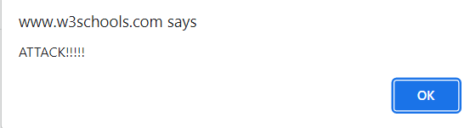
<p> Hello there $value </p>
reese <script> alert(“ATTACK!!”); </script>
(html)
Cross-site scripting works by manipulating a vulnerable web site so that it returns malicious JavaScript to users
We need to investigate any places where input from an HTTP request could possibly make its way into HTML output

Slide 17
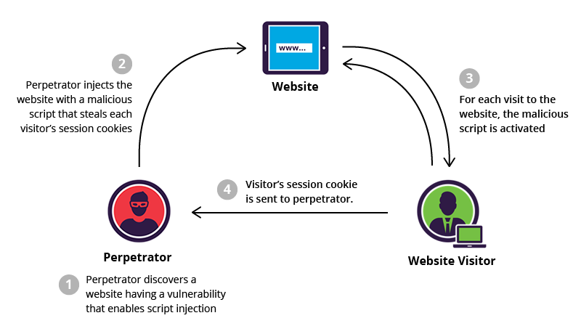
Cross Site Scripting (XSS) is a type of web vulnerability that allows an attack to inject their own malicious client-side scripts into benign webpages that will be loaded by other users

Slide 18
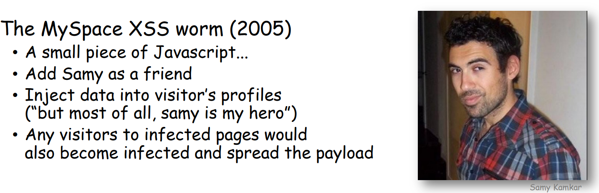

Slide 19
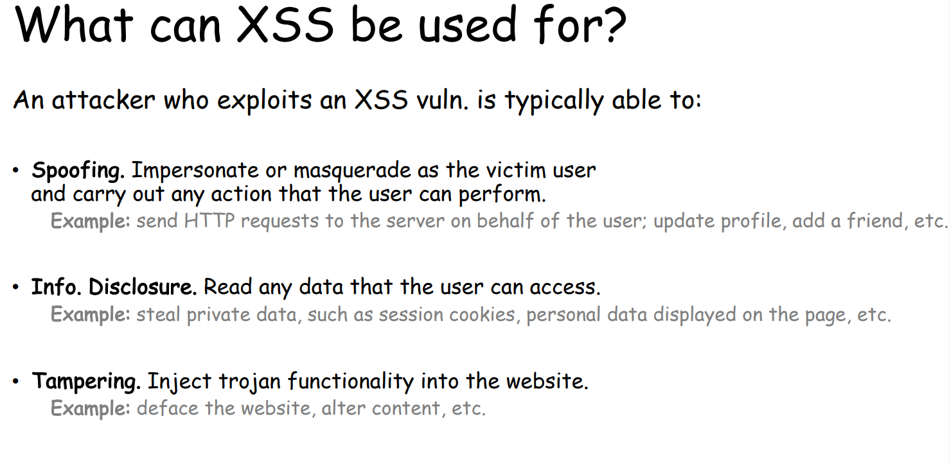

Slide 20
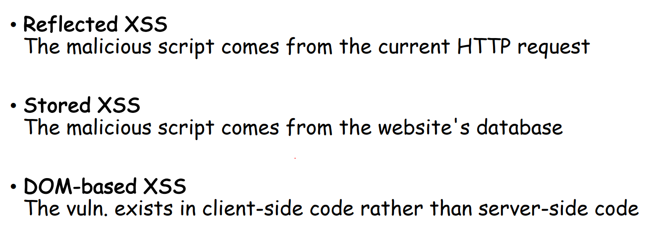
Types of XSS

Slide 21
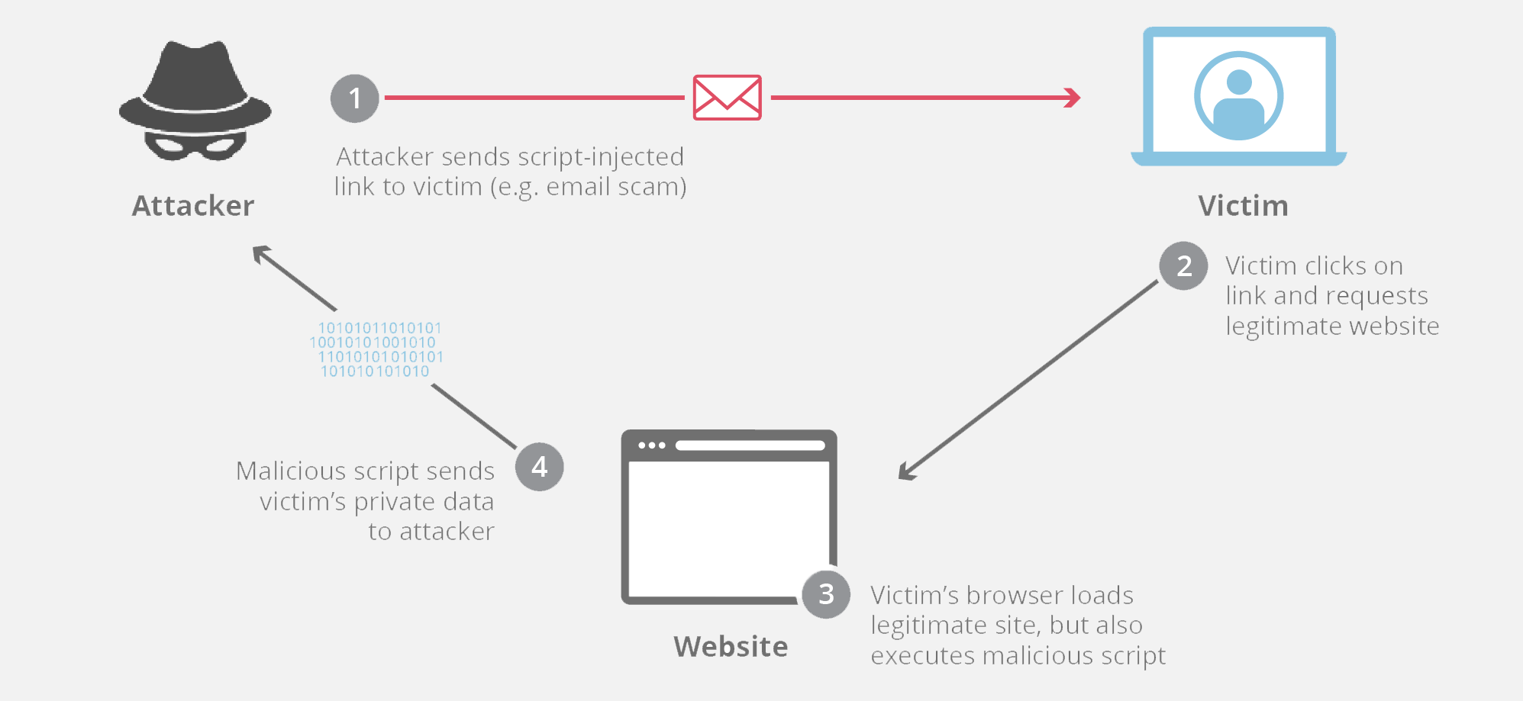
Types of XSS
Reflective
http://www.example.com/search?input=<script>alert(“hacked”);</script>
Alert:
hacked

Slide 22
Reflected XSS (Non-Persistent)
Why does this happen?!
• Many websites are reflective:
user input -> website -> (modified) user input sent back to browser
• If an application receives data from an HTTP request...
...and includes that data within the immediate response in an unsafe way...
...reflective XSS may be possible!

Slide 23
Reflected XSS (Non-Persistent)

Slide 24
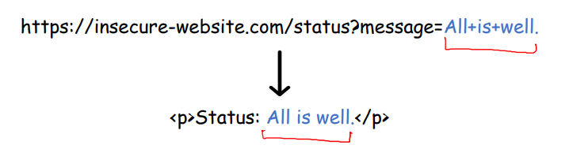
Reflected XSS (Non-Persistent)

Slide 25
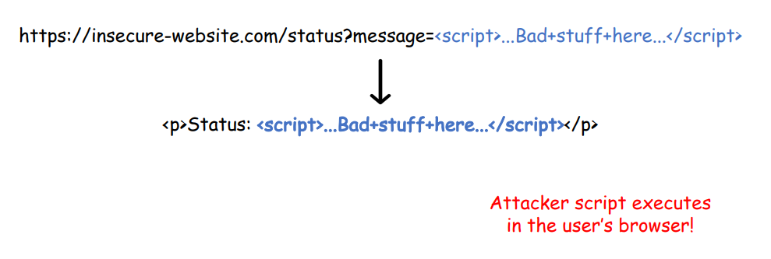
Reflected XSS (Non-Persistent)

Slide 26
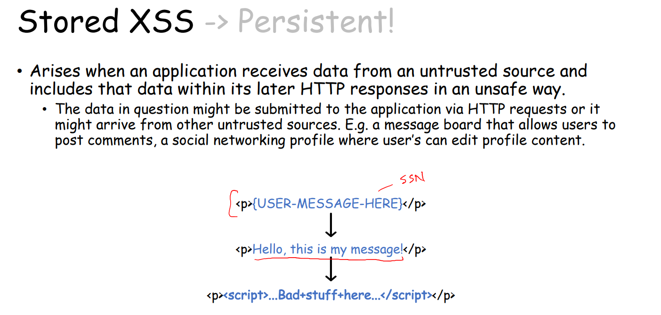

Slide 27
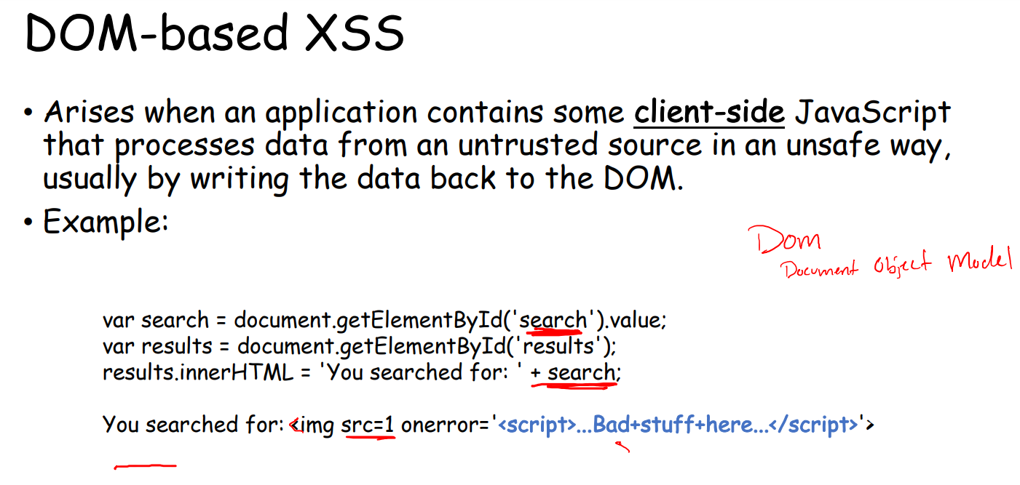

Slide 28
We will once again use docker to create a fake social media network that has XSS countermeasures disables
First, make sure your SQL injection docker container is turned off
cd 05/xss
docker-compose up -d
Elgg is an open source web framework for creating social media sites
Visit http://www.xsslabelgg.com/ on VM browser
<script>alert('EVILLLLLLLLLLLLLLLLLL');</script>
(do not visit this site elsewhere)

Slide 29
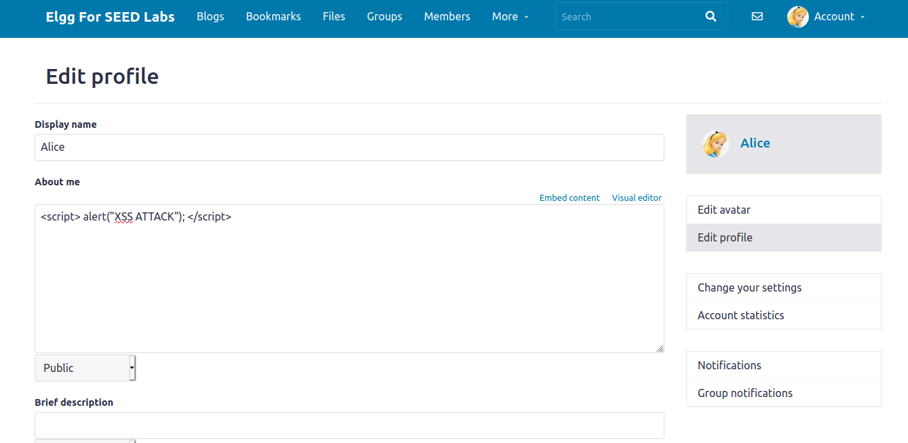
Basic XSS Attack to display a message
Edit HTML
Our malicious JavaScript

Slide 30
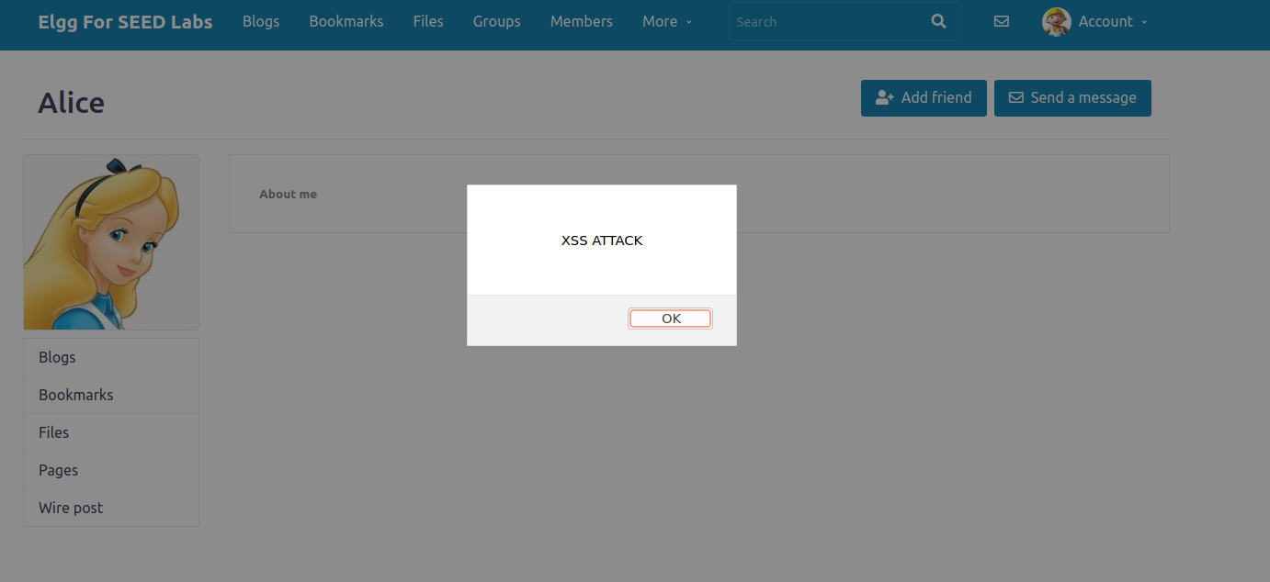
Basic XSS Attack to display a message
Now when I am logged in as Boby, when I visit Alice’s profile, her profile information gets displayed to the screen
The malicious script we injected earlier gets loaded and executed on Boby’s end (!!!)

