Slide 1

CSCI 476: Computer Security
Secret Key Encryption/Symmetric Cryptography (Part 1)
Reese Pearsall
Fall 2024
https://www.cs.montana.edu/pearsall/classes/fall2024/476/main.html

Slide 2
Announcement
DNS Lab due Sunday (11/10)
Project due one week from toady (11/21)
One week from today, I will be gone (recorded lecture will be posted before class time)

Slide 3
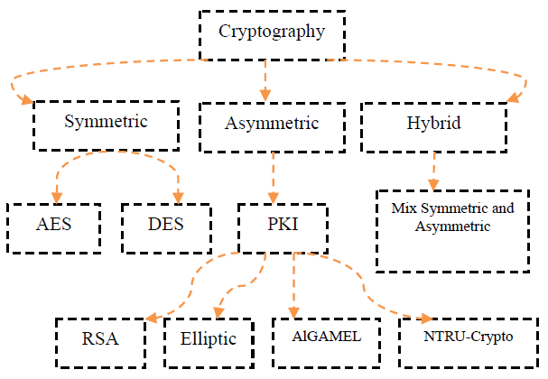
Information Security
The protection of information and information systems
Cryptography is the practice and study of techniques for securing communications and data in the presence of adversaries
There are many types of encryption

Slide 4


Bob
“Hi Alice, my address is 123 Painting Avenue. Please stop by at 6:00”
Alice
Over a wire, wirelessly, via a Pidgeon etc

Slide 5


Bob
“Hi Alice, my address is 123 Painting Avenue. Please stop by at 6:00”
Alice
Because our transmission medium is shared, there is a possible someone else could be eavesdropping
Eve

Slide 6
Bob
“Hi Alice, my address is 123 Painting Avenue. Please stop by at 6:00”
Alice
Because our transmission medium is shared, there is a possible someone else could be eavesdropping
Eve
Our goal is to make sure Alice can receive our message securely, and our original message cannot be intercepted

Slide 7
Bob
Alice
Cleartext/Plaintext
“Hi Alice, my address is 123 Painting Avenue. Please stop by at 6:00”
Eve

Slide 8

Bob
Alice
Cleartext/Plaintext
“Hi Alice, my address is 123 Painting Avenue. Please stop by at 6:00”
Bob encrypts his message with a key
Eve
MuYGoP5LiTTGPVX6U/r2VTpxPSqTFmy5nsoFWURThKMhHk/7tbjYsS2EJ917q7megTAcV+V4ZMU4HjJjiW2DCBroxvJ0V3ZYDgZ8B9lUvGUmdiRMH25Xkf7QrhAGR3FF
The result is a ciphertext

Slide 9

Bob
MuYGoP5LiTTGPVX6U/r2VTpxPSqTFmy5nsoFWURThKMhHk/7tbjYsS2EJ917q7megTAcV+V4ZMU4HjJjiW2DCBroxvJ0V3ZYDgZ8B9lUvGUmdiRMH25Xkf7QrhAGR3FF
Alice
Cleartext/Plaintext
“Hi Alice, my address is 123 Painting Avenue. Please stop by at 6:00”
If Eve intercepts our ciphertext, she can't do very much with it
Eve
MuYGoP5LiTTGPVX6U/r2VTpxPSqTFmy5nsoFWURThKMhHk/7tbjYsS2EJ917q7megTAcV+V4ZMU4HjJjiW2DCBroxvJ0V3ZYDgZ8B9lUvGUmdiRMH25Xkf7QrhAGR3FF

Slide 10
Bob
Alice
Cleartext/Plaintext
MuYGoP5LiTTGPVX6U/r2VTpxPSqTFmy5nsoFWURThKMhHk/7tbjYsS2EJ917q7megTAcV+V4ZMU4HjJjiW2DCBroxvJ0V3ZYDgZ8B9lUvGUmdiRMH25Xkf7QrhAGR3FF
“Hi Alice, my address is 123 Painting Avenue. Please stop by at 6:00”
Eve
Alice receives the ciphertext, and then uses the same key that bob used, and then decrypts the ciphertext
“Hi Alice, my address is 123 Painting Avenue. Please stop by at 6:00”

Slide 11
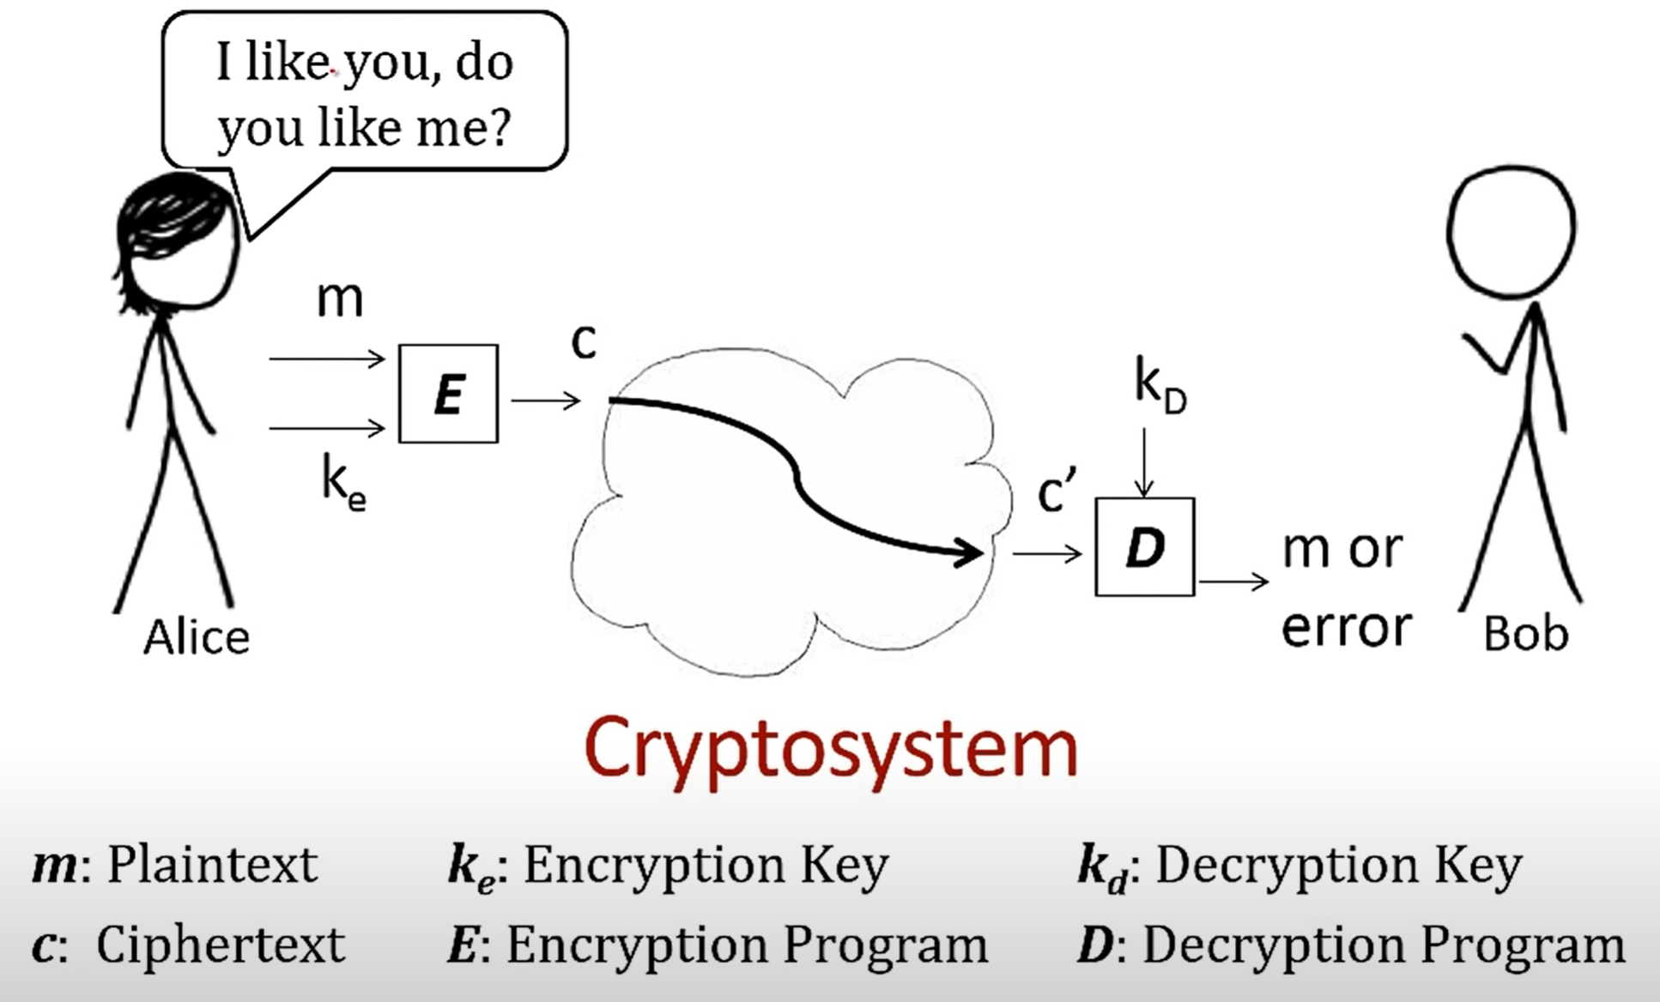
The importance here is that the keys used for encryption/decryption are secret (ie not public knowledge)
The innerworkings of the encryption/decryption program is public knowledge though
Deterministic programs*

Slide 12

Secure cryptography is the foundation for our secure communications in the cyber world (HTTPS, SSH, etc)
The encryption algorithms are typically rooted in very difficult problems in computing (ie there does not exist a program that can efficiently break RSA YET)
There are very intense proofs and prove the secureness of the encryption procedures we use today
Never try to roll out your own cryptography scheme, and never use the built-in RNG for secure communications (import random)

Slide 13
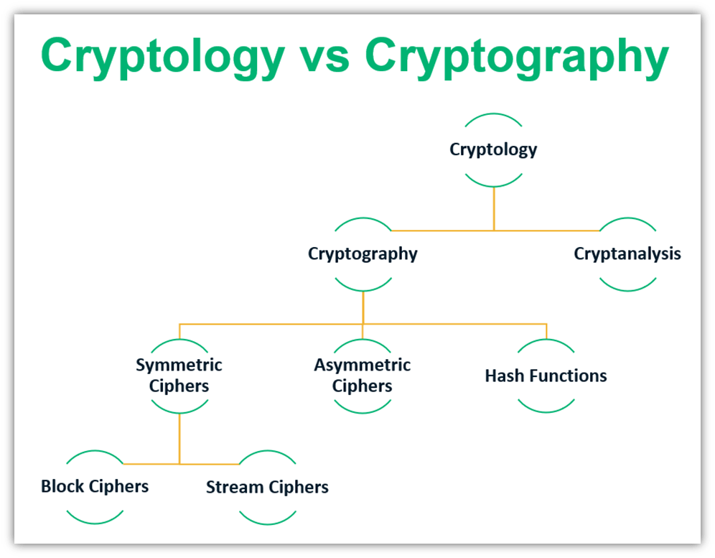

Slide 14
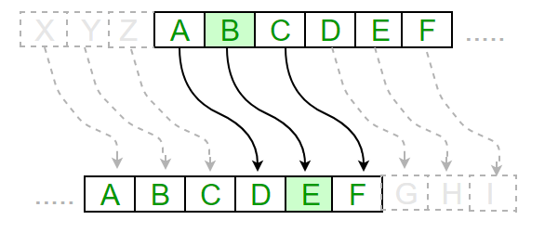

Early cryptography techniques
Shift 3
Caesar Cipher- letters in the plaintext will be replaced by some fixed number of positions downs in the alphabet.
plaintext
hello there world my name is reese
Nifty, but we have the technology to brute force 26 possible shifts
ciphertext
khoor wkhuh zruog pb qdph lv uhhvh

Slide 15
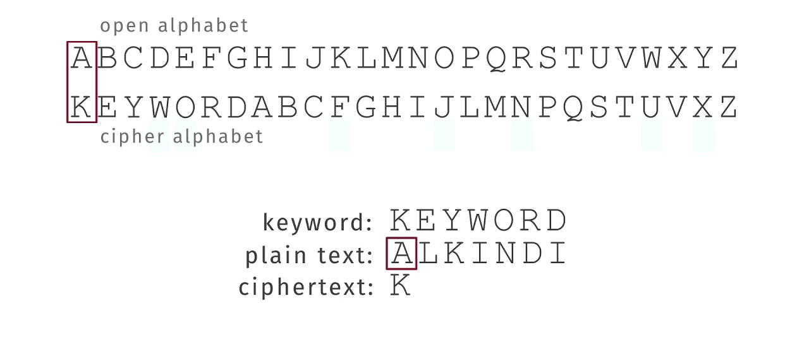
Substitution Cipher
Letters in plaintext are substituted by another letter
E→X
R → Z
REESE = ZXXSX
Monolithic Substitution Cipher – Same “rules” are applied throughout the entire plaintext
Polyalphabetic Substitution Cipher – different “rules” are applied throughout the plaintext

Slide 16
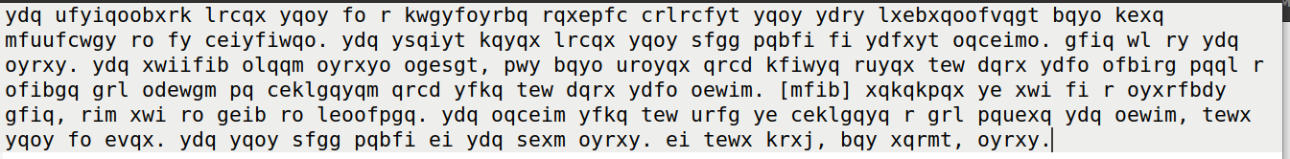
Here is a ciphertext (cipher.txt)
Suppose we know that that this message is an english message encrypted with a monolithic substitution cipher
Can we crack this?

Slide 17
Here is a ciphertext (cipher.txt)
Frequency Analysis leverages the fact that in any given written language, certain letters and combinations occur more frequently than others
In English, T, A , I, and O are the most common letters, so it is likely the letters that appear the most frequently in our ciphertext are one of those

Slide 18
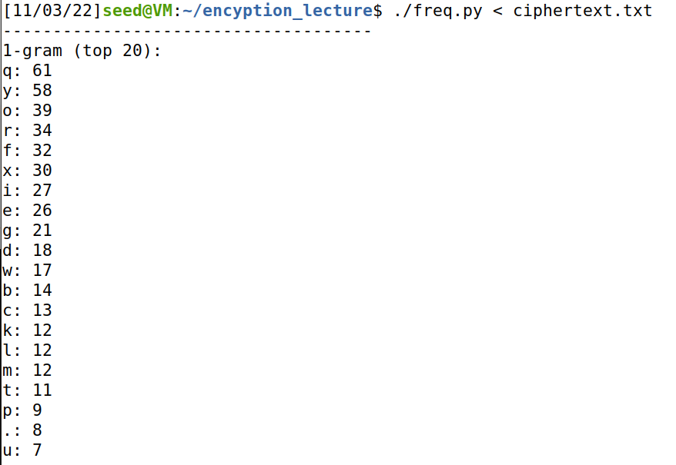
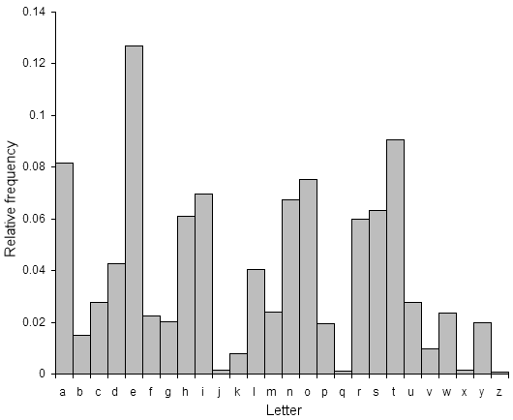
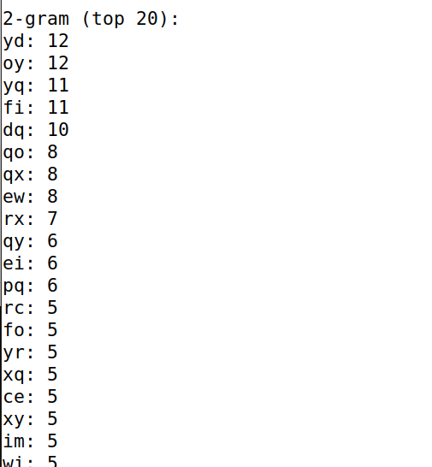
Here is a ciphertext (cipher.txt)
We can write a program that counts the frequency of characters (1-gram) and frequency of character pairs (2-gram)
Frequencies in English Language
We can start making guesses!
Most common bigrams (in order) th, he, in, en, nt, re, er, an, ti, es, on, at, se, nd, or, ar, al, te, co, de, to, ra, et, ed, it, sa, em, ro.

Slide 19
Here is a ciphertext (cipher.txt)
We can write a program that counts the frequency of characters (1-gram) and frequency of character pairs (2-gram)
Frequencies in English Language
We can start making guesses!
Most common bigrams (in order) th, he, in, en, nt, re, er, an, ti, es, on, at, se, nd, or, ar, al, te, co, de, to, ra, et, ed, it, sa, em, ro.

Slide 20
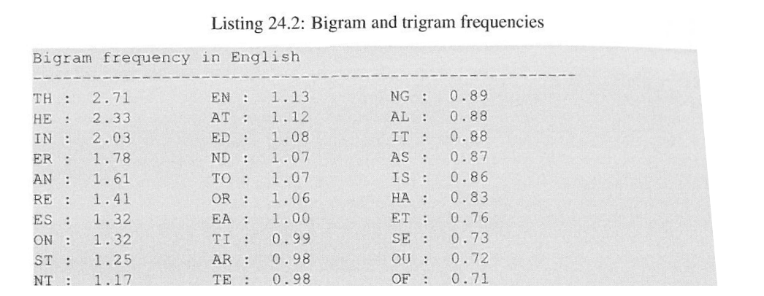
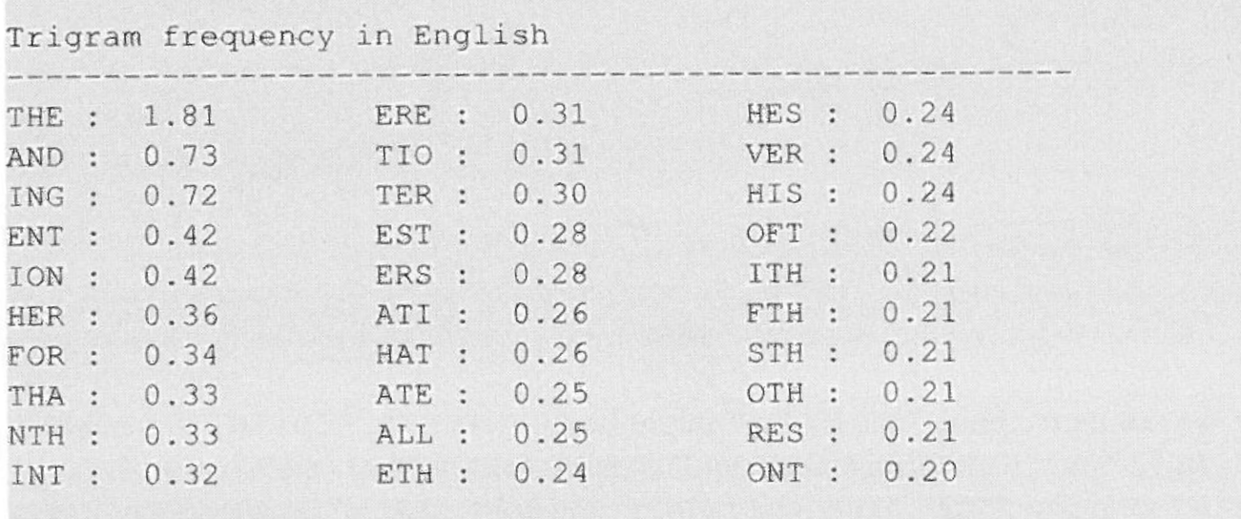

Slide 21
Translate ciphertext.txt, and replace all y with t
Translate ciphertext.txt, and replace all y with t, and replace all d with h
Keep adding more characters to your decryption scheme until you get the full answer ☺

Slide 22
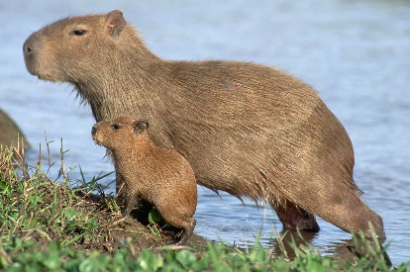
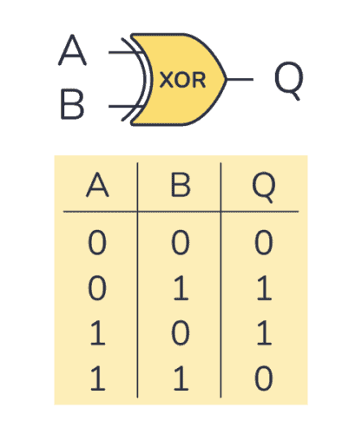
Review the XOR operator:
Everything on a computer is zeros and ones
01010101010100101111010101001000010111001000101010101100101010101011111010010010101010100101010101100101010110101001010101010101010101001010101010101010100101010101010101011010010101010100101…
Hello world
01101000 01100101 01101100 01101100 01101111 00100000 01110111 01101111 01110010 01101100 01100100 00001010
Message:
0001 1010 0011
⊕
1100 1100 0101
Key:
1101 0110 0110
Ciphertext:
1 ⊕ 0 = 1
0 ⊕ 0 = 0
1 ⊕ 1 = 0
0 ⊕ 1 = 1
How to get original message?

Slide 23
Review the XOR operator:
Everything on a computer is zeros and ones
01010101010100101111010101001000010111001000101010101100101010101011111010010010101010100101010101100101010110101001010101010101010101001010101010101010100101010101010101011010010101010100101…
Hello world
01101000 01100101 01101100 01101100 01101111 00100000 01110111 01101111 01110010 01101100 01100100 00001010
Message:
0001 1010 0011
⊕
1100 1100 0101
Key:
1101 0110 0110
Ciphertext:
1 ⊕ 0 = 1
0 ⊕ 0 = 0
1 ⊕ 1 = 0
0 ⊕ 1 = 1
⊕
1100 1100 0101
0001 1010 0011
XOR with the key again!

Slide 24
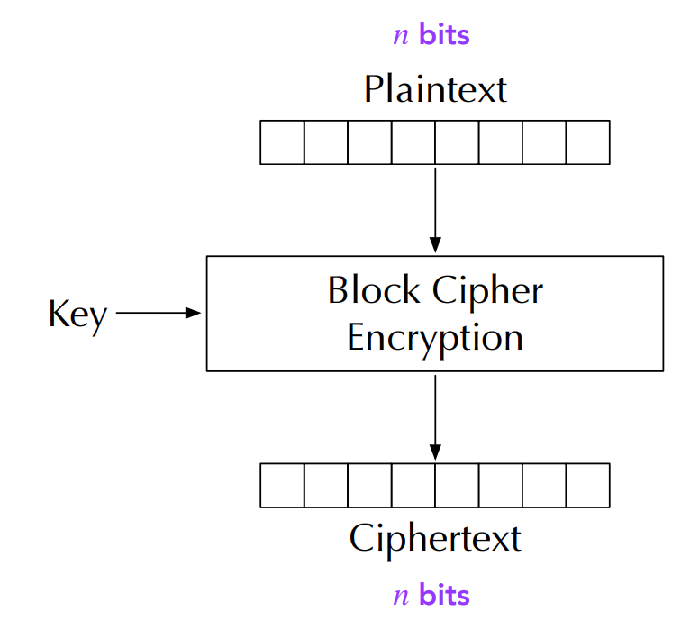
Block Cipher
Split in messages into fixed sized blocks, encrypt each block separately
Hello there world
01101000 01100101 01101100 01101100 01101111 00100000 01110100 01101000 01100101 01110010 01100101 00100000 01110111 01101111 01110010 01101100 01100100 00001010
The specifics of this operation vary depending on your mode of encryption
Block 1
Block 3
Block 2
⊕
⊕
⊕
Decryption is performed by applying the reverse transformation to ciphertext blocks
Important Properties
Even small differences in plaintext result in different ciphertexts
Blocks in plaintext that are the same will also have matching ciphertexts
Ciphertext

Slide 25
Modes of Encryption
Electronic Codebook (ECB)
Cipher Block Chaining (CBC)
Propagating CBC (PCBC)
Cipher Feedback (CFB)
Output Feedback (OFB)
Counter (CTR)
But if we aren’t careful about how we conduct encryption operations, we may accidentally reveal information about the plaintext
All block ciphers!

Slide 26
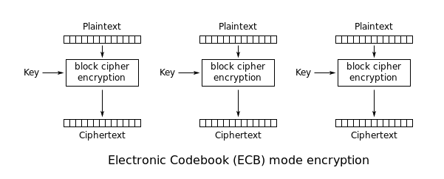
Electronic Codebook ECB
Notice: For the same key, a plaintext always maps to the same ciphertext

Slide 27
Using OpenSSL to encrypt w/ ECB
Encrypt a .txt file
1
2
3
4
openssl enc -aes-128-ecb -e -in plain.txt -out cipher.txt \
-K 00112233445566778899AABBCCDDEEFF
5
1
Encrypt using AES (block cipher) with mode ECB using a 128-bit key
2
Encrypt
3
Input file to be encrypted will be plain.txt
4
Output file created that contains the ciphertext will be cipher.txt
5
Key used for encryption will be 00112233445566778899AABBCCDDEEFF
32 characters in hex → 128 bits

Slide 28
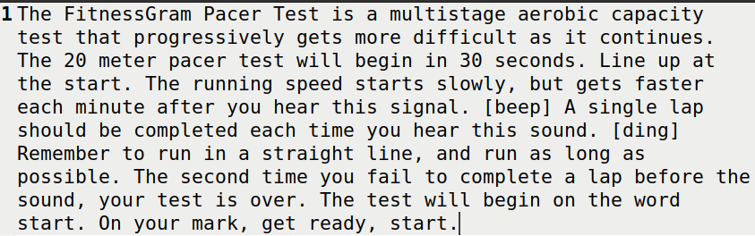
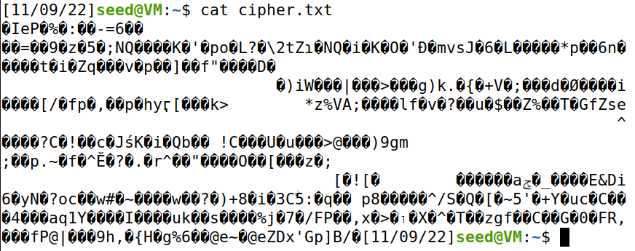


Using OpenSSL to encrypt w/ ECB
Encrypt a .txt file
openssl enc -aes-128-ecb -e -in plain.txt -out cipher.txt \
-K 00112233445566778899AABBCCDDEEFF
plain.txt

Slide 29
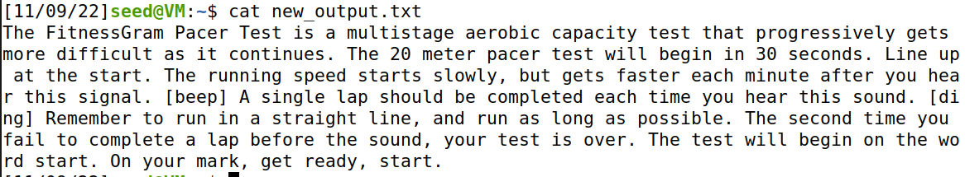

Using OpenSSL to encrypt w/ ECB
Encrypt a .txt file
openssl enc -aes-128-ecb -e -in plain.txt -out cipher.txt \
-K 00112233445566778899AABBCCDDEEFF
Decrypt a .txt file
openssl enc -aes-128-ecb -d -in cipher.txt -out new_output.txt \
-K 00112233445566778899AABBCCDDEEFF

Slide 30
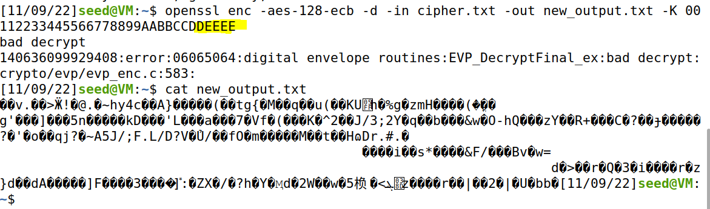
Using OpenSSL to encrypt w/ ECB
Encrypt a .txt file
openssl enc -aes-128-ecb -e -in plain.txt -out cipher.txt \
-K 00112233445566778899AABBCCDDEEFF
Decrypt a .txt file
openssl enc -aes-128-ecb -d -in cipher.txt -out new_output.txt \
-K 00112233445566778899AABBCCDDEEFF
Changing the key used for decryption wont decrypt correctly!

