Slide 1

CSCI 476: Computer Security
Secret Key Encryption/Symmetric Cryptography (Part 2)
Reese Pearsall Fall 2024
https://www.cs.montana.edu/pearsall/classes/fall2024/476/main.html
1

Slide 2
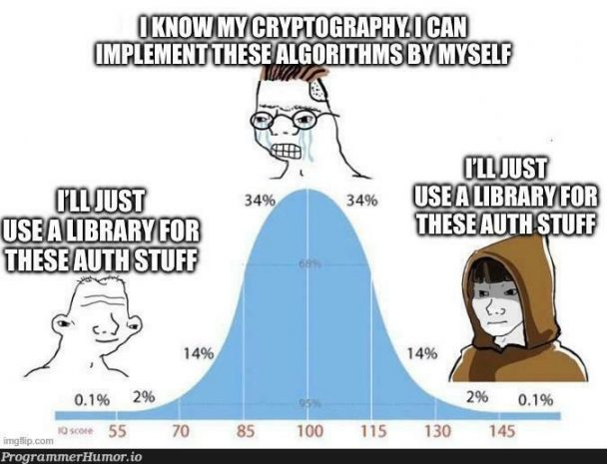
Announcement
Lab 7 due on Sunday
No in-person class on Tuesday
→ I’ll post a recording to the website
2

Slide 3
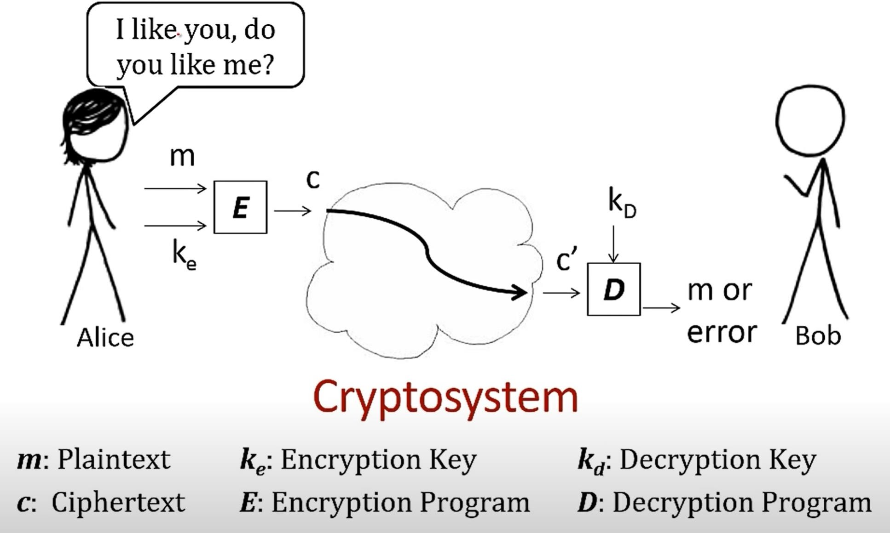
The importance here is that the keys used for encryption/decryption are secret (ie not public knowledge)
The innerworkings of the encryption/decryption program is public knowledge though
Deterministic programs*
3

Slide 4
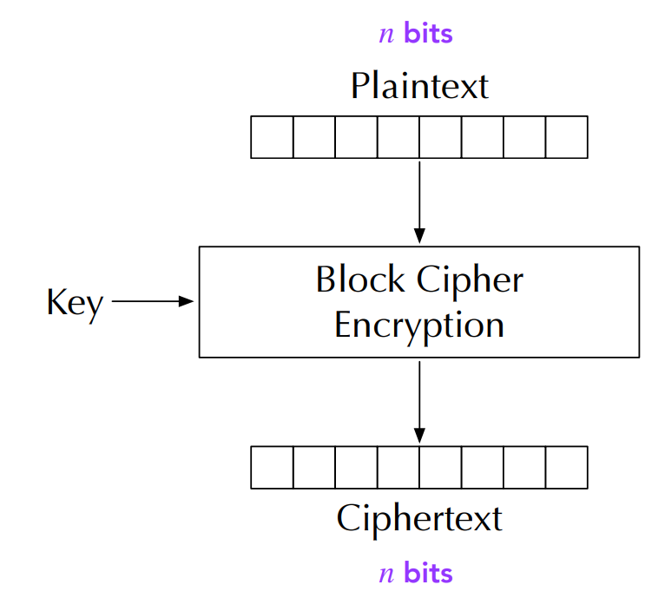
Block Cipher
Split in messages into fixed sized blocks, encrypt eac block separately
Hello there world
h
01101000 | 01100101 | 01101100
01101100 | 01101111 | 00100000
01110100 | 01101000 | 01100101
01110010 | 01100101 | 00100000
01110111 | 01101111 | 01110010
01101100 | 01100100 | 00001010
The specifics of this operation vary depending on
Block 1 Block 2
⊕ ⊕
Block 3
⊕
your mode of
encryption
Decryption is performed by applying the reverse
transformation to ciphertext blocks
Even small differences in plaintext result in
different ciphertexts
Blocks in plaintext that are the same will also have matching ciphertexts
 | Ciphertext
Important Properties
4

Slide 5
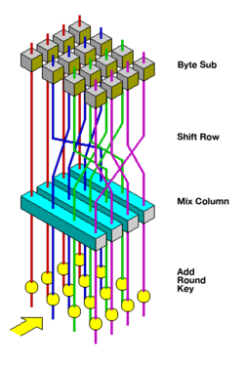
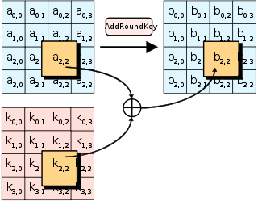
Block Ciphers
AES (Advanced Encryption Standard) and DES (Data Encryption Standard) are both symmetric block ciphers. The way they do block encryptions is slightly different
In AES: Key lengths can be 128, 192, or 256 bits. IN DES, key length can only be 56
AES
Under the hood, these are rather complex ciphers, but each cipher involves multiple rounds of “encryption”
DES is older, broken and has known vulnerabilities, AES is the current widely-used block cipher
5

Slide 6
Modes of Encryption
Electronic Codebook (ECB)
Cipher Block Chaining (CBC)
Propagating CBC (PCBC)
Cipher Feedback (CFB)
Output Feedback (OFB)
Counter (CTR)
Mode of Encryption is used to determine how to handle encryption of a plaintext message that consists of several blocks
But if we aren’t careful about how we conduct encryption operations, we may accidentally reveal information about the plaintext
All block ciphers!
6

Slide 7
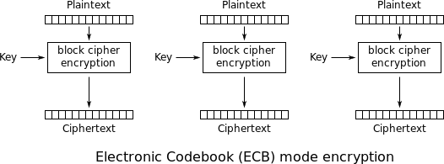
Electronic Codebook ECB
Notice: For the same key, a plaintext always maps to the same ciphertext
7

Slide 8
Using OpenSSL to encrypt w/ ECB
Encrypt a .txt file
1 3
4
2
openssl enc -aes-128-ecb -e -in plain.txt -out cipher.txt \
-K 00112233445566778899AABBCCDDEEFF
5
1
Encrypt using AES (block cipher) with mode ECB using a 128-bit key
2 Encrypt
3
Input file to be encrypted will be plain.txt
4
Output file created that contains the ciphertext will be cipher.txt
5
Key used for encryption will be 00112233445566778899AABBCCDDEEFF
32 characters in hex → 128 bits
8

Slide 9
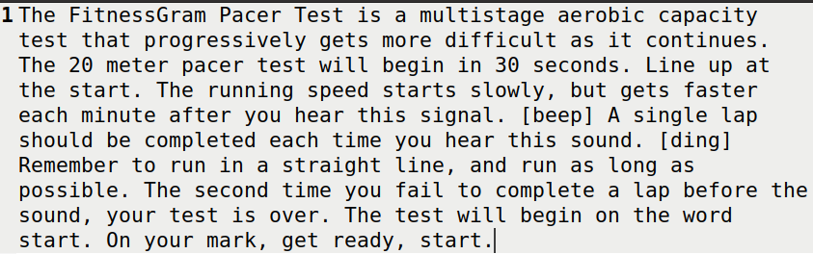

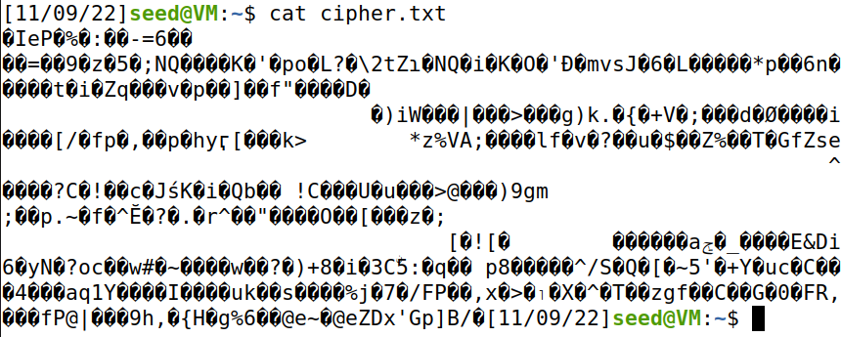

Using OpenSSL to encrypt w/ ECB
Encrypt a .txt file
openssl enc -aes-128-ecb -e -in plain.txt -out cipher.txt \
-K 00112233445566778899AABBCCDDEEFF
plain.txt
9

Slide 10
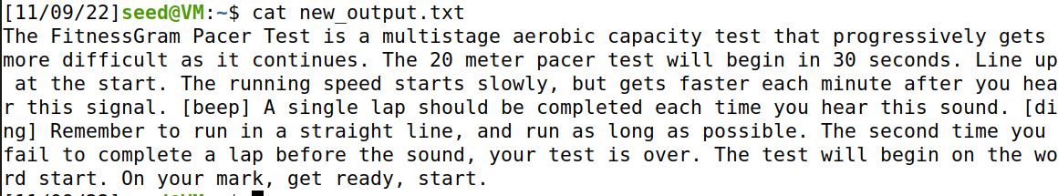

Using OpenSSL to encrypt w/ ECB
Encrypt a .txt file
openssl enc -aes-128-ecb -e -in plain.txt -out cipher.txt \
-K 00112233445566778899AABBCCDDEEFF
Decrypt a .txt file
openssl enc -aes-128-ecb -d -in cipher.txt -out new_output.txt \
-K 00112233445566778899AABBCCDDEEFF
10

Slide 11
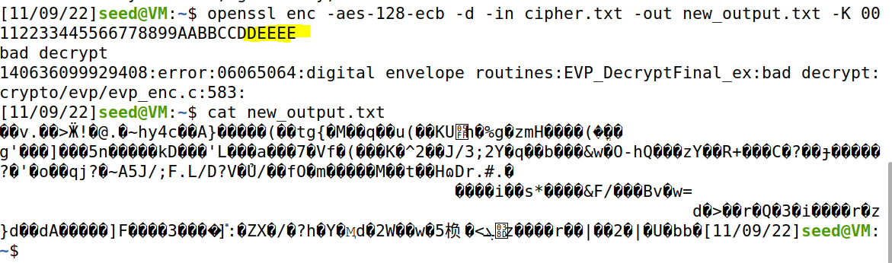
Using OpenSSL to encrypt w/ ECB
Encrypt a .txt file
openssl enc -aes-128-ecb -e -in plain.txt -out cipher.txt \
-K 00112233445566778899AABBCCDDEEFF
Decrypt a .txt file
openssl enc -aes-128-ecb -d -in cipher.txt -out new_output.txt \
-K 00112233445566778899AABBCCDDEEFF
Changing the key used for decryption wont decrypt correctly!
11

Slide 12

Using OpenSSL to encrypt w/ ECB
We can encrypt many things (everything on computers is just 0s and 1s). Let's try an image!
sus.bmp
When encrypting images on the lab, make sure you use a
.bmp image
(You can encrypt jpg and png, but you won’t be able to follow the steps on the next few slides)
12

Slide 13
Using OpenSSL to encrypt w/ ECB
We can encrypt many things (everything on computers is just 0s and 1s). Let's try an image!
sus.bmp
When encrypting images on the lab, make sure you use a
.bmp image
(You can encrypt jpg and png, but you won’t be able to follow the steps on the next few slides)
BMP files (and most files) have headers, which tell the OS
what file type this sequence of 0s and 1s is
When we encrypt the image, the header will also get encrypted
The OS loads the encrypted image → Can't display it!
13

Slide 14
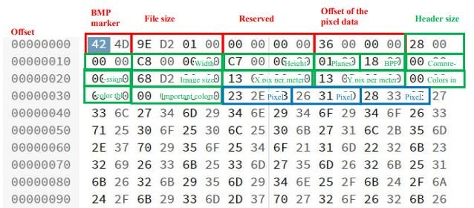
Using OpenSSL to encrypt w/ ECB
We can encrypt many things (everything on computers is just 0s and 1s). Let's try an image!
sus.bmp
01011010101010111010110110110101010101010101010100101
Header
1001010011010101111011100101100010011100000101101100001110011011010111011100000
0010111100100101011011101111011011110111111111001101011101100110010100100010010
0100000100000000101000110101000101001010000001100100011000000110111110110000010
1110001000001100011011110111100010110000001000000111000100101100111110000001001
0000000010110110110010101101101110011111101111101111001000001011001000111001101
1000101010001001010100101010111100000011011011011100011101100100010111111011010
1110100000010011001001110000110011000101000100111110100011101001010000001100011
1001111111001100100101001000110010111101110111111000111000111101100011101101110
1101001111111101110011001011001001110010010010110001001000001010010100011010111
1000001011000100111000101000101001001010100101111011001110100111010010100000111
1011000000101010100110010101111110111111101110001000011001010101000101110000101
1101011111111111011100001110000010001000001001111001110011011100000101000011011
1100100001100111101111011100001001001010111110011110010011101100100010011100100
1101011001111001011000000011011111110111001010011000011001101110011101010100100
0101001001000011011100000110011000111001011111011001010101000010010101011000100
0010111111010000110111011110111011100101101001000001000011110110010100000110000
0110101101110011100100110010111011001000011000010111000101010010001011011000110
0010111000111110110101110010011101010110111110001001011010001010000110101010011
1101001001111111110110110100101001101100101010100111110001011101100101111111011
0110110000010101100111101100011100011111100010001010110111000011010100000011010
1011101010111101011101111110010111111110001011111001000011011110101110111100111
0011000000011111000101110111010000001010101010101011110000111001011000100110101
1010000100110000001010101101101101110100100001000010001001111111111101010001101
0111101001101101111101101111100001101111011101101000110111011001100111101000110
1111101100111001001010101110011011111111001000111101000001110001010110011000110
1011001110011011111011000101011101101010000111011000111111000001110110000101001
1100110001001111100010011000100110011101111111000101011100100011101100101110101
1000101011011101100101010000100000111000100101010111000000111000010000101011110
0011000111010000111111111000101111100011011011001011101011000011110010111001101
0001000110001011000010100011101111100101011010110100001100010110100100101110001
1110111011001100101110111101110111110001101001001110100001010110100101110100101
100000110010111010100010000100101110001011111100111
Body of the image
Fact: The first 54 bytes of a BMP file will be the header
I arbitrarily selected this bit sequence for the header… this would not actually be a valid header
14

Slide 15

Using OpenSSL to encrypt w/ ECB
We can encrypt many things (everything on computers is just 0s and 1s). Let's try an image!
enc.bmp
1000110010010111100001110110000110000111000111110110100000110000100111010001101
sus.bmp
01011010101010111010110110110101010101010101010100101
Header AND image got encrypted
1001010011010101111011100101100010011100000101101100001110011011010111011100000
0010111100100101011011101111011011110111111111001101011101100110010100100010010
0100000100000000101000110101000101001010000001100100011000000110111110110000010
1110001000001100011011110111100010110000001000000111000100101100111110000001001
0000000010110110110010101101101110011111101111101111001000001011001000111001101
1000101010001001010100101010111100000011011011011100011101100100010111111011010
1110100000010011001001110000110011000101000100111110100011101001010000001100011
1001111111001100100101001000110010111101110111111000111000111101100011101101110
1101001111111101110011001011001001110010010010110001001000001010010100011010111
1000001011000100111000101000101001001010100101111011001110100111010010100000111
1011000000101010100110010101111110111111101110001000011001010101000101110000101
1101011111111111011100001110000010001000001001111001110011011100000101000011011
1100100001100111101111011100001001001010111110011110010011101100100010011100100
1101011001111001011000000011011111110111001010011000011001101110011101010100100
0101001001000011011100000110011000111001011111011001010101000010010101011000100
0010111111010000110111011110111011100101101001000001000011110110010100000110000
0110101101110011100100110010111011001000011000010111000101010010001011011000110
0010111000111110110101110010011101010110111110001001011010001010000110101010011
1101001001111111110110110100101001101100101010100111110001011101100101111111011
0110110000010101100111101100011100011111100010001010110111000011010100000011010
1011101010111101011101111110010111111110001011111001000011011110101110111100111
0011000000011111000101110111010000001010101010101011110000111001011000100110101
1010000100110000001010101101101101110100100001000010001001111111111101010001101
0111101001101101111101101111100001101111011101101000110111011001100111101000110
1111101100111001001010101110011011111111001000111101000001110001010110011000110
1011001110011011111011000101011101101010000111011000111111000001110110000101001
1100110001001111100010011000100110011101111111000101011100100011101100101110101
1000101011011101100101010000100000111000100101010111000000111000010000101011110
0011000111010000111111111000101111100011011011001011101011000011110010111001101
0001000110001011000010100011101111100101011010110100001100010110100100101110001
1110111011001100101110111101110111110001101001001110100001010110100101110100101
100000110010111010100010000100101110001011111100111
0011001010000001010010000010110000110100001111100101111010111010110000110110111
1000011111111010000010100000101101010000010110001110101010001001101001110001000
0100010001101100111011001111001101010011100111010010011101110000001010001100001
1010010011100000110000010100011001111010100011010110100111101010100011110010100
1001010001010010010001001010000110111100010110111010101011100011100011110010111
1000011011000011111001001101010100110011100100001101100000000001111101010110011
1101010110011111011100010000000111000000010100010010101010001110100110101110100
1111000110010000011111011111000101011010111101011010100000100110001010011001011
0001011101101001110001001010111110010110101011001111101000100011010011101100000
0111100001011011001001100100011110110110011000100111110100001001011010101110000
0000000100001111110011111110111010111000110010011011110111010101001001100000111
0100000101001000100011011010111010110111000000101100010011010111010011011100110
1110101011111101000001000001000111101101110111010001101000000101110000111101110
1110011000101100000100111111111101110001101111011111101101100010010100000100101
1001100110011001011110100101111101111110010111100001010100000000110100010100100
1101110110001101100111110010001011000101111111010010011001101100101010000011100
0010010010111110010011100111111010110101100111111010110100011010001010011100010
0001110110001000001110011011111110011000001010010100011011000011111111111000001
1110101001101101100110111101000010100101000100011100010100000100001110110010000
0100100000101000110111101101001011010000010011101110100001000100101111001000100
0110111110010100110001011001011110000111111011100101001011010011101011011110011
0110110000100100100010000010010100100000001000111110000100101101101011000101011
1010101000101101010011010000001100000111101101100000111010010100011111000110001
0110100110000000001000001110000101001010000101100000111111111110010000101111000
1001100000010101110000110110110110101001100010111011011101110011100011000010010
1100001010100111111011001000111010101100111111011110011110001010111110111010000
1111111111010101001011001011010101000100001110100011101101100001010001000001111
1101100100101001110010011101001101101100010110000111000001011110000010101011010
1000111010100111111100100001001011000110001110001000100001000011110011101000111
0010001100101000011000011111001111100111010110100100010101111001101101101010111
0100010110101110100111110011100000000001110111101110011111001110000000000111011
1101110011111001110000000000111011110111001111100111000000000011101111011100111
1100111000000000011101111011
Step 2: Frankenstein together the encrypted image so our OS can open it
Take the first 54 bytes of the original image (header)
Take everything after the 54th byte of the encrypted image (image)
15

Slide 16
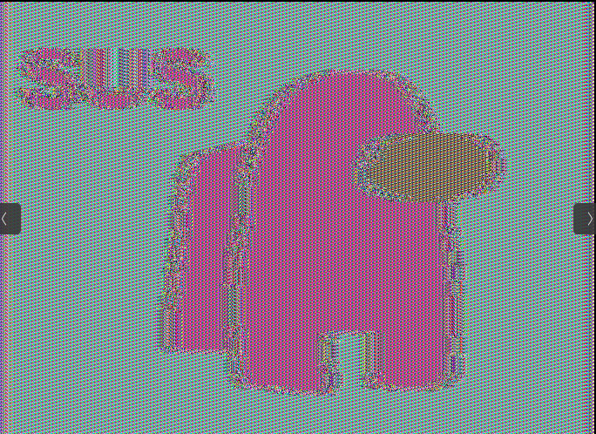
Using OpenSSL to encrypt w/ ECB
We can encrypt many things (everything on computers is just 0s and 1s). Let's try an image!
final.bmp
sus.bmp
01011010101010111010110110110101010101010101010100101
0011001010000001010010000010110000110100001111100101111010111010110000110110111
1000011111111010000010100000101101010000010110001110101010001001101001110001000
0100010001101100111011001111001101010011100111010010011101110000001010001100001
1010010011100000110000010100011001111010100011010110100111101010100011110010100
1001010001010010010001001010000110111100010110111010101011100011100011110010111
1000011011000011111001001101010100110011100100001101100000000001111101010110011
1101010110011111011100010000000111000000010100010010101010001110100110101110100
1111000110010000011111011111000101011010111101011010100000100110001010011001011
0001011101101001110001001010111110010110101011001111101000100011010011101100000
0111100001011011001001100100011110110110011000100111110100001001011010101110000
0000000100001111110011111110111010111000110010011011110111010101001001100000111
0100000101001000100011011010111010110111000000101100010011010111010011011100110
1110101011111101000001000001000111101101110111010001101000000101110000111101110
1110011000101100000100111111111101110001101111011111101101100010010100000100101
1001100110011001011110100101111101111110010111100001010100000000110100010100100
1101110110001101100111110010001011000101111111010010011001101100101010000011100
0010010010111110010011100111111010110101100111111010110100011010001010011100010
0001110110001000001110011011111110011000001010010100011011000011111111111000001
1110101001101101100110111101000010100101000100011100010100000100001110110010000
0100100000101000110111101101001011010000010011101110100001000100101111001000100
0110111110010100110001011001011110000111111011100101001011010011101011011110011
0110110000100100100010000010010100100000001000111110000100101101101011000101011
1010101000101101010011010000001100000111101101100000111010010100011111000110001
0110100110000000001000001110000101001010000101100000111111111110010000101111000
1001100000010101110000110110110110101001100010111011011101110011100011000010010
1100001010100111111011001000111010101100111111011110011110001010111110111010000
1111111111010101001011001011010101000100001110100011101101100001010001000001111
1101100100101001110010011101001101101100010110000111000001011110000010101011010
1000111010100111111100100001001011000110001110001000100001000011110011101000111
Our encrypted image!!!
0010001100101000011000011111001111100111010110100100010101111001101101101010111
0100010110101110100111110011100000000001110111101110011111001110000000000111011
1101110011111001110000000000111011110111001111100111000000000011101111011100111
1100111000000000011101111011
Step 2: Frankenstein together the encrypted image so our OS can open it
Take the first 54 bytes of the original image (header)
Take everything after the 54th byte of the encrypted image (image)
16

Slide 17


Using OpenSSL to encrypt w/ ECB
Why does this suck?
Remember that ECB is a block cipher so it will encrypt the image “block by block”
sus.bmp
Even small differences in plaintext result in different ciphertexts
Blocks in plaintext that are the same will also have matching ciphertexts
Important
Properties
Dividing this image up, we can see that there are many blocks that are the exact same!

Slide 18
Using OpenSSL to encrypt w/ ECB
Lesson learned: ECB can reveal information about our plaintext after encryption has occurred
Why does this suck?
Remember that ECB is a block cipher so it will encrypt the image “block by block”
sus.bmp
Even small differences in plaintext result in different ciphertexts
Blocks in plaintext that are the same will also have matching ciphertexts
Important
Properties
=
=
=

Slide 19
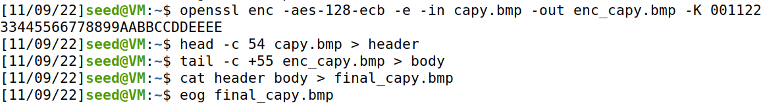

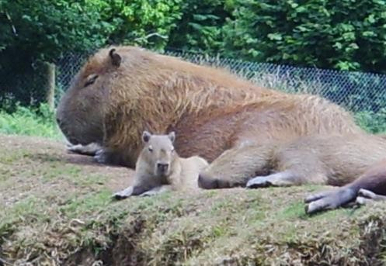
Using OpenSSL to encrypt w/ ECB
Let retry this experiment on a more complex image
capy.bmp
We get much better encryption because the original image
uses a lot more colors!

Slide 20
Using OpenSSL to encrypt w/ ECB
ECB can reveal information about our plaintext if our blocks are similar!
Solution: Add some randomness to each block during encryption
Problem

Slide 21
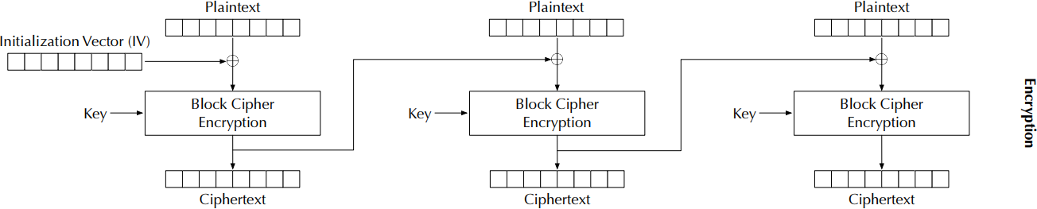
Cipher Block Chaining (CBC) Mode
Introduces block dependency
Introduces an initialization vector (IV) to ensure that even if two plaintexts are identical, their ciphertexts are still different because different IVs will be used

Slide 22
Cipher Block Chaining (CBC) Mode
Reminder: ⊕ = XOR operator
Using CBC to encrypt images??
???
You will do this on the lab.

Slide 23
Using OpenSSL to encrypt w/ CBC
openssl enc -aes-128-cbc -e -in plain.txt -out cipher.txt \
-K 00112233445566778899AABBCCDDEEFF \
-iv 000102030405060708090A0B0C0D0E0F
openssl enc -aes-128-cbc -e -in plain.txt -out cipher2.txt \
-K 00112233445566778899AABBCCDDEEFF \
-iv 000102030405060708090A0B0C0D0E0E
Let’s encrypt the same file, but with different IVs

Slide 24
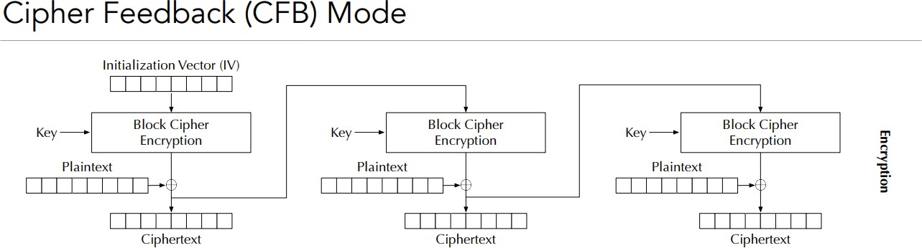
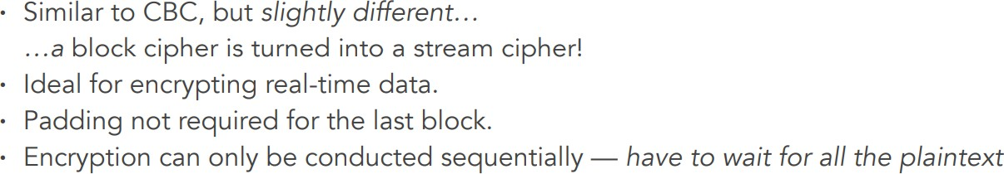

Slide 25
Comparing CBC vs CFB
openssl enc -aes-128-cbc -e -in plain.txt -out cipher.txt \
-K 00112233445566778899AABBCCDDEEFF \
-iv 000102030405060708090A0B0C0D0E0F
openssl enc -aes-128-cfb -e -in plain.txt -out cipher2.txt \
-K 00112233445566778899AABBCCDDEEFF \
-iv 000102030405060708090A0B0C0D0E0F
Any differences in output file sizes?

Slide 26

Comparing CBC vs CFB
openssl enc -aes-128-cbc -e -in plain.txt -out cipher.txt \
-K 00112233445566778899AABBCCDDEEFF \
-iv 000102030405060708090A0B0C0D0E0F
openssl enc -aes-128-cfb -e -in plain.txt -out cipher2.txt \
-K 00112233445566778899AABBCCDDEEFF \
-iv 000102030405060708090A0B0C0D0E0F
Using CFB results in a smaller output file! (woah!)

Slide 27
Padding
In a block cipher (where our block sizes is 4), what happens when we don’t have a multiple of 4?
B3
B1
B2 B4
0011 1110 0011 10
This block is not 4 digits… we need to add more so that our encryption method works!

Slide 28
Padding
In a block cipher (where our block sizes is 4), what happens when we don’t have a multiple of 4?
B3
B1
B2 B4
0011 1110 0011 10
This block is not 4 digits… we need to add more so that our encryption method works!
Extra data or padding, needs to be added to the last block, so its size equals the cipher’s block size

Slide 29
Padding
Questions to answer:
What does the padding look like?
When decrypting, how does the software know where the padding starts?

Slide 30
Padding Experiment #1
What happens when data is smaller than the block size?
Plaintext is 9 bytes
Ciphertext is 16 bytes (7 bytes of padding got added on!)

Slide 31
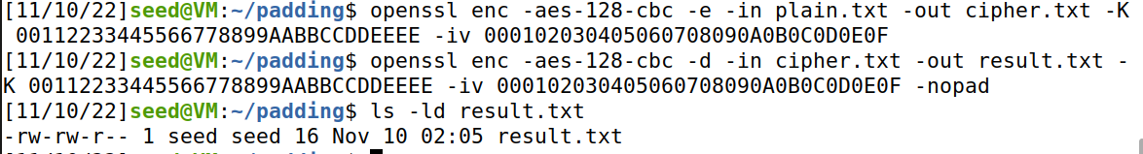

Padding Experiment #2
How does decryption software know where the padding starts?
openssl enc -aes-128-cbc -d -in cipher.bin -out plain3.txt \
-K 00112233445566778899AABBCCDDEEFF \
-iv 000102030405060708090A0B0C0D0E0F -nopad
7 bytes of 0x07 are added as padding data

Slide 32

Padding Experiment #2
How does decryption software know where the padding starts?
Block 1 Block 1
1 2 3 4 5 6 7 8 9 07 07 07 07 07 07 07
K =1
B = 8 characters
In general, for block size B and last block w K bytes,
B-K bytes of value B-K are added as the padding

Slide 33
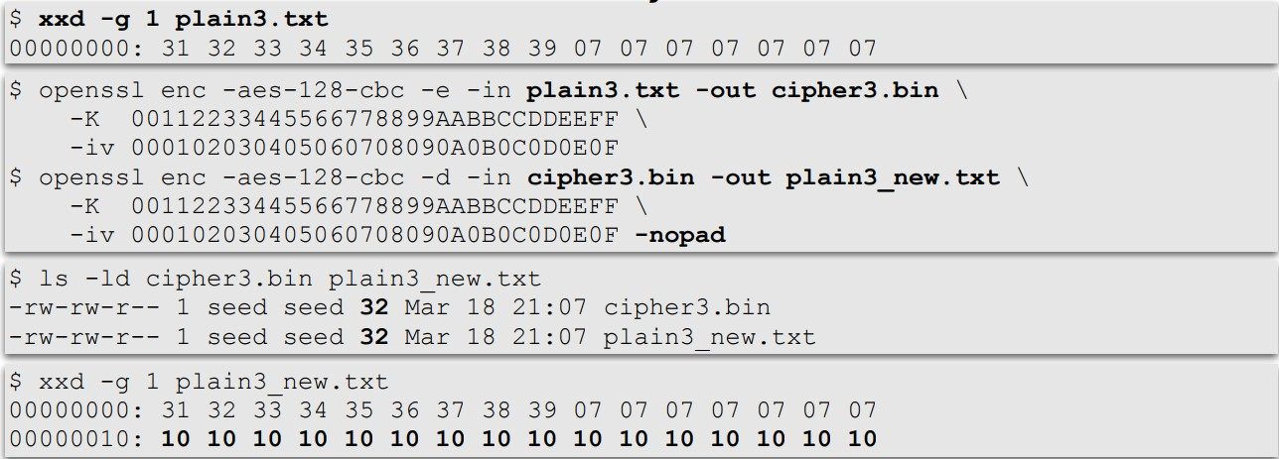
Padding Experiment #3
What if the size of the plaintext is a multiple of the block size? And the last seven
bytes are all 0x07?
Block 1 Block 1
1 2 3 4 5 6 7 8 9 07 07 07 07 07 07 07

Slide 34
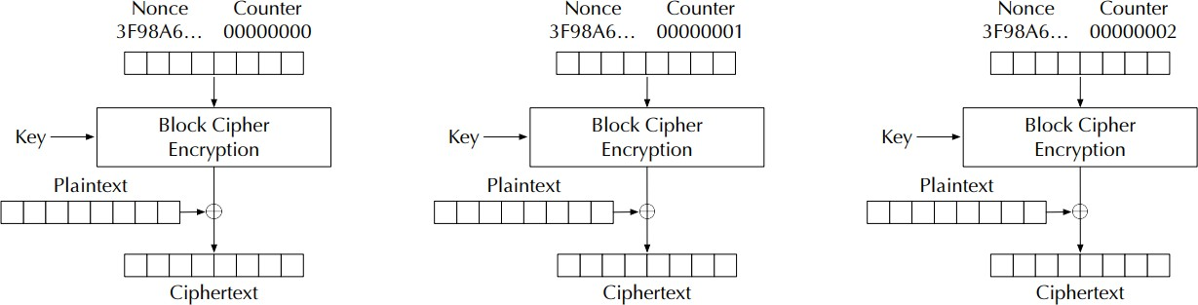
Counter(CTR) Mode
Use a counter to generate the key streams
No key stream can be reused; the counter value for each block is prepended with a randomly
generated value called a nonce (same idea as the IV)

Slide 35
Modes of Encryption
CBC
Counter(CTR) Mode
You will explore these in the lab

Slide 36
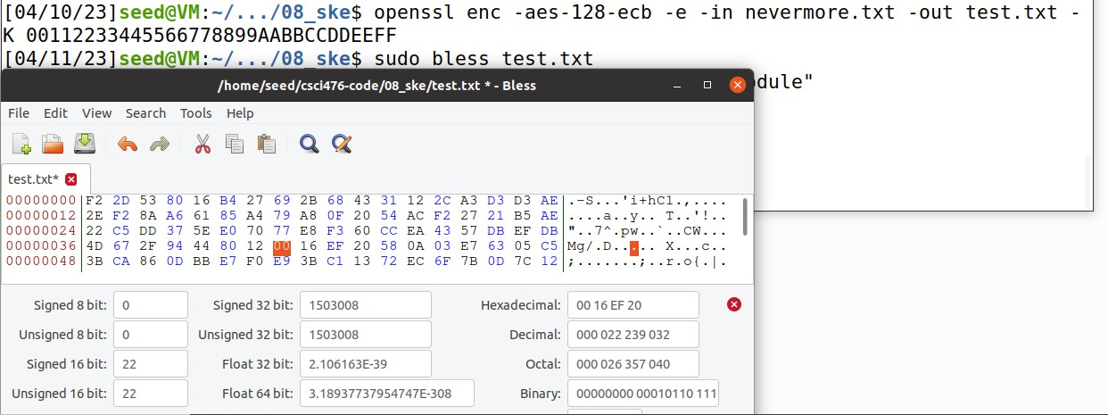
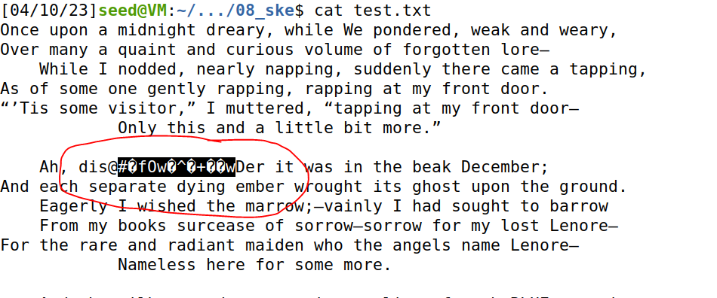
Corrupting a Ciphertext + Recovering
Let's change a byte in the ciphertext using the bless hex editor
When decrypting the ciphertext, we can see

Slide 37
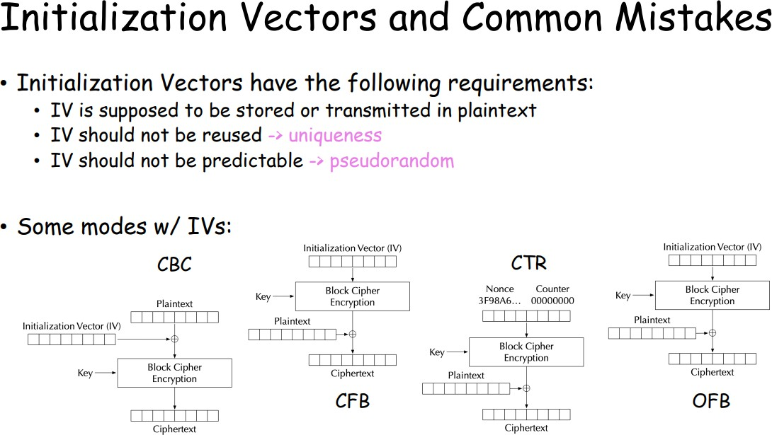

Slide 38
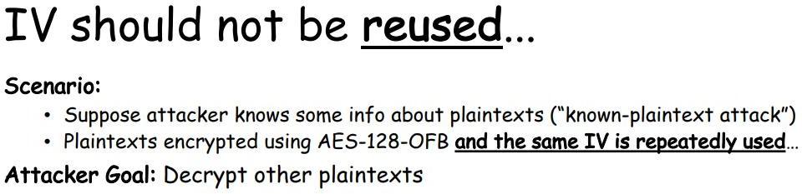
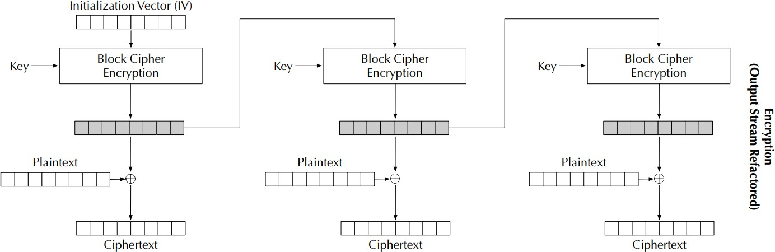

Slide 39
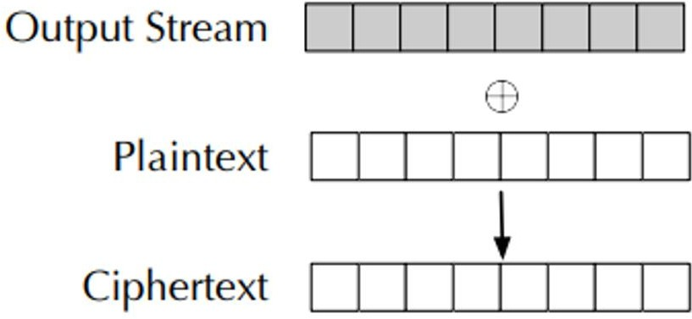
Chosen Plaintext Attack:
Suppose we have the plaintext: 110011
And the ciphertext from that plaintext: 101010
Can we recover information about the key used? Can we decrypt other plaintexts?
??
110011
1010101

Slide 40









Chosen Plaintext Attack:
Suppose we have the plaintext: 110011
And the ciphertext from that plaintext: 101010
Can we recover information about the key used? Can we decrypt other plaintexts?
We can XOR P and C to key our key/IV value!
??
110011
1010101

Slide 41

Chosen Plaintext Attack:
Suppose we have the plaintext: 110011
And the ciphertext from that plaintext: 101010
Can we recover information about the key used? Can we decrypt other plaintexts?
We can XOR P and C to key our key/IV value!
011001
110011
101010
Knowing that an encryption scheme uses the same IV + key …. (you will do this on the lab)

