Slide 1

CSCI 476: Computer Security
Hashing (Part 1)
Reese Pearsall
Fall 2024
https://www.cs.montana.edu/pearsall/classes/fall2024/476/main.html

Slide 2
Announcements
Project due 11/21
Message me about your project idea if you haven’t done so already
Lab 8 (Secret Key Encryption) Due 11/24
I’ll be back on Thursday

Slide 3
Lab 8

Slide 4
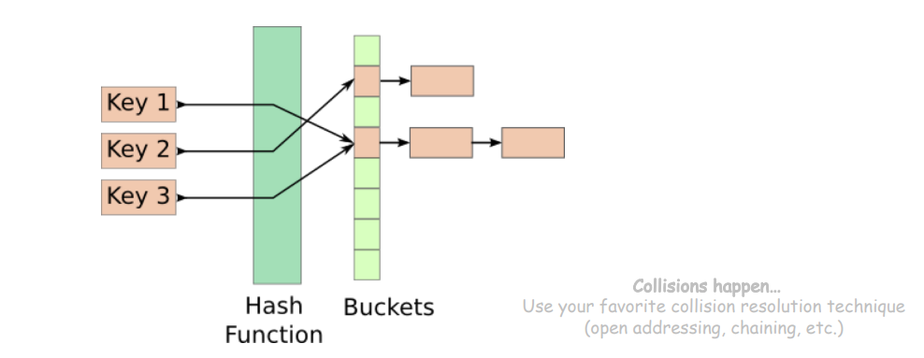
Hash Functions
Hash Functions map arbitrary size data to data of fixed size
An essential building block in cryptography, with desirable practical and security properties
Ex. f(x) = x mod 100
How many buckets?
What to do if two keys map to the same bucket?

Slide 5
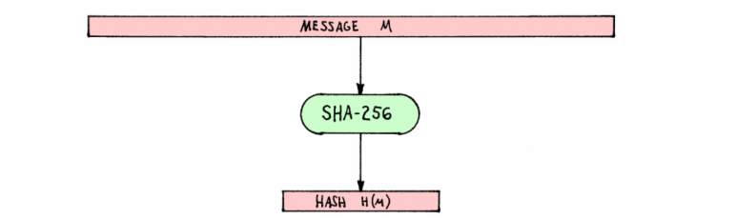
Hash Functions
Cryptographic Hash Functions map arbitrary size data to data of fixed size
But with three additional important properties
Input = Message M
SHA-256 = A cryptographically secure hashing function
Output = Hashed Message M

Slide 6
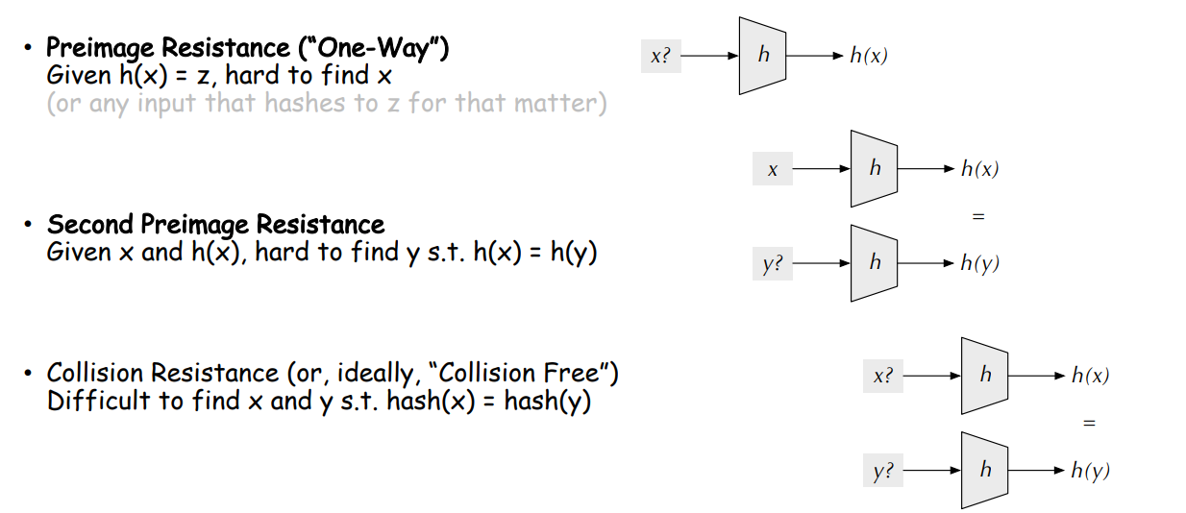
Hash Functions Properties

Slide 7
Hash Functions Properties (tl;dr)
Gives an arbitrary size input a fixed-size unique* hash identifier
Hash values are very difficult to reverse. They were designed to be one-way
The go-to way to reverse a hash is through brute force

Slide 8
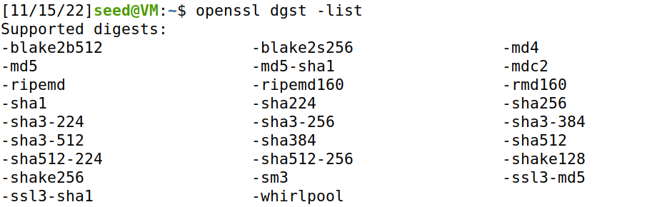
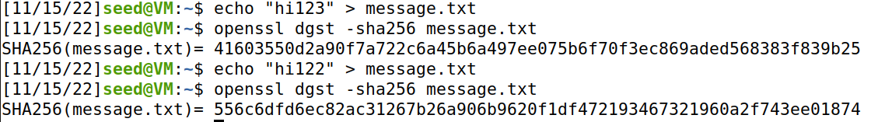
Computing Hashes with OpenSSL
Calculating the Hash for a text file with SHA 256
Property of Hashes: One small change in file → will drastically change hash (avalanche effect)

Slide 9
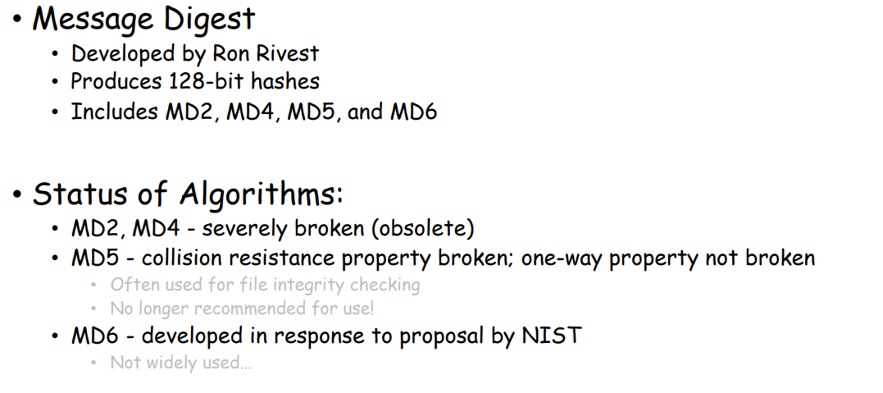
Families of Hash Function
We will be focusing on MD5, and breaking MD5 in our Lab ☺

Slide 10
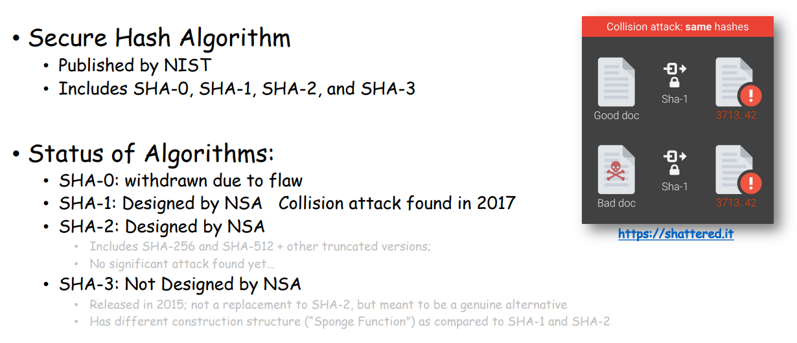
Families of Hash Function

Slide 11
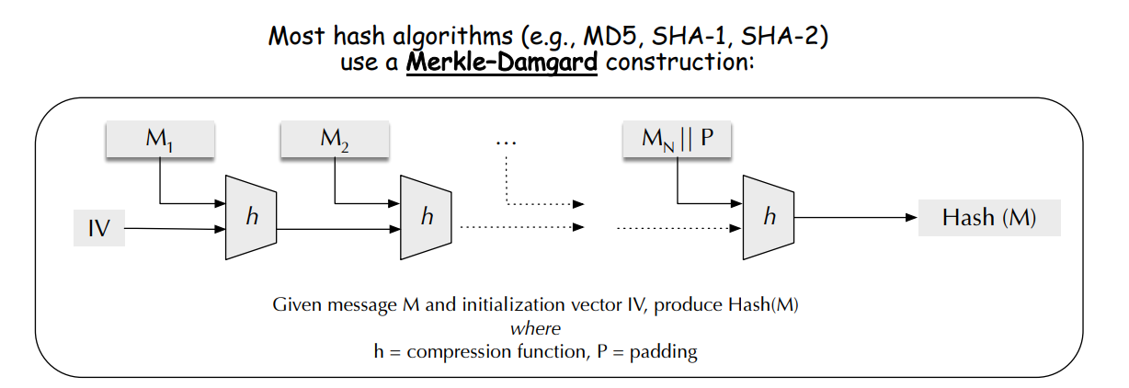
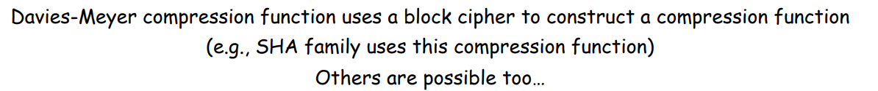
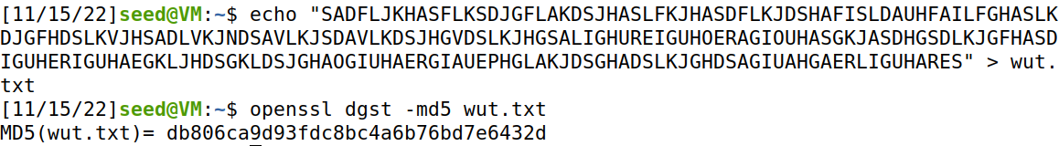
How does MD5 work?
The compression of data is also a helpful application of hash functions

Slide 12
Calculating Hashes in Programming Languages
# Python 3 code to demonstrate the
# working of MD5 (string - hexadecimal)
import hashlib
# initializing string
str2hash = “csci476"
# encoding csci476 using encode()
# then sending to md5()
result = hashlib.md5(str2hash.encode())
# printing the equivalent hexadecimal value.
print("The hexadecimal equivalent of hash is : ", end ="")
print(result.hexdigest())
Pretty much every programming language can calculate hashes

Slide 13
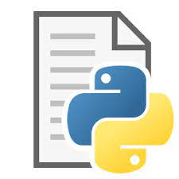
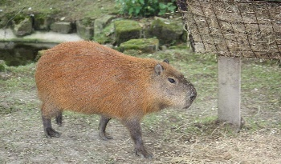

Applications of Hashing
Output space of MD5 (128 bits)
31973ff867a5a4c2546ec4cca1c126b4
MD5
73bd1ddd3ef1051bf5c4bde7a2b5a6c2
c527fc24f5932e932f44c31f1f8c674e
password123
e2ee5b2d1719edef3f8120cff39f0180
FFFFFFFFFFFFFFFFFFFFFFFFFFFFFFFF
What are some uses for hashing?

Slide 14


Applications of Hashing
Integrity Verification
hello_world
A CSCI 112 Student

Slide 15
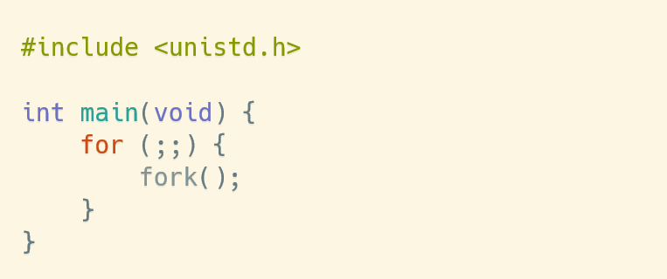



Applications of Hashing
Integrity Verification
hello_world
A CSCI 112 Student
hello_world
What if the message got tampered with?
hello_world
She will have no idea because this executable program seems totally normal and came from a trustworthy source
Instructor

Slide 16
Applications of Hashing
Integrity Verification
hello_world
A CSCI 112 Student
hello_world
What if the message got tampered with?
hello_world
We can use hashing to introduce some integrity to our messages
Instructor

Slide 17
Applications of Hashing
Integrity Verification
hello_world
89defae676abd3e3a42b41df17c40096
A CSCI 112 Student
hello_world
What if the message got tampered with?
hello_world
1. Generate hash for source file
Instructor

Slide 18
Applications of Hashing
Integrity Verification
hello_world
89defae676abd3e3a42b41df17c40096
A CSCI 112 Student
hello_world
What if the message got tampered with?
hello_world
Generate hash for source file
Instructor generates hash for file she received
b0608c4e1775ad8f92e7b5c191774c5d
Instructor

Slide 19
Applications of Hashing
Integrity Verification
When a message gets tampered with, the new hash will be completely different
Different hashes = Something fishy happened!
hello_world
89defae676abd3e3a42b41df17c40096
A CSCI 112 Student
hello_world
b0608c4e1775ad8f92e7b5c191774c5d
Instructor

Slide 20
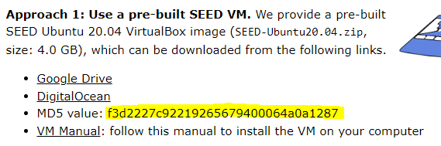
Applications of Hashing
When a message gets tampered with, the new hash will be completely different
Different hashes = Something fishy happened!
Integrity Verification
hello_world
89defae676abd3e3a42b41df17c40096
A CSCI 112 Student
hello_world
If your seed labs ZIP doesn’t match that that hash, then you might have a modified OS image
b0608c4e1775ad8f92e7b5c191774c5d
Instructor

Slide 21
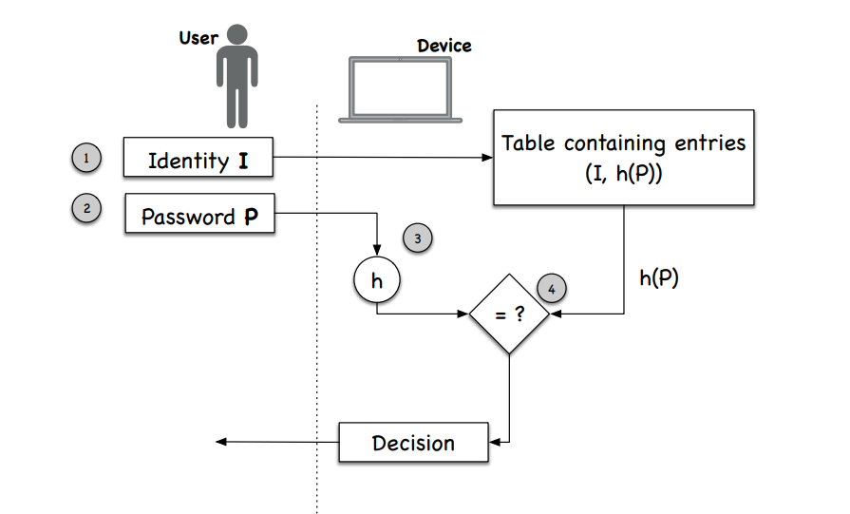
Applications of Hashing
Password Verification
Websites need to know password information so that users can login
But websites should never store passwords in plaintext
Instead, websites will store the hash of your password

Slide 22
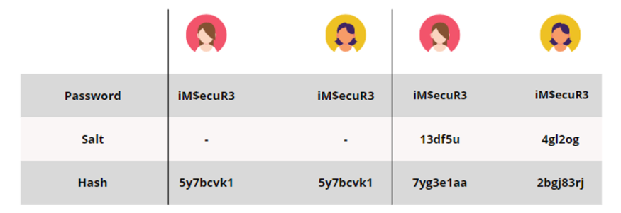
Applications of Hashing
Password Verification
Two people that have the same password will have the same hash → not good!
Salt is just some random string appended to a password
WdRrWCQzpassword123
When a service uses salted passwords, the same input (password) can result in different hashes! → good

Slide 23
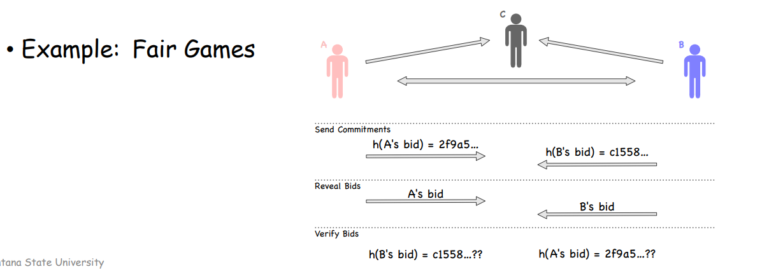
Applications of Hashing
Fairness and Commitment (scary)
Disclosing a hash does not disclose the original message
Useful to commit secret without disclosing the secret itself

Slide 24
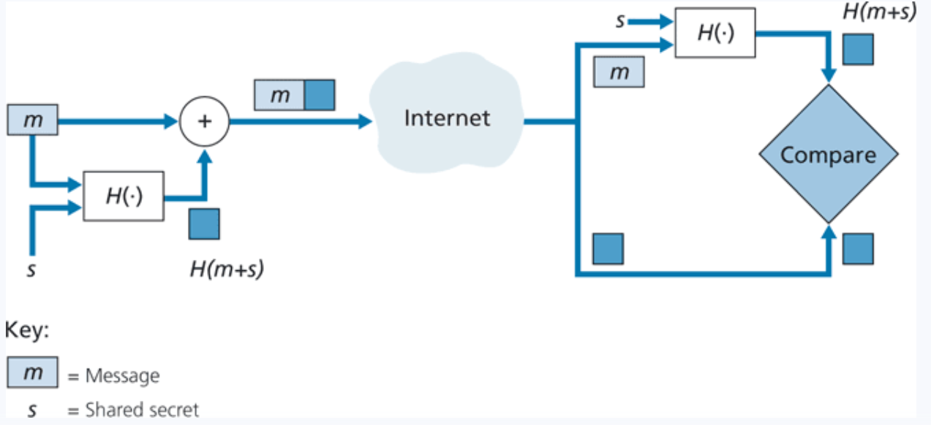
Message Authentication Code (MAC)
Applications of Hashing
Append a message with a shared secret (m + s)
Compute hash of (m+s) → H(m+s)
Send H(m+s) with message m
Sender sends: ( H(m+s), m)
Receiver gets ( H(m+s), m)
Append m with shared secret s (m + s)
Compute H(m+s)
The value receiver computed should match the H(m+s) he received

Slide 25

Collision Attacks
hello_world
89defae676abd3e3a42b41df17c40096
What if we could create two files, with totally different behaviors, but have the same hash?
hello_world
89defae676abd3e3a42b41df17c40096
Hash Collision Attacks compromise the integrity of a program by creating a malicious file that has a same hash

Slide 26
Collision Attacks
00000000000000000000000000000000
00000000000000000000000000000001
00000000000000000000000000000010
There is a very large amount of possible hashes
~(2¹²⁸)
MD5
hello_world
…
106a7d06be131315e25a7cbe57af398c
hello_world
…
EEFFFFFFFFFFFFFFFFFFFFFFFFFFFFFF
EFFFFFFFFFFFFFFFFFFFFFFFFFFFFFFF
FFFFFFFFFFFFFFFFFFFFFFFFFFFFFFFF
How likely is? Very unlikely?

Slide 27
Collision Attacks
00000000000000000000000000000000
00000000000000000000000000000001
00000000000000000000000000000010
There is a very large amount of possible hashes
~(2¹²⁸)
MD5
hello_world
…
106a7d06be131315e25a7cbe57af398c
hello_world
…
EEFFFFFFFFFFFFFFFFFFFFFFFFFFFFFF
EFFFFFFFFFFFFFFFFFFFFFFFFFFFFFFF
FFFFFFFFFFFFFFFFFFFFFFFFFFFFFFFF
How likely is? Very unlikely?
More likely than you think…

Slide 28

Birthday Paradox
In a room of 23 people, what is the probability that two people share the same birthday?
Its not 23/365
We will instead compute the chance that a group of people don’t share a birthday
…
365/365
364/365
362/365
363/365
343/365

Slide 29










Birthday Paradox
In a room of 23 people, what is the probability that two people share the same birthday?
Its not 23/365
We will instead compute the chance that a group of people don’t share a birthday
…
…
365/365
365/365
364/365
364/365
362/365
363/365
343/365
Probability that 23 people do share a birthday
Probability that 23 people don’t share a birthday

Slide 30
Birthday Paradox
What's the probability that two people in a group of 23 people share a birthday?
About 50%
What's the probability that two files share a hash?
More probable than you think…
Turns out, we can generate two files with the same hash in a matter of seconds…

Slide 31
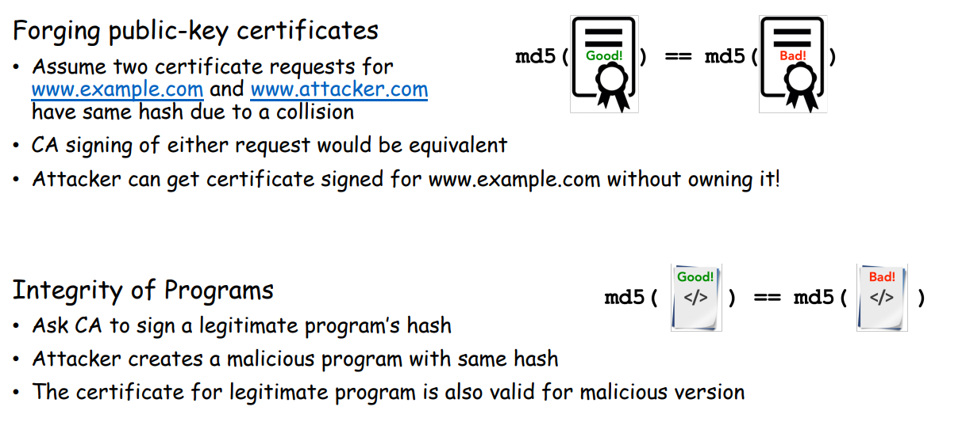
Hash Collisions
Goal: Create two different files with the same md5 hash
Our ultimate goal would be to create two executables (one benign, one malicious) with the same hash
Motivation

Slide 32
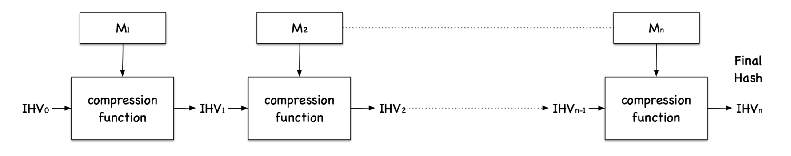
Hash Collisions (MD5collgen)
On our VM, we have a tool called md5collgen that will generate two files with the same prefix
We get to choose this prefix!
MD5 Under the hood
Fact: Message is divided into blocks, and each block is run through a compression function
Important Fact: Each block will be 64 bytes

Slide 33
Hash Collisions (MD5collgen)
On our VM, we have a tool called md5collgen that will generate two files with the same prefix
We get to choose this prefix!

Slide 34
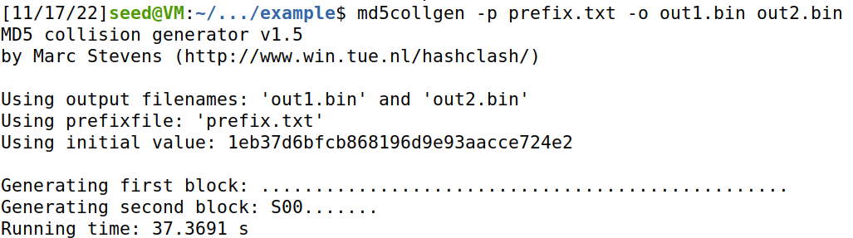
Hash Collisions (MD5collgen)
On our VM, we have a tool called md5collgen that will generate two files with the same prefix
We get to choose this prefix!

Slide 35
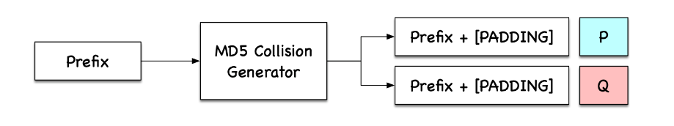
Hash Collisions (MD5collgen)
What if out prefix is a multiple of 64?

Slide 36
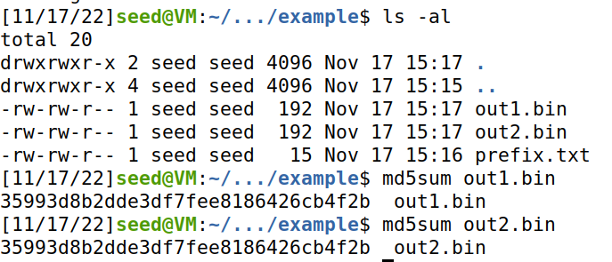
Hash Collisions (MD5collgen)
On our VM, we have a tool called md5collgen that will generate two files with the same prefix
We get to choose this prefix!
Same Hash!

Slide 37
Hash Collisions (MD5collgen)
On our VM, we have a tool called md5collgen that will generate two files with the same prefix
We get to choose this prefix!
Same Hash!
Compare with xxd

Slide 38
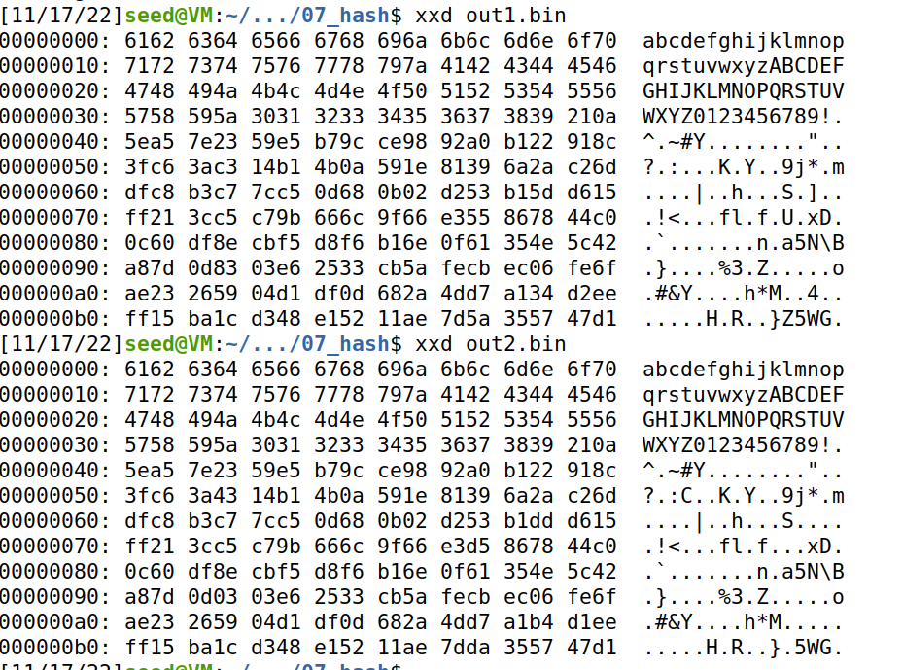
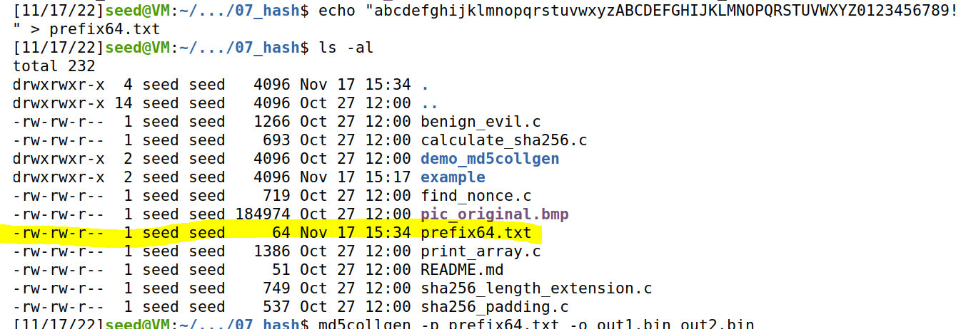
Hash Collisions (MD5collgen)
What if out prefix is a multiple of 64?
Our prefix is exactly 64 bytes
→ No padding is added!

