Slide 1

CSCI 476: Computer Security
Hashing (Part 2)
Reese Pearsall
Fall 2023
https://www.cs.montana.edu/pearsall/classes/fall2023/476/main.html

Slide 2
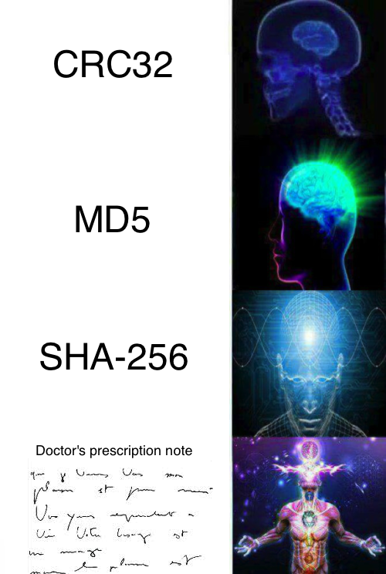
Announcements
Lab 8 due Sunday December 3rd
Lab 9 due Sunday December 10th
Extra credit for attending next Thursday lecture (come to class)
Final Exam
Thursday December 14th 2:00 – 3:50 PM (same classroom)

Slide 3

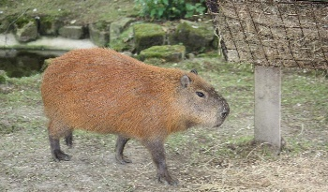

Applications of Hashing
Output space of MD5 (128 bits)
00000000000000000000000000000000
31973ff867a5a4c2546ec4cca1c126b4
MD5
73bd1ddd3ef1051bf5c4bde7a2b5a6c2
c527fc24f5932e932f44c31f1f8c674e
password123
e2ee5b2d1719edef3f8120cff39f0180
FFFFFFFFFFFFFFFFFFFFFFFFFFFFFFFF

Slide 4
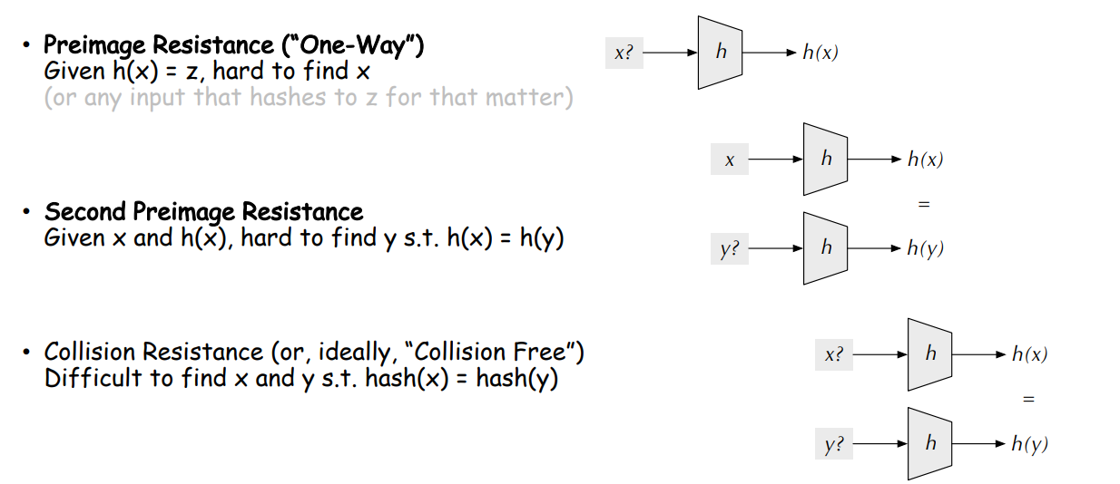
Hash Functions Properties

Slide 5
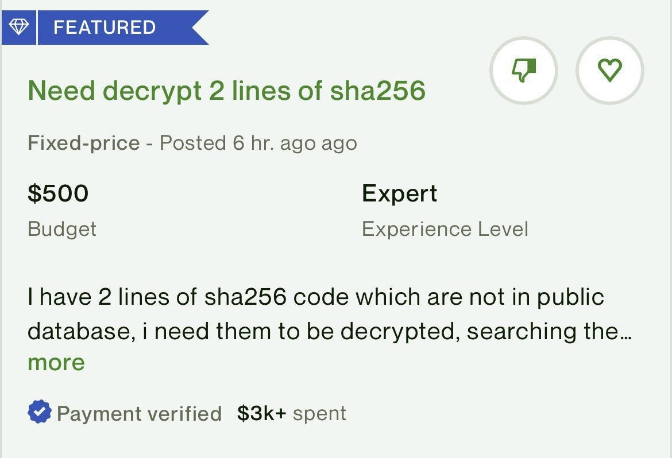

Slide 6
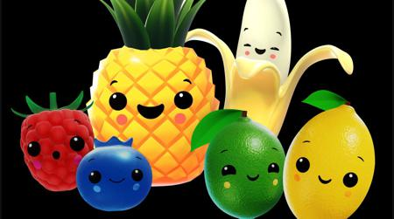

Slide 7
Hash Functions Properties (tl;dr)
Gives an arbitrary size input a fixed-size unique* hash identifier
Hash values are very difficult to reverse. They were designed to be one-way
The go-to way to reverse a hash is through brute force

Slide 8
Brute Force Approaches
Long time, and for very unfeasible for cryptographically secure hash functions
Given a hashed password, can you brute force the original password?
afc285bebb3dd733796cb06db01cd59a
Techniques
Dictionary Attack
Rainbow Tables

Slide 9
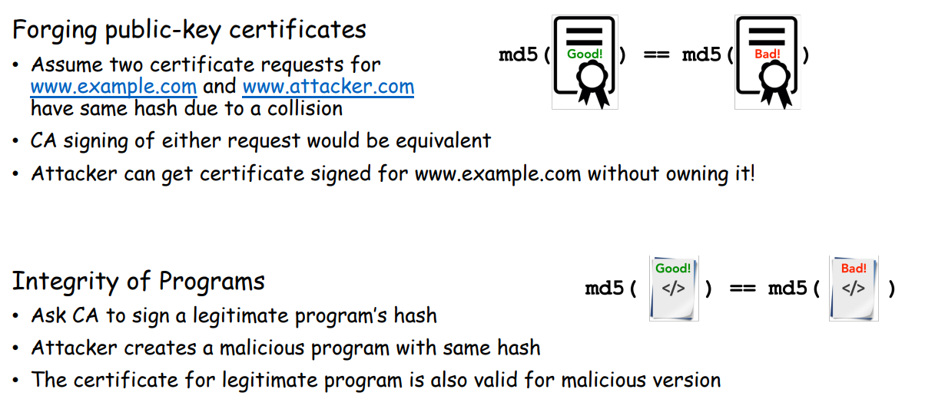
Hash Collisions
Goal: Create two different files with the same md5 hash
Our ultimate goal would be to create two executables (one benign, one malicious) with the same hash
Motivation

Slide 10
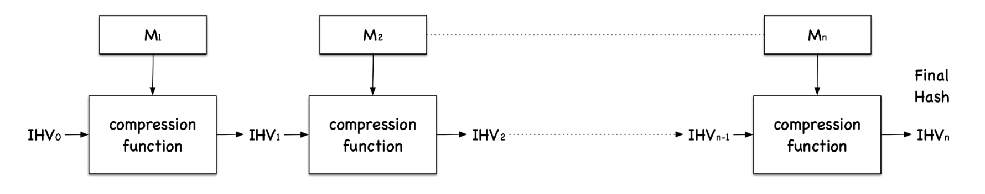
Hash Collisions (MD5collgen)
On our VM, we have a tool called md5collgen that will generate two files with the same prefix
We get to choose this prefix!
MD5 Under the hood
Fact: Message is divided into blocks, and each block is run through a compression function
Important Fact: Each block will be 64 bytes

Slide 11
Hash Collisions (MD5collgen)
On our VM, we have a tool called md5collgen that will generate two files with the same prefix
We get to choose this prefix!

Slide 12
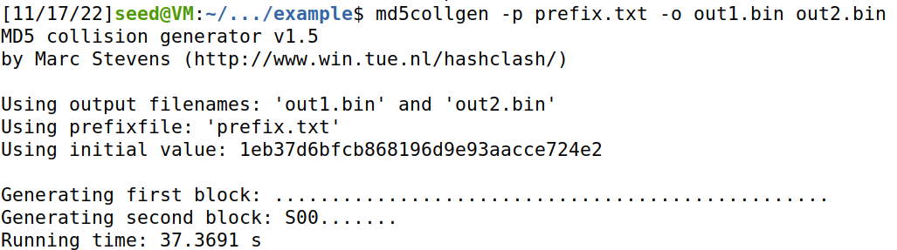
Hash Collisions (MD5collgen)
On our VM, we have a tool called md5collgen that will generate two files with the same prefix
We get to choose this prefix!

Slide 13
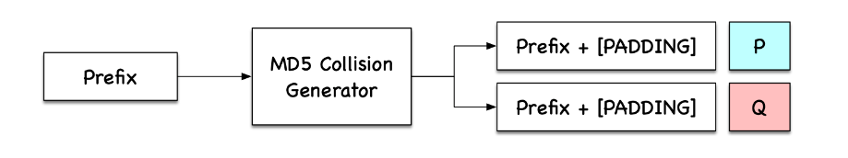
Hash Collisions (MD5collgen)
What if out prefix is a multiple of 64?

Slide 14
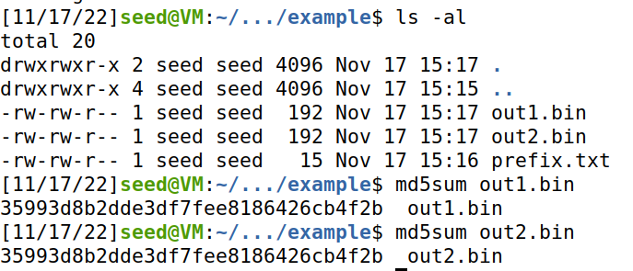
Hash Collisions (MD5collgen)
On our VM, we have a tool called md5collgen that will generate two files with the same prefix
We get to choose this prefix!
Same Hash!

Slide 15
Hash Collisions (MD5collgen)
On our VM, we have a tool called md5collgen that will generate two files with the same prefix
We get to choose this prefix!
Same Hash!
Compare with xxd

Slide 16
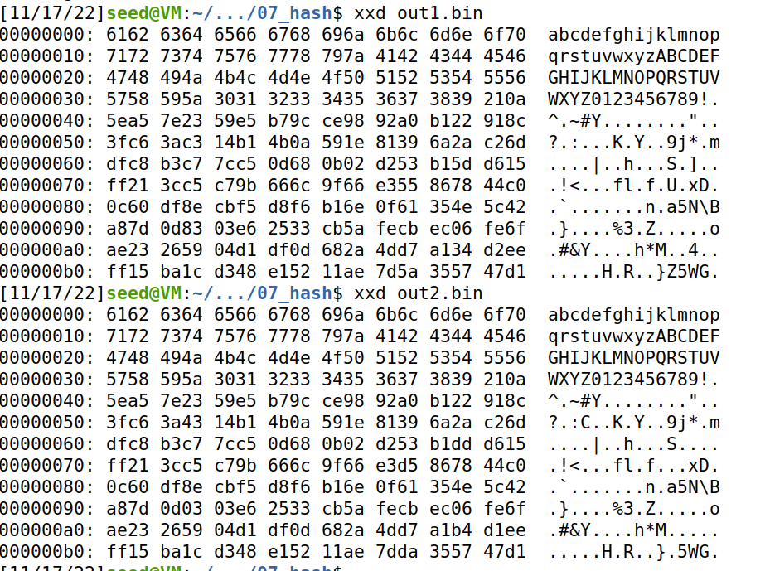
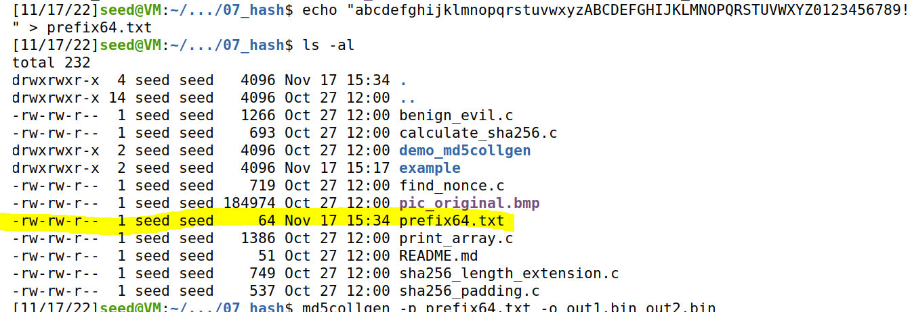
Hash Collisions (MD5collgen)
What if out prefix is a multiple of 64?
Our prefix is exactly 64 bytes
→ No padding is added!

Slide 17
Hash Collisions (MD5collgen)
What if out prefix is a multiple of 64?

Slide 18
Hash Collisions (Suffix Extension)
M
N
H(m) == H(n)

Slide 19
Hash Collisions (Suffix Extension)
H
H
H
H
H
H
H
H
H
Final Hash (same for each)
M
N
64 64 64 64 64 64
64 64 64
H(m) == H(n)

Slide 20
Hash Collisions (Suffix Extension)
If we append the same suffix, then this computation will also be the exact same for M and N
H
H
H
H
H
H
H
H
H
H
H
H
H
M
Suffix
N
Suffix
64 64 64 64 64 64
64 64 64
H(m) == H(n)

Slide 21
Hash Collisions (Suffix Extension)
If we append the same suffix, then this computation will also be the exact same for M and N
H
H
H
H
H
H
H
H
H
H
H
H
H
M
Suffix
N
Suffix
64 64 64 64 64 64
64 64 64
H(m) == H(n)
H(m || s) == H(n || s)
s = shared suffix

Slide 22
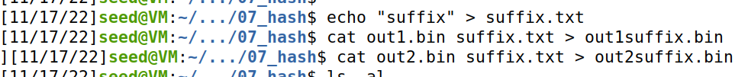
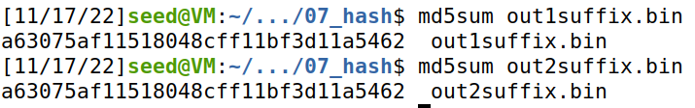
Hash Collisions (Suffix Extension)
If we append the same suffix, then this computation will also be the exact same for M and N
H
H
H
H
H
H
H
H
H
H
H
H
H
M
Suffix
N
Suffix
64 64 64 64 64 64
64 64 64
H(m) == H(n)
H(m || s) == H(n || s)
s = shared suffix
s = shared suffix

Slide 23
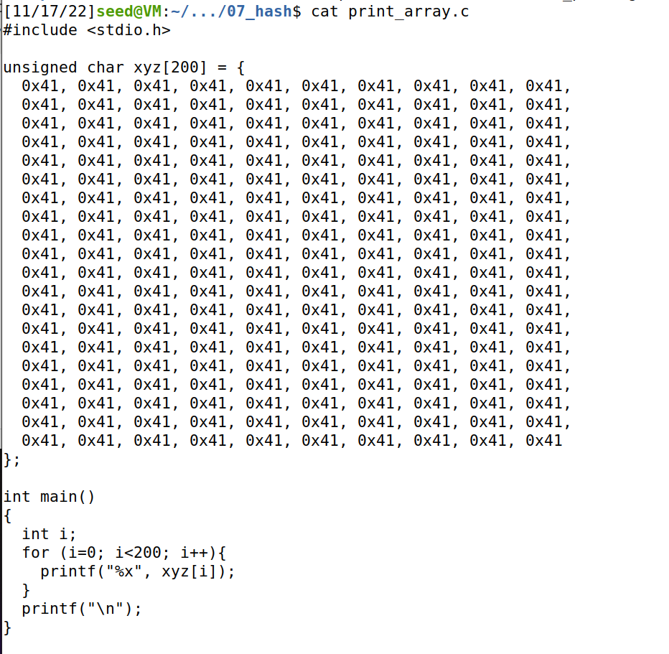
Hash Collisions (Generating Two executable files with the same MD5 hash)
This is a program that will print out the contents of an array
We will create two variants of this program, but the program will have the same hash
Prefix
P
Suffix
Prefix
Q
Suffix

Slide 24
Hash Collisions (Generating Two executable files with the same MD5 hash)
We will create two variants of this program, but the program will have the same hash
Prefix
Suffix

Slide 25
Hash Collisions (Generating Two executable files with the same MD5 hash)
We will create two variants of this program, but the program will have the same hash
Prefix
md5collgen( )
Prefix
P
Prefix
Q
These will have the same hash!
P and Q will be 128 bytes (multiple of 64)
Prefix
P
Suffix
Prefix
Q
Suffix
Because we know the suffix extension property holds true, we know the hash of these two programs will also be the same

Slide 26
Hash Collisions (Generating Two executable files with the same MD5 hash)
Prefix
Prefix
P
Q
Suffix
Suffix

Slide 27
Hash Collisions (Generating Two executable files with the same MD5 hash but behave very differently)
We can change the contents of this section of the program because it is just array data (it won’t break anything)
First, we need to find the starting location (the offset) of the xyz array → this will be the beginning of P and Q

Slide 28
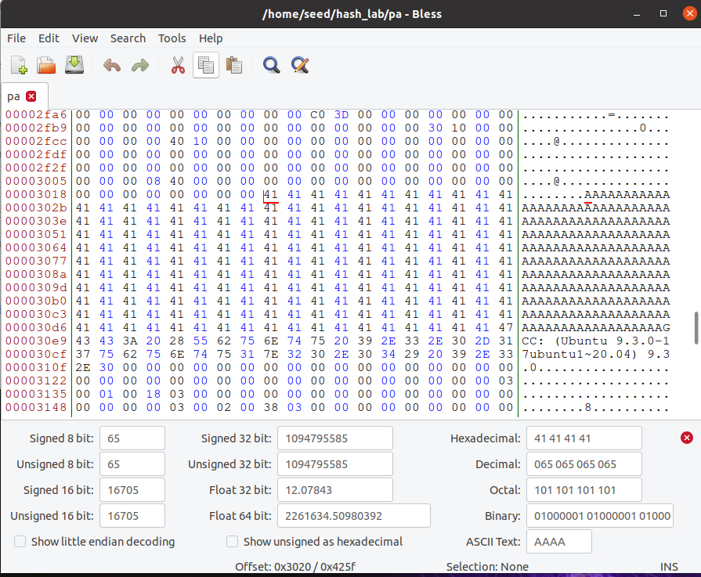
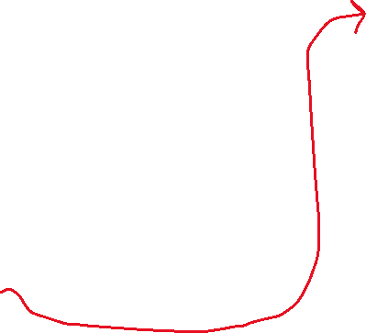

Hash Collisions (Generating Two executable files with the same MD5 hash but behave very differently)
We can find where xyz begins in our program easily, because we filled it with A’s
First Byte of xyz array
Start of XYZ = 0x3020 (Hexadecimal)
12320 (decimal)

Slide 29
Task 4 on the lab
0
Prefix
Our prefix will be bytes 0-12320 of the program!
12320
We want our P and Q to be 128 bytes
Why 128?
Multiple of 64
Wont overflow an array of size 200
(12320 is not a multiple of 64, which means that some padding will be added on, but in this case it’s fine because it will just go in our array section)

Slide 30
Task 4 on the lab
0
Prefix
Our prefix will be bytes 0-12320 of the program!
12320
P
Q
We want our P and Q to be 128 bytes
Why 128?
Multiple of 64
Wont overflow an array of size 200
128 bytes
(12320 is not a multiple of 64, which means that some padding will be added on, but in this case it’s fine because it will just go in our array section)

Slide 31
Task 4 on the lab
0
Prefix
Our prefix will be bytes 0-12320 of the program!
12320
P
Q
We want our P and Q to be 128 bytes
Why 128?
Multiple of 64
Wont overflow an array of size 200
128 bytes
12448
Therefore, our suffix will begin at byte # 12320 + 128 = 12448
Suffix
16992 (size of executable)

Slide 32
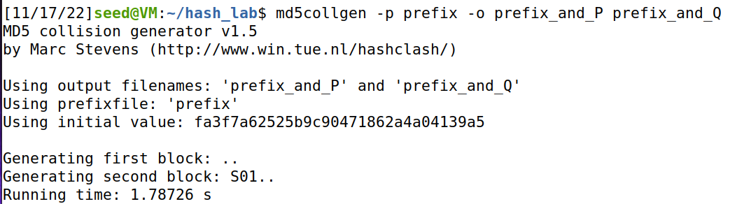
Task 4 on the lab
Get contents of prefix and suffix
0
Prefix
12320
P
Q
Use collision tool to get (prefix + P) and (prefix + Q)
128 bytes
12448
Suffix
16992 (size of executable)

Slide 33
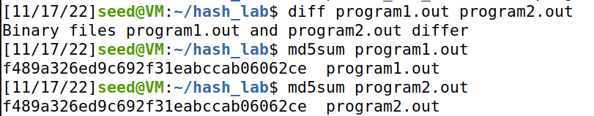


Task 4 on the lab
Get contents of prefix and suffix
0
Prefix
12320
P
Q
Use collision tool to get (prefix + P) and (prefix + Q)
128 bytes
13448
Add suffix to programs
Suffix
Verify that executables are different, but have the same hash
16992 (size of executable)

Slide 34
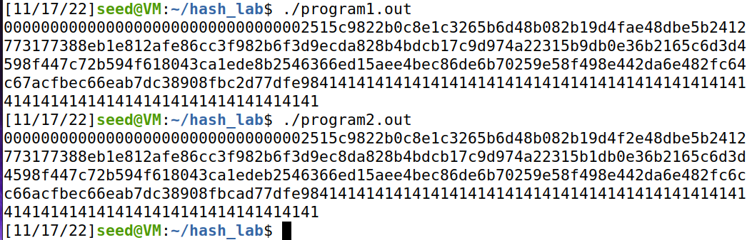

Task 4 on the lab
0
Prefix
12320
Make sure you still have a valid program ☺
P
Q
128 bytes
13448
Suffix
Somewhere in this output, you should find a small difference
16992 (size of executable)

Slide 35

Task 4 on the lab
0
Prefix
12320
Make sure you still have a valid program ☺
P
Q
128 bytes
13448
These programs print out different things, which is very benign
Our next goal is to write two programs with the same MD5 hash, but one does something malicious, and the other does something benign
Suffix
16992 (size of executable)

Slide 36
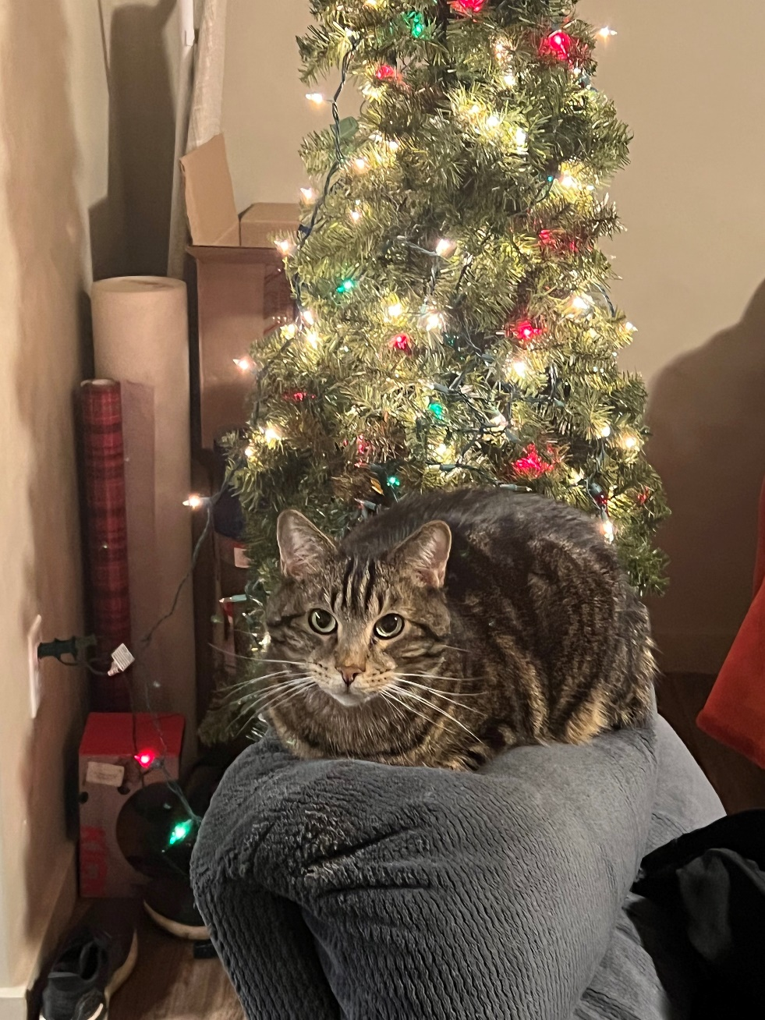

Slide 37
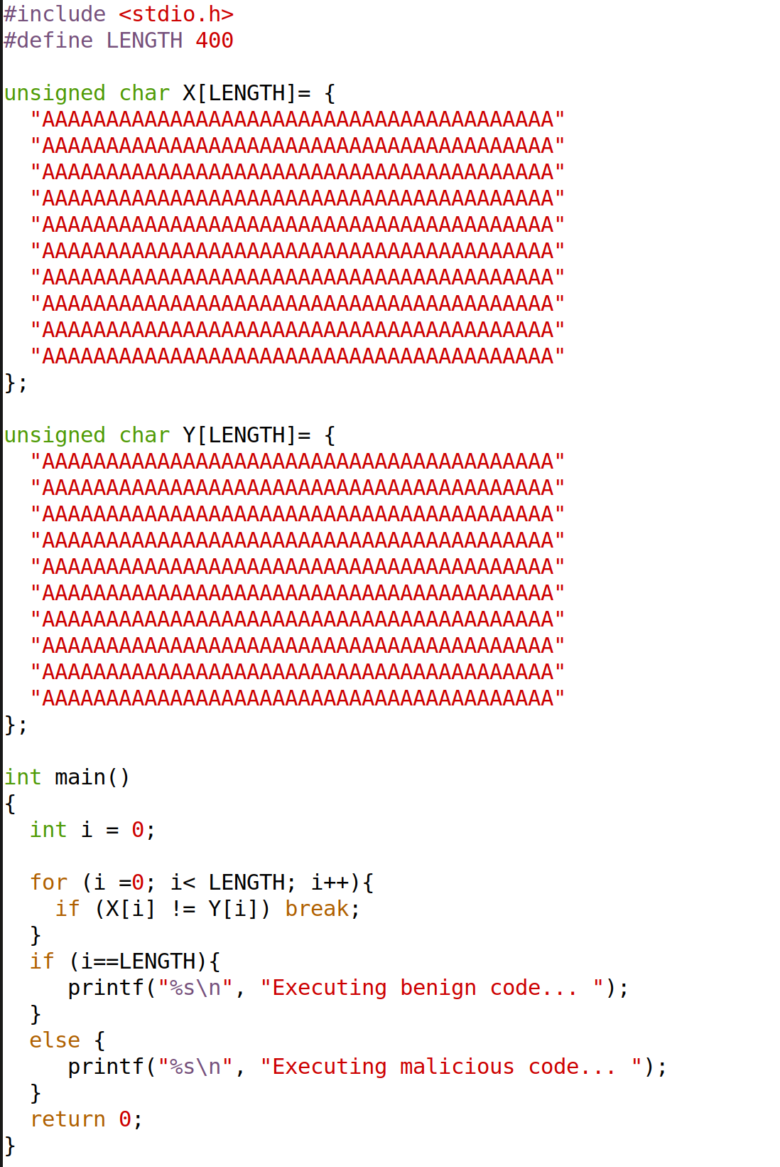
This program has two arrays X and Y
The program compares the contents of these two arrays

Slide 38



This program has two arrays X and Y
The program compares the contents of these two arrays
If the two arrays are the same, then it will execute the benign code

Slide 39


This program has two arrays X and Y
The program compares the contents of these two arrays
If the two arrays are the same, then it will execute the benign code
If the two arrays are different, then it will execute the benign code

Slide 40
Goal: Generate two variants of this program. One variant where the two arrays are the same (benign version), and one variant where the two arrays are different (malicious version)

Slide 41
Goal: Generate two variants of this program. One variant where the two arrays are the same (benign version), and one variant where the two arrays are different (malicious version)
P
P
Q
P
Because we can overwrite Array data without crashing the program, we will once again place P and Q (from md5collgen) into our arrays

Slide 42
Prefix
Prefix
P
P
Q
P

Slide 43
Prefix
Prefix
P
P
Because we are inserting P/Q at two different points into our program, we will have two suffixes
suffix1
suffix1
Q
P

Slide 44
Prefix
Prefix
P
P
Because we are inserting P/Q at two different points into our program, we will have two suffixes
suffix1
suffix1
Q
P
suffix2
suffix2

Slide 45
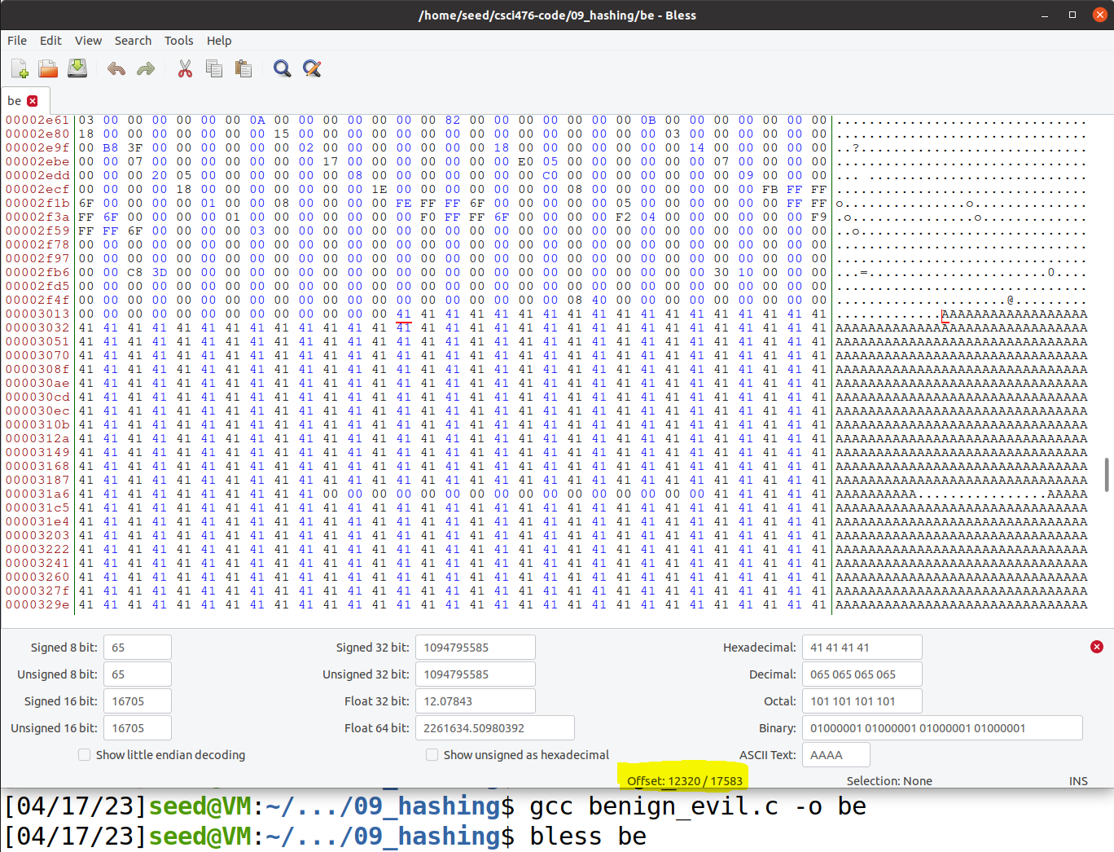
Memory Locations (Bytes)
Prefix
First, we must get the starting location of our array X
P
suffix1
Q
suffix2

Slide 46
Memory Locations (Bytes)
Prefix
First, we must get the starting location of our array X
P
suffix1
Q
Offset = 12320
Padding will mess up out attack, so we must make sure that padding doesn’t get added
suffix2
Offset = 12352 (multiple of 64)

Slide 47
Memory Locations (Bytes)
Offset = 12352
prefix
Prefix
12352
P
P and Q will once again be 128 bytes long
128 bytes
Therefore, P ends at (12352 + 128)
= 12480
12481
suffix
suffix1
(we have to add +1 when getting the suffix to prevent getting an extra byte)
Q
128 bytes
suffix2

Slide 48
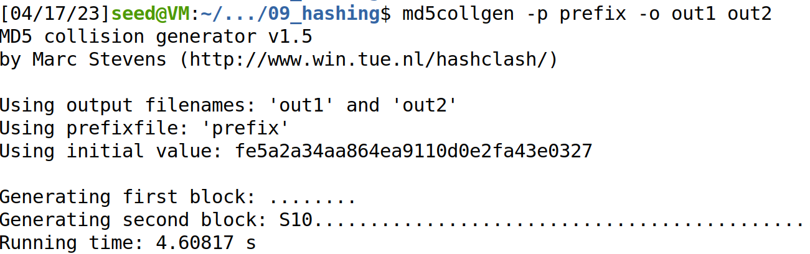
Memory Locations (Bytes)
prefix
Prefix
12352
P
Q
Now that we have the prefix, we can generate P and Q
P
128 bytes
12481
suffix
suffix1
Q
128 bytes
Because we just want P and Q (not the prefix), we will take the final 128 bytes of the output of out1 and out2
suffix2

Slide 49
Memory Locations (Bytes)
prefix
Prefix
To avoid padding, we had to move the beginning of P up 32 bytes into the array X, so when we insert P/Q into array Y, we need to make sure we also do 32 bytes
12352
P
Q
P
128 bytes
12481
suffix
suffix1
Array Y starts at 12736, but we need to inject at byte (12736 + 32) = 12768
12768
Q
128 bytes
suffix2

Slide 50
Memory Locations (Bytes)
prefix
Prefix
To avoid padding, we had to move the beginning of P up 32 bytes into the array X, so when we insert P/Q into array Y, we need to make sure we also do 32 bytes
12352
P
Q
P
128 bytes
12481
288 bytes
suffix
suffix1
Array Y starts at 12736, but we need to inject at byte (12736 + 32) = 12768
12768
Q
128 bytes
Therefore, the size of suffix1 will be
12768 – 12481 = 288
suffix2

Slide 51
Memory Locations (Bytes)
prefix
Prefix
To avoid padding, we had to move the beginning of P up 32 bytes into the array X, so when we insert P/Q into array Y, we need to make sure we also do 32 bytes
12352
P
Q
P
128 bytes
12481
288 bytes
suffix
suffix1
Array Y starts at 12736, but we need to inject at byte (12736 + 28) = 12768
12768
Q
128 bytes
Therefore, the size of suffix1 will be
12768 – 12481 = 288
417
Suffix 2 will begin at byte 288 + 128 = 416 of suffix (but we add +1 to prevent getting an extra byte)
suffix2

Slide 52
Memory Locations (Bytes)
prefix
Prefix
12352
P
Q
P
128 bytes
Now, we put everything together
12481
288 bytes
suffix
suffix1
12768
Q
128 bytes
417
suffix2

Slide 53
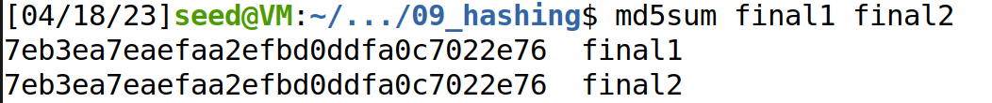

Memory Locations (Bytes)
prefix
Prefix
12352
P
Q
P
128 bytes
Now, we put everything together
12481
288 bytes
suffix
suffix1
12768
Q
Verify that hashes match:
128 bytes
417
suffix2

Slide 54
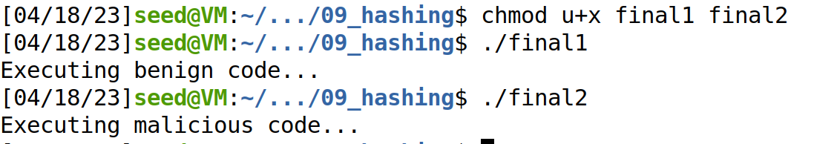


Memory Locations (Bytes)
prefix
Prefix
12352
P
Q
P
128 bytes
Now, we put everything together
12481
288 bytes
suffix
suffix1
12768
Q
Verify that hashes match:
128 bytes
417
Make programs executable and run them!
suffix2

