Slide 1

CSCI 476: Computer Security
Threat Modeling
Reese Pearsall
Fall 2024
*all images are stolen from the internet
https://www.cs.montana.edu/pearsall/classes/fall2024/476/main.html

Slide 2
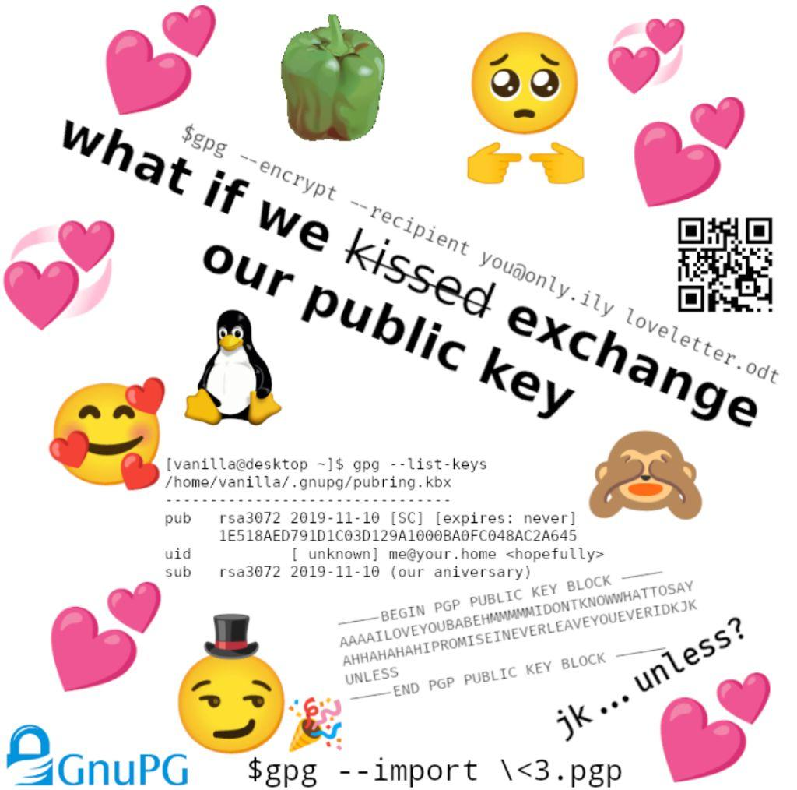
Announcements
Lab 9 due Sunday 12/8
Please fill out the course evaluation (Extra Credit)
Final Exam
Tuesday December 10th 2:00 – 3:50 in Romney 315
You are allowed one notesheet. Study guide posted soon
Please be there
If you are taking the exam at the testing center, make sure you schedule it before friday
Please look at your grades and let me know if you are missing anything

Slide 3


Slide 4
Security Basics
The CIA Triad is a widely accepted model for evaluating the security of a system. Consists of three important principles
CIA Triad

Slide 5

Security Basics
C
The CIA Triad is a widely accepted model for evaluating the security of a system. Consists of three important principles
confidentiality
Confidentiality- protection from unauthorized access
CIA Triad

Slide 6

Security Basics
C
The CIA Triad is a widely accepted model for evaluating the security of a system. Consists of three important principles
confidentiality
Confidentiality- protection from unauthorized access
Integrity- protection from unauthorized modifications
I
CIA Triad
integrity

Slide 7

Security Basics
C
The CIA Triad is a widely accepted model for evaluating the security of a system. Consists of three important principles
confidentiality
Confidentiality- protection from unauthorized access
Integrity- protection from unauthorized modifications
I
CIA Triad
A
Availability- protection from interruption
integrity
availability

Slide 8
Common Threats & Attack Vectors
Denial of Service (DoS / DDos)- attack with intent to shut down a machine or network
Violates the availability property

Slide 9
Common Threats & Attack Vectors
Denial of Service (DoS / DDos)- attack with intent to shut down a machine or network
Violates the availability property
Information Leakage / Data Corruption- unauthorized or accidental reveal of sensitive information
Violates the confidentiality property
Violates the integrity property

Slide 10
Common Threats & Attack Vectors
Denial of Service (DoS / DDos)- attack with intent to shut down a machine or network
Violates the availability property
Information Leakage / Data Corruption- unauthorized or accidental reveal of sensitive information
Violates the confidentiality property
Violates the integrity property
Privilege Escalation- gaining illicit permissions beyond what is intended for that user
Violates the confidentiality property
Violates the integrity property

Slide 11
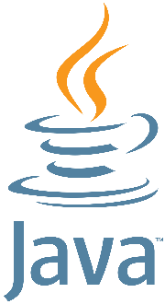

Defense Mechanisms
Countermeasures (ASLR, SYN Cookies, etc)
Software testing
Formal verification
Refactoring software and safe coding practices

Slide 12
Threat Modeling
NEED: a consistent and structured approach for defense and assessing risk

Slide 13
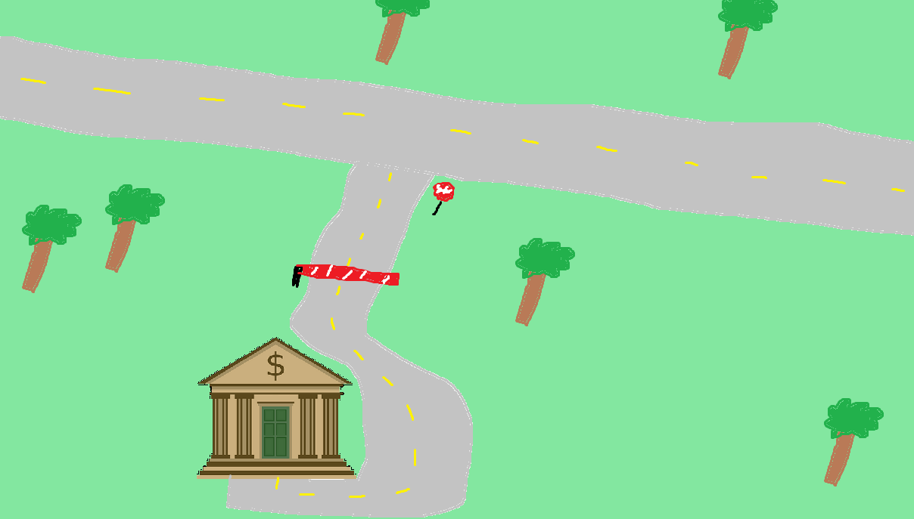


Assessing Risk
We expect users to interact with our system in a certain way

Slide 14
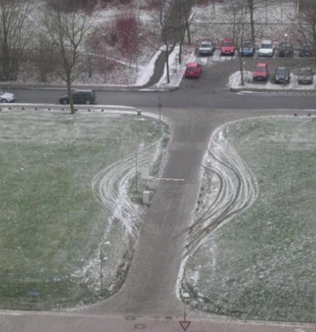

Assessing Risk
We expect users to interact with our system in a certain way
When someone interacts with our system in a way that we did not intend… it could have harmful consequences

Slide 15
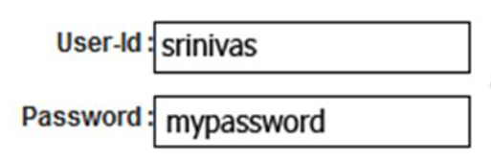
Assessing Risk
We expect users to interact with our system in a certain way
We might expect a user to input a valid username and password when they attempt to log in
When someone interacts with our system in a way that we did not intend… it could have harmful consequences

Slide 16
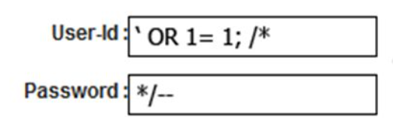
Assessing Risk
We expect users to interact with our system in a certain way
We might expect a user to input a valid username and password when they attempt to log in
When someone interacts with our system in a way that we did not intend… it could have harmful consequences
What if they did something…….. weird?

Slide 17
Assessing Risk
We expect users to interact with our system in a certain way
We might expect a user to input a valid username and password when they attempt to log in
When someone interacts with our system in a way that we did not intend… it could have harmful consequences
What if they did something…….. weird?
LOGIN SUCCESS

Slide 18
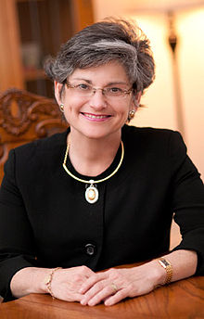

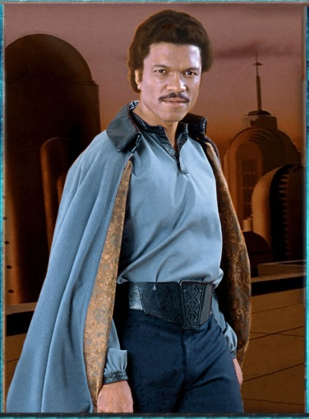

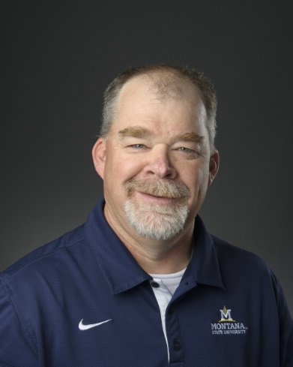
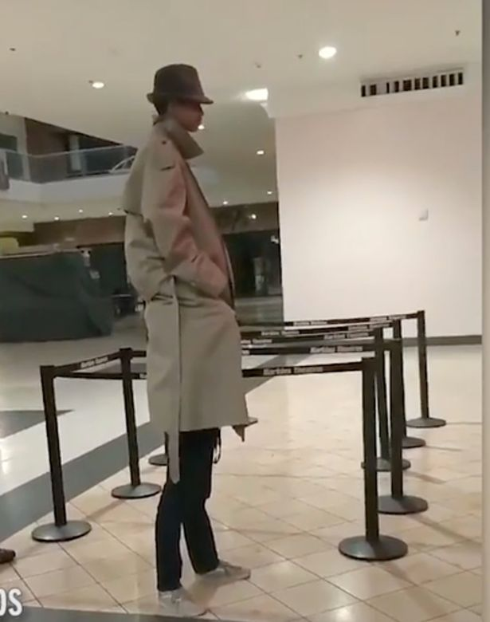
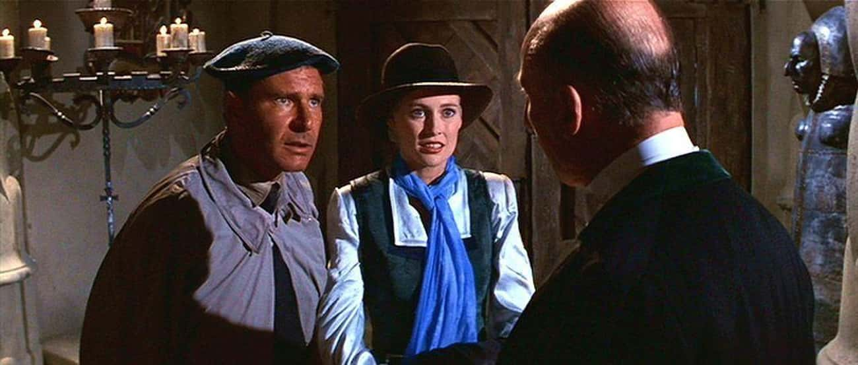

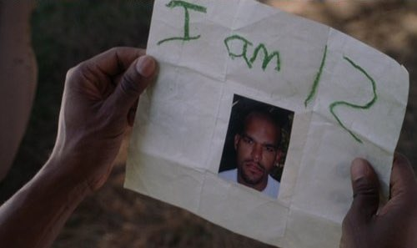

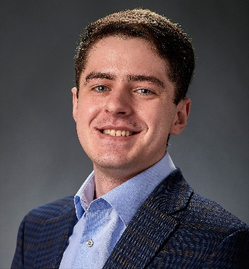
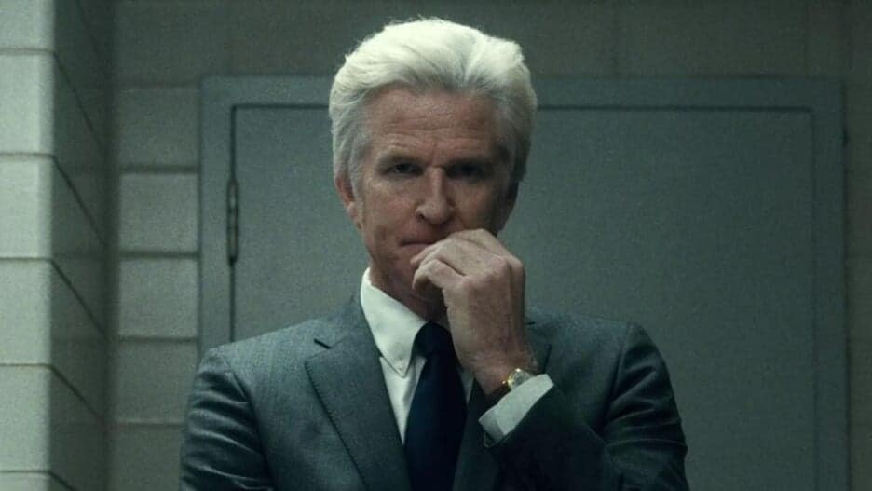
Who do we trust?
Are they honest? Are they reliable? Are they dependable? What are their intentions?

Slide 19
Who do we trust?
Trust as little as possible
Are they honest? Are they reliable? Are they dependable? What are their intentions?

Slide 20
Who do we trust?
Trust as little as possible
Distrust proportionally to level of risk
Are they honest? Are they reliable? Are they dependable? What are their intentions?

Slide 21
Who do we trust?
Trust as little as possible
Be aware of your technology
Distrust proportionally to level of risk
Are they honest? Are they reliable? Are they dependable? What are their intentions?

Slide 22
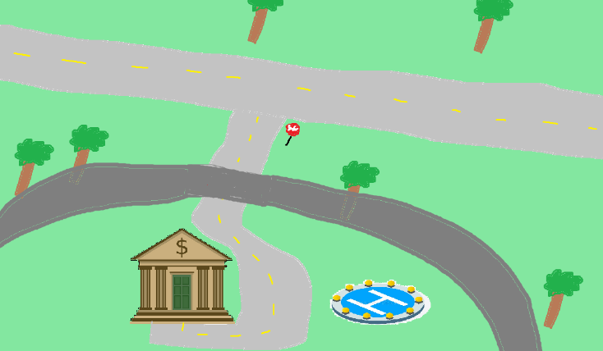
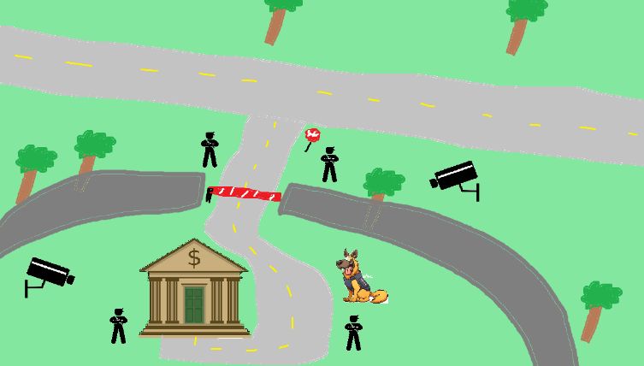
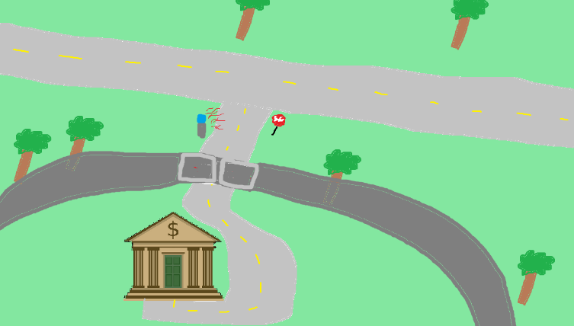
Perfect security is impossible

Slide 23
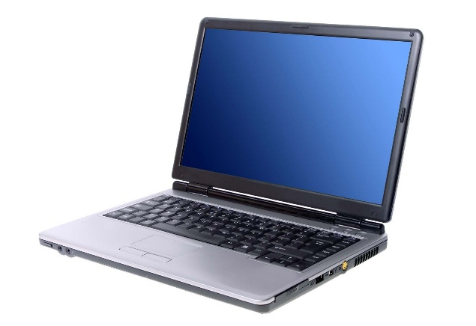
Perfect security is impossible
New assets

Slide 24
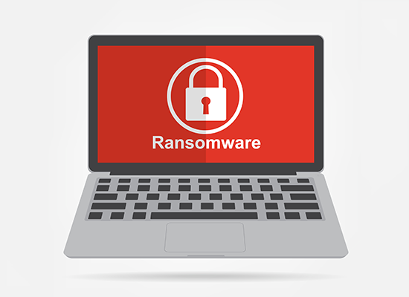
Perfect security is impossible
New assets
New threats

Slide 25
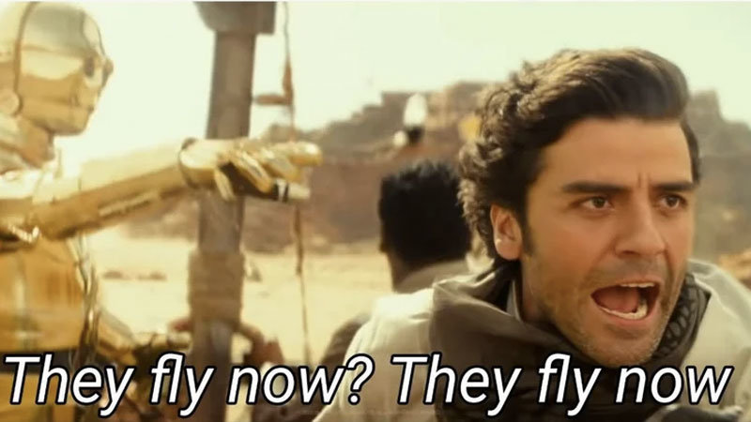
Perfect security is impossible
New assets
New threats
New capabilities

Slide 26
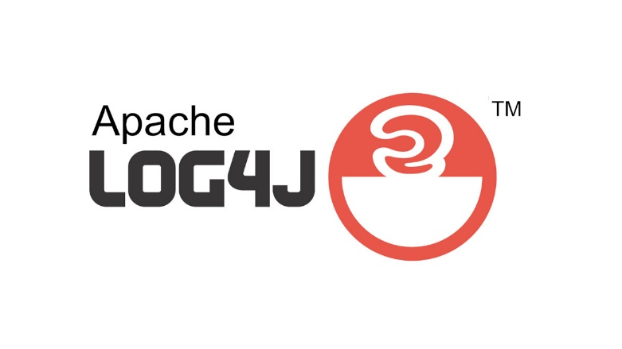
Perfect security is impossible
New assets
New threats
New capabilities
New technology

Slide 27
Perfect security is impossible
New assets
New threats
New capabilities
New technology
My goal is to teach you important cybersecurity principles that are universal across any system

Slide 28
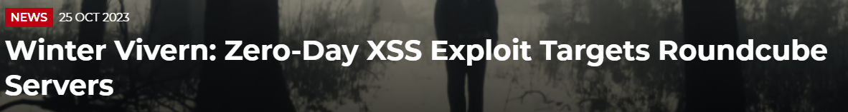
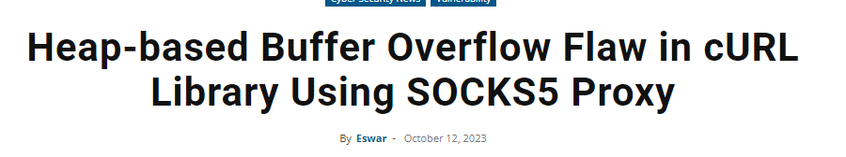
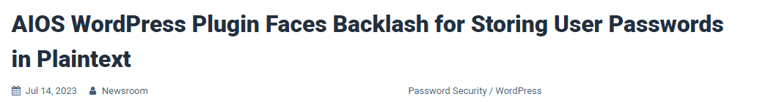
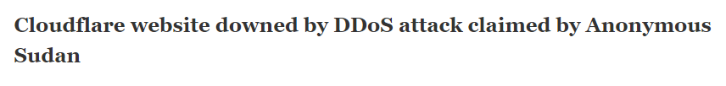

Slide 29
Threat Modeling
You develop a threat model by focusing on five key questions
What are you building?
What are the assets?
What can go wrong? What are the threats?
What mechanisms can we implement to prevent things from going wrong?
Did you do a decent job of analysis?

Slide 30
Threat Modeling
Brainstorming
Free-form brainstorming- gather around a whiteboard; enumerate threats/possible defenses
Scenario Analysis- Propose a scenario and ask “what might go wrong?”
Pre-Mortem- Assuming a failure or compromise, what do you do next?
Movie plotting – Pick outrageous ideas; what happens next?
Literature review- study systems that are similar to yours

Slide 31
Threat Modeling Practice
Free-form brainstorming- gather around a whiteboard; enumerate threats/possible defenses
Scenario Analysis- Propose a scenario and ask “what might go wrong?”
Pre-Mortem- Assuming a failure or compromise, what do you do next?
Movie plotting – Pick outrageous ideas; what happens next?
Literature review- study systems that are similar to yours
Let's develop a threat model
You are at a bar, and you hand your phone to a cute person …

Slide 32
Threat Modeling Practice
Free-form brainstorming- gather around a whiteboard; enumerate threats/possible defenses
Scenario Analysis- Propose a scenario and ask “what might go wrong?”
Pre-Mortem- Assuming a failure or compromise, what do you do next?
Movie plotting – Pick outrageous ideas; what happens next?
Literature review- study systems that are similar to yours
Let's develop a threat model
You are at a bar, and you hand your phone to a cute person …
What are you building?
What are the assets?
What can go wrong? What are the threats?
What mechanisms can we implement to prevent things from going wrong?
Did you do a decent job of analysis?

Slide 33
Structured Approaches
WE NEED STRUCTURE
Asset-centric: focus on things of value: things attack want; things you want to protect
Attacker-centric: focus on attackers/archetypes/personas and their capabilities
Software-centric: focus of SW; most SW is backed by structured models (CFG, State diagrams, etc)
Methodologies
STRIDE
Spoofing, Tampering, Repudiation, Info Disclosure, Denial of Service, Elevation of Privilege
Attack Trees
Attack Lists & Libraries (ie. Common and Current vulnerabilities)
(https://docs.microsoft.com/en-us/azure/security/develop/threat-modeling-tool-threats)
There is no “right” choice

Slide 34
Structured Approaches
On the final lab, you will need to use the knowledge you’ve learned in this class to develop a threat model for some kind of software system
Asset-centric: focus on things of value: things attack want; things you want to protect
Attacker-centric: focus on attackers/archetypes/personas and their capabilities
Software-centric: focus of SW; most SW is backed by structured models (CFG, State diagrams, etc)
Methodologies
STRIDE
Spoofing, Tampering, Repudiation, Info Disclosure, Denial of Service, Elevation of Privilege
Attack Trees
Attack Lists & Libraries (ie. Common and Current vulnerabilities)
(https://docs.microsoft.com/en-us/azure/security/develop/threat-modeling-tool-threats)
There is no “right” choice

Slide 35
Structured Approaches
Asset-centric: focus on things of value: things attack want; things you want to protect
Attacker-centric: focus on attackers/archetypes/personas and their capabilities
Software-centric: focus of SW; most SW is backed by structured models (CFG, State diagrams, etc)
Methodologies
STRIDE
Spoofing, Tampering, Repudiation, Info Disclosure, Denial of Service, Elevation of Privilege
Attack Trees
Attack Lists & Libraries (ie. Common and Current vulnerabilities)
(https://docs.microsoft.com/en-us/azure/security/develop/threat-modeling-tool-threats)
There is no “right” choice

Slide 36
Attack Trees
Goal: Open bank safe

Slide 37
Attack Trees
Goal: Open bank safe
Pick Lock
Learn Combo
Cut Open Safe
Improperly install safe

Slide 38
Attack Trees
Goal: Open bank safe
Pick Lock
Learn Combo
Cut Open Safe
Improperly install safe
Find written combo
Get combo from target

Slide 39
Attack Trees
Goal: Open bank safe
Pick Lock
Learn Combo
Cut Open Safe
Improperly install safe
Find written combo
Get combo from target
Threaten
Blackmail
Eavesdrop
Bribe

Slide 40
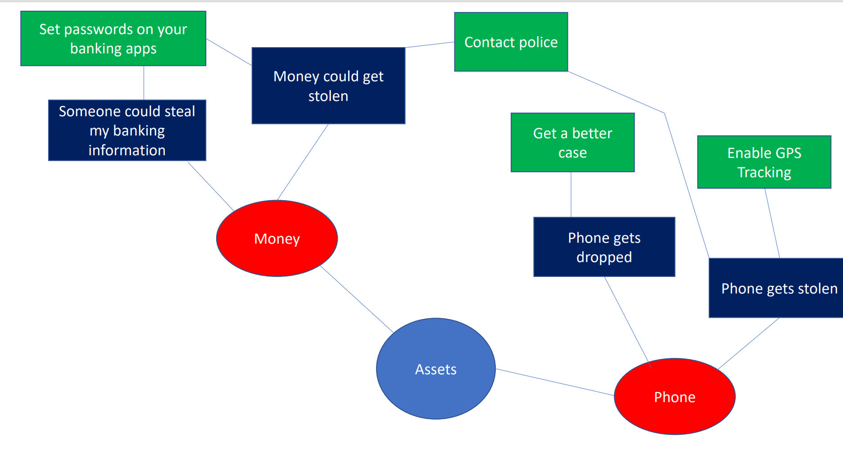
Mind Map

Slide 41
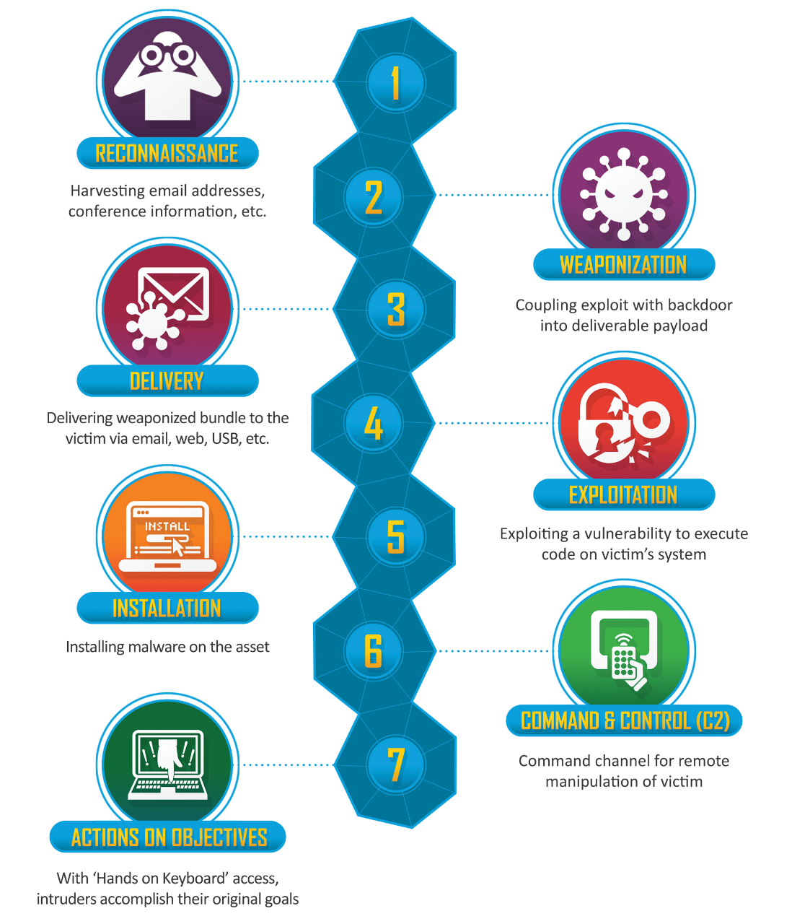
Be aware of the steps taken by a cybercriminal to conduct some cyber attack
“Cyber kill chain”

Slide 42
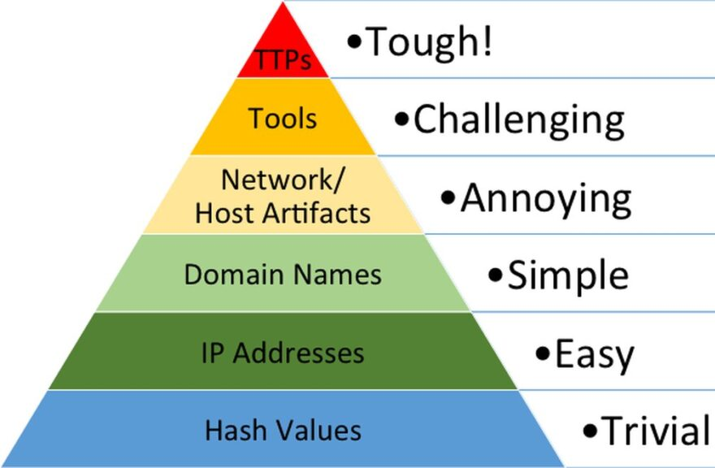
Responding to a threat can have varying levels of difficulty
Indicators of compromise (IOCs) refer to data that indicates a system may have been infiltrated by a cyber threat. They provide cybersecurity teams with crucial knowledge after a data breach or another breach in security.
“Pyramid of Pain”

Slide 43
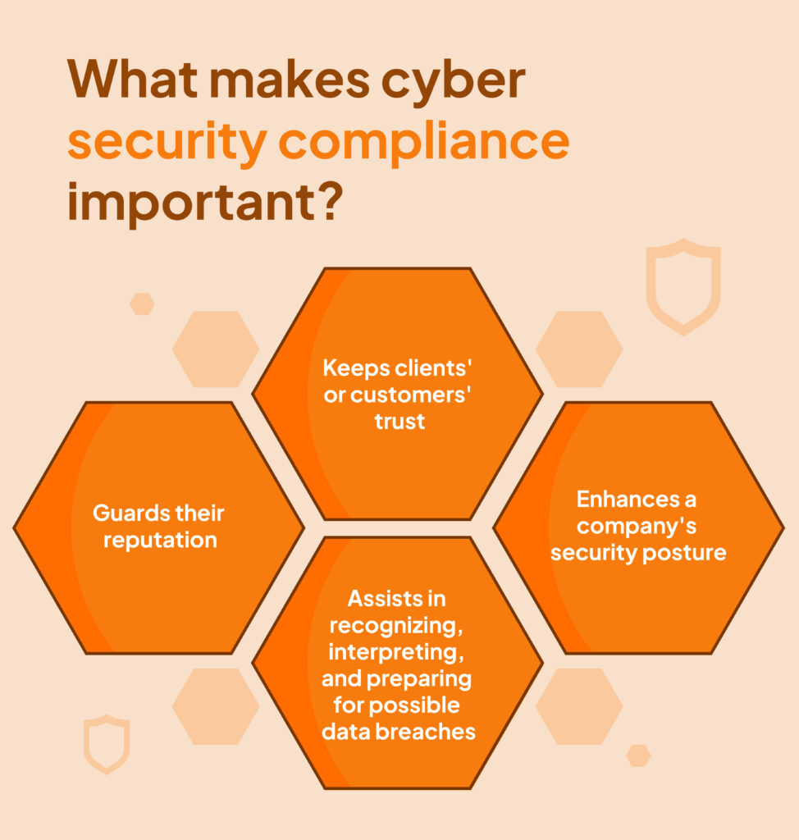
Legitimate organizations must meet compliance standards if they want to do business. This includes things such as handling transactions securely, encrypting user data, no plaintext passwords, etc
These rules are structured as a compliance framework, which is a structures set of guidelines and best practices that details a company’s processes for meeting regulatory requirements

Slide 44
