Slide 1

CSCI 476: Computer Security
Hashing
Reese Pearsall
Fall 2022
https://www.cs.montana.edu/pearsall/classes/fall2022/476/main.html

Slide 2
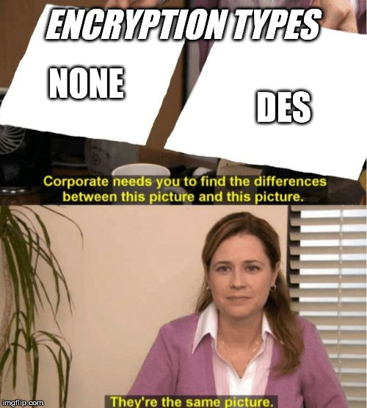
Announcement
Lab 8 (Secret-Key Encryption) due Sunday 20th
Rest of semester dates are posted
Extra credit will be applied at end of semester
How to corrupt a ciphertext
ECB

Slide 3
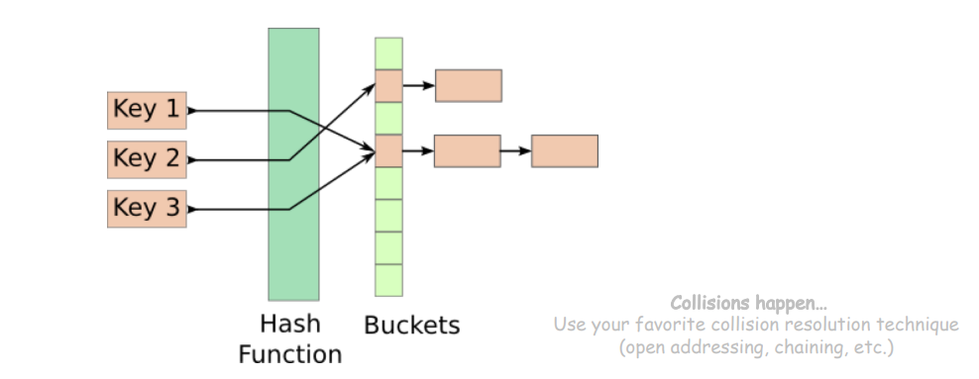
Hash Functions
Hash Functions map arbitrary size data to data of fixed size
An essential building block in cryptography, with desirable practical and security properties
Ex. f(x) = x mod 100
How many buckets?
What to do if two keys map to the same bucket?

Slide 4
Hash Functions
Hash Functions map arbitrary size data to data of fixed size
An essential building block in cryptography, with desirable practical and security properties
Ex. f(x) = x mod 100
How many buckets?
What to do if two keys map to the same bucket?

Slide 5
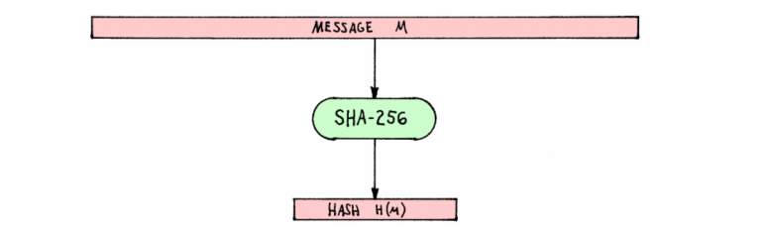
Hash Functions
Cryptographic Hash Functions map arbitrary size data to data of fixed size
But with three additional important properties
Input = Message M
SHA-256 = A cryptographically secure hashing function
Output = Hashed Message M

Slide 6
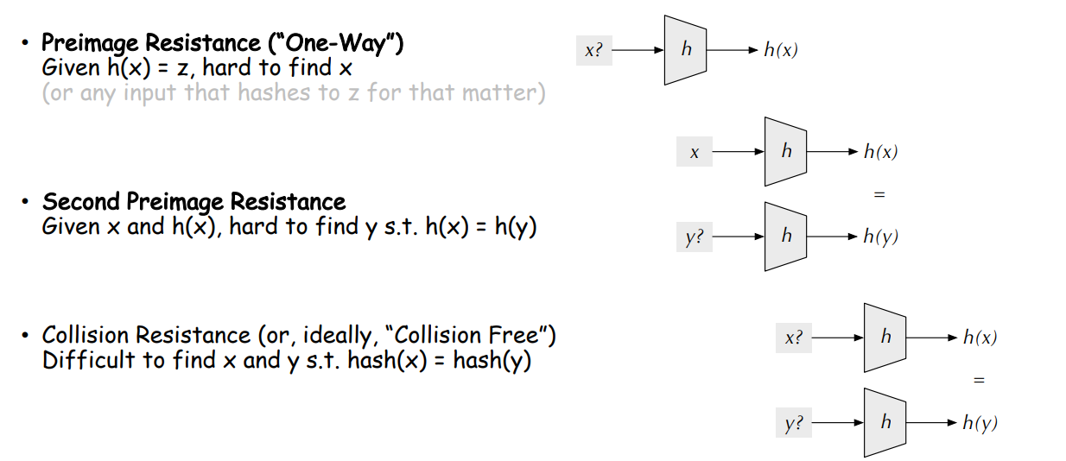
Hash Functions Properties

Slide 7
Hash Functions Properties (tl;dr)
Gives an arbitrary size input a fixed-size unique* hash identifier
Hash values are very difficult to reverse. They were designed to be one-way
The go-to way to reverse a hash is through brute force
* We will break this

Slide 8
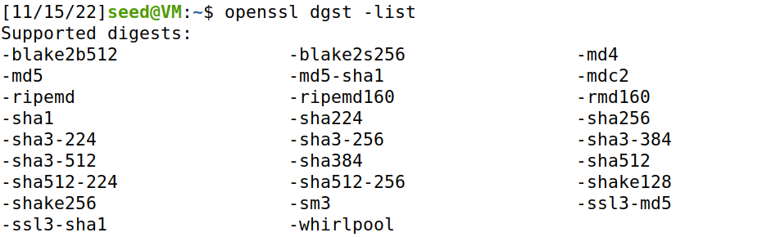
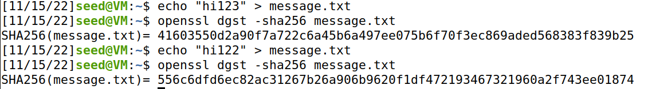
Computing Hashes with OpenSSL
Calculating the Hash for a text file with SHA 256
Property of Hashes: One small change in file → will drastically change hash (avalanche effect)

Slide 9
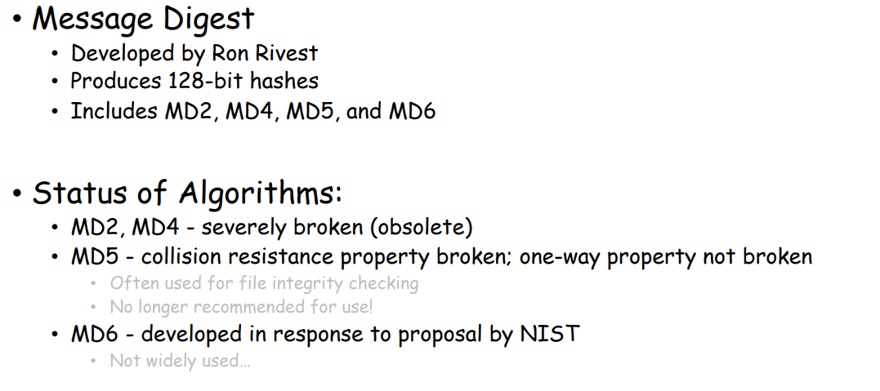
Families of Hash Function
We will be focusing on MD5, and breaking MD5 in our Lab ☺

Slide 10
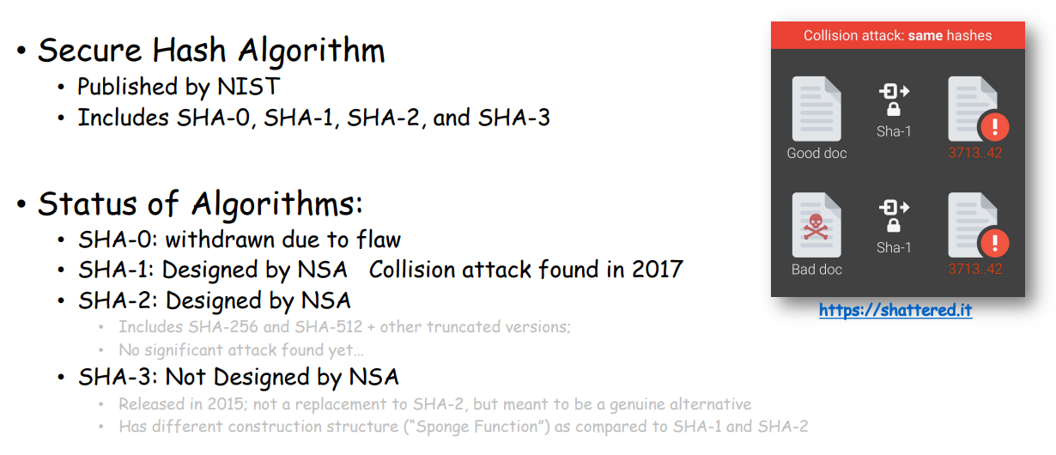
Families of Hash Function

Slide 11
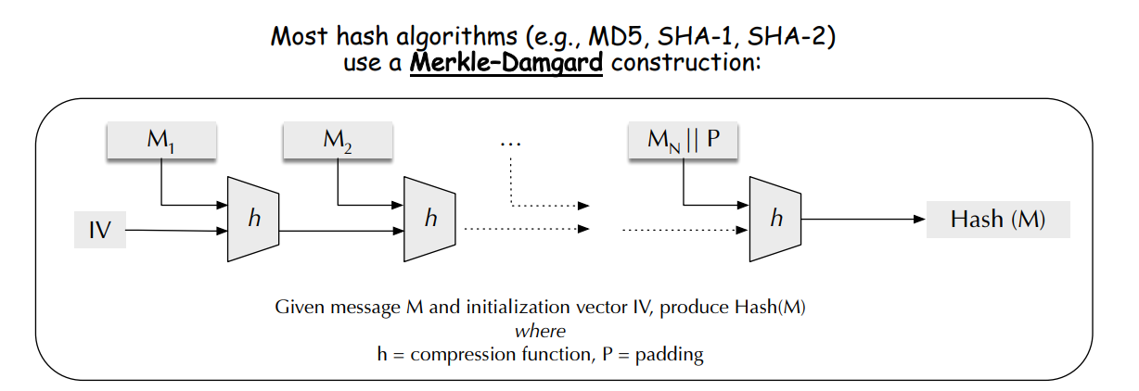
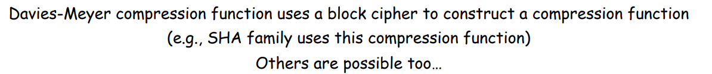
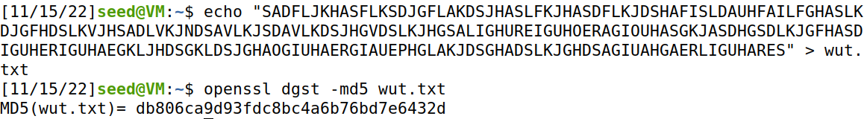
How does MD5 work?
The compression of data is also a helpful application of hash functions

Slide 12
Calculating Hashes in Programming Languages
# Python 3 code to demonstrate the
# working of MD5 (string - hexadecimal)
import hashlib
# initializing string
str2hash = “csci476"
# encoding csci476 using encode()
# then sending to md5()
result = hashlib.md5(str2hash.encode())
# printing the equivalent hexadecimal value.
print("The hexadecimal equivalent of hash is : ", end ="")
print(result.hexdigest())
Pretty much every programming language can calculate hashes

Slide 13

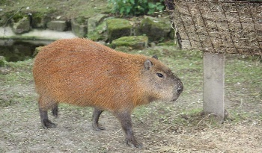

Applications of Hashing
Output space of MD5 (128 bits)
00000000000000000000000000000000
31973ff867a5a4c2546ec4cca1c126b4
MD5
73bd1ddd3ef1051bf5c4bde7a2b5a6c2
c527fc24f5932e932f44c31f1f8c674e
password123
e2ee5b2d1719edef3f8120cff39f0180
FFFFFFFFFFFFFFFFFFFFFFFFFFFFFFFF
What are some uses for hashing?

Slide 14


Applications of Hashing
Integrity Verification
hello_world
A CSCI 112 Student

Slide 15


Applications of Hashing
Integrity Verification
hello_world
A CSCI 112 Student
Sent to professor for grading
hello_world
Instructor

Slide 16
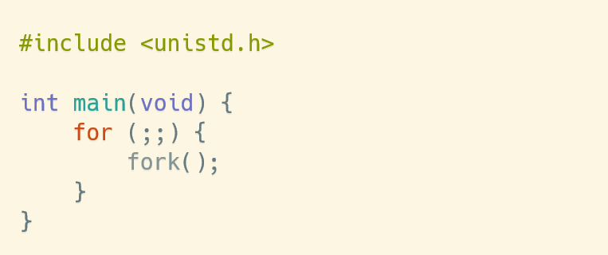


Applications of Hashing
Integrity Verification
hello_world
A CSCI 112 Student
hello_world
What if the message got tampered with?
hello_world
Instructor

Slide 17
Applications of Hashing
Integrity Verification
hello_world
A CSCI 112 Student
hello_world
What if the message got tampered with?
hello_world
She will have no idea because this executable program seems totally normal and came from a trustworthy source
Instructor

Slide 18
Applications of Hashing
Integrity Verification
hello_world
A CSCI 112 Student
hello_world
What if the message got tampered with?
hello_world
We can use hashing to introduce some integrity to our messages
Instructor

Slide 19
Applications of Hashing
Integrity Verification
hello_world
89defae676abd3e3a42b41df17c40096
A CSCI 112 Student
hello_world
hello_world
1. Generate hash for source file
Instructor

Slide 20
Applications of Hashing
Integrity Verification
hello_world
89defae676abd3e3a42b41df17c40096
A CSCI 112 Student
hello_world
hello_world
Generate hash for source file
Instructor generates hash for file she received
b0608c4e1775ad8f92e7b5c191774c5d
Instructor

Slide 21
Applications of Hashing
Integrity Verification
hello_world
89defae676abd3e3a42b41df17c40096
A CSCI 112 Student
hello_world
hello_world
Generate hash for source file
Instructor generates hash for file she received
b0608c4e1775ad8f92e7b5c191774c5d
Instructor
The hashes do not match!

Slide 22
Applications of Hashing
Integrity Verification
hello_world
89defae676abd3e3a42b41df17c40096
When a message gets tampered with, the new hash will be completely different
Different hashes = Something fishy happened!
A CSCI 112 Student
hello_world
b0608c4e1775ad8f92e7b5c191774c5d
Instructor

Slide 23
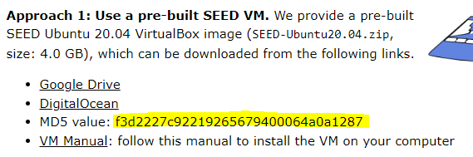
Applications of Hashing
When a message gets tampered with, the new hash will be completely different
Different hashes = Something fishy happened!
Integrity Verification
hello_world
89defae676abd3e3a42b41df17c40096
A CSCI 112 Student
hello_world
b0608c4e1775ad8f92e7b5c191774c5d
If your seed labs ZIP doesn’t match that that hash, then you might have a modified OS image
Instructor

Slide 24
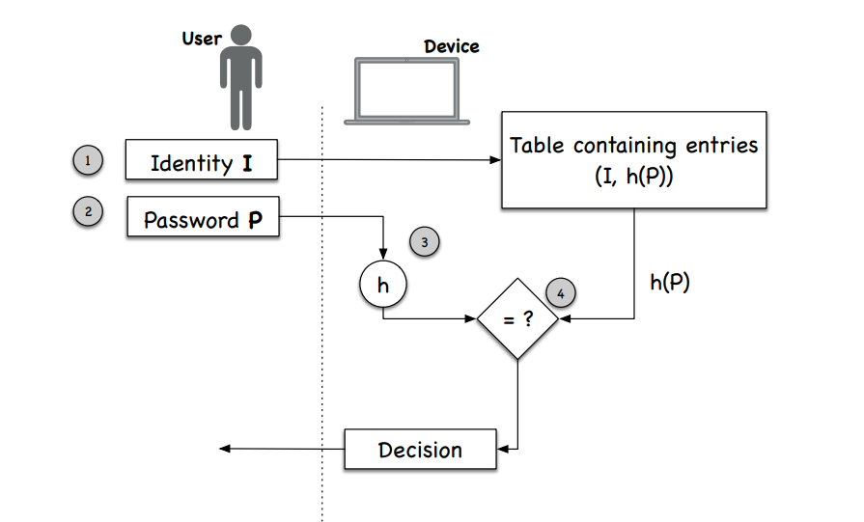
Applications of Hashing
Password Verification
Websites need to know password information so that users can login
But websites should never store passwords in plaintext
Instead, websites will store the hash of your password

Slide 25
Applications of Hashing
Password Verification
Websites need to know password information so that users can login
But websites should never store passwords in plaintext
Instead, websites will store the hash of your password
If two people have the same password….

Slide 26
Applications of Hashing
Password Verification
Websites need to know password information so that users can login
But websites should never store passwords in plaintext
Instead, websites will store the hash of your password
If two people have the same password….
Their passwords will be the same!

Slide 27
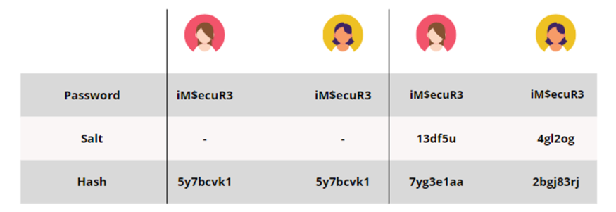
Applications of Hashing
Password Verification
Salt is just some random string appended to a password
WdRrWCQzpassword123
When a service uses salted passwords, the same input (password) can result in different hashes!

Slide 28
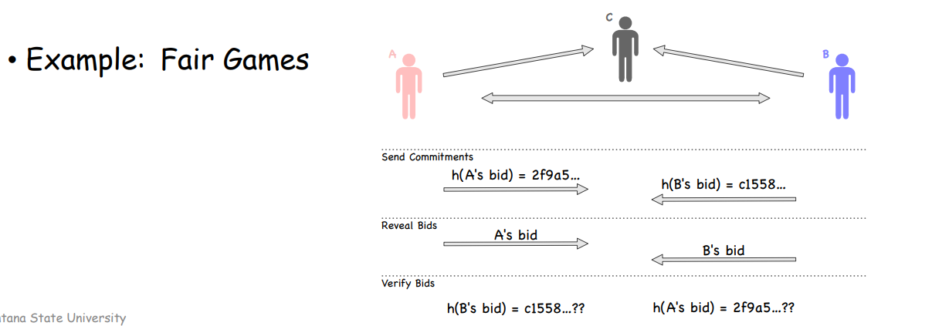
Applications of Hashing
Fairness and Commitment (scary)
Disclosing a hash does not disclose the original message
Useful to commit secret without disclosing the secret itself

Slide 29
Attacks on Hashing
Suppose we get a hash for an unsalted password
cc3a0280e4fc1415930899896574e118
What could we do to retrieve the original password?
Brute Force
Dictionary Attack
Rainbow Tables

Slide 30
Attacks on Hashing
Suppose we get a hash for an unsalted password
cc3a0280e4fc1415930899896574e118
What could we do to retrieve the original password?
Brute Force
Dictionary Attack
Rainbow Tables
Brute force is difficult (time consuming), a more interesting attack is collision attacks

Slide 31

Collision Attacks
hello_world
89defae676abd3e3a42b41df17c40096
What if we could create two files, with totally different behaviors, but have the same hash?
hello_world
89defae676abd3e3a42b41df17c40096

Slide 32
Collision Attacks
hello_world
89defae676abd3e3a42b41df17c40096
hello_world
89defae676abd3e3a42b41df17c40096
Hash Collision Attacks compromise the integrity of a program by creating a malicious file that has a same hash

Slide 33
Collision Attacks
00000000000000000000000000000000
00000000000000000000000000000001
00000000000000000000000000000010
There is a very large amount of possible hashes
~(2¹²⁸)
MD5
hello_world
…
106a7d06be131315e25a7cbe57af398c
hello_world
…
EEFFFFFFFFFFFFFFFFFFFFFFFFFFFFFF
EFFFFFFFFFFFFFFFFFFFFFFFFFFFFFFF
FFFFFFFFFFFFFFFFFFFFFFFFFFFFFFFF
How likely is? Very unlikely?

Slide 34
Collision Attacks
00000000000000000000000000000000
00000000000000000000000000000001
00000000000000000000000000000010
There is a very large amount of possible hashes
~(2¹²⁸)
MD5
hello_world
…
106a7d06be131315e25a7cbe57af398c
hello_world
…
EEFFFFFFFFFFFFFFFFFFFFFFFFFFFFFF
EFFFFFFFFFFFFFFFFFFFFFFFFFFFFFFF
FFFFFFFFFFFFFFFFFFFFFFFFFFFFFFFF
How likely is? Very unlikely?
More likely than you think…

Slide 35

Birthday Paradox
In a room of 23 people, what is the probability that two people share the same birthday?
Its not 23/365
We will instead compute the chance that a group of people don’t share a birthday
365/365

Slide 36
Birthday Paradox
In a room of 23 people, what is the probability that two people share the same birthday?
Its not 23/365
We will instead compute the chance that a group of people don’t share a birthday
365/365
364/365

Slide 37
Birthday Paradox
In a room of 23 people, what is the probability that two people share the same birthday?
Its not 23/365
We will instead compute the chance that a group of people don’t share a birthday
365/365
364/365
363/365

Slide 38
Birthday Paradox
In a room of 23 people, what is the probability that two people share the same birthday?
Its not 23/365
We will instead compute the chance that a group of people don’t share a birthday
…
365/365
364/365
362/365
363/365
343/365

Slide 39










Birthday Paradox
In a room of 23 people, what is the probability that two people share the same birthday?
Its not 23/365
We will instead compute the chance that a group of people don’t share a birthday
…
365/365
364/365
362/365
363/365
343/365
Probability that 23 people do share a birthday
Probability that 23 people don’t share a birthday
Go Watch this video: https://www.youtube.com/watch?v=ofTb57aZHZs

Slide 40
Birthday Paradox
What's the probability that two people in a group of 23 people share a birthday?
About 50%
What's the probability that two files share a hash?
More probable than you think…
Turns out, we can generate two files with the same hash in a matter of seconds…
Go Watch this video: https://www.youtube.com/watch?v=ofTb57aZHZs

Slide 41

Announcements
Lab 8 (Secret-Key Encryption) due Sunday 20th
Email me if you need anything over the break
Last day to drop with a W is today
^{XOR task}

Slide 42
Hash Functions Properties

Slide 43
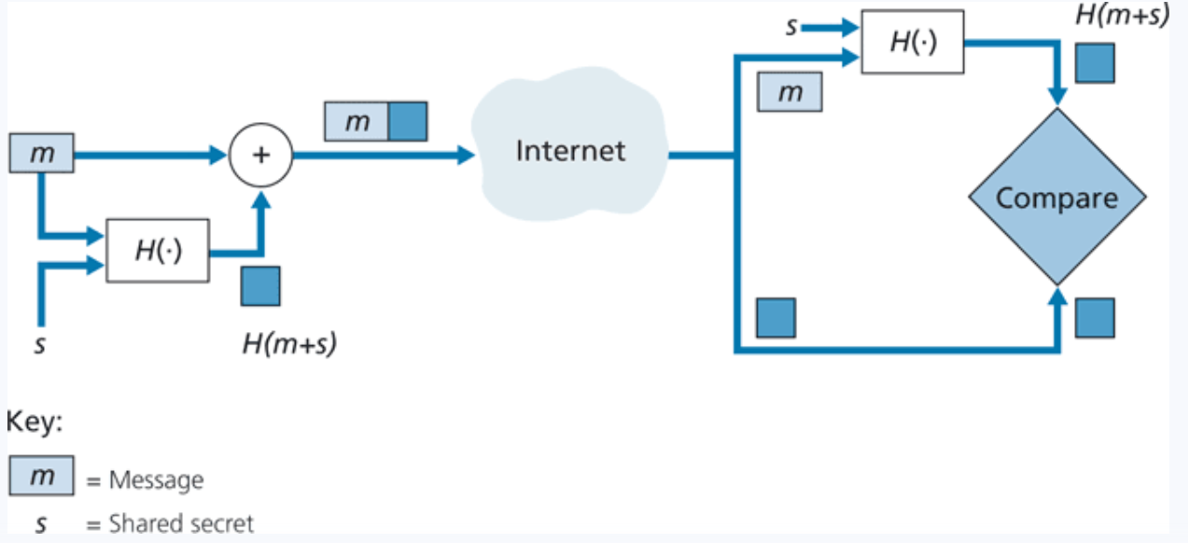
Uses for Hashing:
Message Authentication Code (MAC)
Append a message with a shared secret (m + s)
Compute hash of (m+s) → H(m+s)
Send H(m+s) with message m
Sender sends: ( H(m+s), m)
Receiver gets ( H(m+s), m)
Append m with shared secret s (m + s)
Compute H(m+s)
The value receiver computed should match the H(m+s) he received

Slide 44
Brute Force Approaches
Long time, and for very unfeasible for cryptographically secure hash functions
Given a hashed password, can you brute force the original password?
afc285bebb3dd733796cb06db01cd59a
Techniques
Dictionary Attack
Rainbow Tables

Slide 45
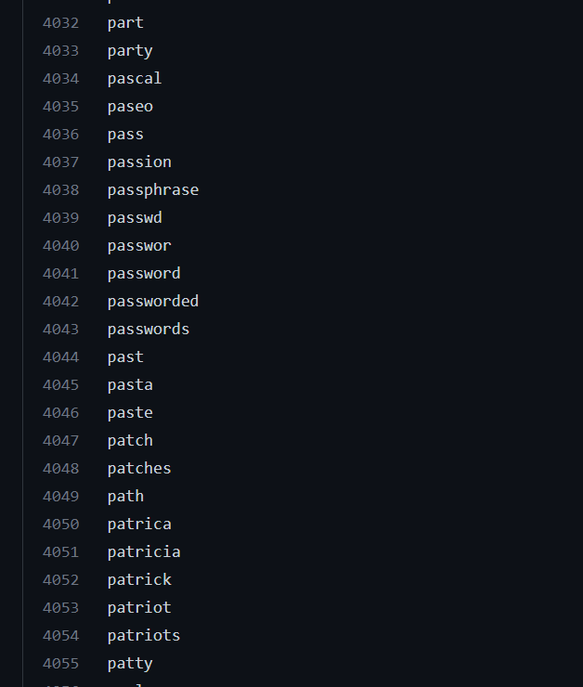




Dictionary Attack
We will use an existing list of common passwords
Iterate through each line of file
Compute hash of word
Check for match
afc285bebb3dd733796cb06db01cd59a
This works for cracking weak, unsalted passwords

Slide 46
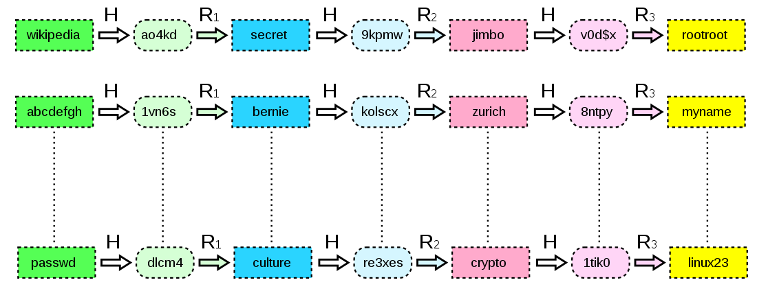
Rainbow Tables
A large file of pre-computed hashes
Efficient way to store password hashes. Consists of plaintext-hash chains
Hash
Reduce
Hash
Reduce
Word
Hash
Word
Hash
Looking up a value in the rainbow table can happen quick, but these files are typically very large
Not efficient for complex, salted passwords
(Brute force can take years, with rainbow tables, it can take weeks/months)
Project-RainbowCrack

Slide 47
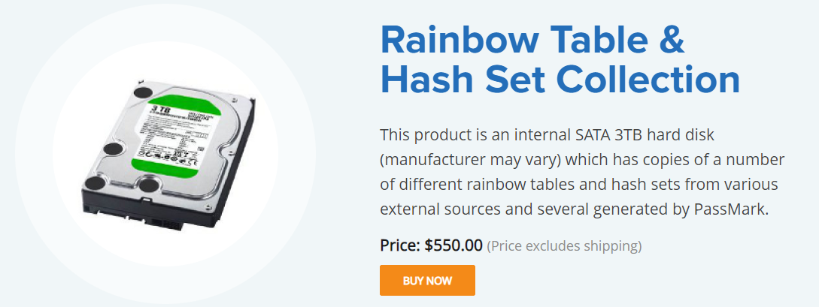
Rainbow Tables
Tables for alphanumeric, special character passwords can take a long time to generate, so instead of doing it yourself, you can buy rainbow tables that other people have generated!
There are free, open-source tools that can generate rainbow tables for you
Project-RainbowCrack

Slide 48
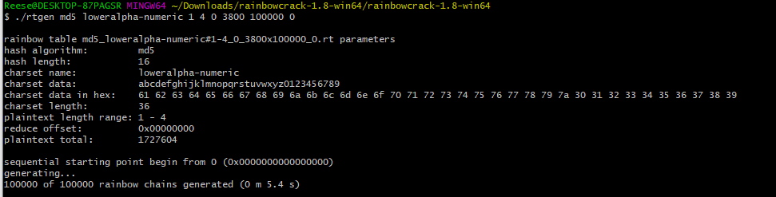
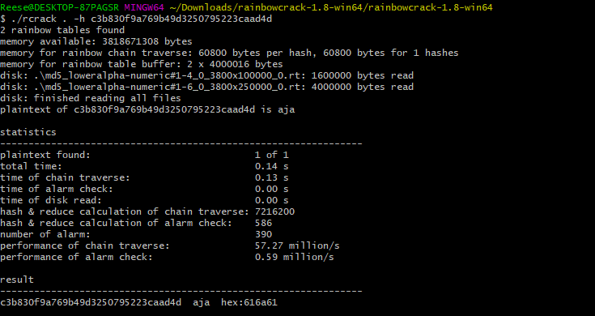



Rainbow Tables using RainbowCrack

Slide 49
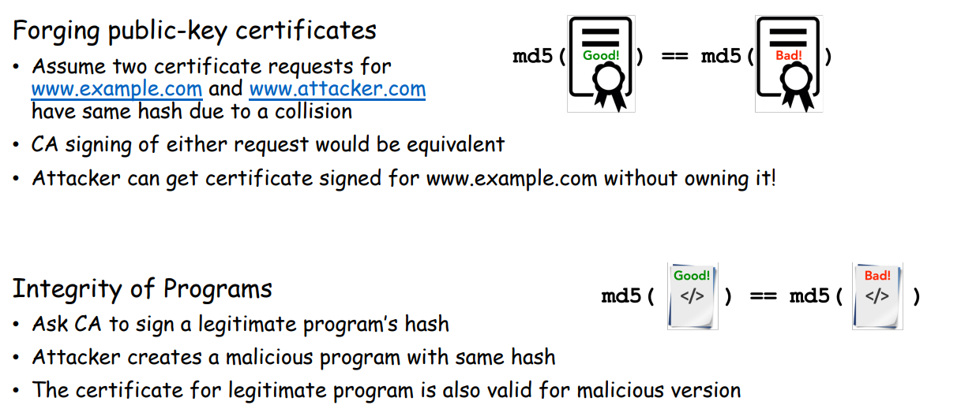
Hash Collisions
Goal: Create two different files with the same md5 hash
Our ultimate goal would be to create two executables (one benign, one malicious) with the same hash
(This is difficult to do, but we will show that it can theoretically happen)
Motivation

Slide 50
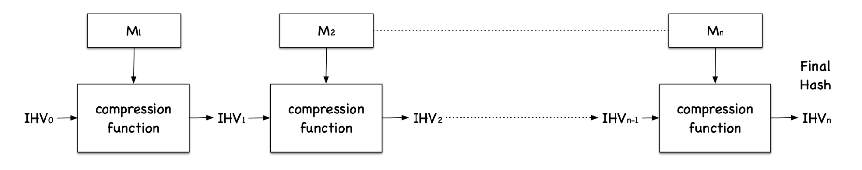
Hash Collisions (MD5collgen)
On our VM, we have a tool called md5collgen that will generate two files with the same prefix
We get to choose this prefix!
MD5 Under the hood
Fact: Message is divided into blocks, and each block is run through a compression function
Important Fact: Each block will be 64 bytes

Slide 51
Hash Collisions (MD5collgen)
On our VM, we have a tool called md5collgen that will generate two files with the same prefix
We get to choose this prefix!

Slide 52
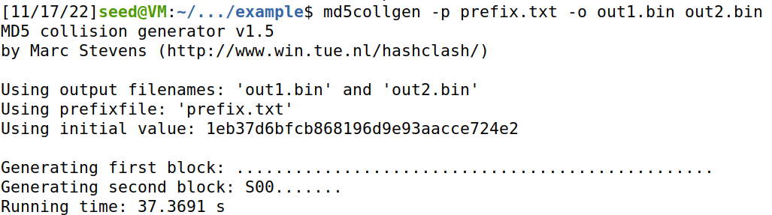
Hash Collisions (MD5collgen)
On our VM, we have a tool called md5collgen that will generate two files with the same prefix
We get to choose this prefix!

Slide 53
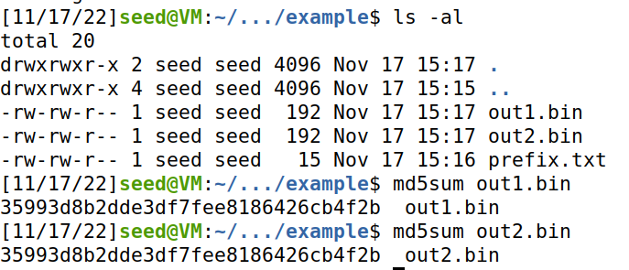
Hash Collisions (MD5collgen)
On our VM, we have a tool called md5collgen that will generate two files with the same prefix
We get to choose this prefix!
Same Hash!

Slide 54
Hash Collisions (MD5collgen)
On our VM, we have a tool called md5collgen that will generate two files with the same prefix
We get to choose this prefix!
Same Hash!
Compare with xxd

Slide 55
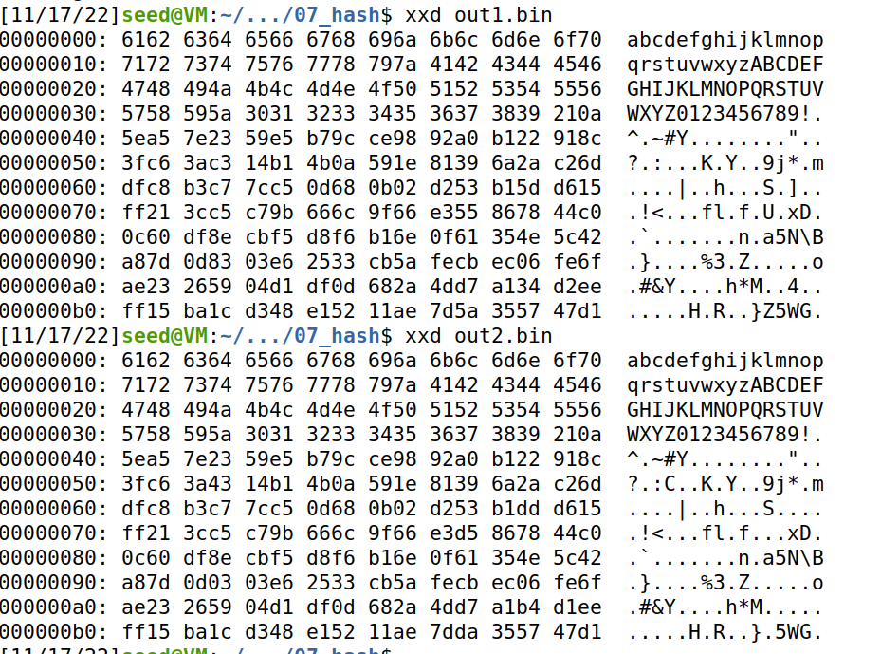
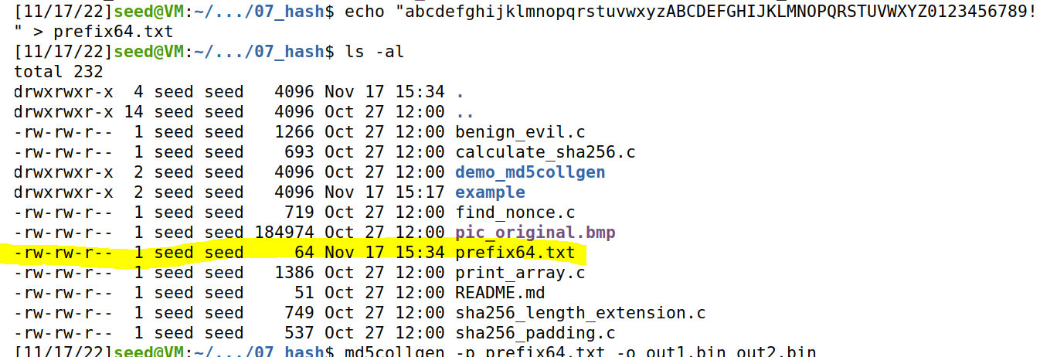
Hash Collisions (MD5collgen)
What if out prefix is a multiple of 64?
Our prefix is exactly 64 bytes
→ No padding is added!

Slide 56
Hash Collisions (MD5collgen)
What if out prefix is a multiple of 64?
Our prefix is exactly 64 bytes
→ No padding is added!

Slide 57
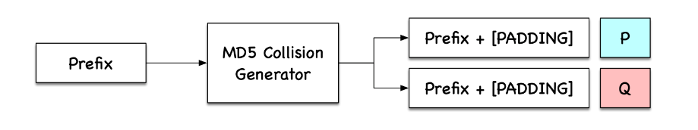
Hash Collisions (md5collgen)

Slide 58
Hash Collisions (Suffix Extension)
M
N
H(m) == H(n)

Slide 59
Hash Collisions (Suffix Extension)
H
H
H
H
H
H
H
H
H
Final Hash (same for each)
M
N
64 64 64 64 64 64
64 64 64
H(m) == H(n)

Slide 60
Hash Collisions (Suffix Extension)
If we append the same suffix, then this computation will also be the exact same for M and N
H
H
H
H
H
H
H
H
H
H
H
H
H
H
M
Suffix
N
Suffix
64 64 64 64 64 64
64 64 64
H(m) == H(n)

Slide 61
Hash Collisions (Suffix Extension)
If we append the same suffix, then this computation will also be the exact same for M and N
H
H
H
H
H
H
H
H
H
H
H
H
H
H
M
Suffix
N
Suffix
64 64 64 64 64 64
64 64 64
H(m) == H(n)
H(m || s) == H(n || s)
s = shared suffix

Slide 62
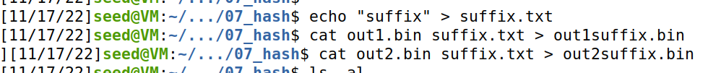
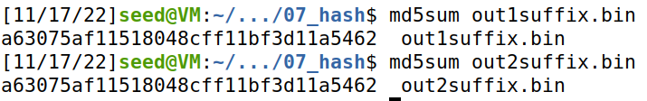
Hash Collisions (Suffix Extension)
If we append the same suffix, then this computation will also be the exact same for M and N
H
H
H
H
H
H
H
H
H
H
H
H
H
H
M
Suffix
N
Suffix
64 64 64 64 64 64
64 64 64
H(m) == H(n)
H(m || s) == H(n || s)
s = shared suffix

Slide 63
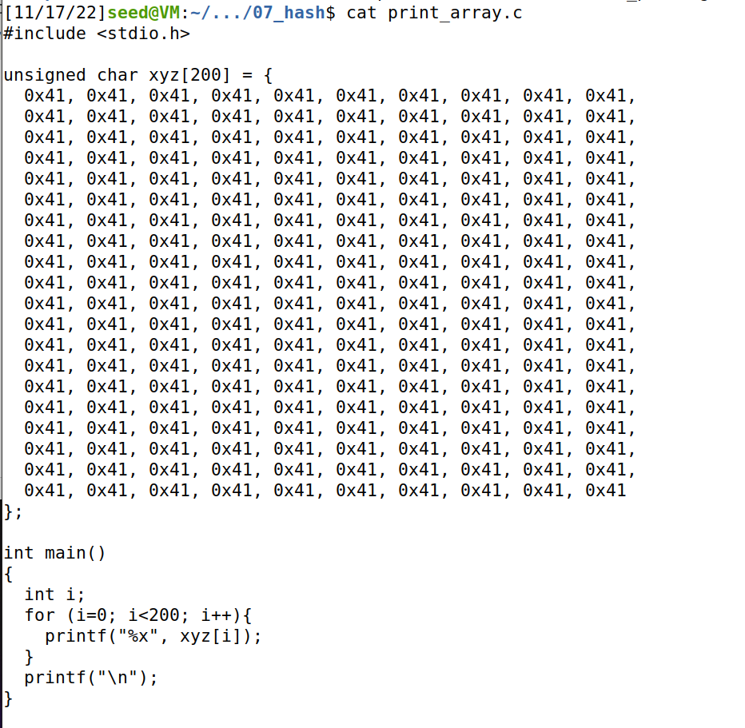
Hash Collisions (Generating Two executable files with the same MD5 hash)
This is a program that will print out the contents of an array
We will create two variants of this program, but the program will have the same hash
Prefix
P
Suffix
Prefix
Q
Suffix

Slide 64
Hash Collisions (Generating Two executable files with the same MD5 hash)
We will create two variants of this program, but the program will have the same hash
Prefix
Suffix

Slide 65
Hash Collisions (Generating Two executable files with the same MD5 hash)
We will create two variants of this program, but the program will have the same hash
Prefix
md5collgen( )
Prefix
P
Prefix
Q
These will have the same hash!
P and Q will be 128 bytes (multiple of 64)
Prefix
P
Suffix
Prefix
Q
Suffix
Because we know the suffix extension property holds true, we know the hash of these two programs will also be the same

Slide 66
Hash Collisions (Generating Two executable files with the same MD5 hash)
Prefix
Prefix
P
Q
Suffix
Suffix

Slide 67
Hash Collisions (Generating Two executable files with the same MD5 hash but behave very differently)
We can change the contents of this section of the program because it is just array data (it won’t break anything)
First, we need to find the starting location (the offset) of the xyz array → this will be the beginning of P and Q

Slide 68
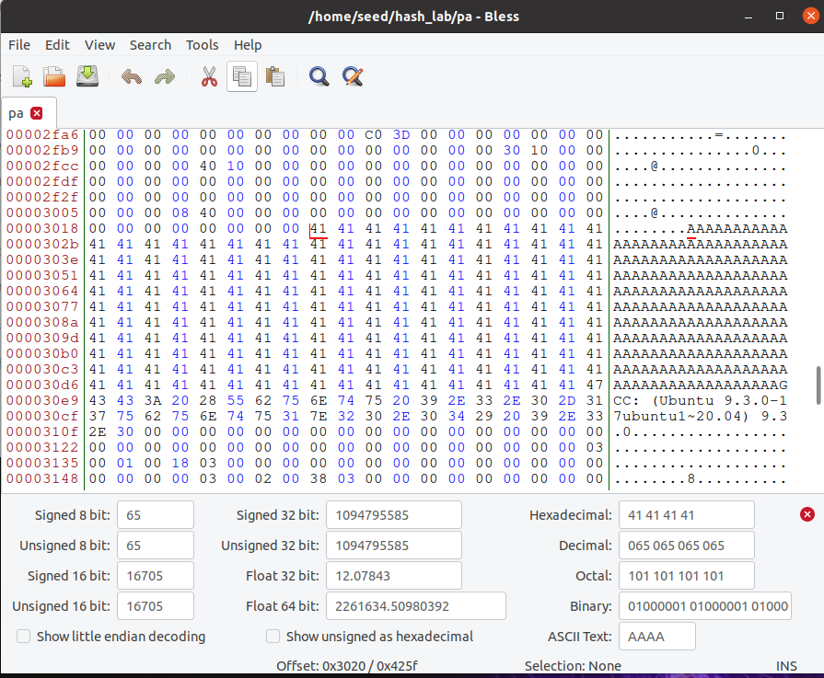
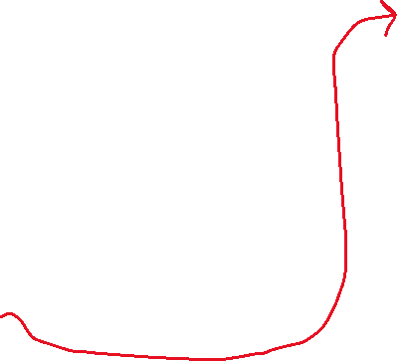

Hash Collisions (Generating Two executable files with the same MD5 hash but behave very differently)
We can find where xyz begins in our program easily, because we filled it with A’s
First Byte of xyz array
Start of XYZ = 0x3020 (Hexadecimal)
12320 (decimal)

Slide 69
Task 4 on the lab
0
Prefix
Our prefix will be bytes 0-12320 of the program!
12320
We want our P and Q to be 128 bytes
Why 128?
Multiple of 64
Wont overflow an array of size 200

Slide 70
Task 4 on the lab
0
Prefix
Our prefix will be bytes 0-12320 of the program!
12320
P
Q
We want our P and Q to be 128 bytes
Why 128?
Multiple of 64
Wont overflow an array of size 200

Slide 71
Task 4 on the lab
0
Prefix
Our prefix will be bytes 0-12320 of the program!
12320
P
Q
We want our P and Q to be 128 bytes
Why 128?
Multiple of 64
Wont overflow an array of size 200
128 bytes
13448
Therefore, our suffix will begin at byte # 12320 + 128 = 13448
Suffix
16992 (size of executable)

Slide 72
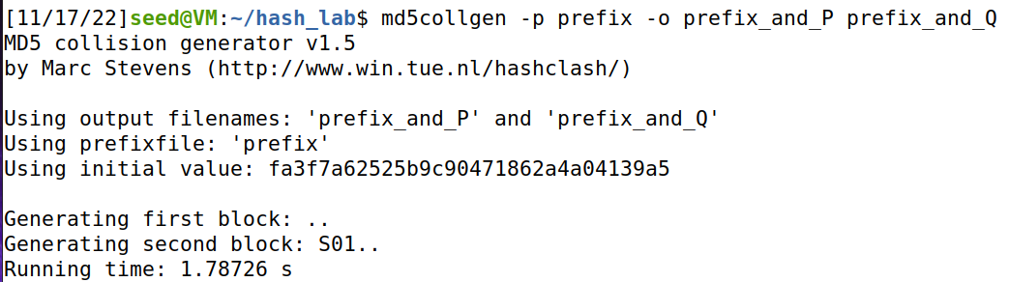


Task 4 on the lab
Get contents of prefix and suffix
0
Prefix
12320
P
Q
Use collision tool to get (prefix + P) and (prefix + Q)
128 bytes
13448
Suffix
(We don’t have to worry about padding because our values are (nicely) divisible by 64)
16992 (size of executable)

Slide 73
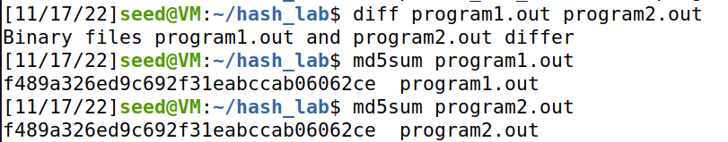


Task 4 on the lab
Get contents of prefix and suffix
0
Prefix
12320
P
Q
Use collision tool to get (prefix + P) and (prefix + Q)
128 bytes
13448
Add suffix to programs
Suffix
Verify that executables are different, but have the same hash
16992 (size of executable)

Slide 74
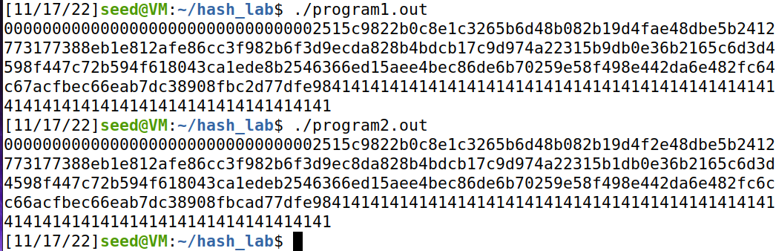

Task 4 on the lab
0
Prefix
12320
Make sure you still have a valid program ☺
P
Q
128 bytes
13448
Suffix
Somewhere in this output, you should find a small difference
16992 (size of executable)

