Slide 1

CSCI 466: Networks
Lecture 4: Application Layer
Reese Pearsall
Fall 2022
https://www.cs.montana.edu/pearsall/classes/fall2022/466/main.html
*All images are stolen from the internet

Slide 2

Application Layer
OSI Model
Presentation Layer
*
Application Layer
Session Layer
*
Messages from Network Applications
Transport Layer
Network Layer
Physical Layer
Data Link Layer
Bits being transmitted over a copper wire
Physical Layer
*In the textbook, they condense it to a 5-layer model, but 7 layers is what is most used

Slide 3






Application Layer
OSI Model
???
???
???

Slide 4


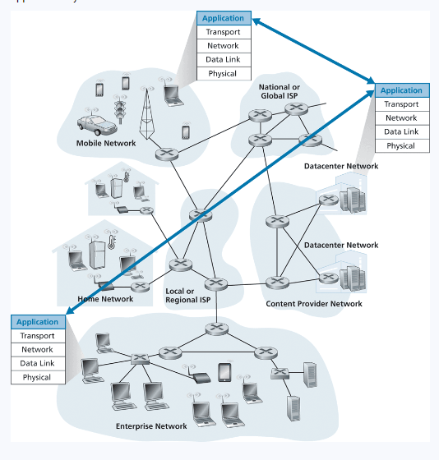







Application Layer Principles
Web applications are built with different technologies
We need a universal method for communicating between applications connected to the internet
New web applications need to be “compatible” with other web applications they communicate with

Slide 5
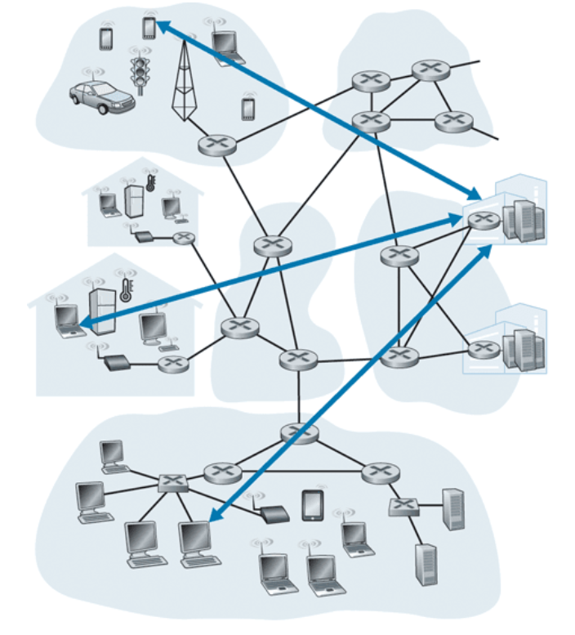
Web Application Architectures
“Server”
Client-server architecture
Clients do not directly interact with each other
“Client”

Slide 6
Web Application Architectures
“Server”
Client-server architecture
Clients do not directly interact with each other
“Client”
ie. My web browser does not directly interact with your web browser

Slide 7


Web Application Architectures
“Server”
Client-server architecture
Clients do not directly interact with each other
“Client”
ie. My web browser does not directly interact with your web browser
Communication is done through a Server
Online 24/7*
Hosted in a data center

Slide 8
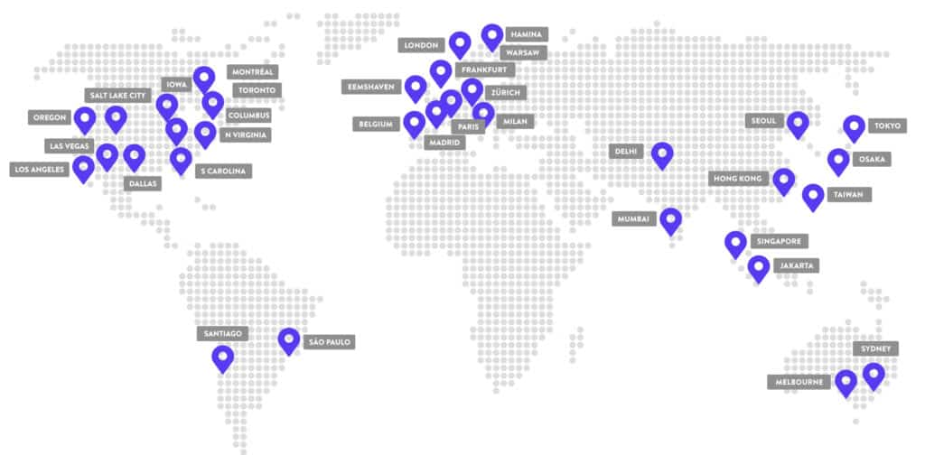
Web Application Architectures
“Server”
Client-server architecture
Clients do not directly interact with each other
“Client”
ie. My web browser does not directly interact with your web browser
Communication is done through a Server
Online 24/7*
Hosted in a data center

Slide 9
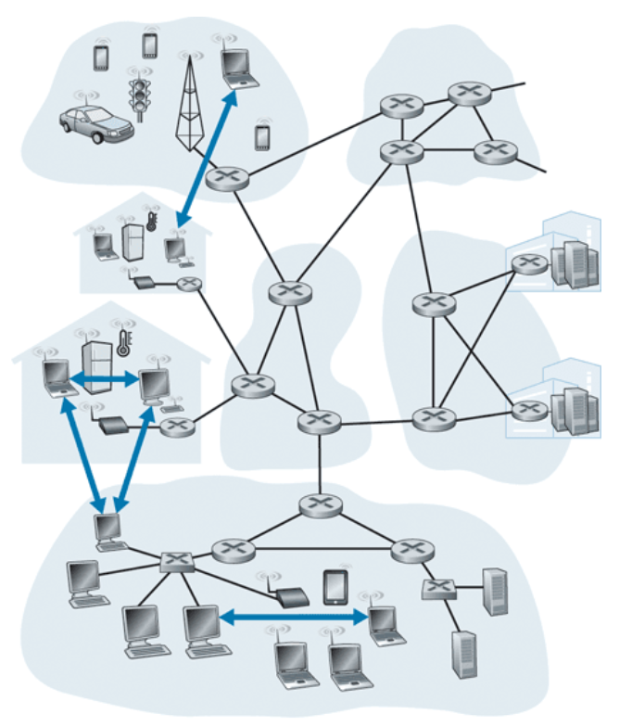
Web Application Architectures
P2P Architecture
No reliance on a dedicated server
“Peer”
“Peer”

Slide 10
Web Application Architectures
P2P Architecture
No reliance on a dedicated server
“Peer”
Each endpoint has same power and responsibilities.
Endpoints can be both a server and an endpoint
“Peer”

Slide 11
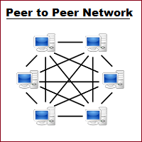
Web Application Architectures
P2P Architecture
No reliance on a dedicated server
“Peer”
Each endpoint has same power and responsibilities.
Endpoints can be both a server and an endpoint
“Peer”
BitTorrent

