Slide 1

CSCI 132: Basic Data Structures and Algorithms
More Java Constructs
Reese Pearsall
Spring 2023
https://www.cs.montana.edu/pearsall/classes/spring2023/132/main.html
*All images are stolen from the internet

Slide 2

Announcements
Rubber Duck Extra credit screenshot due by Friday
Program 5 due Sunday
Lab 13 due tomorrow @ 11:59 PM
→ Easy: just fill out the course evaluation
Current Response Rate: 57%
Final Exam one week from today (5/8) at 2:00 PM – 3:50 PM
Take some time this week to double check your grades
(No lecture on Wednesday)

Slide 3
Since the LinkedList class implements the Queue interface, it can be treated as a Queue object
import java.util.LinkedList;
import java.util.Queue;
LinkedList<String> queue = new LinkedList<String>();
Queue<String> queue = new LinkedList<String>();

Slide 4
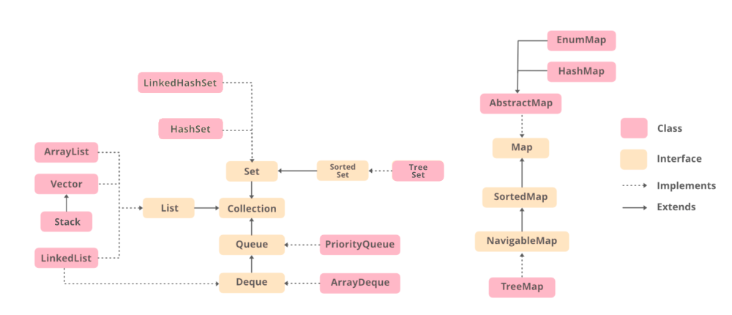

Slide 5
Java has a built-in sort method for Arrays
What sorting algorithm does it use?
https://docs.oracle.com/javase/8/docs/api/java/util/Arrays.html

Slide 6
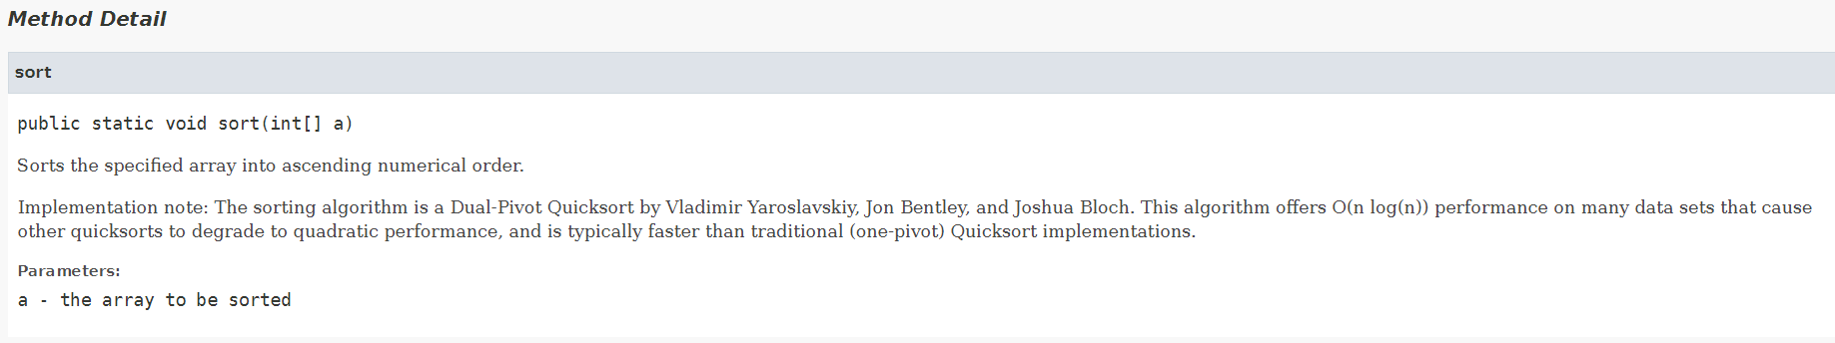

Java has a built-in sort method for Arrays
What sorting algorithm does it use?
https://docs.oracle.com/javase/8/docs/api/java/util/Arrays.html

Slide 7
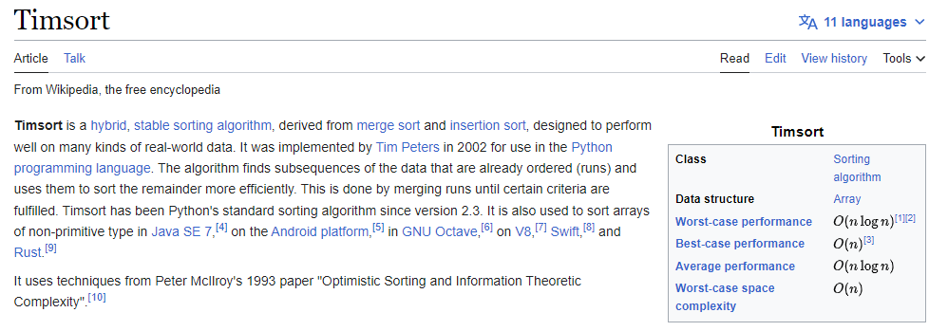

Java has a built-in sort method for Arrays
What sorting algorithm does it use?
Python’s .sort() function uses a hybrid of merge sort and insertion sort, called Timsort

Slide 8
Let’s go back to when we were writing our own Linked List and Node class
For example, this Linked List could only hold Strings
public class Node {
private String name;
private Node next;
public Node(String c) {
this.name = c;
this.next = null
}
…
}

Slide 9
Let’s go back to when we were writing our own Linked List and Node class
If we wanted to have Linked List hold Doubles, we would need to modify parts of the Node and LinkedList class
For example, this Linked List could only hold Strings
public class Node {
private String name;
private Node next;
public Node(String c) {
this.name = c;
this.next = null
}
…
}
public class Node {
private double value;
private Node next;
public Node(String c) {
this.name = c;
this.next = null
}
…
}

Slide 10
Let’s go back to when we were writing our own Linked List and Node class
If we wanted to have Linked List hold Doubles, we would need to modify parts of the Node and LinkedList class
For example, this Linked List could only hold Strings
public class Node {
private String name;
private Node next;
public Node(String c) {
this.name = c;
this.next = null
}
…
}
public class Node {
private double value;
private Node next;
public Node(String c) {
this.name = c;
this.next = null
}
…
}
It would be nice if we could allow our Linked List to hold any type of data without needing to modify the source code of our classes

Slide 11
Let’s go back to when we were writing our own Linked List and Node class
If we wanted to have Linked List hold Doubles, we would need to modify parts of the Node and LinkedList class
For example, this Linked List could only hold Strings
public class Node {
private String name;
private Node next;
public Node(String c) {
this.name = c;
this.next = null
}
…
}
public class Node {
private double value;
private Node next;
public Node(String c) {
this.name = c;
this.next = null
}
…
}
It would be nice if we could allow our Linked List to hold any type of data without needing to modify the source code of our classes→ We can achieve this using Java generics

Slide 12
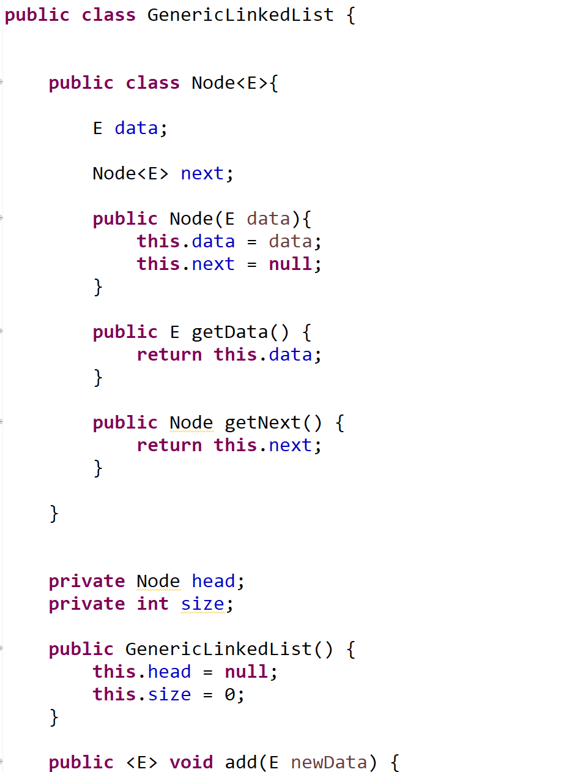







We can embed a class within another class (although I don’t recommend doing this unless the class is very small and/or the classes are strongly related to each other)
The data can be any object
When we create a Node object, we will give it some data type
<E> is used to indicate that this Node class will hold a Generic object. It can be any object
getData() will now return some generic object E
This is very helpful for cases when we might not know what data type we will be working with
Start of Linked List class

Slide 13
Instead of writing many if/else statements, you can use the switch statement
The switch statement selects one of many code blocks to be executed
int day = 4;
switch (day) {
case 1:
System.out.println("Monday");
break;
case 2:
System.out.println("Tuesday");
break;
case 3:
System.out.println("Wednesday");
break;
default:
System.out.println(“???");
These can be efficient when working with many possible conditions. They serve the same purpose as if statements, but are slightly more efficient

Slide 14
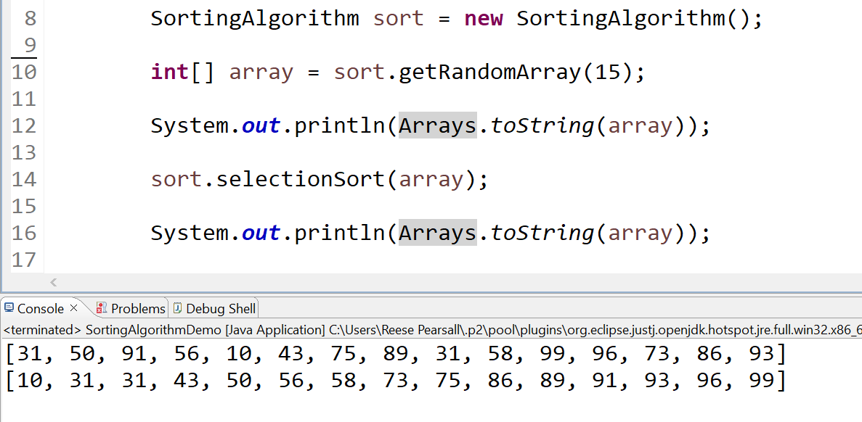
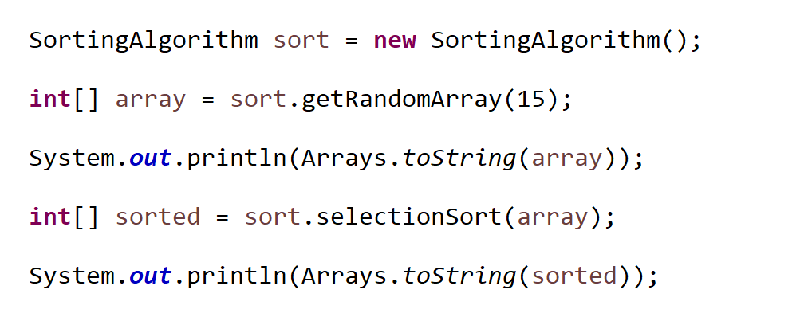

Some of our sorting algorithms don’t need to return an int[ ]. The array created in the demo class, and the array the method sorts is the same array (not a copy)

