Slide 1

CSCI 132: Basic Data Structures and Algorithms
Intro to Java (Loops, Arrays)
Reese Pearsall & Iliana Castillon
Fall 2024
https://www.cs.montana.edu/pearsall/classes/fall2024/132/main.html
*All images are stolen from the internet

Slide 2
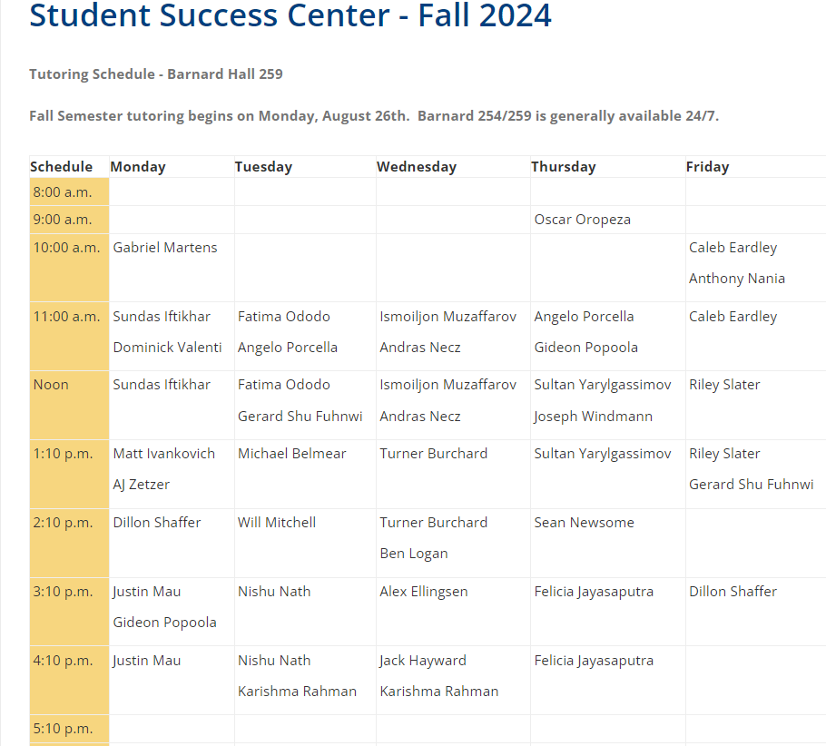




Announcements
Lab 1 due tomorrow at 11:59 PM
After today, you will be able to complete it
Submit .java files (don’t rename them)
I’ll be posting this week’s materials in a Brightspace announcement

Slide 3
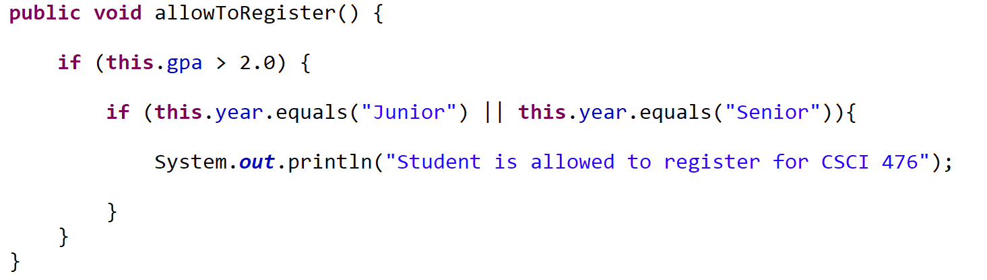

Example: A student is allowed to register for CSCI 476 if they have a GPA greater than 2.0, and if they are a Junior or Senior
// check the first condition (Alternatively, we could use an && here)
We can check one of two conditions is true using the or operator ( || )
(we do not have the or keyword in Java)
Student.Java
StudentDemo.Java

Slide 4
Example: A student is allowed to register for CSCI 476 if they have a GPA greater than 2.0, and if they are a Junior or Senior
// check the first condition (Alternatively, we could use an && here)
Student.Java
Why do this.year.equals("Junior") and not this.year == "Junior“
Checking for string equality in Java is a little bit funky…
Using == does not check for equivalence of values between two strings…

Slide 5
Example: A student is allowed to register for CSCI 476 if they have a GPA greater than 2.0, and if they are a Junior or Senior
// check the first condition (Alternatively, we could use an && here)
Student.Java
Do not use == to compare two strings
Why do this.year.equals("Junior") and not this.year == "Junior“
Checking for string equality in Java is a little bit funky…
Using == does not check for equivalence of values between two strings…
Instead, we need to use the .equals() method between two string

Slide 6
Arrays are a collection of data
Once initialized, are fixed in size
Can only hold one data type
>> 65
>> ERROR
Declaring an array and giving it a value
int[] test_scores = {99, 81, 65, 46};
Declaring an array allocating 5 empty spots (we need to fill them later)
String[] names = new String[5];
test_scores
99 | 81 | 65 | 46
names
null | null | null | null | null

Slide 7
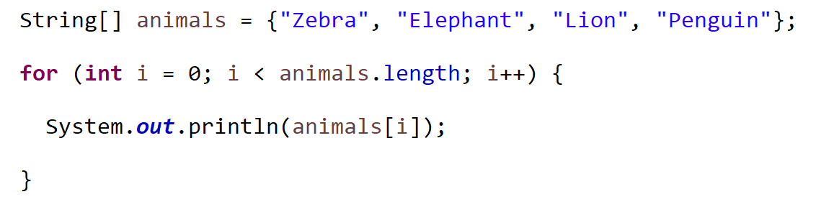
For loops can be used to iterate across an array.
Two ways:
1. Iterate by index
2. Iterate by element

Slide 8
For loops can be used to iterate across an array.
Two ways:
1. Iterate by index
Each for loop has:
A start
A stop
A step
Start at index 0
stop at index 4
(length of array)
Increase the index by 1 each time
2. Iterate by element

Slide 9
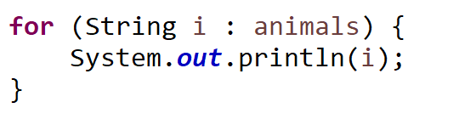
For loops can be used to iterate across an array.
Two ways:
1. Iterate by index
2. Iterate by element
Both will give you the exact same output…

