Slide 1

CSCI 132: Basic Data Structures and Algorithms
Lecture 4: Intro to Java (OOP, Methods, Control Flow)
Reese Pearsall
Spring 2023
https://www.cs.montana.edu/pearsall/classes/spring2023/132/main.html
*All images are stolen from the internet

Slide 2
Announcements
No in-person lecture next Wednesday (2/1)
→ I will post a lecture recording to the website (asynchronous)
Good job on Lab 1. Lab 2 will likely be posted tomorrow or Friday ☺
Course Questionnaire Results

Slide 3
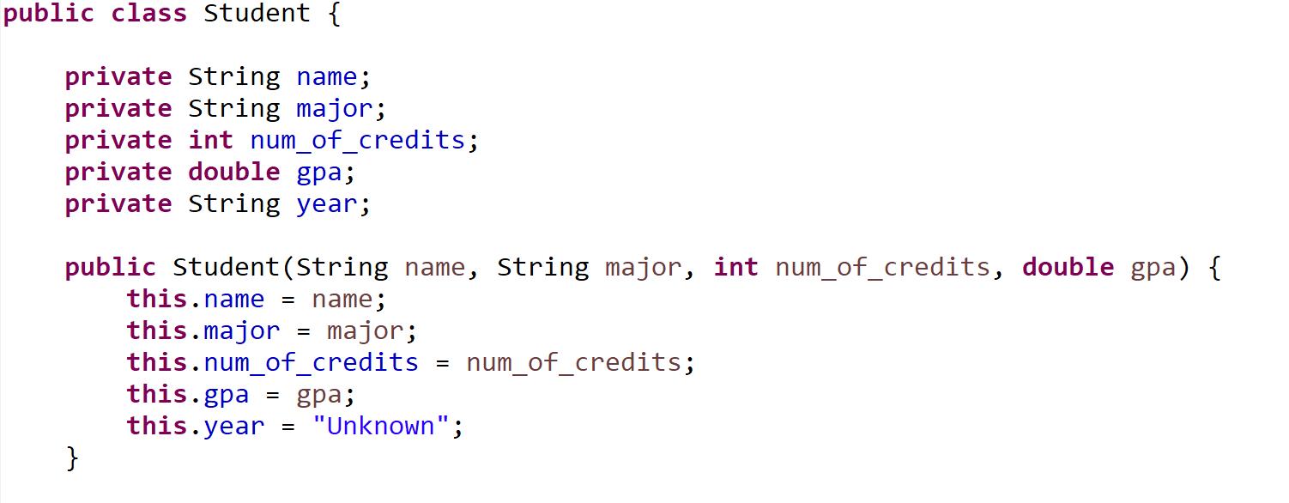
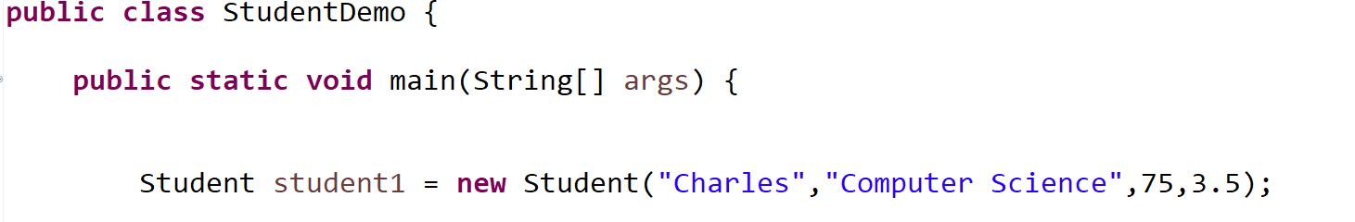
Instance fields of our Student Class
private means they can not be directly accessed outside of the class
Student.Java
StudentDemo.Java

Slide 4

This is the constructor, the special method that creates our objects
Each of our “blueprints” needs a constructor
Student.Java
StudentDemo.Java

Slide 5



Student.Java
When we use the new keyword, it will invoke our constructor
StudentDemo.Java

Slide 6




The constructor has 4 arguments
Name of student
Major of student
Number of credits
Student’s GPA
Student.Java
When we use the new keyword, it will invoke our constructor
StudentDemo.Java

Slide 7







The constructor has 4 arguments
Name of student
Major of student
Number of credits
Student’s GPA
Whenever we create a new Student object with new, we must make sure we pass in these 4 values
Student.Java
When we use the new keyword, it will invoke our constructor
StudentDemo.Java

Slide 8
Student.Java
StudentDemo.Java

Slide 9
Student.Java
StudentDemo.Java

Slide 10

student1
Student.Java
StudentDemo.Java

Slide 11
name
“Charles”
student1
major
num_of_credits
gpa
year
Student.Java
StudentDemo.Java

Slide 12

name
“Charles”
student1
major
“Computer Science”
num_of_credits
gpa
year
Student.Java
StudentDemo.Java

Slide 13
name
“Charles”
student1
major
“Computer Science”
num_of_credits
75
gpa
year
Student.Java
StudentDemo.Java

Slide 14
name
“Charles”
student1
major
“Computer Science”
num_of_credits
75
gpa
3.5
year
Student.Java
StudentDemo.Java

Slide 15
name
“Charles”
student1
major
“Computer Science”
num_of_credits
75
gpa
3.5
year
“Unknown”
Student.Java
StudentDemo.Java

Slide 16
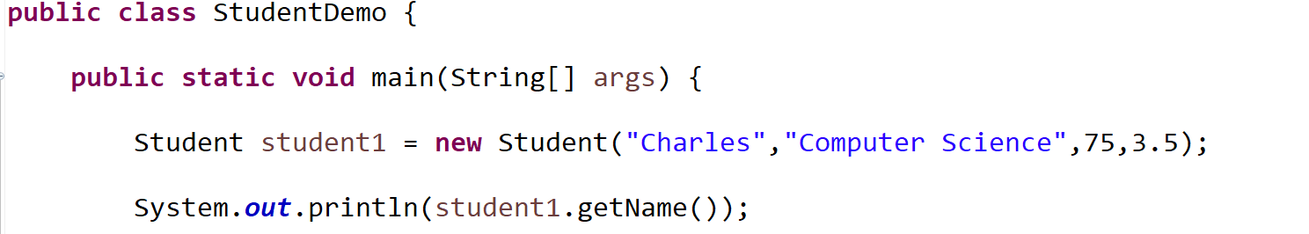
Let’s add a function (a method) that will get a Student’s name
StudentDemo.Java

Slide 17
Let’s add a function (a method) that will get a Student’s name
We called this method on a Student object (student1.getName())
So, our function needs to belong in our Student class (Student.Java)
StudentDemo.Java

Slide 18
Let’s add a function (a method) that will get a Student’s name
We called this method on a Student object (student1.getName())
So, our function needs to belong in our Student class (Student.Java)
What should this function take as input? What should this function output?
Input: a Student object
Output: the name of a student (String)
StudentDemo.Java

Slide 19
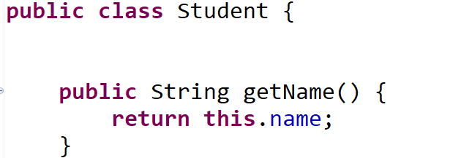
(instance fields and constructor go here)
Student.Java
StudentDemo.Java

Slide 20
Name of method
(instance fields and constructor go here)
Student.Java
StudentDemo.Java

Slide 21
Name of method
(instance fields and constructor go here)
When we define methods in Java, we must declare the data type that the method will return
This method returns a String
Student.Java
StudentDemo.Java

Slide 22
Name of method
(instance fields and constructor go here)
This method returns a String
This method is public (other classes can use it)
(Generally, all methods will be public ☺ )
Student.Java
StudentDemo.Java

Slide 23
Name of method
(instance fields and constructor go here)
This method returns a String
This method is public (other classes can use it)
The this keyword refers to the object that this method was called on (student1)
(return student1’s name attribute)
Student.Java
StudentDemo.Java

Slide 24
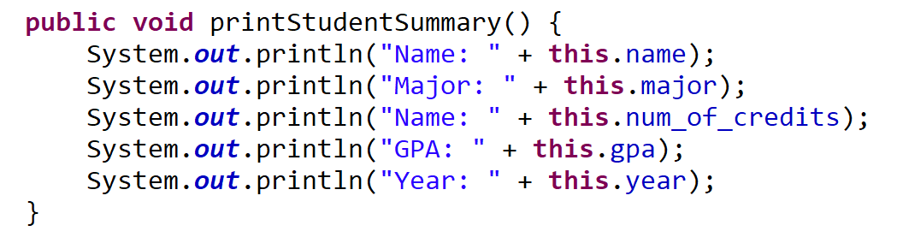
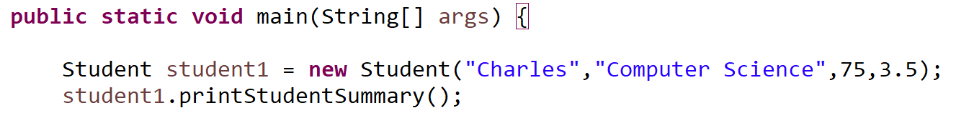
Here is a method that doesn’t return anything
void is used to indicate that a method will not return anything
Student.Java
StudentDemo.Java

Slide 25
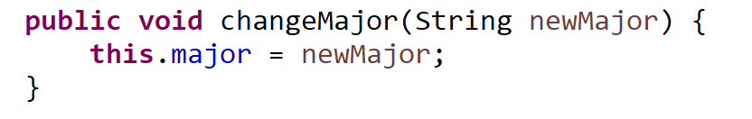
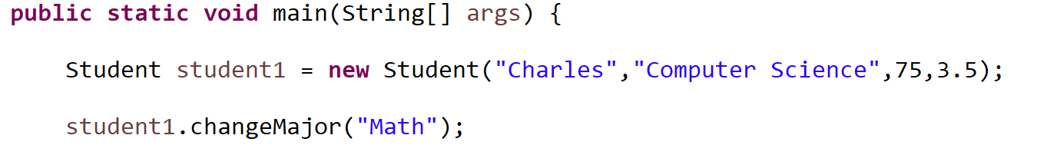
Here is method to change a Student’s major. When we call this method, we pass in the Student’s new major as an argument
So when we define this method, we need to make sure it accepts one argument
Student.Java
StudentDemo.Java

Slide 26
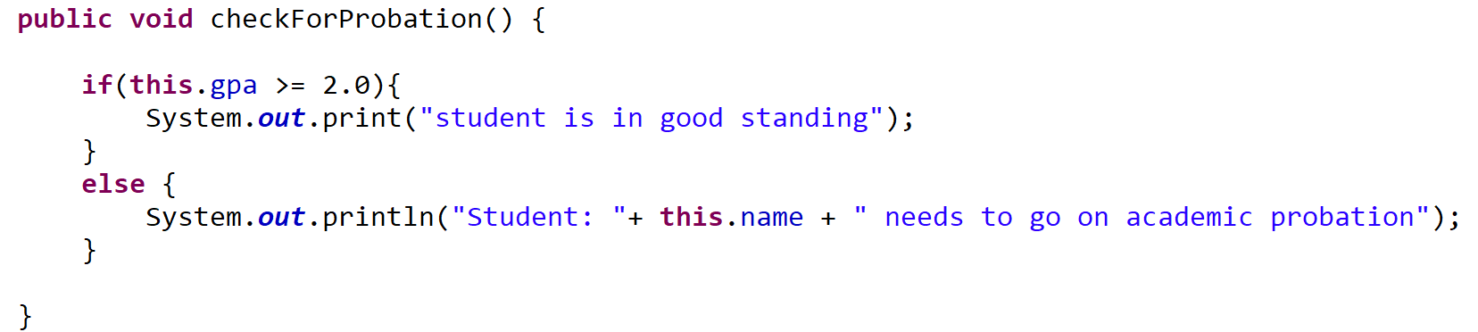
If statements can be used to check a condition.
If the condition is true, execute the code in the body of the if statement
If it is false, proceed to the else statement
Student.Java
StudentDemo.Java

Slide 27
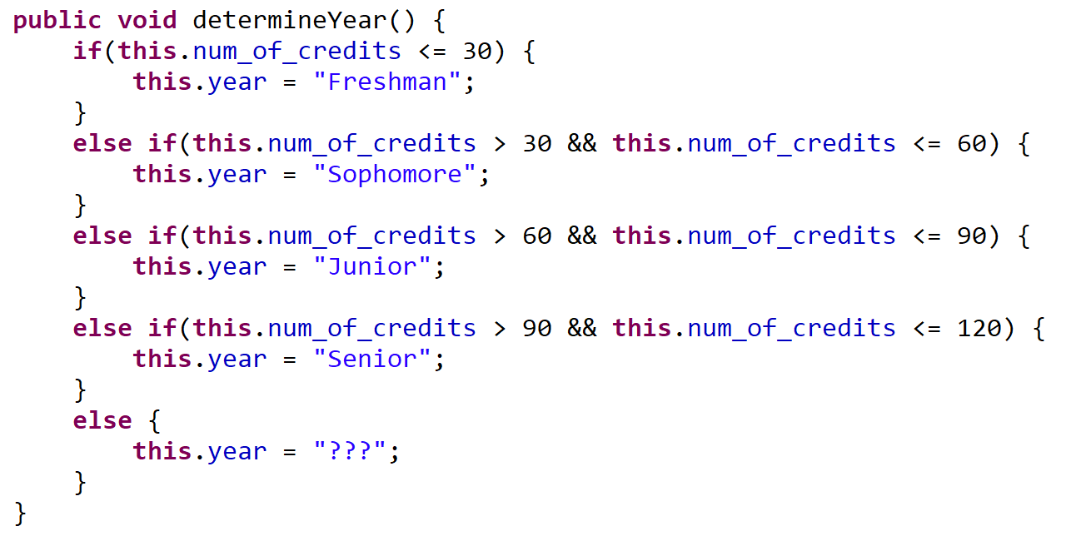

We can check multiple conditions using the and operator (&&)
(we do not have the and keyword in Java)
Student.Java
StudentDemo.Java

Slide 28
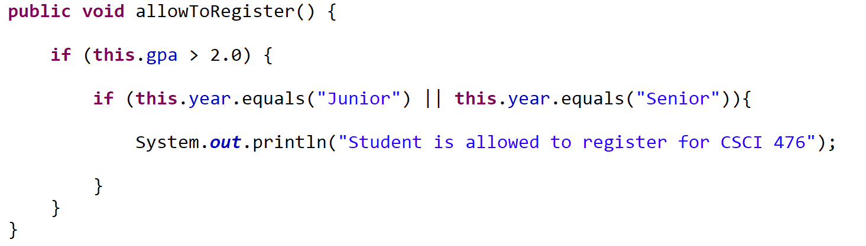
Example: A student is allowed to register for CSCI 476 if they have a GPA greater than 2.0, and if they are a Junior or Senior
// check the first condition (Alternatively, we could use an && here)
We can check one of two conditions is true using the or operator ( || )
(we do not have the or keyword in Java)
Student.Java
StudentDemo.Java

Slide 29
Example: A student is allowed to register for CSCI 476 if they have a GPA greater than 2.0, and if they are a Junior or Senior
// check the first condition (Alternatively, we could use an && here)
Student.Java
Why do this.year.equals("Junior") and not this.year == "Junior“
Checking for string equality in Java is a little bit funky…
Using == does not check for equivalence of values between two strings…

Slide 30
Example: A student is allowed to register for CSCI 476 if they have a GPA greater than 2.0, and if they are a Junior or Senior
// check the first condition (Alternatively, we could use an && here)
Student.Java
Do not use == to compare two strings
Why do this.year.equals("Junior") and not this.year == "Junior“
Checking for string equality in Java is a little bit funky…
Using == does not check for equivalence of values between two strings…
Instead, we need to use the .equals() method between two string

