Slide 1

CSCI 476: Computer Security
Lecture 3: Operating Systems (Processes and forking() )
Reese Pearsall
Spring 2023
*all images are stolen from the internet
https://www.cs.montana.edu/pearsall/classes/spring2023/476/main.html

Slide 2
Announcements
Gerard is here
Lab 0 due on Sunday 1/29 @ 11:59 PM
No in-person lecture next Wednesday (2/1)
I’ll post an asynchronous lecture video to the course web page

Slide 3
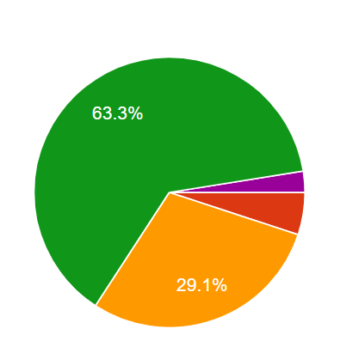
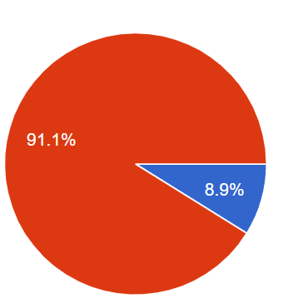
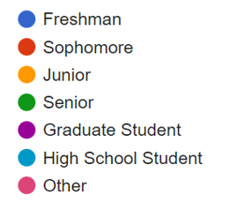

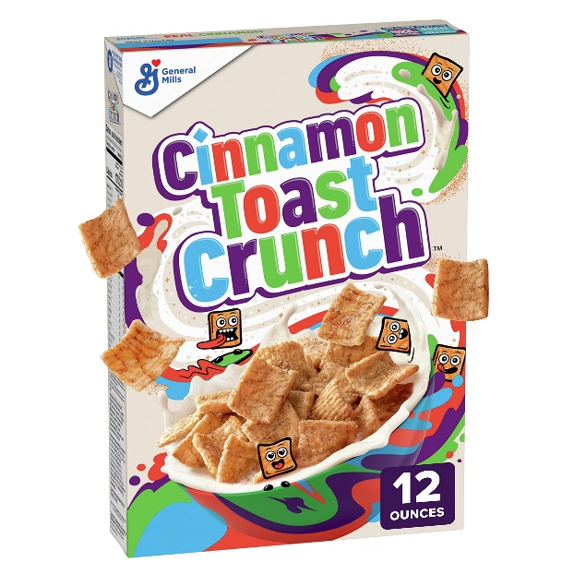
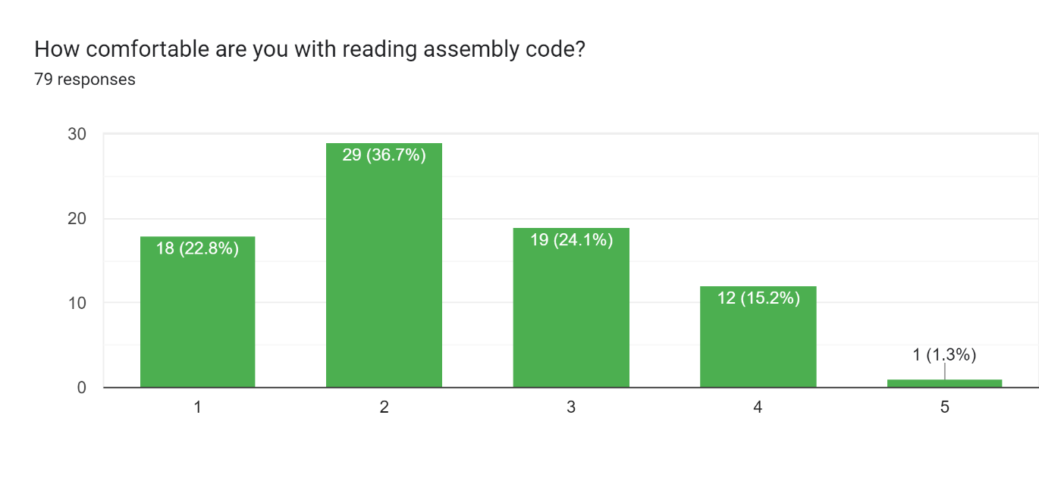
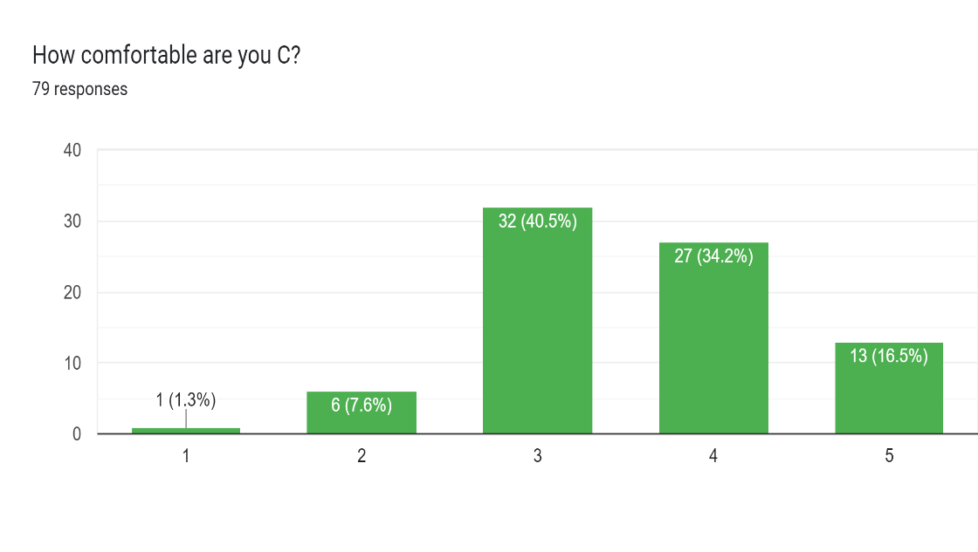
Course Questionnaire Results
Have you taken Operating Systems (CSCI 460)
Class?

Slide 4
Course Questionnaire Results
“I am a big procrastinator”

Slide 5
Course Questionnaire Results
“I am a big procrastinator”
“This class seems relevant to my career path”

Slide 6
Course Questionnaire Results
“Im interested in learning about penetration testing”
“I am a big procrastinator”
“This class seems relevant to my career path”

Slide 7
Course Questionnaire Results
“Im interested in learning about penetration testing”
“I am a big procrastinator”
“This class seems relevant to my career path”
“The best cereal is just milk”

Slide 8

To understand the technical aspects of security, we must have a good understanding of how computers work
operating systems

Slide 9

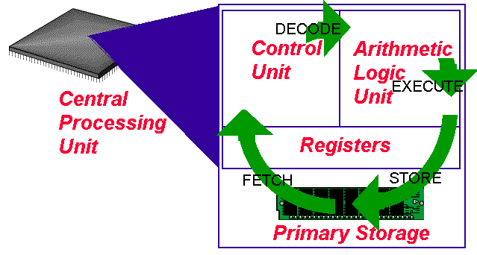
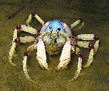
The Operating System
Software
print(“hello world!”)
Operating System
Hardware
CPU
Memory

Slide 10
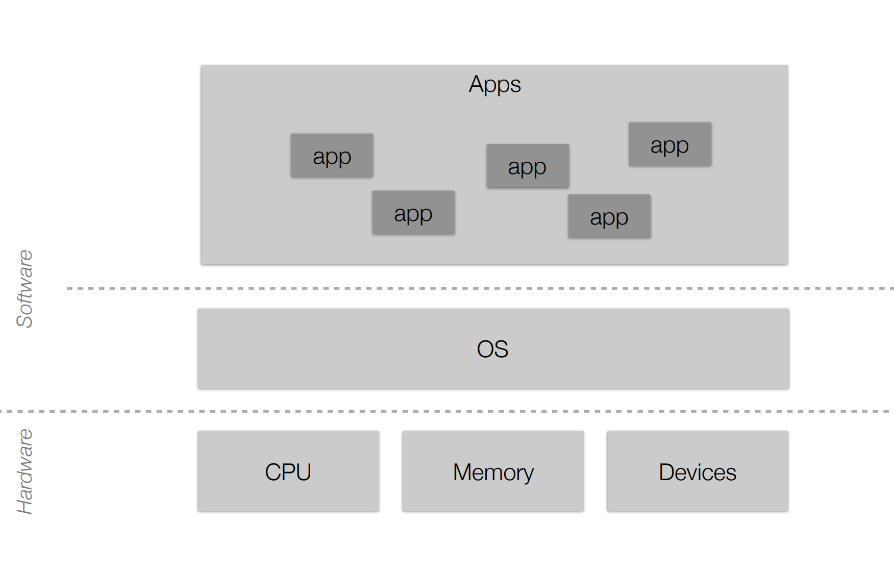
The Operating System
Software
print(“hello world!”)
Operating System
Hardware
CPU
Memory

Slide 11





The jobs of an Operating System
1. Process Manager
2. Interface Manager
3. Memory Manager
4. Traffic Manager
5. Illusion Manager
“The Coach”
“The Bouncer”
“The Farmer”
“The Judge”
“The Illusionist”

Slide 12
The jobs of an Operating System
This will be the focus of today’s lecture
1. Process Manager
2. Interface Manager
3. Memory Manager
4. Traffic Manager
5. Illusion Manager
“The Coach”
“The Bouncer”
“The Farmer”
“The Judge”
“The Illusionist”

Slide 13
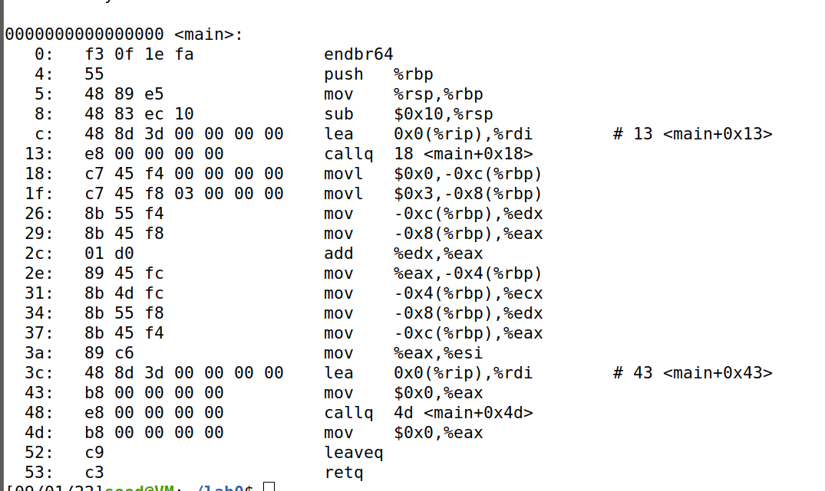
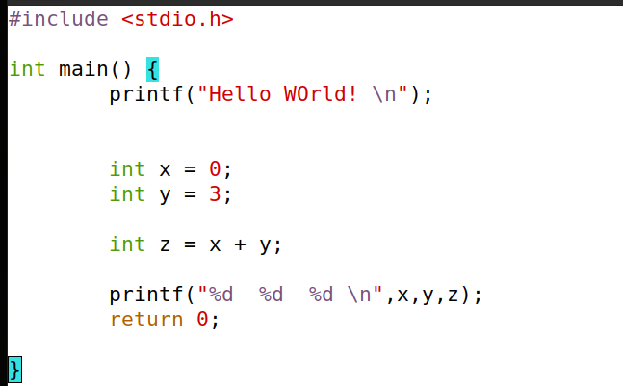

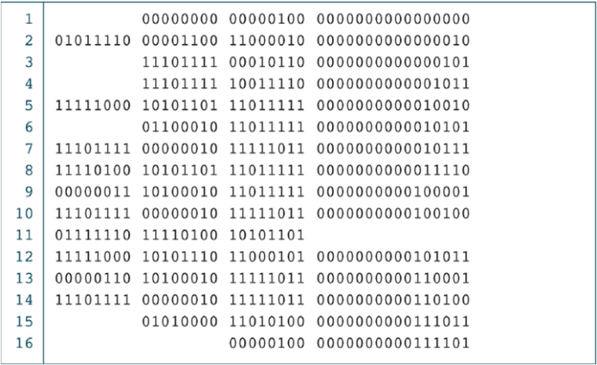

Source code to binary
Preprocessor
Compiler
Assembler
Removal of comments
Expand Macros
Converted to assembly code
.s file
Program A
./hello_world
Linker
Library 1
Library 2
.exe
**THIS PROCESS IS NOT TRUE FOR EVERY LANGUAGE

Slide 14
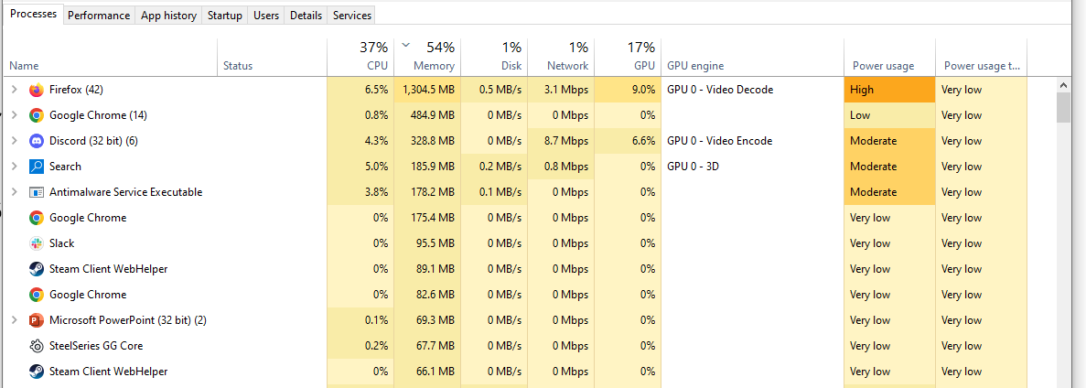
What happens when we run ?
./hello_world
It gets turned into a process
A process is an instance of a running program on a computer

Slide 15
A process is an instance of a running program on a computer
Main Memory
Process A Information
Process A Data
Process A Executable Code
Process B Information
Process B Data
Process B Executable Code
All processes have the following data while they are running:
Executable Code
2. Associated Data
3. Execution Context/Bookkeeping information
(info that the OS needs to handle the process)

Slide 16


Ok, but how do we actually create a process?
• In the Unix family (and others), we use fork() to create a new process
Parent Process
fork()
Parent Process
(such as shell/terminal)
NEW Child Process
fork() duplicates a process so that instead of one process, you get two!

Slide 17
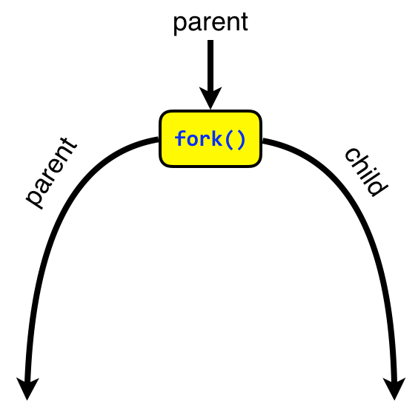
fork() duplicates a process so that instead of one process, you get two!
How can we tell the parent and child apart?
int main(void) {
int pid;
pid = fork();
if (0 == pid) {
// I'm the child
printf("Hi, I'm the child. \n");
}
sleep(1);
printf("I'm the parent.);
return 0;
}
We check the return value of fork()!

Slide 18
fork() duplicates a process so that instead of one process, you get two!
How can we tell the parent and child apart?
int main(void) {
int pid;
pid = fork();
if (0 == pid) {
// I'm the child
printf("Hi, I'm the child. \n");
}
sleep(1);
printf("I'm the parent.);
return 0;
}
We check the return value of fork()!
parent
child
1. Remember, fork()creates two process that are both actively running

Slide 19
fork() duplicates a process so that instead of one process, you get two!
How can we tell the parent and child apart?
int main(void) {
int pid;
pid = fork();
if (0 == pid) {
// I'm the child
printf("Hi, I'm the child. \n");
}
sleep(1);
printf("I'm the parent.);
return 0;
}
We check the return value of fork()!
child
parent
2. fork() always returns 0 for the child process, the parent process jumps to the code after the if statement

Slide 20
fork() duplicates a process so that instead of one process, you get two!
How can we tell the parent and child apart?
int main(void) {
int pid;
pid = fork();
if (0 == pid) {
// I'm the child
printf("Hi, I'm the child. \n");
}
sleep(1);
printf("I'm the parent.);
return 0;
}
We check the return value of fork()!
child
parent
3. fork() always returns 0 for the child process, so the child process will execute the code in the if statement

Slide 21
Demo?
fork1.c

Slide 22
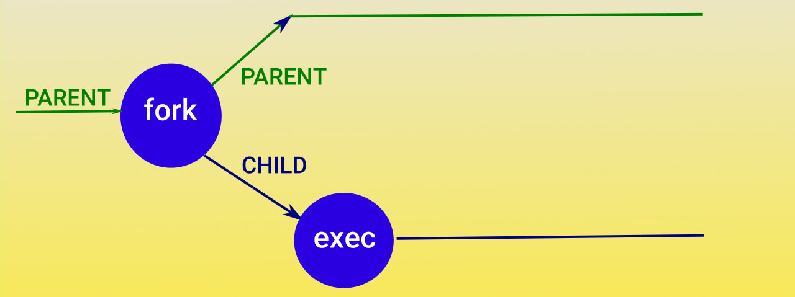
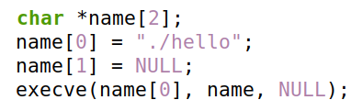
Issue: We want our child process to run an entirely new program (hello_world c program)
We use the exec() family of functions to execute a different program
There are many different forms of the exec() function call

Slide 23
Issue: We want our child process to run an entirely new program (hello_world c program)
We use the exec() family of functions to execute a different program
There are many different forms of the exec() function call
This will invoke a program called hello

Slide 24
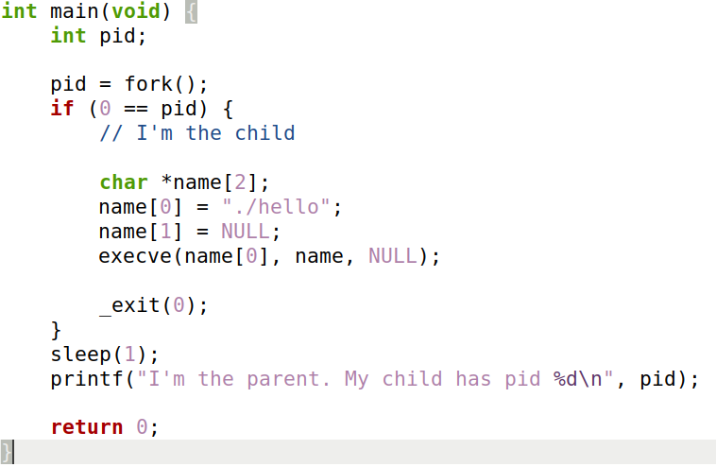
Fork() and Exec()

Slide 25
Fork() and Exec()
Child code
Parent code

Slide 26

Fork() and Exec()
output

Slide 27
Demo?
forkandexec.c

Slide 28
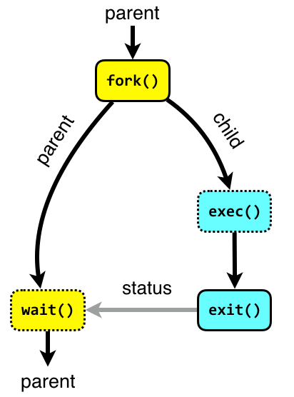
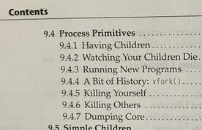
Tl;dr
The programs we run get turned into a process
fork() is used to create a new process
The parent process is typically the shell/terminal, and waits for the child process to finish
The child process runs exec() to run our program
you can kill children with the kill() function
or kill command

Slide 29
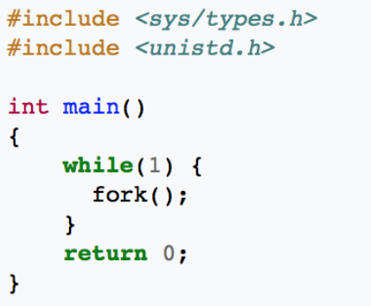
Any ideas what might happen?

Slide 30
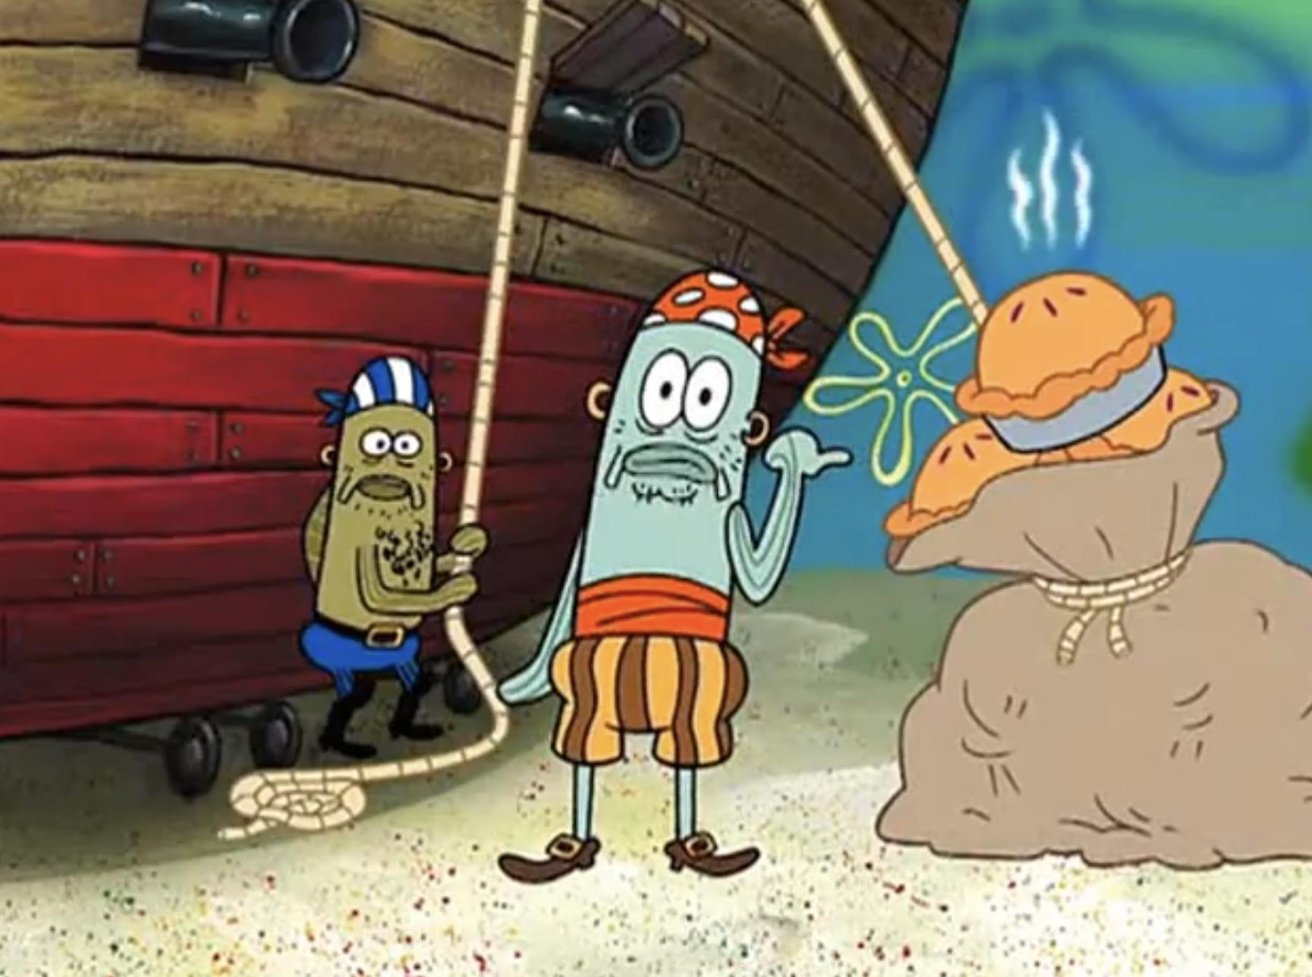

“Oh, these forks() aren’t homemade. They were made in factory. A fork() bomb factory. This is a fork() bomb”

Slide 31
A process is an instance of a running program on a computer
Main Memory
Process A Information
Process A Data
Process A Executable Code
Process B Information
Process B Data
Process B Executable Code
All processes have the following data while they are running:
Executable Code
2. Associated Data
3. Execution Context/Bookkeeping information
(info that the OS needs to handle the process)

Slide 32
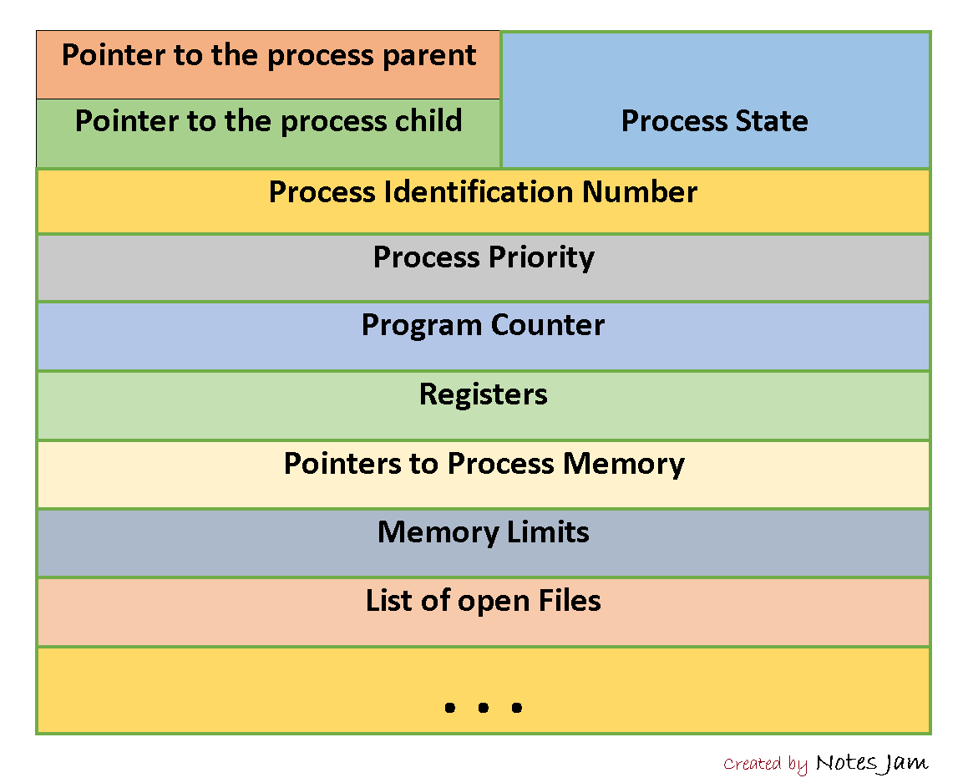
3. Execution Context/Bookkeeping information
Each process has a Process Control Block (PCB)
Example PCB:
Simply just a data structure that holds information
The name of this varies by OS

Slide 33
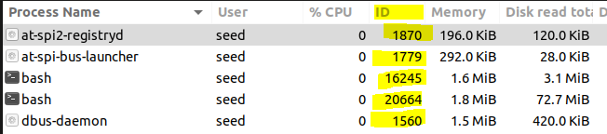

3. Execution Context/Bookkeeping information
Each process has a Process Control Block (PCB)
Example PCB:
Simply just a data structure that holds information
The name of this varies by OS
Every process has a unique process ID (PID)
We can use the PID to search for process, kill process, fork new process, etc

Slide 34

3. Execution Context/Bookkeeping information
Each process has a Process Control Block (PCB)
Example PCB:
Simply just a data structure that holds information
The name of this varies by OS
Each process has a program counter (PC), which tells the CPU the next instruction to run in the process

Slide 35
3. Execution Context/Bookkeeping information
Each process has a Process Control Block (PCB)
Example PCB:
Simply just a data structure that holds information
The name of this varies by OS
PCB also maintains locations for the process Data and Code

Slide 36
3. Execution Context/Bookkeeping information
Each process has a Process Control Block (PCB)
Example PCB:
Simply just a data structure that holds information
The name of this varies by OS

Slide 37

3. Execution Context/Bookkeeping information
Each process has a Process Control Block (PCB)
Example PCB:
Simply just a data structure that holds information
The name of this varies by OS
PCB keeps track of who their parent is, and any child process (good parenting)

Slide 38

3. Execution Context/Bookkeeping information
Each process has a Process Control Block (PCB)
Example PCB:
Simply just a data structure that holds information
The name of this varies by OS
PCB keeps track of who their parent is, and any child process (good parenting)

Slide 39
3. Execution Context/Bookkeeping information
Each process has a Process Control Block (PCB)
Example PCB:
Simply just a data structure that holds information
The name of this varies by OS
A process goes through many states
Active (running)
Blocked
Waiting
Suspended

Slide 40
A process is an instance of a running program on a computer
All processes have the following data while they are running:
Executable Code
2. Associated Data
3. Execution Context/Bookkeeping information
We will talk about what goes here on Friday
(info that the OS needs to handle the process)

Slide 41
The jobs of an Operating System
1. Process Manager
“The Coach”
The OS manages many active processes all at once, and they must create processes, manage current process, and control which processes do what
Program is now running as a process
./hello_world
Fork() and exec()

Slide 42
The jobs of an Operating System
Next time…
1. Process Manager
2. Interface Manager
3. Memory Manager
4. Traffic Manager
5. Illusion Manager
“The Coach”
“The Bouncer”
“The Farmer”
“The Judge”
“The Illusionist”

