Slide 1

CSCI 132: Basic Data Structures and Algorithms
References, Debugging, Program 1
Reese Pearsall & Iliana Castillon
Fall 2024
https://www.cs.montana.edu/pearsall/classes/fall2024/132/main.html
*All images are stolen from the internet

Slide 2
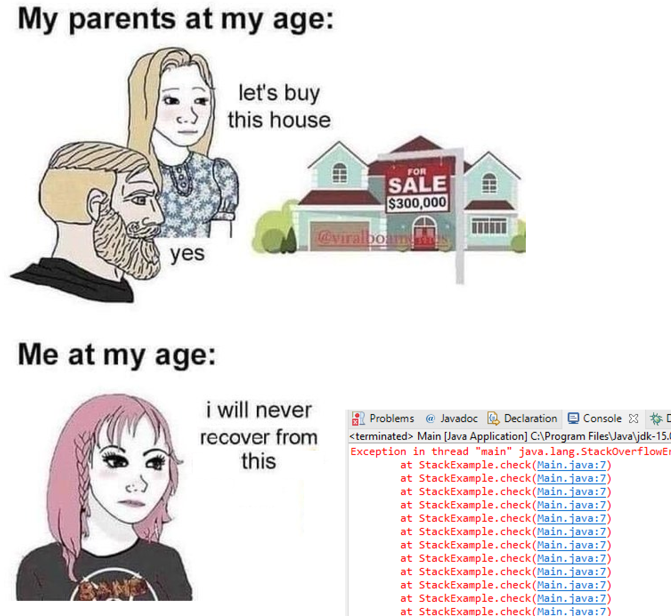
Announcements
Program 1 posted, due Friday 9/20 @ 11:59 PM
Lab 3 will be posted shortly after class today

Slide 3
Program 1

Slide 4
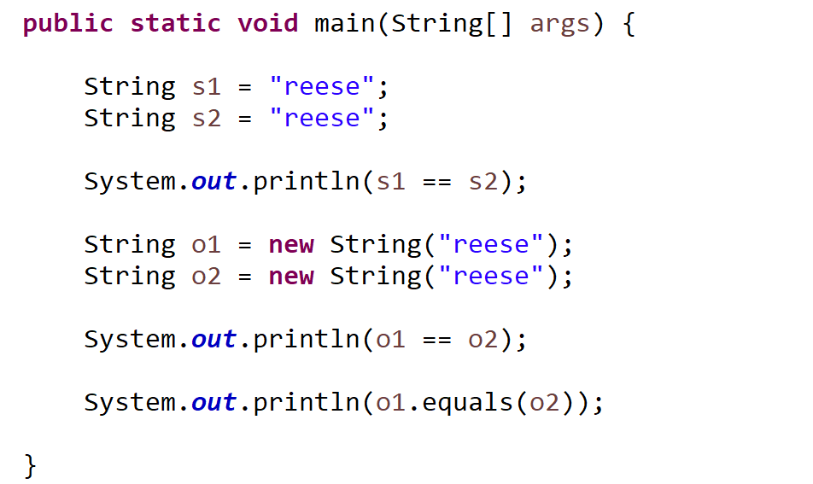



When comparing two objects, the == operator will check if the two reference values are pointing to the same object
String Literals
When using string literals, Java won’t create two separate objects for each string, so sometimes == will work
String Objects
If we make them String objects, now == will not work because these are two different String objects
When comparing Strings, you should still always use .equals()

Slide 5
public class ReferencesDemo {
public static void main(String[] args) {
Person person1 = new Person("Jim Bob", 44);
Person person2 = new Person("Sally", 28);
}
}
person1 and person2 are references to a Person object
person1
name: “Jim Bob”
age: 44
name: “Sally”
age: 28
person2

Slide 6
public class ReferencesDemo {
public static void main(String[] args) {
Person person1 = new Person("Jim Bob", 44);
Person person2 = new Person("Sally", 28);
person1.changeName("Jack");
}
}
person1 and person2 are references to a Person object
person1
name: “Jim Bob”
age: 44
name: “Sally”
age: 28
person2

Slide 7

public class ReferencesDemo {
public static void main(String[] args) {
Person person1 = new Person("Jim Bob", 44);
Person person2 = new Person("Sally", 28);
person1.changeName("Jack");
}
}
person1 and person2 are references to a Person object
person1
name: “Jack”
age: 44
name: “Sally”
age: 28
person2
In this method call, this is referencing the person1 object

Slide 8
public class ReferencesDemo {
public static void main(String[] args) {
Person person1 = new Person("Jim Bob", 44);
Person person2 = new Person("Sally", 28);
Person person3 = person1;
}
}
Suppose we create a new reference variable and link it to an existing object
person1
name: “Jack”
age: 44
name: “Sally”
age: 28
person2
In this method call, this is referencing the person1 object

Slide 9
public class ReferencesDemo {
public static void main(String[] args) {
Person person1 = new Person("Jim Bob", 44);
Person person2 = new Person("Sally", 28);
Person person3 = person1;
}
}
Suppose we create a new reference variable and link it to an existing object
person3 is now pointing to same object and person1
person1
name: “Jack”
age: 44
person3
name: “Sally”
age: 28
person2
In this method call, this is referencing the person1 object

Slide 10
public class ReferencesDemo {
public static void main(String[] args) {
Person person1 = new Person("Jim Bob", 44);
Person person2 = new Person("Sally", 28);
Person person3 = person1;
person1.changeName("test");
}
}
Suppose we create a new reference variable and link it to an existing object
person3 is now pointing to same object and person1
person1
name: “test”
age: 44
person3
Any changes to person1 will also update person3 (and vice versa)
System.out.println(person1.getName()) → “test”
System.out.println(person3.getName()) → “test”

Slide 11
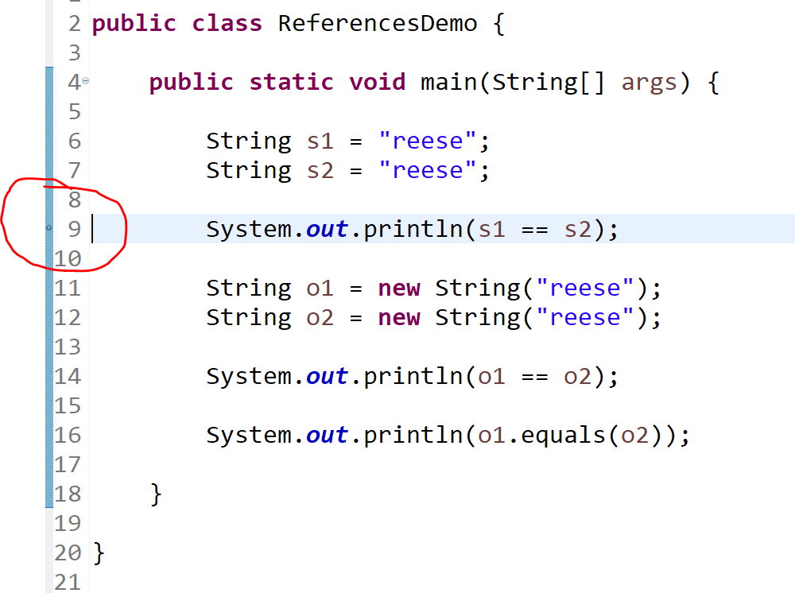
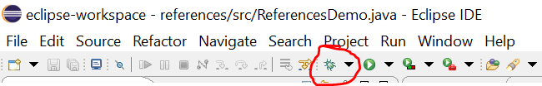
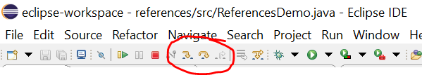
Debugging Code
Our IDE has a super nifty debugger, which allows us to pause our code, and then step through each line in the control flow.
The first thing to do is to place a breakpoint, which is where execution will pause at, and debugging will begin
Usually you try to place the breakpoint where you think things are going wrong
Then, press the little green bug icon next to the play button, which will run the debugger and stop at your breakpoint
Use the “step into” and “step over” buttons to start walking through your code

Slide 12
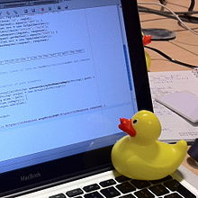
Debugging Code
Our IDE has a super slick debugger built in to it. I highly recommend learning how to use the debugger tool (see lecture)
Rubber Duck Debugging
Many programmers have had the experience of explaining a problem to someone else, possibly even to someone who knows nothing about programming, and then hitting upon the solution in the process of explaining the problem. In describing what the code is supposed to do and observing what it actually does, any incongruity between these two becomes apparent.^{[2]} More generally, teaching a subject forces its evaluation from different perspectives and can provide a deeper understanding.^{[3]} By using an inanimate object, the programmer can try to accomplish this without having to interrupt anyone else, and with better results than have been observed from merely thinking aloud without an audience.
(From Wikipedia)

