Slide 1

CSCI 466: Networks
DNS
Reese Pearsall
Fall 2024
https://www.cs.montana.edu/pearsall/classes/fall2024/466/main.html
*All images are stolen from the internet

Slide 2
Announcements
Wireshark Lab 1 due this Friday @ 11:59 PM
PA1 Posted, due on Sunday September 22nd

Slide 3

Application Layer
OSI Model
Presentation Layer
*
Application Layer
Session Layer
*
Messages from Network Applications
Transport Layer
Network Layer
Physical Layer
Data Link Layer
Bits being transmitted over a copper wire
Physical Layer
*In the textbook, they condense it to a 5-layer model, but 7 layers is what is most used

Slide 4
DNS
Humans browse the web using hostnames
(They need English)
Computers understand numbers
(They need IP addresses)

Slide 5


DNS
Humans browse the web using hostnames
(They need English)
Computers understand numbers
(They need IP addresses)
153.90.127.197

Slide 6

DNS
Humans browse the web using hostnames
(They need English)
Computers understand numbers
(They need IP addresses)
DNS
153.90.127.197
Domain Name System (DNS) is a database of mappings between hostnames and IP addresses

Slide 7




DNS Architecture
youtube.com
irs.gov
Clients will first need to resolve hostnames with DNS
montana.edu
3.
DNS
HTTP
1.
153.90.3.95
montana.edu ?
153.90.3.95
2.
Clients

Slide 8
DNS Architecture
youtube.com
irs.gov
Clients will first need to resolve hostnames with DNS
montana.edu
3.
DNS
HTTP
1.
153.90.3.95
montana.edu ?
153.90.3.95
Is this a good architecture?
2.
Clients

Slide 9
DNS Architecture
youtube.com
irs.gov
Clients will first need to resolve hostnames with DNS
montana.edu
3.
DNS
HTTP
1.
153.90.3.95
montana.edu ?
Single point of failure…
153.90.3.95
Is this a good architecture?
2.
Clients

Slide 10
DNS Architecture
youtube.com
irs.gov
montana.edu
DNS
DNS
DNS
.gov
.com
.edu
Clients

Slide 11
DNS Architecture
(how big would that map be?)
DNS is a distributed, hierarchical database (no DNS server has all the records!)
Hierarchy consists of different types of DNS servers:

Slide 12
DNS Architecture
DNS is a distributed, hierarchical database (no DNS server has all the records!)
Hierarchy consists of different types of DNS servers:
Authoritative DNS servers- Organization’s own DNS with up-to-date records
facebook.com DNS
amazon.com DNS
montana.edu DNS
harvard.edu DNS

Slide 13




DNS Architecture
DNS is a distributed, hierarchical database (no DNS server has all the records!)
Hierarchy consists of different types of DNS servers:
Authoritative DNS servers- Organization’s own DNS with up-to-date records
.com TLD DNS server
.edu TLD DNS server
Top-level domain (TLD) servers- responsible for keeping IP addresses for authoritative DNS servers for each top-level domain (.com, .edu, .jp, etc)
facebook.com DNS
amazon.com DNS
montana.edu DNS
harvard.edu DNS

Slide 14




DNS Architecture
DNS is a distributed, hierarchical database (no DNS server has all the records!)
Hierarchy consists of different types of DNS servers:
Authoritative DNS servers- Organization’s own DNS with up-to-date records
.com TLD DNS server
.edu TLD DNS server
Top-level domain (TLD) servers- responsible for keeping IP addresses for authoritative DNS servers for each top-level domain (.com, .edu, .jp, etc)
facebook.com DNS
amazon.com DNS
montana.edu DNS
harvard.edu DNS

Slide 15


DNS Architecture
DNS is a distributed, hierarchical database (no DNS server has all the records!)
Hierarchy consists of different types of DNS servers:
root DNS server
Authoritative DNS servers- Organization’s own DNS with up-to-date records
.com TLD DNS server
.edu TLD DNS server
Top-level domain (TLD) servers- responsible for keeping IP addresses for authoritative DNS servers for each top-level domain (.com, .edu, .jp, etc)
facebook.com DNS
amazon.com DNS
montana.edu DNS
harvard.edu DNS
Root DNS servers- responsible for maintaining IP addresses for TLD servers

Slide 16


DNS Architecture
DNS is a distributed, hierarchical database (no DNS server has all the records!)
Hierarchy consists of different types of DNS servers:
root DNS server
Authoritative DNS servers- Organization’s own DNS with up-to-date records
.com TLD DNS server
.edu TLD DNS server
Top-level domain (TLD) servers- responsible for keeping IP addresses for authoritative DNS servers for each top-level domain (.com, .edu, .jp, etc)
facebook.com DNS
amazon.com DNS
montana.edu DNS
harvard.edu DNS
Root DNS servers- responsible for maintaining IP addresses for TLD servers

Slide 17
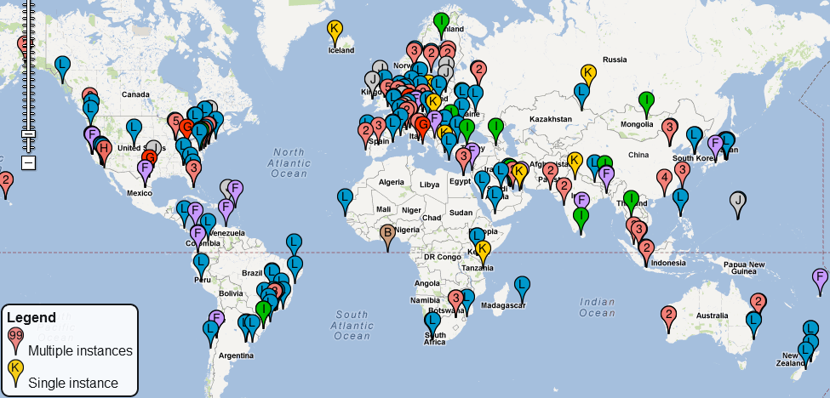
DNS Root server locations
https://root-servers.org/

Slide 18


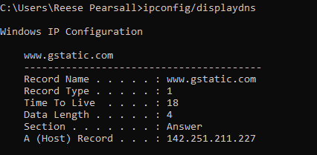

DNS
Application layer protocol
Lookups over UDP on port 53
Client
DNS
Server
(handshake not needed)
(DNS requests are small)
(reliability can be added in the application layer)
montana.edu
???
DNS lookup
153.90.3.95
DNS provides hostname to IP mappings, host aliasing, mail server aliasing, and load distribution
Local DNS servers are also used
Acts as a proxy
Maintained by ISP
Caches records
Root DNS Servers
com DNS servers
org DNS servers
edu DNS servers
Some DNS records are also stored and maintained in your computer
Any issues??
yahoo.com
DNS servers
amazon.com
DNS servers
pbs.org
DNS servers
poly.edu
DNS servers
umass.edu
DNS servers
What if an IP address gets changed?

Slide 19
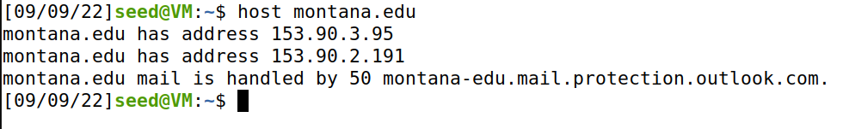
DNS Commands
DNS services
Hostname to IP address translation
host montana.edu
Hostname to IPv6 address translation
host -t AAAA montana.edu
Host aliasing
host -t CNAME img.huffingtonpost.com
Mail server aliasing
host -t MX montana.edu
Load distribution
host huffpost.com | grep "address" | sed -n -e 's/^.*address //p'
Redirection
Look up same host from servers in different regions
host google.com 8.8.8.8
153.90.3.95
(nslookup also works. This is what you will use in the lab)

Slide 20

DNS Commands
DNS services
Hostname to IP address translation
host montana.edu
Hostname to IPv6 address translation
host -t AAAA montana.edu
Host aliasing
host -t CNAME img.huffingtonpost.com
Mail server aliasing
host -t MX montana.edu
Load distribution
host huffpost.com | grep "address" | sed -n -e 's/^.*address //p'
Redirection
Look up same host from servers in different regions
host google.com 8.8.8.8

Slide 21
DNS Commands
DNS services
Hostname to IP address translation
host montana.edu
Hostname to IPv6 address translation
host -t AAAA montana.edu
Host aliasing
host -t CNAME img.huffingtonpost.com
Mail server aliasing
host -t MX montana.edu
Load distribution
host huffpost.com | grep "address" | sed -n -e 's/^.*address //p'
Redirection
Look up same host from servers in different regions
host google.com 8.8.8.8

Slide 22
DNS Commands
DNS services
Hostname to IP address translation
host montana.edu
Hostname to IPv6 address translation
host -t AAAA montana.edu
Host aliasing
host -t CNAME img.huffingtonpost.com
Mail server aliasing
host -t MX montana.edu
Load distribution
host huffpost.com | grep "address" | sed -n -e 's/^.*address //p'
Redirection
Look up same host from servers in different regions
host google.com 8.8.8.8

Slide 23
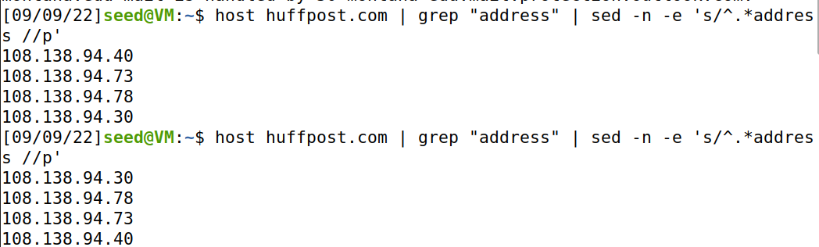
DNS Commands
DNS services
Hostname to IP address translation
host montana.edu
Hostname to IPv6 address translation
host -t AAAA montana.edu
Host aliasing
host -t CNAME img.huffingtonpost.com
Mail server aliasing
host -t MX montana.edu
Load distribution
host huffpost.com | grep "address" | sed -n -e 's/^.*address //p'
Redirection
Look up same host from servers in different regions
host google.com 8.8.8.8
Rotation!

Slide 24
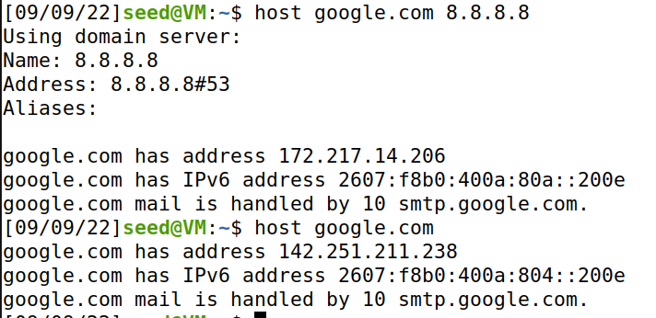

DNS Commands
DNS services
Hostname to IP address translation
host montana.edu
Hostname to IPv6 address translation
host -t AAAA montana.edu
Host aliasing
host -t CNAME img.huffingtonpost.com
Mail server aliasing
host -t MX montana.edu
Load distribution
host huffpost.com | grep "address" | sed -n -e 's/^.*address //p'
Redirection
Look up same host from servers in different regions
host google.com 8.8.8.8

Slide 25
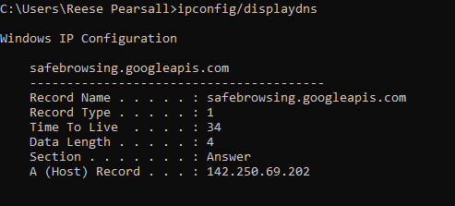
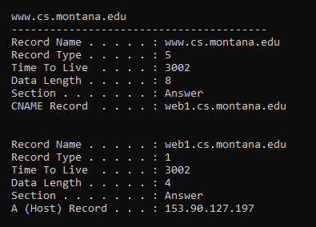
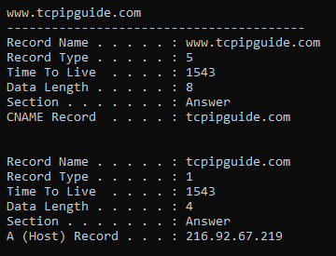
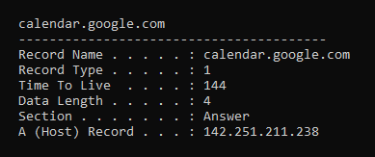
DNS Commands
DNS services
Hostname to IP address translation
host montana.edu
Hostname to IPv6 address translation
host -t AAAA montana.edu
Host aliasing
host -t CNAME img.huffingtonpost.com
Mail server aliasing
host -t MX montana.edu
Load distribution
host huffpost.com | grep "address" | sed -n -e 's/^.*address //p'
Redirection
Look up same host from servers in different regions
host google.com 8.8.8.8
See cached DNS entries on computer
ipconfig/displaydns

Slide 26
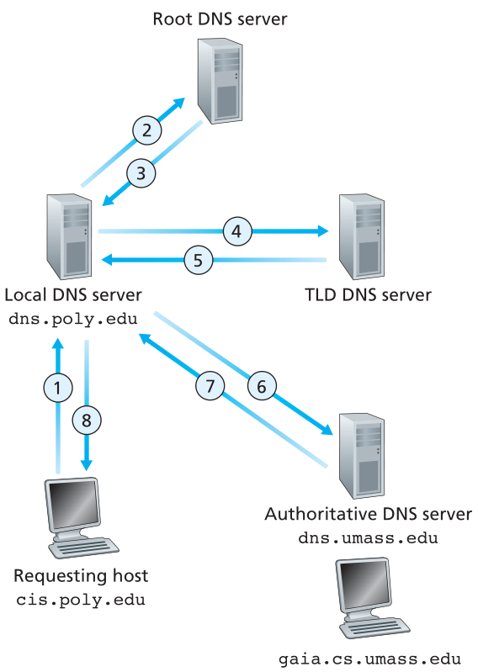
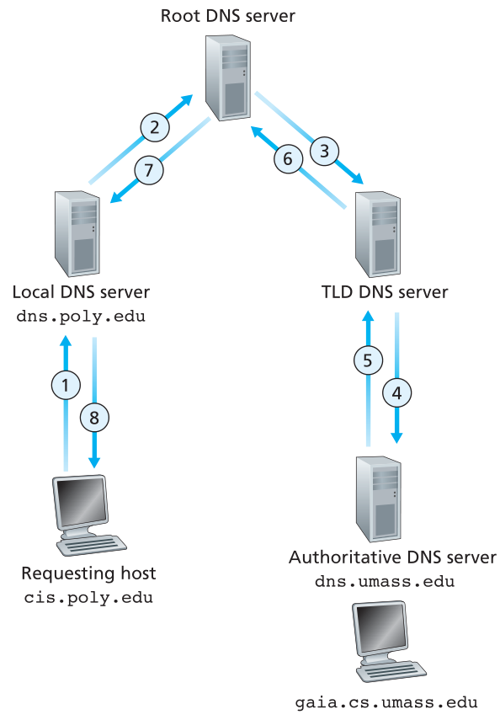
DNS Requests
Iterative Lookup
Recursive Lookup

Slide 27

DNS Response Records
RR is a four-tuple
DNS servers store resource records (RRs)
DNS

Slide 28
DNS Response Records
RR is a four-tuple
DNS servers store resource records (RRs)
DNS
TTL – “Time to Live”. Determines when a resource should be removed from a cache

Slide 29
DNS Response Records
RR is a four-tuple
DNS servers store resource records (RRs)
DNS
TTL – “Time to Live”. Determines when a resource should be removed from a cache
Type – type of record
Type A – IPv4 address
Type AAAA – IPv6 address
Type NS – Authoritative DNS hostname
Type CNAME – Canonical hostname for an alias
Type MX- Canonical name for a mail server
(foo.com, mail.foo.com)
(foo.com, dns.foo.com)
(foo.com, items.foo.com)

Slide 30


DNS Response Records
RR is a four-tuple
DNS servers store resource records (RRs)
DNS
(foo.com, 145.37.93.126, A, 24)
(foo.com, 0913:cc84:9414:59e6:ae63:7299:dae5:b2f9, AAAA, 24)
(foo.com, mail.foo.com, MX, 24)
(foo.com, dns.foo.com, NS, 24)
(foo.com, items.foo.com, CNAME, 24)

Slide 31


DNS Response Records
RR is a four-tuple
DNS servers store resource records (RRs)
DNS
(foo.com, 145.37.93.126, A, 24)
(foo.com, 0913:cc84:9414:59e6:ae63:7299:dae5:b2f9, AAAA, 24)
(foo.com, mail.foo.com, MX, 24)
(foo.com, dns.foo.com, NS, 24)
(foo.com, items.foo.com, CNAME, 24)
If a nameserver is authoritative for a particular domain, it will have type A record(s) for the hostname

Slide 32
DNS Response Records
RR is a four-tuple
DNS servers store resource records (RRs)
DNS
(foo.com, 145.37.93.126, A, 24)
(foo.com, 0913:cc84:9414:59e6:ae63:7299:dae5:b2f9, AAAA, 24)
(foo.com, mail.foo.com, MX, 24)
(foo.com, dns.foo.com, NS, 24)
(foo.com, items.foo.com, CNAME, 24)
If a nameserver is authoritative for a particular domain, it will have type A record(s) for the hostname
Otherwise, it will have NS records for the DNS server that does know the answer

Slide 33
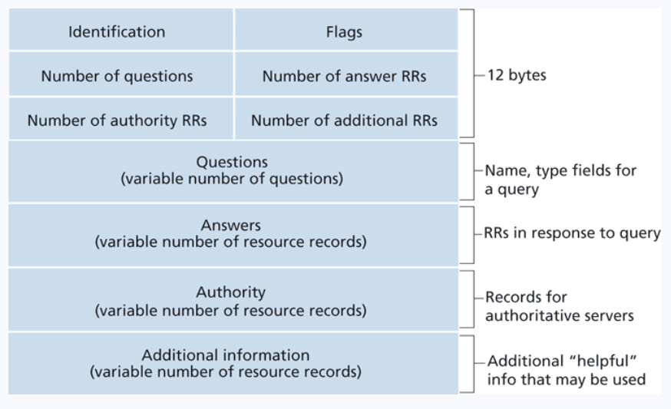
DNS Requests
(The format of a DNS request packet)
ID number for the query. Used to match a request to its response easily

Slide 34
DNS Requests
(The format of a DNS request packet)
ID number for the query. Used to match a request to its response easily
A set of 0/1 that provide information about the query
Is it authoritative?
Is it a response or a query?
Should it be done recursively?

Slide 35
DNS Requests
(The format of a DNS request packet)
ID number for the query. Used to match a request to its response easily
A set of 0/1 that provide information about the query
Is it authoritative?
Is it a response or a query?
Should it be done recursively?
What question is the query asking?
(ie. type A for wikipedia.com)

Slide 36
DNS Requests
(The format of a DNS request packet)
ID number for the query. Used to match a request to its response easily
A set of 0/1 that provide information about the query
Is it authoritative?
Is it a response or a query?
Should it be done recursively?
What question is the query asking?
(ie. type A for wikipedia.com)
If the packet is a response, the answer to the query will be located here

Slide 37
DNS Requests
(The format of a DNS request packet)
ID number for the query. Used to match a request to its response easily
A set of 0/1 that provide information about the query
Is it authoritative?
Is it a response or a query?
Should it be done recursively?
What question is the query asking?
(ie. type A for wikipedia.com)
If the packet is a response, the answer to the query will be located here
Information about other authoritative server

Slide 38
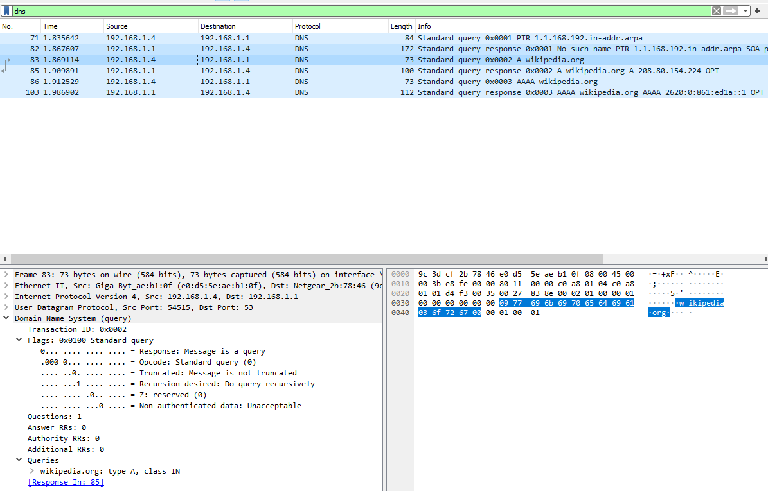
DNS Requests in Wireshark
nslookup wikipedia.org

Slide 39
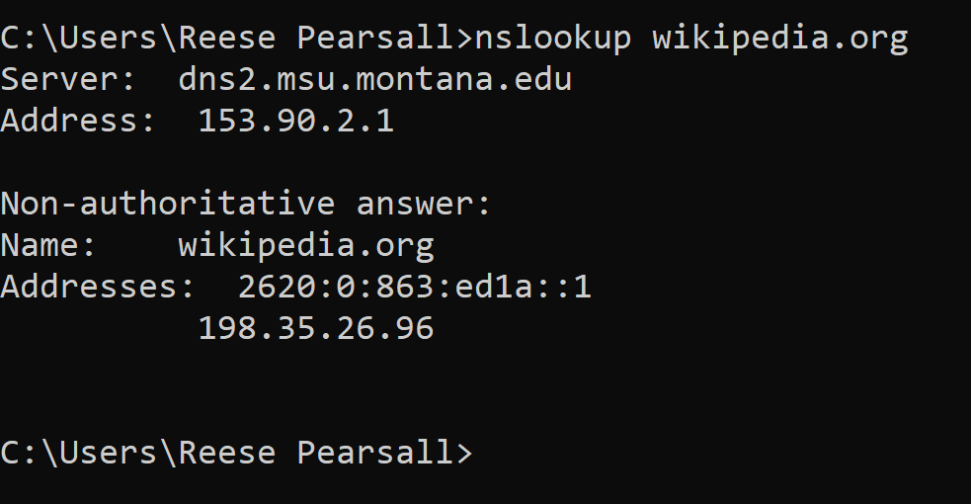


DNS Requests in Wireshark
Information about the local DNS server that was contacted
DNS Response
(Wikipedia.org’s IP address is 198.35.26.96 !)

Slide 40



DNS Requests in Wireshark
Information about the local DNS server that was contacted
DNS Response
(Wikipedia.org’s IP address is 198.35.26.96 !)
“Non-authoritative answer” means that this answer came from a cache somewhere rather than the Authoritative DNS server for Wikipedia.com

Slide 41
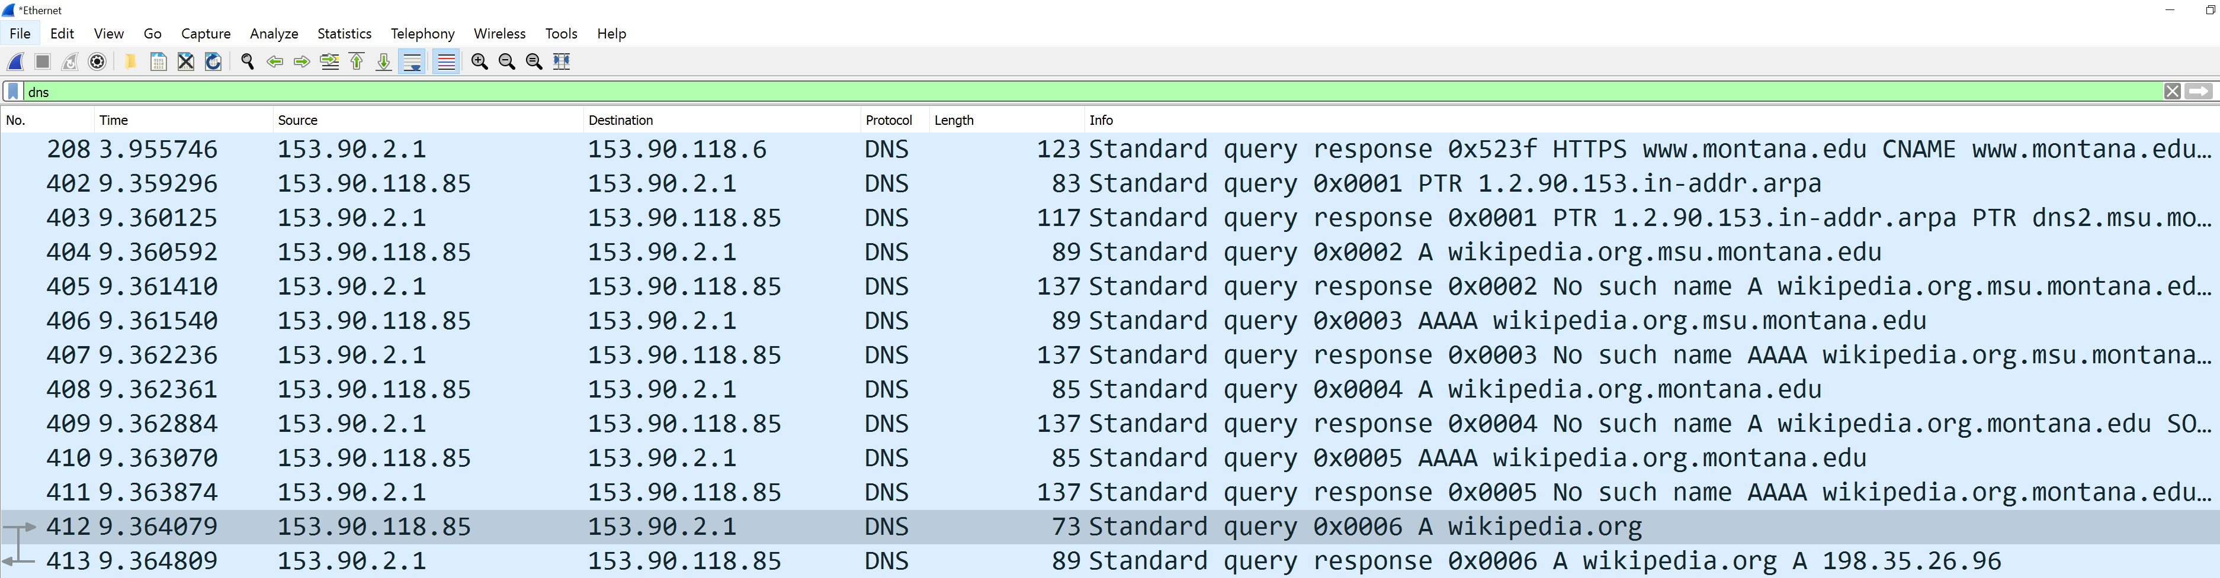
DNS Requests in Wireshark
Filter for just DNS traffic
This is the DNS Request and Response for the Type A record for wikipedia.org

Slide 42


DNS Requests in Wireshark
Filter for just DNS traffic
The IP address of my machine (yours will probably be different)
The IP address of my local DNS server (dns2.msu.montana.edu) (yours will probably be different)

Slide 43
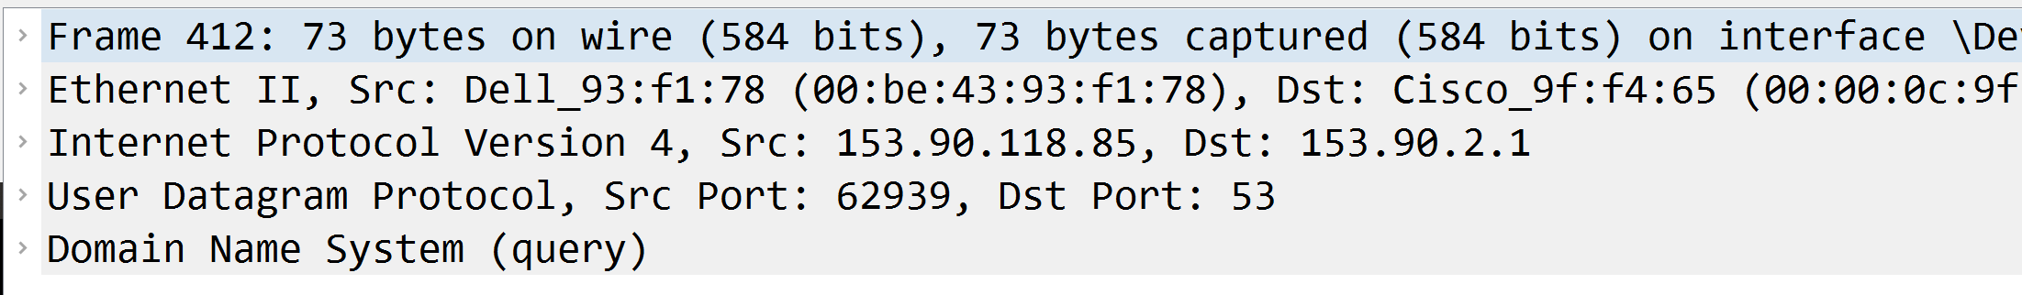
DNS Requests in Wireshark
Filter for just DNS traffic
← Expand this to see UDP information
Expand this to DNS information

Slide 44
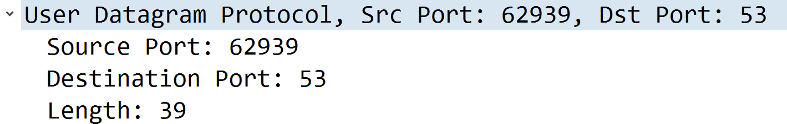
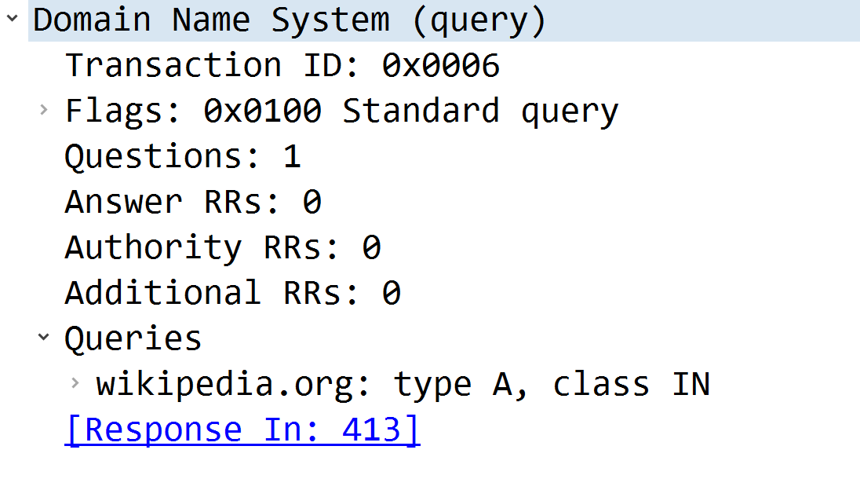
DNS Requests in Wireshark
Filter for just DNS traffic
It is sent to port 53 (the reserved port for DNS traffic)
← This is the question. “What is the IPv4 Address for Wikipedia.org?”
← You can click on this to find the DNS response (the answer)

Slide 45
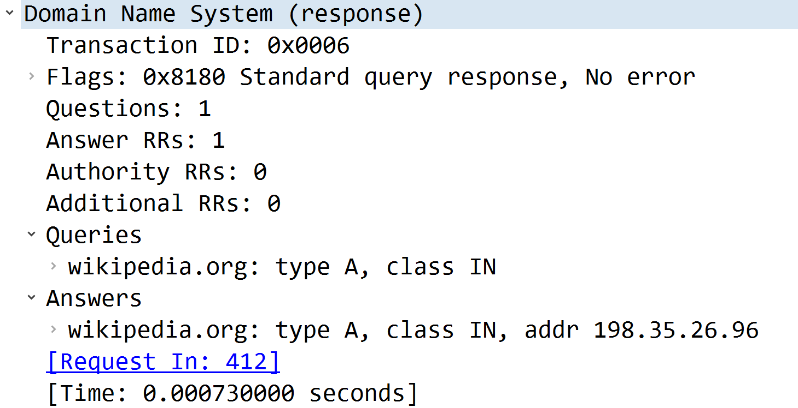
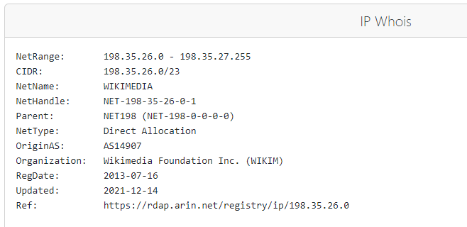

DNS Requests in Wireshark
Filter for just DNS traffic
To find the answer to our query, we find the DNS response and check the “Answers” section
The IP address of wikipedia.com is 198.35.26.96

