Slide 1

CSCI 466: Networks
Link Layer
Reese Pearsall Fall 2022
https://www.cs.montana.edu/pearsall/classes/fall2022/466/main.html
*All images are stolen from the internet
1

Slide 2
Announcements
NO CLASS Friday 11/11
Lab 2 Posted Later today

Slide 3



Application Layer
OSI Model
Presentation Layer
*
Application Layer
Session Layer
*
Messages from Network Applications
Transport Layer
Network Layer
Physical Layer
Data Link Layer
Bits being transmitted over a copper wire
Physical Layer
*In the textbook, they condense it to a 5-layer model, but 7 layers is what is most used

Slide 4
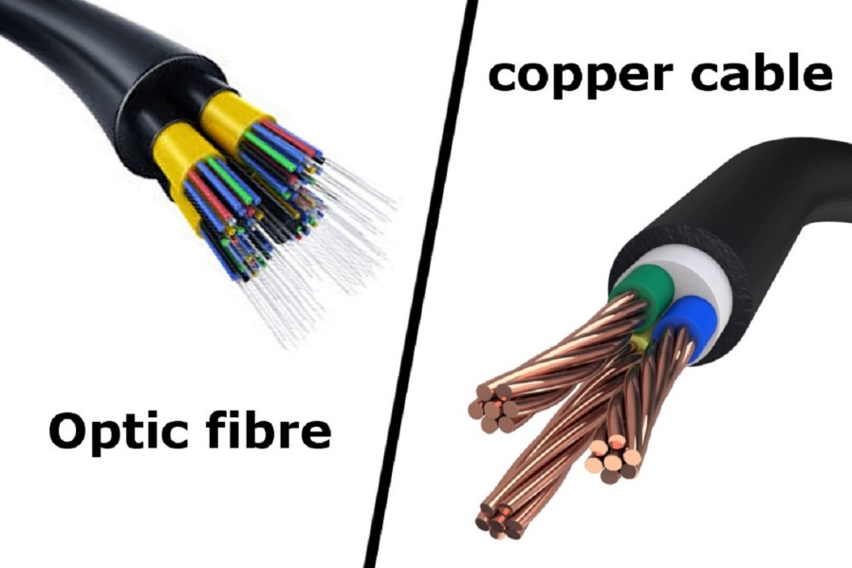
Physical Layer
Bit Pattern
Ethernet Frame
Bit Pattern
0101011101010101010101111101000010101010101010101
Goal: To transmit N bits from a transmitter to a receiver over an analog channel in a timely manner and with low error
What types of medium?
Copper Wire
Optic Fiber
Radio Frequency / Through the air

Slide 5
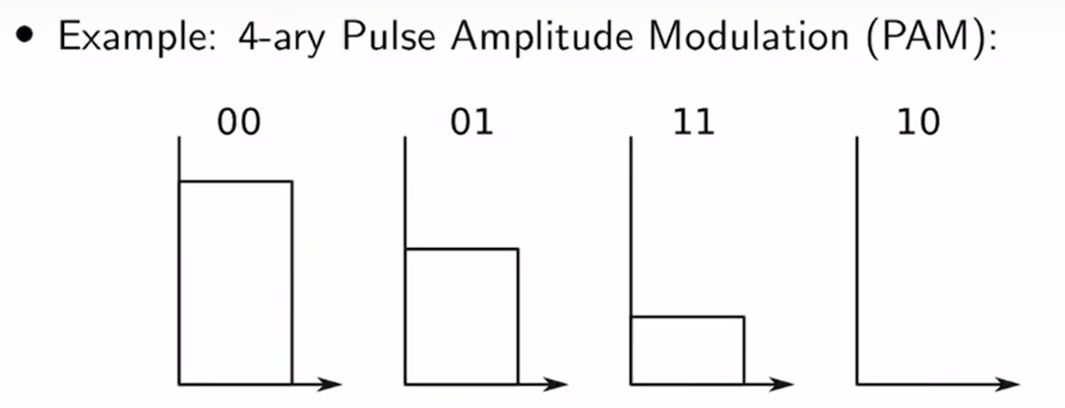
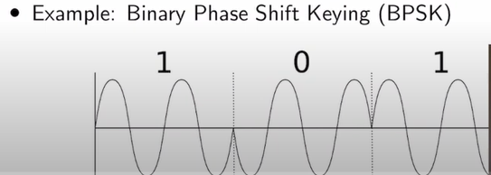

Physical Layer
0101011101010101010101111101000010101010101010101
Ethernet Frame
Representing zeros and ones in the physical layer
0 1 0 1 0 0 1
0 = no electricity
1 = electricity
There are a lot of ways to represent 0/1s

Slide 6
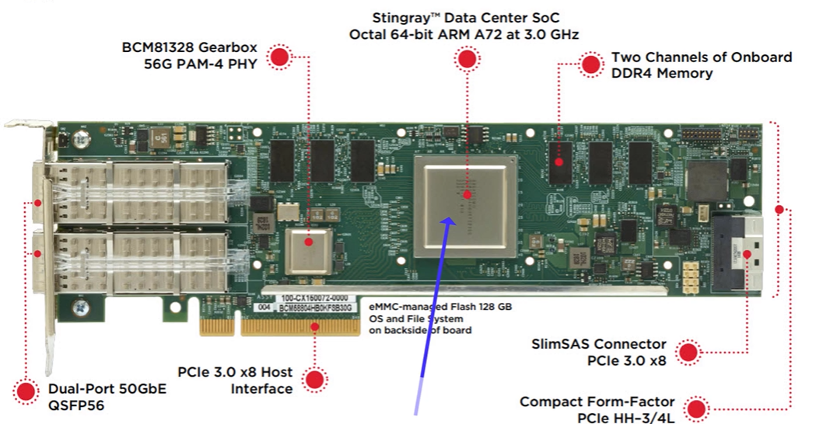

Physical Layer
0101011101010101010101111101000010101010101010101
Ethernet Frame
Representing zeros and ones in the physical layer
0 1 0 1 0 0 1
0 = no electricity
1 = electricity
There are a lot of ways to represent 0/1s

Slide 7
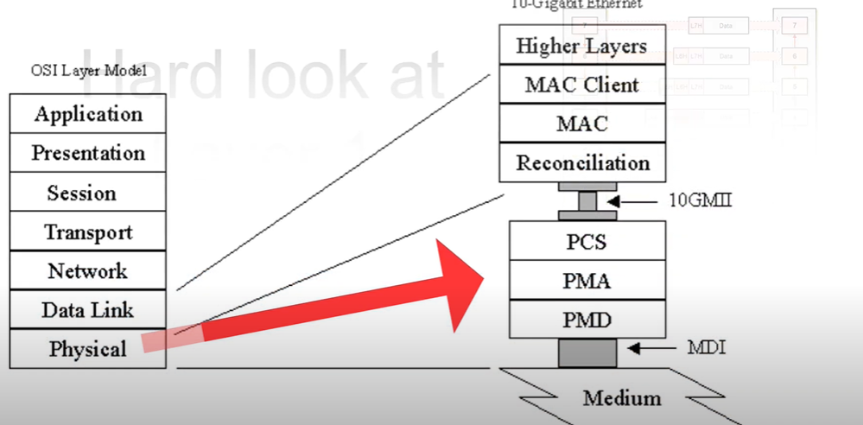
Physical Layer
0101011101010101010101111101000010101010101010101
Ethernet Frame
Physical Layer typically has three sub layers
PCS- Encoding the binary data
PMA- Parallel to serial or serial to parallel
PMD – Voltage amplifiers/LEDs/Lasers

Slide 8
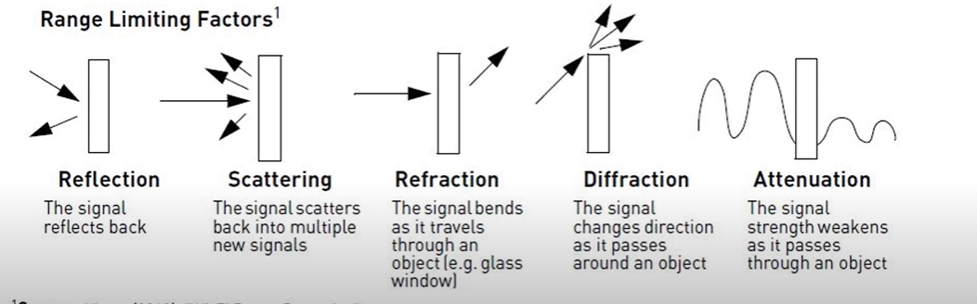
Physical Layer
0101011101010101010101111101000010101010101010101
Ethernet Frame
Noise and interference will corrupt the analog waveforms as they travel through the channel
Each analog channel has a probability p of bit error
Typical Values of p?
A wireless link may have a raw p of 1e-3, with error correction, this can be improved to 1e-6
Fiber optic link may have p of 1e-12
That a very low probability!!!

Slide 9
Physical Layer
0101011101010101010101111101000010101010101010101
Ethernet Frame
Noise and interference will corrupt the analog waveforms as they travel through the channel
Each analog channel has a probability p of bit error
Typical Values of p?
A wireless link may have a raw p of 1e-3, with error correction, this can be improved to 1e-6
Fiber optic link may have p of 1e-12
80 Mbs Wifi Link where p=1e-3 means 4,800 bit errors every minute
10 Gbps fiber optic link where p=1e-12 means 36 bit errors every hour
That a very low probability!!!

Slide 10
Physical Layer
0101011101010101010101111101000010101010101010101
Ethernet Frame
Error Patterns
Frame transmitted: 10110
Error Pattern: 10001
Suppose through error correction in the link layer, we found that a bit error occurred on the first bit and last bit of our pattern
How to get the correct bit pattern of our frame?

Slide 11
Physical Layer
0101011101010101010101111101000010101010101010101
Ethernet Frame
Error Patterns
Frame transmitted: 10110
Error Pattern: 10001
Suppose through error correction in the link layer, we found that a bit error occurred on the first bit and last bit of our pattern
We can run the XOR operator to get the correct pattern back

Slide 12
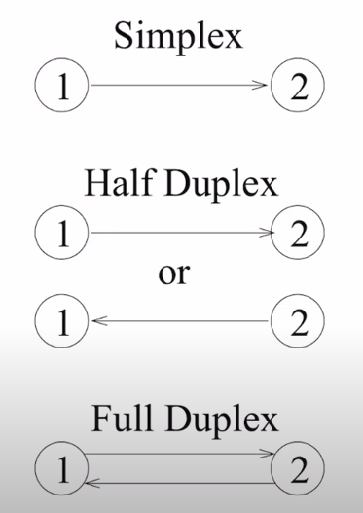
Physical Layer
0101011101010101010101111101000010101010101010101
Ethernet Frame
Physical Layer Transmission

Slide 13
Session Layer
Traffic Control between Computers
Session Layer also makes sure separate files are downloaded correctly
Controls connections and connection information
Establishes, manages, and terminates connections
Authorization, and Authentication between endpoints happens here
Secure Sockets Layer (SSL)- protocol used to establish a safe, encrypted connection between a web application and web server
Establishes a digital certificate to verify a server’s identify
No certificate? Cant do HTTPS
Certificate
Before transmitting Data, your machine may do some SSL communication to verify or check the existence of a certificate
Web Server
Client

Slide 14
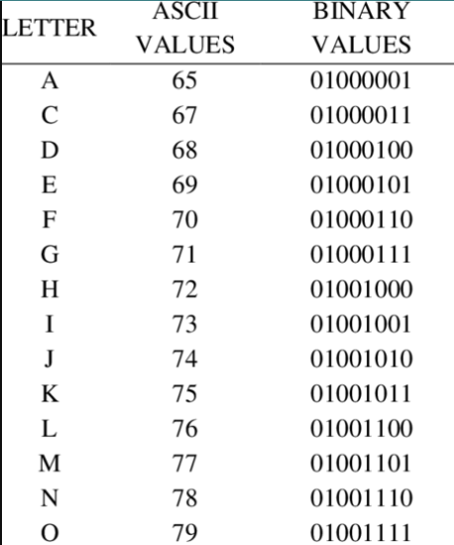
Presentation Layer
The layer that allows applications to interpret meanings of data
Three main jobs:
1. Translation
Formats data for proper compatibility between devices
ASCII
GIF
JPG
Ensures the data is readable by receiving system

Slide 15
Presentation Layer
The layer that allows applications to interpret meanings of data
Three main jobs:
Translation
Compression
“Reduce the size of some data”
Compression Algorithm
Message
Message
Data vs Information??
Type of compression:
1. Lossy- loses some of the original data during compression (is that ok?)
2. Lossless- doesn’t remove data, instead it transforms it to reduce its size

Slide 16
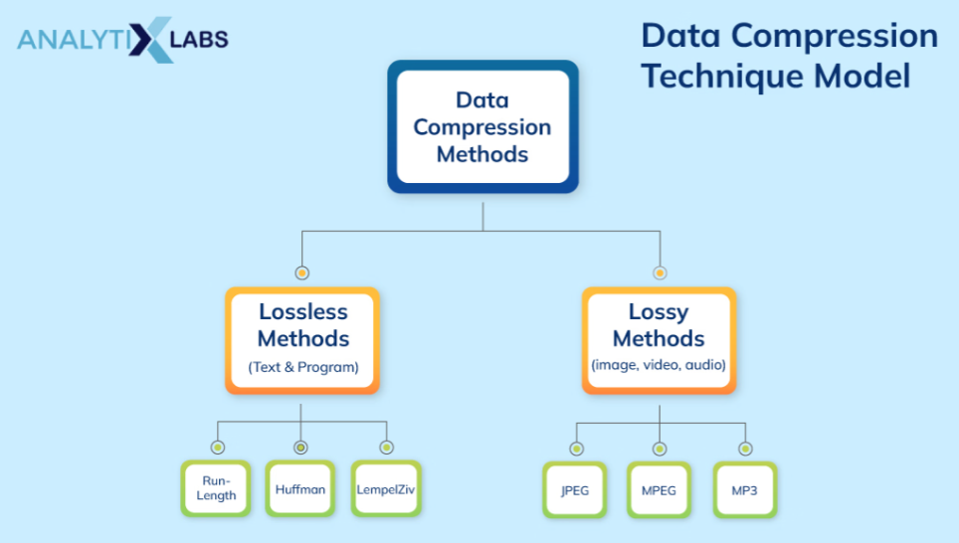
Presentation Layer
The layer that allows applications to interpret meanings of data
Three main jobs:
Translation
Compression

Slide 17
Presentation Layer
The layer that allows applications to interpret meanings of data
Three main jobs:
Translation
Compression

Slide 18



Presentation Layer
The layer that allows applications to interpret meanings of data
Three main jobs:
Translation
Compression
Encryption
Encryption- securing communication between two endpoints (typically in the presence of an adversary)
Hi there!
Shared medium
A threat actor could listen in on these channels

Slide 19

Presentation Layer
The layer that allows applications to interpret meanings of data
Three main jobs:
Translation
Compression
Encryption
Hi there!
Plaintext
Ciphertext
Xb8yDD54zmbm/JFr9phqTjMzKV98m88kMYfvSqBoe+Q=
Encryption- securing communication between two endpoints (typically in the presence of an adversary)
Hi there!
Xb8yDD54zmbm/JFr9phqTjMzKV98m88kMYfvSqBoe+Q=
Bob encrypts his message using a key

Slide 20
Presentation Layer
The layer that allows applications to interpret meanings of data
Three main jobs:
Translation
Compression
Encryption
Hi there!
Plaintext
Ciphertext
Xb8yDD54zmbm/JFr9phqTjMzKV98m88kMYfvSqBoe+Q=
Encryption- securing communication between two endpoints (typically in the presence of an adversary)
Xb8yDD54zmbm/JFr9phqTjMzKV98m88kMYfvSqBoe+Q=
Hi there!
Bob encrypts his message using a key
And sends the ciphertext over the channel

Slide 21
Presentation Layer
The layer that allows applications to interpret meanings of data
Three main jobs:
Translation
Compression
Encryption
Hi there!
Plaintext
Ciphertext
Xb8yDD54zmbm/JFr9phqTjMzKV98m88kMYfvSqBoe+Q=
Encryption- securing communication between two endpoints (typically in the presence of an adversary)
Xb8yDD54zmbm/JFr9phqTjMzKV98m88kMYfvSqBoe+Q=
Hi there!
Alice receives the ciphertext and decrypts it with her key
Hi there!
Bob encrypts his message using a key
And sends the ciphertext over the channel

Slide 22
Presentation Layer
The layer that allows applications to interpret meanings of data
Three main jobs:
Translation
Compression
Encryption
Hi there!
Plaintext
Ciphertext
Xb8yDD54zmbm/JFr9phqTjMzKV98m88kMYfvSqBoe+Q=
Encryption- securing communication between two endpoints (typically in the presence of an adversary)
Symmetric Cryptography (Secret Key Encryption)- Same set of keys are used

Slide 23



Presentation Layer
The layer that allows applications to interpret meanings of data
Three main jobs:
Translation
Compression
Encryption
Hi there!
Plaintext
Ciphertext
Xb8yDD54zmbm/JFr9phqTjMzKV98m88kMYfvSqBoe+Q=
Encryption- securing communication between two endpoints (typically in the presence of an adversary)
Asymmetric Cryptography (Public Key Encryption)- Different set of keys are used

Slide 24
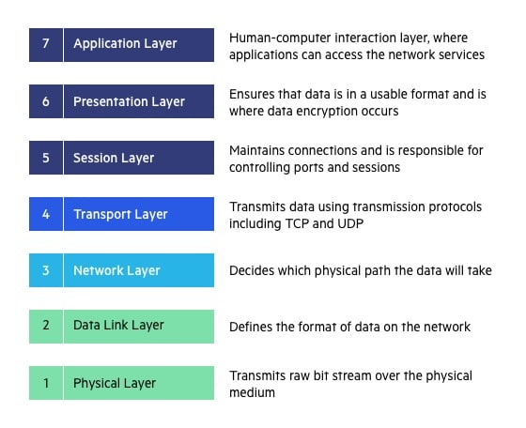
Next up:
Security
Firewalls/Tunnels/VPNs
Encryption
Network Attacks and Defenses
Wireless Networks + Wifi

