Slide 1

CSCI 132: Basic Data Structures and Algorithms
OOP Conclusion, UML
Reese Pearsall
Spring 2023
https://www.cs.montana.edu/pearsall/classes/spring2023/132/main.html
*All images are stolen from the internet

Slide 2
Announcements
Program 1 due SUNDAY at 11:59 PM
If you worked with a partner, make sure you clearly indicate that in your submission
Lab 4 due TUESDAY at 11:59 PM
Interfaces. We will talk more about it on Monday

Slide 3
Inheritance is a mechanism in Java that allows for a class to acquire instance fields and methods from another class
public class Programmer extends Employee {
}
Inheritance is great when you have shared attributes and methods across different classes

Slide 4
Inheritance is a mechanism in Java that allows for a class to acquire instance fields and methods from another class
public class Programmer extends Employee {
}
Inheritance is great when you have shared attributes and methods across different classes
public Abstract class Employee {
}
We can inherit from Abstract classes, but we can’t create instances of Abstract classes (can’t use new keyword)

Slide 5
Interfaces are abstract classes that only contain methods with no body
public class Ferrari implements Vehicle {
}
Interfaces are great when you need shared functionality with different implementations
When a class implements an interface, that class MUST define and write the bodies of the interface methods
public interface Vehicle {
void accelerate(int a);
void slowdown(int a);
void refuel(int a);
}

Slide 6
Inheriting from a class
Implementing an Interface
Class inherits instance fields and methods
Class inherits methods with no bodies
Can only inherit from one class
Can implement multiple interfaces
Sub class is not required to override methods
Sub class is required to override methods

Slide 7
Polymorphism is the ability of a class to provide different implementations of a method, depending on the type of object that is passed to the method.
Bird a2 = new Bird("Puffin",27.0, "North America",7400000,21.5);
Wolf b2 = new Wolf("Arctic Wolf",120.0, "North America",200000, 16);
a2.makeSound();
b2.makeSound();
The makeSound()method does something different for each object

Slide 8
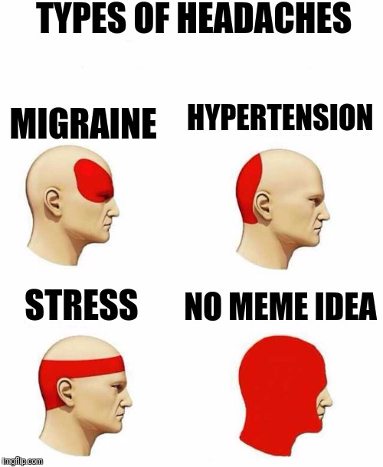

We could have many classes with many kinds of relationships
Many levels of inheritance
Multiple interfaces
Some abstract classes, some not
Method overloading
Reading Java Code
It would be nice to have a way to visualize the architecture of Java classes without needing to dive into complex source code

Slide 9
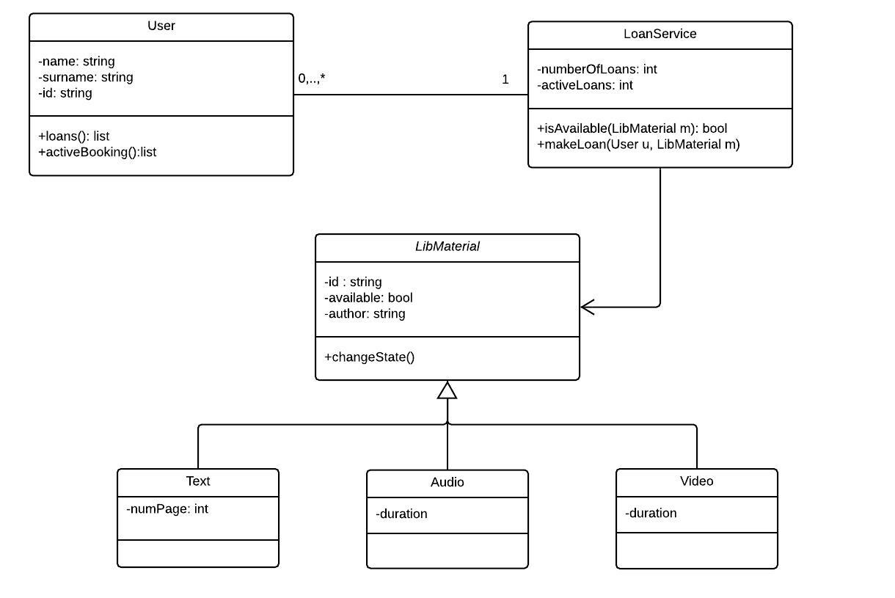
UML (Unified Modeling Language) is a standard language for specifying, visualizing, constructing, and documenting the artifacts of software systems.
We can use a UML Class Diagram to visualize the architecture of our Java classes

Slide 10
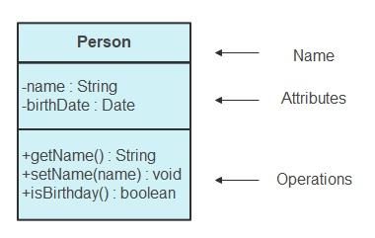

We can use a UML Class Diagram to visualize the architecture of our Java classes
Each Java class is a box.
Each box has the
name of the class
Attributes
operations/methods of the class
+ = public
= private
# = protected
Public Method (+), One argument, Returns nothing

Slide 11
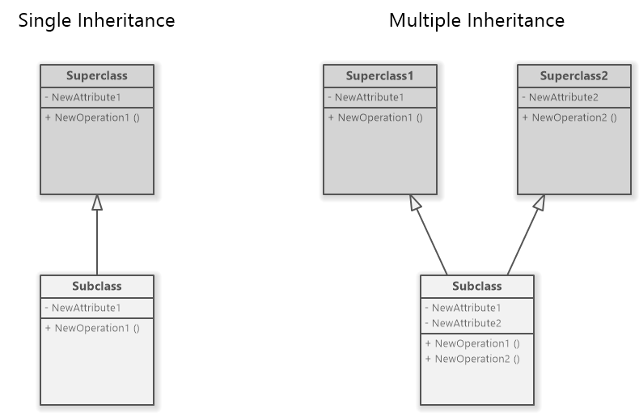

Inheritance is indicated by an open arrow

Slide 12

Card
PokerHand
Indicated by a normal line
Or by a normal arrow
An association is created when a class is referenced from another

Slide 13
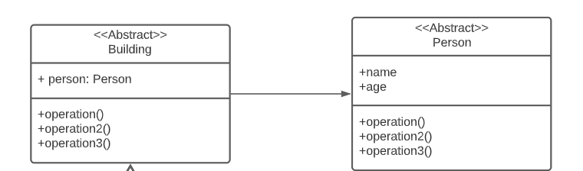
Abstract classes are indicated by
<< Abstract >>

Slide 14
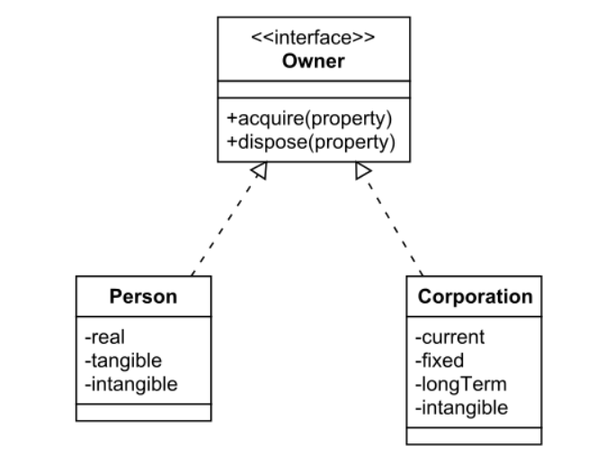

Interfaces are indicated by
<<interface>>
Implementing an interface is a realization relationship

Slide 15





Employee
Basic UML Example
#name (String)
#emp_id (int)
#salary (int)
+getName()
+getID()
+getSalary()
Programmer
-language (String)
+getLanguage()
Salesperson
Accountant
- commission (int)
-cpa_grade (char)
+getCommission()
+getCpaGrade()
ProgrammerIntern
-school (String)
+getSchool()

