Slide 1

CSCI 132: Basic Data Structures and Algorithms
ArrayLists
Reese Pearsall
Spring 2023
https://www.cs.montana.edu/pearsall/classes/spring2023/132/main.html
*All images are stolen from the internet

Slide 2
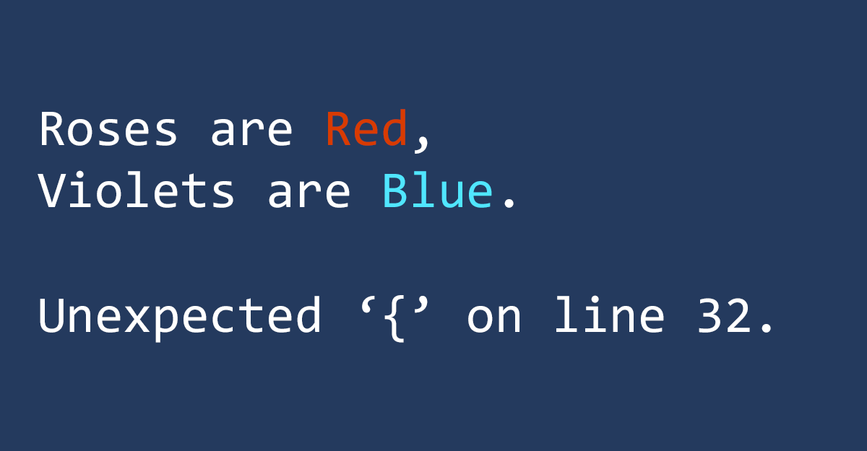
Announcements
Lab 4 due TUESDAY at 11:59 PM
Interfaces.
Gideon (8 AM, 10 AM) is out sick this week

Slide 3

What do you need to dig a hole?
Thank you to Sean Yaw (the goat) for the analogy

Slide 4

What do you need to dig a hole?
Thank you to Sean Yaw (the goat) for the analogy

Slide 5
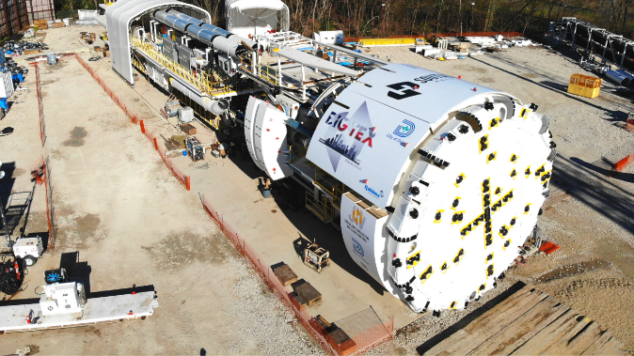
What do you need to dig a hole?
Pros
Cons
Thank you to Sean Yaw (the goat) for the analogy

Slide 6
What do you need to dig a hole?
Pros
Cons
Cheap
Precise
No Training
Availability
Slow
Labor
Thank you to Sean Yaw (the goat) for the analogy

Slide 7
What do you need to dig a hole?
Pros
Cons
Cheap
Precise
No Training
Availability
Slow
Labor
Fast
Labor
Expensive
Training
Thank you to Sean Yaw (the goat) for the analogy

Slide 8
What do you need to dig a hole?
Pros
Cons
Cheap
Precise
No Training
Availability
Slow
Labor
Fast
Labor
Expensive
Training
Really good at digging
Takes up a lot of garage space
Thank you to Sean Yaw (the goat) for the analogy

Slide 9

What do you need to dig a hole?
Pros
Cons
Cheap
Precise
No Training
Availability
Best tool for the job?
Slow
Labor
Burying your pet goldfish
Fast
Labor
Expensive
Training
Really good at digging
Takes up a lot of garage space
Thank you to Sean Yaw (the goat) for the analogy

Slide 10
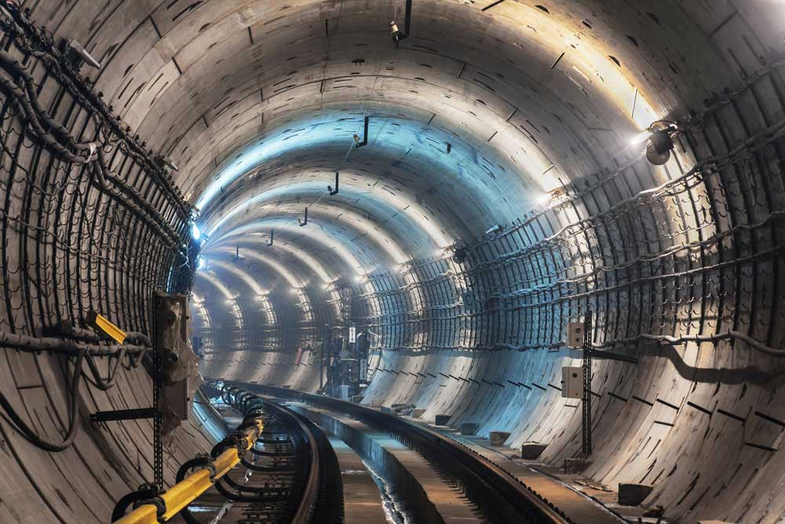
What do you need to dig a hole?
Pros
Cons
Cheap
Precise
No Training
Availability
Best tool for the job?
Slow
Labor
Building Express tunnel to Bridger Bowl
Fast
Labor
Expensive
Training
Really good at digging
Takes up a lot of garage space
Thank you to Sean Yaw (the goat) for the analogy

Slide 11
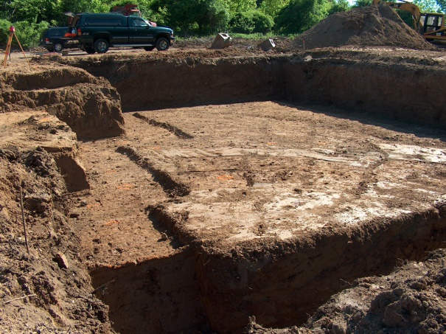
What do you need to dig a hole?
Pros
Cons
Cheap
Precise
No Training
Availability
Best tool for the job?
Slow
Labor
Creating the foundation for a house
Fast
Labor
Expensive
Training
Really good at digging
Takes up a lot of garage space
Thank you to Sean Yaw (the goat) for the analogy

Slide 12
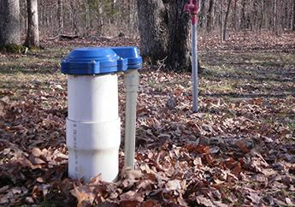
What do you need to dig a hole?
Pros
Cons
Cheap
Precise
No Training
Availability
Best tool for the job?
Slow
Labor
Digging a Well for water
Fast
Labor
Expensive
Training
Really good at digging
Takes up a lot of garage space
Thank you to Sean Yaw (the goat) for the analogy

Slide 13

What do you need to dig a hole?
Pros
Cons
Cheap
Precise
No Training
Availability
Best tool for the job?
Slow
Labor
Digging a Well for water
Fast
Labor
Expensive
Training
Really good at digging
Takes up a lot of garage space
Thank you to Sean Yaw (the goat) for the analogy

Slide 14
What do you need to dig a hole?
Pros
Cons
Cheap
Precise
No Training
Availability
Best tool for the job?
We can’t use the best tool for the job unless we know that tool exists!
Slow
Labor
Digging a Well for water
Fast
Labor
Expensive
Training
Really good at digging
Takes up a lot of garage space
Thank you to Sean Yaw (the goat) for the analogy

Slide 15

What do you need to dig a hole?
Pros
Cons
Cheap
Precise
No Training
Availability
Best tool for the job?
Slow
Labor
Creating the foundation for a house
Fast
Labor
Expensive
Training
Really good at digging
Takes up a lot of garage space
Thank you to Sean Yaw (the goat) for the analogy

Slide 16
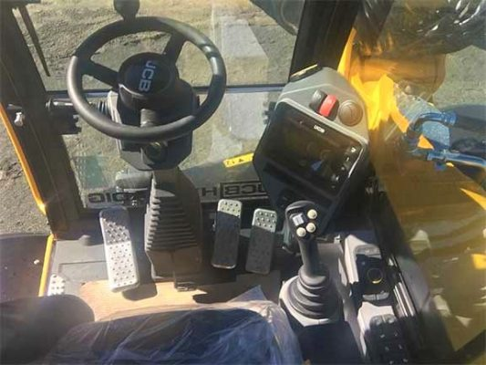

What do you need to dig a hole?
Pros
Cons
Cheap
Precise
No Training
Availability
Best tool for the job?
Slow
Labor
Creating the foundation for a house
Fast
Labor
Expensive
Training
Really good at digging
Takes up a lot of garage space
Thank you to Sean Yaw (the goat) for the analogy

Slide 17
What do you need to dig a hole?
Pros
Cons
Cheap
Precise
No Training
Availability
Best tool for the job?
Slow
Labor
Creating the foundation for a house
We can’t use the best tool for the job unless we know how to use that tool
Fast
Labor
Expensive
Training
Really good at digging
Takes up a lot of garage space
Thank you to Sean Yaw (the goat) for the analogy

Slide 18
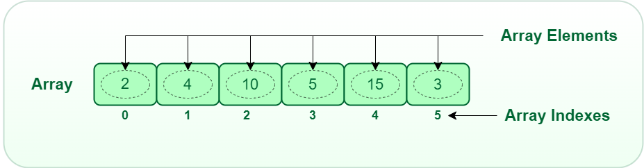
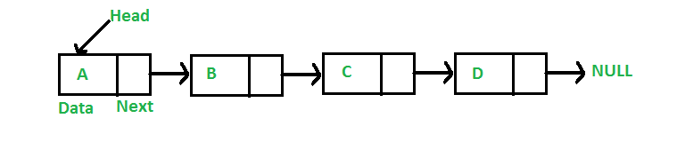
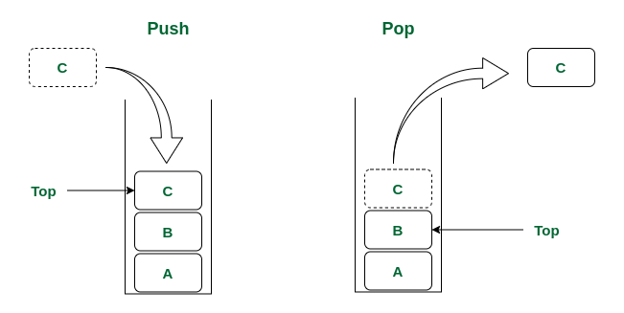
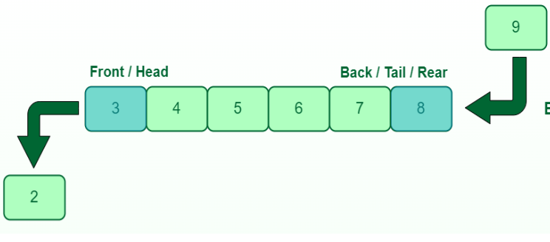
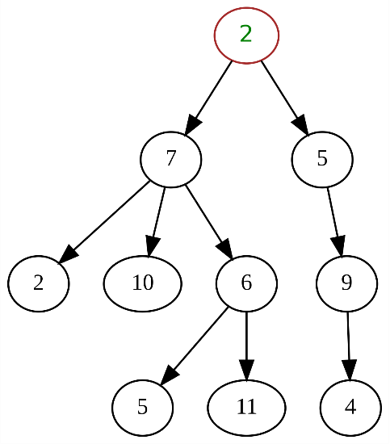
A data structure is a mechanism for storing and organizing data
Linked List
Arrays
Queue
Stack
Trees

Slide 19





A data structure is a mechanism for storing and organizing data
We have structured ways of accessing and managing data
Linked List
Arrays
Queue
There are many types of data structure, and each data structure has its pros and cons
Stack
Trees

Slide 20
An array is a data structure that can hold multiple, similar values
String[] cars = {"Volvo", "BMW", "Ford", "Mazda"};
int[] myNum = {10, 20, 30, 40};
Pros
Holds multiple pieces of information
Information is ordered (by index)
Can easily change what is stored in each slot
Can store duplicate data
Easy to iterate through

Slide 21
An array is a data structure that can hold multiple, similar values
String[] cars = {"Volvo", "BMW", "Ford", "Mazda"};
int[] myNum = {10, 20, 30, 40};
Cons
Can’t change the length
Can only store one data type
Pros
Holds multiple pieces of information
Information is ordered (by index)
Can easily change what is stored in each slot
Can store duplicate data
Easy to iterate through

Slide 22
Array Limitations
Cons
Can’t change the length
Can only store one data type
What can we do about this?
int[] myArray = {1, 2, 3};
System.out.println(Arrays.toString(myArray));
What if we wanted to add 4 to the array?

Slide 23
Array Limitations
Cons
Can’t change the length
Can only store one data type
What can we do about this?
int[] myArray = {1, 2, 3};
System.out.println(Arrays.toString(myArray));
int[] newArray = new int[myArray.length + 1];
for(int i = 0; i < myArray.length; i++) {
newArray[i] = myArray[i];
}
// Create a new array that is one spot bigger
// Fill new array with contents of old array

Slide 24
Array Limitations
Cons
Can’t change the length
Can only store one data type
What can we do about this?
int[] myArray = {1, 2, 3};
System.out.println(Arrays.toString(myArray));
int[] newArray = new int[myArray.length + 1];
for(int i = 0; i < myArray.length; i++) {
newArray[i] = myArray[i];
}
// Create a new array that is one spot bigger
// Fill new array with contents of old array
int new_value = 4;
newArray[myArray.length] = new_value;
myArray = newArray;
// add new value to array
// Update reference variable

Slide 25


Array Limitations
We updated our reference variable (myArray) to point to our new array with the new element
int[] myArray = {1, 2, 3};
System.out.println(Arrays.toString(myArray));
int[] newArray = new int[myArray.length + 1];
for(int i = 0; i < myArray.length; i++) {
newArray[i] = myArray[i];
}
int new_value = 4;
newArray[myArray.length] = new_value;
myArray = newArray;
myArray
newArray
1 | 2 | 3
1 | 2 | 3 | 4

Slide 26


Array Limitations
We updated our reference variable (myArray) to point to our new array with the new element
int[] myArray = {1, 2, 3};
System.out.println(Arrays.toString(myArray));
int[] newArray = new int[myArray.length + 1];
for(int i = 0; i < myArray.length; i++) {
newArray[i] = myArray[i];
}
int new_value = 4;
newArray[myArray.length] = new_value;
myArray = newArray;
myArray
newArray
1 | 2 | 3
1 | 2 | 3 | 4
What happens to this array?
This is an unused object

Slide 27
Array Limitations
We updated our reference variable (myArray) to point to our new array with the new element
int[] myArray = {1, 2, 3};
System.out.println(Arrays.toString(myArray));
int[] newArray = new int[myArray.length + 1];
for(int i = 0; i < myArray.length; i++) {
newArray[i] = myArray[i];
}
Java has a mechanism called Garbage Collection, with deletes unused object to free up memory
int new_value = 4;
newArray[myArray.length] = new_value;
myArray = newArray;
(this runs automatically!)
myArray
newArray
1 | 2 | 3
1 | 2 | 3 | 4
What happens to this array?
This is an unused object

Slide 28
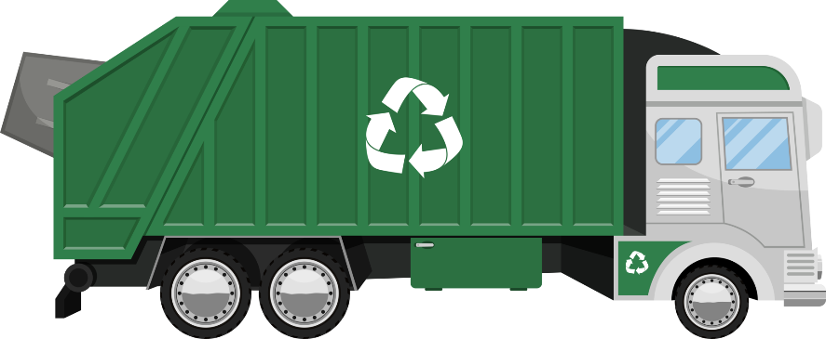
Array Limitations
We updated our reference variable (myArray) to point to our new array with the new element
int[] myArray = {1, 2, 3};
System.out.println(Arrays.toString(myArray));
int[] newArray = new int[myArray.length + 1];
for(int i = 0; i < myArray.length; i++) {
newArray[i] = myArray[i];
}
Java has a mechanism called Garbage Collection, with deletes unused object to free up memory
int new_value = 4;
newArray[myArray.length] = new_value;
myArray = newArray;
(this runs automatically!)
myArray
1 | 2 | 3
newArray
1 | 2 | 3 | 4
Java sees that we have an used/unreferenced object, so it will delete it!

Slide 29
Array Limitations
Cons
Can’t change the length
Can only store one data type
int[] myArray = {1, 2, 3};
System.out.println(Arrays.toString(myArray));
Solution
Create new array, copy everything over
int[] newArray = new int[myArray.length + 1];
for(int i = 0; i < myArray.length; i++) {
newArray[i] = myArray[i];
}
(this can be expensive ☹ )
int new_value = 4;
newArray[myArray.length] = new_value;
myArray = newArray;
Solution
Store an object, use two separate arrays, use a different data structure

Slide 30
An ArrayList is a data structure that can hold multiple, similar values (just like an array), BUT
Dynamic, can easily resize
Can easily add new elements and remove elements
Like a Python list ☺
Somebody took arrays, and made them better
Still have indices
Still can only store one data type

Slide 31
Java ArrayLists
We first need to remember to import it ☺
import java.util.ArrayList;
Creating a new ArrayList
ArrayList<String> mylist = new ArrayList<String>();
We must specify what datatype the ArrayList will hold
We never have to specify the size, because we can now easily grow/shrink our ArrayList!
Reference Variable

Slide 32
Java ArrayLists
We first need to remember to import it ☺
import java.util.ArrayList;
Creating a new ArrayList
ArrayList<String> mylist = new ArrayList<String>();
We can add stuff to the ArrayList using the .add() method (built in method!)
mylist.add("Jack");

Slide 33


Java ArrayLists
We first need to remember to import it ☺
import java.util.ArrayList;
Creating a new ArrayList
ArrayList<String> mylist = new ArrayList<String>();
We can add stuff to the ArrayList using the .add() method (built in method!)
mylist.add("Jack");
Under the hood, it is
Creating a new array
Copy old contents
Add new element at the end
Updating reference variable
int[] myArray = {1, 2, 3};
System.out.println(Arrays.toString(myArray));
int[] newArray = new int[myArray.length + 1];
for(int i = 0; i < myArray.length; i++) {
newArray[i] = myArray[i];
}
int new_value = 4;
newArray[myArray.length] = new_value;
myArray = newArray;

Slide 34
Java ArrayLists
We first need to remember to import it ☺
import java.util.ArrayList;
Creating a new ArrayList
ArrayList<String> mylist = new ArrayList<String>();
We can add stuff to the ArrayList using the .add() method (built in method!)
mylist.add("Jack");
To access elements in the array, we use the .get() method (we cannot use the square bracket index [ ] )
System.out.println(mylist.get(2));
// this will print the String at index 2

Slide 35
Java ArrayLists
We first need to remember to import it ☺
import java.util.ArrayList;
Creating a new ArrayList
ArrayList<String> mylist = new ArrayList<String>();
We can add stuff to the ArrayList using the .add() method (built in method!)
mylist.add("Jack");
To access elements in the array, we use the .get() method (we cannot use the square bracket index [ ] )
System.out.println(mylist.get(2));
// this will print the String at index 2
We can remove stuff by index, or by searching for a specific element
mylist.remove("Eli");
mylist.remove(0);

Slide 36
Java ArrayLists
import java.util.ArrayList;
public class ArrayListDemo {
public static void main(String[] args) {
ArrayList<String> mylist = new ArrayList<String>();
mylist.add("Jack");
mylist.add("Tory");
mylist.add("Sam");
mylist.add("Eli");
System.out.println(mylist);
System.out.println(mylist.get(2));
mylist.remove("Eli");
mylist.remove(0);
System.out.println(mylist);
System.out.println(mylist.isEmpty());
}
}

Slide 37
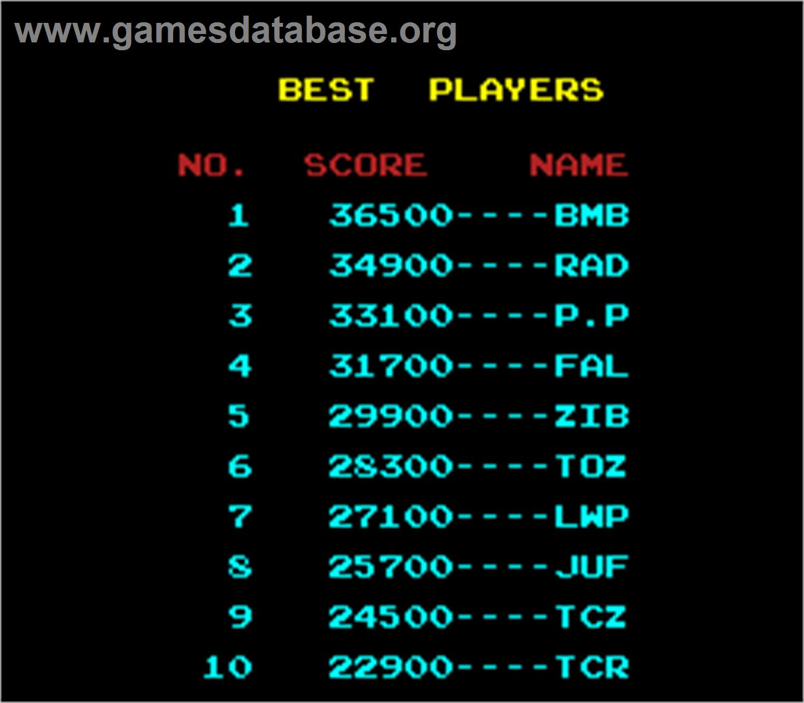
Java ArrayLists Example
Let’s write a program that will keep track of high scores on an arcade machine
Each entry will have the player name (String), and their score (Int)
The program should allow for
Adding a new high score
Removing a score
Print out scoreboard
Print out top N scores
Search for score by name
And we must use an ArrayList to hold all this information!

