Slide 1

CSCI 476: Computer Security
Lecture 6: Set-UID and Environment Variables (Part 2)
Reese Pearsall
Spring 2023
*all images are stolen from the internet
https://www.cs.montana.edu/pearsall/classes/spring2023/476/main.html

Slide 2
Set-UID In a Nutshell
Set-UID allows a user to run a program with the program owner’s privilege
User runs a program w/ temporarily elevated privileges
Created to deal with inflexibilities of UNIX access control
Example: The passwd program

Slide 3
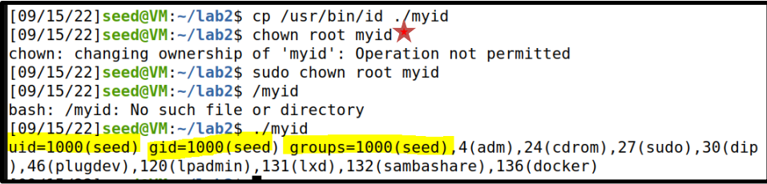
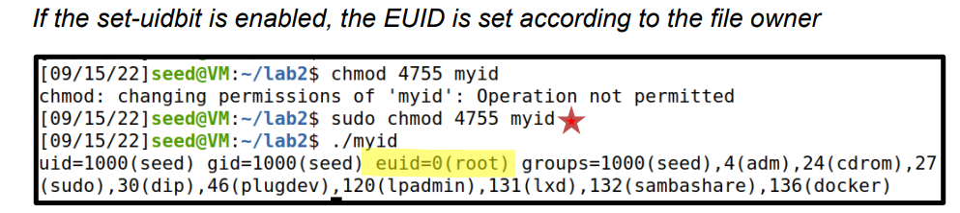
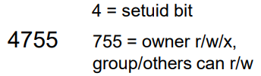
A Set-UID program is just like any other program, except that is has a special bit set
Steps for creating a set-uid program
Change file ownership to root (chown)
2. Enable to Set-uid bit (chmod)
Access control decisions made based on EUID, not RUID !

Slide 4
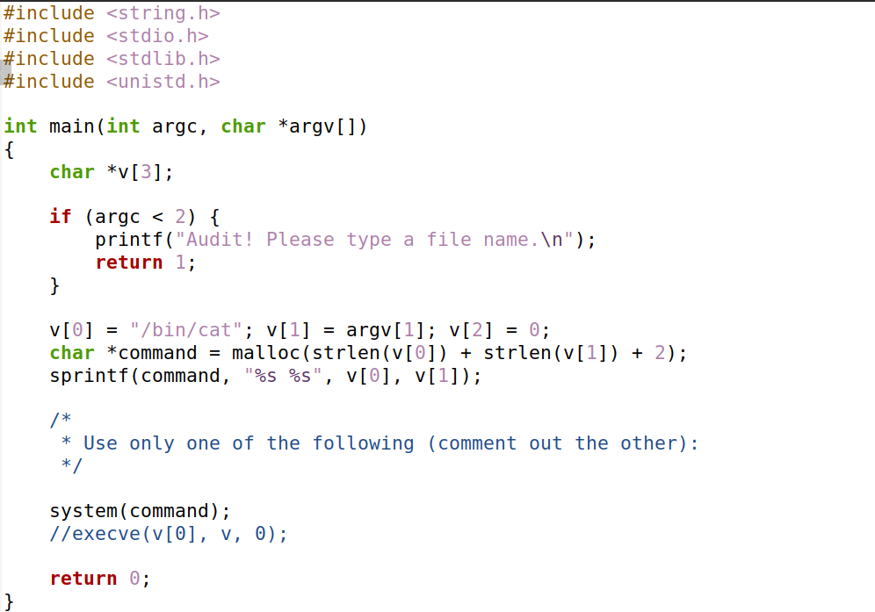
catall.c
The command line argument (file path) is appended to the string “/bin/cat”
Spawns a new process that executes:
/bin/cat [FILE_PATH]
ex. /bin/cat my_file.txt

Slide 5
Suppose you are preparing for an audit. An auditor may need the access to view certain files.
Instead of giving them total access to everything on the system, we will create a privileged program that will the auditor view the content of some file
Set-UID program name
Name of file the auditor will view
./audit company_data.csv
./audit ../lab0/solution.docx
/bin/cat company_data.csv
/bin/cat ../lab0/solution.docx

Slide 6
system() is a very unsafe function
We can exploit this by maliciously constructing the input to this program
Hint: the string passed to system() can include multiple commands

Slide 7
system() is a very unsafe function
We can exploit this by maliciously constructing the input to this program
Hint: the string passed to system() can include multiple commands
./audit “my_info.txt; /bin/sh”

Slide 8
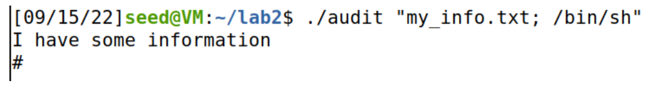
./audit “my_info.txt; /bin/sh”
system(/bin/cat my_info.txt; /bin/sh)
system() interprets this as two separate commands

Slide 9




./audit “my_info.txt; /bin/sh”
system(/bin/cat my_info.txt; /bin/sh)
system() interprets this as two separate commands

Slide 10
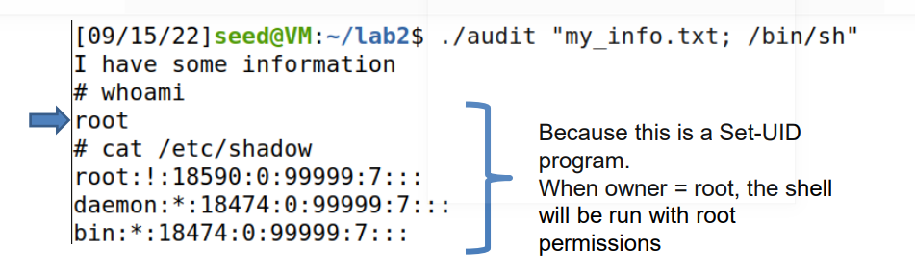

./audit “my_info.txt; /bin/sh”
system(/bin/cat my_info.txt; /bin/sh)

Slide 11



./audit “my_info.txt; /bin/sh”
system(/bin/cat my_info.txt; /bin/sh)
We have gained access into the system

Slide 12

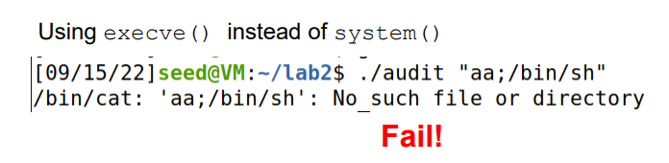
A safer way to invoke programs
int execve(const char *pathname, char *const argv[], char *const envp[]);
execve() executes the program referred to by pathname.
argv[] is the command line arguments for the command

Slide 13
A safer way to invoke programs
int execve(const char *pathname, char *const argv[], char *const envp[]);
execve() executes the program referred to by pathname.
argv[] is the command line arguments for the command
execve(“/bin/cat”,[“aa;/bin/sh”])
/bin/cat “aa;/bin/sh”
Treated as an entire argument to the command
Fail!

Slide 14

The ability (and risks) of invoking external commands is not limited to C
Python has a system call
Perl has open()
PHP has system

Slide 15
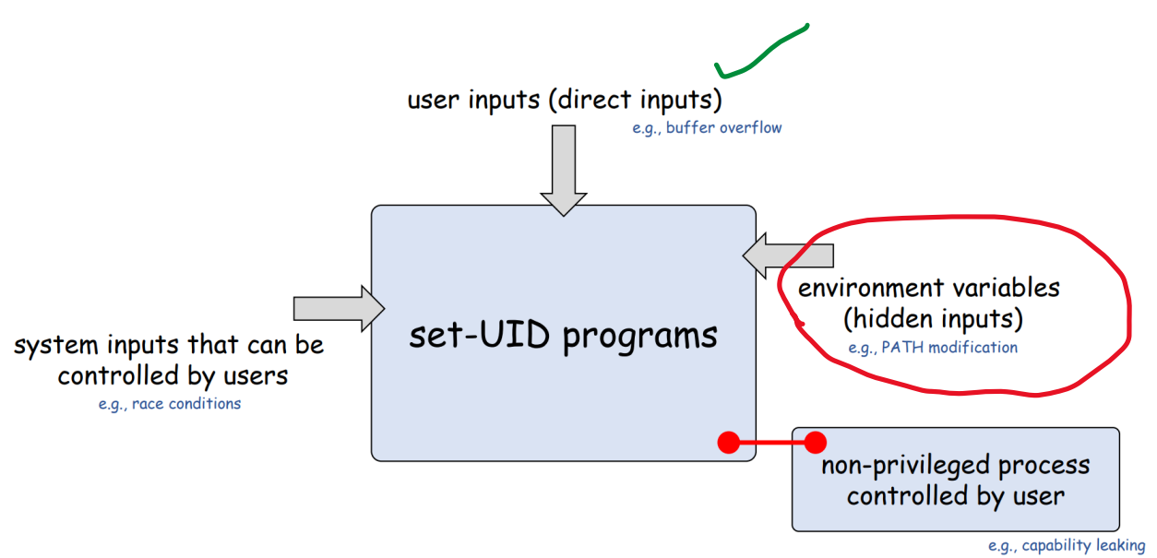

Slide 16
Environment variable are a set of dynamic named values that affect the way a running process will behave (key-value pairs)
Example: The PATH variable
• We use command such as ls and passwd
We could be in any directory.
How does it know to run /bin/ls ?

Slide 17
Environment variable are a set of dynamic named values that affect the way a running process will behave (key-value pairs)
Example: The PATH variable
• We use command such as ls and passwd
We could be in any directory.
How does it know to run /bin/ls ?
If the full path is not provided, the shell process will use the PATH env. variable to search for it!
Tells the OS to look for the ls program in /usr/local/bin

Slide 18
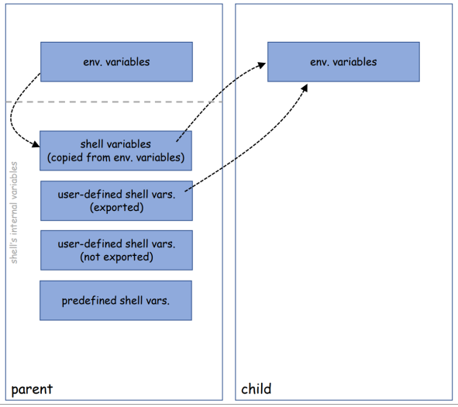
Where do environment variables come from?
Processes can get environment variables in one of two ways:
fork() → the child process inherits its parent process’s environment variables.
exec() → the memory space is overwritten, and all old environment variables are lost.
However, execve()can explicitly pass environment variables from one process to another

Slide 19
Creating our own environment variables
(Task 1 on Lab 1)
We can define our own environment variables using the export command
env var name
value

Slide 20
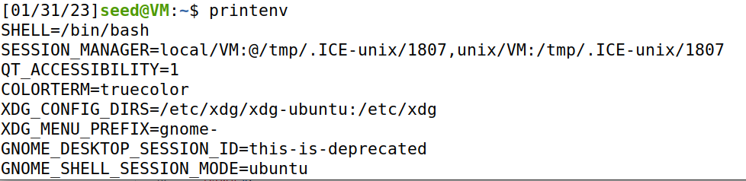
Creating our own environment variables
(Task 1 on Lab 1)
We can define our own environment variables using the export command
We can use printenv to print out all the environment variables on the system

Slide 21
Creating our own environment variables
(Task 1 on Lab 1)
We can define our own environment variables using the export command
We can use printenv to print out all the environment variables on the system
There are a lot of environment variables, so we can combine printenv with the grep command to find out specific environment variables

Slide 22
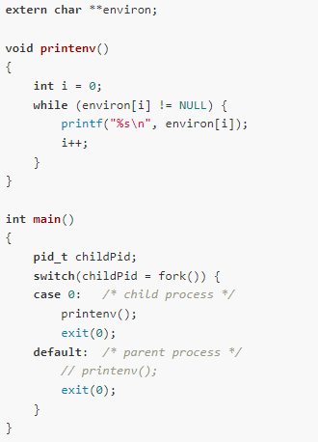
Demo: Seeing environment variables in a parent and child process
Do all environment variables get inherited by the child process?
(Task 2 on Lab 1)
myprintenv.c

Slide 23
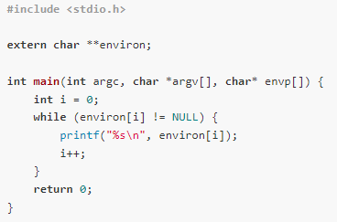
Experiment: Do all environment variables get inherited by SET-UID programs?
PATH ?
LD_LIBRARY_PATH ?
MYVAR ?
myenv_environ.c
(Task 3 on lab 1)

Slide 24
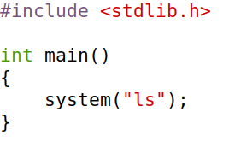
Exploiting a Set-UID program with environment variables
(Task 5 on lab 1)
This program uses the system() command to run the ls program
However, this program does not use the absolute path of the ls program (/bin/ls)

Slide 25
Exploiting a Set-UID program with environment variables
(Task 5 on lab 1)
This program uses the system() command to run the ls program
However, this program does not use the absolute path of the ls program (/bin/ls)
… which means it will use the PATH environment variable to locate the ls program

Slide 26
Exploiting a Set-UID program with environment variables
(Task 5 on lab 1)
This program uses the system() command to run the ls program
However, this program does not use the absolute path of the ls program (/bin/ls)
… which means it will use the PATH environment variable to locate the ls program
Important reminder: We can set the value of the PATH env variable

Slide 27
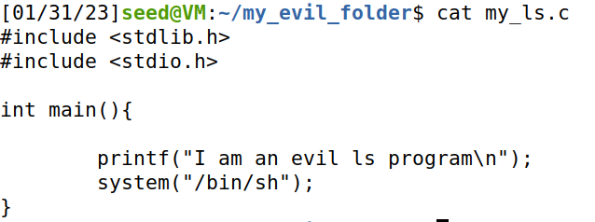
Exploiting a Set-UID program with environment variables
(Task 5 on lab 1)
We first make our own malicious program that creates a shell with system()
Compile it and make the executable is named ls

Slide 28

Exploiting a Set-UID program with environment variables
(Task 5 on lab 1)
This is the program we are going to exploit… and if this is a Set-UID program, things can get scary
Make ls_vuln a Set-UID progam

Slide 29

Exploiting a Set-UID program with environment variables
(Task 5 on lab 1)
Update the PATH environment variable to point to our malicious ls program that’s located in the my_evil_folder directory
When we run ls_vuln, system()will execute OUR ls program instead of the normal one
Root shell!!!

