Slide 1

CSCI 476: Computer Security
Lecture 6: Set-UID and Environment Variables (Part 3)
Reese Pearsall
Spring 2023
*all images are stolen from the internet
https://www.cs.montana.edu/pearsall/classes/spring2023/476/main.html

Slide 2
Set-UID In a Nutshell
Set-UID allows a user to run a program with the program owner’s privilege
User runs a program w/ temporarily elevated privileges
Created to deal with inflexibilities of UNIX access control
Example: The passwd program

Slide 3
RUID vs EUID
Real User ID (RUID) and Effective User ID (EUID) are values that are tracked by OS for each process. These IDs are used for access control decisions
ex. Should this process be allowed to do _____ ?
RUID refers to the user that created the process
ex. A normal user running ./hello_world, the RUID == seed
EUID refers to the current privilege of the process, and is used for most permission checks
ex. A normal user running ./hello_world, the EUID == seed

Slide 4
RUID vs EUID
RUID refers to the user that created the process
EUID refers to the current privilege of the process, and is used for most permission checks
When running a process, generally RUID and EUID will be the same
However, when the process is a Set UID program, the EUID now becomes the owner of the program, which will typically be root (now RUID != EUID)

Slide 5
RUID vs EUID
RUID refers to the user that created the process
EUID refers to the current privilege of the process, and is used for most permission checks
However, when the process is a Set UID program, the EUID now becomes the owner of the program, which will typically be root (now RUID != EUID)
There are shell countermeasures (/bin/dash) that prevents a process from doing things when it detects that the RUID != EUID, which is why we must disable the countermeasure before starting the lab
sudo ln –sf /bin/zsh /bin/sh

Slide 6
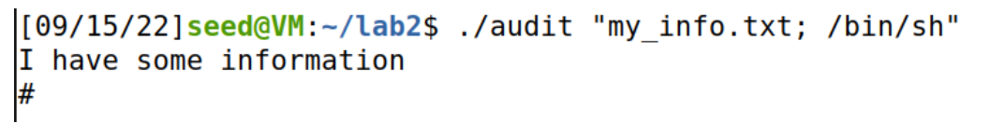




./audit “my_info.txt; /bin/sh”
system(/bin/cat my_info.txt; /bin/sh)
system() interprets this as two separate commands

Slide 7
Environment variable are a set of dynamic named values that affect the way a running process will behave (key-value pairs)
Example: The PATH variable
• We use command such as ls and passwd
We could be in any directory.
How does it know to run /bin/ls ?
If the full path is not provided, the shell process will use the PATH env. variable to search for it!
Tells the OS to look for the ls program in /usr/local/bin

Slide 8
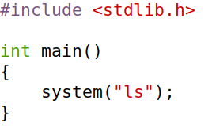

Exploiting a Set-UID program with environment variables
(Task 5 on lab 1)
This program uses the system() command to run the ls program
However, this program does not use the absolute path of the ls program (/bin/ls)
… which means it will use the PATH environment variable to locate the ls program
Important reminder: We can set the value of the PATH env variable

Slide 9
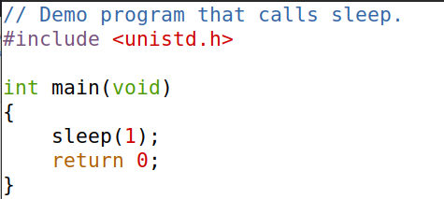
Linking finds the external library code referenced in a program
Static Linking – Linker combines program code/external code into final executable
Dynamic Linking- linker uses env variables to locate external dependencies
This program uses the sleep function. When compiling this program, how does it know where to find the source code for the sleep() function ?

Slide 10
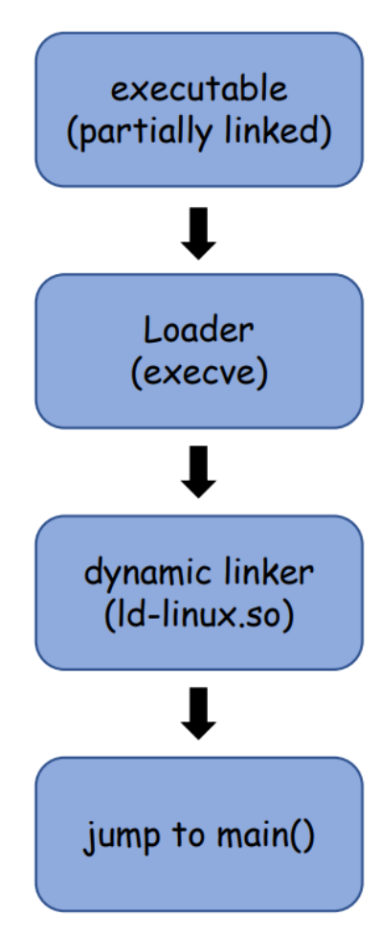
Linking finds the external library code referenced in a program
Static Linking – Linker combines program code/external code into final executable
Dynamic Linking- linker uses env variables to locate external dependencies
This program uses the sleep function. When compiling this program, how does it know where to find the source code for the sleep() function ?
It will use environment variables !

Slide 11
Linking finds the external library code referenced in a program
Static Linking – Linker combines program code/external code into final executable
Dynamic Linking- linker uses env variables to locate external dependencies
This program uses the sleep function. When compiling this program, how does it know where to find the source code for the sleep() function ?
It will use environment variables !
Specifically, it will use the LD_PRELOAD env variable

Slide 12
Dynamic Linking- linker uses env variables to locate external dependencies
LD_PRELOAD contains a list of shared libraries to search through during the linking process
Provides precedent over standard functions calls (malloc, free, etc)
If functions are not found, it will consult the location specified in LD_LIBRARY_PATH
Because these are just environment variables, we can set both of these values (LD_PRELOAD, LD_LIBRARY_PATH)
Any ideas how we could exploit this program?

Slide 13

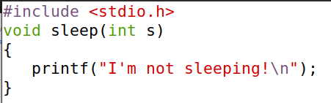
sleep_prog.c
Let’s write our own sleep() function!
We could put any code here (printf is not very malicious…)
mylib.c

Slide 14
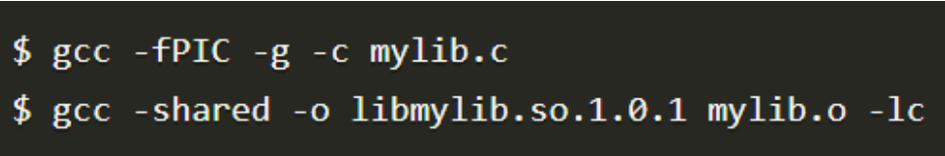
sleep_prog.c
2
Add code to a shared library, libmylib.so.1.0.1
1
Let’s write our own sleep() function!
mylib.c

Slide 15
sleep_prog.c
2
Add code to a shared library, libmylib.so.1.0.1
1
Let’s write our own sleep() function!
3
Set the LD_PRELOAD environment variable, which tells linker to use our malicious library instead of the default one
mylib.c

Slide 16
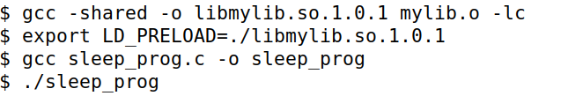
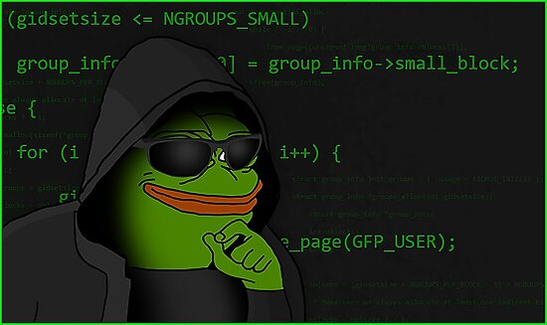
sleep_prog.c
(the program we are exploiting)
Task 6 Lab 1:
What if run this program as a normal user?
1
Let’s write our own sleep() function!
mylib.c
2
Add code to a shared library, libmylib.so.1.0.1
The program uses our sleep function!!
3
Set the LD_PRELOAD environment variable, which tells linker to use our malicious library instead of the default one

Slide 17


sleep_prog.c
(the program we are exploiting)
Task 6 Lab 1:
What if we make the program a Set-UID program and run as a normal user?
1
Let’s write our own sleep() function!
mylib.c
2
Add code to a shared library, libmylib.so.1.0.1
The program sleeps normally (it does not use our sleep function)
3
Set the LD_PRELOAD environment variable, which tells linker to use our malicious library instead of the default one

Slide 18
sleep_prog.c
(the program we are exploiting)
Task 6 Lab 1:
What if we make the program a Set-UID program and run as the root user?
1
Let’s write our own sleep() function!
mylib.c
2
Add code to a shared library, libmylib.so.1.0.1
3
Set the LD_PRELOAD environment variable, which tells linker to use our malicious library instead of the default one
The program uses our sleep function!!

Slide 19


We have mixed results. Sometimes the program used our malicious sleep function, other times it did not
Process Owner Set-UID program? Success?
seed
seed
root
Any ideas what could be causing this?

Slide 20
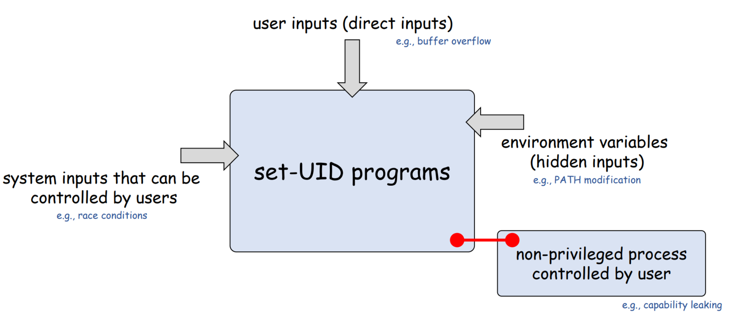

Exploiting Set-UID programs via capability leaking
(This won’t be on the lab ☺ )

Slide 21
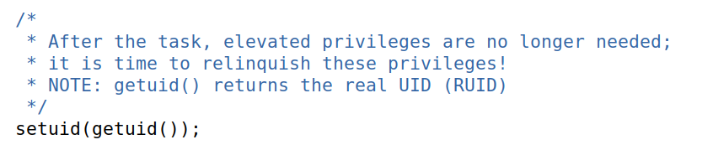
Exploiting Set-UID programs via capability leaking
Often times, a process will downgrade its privileges when it no longer needs them
It can do this by using the setuid()function
Capability leaking can occur when a privilege process does not properly clean up its privileges when downgrading

Slide 22
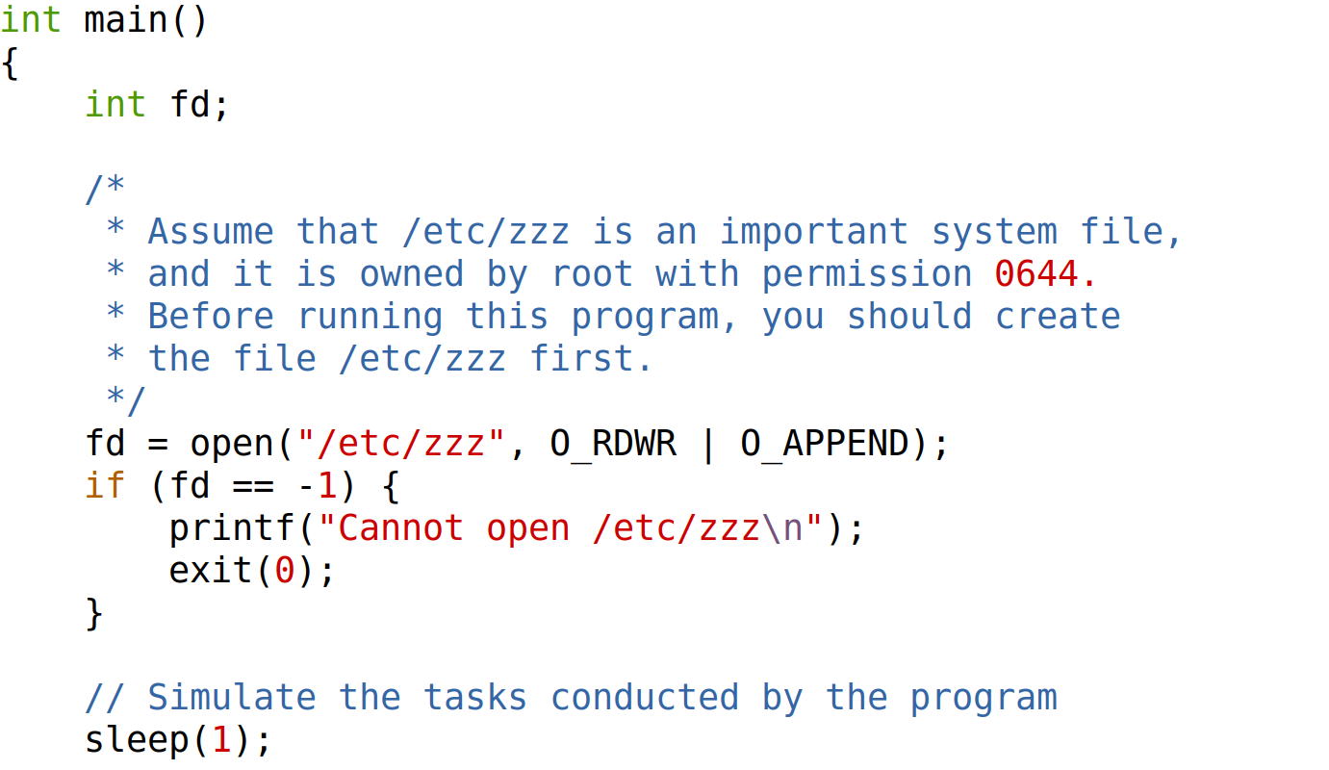
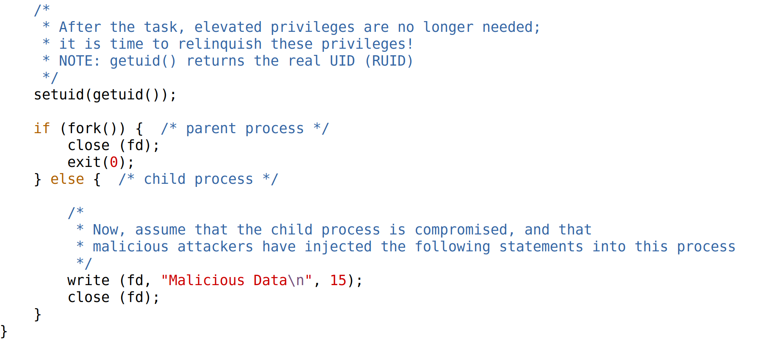



First opens a file descriptor (fd) for “/etc/zzz”, which is only writeable by root
Suppose this program does some stuff with the file before dropping privileges

Slide 23

We then fork() and create a new process
In the parent process, we close the file
However, in the child process, the file descriptor is still open!

Slide 24
If this a Set-UID program, then fd is a root-level file descriptor, and the child process inherits this!
Thus, the child process (which was created after dropping privileges) can write to /etc/zzz (bad!!!!)

Slide 25
Capability leaking can occur when a privilege process does not properly clean up its privileges when downgrading
Always be careful about the privileges you are giving to a process!

Slide 26
That’s it for Set-UID Programs, but we will continue to use Set-UID programs in future sections
Did we learn any valuable lessons?

Slide 27
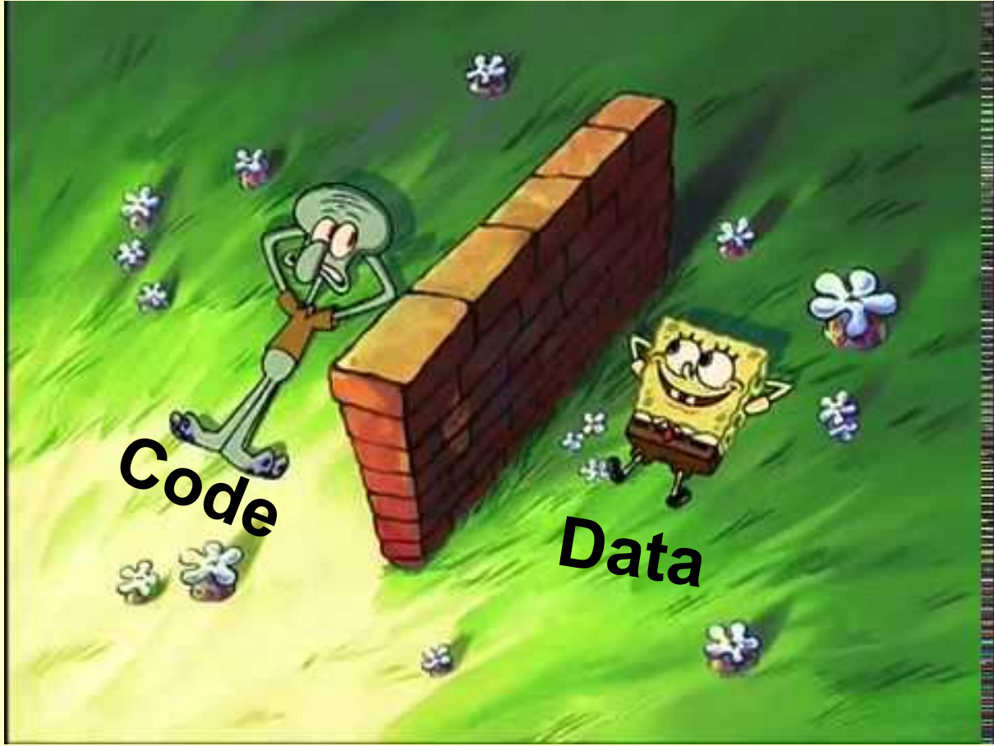
Security Principle #1
Principle of Isolation
There needs to be a clear separation of data and code
If user input is needed as data, it should not be interpreted as code

Slide 28
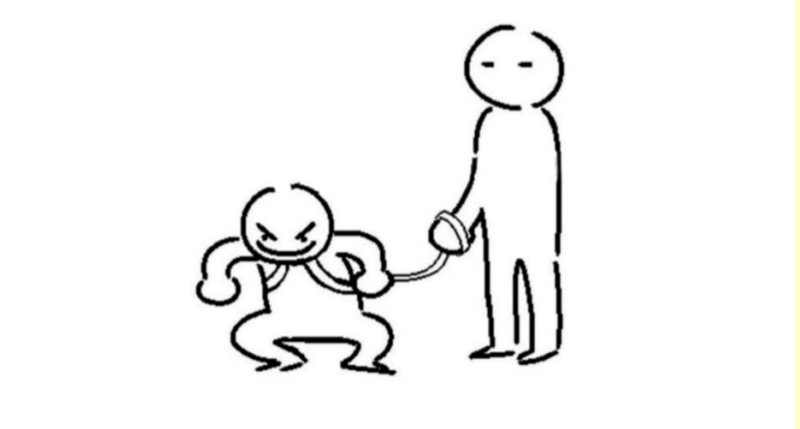
Security Principle #1
Principle of Least Privilege
Subjects and Programs should be given only the privileges needed to complete their task
Disable privileges when they are not needed

