Slide 1

CSCI 476: Computer Security
Buffer Overflow Attack (Part 4)
Bypassing Countermeasures, Return to Lib-C
Reese Pearsall
Spring 2023
*all images are stolen from the internet
https://www.cs.montana.edu/pearsall/classes/spring2023/476/main.html

Slide 2


Announcements
Lab 3 (Buffer Overflow) Due Sunday March 5th @ 11:59 PM
On Monday I will Discuss the Project
Next Friday (3/3) will be a work day for lab 3
strcpy()
My child will safely copy strings inside of a C function

Slide 3
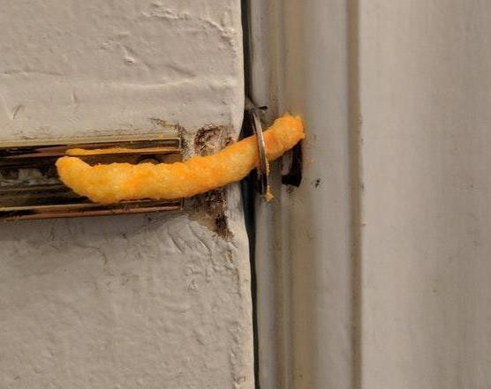
Defeating Countermeasures

Slide 4
Buffer Overflow Countermeasures
Safe Shell (/bin/dash)
Address space layout randomization (ASLR)
Stack Guard
•
Non executable stack

Slide 5
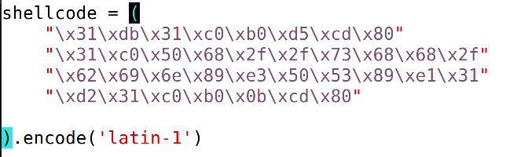
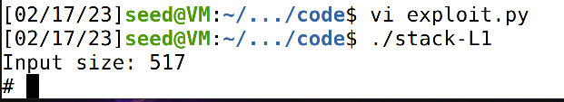


Countermeasure #1: Dash Secure Shell
To bypass /dash/, we add shellcode that sets the real user uid of the process to be 0 (root)
setuid(0)
execve(/bin/sh)
We got our root shell back!!

Slide 6
Buffer Overflow Countermeasures
Safe Shell (/bin/dash)
Address space layout randomization (ASLR)
Bypass: Add shellcode to our payload the sets RUID = 0
Stack Guard
•
Non executable stack

Slide 7
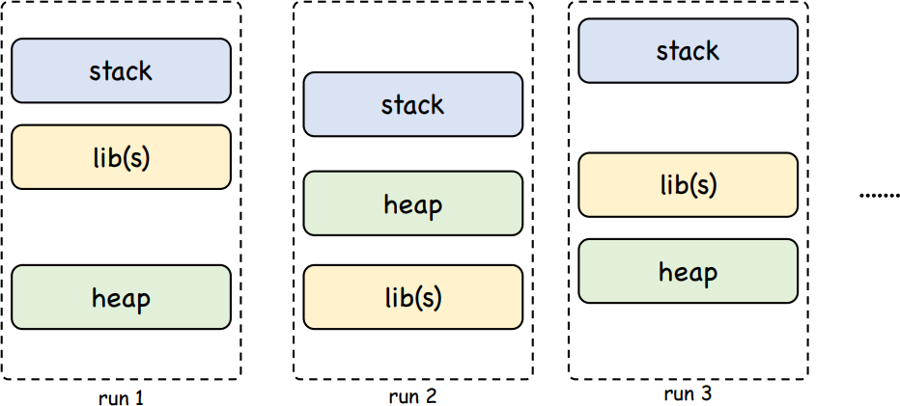
Countermeasure #2: ASLR
(address space layout randomization)
ASLR = Randomize the start location of the stack, heap, libs, etc
This makes guessing stack addresses more difficult!

Slide 8
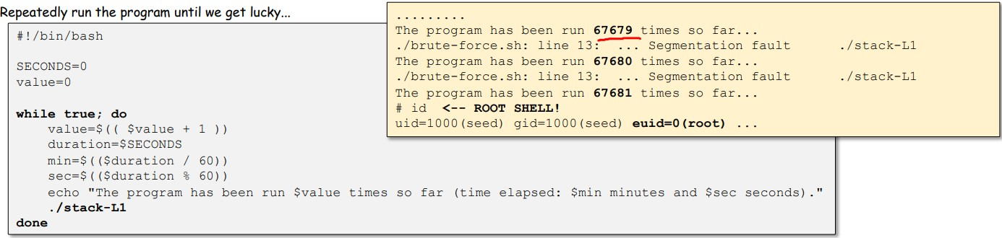
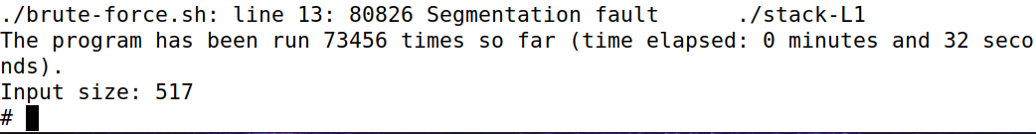
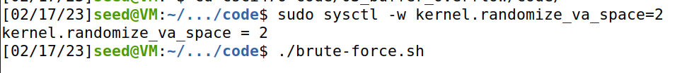
Countermeasure #2: ASLR
(address space layout randomization)
We are going to guess (a lot!!!) and hope that we eventually get lucky
!!! Endpoints might have additional Brute-Force countermeasures active
After 32 seconds, I got a root shell

Slide 9
Buffer Overflow Countermeasures
Safe Shell (/bin/dash)
Address space layout randomization (ASLR)
Bypass: Add shellcode to our payload the sets RUID = 0
Bypass: Brute-Force / Wait to get lucky
Stack Guard
•
Non executable stack

Slide 10
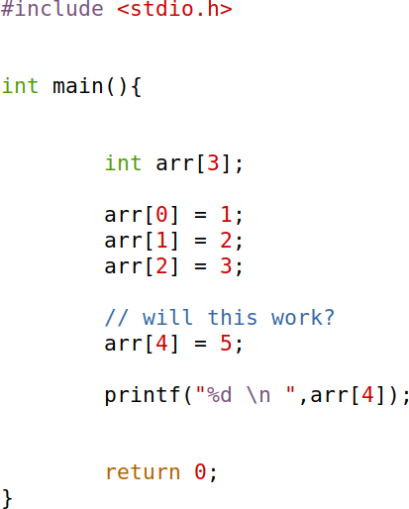
Stack Guard
THE STACK
Compiler Countermeasure***
… previous stack frames…
Arguments
Return Address
Previous frame pointer
Guard
buffer[99] . . . . . buffer[0]
Places a special value (guard) between the return address/previous frame pointer and local function values
When the function finishes, and the OS sees that the stack guard has ben overwritten, the program aborts and does not proceed

Slide 11
Stack Guard
THE STACK
Compiler Countermeasure***
… previous stack frames…
Arguments
Return Address
Previous frame pointer
Guard
buffer[99] . . . . . buffer[0]
Compile with stack guard turned off:
We overflowed the array!

Slide 12
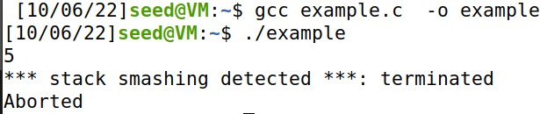
Stack Guard
THE STACK
Compiler Countermeasure***
… previous stack frames…
Arguments
Return Address
Previous frame pointer
Guard
buffer[99] . . . . . buffer[0]
Compile with stack guard turned off:
We overflowed the array!
Compile with stack guard turned on:
Aborted when we pass the stack guard

Slide 13
Stack Guard
Somewhere else in Memory (not on stack)
THE STACK
Compiler Countermeasure***
… previous stack frames…
Arguments
Return Address
Previous frame pointer
Guard (45)
buffer[99] . . . . . buffer[0]
Stack Canary Value: 45
How is stack guard implemented?
The compiler places a secret value (a stack canary) at the stack guard memory location, and in a safe location off the stack

Slide 14

Stack Guard
Somewhere else in Memory (not on stack)
THE STACK
Compiler Countermeasure***
… previous stack frames…
Arguments
Return Address
Previous frame pointer
Guard (45)
buffer[99] . . . . . buffer[0]
Stack Canary Value: 45
How is stack guard implemented?
The compiler places a secret value (a stack canary) at the stack guard memory location, and in a safe location off the stack
When the function finishes, check the stack canary value.
If the stack canary on the stack has not been modified, then no buffer overflow has occurred

Slide 15



Stack Guard
Somewhere else in Memory (not on stack)
THE STACK
Compiler Countermeasure***
… previous stack frames…
Arguments
Return Address
Previous frame pointer
Guard (45)
buffer[99] . . . . . buffer[0]
Stack Canary Value: 45
How is stack guard implemented?
The compiler places a secret value (a stack canary) at the stack guard memory location, and in a safe location off the stack
NOP NOP NOP
NOP NOP NOP
NOP NOP NOP
NOP NOP NOP
NOP NOP NOP
NOP NOP NOP
NOP NOP NOP
NOP NOP NOP
NOP NOP NOP
NOP NOP NOP
NOP NOP NOP
NOP NOP NOP
NOP NOP NOP
When the function finishes, check the stack canary value.
If the stack canary on the stack has not been modified, then no buffer overflow has occurred
If the stack canary on the stack has been modified, then our stack guard has been overwritten– Potential overflow detected! Abort

Slide 16


Stack Guard
Somewhere else in Memory (not on stack)
THE STACK
Compiler Countermeasure***
… previous stack frames…
Arguments
Return Address
Previous frame pointer
Guard (45)
buffer[99] . . . . . buffer[0]
Stack Canary Value: 45
How is stack guard implemented?
The compiler places a secret value (a stack canary) at the stack guard memory location, and in a safe location off the stack
NOP NOP NOP
NOP NOP NOP
NOP NOP NOP
NOP NOP NOP
NOP NOP NOP
NOP NOP NOP
NOP NOP NOP
NOP NOP NOP
NOP NOP NOP
NOP NOP NOP
NOP NOP NOP
NOP NOP NOP
NOP NOP NOP
When the function finishes, check the stack canary value.
If the stack canary on the stack has not been modified, then no buffer overflow has occurred
If the stack canary on the stack has been modified, then our stack guard has been overwritten– Potential overflow detected! Abort
The insertion, checking, and aborting for stack guard/canary is done for us in the Function Prologue and Epilogue!

Slide 17
Stack Guard
Somewhere else in Memory (not on stack)
THE STACK
Compiler Countermeasure***
… previous stack frames…
Arguments
Return Address
Previous frame pointer
Guard (45)
buffer[99] . . . . . buffer[0]
Stack Canary Value: 45
How to bypass stack guard?

Slide 18
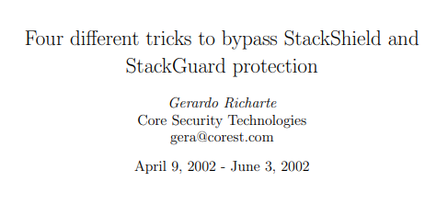
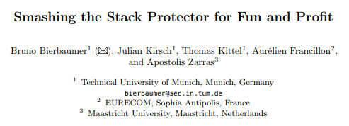
Stack Guard
Somewhere else in Memory (not on stack)
THE STACK
Compiler Countermeasure***
… previous stack frames…
Arguments
Return Address
Previous frame pointer
Guard (45)
buffer[99] . . . . . buffer[0]
Stack Canary Value: 45
How to bypass stack guard?
We won’t discuss these techniques in this class, as they involve some advanced memory manipulation and magic, but just know that techniques to bypass stack guard exist ☺

Slide 19
Stack Guard
Somewhere else in Memory (not on stack)
THE STACK
Compiler Countermeasure***
… previous stack frames…
Arguments
Return Address
Previous frame pointer
Guard (45)
buffer[99] . . . . . buffer[0]
Stack Canary Value: 45
How to bypass stack guard?
We won’t discuss these techniques in this class, as they involve some advanced memory manipulation and magic, but just know that techniques to bypass stack guard exist ☺

Slide 20
Buffer Overflow Countermeasures
Safe Shell (/bin/dash)
Address space layout randomization (ASLR)
Bypass: Add shellcode to our payload the sets RUID = 0
Bypass: Brute-Force / Wait to get lucky
Stack Guard
Bypass: Don’t worry about it (advanced memory manipulation, PRNG manipulation)
•
Non executable stack

Slide 21

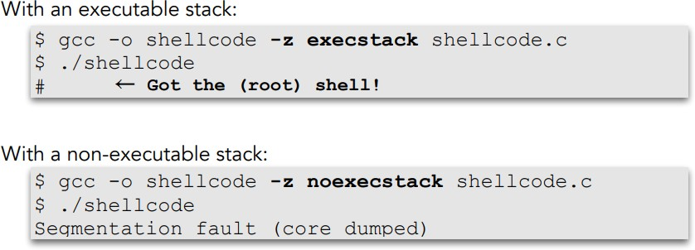
Non-Executable Stack
THE STACK
Malicious Code
NOP NOP NOP ONP
Arguments
Return Address
Previous frame pointer
buffer[99] . . . . . buffer[0]
In a normal program, executable code is not put on the stack
Non-Executable Stack: Writeable areas of program data & are not executable

Slide 22
Non-Executable Stack
THE STACK
Malicious Code
NOP NOP NOP ONP
Arguments
Return Address
Previous frame pointer
buffer[99] . . . . . buffer[0]
Non-Executable Stack: Writeable areas of program data & are not executable
This does not prevent buffer overflow, however
Instead of injecting our own code,
we could….

Slide 23
Non-Executable Stack
THE STACK
Malicious Code
NOP NOP NOP ONP
Arguments
Return Address
Previous frame pointer
buffer[99] . . . . . buffer[0]
Non-Executable Stack: Writeable areas of program data & are not executable
This does not prevent buffer overflow, however
Instead of injecting our own code,
jump to existing code
Which existing code?

Slide 24
Non-Executable Stack
Instead of injecting our own code, we will jump to existing code
Libc Shared Library
Printf
fopen
Malloc
…
………
Arguments
Return Address
Previous frame pointer
Executable

Slide 25
Non-Executable Stack
Instead of injecting our own code, we will jump to existing code
Libc Shared Library
Printf
fopen
Malloc
…
system()
Arguments
Return Address
Previous frame pointer
Executable

Slide 26
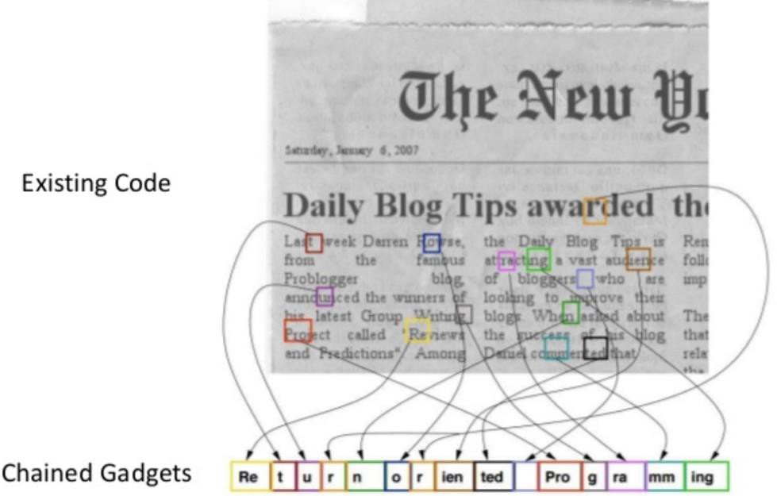
Return-to-libc Attack
Libc Shared Library
Printf
fopen
Malloc
…
system()
(Bypass for non-executable stack)
Arguments
Return Address
Previous frame pointer
Construct Payload using code and data that is already on the system

Slide 27
Return-to-libc Attack
Libc Shared Library
Printf
fopen
Malloc
…
system()
(Bypass for non-executable stack)
Arguments
Return Address
Previous frame pointer
Goal: Run the command
system(“bin/sh”)
General Plan of Attack for Return-to-Lib
1. Find address of system()
Overwrite the return address with system()’s address
2. Find the address of the “/bin/sh” string
To get system() to run this command
3. Construct arguments for system()
To find the location in the stack to place the address to the “/bin/sh” string (arg for system())

Slide 28
Return-to-libc Attack
Libc Shared Library
Printf
fopen
Malloc
…
system()
(Bypass for non-executable stack)
Arguments
Return Address
Previous frame pointer
Goal: Run the command
system(“bin/sh”)
General Plan of Attack for Return-to-Lib
1. Find address of system()
Overwrite the return address with system()’s address

Slide 29
Return-to-libc Attack
Libc Shared Library
Printf
fopen
Malloc
…
system()
(Bypass for non-executable stack)
Arguments
Return Address
Previous frame pointer
Goal: Run the command
system(“bin/sh”)
General Plan of Attack for Return-to-Lib
1. Find address of system()
Overwrite the return address with system()’s address
This can be found by using gdb

Slide 30
Return-to-libc Attack
Libc Shared Library
Printf
fopen
Malloc
…
system()
(Bypass for non-executable stack)
Arguments
Return Address
Previous frame pointer
Goal: Run the command
system(“bin/sh”)
General Plan of Attack for Return-to-Lib
1. Find address of system()
Overwrite the return address with system()’s address
2. Find the address of the “/bin/sh” string
To get system() to run this command

Slide 31
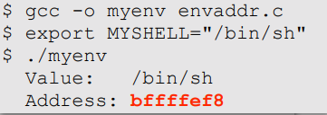
Return-to-libc Attack
Libc Shared Library
Printf
fopen
Malloc
…
system()
(Bypass for non-executable stack)
Arguments
Return Address
Previous frame pointer
Goal: Run the command
system(“bin/sh”)
General Plan of Attack for Return-to-Lib
1. Find address of system()
Overwrite the return address with system()’s address
2. Find the address of the “/bin/sh” string
To get system() to run this command
We can define an environment variable that has the value “bin/sh”
The environment variable gets loaded into the program and placed onto the stack

Slide 32
Return-to-libc Attack
Libc Shared Library
Printf
fopen
Malloc
…
system()
(Bypass for non-executable stack)
Arguments
Return Address
Previous frame pointer
Goal: Run the command
system(“bin/sh”)
General Plan of Attack for Return-to-Lib
1. Find address of system()
Overwrite the return address with system()’s address
2. Find the address of the “/bin/sh” string
To get system() to run this command

Slide 33
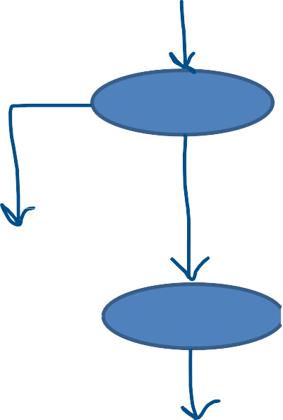
Return-to-libc Attack
Libc Shared Library
Printf
fopen
Malloc
…
system()
(Bypass for non-executable stack)
Arguments
Return Address
Previous frame pointer
Goal: Run the command
system(“bin/sh”)
General Plan of Attack for Return-to-Lib
1. Find address of system()
Overwrite the return address with system()’s address
Remember that system(“/bin/ls”) will fork and spawn a new process
./stack
2. Find address of “/bin/sh” string
To get system() to run this command
/bin/sh
./stack
3. Construct arguments for system()
To find the location in the stack to place the address to the “/bin/sh” string (arg for system())
**We also need to find the address for the exit() function so the original process can terminate gracefully
exit()

Slide 34
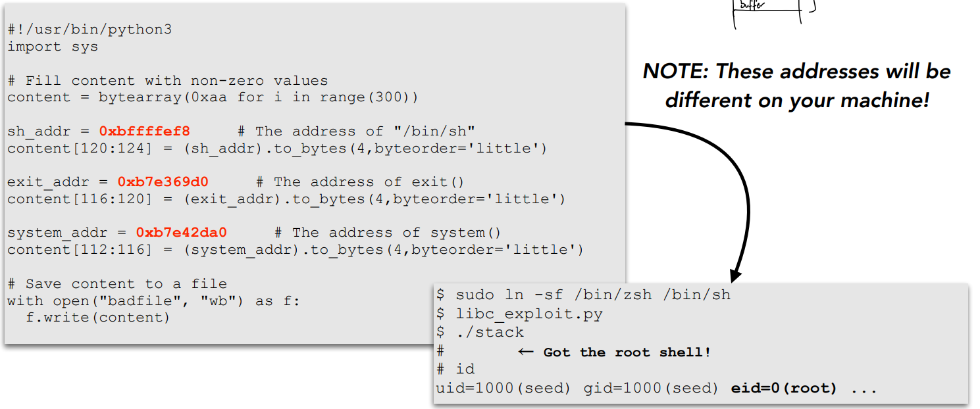
Return-to-libc Attack
Libc Shared Library
Printf
fopen
Malloc
…
system()
(Bypass for non-executable stack)
Arguments
Return Address
Previous frame pointer
Goal: Run the command
system(“bin/sh”)
In this example, we are only chaining two functions together, but we can generalize this to chain multiple function calls
ex. bof() → setuid(0) → /bin/sh → exit

Slide 35
Return-to-libc Attack
Libc Shared Library
Printf
fopen
Malloc
…
system()
(Bypass for non-executable stack)
Arguments
Return Address
Previous frame pointer
Goal: Run the command
system(“bin/sh”)
In this example, we are only chaining two functions together, but we can generalize this to chain multiple function calls
ex. bof() → setuid(0) → /bin/sh → exit
(This attack is much more complicated than a normal BOF attack, and we won’t cover it in this class)

Slide 36
Buffer Overflow Countermeasures
Safe Shell (/bin/dash)
Address space layout randomization (ASLR)
Bypass: Add shellcode to our payload the sets RUID = 0
Bypass: Brute-Force / Wait to get lucky
Stack Guard
Bypass: Don’t worry about it (advanced memory manipulation, PRNG manipulation)
•
Non executable stack
Bypass: Return-to-libc, Return-Oriented Programming (ROP)

Slide 37
“What ifs”
In our basic buffer overflow attack (stack.c), we have the privilege of having important information that made our attack much easier
Size of buffer
Location of buffer
Location of EBP
Let’s look at a scenario where we don’t know some of this information

Slide 38
Unknown Buffer Size
THE STACK
… previous stack frames…
Arguments
Return Address
Previous frame pointer
buffer[99] . . . . . buffer[0]
The size of the buffer is important, because we need it in order to determine where to place the new return address
buffer[???]
buffer[99]
.
.
.
.
.
buffer[0]

Slide 39
Unknown Buffer Size
THE STACK
… previous stack frames…
Arguments
Return Address
Previous frame pointer
buffer[99] . . . . . buffer[0]
The size of the buffer is important, because we need it in order to determine where to place the new return address
Solution: Instead of placing the new return address at one specific, let’s place it at many locations, and hopefully one of the locations works
buffer[???]
buffer[99]
.
.
.
.
.
buffer[0]

Slide 40
Unknown Buffer Size
THE STACK
… previous stack frames…
Arguments
Return Address
Previous frame pointer
buffer[99] . . . . . buffer[0]
The size of the buffer is important, because we need it in order to determine where to place the new return address
New Return Address
Solution: Instead of placing the new return address at one specific, let’s place it at many locations, and hopefully one of the locations works
New Return Address
New Return Address
buffer[???]
New Return Address
buffer[99]
.
.
.
.
.
buffer[0]
This process is known as Address Spraying
New Return Address
New Return Address
From the program’s behavior, we might be able to derive a range of possible buffer sizes, so place the same return address at all possible return address locations
New Return Address

Slide 41
Unknown Buffer Location
THE STACK
… previous stack frames…
Arguments
Return Address
Previous frame pointer
buffer[99] . . . . . buffer[0]
The location of the buffer is important, because we need it in order to determine where to place the new return address
We also used the buffer location in order figure out what our guess should be, so now we need to figure out what we should guess
buffer[99]
buffer[99]
.
.
.
.
.
buffer[0]
Suppose that we do know the range of possible starting locations [A, A + 100]

Slide 42











Unknown Buffer Location
Malicious Code
The location of the buffer is important, because we need it in order to determine where to place the new return address
NOP NOP NOP NOP NOP NOP
Solution: We will still use address spraying, but now we need to derive the possible location(s) of our NOP sled
NOP NOP NOP NOP NOP NOP
NOP NOP NOP NOP NOP NOP
If we know we insert 150 bytes of NOPs after the return address, we can iterate through all possible locations of our NOP sled
New return address
New Return Address
NOP NOP NOP NOP NOP NOP
Buffer Address | NOP Section
A | [A + 120, A +270]
A + 4 | [A + 124, A +274]
A + 8 | [A + 128, A +278]
…
A + 100 | [A + 220, A +370]
New Return Address
NOP NOP NOP NOP NOP NOP NOP NOP NOP NOP NOP NOP NOP NOP NOP NOP NOP NOP NOP NOP NOP NOP NOP NOP NOP NOP NOP NOP NOP NOP NOP NOP NOP NOP NOP
New Return Address
New Return Address
New Return Address
New Return Address
New Return Address

Slide 43
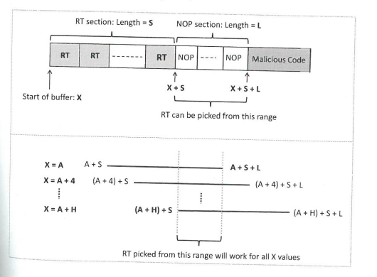
Unknown Buffer Location
Buffer Address | NOP Section
A | [A + 120, A +270]
A + 4 | [A + 124, A +274]
A + 8 | [A + 128, A +278]
…
A + 100 | [A + 220, A +370]
Malicious Code
NOP NOP NOP NOP NOP NOP
NOP NOP NOP NOP NOP NOP
NOP NOP NOP NOP NOP NOP
New return address
New Return Address
NOP NOP NOP NOP NOP NOP
Try to find a NOP section range that will work for ALL values of A
New Return Address
NOP NOP NOP NOP NOP NOP NOP NOP NOP NOP NOP NOP NOP NOP NOP NOP NOP NOP NOP NOP NOP NOP NOP NOP NOP NOP NOP NOP NOP NOP NOP NOP NOP NOP NOP
New Return Address
New Return Address
New Return Address
New Return Address
New Return Address

Slide 44
Small Buffer Size
Main() Stack Frame
In a buffer of 517, we can fit quite a lot of stuff in our payload,
But what if the buffer is small, or if we are not allowed to overflow into other stack frames ?
… previous stack frames…
Arguments
Return Address
Previous frame pointer
buffer[99] . . . . . buffer[0]
Important Function’s Stack Frame
BOF’s Stack Frame
In 64-bit systems, we are not able to overflow stuff after the return address
New Return Address
NOP NOP NOP NOP NOP NOP
NOP NOP NOP NOP NOP NOP
Malicious Code
buffer[99]
So, our malicious code needs to be injected below the return address, and have much less space to work with
buffer[99]
.
.
.
.
.
buffer[0]
NOP NOP NOP NOP NOP NOP
NOP NOP NOP NOP NOP NOP
NOP NOP NOP NOP NOP NOP

Slide 45




Small Buffer Size
Main() Stack Frame
In a buffer of 517, we can fit quite a lot of stuff in our payload,
But what if the buffer is small, or if we are not allowed to overflow into other stack frames ?
Important Function’s Stack Frame
NOP
NOP
NOP
NOP
BOF’s Stack Frame
Malicious Code

Slide 46


Small Buffer Size
Main() Stack Frame
Malicious Code
In a buffer of 517, we can fit quite a lot of stuff in our payload,
But what if the buffer is small, or if we are not allowed to overflow into other stack frames ?
Important Function’s Stack Frame
NOP
NOP
NOP
NOP
BOF’s Stack Frame
Solution: Place the malicious code in another stack frame
(As long as we can figure out its address, we really do not care if the malicious code is in the BOF stack frame)

Slide 47
Lessons Learned?

Slide 48
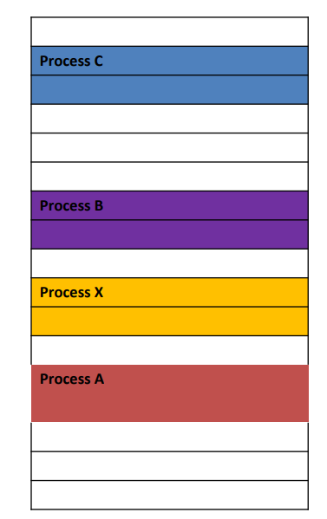


Address spaces for processes should be isolated from one another,
and there should be no interference between two address spaces
Security Principle #3
Lessons Learned
Process D | Buffer
Process A | Overflow

Slide 49




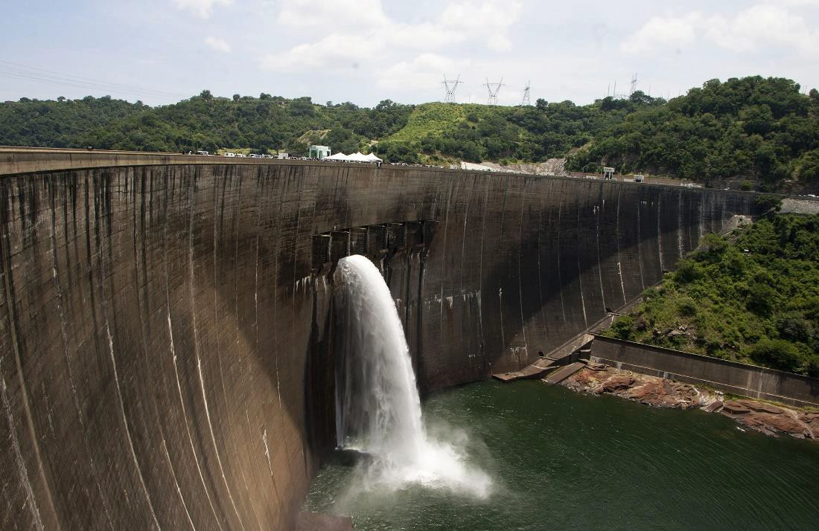
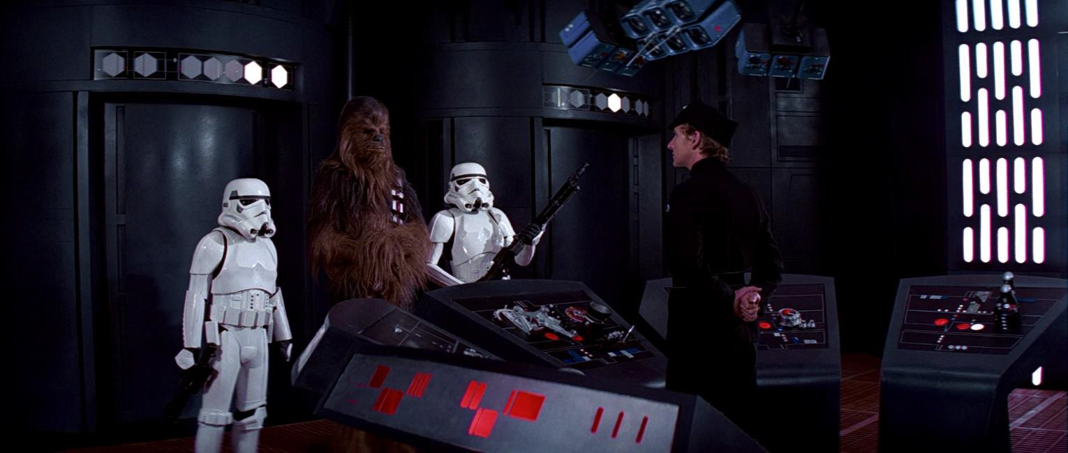
Security Principle #4
In a process or system FAILS for whatever reason, it will default to a
SAFE outcome
Lessons Learned
(Think Stack Guard)

Slide 50
Lab 3

