Slide 1

CSCI 476: Computer Security
Cross Site Scripting (XSS) Attack (Part 2)
Reese Pearsall
Spring 2023
https://www.cs.montana.edu/pearsall/classes/spring2023/476/main.html

Slide 2
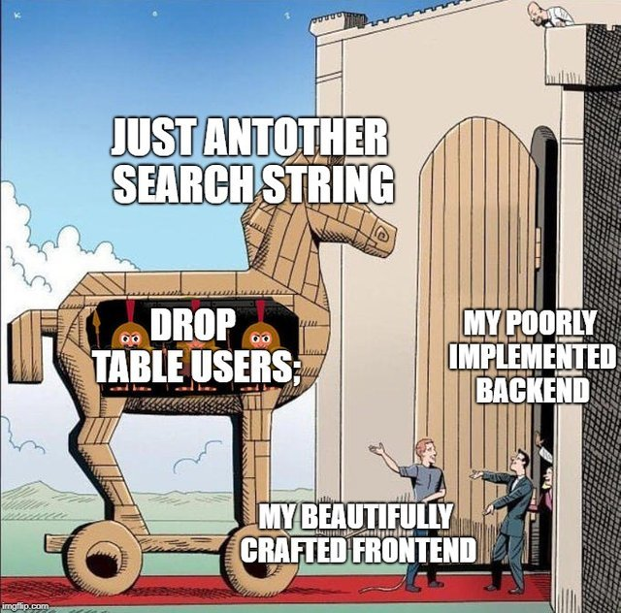
Announcement
Lab 4 (SQL injections) Due Sunday 3/12 @ 11:59 PM
Friday (3/10) will be a help session for lab 4 (no lecture)

Slide 3
Our Attacks So far
Shellshock- We were able to execute operating system commands of our choosing (/bin/sh) on someone else’s server due to unsafe environment variable parsing
Buffer Overflow- We were able to execute arbitrary code by hijacking a program that unsafely writes data to the stack
SQL Injection- We were able to run our own arbitrary SQL queries due to unsafe user input handling
XSS – We are able to get someone else’s browser to execute our own JavaScript code due to unsafe input handling and unsafe web communication policies

Slide 4


XSS (Reflective Example)
HTTP Request
GET http://www.website.com?input=???

Slide 5
XSS (Reflective Example)
HTTP Request
GET http://www.website.com?input=hello

Slide 6
XSS (Reflective Example)
HTTP Request
GET http://www.website.com?input=hello
HTTP Response (HTML)
HTML
hello
HTML Gets rendered by browser

Slide 7
XSS (Reflective Example)
HTTP Request
GET http://www.website.com?input=<script>alert(“BAD!”);</script>
HTTP Response (HTML)

Slide 8
XSS (Reflective Example)
HTTP Request
GET http://www.website.com?input=<script>alert(“BAD!”);</script>
HTTP Response (HTML)
HTML
<script> alert(“BAD!”);<script>
HTML Gets rendered by browser
And script is executed!!

Slide 9



XSS (Reflective Example)
HTTP Request
GET http://www.website.com?input=<script>alert(“BAD!”);</script>
HTTP Response (HTML)
Click this link!
HTML
<script> alert(“BAD!”);<script>
In this reflective example, the user typically issues this HTTP request by getting tricked into clicking the link

