Slide 1

CSCI 466: Networks
Lecture 5(?): Transport Layer
Reese Pearsall
Fall 2022
https://www.cs.montana.edu/pearsall/classes/fall2022/466/main.html
*All images are stolen from the internet

Slide 2

Announcements
PA1 Due Monday September 26th
Files must be pushed to a PA1 folder on your GitHub Repo
Video demo is required
Submit your repo link to D2L when finished
Next Friday will be a work day + help session. No Lecture
Got my new laptop today
Wireshark next week!

Slide 3
Announcements
PA1

Slide 4
Announcements
PA1
UDP Example

Slide 5

Application Layer
OSI Model
Presentation Layer
*
Application Layer
Session Layer
*
Messages from Network Applications
Transport Layer
Network Layer
Physical Layer
Data Link Layer
Bits being transmitted over a copper wire
Physical Layer
*In the textbook, they condense it to a 5-layer model, but 7 layers is what is most used

Slide 6
Transport Layer
Provides logical end-to-end communication between application processes
Transport Layer Services
Important Services
Flow Control
Reliability
Segmentation
Error Checking
Addressing
Flow Control
Reliability
Error Checking
Addressing
Segmentation

Slide 7
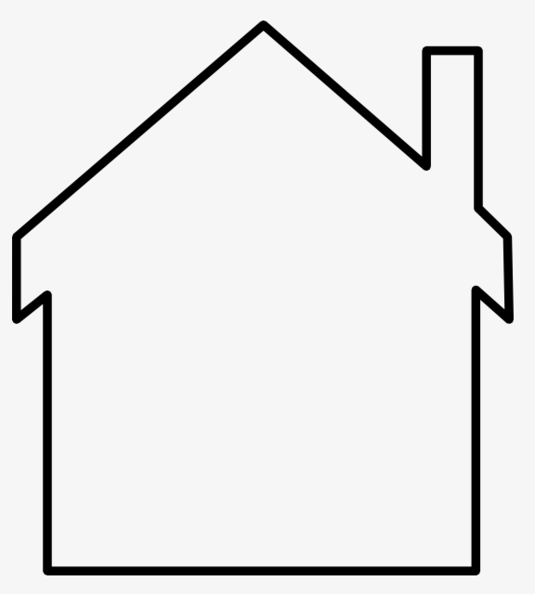



Transport Layer

Slide 8


Transport Layer
Bill
Ann

Slide 9
Transport Layer
Bill
Ann
Bill and Ann are responsible for collecting their siblings mail…

Slide 10


Transport Layer
Bill
Ann
Bill and Ann are responsible for collecting their siblings mail…
And delivering it to the postal service worker

Slide 11
Transport Layer
Bill
Ann
Bill and Ann are responsible for collecting their siblings mail…
And delivering it to the postal service worker

Slide 12
Transport Layer
When new mail arrives, Bill and Ann receive it from the postman and distribute it to the correct cousin
Bill
Ann
Bill and Ann are responsible for collecting their siblings mail…
And delivering it to the postal service worker

Slide 13
Transport Layer
Letters in envelopes = Application messages
Bill
Ann

Slide 14
Transport Layer
Letters in envelopes = Application messages
Cousins = Processes
Bill
Ann

Slide 15
Transport Layer
Letters in envelopes = Application messages
Cousins = Processes
Houses = Hosts/End systems
Bill
Ann

Slide 16
Transport Layer
Letters in envelopes = Application messages
Cousins = Processes
Houses = Hosts/End systems
Ann and Bill = Transport Layer Protocol
Bill
Ann

Slide 17
Transport Layer
Letters in envelopes = Application messages
Cousins = Processes
Houses = Hosts/End systems
Ann and Bill = Transport Layer Protocol
Postal Service = Postal Service
Bill
Ann

Slide 18
Transport Layer
Letters in envelopes = Application messages
Cousins = Processes
Houses = Hosts/End systems
Ann and Bill = Transport Layer Protocol
Postal Service = Postal Service
Bill
Ann

Slide 19
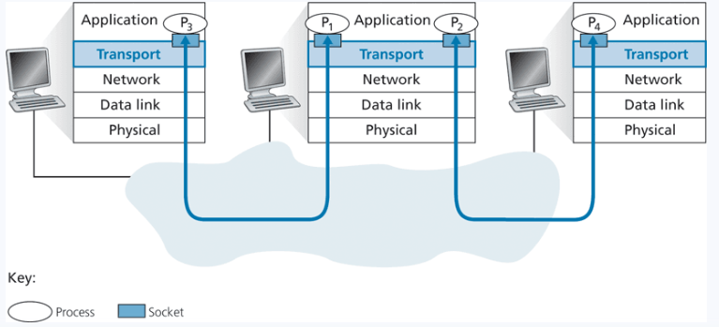
Transport Layer
TCP – Reliable, Connection-oriented transport layer protocol
UDP – Unreliable, connectionless transport layer protocl
Transport layer delivers to sockets

Slide 20
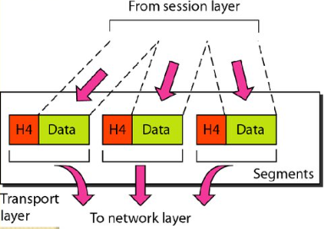
Transport Layer
TCP – Reliable, Connection-oriented transport layer protocol
UDP – Unreliable, connectionless transport layer protocl
Transport layer delivers to sockets
Messages from the Application Layer/Session Layer are split into smaller chunks called segments, and passed into the network layer

Slide 21
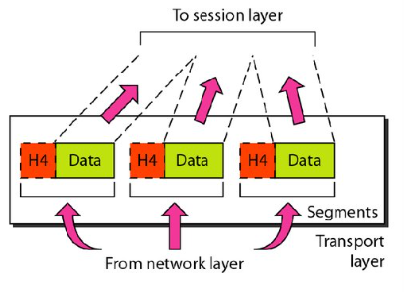
Transport Layer
TCP – Reliable, Connection-oriented transport layer protocol
UDP – Unreliable, connectionless transport layer protocl
Transport layer delivers to sockets
Messages from the network layer arrive as segments. Transport layer must reassemble to send it to the correct process

Slide 22
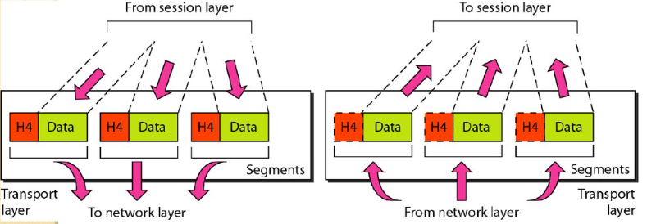
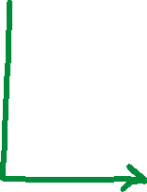
Transport Layer
TCP – Reliable, Connection-oriented transport layer protocol
UDP – Unreliable, connectionless transport layer protocl
Multiplexing is the process of gathering chunks from sockets, encapsulating chunks with header information, and passing the segment into the network layer
Socket
Segment
data
data
header
data
header
data
header
data
data

Slide 23
Transport Layer
TCP – Reliable, Connection-oriented transport layer protocol
UDP – Unreliable, connectionless transport layer protocl
Demultiplexing is the receiving segments from the transport layer and delivering the segment to the correct socket.
Socket
Socket
Socket
header
data
header
data
header
data

Slide 24
Transport Layer
TCP – Reliable, Connection-oriented transport layer protocol
UDP – Unreliable, connectionless transport layer protocl
Demultiplexing is the receiving segments from the transport layer and delivering the segment to the correct socket.
Socket
Socket
Socket
header
data
header
data
header
data
Bill and Ann?

Slide 25
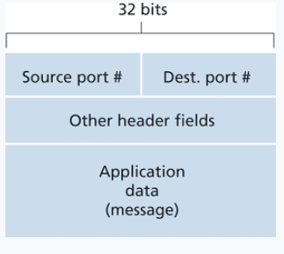
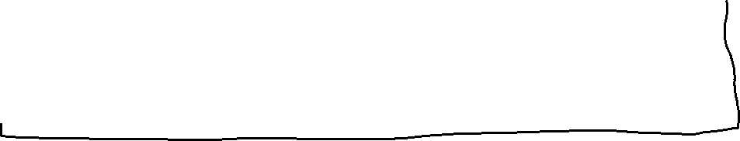
Transport Layer
TCP – Reliable, Connection-oriented transport layer protocol
UDP – Unreliable, connectionless transport layer protocl
Socket
Socket
Socket
Socket
A port is a 16-bit number that is an entrance/exit point of a machine
Socket
Socket
header
data
An active port is associated with a specific process or service
Network Layer

Slide 26
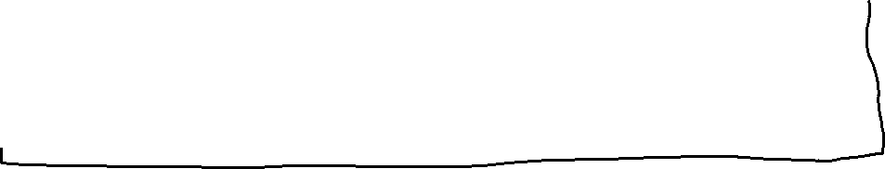
Transport Layer
TCP – Reliable, Connection-oriented transport layer protocol
UDP – Unreliable, connectionless transport layer protocl
Socket
Socket
https://en.wikipedia.org/wiki/List_of_TCP_and_UDP_port_numbers
Socket
Socket
A port is a 16-bit number that is an entrance/exit point of a machine
Socket
Socket
header
data
An active port is associated with a specific process or service
Network Layer

Slide 27



Transport Layer
TCP – Reliable, Connection-oriented transport layer protocol
UDP – Unreliable, connectionless transport layer protocl
Socket
Socket
Socket
Socket
A port is a 16-bit number that is an entrance/exit point of a machine
Socket
Socket
header
data
An active port is associated with a specific process or service
When developing a new application, we need to assigned the application a port number (greater than 1024)
Network Layer

Slide 28
Transport Layer
TCP – Reliable, Connection-oriented transport layer protocol
UDP – Unreliable, connectionless transport layer protocl
Socket
Socket
Socket
Socket
A port is a 16-bit number that is an entrance/exit point of a machine
Socket
Socket
header
data
An active port is associated with a specific process or service
Why does a UDP packet header need a source port??
Network Layer

