Slide 1

CSCI 466: Networks
Lecture 6: UDP and RDT
Reese Pearsall
Fall 2022
https://www.cs.montana.edu/pearsall/classes/fall2022/466/main.html
*All images are stolen from the internet

Slide 2
Announcements
PA1 Due Monday September 26th
Files must be pushed to a PA1 folder on your GitHub Repo
Video demo is required
Submit your repo link to D2L when finished
Next Friday will be a work day + help session. No Lecture

Slide 3
Announcements
PA1

Slide 4
Announcements
PA1
UDP Example

Slide 5

Application Layer
OSI Model
Presentation Layer
*
Application Layer
Session Layer
*
Messages from Network Applications
Transport Layer
Network Layer
Physical Layer
Data Link Layer
Bits being transmitted over some medium
Physical Layer
*In the textbook, they condense it to a 5-layer model, but 7 layers is what is most used

Slide 6
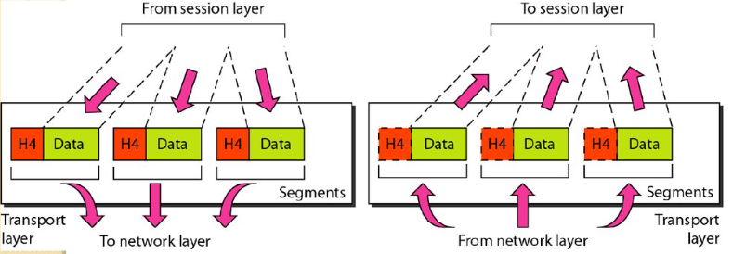
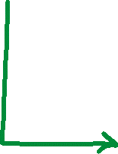
Transport Layer
Multiplexing is the process of gathering chunks from sockets, encapsulating chunks with header information, and passing the segment into the network layer
Demultiplexing is the receiving segments from the transport layer and delivering the segment to the correct socket.
Socket
Segment
data
data
header
data
header
data
header
data
data

Slide 7
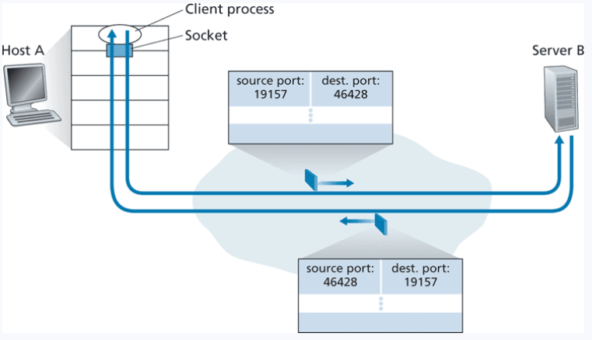
Transport Layer

Slide 8
Transport Layer
UDP sockets are identified by a two-tuple
(destination IP address, destination port number)

Slide 9


Transport Layer
92.7.32.223
8000
Socket
UDP sockets are identified by a two-tuple
92.7.32.223
8000
(destination IP address, destination port number)
( 92.7.32.223, 8000 )

Slide 10
Transport Layer
92.7.32.223
8000
Socket
UDP sockets are identified by a two-tuple
92.7.32.223
8000
(destination IP address, destination port number)
( 92.7.32.223, 8000 )
The socket won’t be able to distinguish between the two endpoints
The two segments will be directed to the same process

Slide 11
Transport Layer
TCP sockets are identified by a four-tuple
A host will demultiplex segments using all of these values
(source IP address, source port number, destination IP address, destination port number)
TCP servers will have a “welcoming socket” before creating the processes' socket

Slide 12
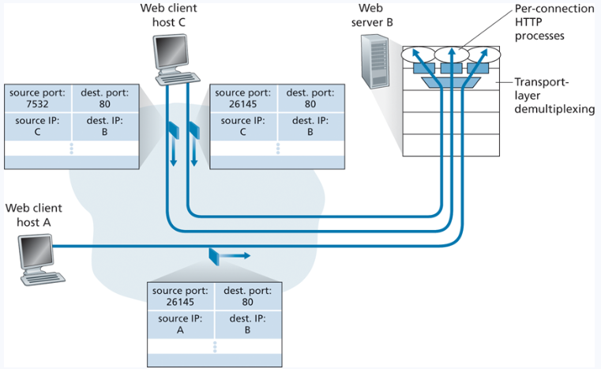
Transport Layer
(source IP address, source port number, destination IP address, destination port number)
TCP sockets are identified by a four-tuple

Slide 13




Transport Layer
(source IP address, source port number, destination IP address, destination port number)
TCP sockets are identified by a four-tuple
These segments have the same dest. port and dest. IP.

Slide 14






Transport Layer
(source IP address, source port number, destination IP address, destination port number)
TCP sockets are identified by a four-tuple
These segments have the same dest. port and dest. IP.
We can now handle concurrent connections using the source information

Slide 15
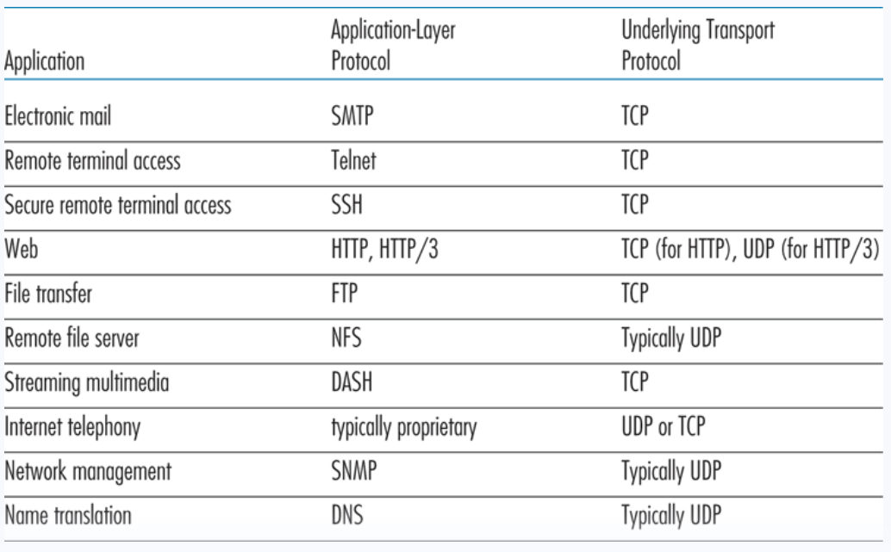
Transport Layer

Slide 16
Transport Layer
UDP
“Do as little as possible and give it our best effort”
Bare bones and connectionless
Advantages of UDP:
Immediate transmission
No connection establishment
Lower memory requirements
No connection state, 8B for UDP vs 20B for TCP
Disadvantages
No congestion control
No guarantee for in-order delivery
Reliability and Flow control
QUIC (Quick UDP Internet Connection) is a transport layer protocol that adds reliability to UDP

Slide 17
Transport Layer
UDP
“Do as little as possible and give it our best effort”
16 bits
16 bits
Source Port #
Dest. Port #
UDP Header
Length
Checksum
UDP Segment
Data

Slide 18
Transport Layer
UDP
“Do as little as possible and give it our best effort”
16 bits
16 bits
UDP provides a checksum that is used to determine whether bits within the UDP segment have been altered
Source Port #
Dest. Port #
Length
Checksum
It is the sum of all n bit words in the segment followed by the 1s complement
Data

Slide 19
Transport Layer
UDP
“Do as little as possible and give it our best effort”
16 bits
16 bits
0110011001100000
0101010101010101
1000111100001100
Source Port #
Dest. Port #
Length
Checksum
Data

Slide 20
Transport Layer
UDP
“Do as little as possible and give it our best effort”
16 bits
16 bits
0110011001100000
0101010101010101
1000111100001100
Source Port #
Dest. Port #
Length
Checksum
0110011001100000
0101010101010101
1011101110110101
Data

Slide 21
Transport Layer
UDP
“Do as little as possible and give it our best effort”
16 bits
16 bits
0110011001100000
0101010101010101
1000111100001100
Source Port #
Dest. Port #
Length
Checksum
1011101110110101
1000111100001100
0100101011000010
Data

Slide 22
Transport Layer
UDP
“Do as little as possible and give it our best effort”
16 bits
16 bits
0110011001100000
0101010101010101
1000111100001100
Source Port #
Dest. Port #
Length
Checksum
1011101110110101
1000111100001100
0100101011000010
1011010100111101 = checksum
Data
(one’s complement)

Slide 23
Transport Layer
UDP
“Do as little as possible and give it our best effort”
16 bits
16 bits
0110011001100000
0101010101010101
1000111100001100
1011010100111101
Source Port #
Dest. Port #
Length
Checksum
Data
Receiving packet: Sum up all 16-bit words → 1111111111111111
If there are zeros, errors were introduced into the packet

Slide 24
Transport Layer
UDP
“Do as little as possible and give it our best effort”
16 bits
16 bits
Source Port #
Dest. Port #
Why do error checking here?
Length
Checksum
End-to-end principle states that since certain functionality such as error detection, must be implemented on an end-end bases
Data
Functionality places at the lower levels may be redundant or of little value when compared to the cost of providing them at a higher level

Slide 25
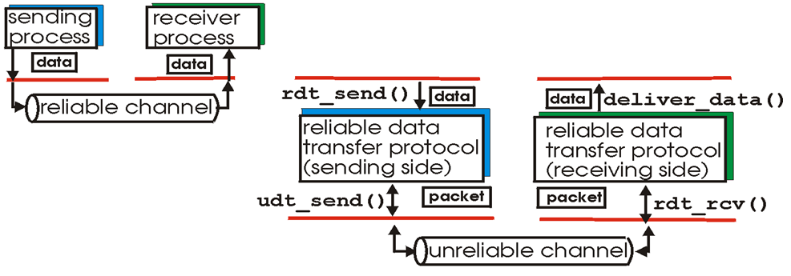
Transport Layer
Reliable Data Transfer
Application
Transport
Network
Characteristics of unreliable channel will determine complexity of reliable data transfer protocol (rdt)
Things to consider:
Corruption
Loss of packets
Duplicate delivery
What are some ways in which the network channel can be unreliable?

Slide 26

Transport Layer
Reliable Data Transfer

Slide 27
Transport Layer
Reliable Data Transfer
Bruce Lee FSM
Event causing state transition
Wait for ball
in_court(ball) == True
send_it(ball)
Actions taken on state transition

Slide 28

Transport Layer
Reliable Data Transfer 1.0
RDT 1.0
Assumptions:
Unidirectional long data flows
Perfectly reliable channel
No bit errors
No packet loss
No packet reordering

Slide 29
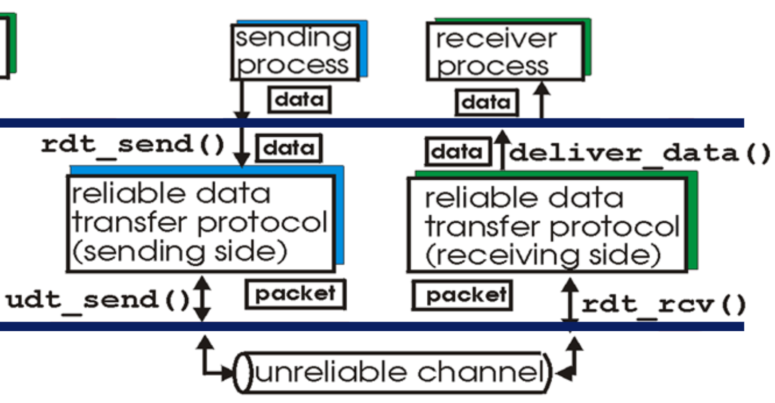
Transport Layer
Reliable Data Transfer 1.0
RDT 1.0
Event causing state transition
Sender
Assumptions:
Unidirectional long data flows
Perfectly reliable channel
No bit errors
No packet loss
No packet reordering
Wait for call from app
rdt_send(data)
packet = make_pkt(data)
udt_send(packet)
Actions taken on state transition

Slide 30
Transport Layer
Reliable Data Transfer 1.0
RDT 1.0
Event causing state transition
Sender
Assumptions:
Unidirectional long data flows
Perfectly reliable channel
No bit errors
No packet loss
No packet reordering
Wait for call from app
rdt_send(data)
packet = make_pkt(data)
udt_send(packet)
Actions taken on state transition
Receiver
Wait for call from network
rdt_rcv(packet)
data = extract(packet)
deliver_data(data)

Slide 31
Transport Layer
Reliable Data Transfer 2.0
RDT 2.0
Potential for bit errors
How can we detect errors?
1110
???
0010
Reliable Channel
Unreliable Channel
Reliable Channel

Slide 32
Transport Layer
Reliable Data Transfer 2.0
RDT 2.0
Potential for bit errors
How can we detect errors?
-Checksum
1110
???
0010
Reliable Channel
Unreliable Channel
Reliable Channel

Slide 33
Transport Layer
Reliable Data Transfer 2.0
RDT 2.0
Potential for bit errors
How can we detect errors?
-Checksum
What is a good way to handle and prevent errors?
1110
???
0010
Reliable Channel
Unreliable Channel
Reliable Channel

Slide 34
Transport Layer
Reliable Data Transfer 2.0
RDT 2.0
Potential for bit errors
How can we detect errors?
-Checksum
What is a good way to handle and prevent errors?
- Acknowledged packet, Ask for retransmit if needed
1110
???
0010
Reliable Channel
Unreliable Channel
Reliable Channel

Slide 35

Transport Layer
Reliable Data Transfer 2.0
RDT 2.0
How can we detect errors?
-Checksum
What is a good way to handle and prevent errors?
- Acknowledged packet, Ask for retransmit if needed
Potential for bit errors
Stop-and-wait: sender sends one packet, then waits for receiver response
Sender
rdt_send(data)
sndpkt = make_pkt(data, checksum)
udt_send(sndpkt)
Wait for call from appl

Slide 36

Transport Layer
Reliable Data Transfer 2.0
RDT 2.0
How can we detect errors?
-Checksum
What is a good way to handle and prevent errors?
- Acknowledged packet, Ask for retransmit if needed
Potential for bit errors
Stop-and-wait: sender sends one packet, then waits for receiver response
Sender
rdt_send(data)
sndpkt = make_pkt(data, checksum)
udt_send(sndpkt)
rdt_rcv(rcvpkt) &&
isNAK(rcvpkt)
Wait for call from appl
Wait for ACK or NAK
udt_send(sndpkt)

Slide 37


Transport Layer
Reliable Data Transfer 2.0
RDT 2.0
How can we detect errors?
-Checksum
What is a good way to handle and prevent errors?
- Acknowledged packet, Ask for retransmit if needed
Potential for bit errors
Stop-and-wait: sender sends one packet, then waits for receiver response
Sender
rdt_send(data)
sndpkt = make_pkt(data, checksum)
udt_send(sndpkt)
rdt_rcv(rcvpkt) &&
isNAK(rcvpkt)
Wait for call from appl
Wait for ACK or NAK
udt_send(sndpkt)
rdt_rcv(rcvpkt) && isACK(rcvpkt)
Λ

Slide 38


Transport Layer
Reliable Data Transfer 2.0
RDT 2.0
How can we detect errors?
-Checksum
What is a good way to handle and prevent errors?
- Acknowledged packet, Ask for retransmit if needed
Potential for bit errors
Stop-and-wait: sender sends one packet, then waits for receiver response
Receiver
rdt_rcv(rcvpkt) && corrupt(rcvpkt)
rdt_send(data)
udt_send(NAK)
Sender
sndpkt = make_pkt(data, checksum)
udt_send(sndpkt)
Wait for ACK or NAK
rdt_rcv(rcvpkt) &&
isNAK(rcvpkt)
Wait for call from net
Wait for call from appl
udt_send(sndpkt)
rdt_rcv(rcvpkt) && isACK(rcvpkt)
rdt_rcv(rcvpkt) && !corrupt(rcvpkt)
Λ
data = extract(packet)
deliver_data(data)
udt_send(ACK)

Slide 39


Transport Layer
Reliable Data Transfer 2.0
RDT 2.0
How can we detect errors?
-Checksum
What is a good way to handle and prevent errors?
- Acknowledged packet, Ask for retransmit if needed
Potential for bit errors
Stop-and-wait: sender sends one packet, then waits for receiver response
Receiver
Sender
What happens if ACK/NAK Corrupted?
Duplicate delivery, or no retransmission
Solution?
Retransmit is CORRUPT packet received
How to deal we duplicate Packets?
→ ???
rdt_rcv(rcvpkt) && corrupt(rcvpkt)
rdt_send(data)
udt_send(NAK)
sndpkt = make_pkt(data, checksum)
udt_send(sndpkt)
Wait for ACK or NAK
rdt_rcv(rcvpkt) &&
isNAK(rcvpkt)
Wait for call from net
Wait for call from appl
udt_send(sndpkt)
rdt_rcv(rcvpkt) && isACK(rcvpkt)
rdt_rcv(rcvpkt) && !corrupt(rcvpkt)
Λ
data = extract(packet)
deliver_data(data)
udt_send(ACK)

Slide 40
Transport Layer
Reliable Data Transfer 2.0
RDT 2.0
How can we detect errors?
-Checksum
What is a good way to handle and prevent errors?
- Acknowledged packet, Ask for retransmit if needed
Potential for bit errors
Stop-and-wait: sender sends one packet, then waits for receiver response
Receiver
Sender
What happens if ACK/NAK Corrupted?
Duplicate delivery, or no retransmission
Solution?
Retransmit is CORRUPT packet received
How to deal we duplicate Packets?
→ Sequence Number
rdt_rcv(rcvpkt) && corrupt(rcvpkt)
rdt_send(data)
udt_send(NAK)
sndpkt = make_pkt(data, checksum)
udt_send(sndpkt)
Wait for ACK or NAK
rdt_rcv(rcvpkt) &&
isNAK(rcvpkt)
Wait for call from net
Wait for call from appl
udt_send(sndpkt)
rdt_rcv(rcvpkt) && isACK(rcvpkt)
rdt_rcv(rcvpkt) && !corrupt(rcvpkt)
Λ
data = extract(packet)
deliver_data(data)
udt_send(ACK)

Slide 41
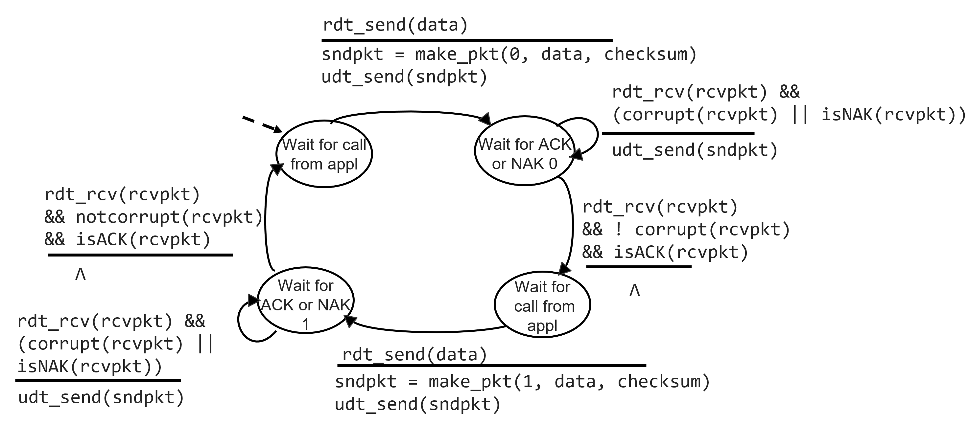
Transport Layer
Reliable Data Transfer 2.1
RDT 2.1
Stop-and-wait: sender sends one packet, then waits for receiver response
Potential for bit errors and garbled ACKs
(We only need 0 or 1 for the sequence #)

Slide 42
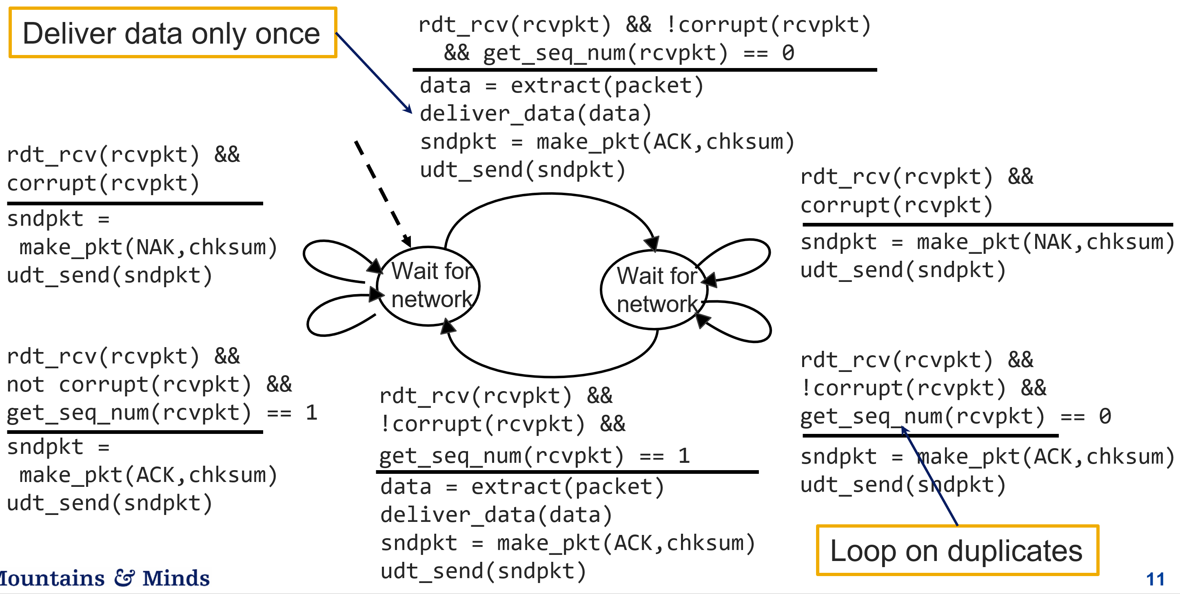
Transport Layer
Reliable Data Transfer 2.1
RDT 2.1
Stop-and-wait: sender sends one packet, then waits for receiver response
Potential for bit errors and garbled ACKs

