Slide 1

CSCI 466: Networks
Lecture 7: Transport Layer Wrap-up
Reese Pearsall
Fall 2022
https://www.cs.montana.edu/pearsall/classes/fall2022/466/main.html
*All images are stolen from the internet

Slide 2
Announcements
PA2 Due Wednesday October 19th
Files must be pushed to a PA2 folder on your GitHub Repo
(NEW) BOTH MEMBERS MUST SUBMIT A REPO LINK TO D2L
Video demo with commentary is required
GLHF
October is very busy for Reese
Reese is out of the country 10/13 – 10/18
No class next Friday (10/14)→ Work day for PA2
No class next next Monday (10/17)
I will still be reachable by email and discord
Extra Credit survey still available !!
Virtual class on Monday 10/23

Slide 3


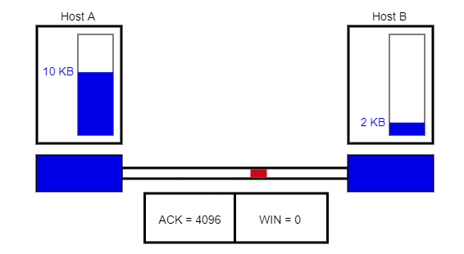


TCP Congestion Control
We also want to make sure we don’t congest the work!
???
Issues:
If the network is congested, we want to slow down our sending rate
If the network is not congested, we should try to send more stuff
TCP sends back amount of available buffer space in the receiver
This helps make sure we don’t overwhelm the receiver

Slide 4


TCP Congestion Control
We also want to make sure we don’t congest the work!
???
Issues:
If the network is congested, we want to slow down our sending rate
If the network is not congested, we should try to send more stuff
TCP sends back amount of available buffer space in the receiver
This helps make sure we don’t overwhelm the receiver
From the sender perspective, how could we measure how congested the network is?

Slide 5
TCP Congestion Control
We also want to make sure we don’t congest the work!
???
Issues:
If the network is congested, we want to slow down our sending rate
If the network is not congested, we should try to send more stuff
TCP sends back amount of available buffer space in the receiver
This helps make sure we don’t overwhelm the receiver
Some ways we could measure how congested the network is
-See how many dropped packets we are getting
-Amount of duplicate ACKs received
-Amount of UnAcked packets

Slide 6
TCP Congestion Control
We also want to make sure we don’t congest the work!
TCP is self-clocking
???
TCP sender also has a congestion window, which controls the amount of unAck’d that can be sent out
The amount of unacknowledged data at a sender may not exceed the minimum of the congestion window and receiving window

Slide 7
TCP Congestion Control
We also want to make sure we don’t congest the work!
TCP is self-clocking
???
TCP sender also has a congestion window, which controls the amount of unAck’d that can be sent out
If TCP notices a loss event, it will slow down the sending rate

Slide 8
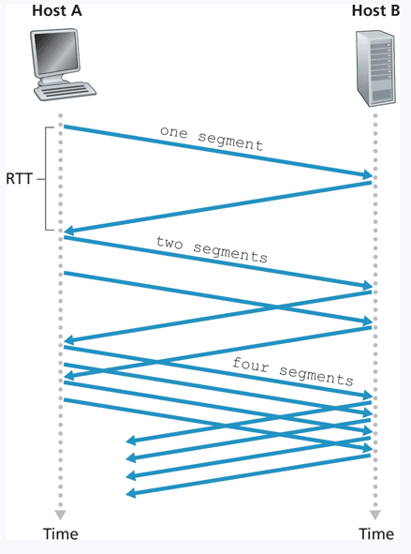
TCP Congestion Control Algorithm
TCP Algorithm to prevent network congestion
Slow Start
Congestion Avoidance
Fast recovery
Start sending slow, but exponentially grows up to a threshold

Slide 9
TCP Congestion Control Algorithm
TCP Algorithm to prevent network congestion
Slow Start
Congestion Avoidance
Fast recovery
Linearly increase congestion window for each ACK received

Slide 10
TCP Congestion Control Algorithm
TCP Algorithm to prevent network congestion
Slow Start
Congestion Avoidance
Fast recovery
Upon knowledge of packet loss, throttle the TCP connection and start off slow again

Slide 11
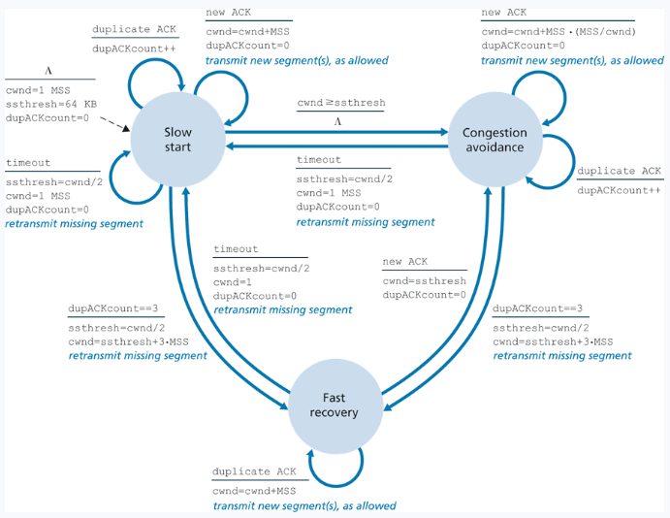

Slide 12
TCP Congestion Control Algorithm
Animation time!
https://media.pearsoncmg.com/aw/ecs_kurose_compnetwork_7/cw/content/interactiveanimations/tcp-congestion/index.html
TCP Algorithm to prevent network congestion
Slow Start
Congestion Avoidance
Fast recovery
Upon knowledge of packet loss, throttle the TCP connection and start off slow again

Slide 13
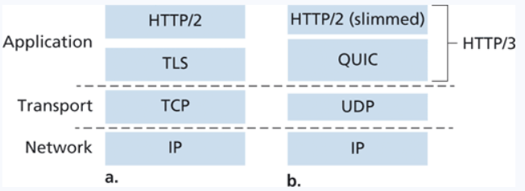
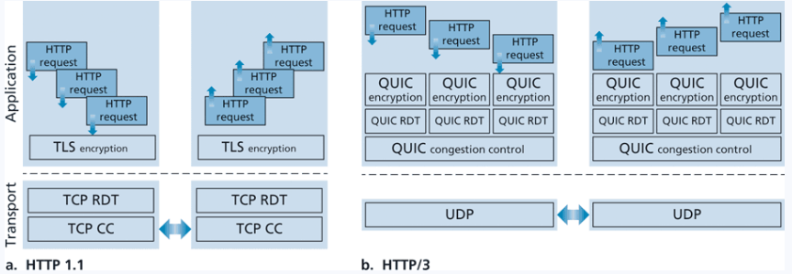
Current transport layer implementation
Transport layer protocols and congestion control is still a heavily researched area!

Slide 14
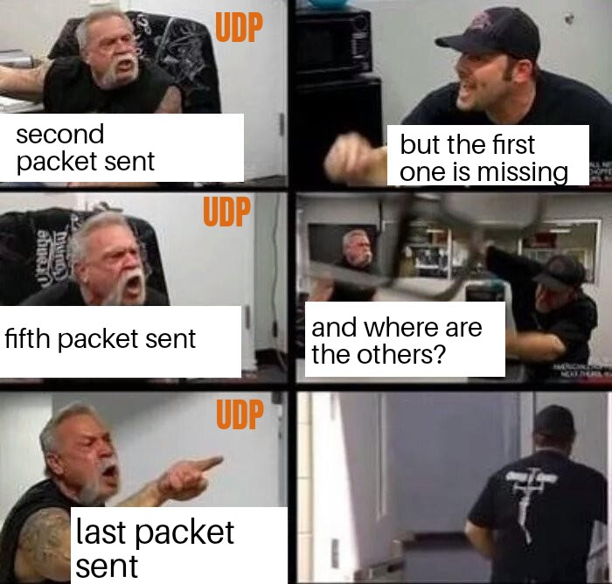

FIN

