Slide 1

CSCI 466: Networks
Network Layer – Routing (Control Plane)
Reese Pearsall Fall 2022
https://www.cs.montana.edu/pearsall/classes/fall2022/466/main.html
*All images are stolen from the internet
1

Slide 2
Announcements
NO CLASS on Monday (10/24)
Email/DM me if you need to chat or have questions
PA2 due tonight* at 11:59 PM
→ You can submit it any time this weekend without a late pass and you won’t lose points ☺
HW2 Released. Due one week from today (10/28)

Slide 3
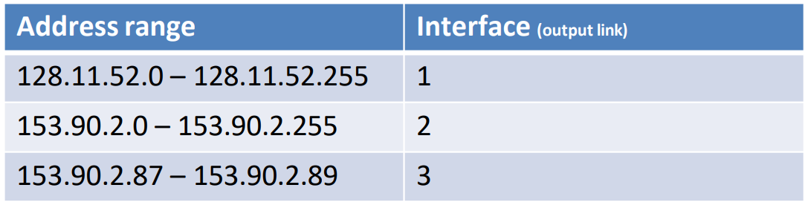
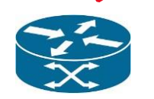
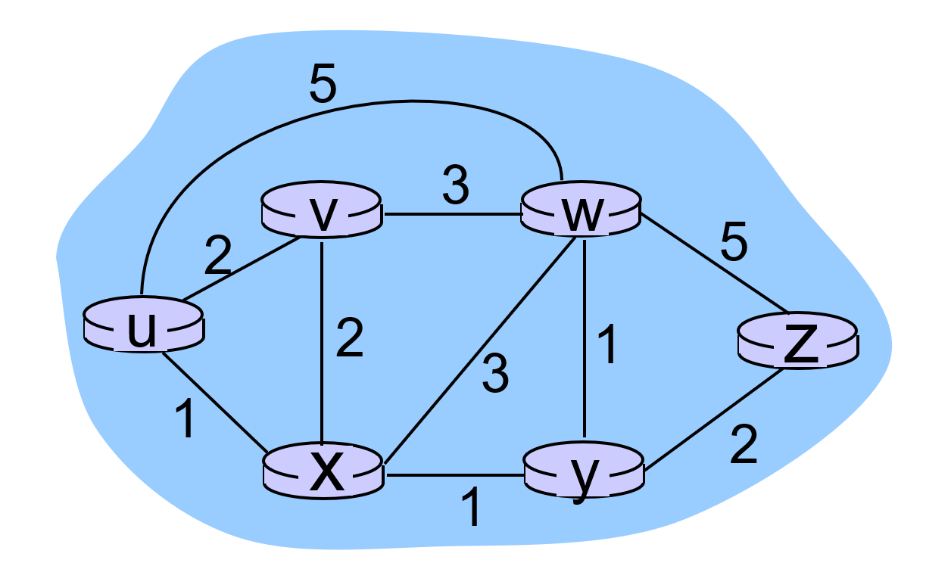
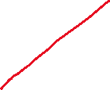
Forwarding refers to moving packets from a router’s input to appropriate router output, and is implemented in the data plane.
Ideally, this output links are the most optimal path to get to the destination
Routing refers to determining the route taken by packets from source to destination, and is implemented in the control plane.
What is the best way to get from u to z?

Slide 4
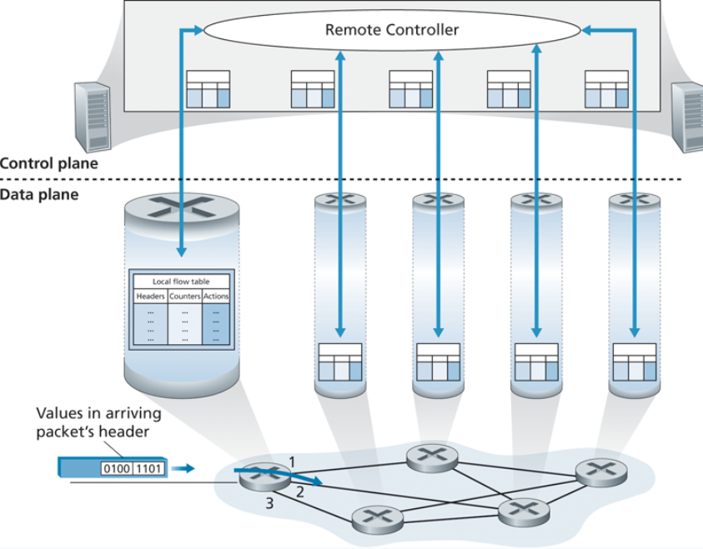
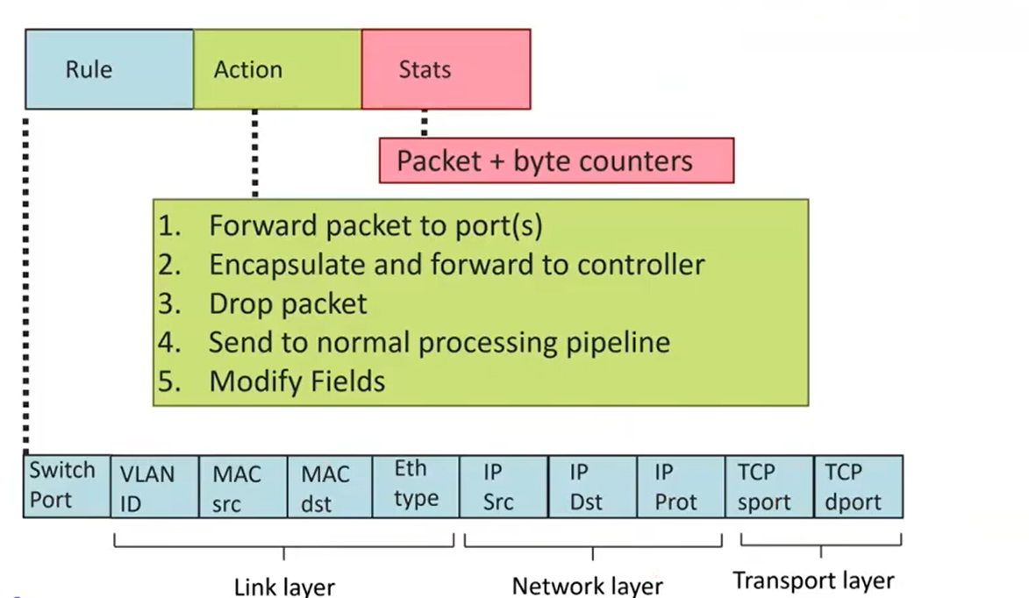
Generalized Forwarding and Software Defines Network (SDN)
Control Plane and Data Plane need to work together in order to create efficient routing tables

Slide 5


Network as a Graph
A graph G consists of N nodes
N = { u v x w y z }
A node could be a host, a router, or a smaller network!
A graph consists of edges E
E₁
(u,v) = 2
E₂
(u,w) = 5
E₆
(x,y) = 1
An example network with 6 hosts/routers
In most cases, edges will also have a cost
What do the costs represent??

Slide 6


Network as a Graph
A graph G consists of N nodes
N = { u v x w y z }
A node could be a host, a router, or a smaller network!
A graph consists of edges E
E₁
(u,v) = 2
E₂
(u,w) = 5
E₆
(x,y) = 1
An example network with 6 hosts/routers
In most cases, edges will also have a cost
What do the costs represent?? Physical distance, time needed, bandwidth, delay

Slide 7




Network as a Graph
The cost from A to B is the sum of the edge weights of the path taken
C(u,z) = 1 + 1 + 2 = 4
C(u,z) = 2 + 3 + 5 = 10
If a packet needs to go from U to Z, we want it to take the most optimal path!
Routing algorithm: algorithm that finds the least cost path
Do you know any?
👀

Slide 8
Link-state Algorithm (Dijkstra’s algorithm)
Dijkstra’s algorithm is a shortest path algorithm that is guaranteed to find a solution
step | N’ | D(v), p(v) | D(w), p(w) | D(x), p(x) | D(y), p(y) | D(z), p(z)
0 | u | 2, u | 5, u | 1, u | N/A | N/A
1
2
3
4
5
Goal: Find shortest path from u to z
N’ is our current optimal path. We must start at u obviously

Slide 9



Link-state Algorithm (Dijkstra’s algorithm)
Dijkstra’s algorithm is a shortest path algorithm that is guaranteed to find a solution
step | N’ | D(v), p(v) | D(w), p(w) | D(x), p(x) | D(y), p(y) | D(z), p(z)
0 | u | 2, u | 5, u | 1, u | N/A | N/A
1
2
3
4
5
Goal: Find shortest path from u to z
N’ is our current optimal path. We must start at u obviously

Slide 10



Link-state Algorithm (Dijkstra’s algorithm)
Dijkstra’s algorithm is a shortest path algorithm that is guaranteed to find a solution
step | N’ | D(v), p(v) | D(w), p(w) | D(x), p(x) | D(y), p(y) | D(z), p(z)
0 | u | 2, u | 5, u | 1, u | N/A | N/A
1
2
3
4
5
The path with the least cost is to X, so x will get added onto our path!
Goal: Find shortest path from u to z

Slide 11
Link-state Algorithm (Dijkstra’s algorithm)
Dijkstra’s algorithm is a shortest path algorithm that is guaranteed to find a solution
step | N’ | D(v), p(v) | D(w), p(w) | D(x), p(x) | D(y), p(y) | D(z), p(z)
0 | u | 2, u | 5, u | 1, u | N/A | N/A
1 | ux
2
3
4
5
Goal: Find shortest path from u to z

Slide 12



Link-state Algorithm (Dijkstra’s algorithm)
Dijkstra’s algorithm is a shortest path algorithm that is guaranteed to find a solution
step | N’ | D(v), p(v) | D(w), p(w) | D(x), p(x) | D(y), p(y) | D(z), p(z)
0 | u | 2, u | 5, u | 1, u | N/A | N/A
1 | ux | 2, u | 4, x |  | 2, x | N/A
2
3
4
5
The shortest path from u to w is now 4 (travel through x) instead of taking the 4 cost path
The shortest path from u to v is still the same
Goal: Find shortest path from u to z

Slide 13

Link-state Algorithm (Dijkstra’s algorithm)
Dijkstra’s algorithm is a shortest path algorithm that is guaranteed to find a solution
step | N’ | D(v), p(v) | D(w), p(w) | D(x), p(x) | D(y), p(y) | D(z), p(z)
0 | u | 2, u | 5, u | 1, u | N/A | N/A
1 | ux | 2, u | 4, x |  | 2, x | N/A
2 | uxy | 2, u | 3, y |  |  | 4,y
3
4
5
We also have a more optimal path to W now
Now that y is on our path, we can now reach z!
Goal: Find shortest path from u to z
Path(u,z) = uxyz
Cost = 1 +1 + 2 = 4

Slide 14
Link-state Algorithm (Dijkstra’s algorithm)
Dijkstra’s algorithm is a shortest path algorithm that is guaranteed to find a solution
step | N’ | D(v), p(v) | D(w), p(w) | D(x), p(x) | D(y), p(y) | D(z), p(z)
0 | u | 2, u | 5, u | 1, u | N/A | N/A
1 | ux | 2, u | 4, x |  | 2, x | N/A
2 | uxy | 2, u | 3, y |  |  | 4,y
3 | uxyv |  | 3,y |  |  | 4,y
4
5
NEW Goal: Find shortest path from u to any node

Slide 15
Link-state Algorithm (Dijkstra’s algorithm)
Dijkstra’s algorithm is a shortest path algorithm that is guaranteed to find a solution
step | N’ | D(v), p(v) | D(w), p(w) | D(x), p(x) | D(y), p(y) | D(z), p(z)
0 | u | 2, u | 5, u | 1, u | N/A | N/A
1 | ux | 2, u | 4, x |  | 2, x | N/A
2 | uxy | 2, u | 3, y |  |  | 4,y
3 | uxyv |  | 3,y |  |  | 4,y
4 | uxyvw |  |  |  |  | 4,y
5 | uxyvwz
NEW Goal: Find shortest path from u to any node

Slide 16
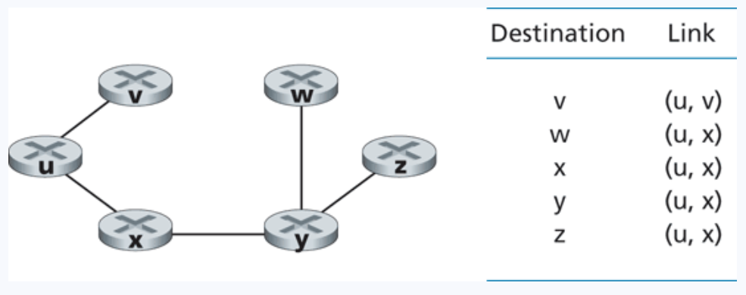
Link-state Algorithm (Dijkstra’s algorithm)
LS complexity = O(N^2)
Issues? Concerns?
Routing table for node u
We will then run the same algorithm on each node to create its forwarding table!

Slide 17
Link-state Algorithm (Dijkstra’s algorithm)
LS is a centralized routing algorithm, which means it has global knowledge about all the edge of the network!
However, it is very likely we will not know information about the network beforehand!
?
?
?
?
Additionally, path costs can frequently change based on network congestion
?
?
?

Slide 18

Have a good weekend

