Slide 1

CSCI 132: Basic Data Structures and Algorithms
Intro to Java (Data Types, Variables, Operators)
Reese Pearsall
Spring 2024
https://www.cs.montana.edu/pearsall/classes/spring2024/132/main.html
*All images are stolen from the internet

Slide 2
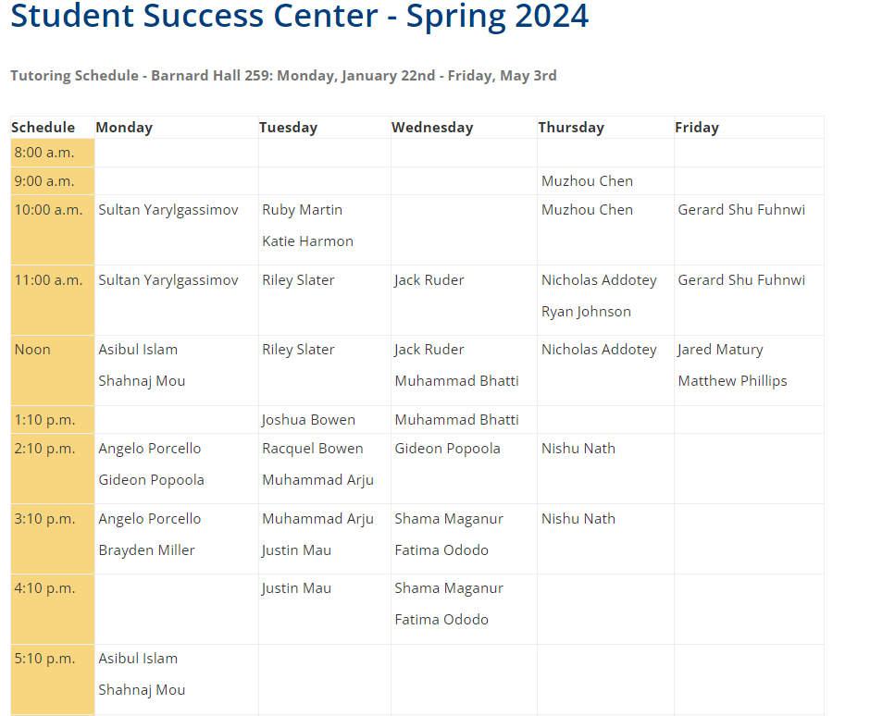
Announcements
Fill out the course questionnaire and join Discord
CSCI 127 Prereq
CSCI 132 TAs
They all have office hours in the Computer Science Student Success Center (Barnard Hall 259)
Section 003- Shama Maganur
Email: shama.maganur@gmail.com
Section 004- Shama Maganur
Email: shama.maganur@gmail.com
Section 005- Fatima Ododo
Email: fatima.ododo@student.montana.edu
Section 006- Fatima Ododo
Email: fatima.ododo@student.montana.edu
There will also be junior/senior CS lab assistants present during lab

Slide 3
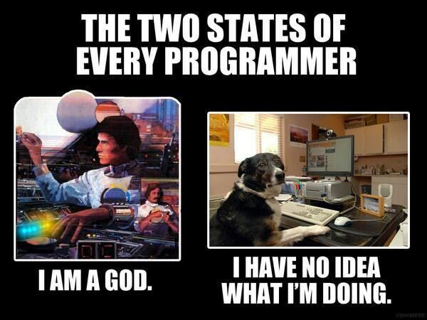

Slide 4
Hello World Program
Java programs always start execution in public static void main(String[] args)
public class HelloWorld {
public static void main(String[] args) {
// This is a comment
System.out.println("Hello World");
}
}
Code needs to go inside of the curley brackets { }
Whitespace does not matter ☺

Slide 5
Declaring Variables
Valid Variable Declaration
int i = 5;
int x;
int num = 125;
char grade = “A”;
boolean flag = true;
Primitive Data Types
int
double
boolean
char
float
When we declare a variable, we must define the datatype as well
Non-Primitive Data Types
String
Invalid Variable Declaration
String s = “Reese”;
String last_name = “Pearsall”;
System.out.println(s + last_name)
i = 5; (data type is not declared)
int 2023year = 2023; (bad variable name)
char final = “F”; (bad variable name)

Slide 6
Using the plus operator (+) between two values that are Strings will result in String concatenation
Operators
+ (Addition)
- (Subtraction)
* (Multiplication)
/ (Division)
% (Modulo)
+ (String concatenation)
++ (Increment)
-- (Decrement)
String x = “hi ”;
String y = “there”;
System.out.println(x + y);
>> hi there
Increment operator (++) will add 1 to a variable
int counter = 0;
System.out.println(counter);
counter++;
System.out.println(counter);
counter++;
System.out.println(counter);
>> 0
1
2
int x, y, answer;
x= 2;
y = 3;
answer = x + y;

Slide 7
User input
We use Java’s Scanner library to get user input
Remember to import the Scanner library!
import java.util.Scanner;
public class ScannerExample {
public static void main(String Args[]) {
Scanner scanner = new Scanner(System.in); //Creates Scanner object
System.out.println("Enter your name:"); //prompt user for name
String input = scanner.next(); // Accepts user input, stores result in input
System.out.println(“Your name is:"+ input);
}
}

Slide 8
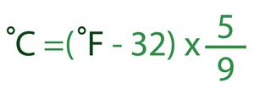
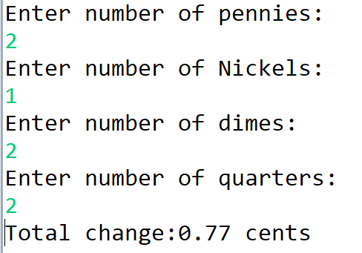
In class exercise
1. Write a program that will take in a temperature in Fahrenheit. The Program should convert the temperature to Celsius, and print it out to the screen
2. Write a program that will ask the user for an amount of pennies, nickels, dimes, and quarters. The program should compute the total change value, and print it to the screen

