Slide 1

CSCI 132: Basic Data Structures and Algorithms
Java file I/O
Reese Pearsall
Spring 2024
https://www.cs.montana.edu/pearsall/classes/spring2024/132/main.html
*All images are stolen from the internet

Slide 2
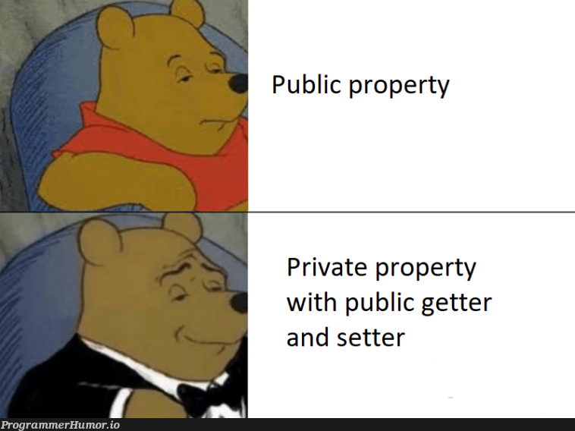
Announcements
Lab 2 due tomorrow at 11:59 PM
Program1 will be posted later this week
Schedule is changing a little bit

Slide 3
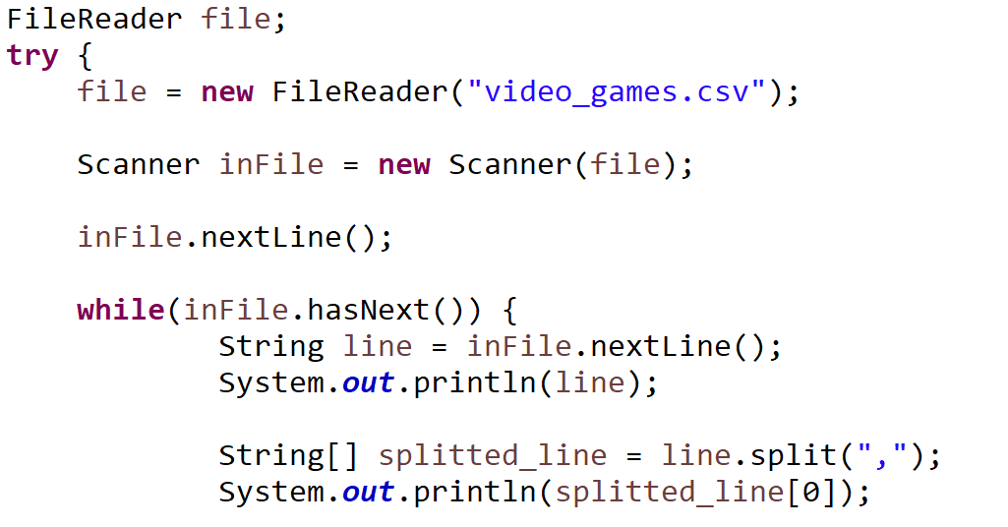
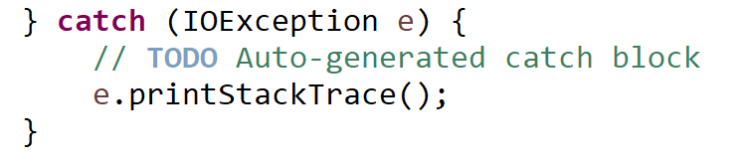
Reading in a file in Java
Opening a reading a file must be done inside of a try/catch statement

Slide 4

Reading in a file in Java
Open a file with the FileReader library

Slide 5
Reading in a file in Java
Open a file with the FileReader library
Read contents of file with Scanner

Slide 6

Reading in a file in Java
Open a file with the FileReader library
Read contents of file with Scanner
Read headers of csv file (discard them)

Slide 7

Reading in a file in Java
Open a file with the FileReader library
Read contents of file with Scanner
Read headers of csv file (discard them)
Iterate through each line of file

Slide 8



Reading in a file in Java
Open a file with the FileReader library
Read contents of file with Scanner
Read headers of csv file (discard them)
Iterate through each line of file
Get each line and print it out

Slide 9
Reading in a file in Java
Open a file with the FileReader library
Read contents of file with Scanner
Read headers of csv file (discard them)
Iterate through each line of file
Get each line and print it out
“Reese,Susan,Spencer”
One long String
To print out the first column of the file, we can split each line, and print out the first column
.split(“,”)
[ “Reese”, “Susan”, “Spencer” ]
Array of Strings

Slide 10
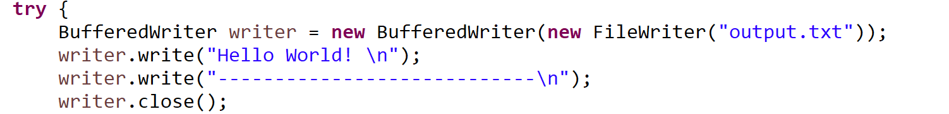
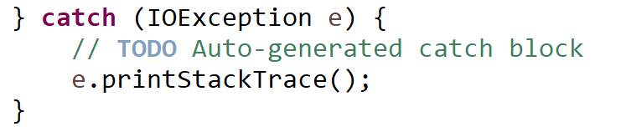
Writing to a file in Java

Slide 11



Writing to a file in Java
Name of output file

Slide 12

Writing to a file in Java
We write out contents to file using the write() method

Slide 13
Writing to a file in Java
When writing to a file, it is very important to close the file when you are finished

