Slide 1

CSCI 132: Basic Data Structures and Algorithms
More Java (while loops, practice)
Reese Pearsall
Spring 2024
https://www.cs.montana.edu/pearsall/classes/spring2024/132/main.html
*All images are stolen from the internet

Slide 2

Announcements
Program 1 is posted soon
I will talk about it and give some hints on Friday
I do not publicly post solutions, but you can stop by office hours or email me if you want to discuss homework solutions

Slide 3
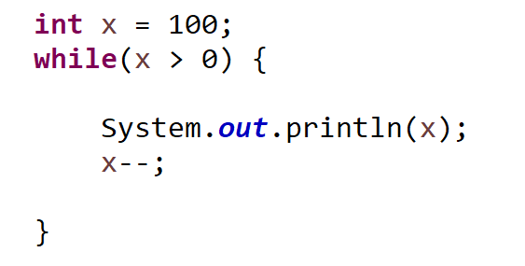
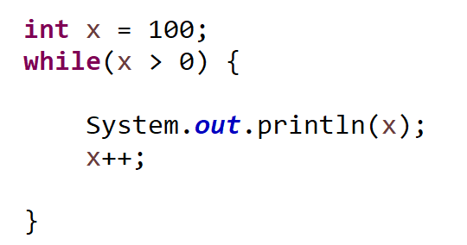
While loops can be used to iterate if a condition is true.
Check Condition
If condition is true, execute body of loop
Repeat
You do have to worry about the possibility of infinite loops….

Slide 4
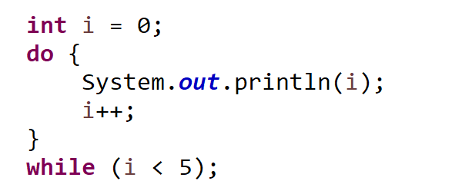
The do/while loop will always execute the body of the loop once, and then check the condition
New
Execute body of loop
Check condition
Repeat
!!! You are guaranteed at least one execution of the loop body

Slide 5
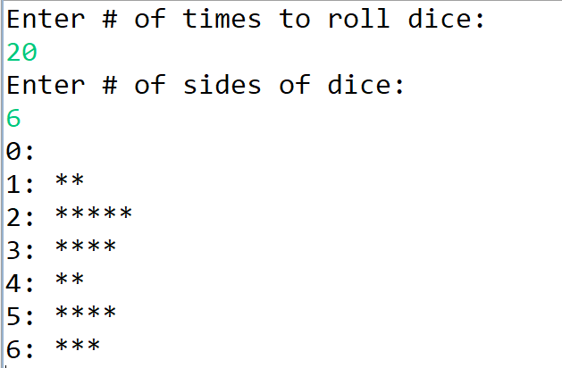
Practice
Write a Java program that will simulate dice being rolled. The Java program should keep track of the frequencies of how much each dice number was rolled (# of 1s rolled, # of 2s rolled, etc) and print it out to the screen like a Histogram

Slide 6
Random Numbers
import java.util.Random;
public static void main(String args[]) {
// create instance of Random class
Random rand = new Random();
// Generate random integers in range 0 to 999
int rand_int1 = rand.nextInt(1000);
int rand_int2 = rand.nextInt(1000);
// Print random integers
System.out.println("Random Integers: "+rand_int1);
System.out.println("Random Integers: "+rand_int2);
// Generate Random doubles
double rand_dub1 = rand.nextDouble();
double rand_dub2 = rand.nextDouble();
// Print random doubles
System.out.println("Random Doubles: "+rand_dub1);
System.out.println("Random Doubles: "+rand_dub2);
}
Easiest way to generate random numbers is with Random.nextInt()

Slide 7

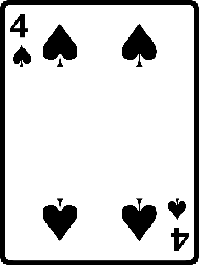
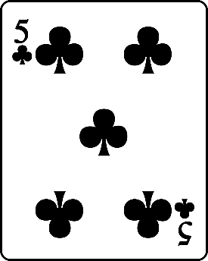
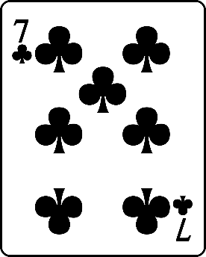

Write a program that will evaluate a three card poker hand. Your program should be able to identify
Three of a kind
Flush
Sequence
Two of a kind
Sequence
Flush
Two of a kind

