Slide 1

CSCI 132: Basic Data Structures and Algorithms
References, Program 1
Reese Pearsall
Spring 2024
https://www.cs.montana.edu/pearsall/classes/spring2024/132/main.html
*All images are stolen from the internet

Slide 2
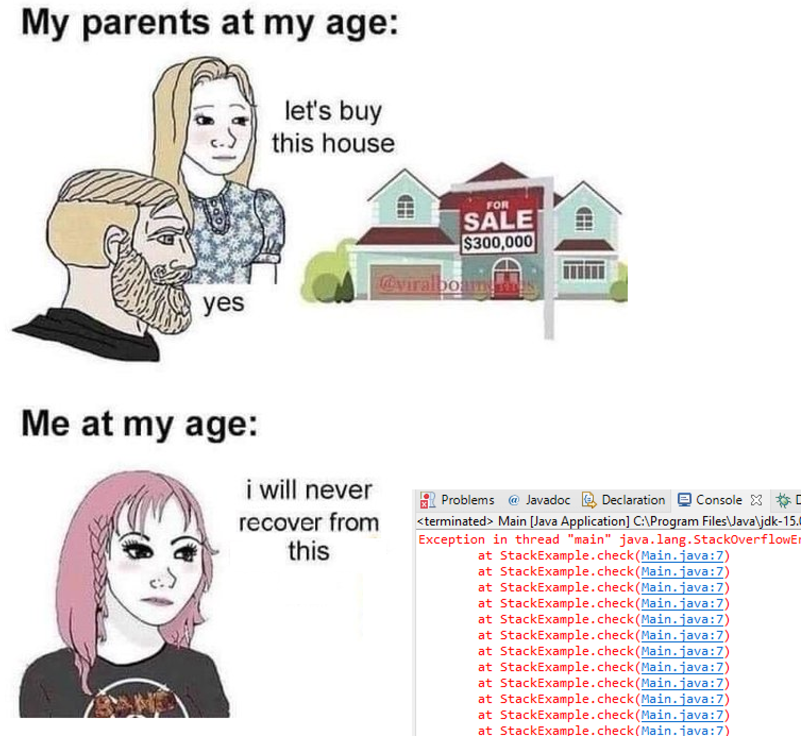
Announcements
Program 1 posted, due Friday 2/16 @ 11:59 PM
Lab 3 will be posted soon

Slide 3

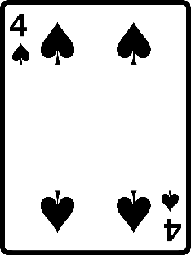
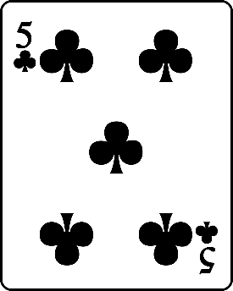
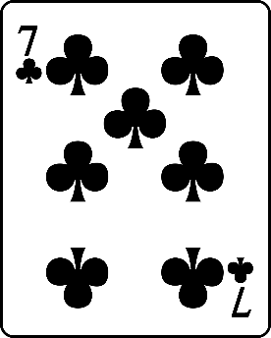

Write a program that will evaluate a three card poker hand. Your program should be able to identify
Three of a kind
Flush
Sequence
Two of a kind
Sequence
Flush
Two of a kind

Slide 4
public class ReferencesDemo {
public static void main(String[] args) {
Person person1 = new Person("Jim Bob", 44);
Person person2 = new Person("Sally", 28);
}
}
person1 and person2 are references to a Person object
person1
name: “Jim Bob”
age: 44
name: “Sally”
age: 28
person2

Slide 5
public class ReferencesDemo {
public static void main(String[] args) {
Person person1 = new Person("Jim Bob", 44);
Person person2 = new Person("Sally", 28);
person1.changeName("Jack");
}
}
person1 and person2 are references to a Person object
person1
name: “Jim Bob”
age: 44
name: “Sally”
age: 28
person2

Slide 6

public class ReferencesDemo {
public static void main(String[] args) {
Person person1 = new Person("Jim Bob", 44);
Person person2 = new Person("Sally", 28);
person1.changeName("Jack");
}
}
person1 and person2 are references to a Person object
person1
name: “Jack”
age: 44
name: “Sally”
age: 28
person2
In this method call, this is referencing the person1 object

Slide 7
public class ReferencesDemo {
public static void main(String[] args) {
Person person1 = new Person("Jim Bob", 44);
Person person2 = new Person("Sally", 28);
Person person3 = person1;
}
}
Suppose we create a new reference variable and link it to an existing object
person1
name: “Jack”
age: 44
name: “Sally”
age: 28
person2
In this method call, this is referencing the person1 object

Slide 8
public class ReferencesDemo {
public static void main(String[] args) {
Person person1 = new Person("Jim Bob", 44);
Person person2 = new Person("Sally", 28);
Person person3 = person1;
}
}
Suppose we create a new reference variable and link it to an existing object
person3 is now pointing to same object and person1
person1
name: “Jack”
age: 44
person3
name: “Sally”
age: 28
person2
In this method call, this is referencing the person1 object

Slide 9
public class ReferencesDemo {
public static void main(String[] args) {
Person person1 = new Person("Jim Bob", 44);
Person person2 = new Person("Sally", 28);
Person person3 = person1;
person1.changeName("test");
}
}
Suppose we create a new reference variable and link it to an existing object
person3 is now pointing to same object and person1
person1
name: “test”
age: 44
person3
Any changes to person1 will also update person3 (and vice versa)
System.out.println(person1.getName()) → “test”
System.out.println(person3.getName()) → “test”

Slide 10
Program 1

