Slide 1

CSCI 132: Basic Data Structures and Algorithms
Interfaces
Reese Pearsall
Spring 2024
https://www.cs.montana.edu/pearsall/classes/spring2024/132/main.html
*All images are stolen from the internet

Slide 2

Announcements
Program 1 due on February 16th @ 11:59 PM
Friday and Monday is Rubber Duck day!!
You can also grab a rubber duck from my office

Slide 3
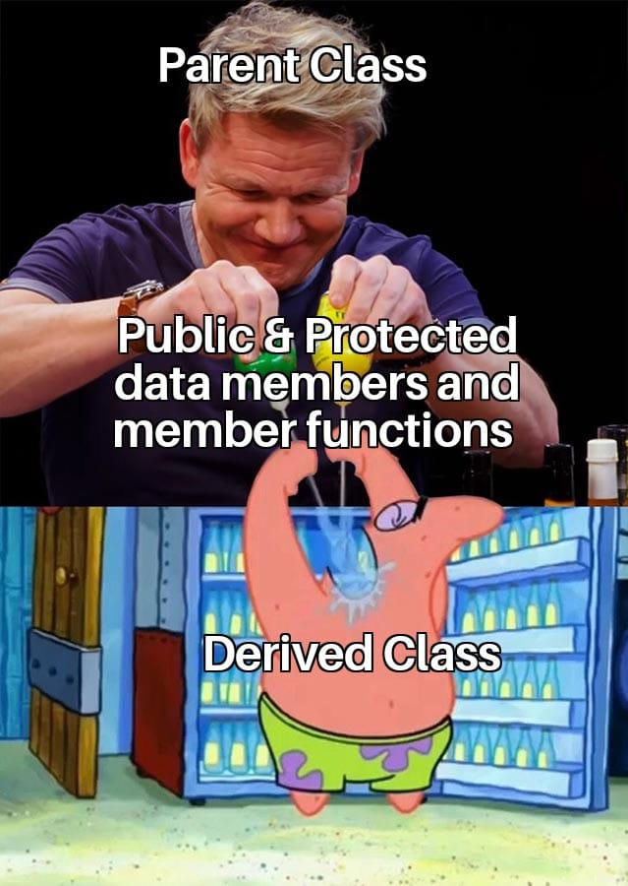

Inheritance is a mechanism that allows a parent class to pass on public and protected instance fields and methods to a child class
Inheritance is great when you have shared behaviors and attributes across classes with the same implementation
Programmer
Salesperson
Lawyer
public String getName() {
return this.name;
}
public String getName() {
return this.name;
}
public String getName() {
return this.name;
}
Same code (same implementation!!!)

Slide 4
Interfaces are abstract classes that only contain methods with no body
Accelerate, Slow down, and refuel are all common behavior that all vehicles will have
However, the specifics of how they accelerate, slow down, refuel will be different between vehicles (ie the body of the methods will be slightly different)
public interface Vehicle {
void accelerate(int a);
void slowdown(int a);
void refuel(int a);
}
Interfaces can be used to specify what a class must do, but not how

Slide 5
Interfaces are abstract classes that only contain methods with no body
public interface Vehicle {
void accelerate(int a);
void slowdown(int a);
void refuel(int a);
}
public class Ferrari implements Vehicle {
}
For a Java class to use an interface, it must use the implements keyword
We can implement multiple interfaces (unlike inheritance)

Slide 6



Interfaces are abstract classes that only contain methods with no body
public class Ferrari implements Vehicle {
@Override
public void accelerate(int a) {
…
}
@Override
public void slowdown(int a) {
…
}
@Override
public void refuel(int a) {
}
…
}
public interface Vehicle {
void accelerate(int a);
void slowdown(int a);
void refuel(int a);
}
Now, any Class that also has the behavior of accelerating, slowdown, and refuel can implement our interface, and those classes are forced to write the body of the methods
The code of the method body is omitted, but that is where the programmer can put the specific behavior of:
how a Ferrari will accelerate
how a Ferrari will slow down
how a Ferrari will refuel

Slide 7



Interfaces are abstract classes that only contain methods with no body
public class Ferrari implements Vehicle {
@Override
public void accelerate(int a) {
…
}
@Override
public void slowdown(int a) {
…
}
@Override
public void refuel(int a) {
}
…
}
public interface Vehicle {
void accelerate(int a);
void slowdown(int a);
void refuel(int a);
}
You can not create an instance of an interface
In the interface, the method bodies must be empty
(Remember, the classes that use our interface will have the method bodies)
The code of the method body is omitted, but that is where the programmer can put the specific behavior of:
how a Ferrari will accelerate
how a Ferrari will slow down
how a Ferrari will refuel

Slide 8
Interfaces are abstract classes that only contain methods with no body
Why use interfaces?
Interfaces are great when you shared behavior with different implementations
It forces classes to implement X methods that might not logically belong to them (more control)
It provides abstraction
(ie the details of how things are implemented are not revealed in an interface)

Slide 9
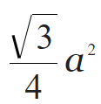

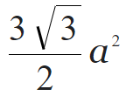
Given a side length a
Shape | Perimeter Formula | Area Formula
Square | a * 4 | a²
Equilateral Triangle | a * 3
Regular Pentagon | a * 5
Regular Hexagon | a * 6

Slide 10
Given a side length a
Shape | Perimeter Formula | Area Formula
Square | a * 4 | a²
Equilateral Triangle | a * 3
Regular Pentagon | a * 5
Regular Hexagon | a * 6
Shared behaviors with different implementations

