Slide 1

CSCI 132: Basic Data Structures and Algorithms
Static methods, Polymorphism, Exceptions, Abstract Classes, Debugging
Reese Pearsall
Spring 2024
https://www.cs.montana.edu/pearsall/classes/spring2024/132/main.html
*All images are stolen from the internet

Slide 2
Opening a project in Eclipse

Slide 3

Static methods are methods in Java that can be called without creating an object of a class
public class StaticDemo {
public static void fun1(String arg1) {
System.out.println(arg1);
}
public static void main(String[] args) {
fun1("Hello");
}
}
I do not need to create a StaticDemo object in order to call the fun1() method

Slide 4


Static methods are methods in Java that can be called without creating an object of a class
public class StaticDemo {
public static void main(String[] args) {
AnotherClass.funMethod("Hello");
}
}
public class AnotherClass {
public static void funMethod(String arg)
{
System.out.println(arg);
}
}
StaticDemo.java
AnotherClass.java
If the static method is in another class, we can access it by giving the class name (AnotherClass)
Once again, I do not need to create an AnotherClass object to call this static method
However, now objects are no longer an implicit argument to this method (cant use this anymore)

Slide 5
Static methods are methods in Java that can be called without creating an object of a class
Error: static method cannot be referenced from a non static context
funMethod("Hello");
This is a very common error to see in Java.
You can turn the method static by adding the static keyword in the method definition
Or you use OOP and call the method on an instance of the class
(Easy and quick fix)
AnotherClass obj = new AnotherClass()
obj.funMethod(“Hello”)
(Usually this is the better solution 80% of the time)

Slide 6



Abstract Classes are restricted classes that cannot be used to create objects. To access it, it must be inherited from another class.
public abstract class Employee {
…
}
Employee e = new Employee("Sally", 4444, 123456);
You cannot create instances of an abstract class.
Accountant kevin = new Accountant("Kevin Malone", 4444, 42000, 'C');
Instead, we use objects from another class that inherits from the abstract class

Slide 7
Polymorphism is the ability of a class to provide different implementations of a method, depending on the type of object that is passed to the method.
Bird a2 = new Bird("Puffin",27.0, "North America",7400000,21.5);
Wolf b2 = new Wolf("Arctic Wolf",120.0, "North America",200000, 16);
a2.makeSound();
b2.makeSound();
The makeSound()method does something different for each object

Slide 8


Polymorphism is the ability of a class to provide different implementations of a method, depending on the type of object that is passed to the method.
Polymorphism also refers to the ability for an object to take many forms
Programmer me = new Programmer(“Reese", 12345, 80000, “Python”);
Employee me = new Programmer(“Reese", 12345, 80000, “Python”);
We can also treat the me reference variable as an Employee, since Programmer inherits from Employee
Animal
Dog tater = new Dog();
Cat meatball = new Cat();
Animal[] myAnimalArray = {tater, meatball};
Dog
Cat

Slide 9
try/catch and exceptions are a way to run a piece of code (“try”), and then deal (“catch”) with errors
It will execute the body of try, and if a certain error/exceptions arises, then it will run the body of the catch statement
You can catch any error, or a specific error (FileNotFound, ArrayIndexOutOfBounds, NullPointerException)

Slide 10
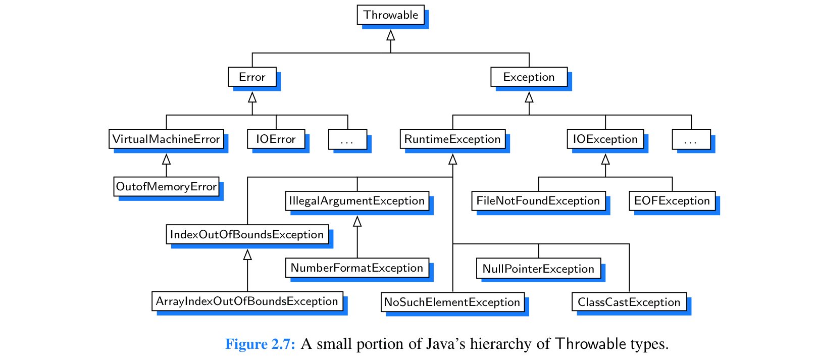

Slide 11
while(userChoice != 3) {
try {
Scanner scanner = new Scanner(System.in);
userChoice = scanner.nextInt();
if(userChoice == 1) {
System.out.println("Hello");
}
else if(userChoice == 2) {
System.out.println("Hey");
}
else if(userChoice == 3) {
System.out.println("Goodbye");
}
else {
System.out.println("Enter a valid integer");
}
}
catch(Exception e) {
System.out.println(e);
System.out.println("Invalid input detected. Please try again");
}
printOptions();
Java will try to execute this block of code

Slide 12


while(userChoice != 3) {
try {
Scanner scanner = new Scanner(System.in);
userChoice = scanner.nextInt();
if(userChoice == 1) {
System.out.println("Hello");
}
else if(userChoice == 2) {
System.out.println("Hey");
}
else if(userChoice == 3) {
System.out.println("Goodbye");
}
else {
System.out.println("Enter a valid integer");
}
}
catch(Exception e) {
System.out.println(e);
System.out.println("Invalid input detected. Please try again");
}
printOptions();
Java will try to execute this block of code
If any error happens, instead of crashing, it will execute the body of the catch

Slide 13
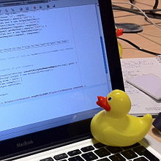
Debugging Code
Our IDE has a super slick debugger built in to it. I highly recommend learning how to use the debugger tool (see lecture)
Rubber Duck Debugging
Many programmers have had the experience of explaining a problem to someone else, possibly even to someone who knows nothing about programming, and then hitting upon the solution in the process of explaining the problem. In describing what the code is supposed to do and observing what it actually does, any incongruity between these two becomes apparent.^{[2]} More generally, teaching a subject forces its evaluation from different perspectives and can provide a deeper understanding.^{[3]} By using an inanimate object, the programmer can try to accomplish this without having to interrupt anyone else, and with better results than have been observed from merely thinking aloud without an audience.
(From Wikipedia)

