Slide 1

CSCI 132: Basic Data Structures and Algorithms
Lessons Learned so far + Importing Linked Lists
Reese Pearsall
Spring 2024
https://www.cs.montana.edu/pearsall/classes/spring2024/132/main.html
*All images are stolen from the internet

Slide 2

Announcements
Come get your midterm exam
Exam average was 83
Don’t stress if you didn’t do well
Make sure I calculated your score correctly
Lab 7 due tomorrow
Class Registration

Slide 3
Lab 7

Slide 4
Class Registration

Slide 5

Next Class to Register for:
CSCI 232- Data Structures and Algorithms
(Offered in Summer 2024 and Fall 2024)
Other classes that may be of interest:
CS 145 – Web Design
CSCI 112- Programming in C
CSCI 215 – Social and Ethical issues in Computer Science
CSCI 204 – Multimedia Dev Methods (Game Design)
CSCI 291- Introduction to Data Science (NEW)

Slide 6




Resources Available to you
Smarty Cats Tutoring
TA Office Hours and Email
CS Tutoring Center: Barnard Hall 259
My email, Discord, office hours

Slide 7
Big-O
Big-O notation is a way to describe the running-time/time complexity of an algorithm regarding the number of operations that are executed in the algorithm (in relation to some input n)
Focus on worst-case scenario, and how the algorithm scales as n gets really big

Slide 8
Big-O
Big-O notation is a way to describe the running-time/time complexity of an algorithm regarding the number of operations that are executed in the algorithm (in relation to some input n)
Focus on worst-case scenario, and how the algorithm scales as n gets really big
A very powerful computer and a very weak computer running the same algorithm will both execute the same number of operations (the speed at which they execute these operations will be different)
Takeaway: the asymptotic running time (the big-o running time) will be the same for each computer

Slide 9
Big-O
Big-O notation is a way to describe the running-time/time complexity of an algorithm regarding the number of operations that are executed in the algorithm (in relation to some input n)
Focus on worst-case scenario, and how the algorithm scales as n gets really big
To find the total running time of an algorithm, we calculate the running-time of each operation in the algorithm and then add everything together
In Big-O, we can drop non-dominant factors and multiplicative constants (coefficients)
O(n) + O(n) + O(n): Total running time = O(3n) O(n)
∈
Where n is ________

Slide 10
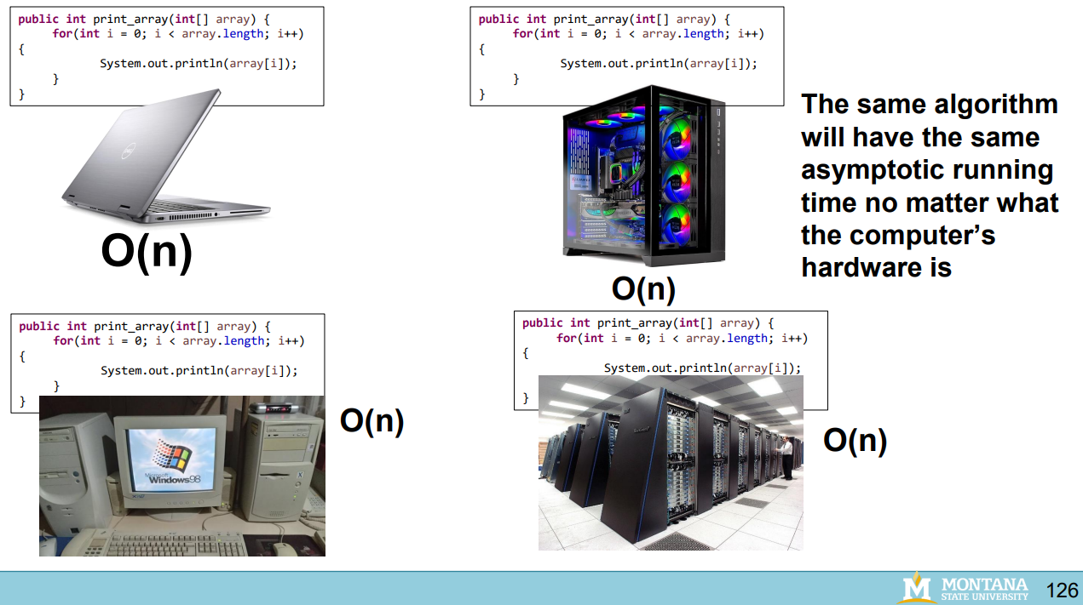
Big-O

Slide 11
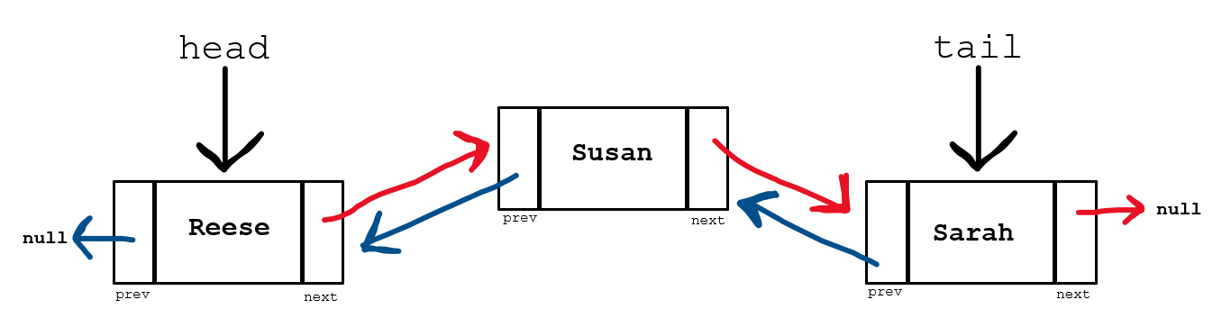
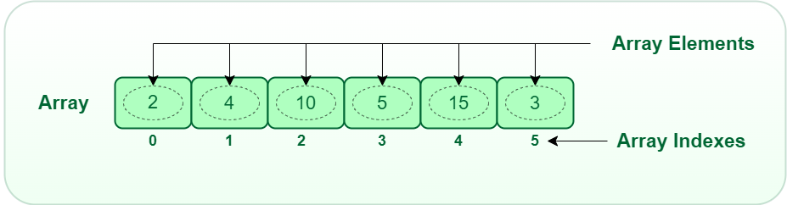
Data Structures so far:
ArrayLists (Arrays)
Linked Lists

Slide 12
Data Structures so far:
ArrayLists (Arrays)
Linked Lists
Can hold one data type
Can hold multiple data types

Slide 13
Data Structures so far:
ArrayLists (Arrays)
Linked Lists
Can hold one data type
Can also store objects, which allow for multiple data types
Nodes in the linked list can hold multiple data types

Slide 14
Data Structures so far:
ArrayLists (Arrays)
Linked Lists
Can hold one data type
Can also store objects, which allow for multiple data types
Nodes in the linked list can hold multiple data types
Entire array is stored at a contiguous spot in memory
Linked list nodes are stored at non-contiguous spots in memory

Slide 15






Can hold one data type
Can also store objects, which allow for multiple data types
Nodes in the linked list can hold multiple data types
Entire array is stored at a contiguous spot in memory
Linked list nodes are stored at non-contiguous spots in memory

Slide 16
Data Structures so far:
ArrayLists (Arrays)
Linked Lists
Objects in the ArrayLists can hold multiple data types
Nodes in the linked list can hold multiple data types
Entire array is stored at a contiguous spot in memory
Linked list nodes are stored at non-contiguous spots in memory
Elements are ordered by their next pointer
Elements are ordered by index
(Easy to go directly to array spot)
(Must traverse from the head to reach node)

Slide 17
Data Structures so far:
ArrayLists (Arrays)
Linked Lists
Can hold one data type
Can also store objects, which allow for multiple data types
Nodes in the linked list can hold multiple data types
Entire array is stored at a contiguous spot in memory
Linked list nodes are stored at non-contiguous spots in memory
Traversing a linked list requires more work than traversing an array

Slide 18
Data Structures so far:
ArrayLists (Arrays)
Linked Lists
Can add new elements to data structure (resizable)
Can add new elements to data structure (resizable)
Both data structures can grow dynamically, and new elements can be added, but they way they add new elements is drastically different

Slide 19
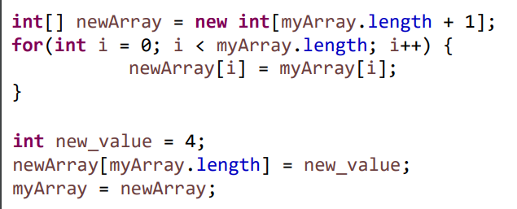
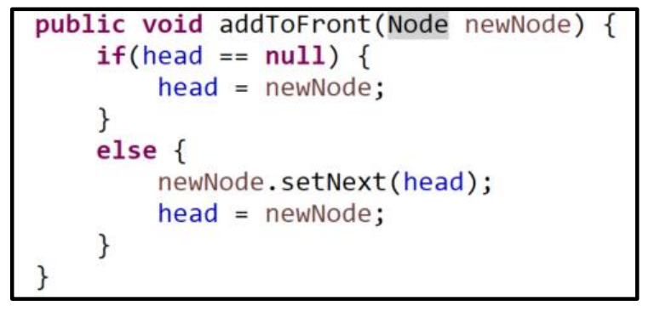
Data Structures so far:
ArrayLists (Arrays)
Linked Lists
Create a brand-new array, copy everything over from old array
Update pointers

Slide 20
Data Structures so far:
ArrayLists (Arrays)
Linked Lists
Create a brand-new array, copy everything over from old array
Update pointers
O(1)
O(n)

Slide 21
Data Structures so far:
ArrayLists (Arrays)
Linked Lists
Takeaway: Adding a new element to an ArrayList requires much more work than adding a new element to a Linked List

Slide 22
Data Structures so far:
ArrayLists (Arrays)
Linked Lists
Arrays are generally much easier to sort than Nodes in a Linked List
If you are constantly needing to add new elements to the data structure, using a Linked List requires much less work in the long run
Arrays are more memory efficient (adding is not very memory efficient though)

Slide 23
Data Structures so far:
ArrayLists (Arrays)
Linked Lists
When to use each data structure?
It depends on how you are using your data and if you know how much data you have
If you don’t know how much data you need to store, or if you are constantly needing to add new elements to the data structure → Linked Lists
If you know how much data you need to store, and if you can add all your data at once → Arrays/ArrayLists

Slide 24
Data Structures so far:
ArrayLists (Arrays)
Linked Lists
These two data structures are implementations of a List Abstract Data Type (ADT)
ADT is a class whose behavior is defined by a set of operations and how a user interacts with it.
A list data type must be able to get an element, add an element, remove an element, etc
→ How they do these operations is up to the subclass (LL and AL)
As programmers, we use handy methods that were written by other people that allows us to use these data structures

Slide 25
References
Car car1 = new Car(“Ferrari”,”Black”);

Slide 26

References
Car car1 = new Car(“Ferrari”,”Black”);
car1
make: “Ferrari”
color: “Black”

Slide 27

References
Car car1 = new Car(“Ferrari”,”Black”);
Car car2 = new Car(“Toyota”,”Blue”);
car1
make: “Ferrari”
color: “Black”
car2
make: “Toyota”
color: “Blue”

Slide 28
References
Car car1 = new Car(“Ferrari”,”Black”);
Car car2 = new Car(“Toyota”,”Blue”);
Car car3 = car1;
car1
make: “Ferrari”
color: “Black”
car2
make: “Toyota”
color: “Blue”

Slide 29

References
Car car1 = new Car(“Ferrari”,”Black”);
Car car2 = new Car(“Toyota”,”Blue”);
Car car3 = car1;
car1
make: “Ferrari”
color: “Black”
car3
The new keyword is not used, so a new object is not created. Instead, it will point to the same object that car1 is pointing to
car2
make: “Toyota”
color: “Blue”

Slide 30

References
Car car1 = new Car(“Ferrari”,”Black”);
Car car2 = new Car(“Toyota”,”Blue”);
Car car3 = car1;
car3.set_color(“Red”);
car1
make: “Ferrari”
color: “Red”
car3
car2
make: “Toyota”
color: “Blue”

Slide 31
References
Car car1 = new Car(“Ferrari”,”Black”);
Car car2 = new Car(“Toyota”,”Blue”);
Car car3 = car1;
car3.set_color(“Red”);
System.out.println(car1.getColor());
car1
make: “Ferrari”
color: “Red”
car3
car2
make: “Toyota”
color: “Blue”

Slide 32
References
Car car1 = new Car(“Ferrari”,”Black”);
Car car2 = new Car(“Toyota”,”Blue”);
Car car3 = car1;
car3.set_color(“Red”);
System.out.println(car1.getColor());
car1
make: “Ferrari”
color: “Red”
car3
car2
make: “Toyota”
color: “Blue”
Red

Slide 33
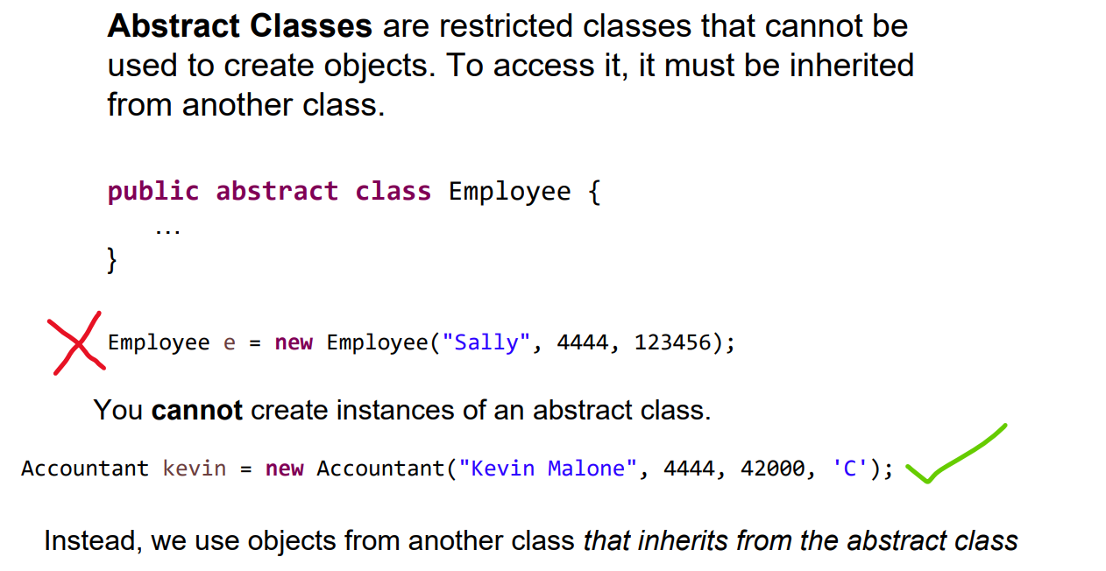

Slide 34
The Linked List Class
We will no longer be writing our own Linked List class, instead we will now import the Java-provided Linked List Class
import java.util.LinkedList;

Slide 35
The Linked List Class
We will no longer be writing our own Linked List class, instead we will now import the Java-provided Linked List Class
import java.util.LinkedList;
LinkedList<String> names = new LinkedList<String>();
The data type the linked list will be holding
Reference variable for LL

Slide 36

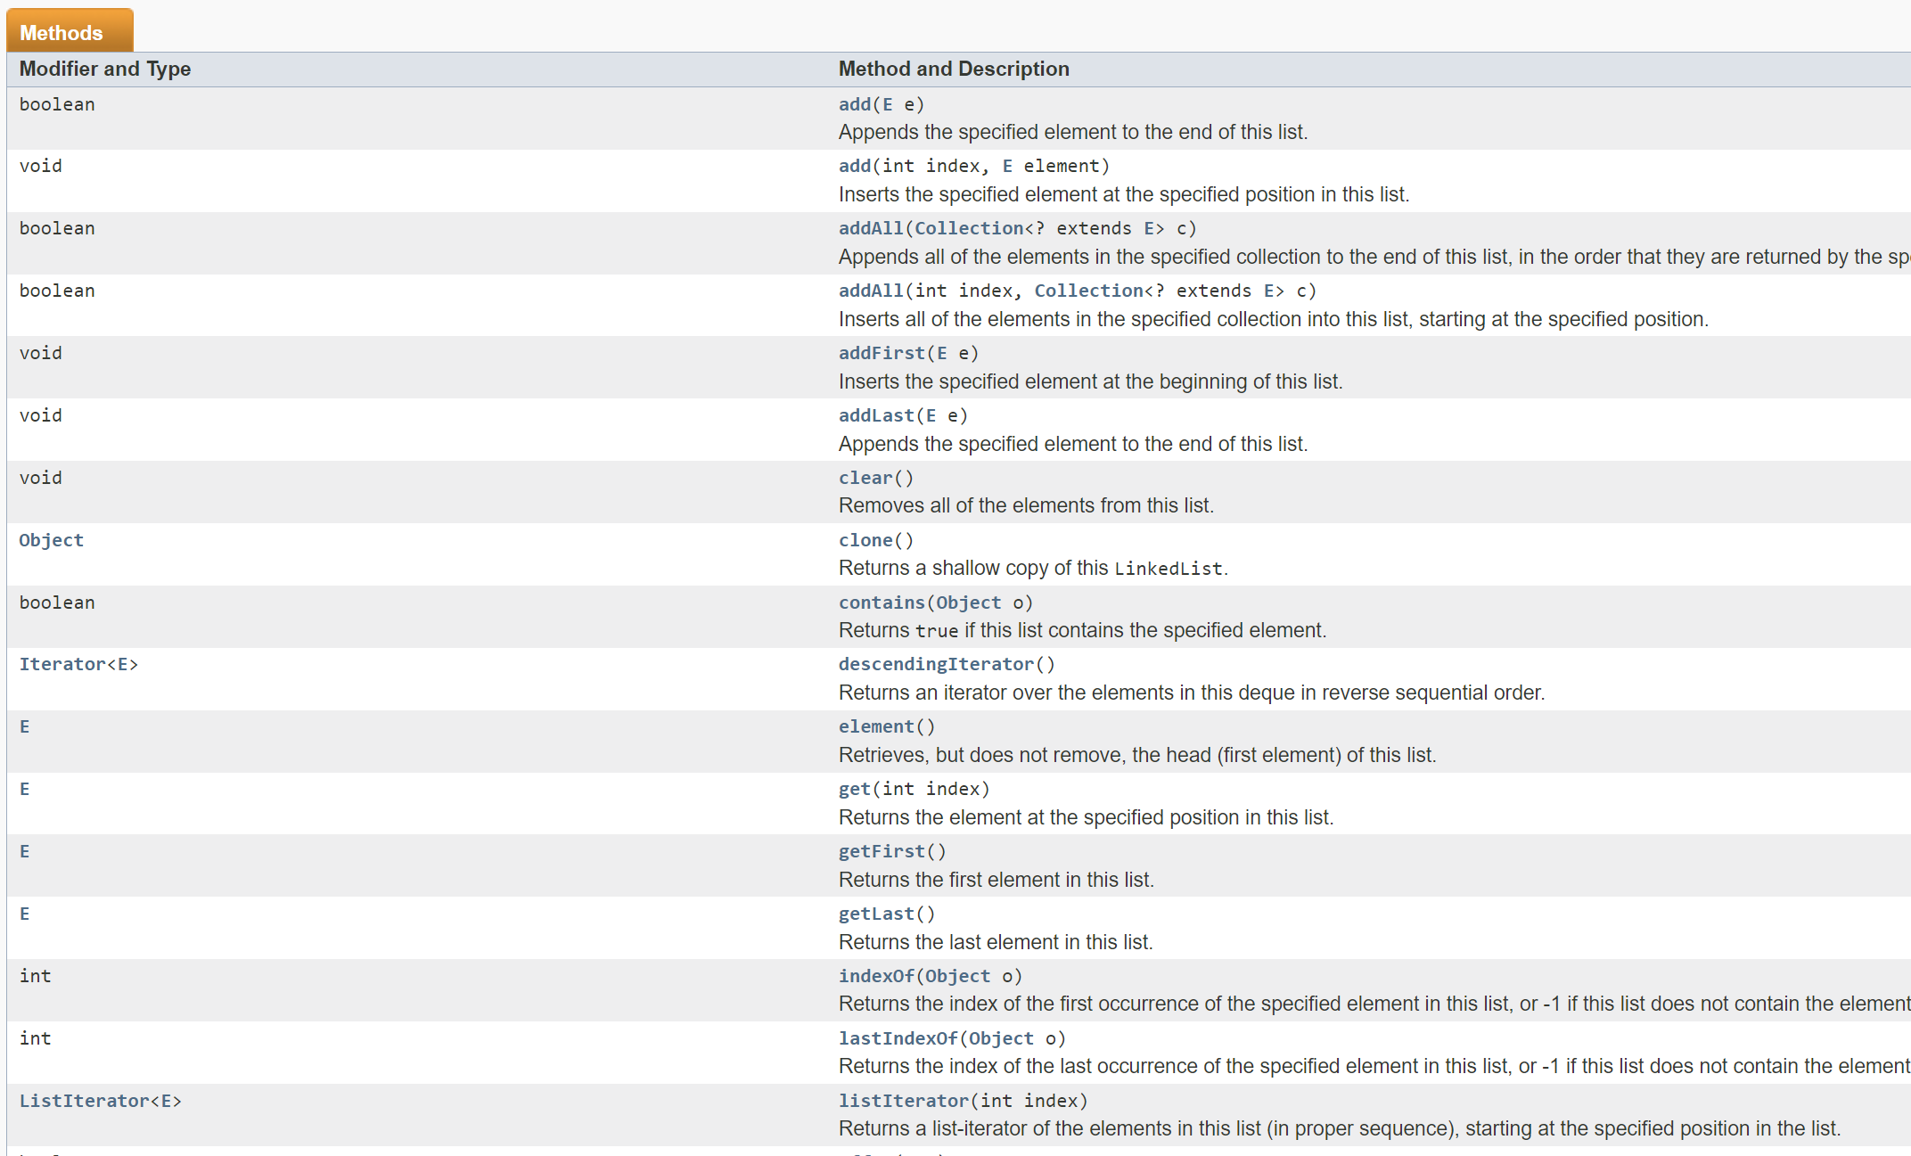
The Linked List Class
https://docs.oracle.com/javase/7/docs/api/java/util/LinkedList.html
The documentation describe how the LinkedList class was implemented, and all the methods/operations we can do with the Linked List class

Slide 37
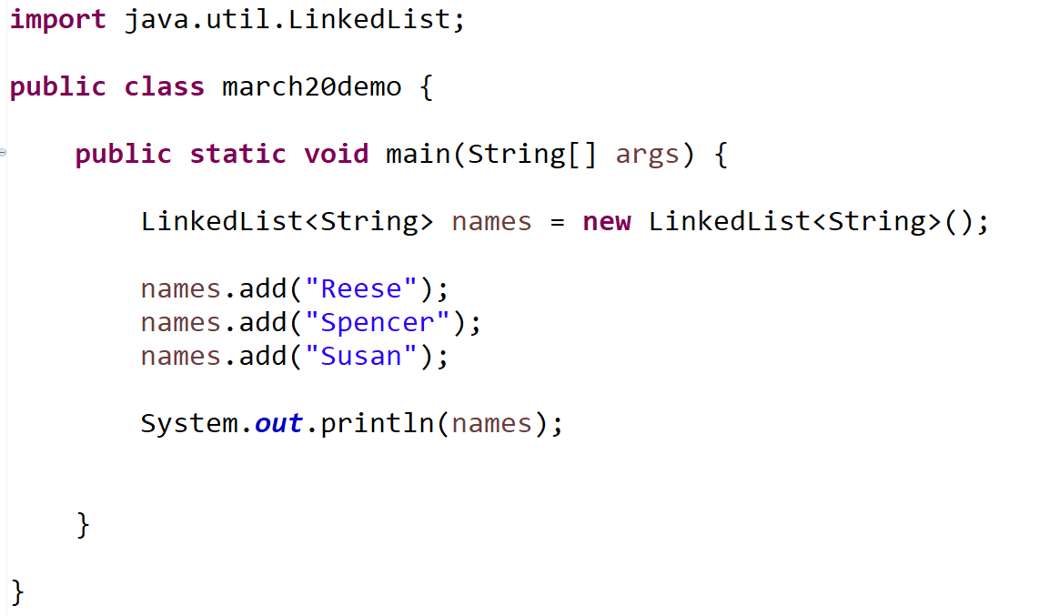
The Linked List Class

