Slide 1

CSCI 132: Basic Data Structures and Algorithms
Stacks (Array Representation)
Reese Pearsall
Spring 2024
https://www.cs.montana.edu/pearsall/classes/spring2024/132/main.html
*All images are stolen from the internet

Slide 2
A stack is a data structure that can hold data, however the way we interact with a stack is a little bit different
Top of Stack
Cosmo
Elements of Data Structure
Susan
Reese

Slide 3
A stack is a data structure that can hold data, however the way we interact with a stack is a little bit different
Spencer
When only interact with the top of the stack.
If we want to add a new element, we must put it on the top of the stack
Top of Stack
Cosmo
Elements of Data Structure
Susan
Reese

Slide 4
A stack is a data structure that can hold data, however the way we interact with a stack is a little bit different
Top of Stack
Spencer
Cosmo
Adding something to a stack is known as the push operation
Elements of Data Structure
Susan
Reese

Slide 5
A stack is a data structure that can hold data, however the way we interact with a stack is a little bit different
If we want to remove something, we must always remove the element on the top of the stack
Top of Stack
Spencer
Cosmo
Elements of Data Structure
Susan
Reese

Slide 6
A stack is a data structure that can hold data, however the way we interact with a stack is a little bit different
Spencer
Removing an element is known as the pop operation
Top of Stack
Cosmo
Elements of Data Structure
Susan
Reese
stack.pop() → Top node (spencer) is removed

Slide 7
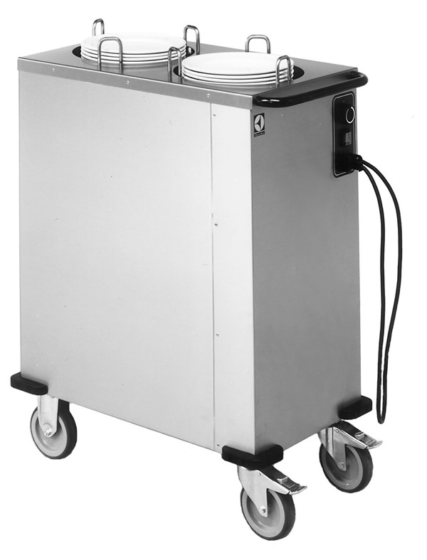
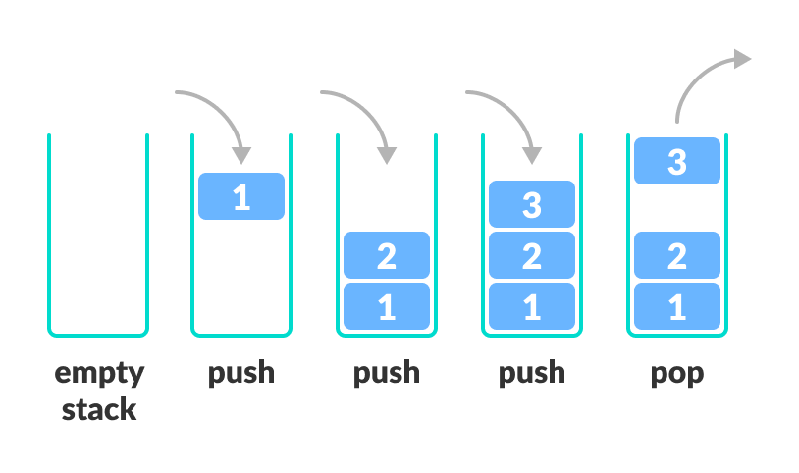
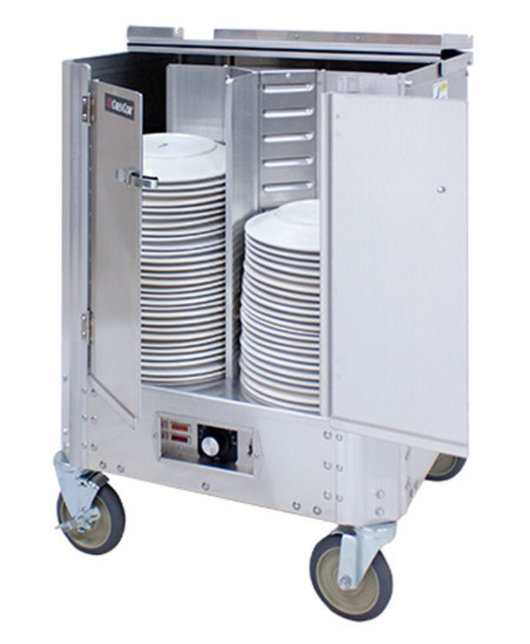
A stack is a data structure that can hold data, and follows the last in first out (LIFO) principle
We can:
Add an element to the top of the stack (push)
Remove the top element (pop)
Stack Operations
push()
pop()
peek()
isEmpty()

Slide 8
A stack is a data structure that can hold data, and follows the last in first out (LIFO) principle
Top of Stack
Our stack data structure needs to keep track of a few things
1. Something to hold our stack elements
Spencer
Cosmo
Elements of Data Structure
Susan
Reese

Slide 9
A stack is a data structure that can hold data, and follows the last in first out (LIFO) principle
Top of Stack
Our stack data structure needs to keep track of a few things
1. Something to hold our stack elements
Spencer
Cosmo
Elements of Data Structure
Susan
We have a few options:
Reese
1. Array
Spencer
Cosmo
Susan
Reese

Slide 10
A stack is a data structure that can hold data, and follows the last in first out (LIFO) principle
Top of Stack
Our stack data structure needs to keep track of a few things
1. Something to hold our stack elements
Spencer
Cosmo
Elements of Data Structure
Susan
We have a few options:
Reese
Array
ArrayList
Spencer
Cosmo
Susan
Reese

Slide 11
A stack is a data structure that can hold data, and follows the last in first out (LIFO) principle
Top of Stack
Our stack data structure needs to keep track of a few things
1. Something to hold our stack elements
Spencer
Cosmo
Elements of Data Structure
Susan
We have a few options:
Reese
Spencer
Array
ArrayList
3. Linked List
Spencer
Cosmo
Susan
Reese
Cosmo
Susan
Reese

Slide 12
A stack is a data structure that can hold data, and follows the last in first out (LIFO) principle
Top of Stack
Our stack data structure needs to keep track of a few things
1. Something to hold our stack elements
Spencer
Cosmo
Elements of Data Structure
Susan
We have a few options:
Reese
Spencer
Array
ArrayList
3. Linked List
Which should you pick?
Spencer
Cosmo
Susan
Reese
Cosmo
Susan
Reese

Slide 13
A stack is a data structure that can hold data, and follows the last in first out (LIFO) principle
Top of Stack
Our stack data structure needs to keep track of a few things
1. Something to hold our stack elements
Spencer
Cosmo
Elements of Data Structure
Susan
We have a few options:
Reese
Spencer
Array
ArrayList
3. Linked List
Which should you pick?
Depends on how you are using the stack
Spencer
Cosmo
Susan
Reese
Cosmo
Susan
Reese

Slide 14
A stack is a data structure that can hold data, and follows the last in first out (LIFO) principle
Top of Stack
Our stack data structure needs to keep track of a few things
1. Something to hold our stack elements
Spencer
Cosmo
Elements of Data Structure
Susan
We have a few options:
Reese
Spencer
Array
ArrayList
3. Linked List
Which should you pick?
If you know how big the stack needs to be
→ Array
If you don’t know how big the stack needs to be
→ Linked List
Spencer
Cosmo
Susan
Reese
Cosmo
Susan
Reese

Slide 15
A stack is a data structure that can hold data, and follows the last in first out (LIFO) principle
Top of Stack
Our stack data structure needs to keep track of a few things
Something to hold our stack elements (Array/LinkedList)
Something that points the current top element of the stack
The size of the stack
Spencer
Cosmo
Elements of Data Structure
Susan
Reese

Slide 16
Stack Implementation (Array)
To Do List:
Push()
Pop()
Peek()
IsEmpty()
Here, we’ve created an array of size 8 to hold our stack data
7
6
5
4
3
2
1
0

Slide 17
Stack Implementation (Array)
To Do List:
Push()
Pop()
Peek()
IsEmpty()
Here, we’ve created an array of size 8 to hold our stack data
The bottom of the stack will always be at index 0, and grows towards the higher indices
7
String[] data = new String[8]
6
5
When the stack is empty, the index of the bottom of the stack, and the index of the top of the stack will be the same
top_of_stack = 0
4
3
2
1
The size of the stack will start at 0
size = 0
Top of Stack
0

Slide 18
Stack Implementation (Array)
To Do List:
Push()
Pop()
Peek()
IsEmpty()
Here, we’ve created an array of size 8 to hold our stack data
public void push(newElement){
}
Stack Instance Fields
7
String[] data = new String[8]
6
top_of_stack = 0
5
size = 0
4
3
2
1
Top of Stack
0

Slide 19
Stack Implementation (Array)
To Do List:
Push()
Pop()
Peek()
IsEmpty()
Here, we’ve created an array of size 8 to hold our stack data
public void push(newElement){
}
Stack Instance Fields
Reese
7
if stack is empty:
place newElement at current top_of_stack
size++
if stack if full:
return
String[] data = new String[8]
6
top_of_stack = 0
5
size = 1
4
3
2
1
Top of Stack
0

Slide 20
Stack Implementation (Array)
To Do List:
Push()
Pop()
Peek()
IsEmpty()
Here, we’ve created an array of size 8 to hold our stack data
public void push(newElement){
}
Stack Instance Fields
Reese
7
if stack is empty:
place newElement at current top_of_stack
size++
if stack if full:
return
else:
top_of_stack++;
place newElement at index top_of_stack
size++
String[] data = new String[8]
6
top_of_stack = 0
5
size = 1
4
3
2
1
Top of Stack
0

Slide 21
Stack Implementation (Array)
To Do List:
Push()
Pop()
Peek()
IsEmpty()
Here, we’ve created an array of size 8 to hold our stack data
Susan
public void push(newElement){
}
Stack Instance Fields
Reese
7
if stack is empty:
place newElement at current top_of_stack
size++
if stack if full:
return
else:
top_of_stack++;
place newElement at index top_of_stack
size++
String[] data = new String[8]
6
top_of_stack = 0
5
size = 1
4
3
2
1
Top of Stack
0
stack.push(“Susan”)

Slide 22
Stack Implementation (Array)
To Do List:
Push()
Pop()
Peek()
IsEmpty()
Here, we’ve created an array of size 8 to hold our stack data
Susan
public void push(newElement){
}
Stack Instance Fields
Reese
7
if stack is empty:
place newElement at current top_of_stack
size++
if stack if full:
return
else:
top_of_stack++;
place newElement at index top_of_stack
size++
String[] data = new String[8]
6
top_of_stack = 1
5
size = 1
4
3
2
Top of Stack
1
0
stack.push(“Susan”)

Slide 23
Stack Implementation (Array)
To Do List:
Push()
Pop()
Peek()
IsEmpty()
Here, we’ve created an array of size 8 to hold our stack data
public void push(newElement){
}
Stack Instance Fields
Susan
Reese
7
if stack is empty:
place newElement at current top_of_stack
size++
if stack if full:
return
else:
top_of_stack++;
place newElement at index top_of_stack
size++
String[] data = new String[8]
6
top_of_stack = 1
5
size = 1
4
3
2
Top of Stack
1
0
stack.push(“Susan”)

Slide 24
Stack Implementation (Array)
To Do List:
Push()
Pop()
Peek()
IsEmpty()
Here, we’ve created an array of size 8 to hold our stack data
public void push(newElement){
}
Stack Instance Fields
Susan
Reese
7
if stack is empty:
place newElement at current top_of_stack
size++
if stack if full:
return
else:
top_of_stack++;
place newElement at index top_of_stack
size++
String[] data = new String[8]
6
top_of_stack = 1
5
size = 2
4
3
2
Top of Stack
1
0
stack.push(“Susan”)

Slide 25
Stack Implementation (Array)
To Do List:
Push()
Pop()
Peek()
IsEmpty()
Here, we’ve created an array of size 8 to hold our stack data
Cosmo
public void push(newElement){
}
Stack Instance Fields
Susan
Reese
7
if stack is empty:
place newElement at current top_of_stack
size++
if stack if full:
return
else:
top_of_stack++;
place newElement at index top_of_stack
size++
String[] data = new String[8]
6
top_of_stack = 1
5
size = 2
4
3
2
Top of Stack
1
0
stack.push(“Cosmo”)

Slide 26
Stack Implementation (Array)
To Do List:
Push()
Pop()
Peek()
IsEmpty()
Here, we’ve created an array of size 8 to hold our stack data
Cosmo
public void push(newElement){
}
Stack Instance Fields
Susan
Reese
7
if stack is empty:
place newElement at current top_of_stack
size++
if stack if full:
return
else:
top_of_stack++;
place newElement at index top_of_stack
size++
String[] data = new String[8]
6
top_of_stack = 2
5
size = 2
4
3
Top of Stack
2
1
0
stack.push(“Cosmo”)

Slide 27
Stack Implementation (Array)
To Do List:
Push()
Pop()
Peek()
IsEmpty()
Here, we’ve created an array of size 8 to hold our stack data
public void push(newElement){
}
Stack Instance Fields
Cosmo
Susan
Reese
7
if stack is empty:
place newElement at current top_of_stack
size++
if stack if full:
return
else:
top_of_stack++;
place newElement at index top_of_stack
size++
String[] data = new String[8]
6
top_of_stack = 2
5
size = 3
4
3
Top of Stack
2
1
0
stack.push(“Cosmo”)

Slide 28
Stack Implementation (Array)
To Do List:
Push()
Pop()
Peek()
IsEmpty()
Here, we’ve created an array of size 8 to hold our stack data
public void pop(){
}
Stack Instance Fields
Cosmo
Susan
Reese
7
String[] data = new String[8]
6
top_of_stack = 2
5
size = 3
4
3
Top of Stack
2
The pop method will always remove the element on the top of the stack
1
0

Slide 29
Stack Implementation (Array)
To Do List:
Push()
Pop()
Peek()
IsEmpty()
Here, we’ve created an array of size 8 to hold our stack data
public void pop(){
}
Stack Instance Fields
Cosmo
Susan
Reese
7
if stack is empty:
return
Set index top_of_stack to be null
top_of_stack--
size--
String[] data = new String[8]
6
top_of_stack = 2
5
size = 3
4
3
Top of Stack
2
1
0
stack.pop()

Slide 30
Stack Implementation (Array)
To Do List:
Push()
Pop()
Peek()
IsEmpty()
Here, we’ve created an array of size 8 to hold our stack data
public void pop(){
}
Stack Instance Fields
null
Susan
Reese
7
if stack is empty:
return
Set index top_of_stack to be null
top_of_stack--
size--
String[] data = new String[8]
6
top_of_stack = 2
5
size = 3
4
3
Top of Stack
2
1
0
stack.pop()

Slide 31
Stack Implementation (Array)
To Do List:
Push()
Pop()
Peek()
IsEmpty()
Here, we’ve created an array of size 8 to hold our stack data
public void pop(){
}
Stack Instance Fields
null
Susan
Reese
7
if stack is empty:
return
Set index top_of_stack to be null
top_of_stack--
size--
String[] data = new String[8]
6
top_of_stack = 1
5
size = 3
4
3
2
Top of Stack
1
0
stack.pop()

Slide 32
Stack Implementation (Array)
To Do List:
Push()
Pop()
Peek()
IsEmpty()
Here, we’ve created an array of size 8 to hold our stack data
public void pop(){
}
Stack Instance Fields
null
Susan
Reese
7
if stack is empty:
return
Set index top_of_stack to be null
top_of_stack--
size--
String[] data = new String[8]
6
top_of_stack = 1
5
size = 2
4
3
2
Top of Stack
1
0
stack.pop()

Slide 33
Stack Implementation (Array)
To Do List:
Push()
Pop()
Peek()
IsEmpty()
Here, we’ve created an array of size 8 to hold our stack data
public void pop(){
}
Stack Instance Fields
null
Susan
Reese
7
if stack is empty:
return
Set index top_of_stack to be null
top_of_stack--
size--
String[] data = new String[8]
6
top_of_stack = 1
5
size = 2
4
3
2
Top of Stack
1
0
Note: This method does not return the element that was removed, however there may be times where the pop() method returns the element that got removed

Slide 34
Stack Implementation (Array)
To Do List:
Push()
Pop()
Peek()
IsEmpty()
Here, we’ve created an array of size 8 to hold our stack data
public String peek(){
}
Stack Instance Fields
null
Susan
Reese
7
String[] data = new String[8]
6
top_of_stack = 1
5
size = 2
4
3
2
Top of Stack
1
0
The peek()method returns the element that is currently on the top of the stack

Slide 35
Stack Implementation (Array)
To Do List:
Push()
Pop()
Peek()
IsEmpty()
Here, we’ve created an array of size 8 to hold our stack data
public String peek(){
}
Stack Instance Fields
null
Susan
Reese
7
String[] data = new String[8]
6
top_of_stack = 1
5
If stack is not empty:
return data[top_of_stack]
size = 2
4
3
2
Top of Stack
1
0
The peek()method returns the element that is currently on the top of the stack

Slide 36
Stack Implementation (Array)
To Do List:
Push()
Pop()
Peek()
IsEmpty()
Here, we’ve created an array of size 8 to hold our stack data
public boolean isEmpty(){
}
Stack Instance Fields
null
Susan
Reese
7
String[] data = new String[8]
6
top_of_stack = 1
5
if size == 0:
return true
else:
return false
size = 2
4
3
2
Top of Stack
1
0
The isEmpty()method returns a boolean: true if the stack is empty, false if the stack is not empty

