Slide 1

CSCI 132: Basic Data Structures and Algorithms
Queues (Array Implementation)
Reese Pearsall
Spring 2024
https://www.cs.montana.edu/pearsall/classes/spring2024/132/main.html
*All images are stolen from the internet

Slide 2
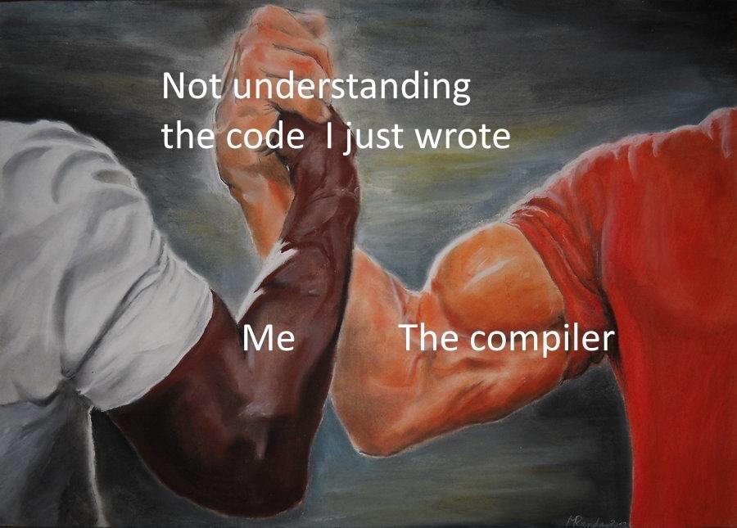
Announcements
Lab 9 due tomorrow 4/2
@ 11:59 PM (Queues)
No office hours tomorrow ☺
Program 3 due this Friday 4/5

Slide 3
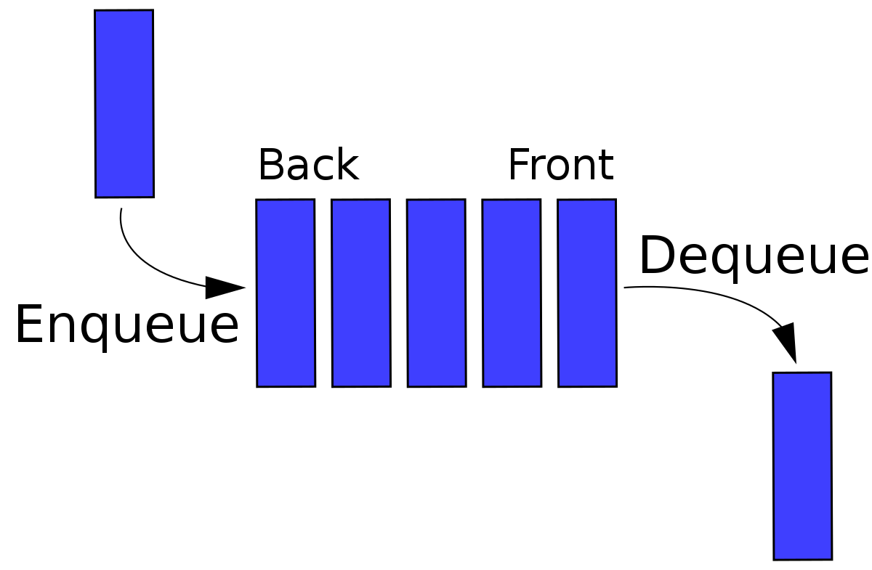
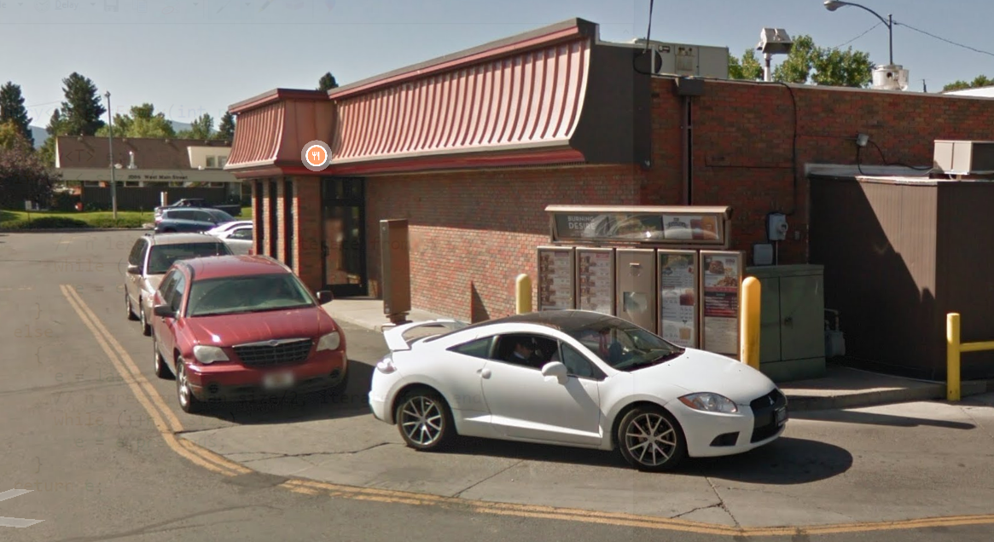

A Queue is a data structure that holds data, but operates in a First-in First-out (FIFO) fashion
Elements get added to the Back of the Queue.
Elements get removed from the Front of the queue
Once again, we need a data structure to hold the data of the queue
Linked List
Array

Slide 4
A Queue is a data structure that holds data, but operates in a First-in First-out (FIFO) fashion
The Queue ADT has the following methods:
Enqueue- Add new element to the queue
Dequeue- Remove element from the queue
** Always remove the front-most element
Peek()- Return the element that is at the front of the queue
IsEmpty() – Returns true if queue is empty, returns false is queue is not empty

Slide 5
Today, we will be implementing a Queue with an Array.
Suppose that we have a queue that can hold 6 elements
0
1
2
3
4
5

Slide 6
Today, we will be implementing a Queue with an Array.
Suppose that we have a queue that can hold 6 elements
We need to keep track of a few things:
The index of the front of the queue
The index of the rear of the queue
The size of the queue
The capacity of the queue
0
1
2
3
4
5

Slide 7
Today, we will be implementing a Queue with an Array.
Suppose that we have a queue that can hold 6 elements
We need to keep track of a few things:
The index of the front of the queue
The index of the rear of the queue
The size of the queue
The capacity of the queue
0
1
2
3
4
5
capacity = 6
size = 0
front = 0
rear = 0

Slide 8
Today, we will be implementing a Queue with an Array.
Suppose that we have a queue that can hold 6 elements
0
1
2
3
4
5
capacity = 6
size = 0
front = 0
rear = 0

Slide 9
Today, we will be implementing a Queue with an Array.
Suppose that we have a queue that can hold 6 elements
Order
Tom
Order
Jane
0
1
2
3
4
5
capacity = 6
size = 2
front = 0
rear = 1

Slide 10
Today, we will be implementing a Queue with an Array.
Suppose that we have a queue that can hold 6 elements
Order
Tom
Order
Jane
Enqueue?
0
1
2
3
4
5
capacity = 6
size = 2
front = 0
rear = 1

Slide 11
Today, we will be implementing a Queue with an Array.
Suppose that we have a queue that can hold 6 elements
public void enqueue(Order newOrder) {
if(rear == capacity) {
System.out.println("full...");
return;
}
else {
rear++;
this.data[rear] = newOrder;
this.size++;
}
}
Order
Tom
Order
Jane
Order
John
0
1
2
3
4
5
capacity = 6
size = 2
front = 0
rear = 1

Slide 12
Today, we will be implementing a Queue with an Array.
Suppose that we have a queue that can hold 6 elements
public void enqueue(Order newOrder) {
if(rear == capacity) {
System.out.println("full...");
return;
}
else {
rear++;
this.data[rear] = newOrder;
this.size++;
}
}
Order
Tom
Order
Jane
Order
John
0
1
2
3
4
5
capacity = 6
size = 2
front = 0
rear = 2

Slide 13
Today, we will be implementing a Queue with an Array.
Suppose that we have a queue that can hold 6 elements
public void enqueue(Order newOrder) {
if(rear == capacity) {
System.out.println("full...");
return;
}
else {
rear++;
this.data[rear] = newOrder;
this.size++;
}
}
Order
Tom
Order
Jane
Order
John
0
1
2
3
4
5
capacity = 6
size = 2
front = 0
rear = 2

Slide 14
Today, we will be implementing a Queue with an Array.
Suppose that we have a queue that can hold 6 elements
public void enqueue(Order newOrder) {
if(rear == capacity) {
System.out.println("full...");
return;
}
else {
rear++;
this.data[rear] = newOrder;
this.size++;
}
}
Order
Tom
Order
Jane
Order
John
0
1
2
3
4
5
capacity = 6
size = 3
front = 0
rear = 2

Slide 15
Today, we will be implementing a Queue with an Array.
Suppose that we have a queue that can hold 6 elements
public void enqueue(Order newOrder) {
if(rear == capacity) {
System.out.println("full...");
return;
}
else {
rear++;
this.data[rear] = newOrder;
this.size++;
}
}
Order
Tom
Order
Jane
Order
John
0
1
2
3
4
5
capacity = 6
size = 3
front = 0
rear = 2

Slide 16
Today, we will be implementing a Queue with an Array.
Suppose that we have a queue that can hold 6 elements
public void enqueue(Order newOrder) {
if(rear == capacity) {
System.out.println("full...");
return;
}
else {
rear++;
this.data[rear] = newOrder;
this.size++;
}
}
Order
Tom
Order
Jane
Order
John
Order
Cosmo
0
1
2
3
4
5
capacity = 6
size = 3
front = 0
rear = 2

Slide 17
Today, we will be implementing a Queue with an Array.
Suppose that we have a queue that can hold 6 elements
public void enqueue(Order newOrder) {
if(rear == capacity) {
System.out.println("full...");
return;
}
else {
rear++;
this.data[rear] = newOrder;
this.size++;
}
}
Order
Tom
Order
Jane
Order
John
Order
Cosmo
0
1
2
3
4
5
capacity = 6
size = 3
front = 0
rear = 3

Slide 18
Today, we will be implementing a Queue with an Array.
Suppose that we have a queue that can hold 6 elements
public void enqueue(Order newOrder) {
if(rear == capacity) {
System.out.println("full...");
return;
}
else {
rear++;
this.data[rear] = newOrder;
this.size++;
}
}
Order
Tom
Order
Jane
Order
John
Order
Cosmo
0
1
2
3
4
5
capacity = 6
size = 3
front = 0
rear = 3

Slide 19
Today, we will be implementing a Queue with an Array.
Suppose that we have a queue that can hold 6 elements
public void enqueue(Order newOrder) {
if(rear == capacity) {
System.out.println("full...");
return;
}
else {
rear++;
this.data[rear] = newOrder;
this.size++;
}
}
Order
Tom
Order
Jane
Order
John
Order
Cosmo
0
1
2
3
4
5
capacity = 6
size = 4
front = 0
rear = 3

Slide 20
Today, we will be implementing a Queue with an Array.
Suppose that we have a queue that can hold 6 elements
public void enqueue(Order newOrder) {
if(rear == capacity) {
System.out.println("full...");
return;
}
else {
rear++;
this.data[rear] = newOrder;
this.size++;
}
}
Order
Tom
Order
Jane
Order
John
Order
Cosmo
Order
Leo
Order
Juliet
0
1
2
3
4
5
capacity = 6
size = 6
front = 0
rear = 5
Issues with this?

Slide 21
Today, we will be implementing a Queue with an Array.
Suppose that we have a queue that can hold 6 elements
public void enqueue(Order newOrder) {
if(rear == capacity) {
System.out.println("full...");
return;
}
else {
rear++;
this.data[rear] = newOrder;
this.size++;
}
}
Order
Tom
Order
Jane
Order
John
Order
Cosmo
Order
Leo
Order
Juliet
0
1
2
3
4
5
This if statement is not satisfied, so we will try to add to a full queue → Array index out of bounds
capacity = 6
size = 6
front = 0
rear = 5

Slide 22

Today, we will be implementing a Queue with an Array.
Suppose that we have a queue that can hold 6 elements
public void enqueue(Order newOrder) {
if(size == capacity) {
System.out.println("full...");
return;
}
else {
rear++;
this.data[rear] = newOrder;
this.size++;
}
}
Order
Tom
Order
Jane
Order
John
Order
Cosmo
Order
Leo
Order
Juliet
0
1
2
3
4
5
capacity = 6
size = 6
front = 0
rear = 5

Slide 23
Today, we will be implementing a Queue with an Array.
Suppose that we have a queue that can hold 6 elements
Order
Tom
Order
Jane
Order
John
Order
Cosmo
Order
Leo
Order
Juliet
Dequeue?
0
1
2
3
4
5
capacity = 6
size = 6
front = 0
rear = 5

Slide 24
Today, we will be implementing a Queue with an Array.
Suppose that we have a queue that can hold 6 elements
Order
Tom
Order
Jane
Order
John
Order
Cosmo
Order
Leo
Order
Juliet
Remove the front element, move front pointer forward one spot
0
1
2
3
4
5
capacity = 6
size = 6
front = 0
rear = 5

Slide 25
Today, we will be implementing a Queue with an Array.
Suppose that we have a queue that can hold 6 elements
Order
Jane
Order
John
Order
Cosmo
Order
Leo
Order
Juliet
Remove the front element, move front pointer forward one spot
0
1
2
3
4
5
capacity = 6
size = 6
front = 0
rear = 5

Slide 26
Today, we will be implementing a Queue with an Array.
Suppose that we have a queue that can hold 6 elements
Enqueue again?
public void enqueue(Order newOrder) {
if(size == capacity) {
System.out.println("full...");
return;
}
else {
rear++;
this.data[rear] = newOrder;
this.size++;
}
}
Order
Jane
Order
John
Order
Cosmo
Order
Leo
Order
Juliet
0
1
2
3
4
5
capacity = 6
size = 6
front = 0
rear = 5

Slide 27
Today, we will be implementing a Queue with an Array.
Suppose that we have a queue that can hold 6 elements
Enqueue again?
public void enqueue(Order newOrder) {
if(size == capacity) {
System.out.println("full...");
return;
}
else {
rear++;
this.data[rear] = newOrder;
this.size++;
}
}
Order
Jane
Order
John
Order
Cosmo
Order
Leo
Order
Juliet
0
1
2
3
4
5
Array index out of bounds error!
capacity = 6
size = 6
front = 0
rear = 5

Slide 28
Today, we will be implementing a Queue with an Array.
Suppose that we have a queue that can hold 6 elements
Dequeue?
Order
Tom
Order
Jane
Order
John
Order
Cosmo
Order
Leo
Order
Juliet
Remove the front element
Make some room in the back
0
1
2
3
4
5
capacity = 6
size = 6
front = 0
rear = 5

Slide 29
Today, we will be implementing a Queue with an Array.
Suppose that we have a queue that can hold 6 elements
Dequeue?
Order
Jane
Order
John
Order
Cosmo
Order
Leo
Order
Juliet
Remove the front element
Make some room in the back
0
1
2
3
4
5
capacity = 6
size = 6
front = 0
rear = 5

Slide 30
Today, we will be implementing a Queue with an Array.
Suppose that we have a queue that can hold 6 elements
Dequeue?
Order
Jane
Order
John
Order
Cosmo
Order
Leo
Order
Juliet
Remove the front element
Make some room in the back
Shift all of our data over one spot
0
1
2
3
4
5
capacity = 6
size = 6
front = 0
rear = 5

Slide 31
Today, we will be implementing a Queue with an Array.
Suppose that we have a queue that can hold 6 elements
Dequeue?
Order
Jane
Order
John
Order
Cosmo
Order
Leo
Order
Juliet
Remove the front element
Make some room in the back
Shift all of our data over one spot
0
1
2
3
4
5
The front of our queue will always stay at zero
capacity = 6
size = 5
front = 0
rear = 4

Slide 32
Today, we will be implementing a Queue with an Array.
Suppose that we have a queue that can hold 6 elements
public void dequeue() {
if(this.size == 0) {
System.out.println("empty...");
return;
}
else {
for(int i = 0; i < back-1; i++) {
this.orders[i] = this.orders[i+1];
}
if(back < capacity) {
this.orders[back] = null;
}
this.back--;
this.size--;
}
}
Order
Jane
Order
John
Order
Cosmo
Order
Leo
Order
Juliet
0
1
2
3
4
5
capacity = 6
size = 5
front = 0
rear = 4

Slide 33
Today, we will be implementing a Queue with an Array.
Suppose that we have a queue that can hold 6 elements
public void dequeue() {
if(this.size == 0) {
System.out.println("empty...");
return;
}
else {
for(int i = 0; i < back-1; i++) {
this.orders[i] = this.orders[i+1];
}
if(back < capacity) {
this.orders[back] = null;
}
this.back--;
this.size--;
}
}
Order
Jane
Order
John
Order
Cosmo
Order
Leo
Order
Juliet
0
1
2
3
4
5
capacity = 6
size = 5
front = 0
rear = 4

Slide 34
Today, we will be implementing a Queue with an Array.
Suppose that we have a queue that can hold 6 elements
public void dequeue() {
if(this.size == 0) {
System.out.println("empty...");
return;
}
else {
for(int i = 0; i < back-1; i++) {
this.orders[i] = this.orders[i+1];
}
if(back < capacity) {
this.orders[back] = null;
}
this.back--;
this.size--;
}
}
Order
Jane
Order
John
Order
Cosmo
Order
Leo
Order
Juliet
0
1
2
3
4
5
capacity = 6
size = 5
front = 0
rear = 4
Shift everything over one spot

Slide 35

Today, we will be implementing a Queue with an Array.
Suppose that we have a queue that can hold 6 elements
public void dequeue() {
if(this.size == 0) {
System.out.println("empty...");
return;
}
else {
for(int i = 0; i < back-1; i++) {
this.orders[i] = this.orders[i+1];
}
if(back < capacity) {
this.orders[back] = null;
}
this.back--;
this.size--;
}
}
Order
Jane
Order
John
Order
Cosmo
Order
Leo
Order
Juliet
0
1
2
3
4
5
capacity = 6
size = 5
front = 0
rear = 4

Slide 36

Today, we will be implementing a Queue with an Array.
Suppose that we have a queue that can hold 6 elements
public void dequeue() {
if(this.size == 0) {
System.out.println("empty...");
return;
}
else {
for(int i = 0; i < back-1; i++) {
this.orders[i] = this.orders[i+1];
}
if(back < capacity) {
this.orders[back] = null;
}
this.back--;
this.size--;
}
}
Order
John
Order
Jane
Order
John
Order
Cosmo
Order
Leo
Order
Juliet
0
1
2
3
4
5
capacity = 6
size = 5
front = 0
rear = 4

Slide 37
Today, we will be implementing a Queue with an Array.
Suppose that we have a queue that can hold 6 elements
public void dequeue() {
if(this.size == 0) {
System.out.println("empty...");
return;
}
else {
for(int i = 0; i < back-1; i++) {
this.orders[i] = this.orders[i+1];
}
if(back < capacity) {
this.orders[back] = null;
}
this.back--;
this.size--;
}
}
Order
John
Order
Jane
Order
John
Order
Cosmo
Order
Leo
Order
Juliet
0
1
2
3
4
5
capacity = 6
size = 5
front = 0
rear = 4

Slide 38
Today, we will be implementing a Queue with an Array.
Suppose that we have a queue that can hold 6 elements
public void dequeue() {
if(this.size == 0) {
System.out.println("empty...");
return;
}
else {
for(int i = 0; i < back-1; i++) {
this.orders[i] = this.orders[i+1];
}
if(back < capacity) {
this.orders[back] = null;
}
this.back--;
this.size--;
}
}
Order
John
Order
Jane
Order
Cosmo
Order
Cosmo
Order
John
Order
Leo
Order
Juliet
0
1
2
3
4
5
capacity = 6
size = 5
front = 0
rear = 5

Slide 39
Today, we will be implementing a Queue with an Array.
Suppose that we have a queue that can hold 6 elements
public void dequeue() {
if(this.size == 0) {
System.out.println("empty...");
return;
}
else {
for(int i = 0; i < back-1; i++) {
this.orders[i] = this.orders[i+1];
}
if(back < capacity) {
this.orders[back] = null;
}
this.back--;
this.size--;
}
}
Order
John
Order
Jane
Order
Cosmo
Order
Cosmo
Order
John
Order
Leo
Order
Juliet
0
1
2
3
4
5
capacity = 6
size = 5
front = 0
rear = 4

Slide 40
Today, we will be implementing a Queue with an Array.
Suppose that we have a queue that can hold 6 elements
public void dequeue() {
if(this.size == 0) {
System.out.println("empty...");
return;
}
else {
for(int i = 0; i < back-1; i++) {
this.orders[i] = this.orders[i+1];
}
if(back < capacity) {
this.orders[back] = null;
}
this.back--;
this.size--;
}
}
Order
John
Order
Jane
Order
Cosmo
Order
Cosmo
Order
Leo
Order
John
Order
Leo
Order
Juliet
0
1
2
3
4
5
capacity = 6
size = 5
front = 0
rear = 4

Slide 41
Today, we will be implementing a Queue with an Array.
Suppose that we have a queue that can hold 6 elements
public void dequeue() {
if(this.size == 0) {
System.out.println("empty...");
return;
}
else {
for(int i = 0; i < back-1; i++) {
this.orders[i] = this.orders[i+1];
}
if(back < capacity) {
this.orders[back] = null;
}
this.back--;
this.size--;
}
}
Order
John
Order
Jane
Order
Cosmo
Order
Cosmo
Order
Leo
Order
John
Order
Leo
Order
Juliet
0
1
2
3
4
5
capacity = 6
size = 5
front = 0
rear = 4

Slide 42
Today, we will be implementing a Queue with an Array.
Suppose that we have a queue that can hold 6 elements
public void dequeue() {
if(this.size == 0) {
System.out.println("empty...");
return;
}
else {
for(int i = 0; i < back-1; i++) {
this.orders[i] = this.orders[i+1];
}
if(back < capacity) {
this.orders[back] = null;
}
this.back--;
this.size--;
}
}
Order
John
Order
Jane
Order
Cosmo
Order
Cosmo
Order
Leo
Order
John
Order
Leo
Order
Juliet
Order
Juliet
0
1
2
3
4
5
capacity = 6
size = 5
front = 0
rear = 4

Slide 43
Today, we will be implementing a Queue with an Array.
Suppose that we have a queue that can hold 6 elements
public void dequeue() {
if(this.size == 0) {
System.out.println("empty...");
return;
}
else {
for(int i = 0; i < back-1; i++) {
this.orders[i] = this.orders[i+1];
}
if(back < capacity) {
this.orders[back] = null;
}
this.back--;
this.size--;
}
}
Order
John
Order
Jane
Order
Cosmo
Order
Cosmo
Order
Leo
Order
John
Order
Leo
Order
Juliet
Order
Juliet
0
1
2
3
4
5
capacity = 6
size = 5
front = 0
rear = 4

Slide 44
Today, we will be implementing a Queue with an Array.
Suppose that we have a queue that can hold 6 elements
public void dequeue() {
if(this.size == 0) {
System.out.println("empty...");
return;
}
else {
for(int i = 0; i < back-1; i++) {
this.orders[i] = this.orders[i+1];
}
if(back < capacity) {
this.orders[back] = null;
}
this.back--;
this.size--;
}
}
Order
John
Order
Jane
Order
Cosmo
Order
Cosmo
Order
Leo
Order
John
Order
Leo
Order
Juliet
Order
Juliet
0
1
2
3
4
5
capacity = 6
size = 5
front = 0
rear = 4

Slide 45
Today, we will be implementing a Queue with an Array.
Suppose that we have a queue that can hold 6 elements
public void dequeue() {
if(this.size == 0) {
System.out.println("empty...");
return;
}
else {
for(int i = 0; i < back-1; i++) {
this.orders[i] = this.orders[i+1];
}
if(back < capacity) {
this.orders[back] = null;
}
this.back--;
this.size--;
}
}
Order
John
Order
Jane
Order
Cosmo
Order
Cosmo
Order
Leo
Order
John
Order
Leo
Order
Juliet
0
1
2
3
4
5
capacity = 6
size = 5
front = 0
rear = 4

Slide 46
Today, we will be implementing a Queue with an Array.
Suppose that we have a queue that can hold 6 elements
public void dequeue() {
if(this.size == 0) {
System.out.println("empty...");
return;
}
else {
for(int i = 0; i < back-1; i++) {
this.orders[i] = this.orders[i+1];
}
if(back < capacity) {
this.orders[back] = null;
}
this.back--;
this.size--;
}
}
Order
John
Order
Jane
Order
Cosmo
Order
Cosmo
Order
Leo
Order
John
Order
Leo
Order
Juliet
0
1
2
3
4
5
capacity = 6
size = 5
front = 0
rear = 4

Slide 47
Today, we will be implementing a Queue with an Array.
Suppose that we have a queue that can hold 6 elements
public void dequeue() {
if(this.size == 0) {
System.out.println("empty...");
return;
}
else {
for(int i = 0; i < back-1; i++) {
this.orders[i] = this.orders[i+1];
}
if(back < capacity) {
this.orders[back] = null;
}
this.back--;
this.size--;
}
}
Order
John
Order
Jane
Order
Cosmo
Order
Cosmo
Order
Leo
Order
John
Order
Leo
Order
Juliet
0
1
2
3
4
5
capacity = 6
size = 4
front = 0
rear = 3

Slide 48

Today, we will be implementing a Queue with an Array.
Suppose that we have a queue that can hold 6 elements
public void dequeue() {
if(this.size == 0) {
System.out.println("empty...");
return;
}
else {
for(int i = 0; i < back-1; i++) {
this.orders[i] = this.orders[i+1];
}
if(back < capacity) {
this.orders[back] = null;
}
this.back--;
this.size--;
}
}
Order
John
Order
Jane
Order
Cosmo
Order
Cosmo
Order
Leo
Order
John
Order
Leo
Order
Juliet
0
1
2
3
4
5
capacity = 6
size = 4
front = 0
rear = 3

Slide 49
Today, we will be implementing a Queue with an Array.
Suppose that we have a queue that can hold 6 elements
public void dequeue() {
if(this.size == 0) {
System.out.println("empty...");
return;
}
else {
for(int i = 0; i < back-1; i++) {
this.orders[i] = this.orders[i+1];
}
if(back < capacity) {
this.orders[back] = null;
}
this.back--;
this.size--;
}
}
Order
John
Order
Cosmo
Order
Jane
Order
Cosmo
Order
Leo
Order
Leo
Order
Cosmo
Order
Juliet
Order
John
Order
Leo
Order
Juliet
0
1
2
3
4
5
capacity = 6
size = 4
front = 0
rear = 3

Slide 50
Today, we will be implementing a Queue with an Array.
Suppose that we have a queue that can hold 6 elements
public void dequeue() {
if(this.size == 0) {
System.out.println("empty...");
return;
}
else {
for(int i = 0; i < back-1; i++) {
this.orders[i] = this.orders[i+1];
}
if(back < capacity) {
this.orders[back] = null;
}
this.back--;
this.size--;
}
}
Order
John
Order
Cosmo
Order
Jane
Order
Cosmo
Order
Leo
Order
Leo
Order
Cosmo
Order
Juliet
Order
John
Order
Leo
Order
Juliet
0
1
2
3
4
5
capacity = 6
size = 4
front = 0
rear = 3

Slide 51
Today, we will be implementing a Queue with an Array.
Suppose that we have a queue that can hold 6 elements
public void dequeue() {
if(this.size == 0) {
System.out.println("empty...");
return;
}
else {
for(int i = 0; i < back-1; i++) {
this.orders[i] = this.orders[i+1];
}
if(back < capacity) {
this.orders[back] = null;
}
this.back--;
this.size--;
}
}
Order
John
Order
Cosmo
Order
Jane
Order
Cosmo
Order
Leo
Order
Leo
Order
Cosmo
Order
Juliet
Order
John
0
1
2
3
4
5
capacity = 6
size = 4
front = 0
rear = 3

Slide 52
Today, we will be implementing a Queue with an Array.
Suppose that we have a queue that can hold 6 elements
public void dequeue() {
if(this.size == 0) {
System.out.println("empty...");
return;
}
else {
for(int i = 0; i < back-1; i++) {
this.orders[i] = this.orders[i+1];
}
if(back < capacity) {
this.orders[back] = null;
}
this.back--;
this.size--;
}
}
Order
John
Order
Cosmo
Order
Jane
Order
Cosmo
Order
Leo
Order
Leo
Order
Cosmo
Order
Juliet
Order
John
0
1
2
3
4
5
capacity = 6
size = 3
front = 0
rear = 2

Slide 53
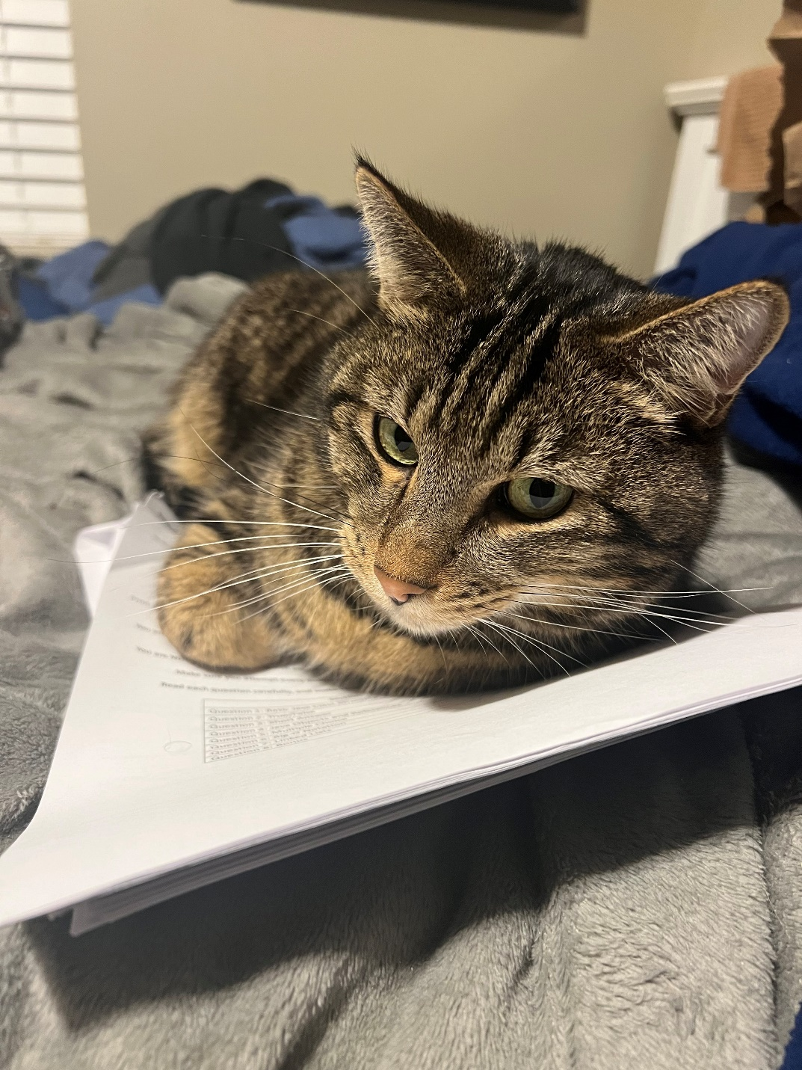

Slide 54
Runtime Analysis
public void enqueue(Order newOrder) {
if(rear == capacity) {
System.out.println("full...");
return;
}
else {
rear++;
this.data[rear] = newOrder;
this.size++;
}
}

Slide 55
Runtime Analysis
public void enqueue(Order newOrder) {
if(rear == capacity) {
System.out.println("full...");
return;
}
else {
rear++;
this.data[rear] = newOrder;
this.size++;
}
}
O(1)
O(1)
O(1)
O(1)
O(1)
O(1)

Slide 56
Runtime Analysis
public void enqueue(Order newOrder) {
if(rear == capacity) {
System.out.println("full...");
return;
}
else {
rear++;
this.data[rear] = newOrder;
this.size++;
}
}
O(1)
O(1)
O(1)
Total running time:
O(1)
O(1)
O(1)
O(1)

Slide 57
Runtime Analysis
public void dequeue() {
if(this.size == 0) {
System.out.println("empty...");
return;
}
else {
for(int i = 0; i < back-1; i++) {
this.orders[i] = this.orders[i+1];
}
if(back < capacity) {
this.orders[back] = null;
}
this.back--;
this.size--;
}
}

Slide 58
Runtime Analysis
public void dequeue() {
if(this.size == 0) {
System.out.println("empty...");
return;
}
else {
for(int i = 0; i < back-1; i++) {
this.orders[i] = this.orders[i+1];
}
if(back < capacity) {
this.orders[back] = null;
}
this.back--;
this.size--;
}
}
O(1)
O(1)
O(1)
O(N-1)
N = # elements in our queue
O(1)
O(1)
O(1)
O(1)
O(1)

Slide 59
Runtime Analysis
public void dequeue() {
if(this.size == 0) {
System.out.println("empty...");
return;
}
else {
for(int i = 0; i < back-1; i++) {
this.orders[i] = this.orders[i+1];
}
if(back < capacity) {
this.orders[back] = null;
}
this.back--;
this.size--;
}
}
O(1)
O(1)
O(1)
O(N-1)
N = # elements in our queue
O(1)
O(1)
O(1)
Total running time:
O(N)
O(1)
O(1)

Slide 60
Runtime Analysis
Total running time:
O(N)
public void dequeue() {
if(this.size == 0) {
System.out.println("empty...");
return;
}
else {
for(int i = 0; i < back-1; i++) {
this.orders[i] = this.orders[i+1];
}
if(back < capacity) {
this.orders[back] = null;
}
this.back--;
this.size--;
}
}
O(1)
O(1)
O(1)
This algorithm works fine, but the issue is that shifting data can be costly
(think about if this queue has 1000000 things in it→ we must shift 999999 elements!)
O(N-1)
O(1)
O(1)
O(1)
O(1)
O(1)

Slide 61
How to improve our queue?

Slide 62
A Queue is a data structure that holds data, but operates in a First-in First-out (FIFO) fashion
We are going to make use of the modulus (%) operator !
Order
Tom
Order
Jane
Order
John
Order
Cosmo
10 % 6 = 4
3 % 6 = 3
6 % 6 = 0
0
1
2
3
4
5
capacity = 6
size = 4
front = 0

Slide 63
A Queue is a data structure that holds data, but operates in a First-in First-out (FIFO) fashion
Let’s enqueue
Here is the formula for determining where to insert the new element
Order
Tom
Order
Jane
Order
John
Order
Cosmo
insert_spot = (front + size) % 6
0
1
2
3
4
5
capacity = 6
size = 4
front = 0

Slide 64
A Queue is a data structure that holds data, but operates in a First-in First-out (FIFO) fashion
Let’s enqueue
Here is the formula for determining where to insert the new element
Order
Tom
Order
Jane
Order
John
Order
Cosmo
insert_spot = (front + size) % 6
Order
Todd
0
1
2
3
4
5
capacity = 6
size = 4
front = 0
insert_spot = 4
(0 + 4) % 6 = Insert at spot 4

Slide 65
A Queue is a data structure that holds data, but operates in a First-in First-out (FIFO) fashion
Let’s enqueue
Here is the formula for determining where to insert the new element
Order
Tom
Order
Jane
Order
John
Order
Cosmo
Order
Todd
insert_spot = (front + size) % 6
0
1
2
3
4
5
capacity = 6
size = 4
front = 0
insert_spot = 4

Slide 66
A Queue is a data structure that holds data, but operates in a First-in First-out (FIFO) fashion
Let’s dequeue
data[front] = null
Order
Tom
Order
Jane
Order
John
Order
Cosmo
Order
Todd
0
1
2
3
4
5
capacity = 6
size = 4
front = 0
insert_spot = 4

Slide 67
A Queue is a data structure that holds data, but operates in a First-in First-out (FIFO) fashion
Let’s dequeue
data[front] = null
Order
Jane
Order
John
Order
Cosmo
Order
Todd
front = (front + 1) % 6
move the front pointer to the next element
= (0 + 1) % 6 = 1
0
1
2
3
4
5
capacity = 6
size = 4
front = 1
insert_spot = 4

Slide 68
A Queue is a data structure that holds data, but operates in a First-in First-out (FIFO) fashion
Let’s dequeue (again)
data[front] = null
Order
Jane
Order
John
Order
Cosmo
Order
Todd
front = (front + 1) % 6
move the front pointer to the next element
= (0 + 1) % 6 = 1
0
1
2
3
4
5
capacity = 6
size = 4
front = 1
insert_spot = 4

Slide 69
A Queue is a data structure that holds data, but operates in a First-in First-out (FIFO) fashion
Let’s dequeue (again)
data[front] = null
Order
John
Order
Cosmo
Order
Todd
front = (front + 1) % 6
move the front pointer to the next element
= (1 + 1) % 6 = 2
0
1
2
3
4
5
capacity = 6
size = 3
front = 2
insert_spot = 4

Slide 70
A Queue is a data structure that holds data, but operates in a First-in First-out (FIFO) fashion
Let’s enqueue (again)
Order
John
Order
Cosmo
Order
Todd
insert_spot = (front + size) % 6
insert_spot = (2 + 3) % 6
1
Order
Sam
0
2
3
4
5
5%6 = 5
capacity = 6
size = 3
front = 2
insert_spot = 5

Slide 71
A Queue is a data structure that holds data, but operates in a First-in First-out (FIFO) fashion
Let’s enqueue (again)
Order
John
Order
Cosmo
Order
Todd
Order
Sam
insert_spot = (front + size) % 6
insert_spot = (2 + 3) % 6
0
1
2
3
4
5
5%6 = 5
capacity = 6
size = 4
front = 2
insert_spot = 5

Slide 72
A Queue is a data structure that holds data, but operates in a First-in First-out (FIFO) fashion
Let’s enqueue (again)
Order
John
Order
Cosmo
Order
Todd
Order
Sam
insert_spot = (front + size) % 6
(2 + 4) % 6 = 0
0
1
2
3
4
5
Order
Jin
capacity = 6
size = 4
front = 2
insert_spot = 0

Slide 73
A Queue is a data structure that holds data, but operates in a First-in First-out (FIFO) fashion
Let’s enqueue (again)
Order
Jin
Order
John
Order
Cosmo
Order
Todd
Order
Sam
insert_spot = (front + size) % 6
(2 + 4) % 6 = 0
0
1
2
3
4
5
The modulus operator allows us to “wrap around” in our array!
capacity = 6
size = 4
front = 2
insert_spot = 0

Slide 74
A Queue is a data structure that holds data, but operates in a First-in First-out (FIFO) fashion
Let’s dequqe (again)
data[front] = null
Order
Jin
Order
John
Order
Cosmo
Order
Todd
Order
Sam
front = (front + 1) % 6
0
1
2
3
4
5
The modulus operator allows us to “wrap around” in our array!
capacity = 6
size = 4
front = 2
insert_spot = 0

Slide 75
A Queue is a data structure that holds data, but operates in a First-in First-out (FIFO) fashion
Let’s dequqe (again)
data[front] = null
Order
Jin
Order
Cosmo
Order
Todd
Order
Sam
front = (front + 1) % 6
(2+1) % 6 = 3
0
1
2
3
4
5
The modulus operator allows us to “wrap around” in our array!
capacity = 6
size = 4
front = 3
insert_spot = 0

Slide 76
A Queue is a data structure that holds data, but operates in a First-in First-out (FIFO) fashion
Let’s dequqe (again)
data[front] = null
Order
Jin
Order
Sam
front = (front + 1) % 6
0
1
2
3
4
5
capacity = 6
size = 2
front = 5
insert_spot = 0

Slide 77
A Queue is a data structure that holds data, but operates in a First-in First-out (FIFO) fashion
Let’s dequqe (again)
data[front] = null
Order
Jin
Order
Sam
front = (front + 1) % 6
Front = (5 + 1) % 6 = 0
0
1
2
3
4
5
capacity = 6
size = 2
front = 5
insert_spot = 0

Slide 78
A Queue is a data structure that holds data, but operates in a First-in First-out (FIFO) fashion
Let’s dequqe (again)
data[front] = null
Order
Jin
front = (front + 1) % 6
Front = (5 + 1) % 6 = 0
0
1
2
3
4
5
capacity = 6
size = 1
front = 0
insert_spot = 0

Slide 79
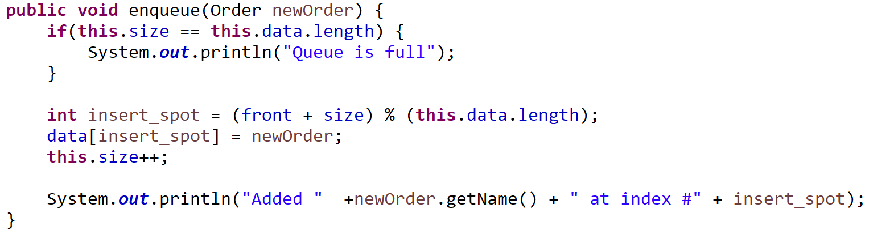
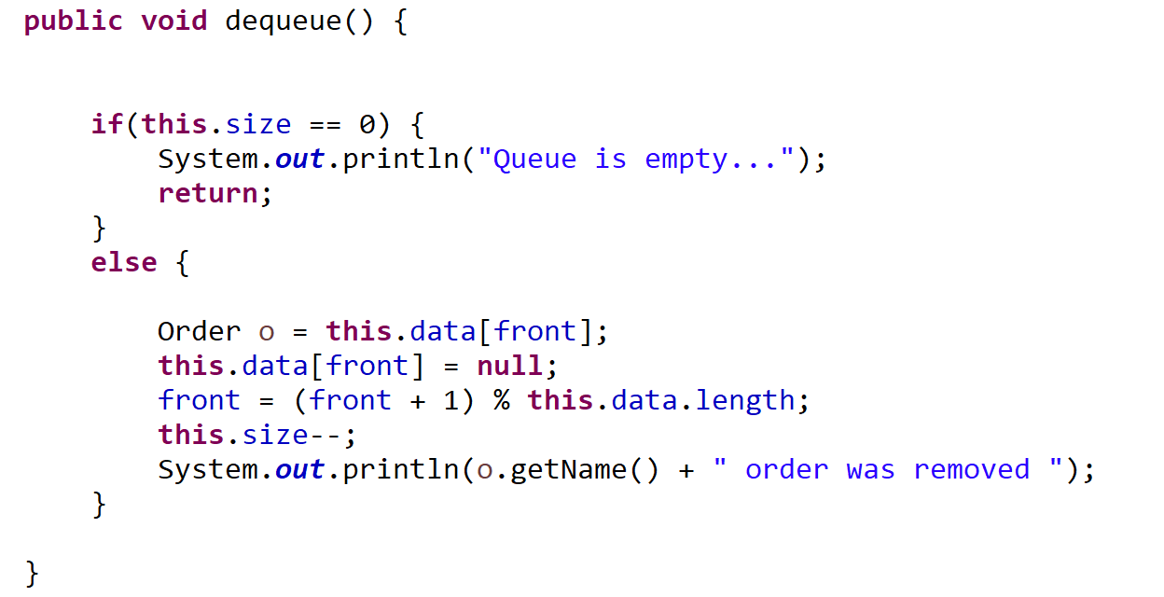

Slide 80
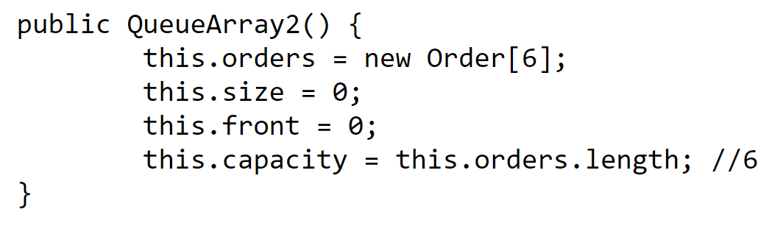
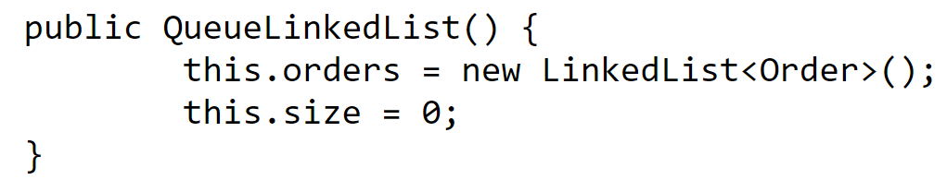
Queue Runtime Analysis
 | Linked List | Array
Creation
Enqueue
Dequeue
Peek
Print Queue

Slide 81
Queue Runtime Analysis
O(1)
O(n), n = | array |
 | Linked List | Array
Creation | O(1) | O(n)
Enqueue
Dequeue
Peek
Print Queue

Slide 82
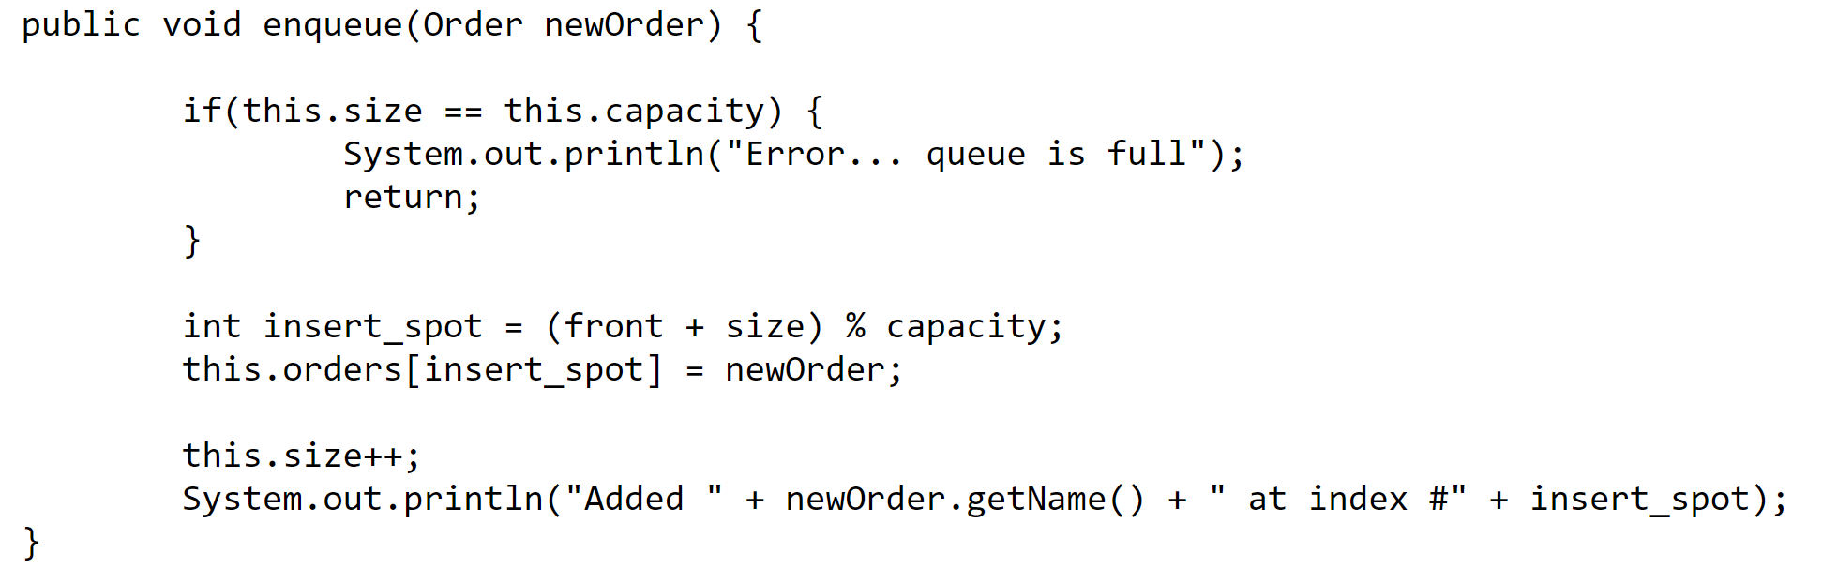
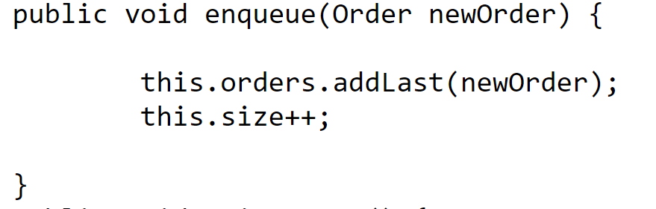
Queue Runtime Analysis
 | Linked List | Array
Creation | O(1) | O(n)
Enqueue
Dequeue
Peek
Print Queue

Slide 83
Queue Runtime Analysis
O(1)
O(1)
O(1)
O(1)
O(1)
O(1)
O(1)
O(1)
 | Linked List | Array
Creation | O(1) | O(n)
Enqueue | O(1) | O(1)
Dequeue
Peek
Print Queue

Slide 84
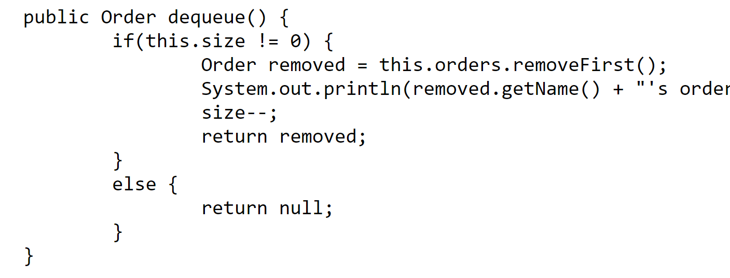
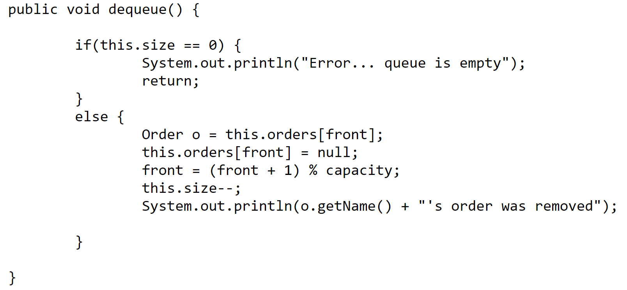
Queue Runtime Analysis
 | Linked List | Array
Creation | O(1) | O(n)
Enqueue | O(1) | O(1)
Dequeue
Peek
Print Queue

Slide 85
Queue Runtime Analysis
O(1)
O(1)
O(1)
O(1)
 | Linked List | Array
Creation | O(1) | O(n)
Enqueue | O(1) | O(1)
Dequeue | O(1) | O(1)
Peek
Print Queue

Slide 86
Queue Runtime Analysis
return this.orders.getFirst()
return this.orders[front]
 | Linked List | Array
Creation | O(1) | O(n)
Enqueue | O(1) | O(1)
Dequeue | O(1) | O(1)
Peek
Print Queue

Slide 87
Queue Runtime Analysis
return this.orders.getFirst()
O(1)
return this.orders[front]
O(1)
 | Linked List | Array
Creation | O(1) | O(n)
Enqueue | O(1) | O(1)
Dequeue | O(1) | O(1)
Peek | O(1) | O(1)
Print Queue

Slide 88
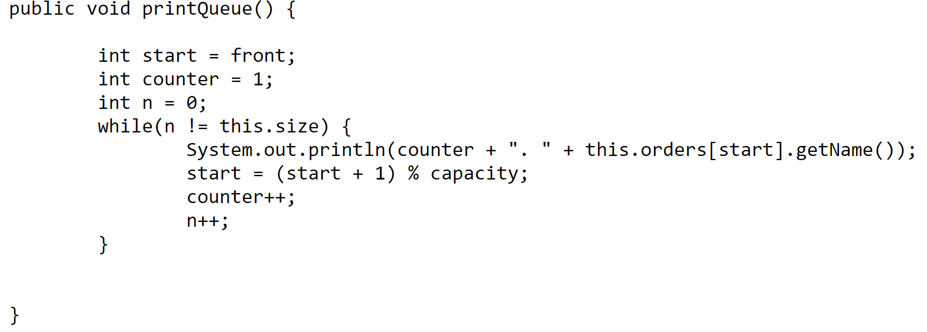
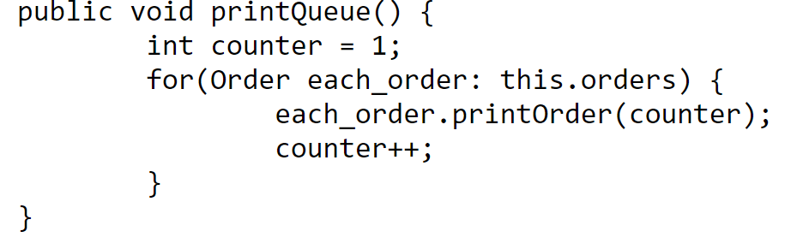
Queue Runtime Analysis
 | Linked List | Array
Creation | O(1) | O(n)
Enqueue | O(1) | O(1)
Dequeue | O(1) | O(1)
Peek | O(1) | O(1)
Print Queue

Slide 89
Queue Runtime Analysis
O(1)
O(1)
O(1)
O(1)
O(n)
O(n)
O(1)
O(1)
O(1)
n = # of elements in queue
n = # of elements in queue
 | Linked List | Array
Creation | O(1) | O(n)
Enqueue | O(1) | O(1)
Dequeue | O(1) | O(1)
Peek | O(1) | O(1)
Print Queue | O(n) | O(n)

Slide 90
Queue Runtime Analysis
 | Linked List | Array
Creation | O(1) | O(n)
Enqueue | O(1) | O(1)
Dequeue | O(1) | O(1)
Peek | O(1) | O(1)
Print Queue | O(n) | O(n)
Takeaway: Adding and removing elements from a queue runs in constant time ( O(1) )
(FIFO)
Stack Runtime Analysis
 | w/ Array | w/ Linked List
Creation | O(n) | O(1)
Push() | O(1) | O(1)
Pop() | O(1) | O(1)
peek() | O(1) | O(1)
Print() | O(n) | O(n)
Takeaway: Adding and removing elements from a stack runs in constant time ( O(1) )
(LIFO)

