Slide 1

CSCI 132: Basic Data Structures and Algorithms
Recursion (Part 1)
Reese Pearsall
Spring 2024
https://www.cs.montana.edu/pearsall/classes/spring2024/132/main.html
*All images are stolen from the internet

Slide 2
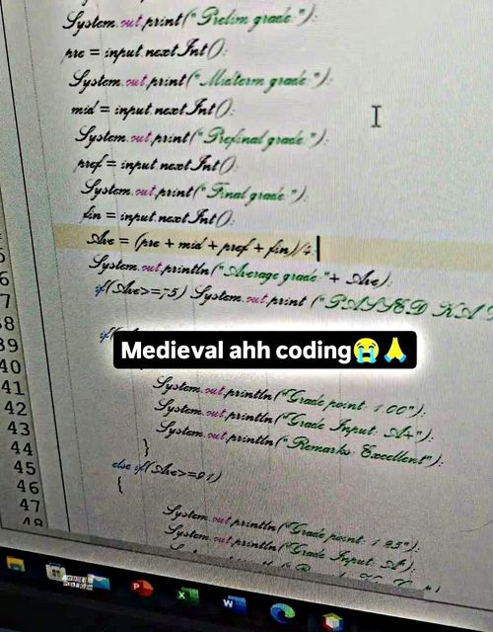
Announcements
Program 3 due tonight
No in-person lecture on Wednesday
Program 4 posted, due two weeks from now (April 19)

Slide 3
Program 4

Slide 4
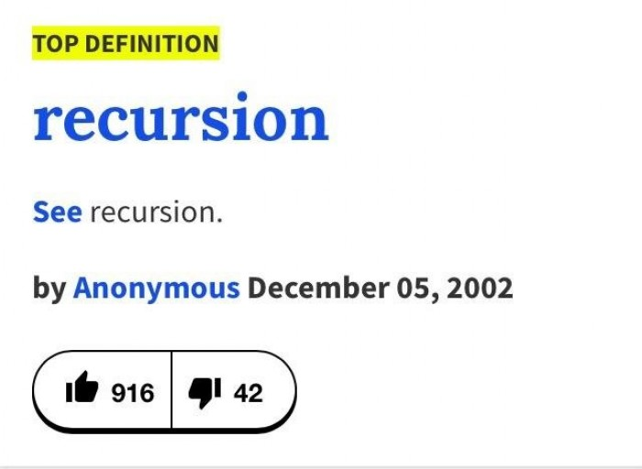
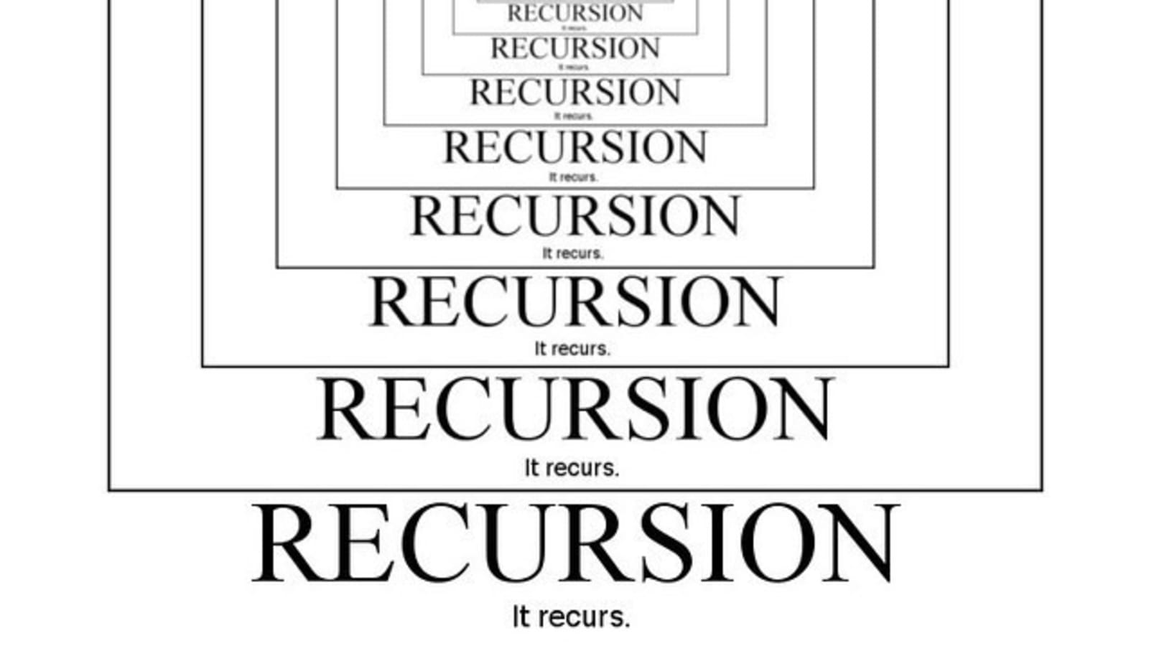
Recursion is a problem-solving technique that involves a method calling itself to solve some smaller problem
static int factorial(int n)
{
if (n == 0)
return 1;
return n * factorial(n - 1);
}

Slide 5
static int factorial(int n)
{
if (n == 0)
return 1;
return n * factorial(n - 1);
}
We can solve the factorial for n by solving smaller problems ( factorial of n-1 ) !
factorial(5)
factorial(4)
factorial(3)
factorial(2)
factorial(1)
factorial(0)

Slide 6
We can solve the factorial for n by solving smaller problems ( factorial of n-1 ) !
static int factorial(int n)
{
if (n == 0)
return 1;
return n * factorial(n - 1);
}
(base case)
(recursive case)
factorial(5)

Slide 7
We can solve the factorial for n by solving smaller problems ( factorial of n-1 ) !
static int factorial(int n)
{
if (n == 0)
return 1;
return n * factorial(n - 1);
}
(base case)
(recursive case)
factorial(5)
factorial(4)

Slide 8
We can solve the factorial for n by solving smaller problems ( factorial of n-1 ) !
static int factorial(int n)
{
if (n == 0)
return 1;
return n * factorial(n - 1);
}
(base case)
(recursive case)
factorial(5)
factorial(4)
factorial(3)

Slide 9
We can solve the factorial for n by solving smaller problems ( factorial of n-1 ) !
static int factorial(int n)
{
if (n == 0)
return 1;
return n * factorial(n - 1);
}
(base case)
(recursive case)
factorial(5)
factorial(4)
factorial(3)
factorial(2)

Slide 10
We can solve the factorial for n by solving smaller problems ( factorial of n-1 ) !
static int factorial(int n)
{
if (n == 0)
return 1;
return n * factorial(n - 1);
}
(base case)
(recursive case)
factorial(5)
factorial(4)
factorial(3)
factorial(2)
factorial(1)

Slide 11
We can solve the factorial for n by solving smaller problems ( factorial of n-1 ) !
static int factorial(int n)
{
if (n == 0)
return 1;
return n * factorial(n - 1);
}
(base case)
(recursive case)
factorial(5)
factorial(4)
factorial(3)
factorial(2)
factorial(1)
factorial(0)

Slide 12
We can solve the factorial for n by solving smaller problems ( factorial of n-1 ) !
static int factorial(int n)
{
if (n == 0)
return 1;
return n * factorial(n - 1);
}
(base case)
(recursive case)
factorial(5)
factorial(4)
factorial(3)
factorial(2)
factorial(1)
1 * factorial(0)
factorial(0)
1 * 1

Slide 13
We can solve the factorial for n by solving smaller problems ( factorial of n-1 ) !
static int factorial(int n)
{
if (n == 0)
return 1;
return n * factorial(n - 1);
}
(base case)
(recursive case)
factorial(5)
factorial(4)
factorial(3)
factorial(2)
factorial(1)
2 * factorial(1)
2 * 1 = 2
1 * factorial(0)
factorial(0)
1 * 1 = 1

Slide 14
We can solve the factorial for n by solving smaller problems ( factorial of n-1 ) !
static int factorial(int n)
{
if (n == 0)
return 1;
return n * factorial(n - 1);
}
(base case)
(recursive case)
factorial(5)
factorial(4)
factorial(3)
factorial(2)
3* factorial(2)
3 * 2 = 6
factorial(1)
2 * factorial(1)
2 * 1 = 2
1 * factorial(0)
factorial(0)
1 * 1 = 1

Slide 15
We can solve the factorial for n by solving smaller problems ( factorial of n-1 ) !
static int factorial(int n)
{
if (n == 0)
return 1;
return n * factorial(n - 1);
}
(base case)
(recursive case)
factorial(5)
factorial(4)
4* factorial(3)
4 * 6 = 24
factorial(3)
factorial(2)
3* factorial(2)
3 * 2 = 6
factorial(1)
2 * factorial(1)
2 * 1 = 2
1 * factorial(0)
factorial(0)
1 * 1 = 1

Slide 16
We can solve the factorial for n by solving smaller problems ( factorial of n-1 ) !
static int factorial(int n)
{
if (n == 0)
return 1;
return n * factorial(n - 1);
}
(base case)
(recursive case)
factorial(5)
5* factorial(4)
5 * 24 = 120
factorial(4)
4* factorial(3)
4 * 6 = 24
factorial(3)
factorial(2)
3* factorial(2)
3 * 2 = 6
factorial(1)
2 * factorial(1)
2 * 1 = 2
1 * factorial(0)
factorial(0)
1 * 1 = 1

Slide 17


We can solve the factorial for n by solving smaller problems ( factorial of n-1 ) !
static int factorial(int n)
{
if (n == 0)
return 1;
return n * factorial(n - 1);
}
(base case)
(recursive case)
120
factorial(5)
factorial(4)
24
6
factorial(3)
Recursive solutions must have the two following conditions:
factorial(2)
Base Case
Recursive Case
2
factorial(1)
1
factorial(0)
1

Slide 18
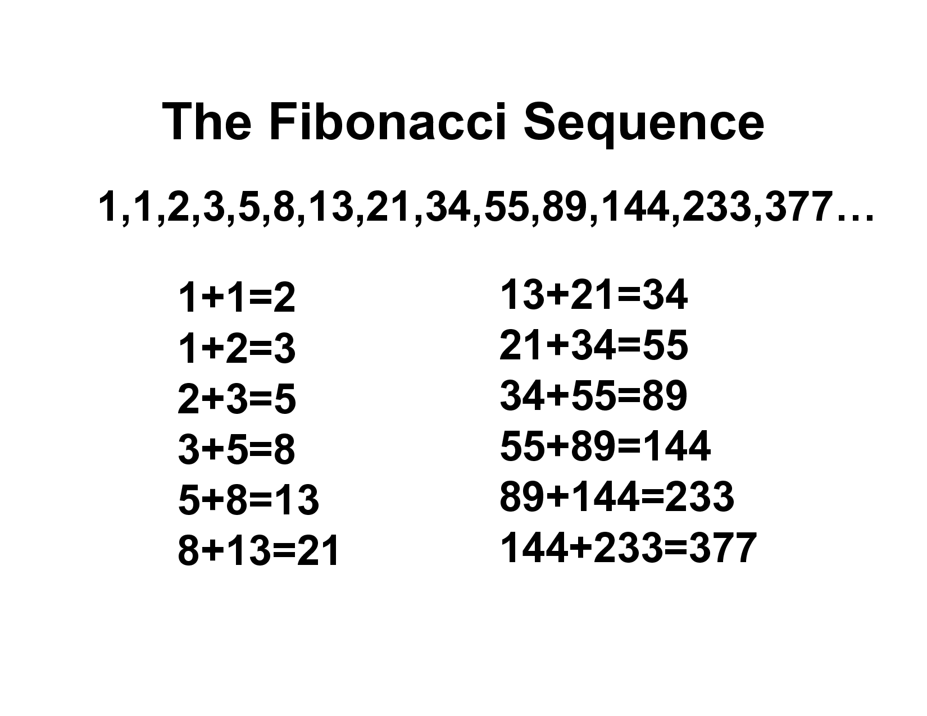
The Fibonacci sequence is a sequence in which each number is the sum of the two preceding ones
So, the N^{th} digit of the Fibonacci Sequence = f(N-1) + f(N-2)
Because the solution to some problem can be expressed in terms of some smaller problem(s), recursion may be a good fit here

Slide 19
The Fibonacci sequence is a sequence in which each number is the sum of the two preceding ones
So, the N^{th} digit of the Fibonacci Sequence = f(N-1) + f(N-2)
Base Case?
Recursive Case?
Calculate

Slide 20
The Fibonacci sequence is a sequence in which each number is the sum of the two preceding ones
So, the N^{th} digit of the Fibonacci Sequence = f(N-1) + f(N-2)
Base Case?
Recursive Case?
If finding the 1st or 2nd digit, return 1
Calculate the previous two digits, f(n-1), f(n-2)

Slide 21
fib(5)
private static int fib(int n) {
if(n == 1 || n == 2) {
return 1;
}
else {
return fib(n-1) + fib(n-2);
}
}

Slide 22
fib(5)
private static int fib(int n) {
if(n == 1 || n == 2) {
return 1;
}
else {
return fib(n-1) + fib(n-2);
}
}
fib(4)
+
fib(3)

Slide 23
Number of recursive calls = 8
fib(5)
private static int fib(int n) {
if(n == 1 || n == 2) {
return 1;
}
else {
return fib(n-1) + fib(n-2);
}
}
fib(4)
+
fib(3)
fib(3)
+
fib(2)
fib(2)
fib(1)
+
fib(2)
+
fib(1)

Slide 24
Number of recursive calls = 8
fib(5)
private static int fib(int n) {
if(n == 1 || n == 2) {
return 1;
}
else {
return fib(n-1) + fib(n-2);
}
}
fib(4)
+
fib(3)
fib(3)
+
1
1
1
+
1
+
1

Slide 25
Number of recursive calls = 8
fib(5)
private static int fib(int n) {
if(n == 1 || n == 2) {
return 1;
}
else {
return fib(n-1) + fib(n-2);
}
}
fib(4)
+
fib(3)
2
+
1
1
1
+

Slide 26
Number of recursive calls = 8
fib(5)
private static int fib(int n) {
if(n == 1 || n == 2) {
return 1;
}
else {
return fib(n-1) + fib(n-2);
}
}
3
2
+

Slide 27
Number of recursive calls = 8
5
private static int fib(int n) {
if(n == 1 || n == 2) {
return 1;
}
else {
return fib(n-1) + fib(n-2);
}
}
Final answer!

Slide 28
private static int fib(int n) {
if(n == 1 || n == 2) {
return 1;
}
else {
return fib(n-1) + fib(n-2);
}
}
Running Time?

Slide 29
private static int fib(int n) {
if(n == 1 || n == 2) {
return 1;
}
else {
return fib(n-1) + fib(n-2);
}
}
Running Time?
O(1)
O(1)
O(1) ?
O(1)
O(1)

Slide 30
private static int fib(int n) {
if(n == 1 || n == 2) {
return 1;
}
else {
return fib(n-1) + fib(n-2);
}
}
Running Time?
O(1)
O(1)
O(1) ?
O(1)
O(1)
No!
When we are analyzing recursive algorithms, we have to calculate running time slightly different

Slide 31
private static int fib(int n) {
if(n == 1 || n == 2) {
return 1;
}
else {
return fib(n-1) + fib(n-2);
}
}
Generally speaking, we can compute the running time of a recursive algorithm by using the following formula:
Running time = # of recursive calls made * amount of work done in each call

Slide 32
private static int fib(int n) {
if(n == 1 || n == 2) {
return 1;
}
else {
return fib(n-1) + fib(n-2);
}
}
O(1)
O(1)
O(1)
O(1)
Generally speaking, we can compute the running time of a recursive algorithm by using the following formula:
Running time = # of recursive calls made * amount of work done in each call
Running time = ??? * O(1)

Slide 33
Number of recursive calls = 8
fib(5)
private static int fib(int n) {
if(n == 1 || n == 2) {
return 1;
}
else {
return fib(n-1) + fib(n-2);
}
}
fib(4)
+
fib(3)
fib(3)
+
fib(2)
fib(2)
fib(1)
+
fib(2)
+
fib(1)

Slide 34
Number of recursive calls = 14
fib(6)
private static int fib(int n) {
if(n == 1 || n == 2) {
return 1;
}
else {
return fib(n-1) + fib(n-2);
}
}
fib(5)
fib(4)
fib(4)
fib(3)
fib(3)
fib(2)
fib(2)
fib(1)
fib(3)
fib(2)
fib(2)
fib(1)
fib(2)
fib(1)

Slide 35
Number of recursive calls = 24
private static int fib(int n) {
if(n == 1 || n == 2) {
return 1;
}
else {
return fib(n-1) + fib(n-2);
}
}
fib(7)
fib(6)
fib(5)
fib(5)
fib(4)
fib(4)
fib(3)
fib(4)
fib(3)
fib(3)
fib(2)
fib(3)
fib(2)
fib(2)
fib(1)
fib(2)
fib(1)
fib(3)
fib(2)
fib(2)
fib(1)
fib(2)
fib(1)
fib(2)
fib(1)

Slide 36

private static int fib(int n) {
if(n == 1 || n == 2) {
return 1;
}
else {
return fib(n-1) + fib(n-2);
}
}
If we were to plot the number of recursive calls made as n increases, it would look something like his:
Exponential
Recursive Calls
Aka. O(2^{n})
N (input to program)

Slide 37
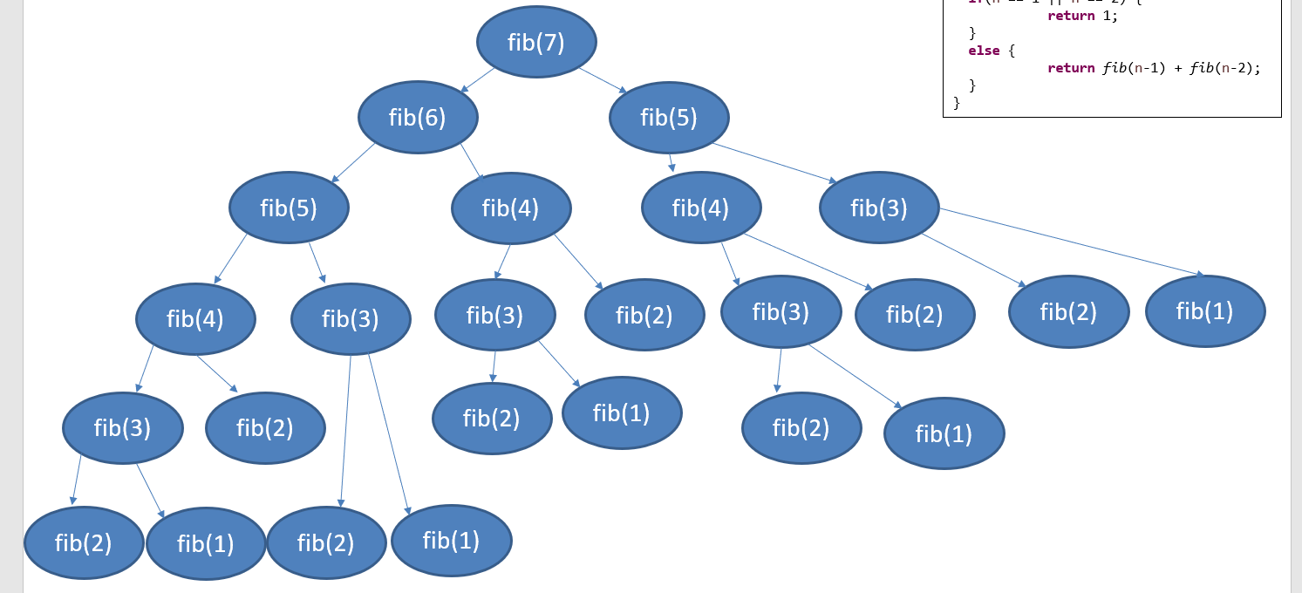
private static int fib(int n) {
if(n == 1 || n == 2) {
return 1;
}
else {
return fib(n-1) + fib(n-2);
}
}
O(2^{n})
O(1)
O(1)
O(1)
O(1)
Generally speaking, we can compute the running time of a recursive algorithm by using the following formula:
Running time = # of recursive calls made * amount of work done in each call
Running time = O(2^{n}) * O(1)
Total running time = O(2^{n})
n = requested Fibonacci digit
O(2^{n}) is very bad…

Slide 38
Number of recursive calls = 24
private static int fib(int n) {
if(n == 1 || n == 2) {
return 1;
}
else {
return fib(n-1) + fib(n-2);
}
}
fib(7)
fib(6)
fib(5)
fib(5)
fib(4)
fib(4)
fib(3)
fib(4)
fib(3)
fib(3)
fib(2)
fib(3)
fib(2)
fib(2)
fib(1)
fib(2)
fib(1)
fib(3)
fib(2)
fib(2)
fib(1)
fib(2)
fib(1)
fib(2)
fib(1)
Any ideas for how to improve this algorithm?

Slide 39
Number of recursive calls = 24
private static int fib(int n) {
if(n == 1 || n == 2) {
return 1;
}
else {
return fib(n-1) + fib(n-2);
}
}
fib(7)
fib(6)
fib(5)
fib(5)
fib(4)
fib(4)
fib(3)
fib(4)
fib(3)
fib(3)
fib(2)
fib(3)
fib(2)
fib(2)
fib(1)
fib(2)
fib(1)
fib(3)
fib(2)
fib(2)
fib(1)
fib(2)
fib(1)
fib(2)
fib(1)
There is a lot of overlap…

Slide 40
Number of recursive calls = 24
private static int fib(int n) {
if(n == 1 || n == 2) {
return 1;
}
else {
return fib(n-1) + fib(n-2);
}
}
fib(7)
fib(1) | 1
fib(2) | 1
fib(3) | 3
fib(4) | …
fib(5) | …
fib(6)
fib(5)
fib(5)
fib(4)
fib(4)
fib(3)
fib(4)
fib(3)
fib(3)
fib(2)
fib(3)
fib(2)
fib(2)
fib(1)
fib(2)
fib(1)
fib(3)
fib(2)
fib(2)
fib(1)
fib(2)
fib(2)
fib(1)
Solution: Introduce a data structure to store Fibonacci digits in that we can reference later on (memoization)
fib(1)
(These lookups happen in constant time!)

Slide 41
public static int countX(String str) {
if(str.length() == 0){
return 0;
}
if(str.charAt(0) == 'x’){
return 1 + countX(str.substring(1));
}
else{
return 0 + countX(str.substring(1));
}
}
countX(“oxxo”)

Slide 42
public static int countX(String str) {
if(str.length() == 0){
return 0;
}
if(str.charAt(0) == 'x’){
return 1 + countX(str.substring(1));
}
else{
return 0 + countX(str.substring(1));
}
}
countX(“oxxo”)
0 + countX(“xxo”)

Slide 43
public static int countX(String str) {
if(str.length() == 0){
return 0;
}
if(str.charAt(0) == 'x’){
return 1 + countX(str.substring(1));
}
else{
return 0 + countX(str.substring(1));
}
}
countX(“oxxo”)
0 + countX(“xxo”)
1 + countX(“xo”)

Slide 44
public static int countX(String str) {
if(str.length() == 0){
return 0;
}
if(str.charAt(0) == 'x’){
return 1 + countX(str.substring(1));
}
else{
return 0 + countX(str.substring(1));
}
}
countX(“oxxo”)
0 + countX(“xxo”)
1 + countX(“xo”)
1 + countX(“o”)

Slide 45
public static int countX(String str) {
if(str.length() == 0){
return 0;
}
if(str.charAt(0) == 'x’){
return 1 + countX(str.substring(1));
}
else{
return 0 + countX(str.substring(1));
}
}
countX(“oxxo”)
0 + countX(“xxo”)
1 + countX(“xo”)
1 + countX(“o”)
0 + countX(“”)

Slide 46
public static int countX(String str) {
if(str.length() == 0){
return 0;
}
if(str.charAt(0) == 'x’){
return 1 + countX(str.substring(1));
}
else{
return 0 + countX(str.substring(1));
}
}
countX(“oxxo”)
0 + countX(“xxo”)
1 + countX(“xo”)
1 + countX(“o”)
0 + countX(“”)
0

Slide 47
public static int countX(String str) {
if(str.length() == 0){
return 0;
}
if(str.charAt(0) == 'x’){
return 1 + countX(str.substring(1));
}
else{
return 0 + countX(str.substring(1));
}
}
countX(“oxxo”)
0 + countX(“xxo”)
1 + countX(“xo”)
1 + countX(“o”)
0 + 0

Slide 48
public static int countX(String str) {
if(str.length() == 0){
return 0;
}
if(str.charAt(0) == 'x’){
return 1 + countX(str.substring(1));
}
else{
return 0 + countX(str.substring(1));
}
}
countX(“oxxo”)
0 + countX(“xxo”)
1 + countX(“xo”)
1 + 0

Slide 49
public static int countX(String str) {
if(str.length() == 0){
return 0;
}
if(str.charAt(0) == 'x’){
return 1 + countX(str.substring(1));
}
else{
return 0 + countX(str.substring(1));
}
}
countX(“oxxo”)
0 + countX(“xxo”)
1 + countX(“xo”)
1 + 0

Slide 50
public static int countX(String str) {
if(str.length() == 0){
return 0;
}
if(str.charAt(0) == 'x’){
return 1 + countX(str.substring(1));
}
else{
return 0 + countX(str.substring(1));
}
}
countX(“oxxo”)
0 + countX(“xxo”)
1 + 1

Slide 51
public static int countX(String str) {
if(str.length() == 0){
return 0;
}
if(str.charAt(0) == 'x’){
return 1 + countX(str.substring(1));
}
else{
return 0 + countX(str.substring(1));
}
}
countX(“oxxo”)
0 + 2

Slide 52
public static int countX(String str) {
if(str.length() == 0){
return 0;
}
if(str.charAt(0) == 'x’){
return 1 + countX(str.substring(1));
}
else{
return 0 + countX(str.substring(1));
}
}
Final answer = 2

Slide 53
Limitations of recursion?

