Slide 1

CSCI 132: Basic Data Structures and Algorithms
Recursion (Part 2)
Reese Pearsall
Spring 2024
https://www.cs.montana.edu/pearsall/classes/spring2024/132/main.html
*All images are stolen from the internet

Slide 2

Announcements
Lab 10 due tomorrow
→ Lowest lab grade gets dropped at end of semester
No in-person lecture on Wednesday

Slide 3
Counting number of characters
Count “X” : “xooxo” → 2
“xxxxx” → 5
“abcdf” → 0
Base Case:
Recursive Case:

Slide 4
Counting number of characters
Count “X” : “xooxo” → 2
“xxxxx” → 5
“abcdf” → 0
Base Case:
Recursive Case:
If we ever have a string length of 0, return 0
Look at the first character, if it is an “X” return 1 and recurse
Look at the first character, if it is not an “X” return 0 and recurse

Slide 5
public static int countX(String str) {
if(str.length() == 0){
return 0;
}
if(str.charAt(0) == 'x’){
return 1 + countX(str.substring(1));
}
else{
return 0 + countX(str.substring(1));
}
}
countX(“oxxo”)

Slide 6
public static int countX(String str) {
if(str.length() == 0){
return 0;
}
if(str.charAt(0) == 'x’){
return 1 + countX(str.substring(1));
}
else{
return 0 + countX(str.substring(1));
}
}
countX(“oxxo”)
0 + countX(“xxo”)

Slide 7
public static int countX(String str) {
if(str.length() == 0){
return 0;
}
if(str.charAt(0) == 'x’){
return 1 + countX(str.substring(1));
}
else{
return 0 + countX(str.substring(1));
}
}
countX(“oxxo”)
0 + countX(“xxo”)
1 + countX(“xo”)

Slide 8
public static int countX(String str) {
if(str.length() == 0){
return 0;
}
if(str.charAt(0) == 'x’){
return 1 + countX(str.substring(1));
}
else{
return 0 + countX(str.substring(1));
}
}
countX(“oxxo”)
0 + countX(“xxo”)
1 + countX(“xo”)
1 + countX(“o”)

Slide 9
public static int countX(String str) {
if(str.length() == 0){
return 0;
}
if(str.charAt(0) == 'x’){
return 1 + countX(str.substring(1));
}
else{
return 0 + countX(str.substring(1));
}
}
countX(“oxxo”)
0 + countX(“xxo”)
1 + countX(“xo”)
1 + countX(“o”)
0 + countX(“”)

Slide 10
public static int countX(String str) {
if(str.length() == 0){
return 0;
}
if(str.charAt(0) == 'x’){
return 1 + countX(str.substring(1));
}
else{
return 0 + countX(str.substring(1));
}
}
countX(“oxxo”)
0 + countX(“xxo”)
1 + countX(“xo”)
1 + countX(“o”)
0 + countX(“”)
0

Slide 11
public static int countX(String str) {
if(str.length() == 0){
return 0;
}
if(str.charAt(0) == 'x’){
return 1 + countX(str.substring(1));
}
else{
return 0 + countX(str.substring(1));
}
}
countX(“oxxo”)
0 + countX(“xxo”)
1 + countX(“xo”)
1 + countX(“o”)
0 + 0

Slide 12
public static int countX(String str) {
if(str.length() == 0){
return 0;
}
if(str.charAt(0) == 'x’){
return 1 + countX(str.substring(1));
}
else{
return 0 + countX(str.substring(1));
}
}
countX(“oxxo”)
0 + countX(“xxo”)
1 + countX(“xo”)
1 + 0

Slide 13
public static int countX(String str) {
if(str.length() == 0){
return 0;
}
if(str.charAt(0) == 'x’){
return 1 + countX(str.substring(1));
}
else{
return 0 + countX(str.substring(1));
}
}
countX(“oxxo”)
0 + countX(“xxo”)
1 + countX(“xo”)
1 + 0

Slide 14
public static int countX(String str) {
if(str.length() == 0){
return 0;
}
if(str.charAt(0) == 'x’){
return 1 + countX(str.substring(1));
}
else{
return 0 + countX(str.substring(1));
}
}
countX(“oxxo”)
0 + countX(“xxo”)
1 + 1

Slide 15
public static int countX(String str) {
if(str.length() == 0){
return 0;
}
if(str.charAt(0) == 'x’){
return 1 + countX(str.substring(1));
}
else{
return 0 + countX(str.substring(1));
}
}
countX(“oxxo”)
0 + 2

Slide 16
public static int countX(String str) {
if(str.length() == 0){
return 0;
}
if(str.charAt(0) == 'x’){
return 1 + countX(str.substring(1));
}
else{
return 0 + countX(str.substring(1));
}
}
Final answer = 2

Slide 17
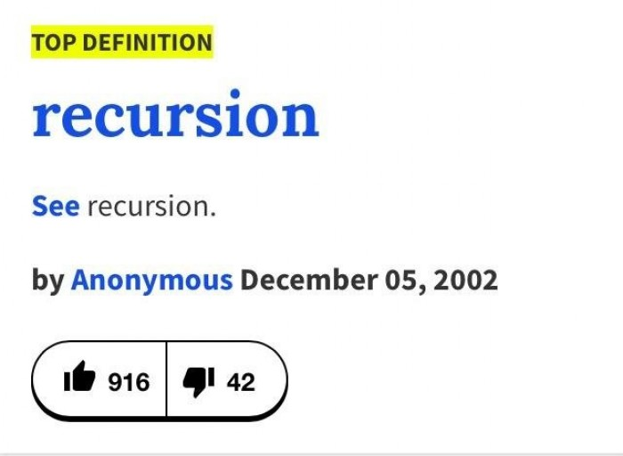
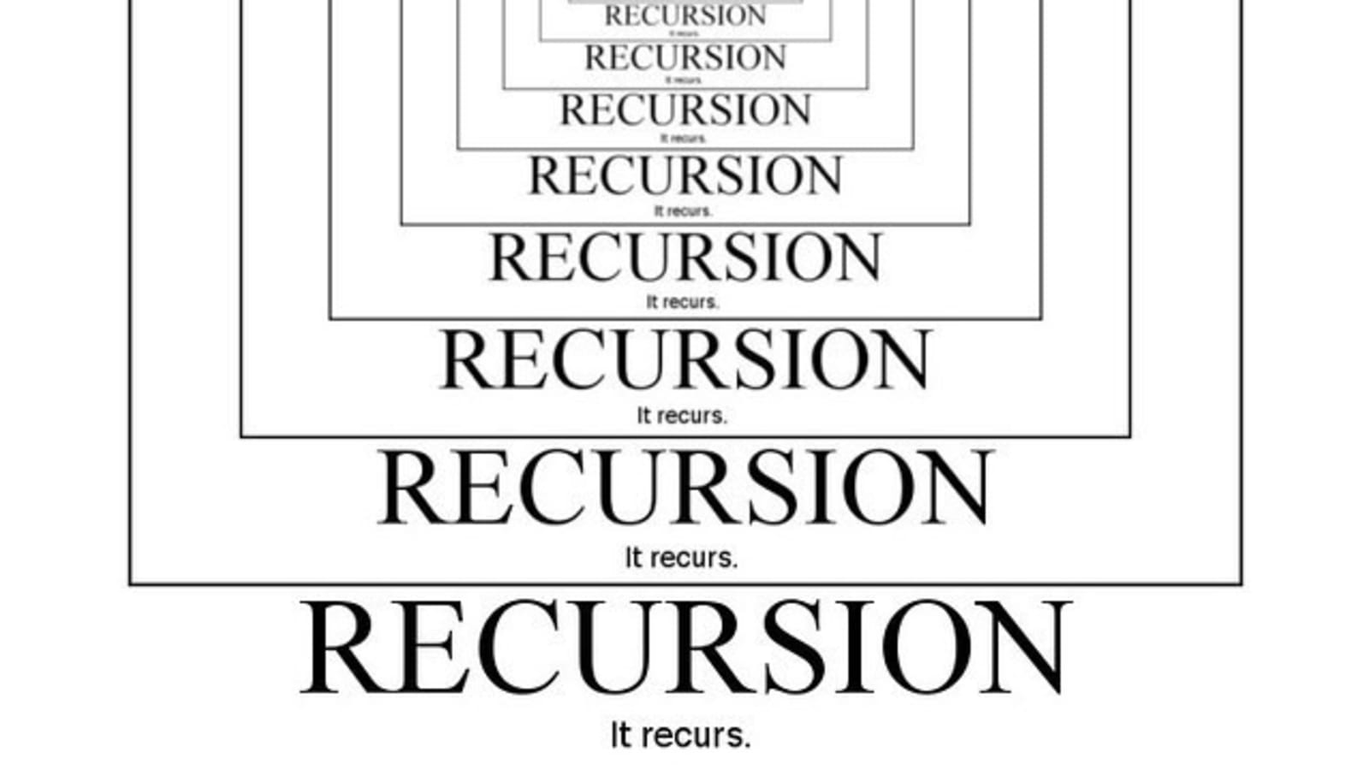
Recursion is a problem-solving technique that involves a method calling itself to solve some smaller problem
static int factorial(int n)
{
if (n == 0)
return 1;
return n * factorial(n - 1);
}

Slide 18


We can solve the factorial for n by solving smaller problems ( factorial of n-1 ) !
static int factorial(int n)
{
if (n == 0)
return 1;
return n * factorial(n - 1);
}
(base case)
(recursive case)
120
factorial(5)
factorial(4)
24
6
factorial(3)
Recursive solutions must have the two following conditions:
factorial(2)
Base Case
Recursive Case
2
factorial(1)
1
factorial(0)
1

Slide 19
Example #1: Star String
Write a method that will take a string s as an argument. This method should return the string, but with a star character (*) between matching characters
aabbcc → a*ab*bc*c
abcdd → abcd*d
abcd → abcd
Base Case?
Recursive Case?

Slide 20
Example #1: Star String
Write a method that will take a string s as an argument. This method should return the string, but with a star character (*) between matching characters
aabbcc → a*ab*bc*c
abcdd → abcd*d
abcd → abcd
Base Case?
Recursive Case?
If the length of the string is 1, return the current string (we can’t go any smaller)
Look at the first two characters of the string. Return the first character (and a * if needed), call the method again, but pass it the string without the first character

Slide 21
Example #1: Star String
Write a method that will take a string s as an argument. This method should return the string, but with a star character (*) between matching characters
public static String star_string(String s) {
if(s.length() == 1) {
return s;
}
else {
if(s.charAt(0) == s.charAt(1)) {
return s.charAt(0) + "*" + star_string(s.substring(1));
}
else {
return s.charAt(0) + star_string(s.substring(1));
}
}
}
Base Case
Recursive Case

Slide 22
Example #1: Star String
star_string(“aabbcc”)
a + * + star_string(“abbcc”)
a + star_string(“bbcc”)
b + * + star_string(“bcc”)
b + star_string(“cc”)
c + * + star_string(“c”)
c

Slide 23

Example #1: Star String
star_string(“aabbcc”)
a + * + star_string(“abbcc”)
a + star_string(“bbcc”)
b + * + star_string(“bcc”)
b + star_string(“cc”)
c + * + star_string(“c”)
c
a+*a+b+*+b+c+*c = a*ab*bc*c

Slide 24
Example #2: Printing a Linked List
first
second
third
fourth
Goal: Print contents of linked list using recursion
Base Case?
Recursive Case?

Slide 25
Example #2: Printing a Linked List
first
second
third
fourth
Goal: Print contents of linked list using recursion
Base Case?
Recursive Case?
If the size of the LL is 1, print the only node
Remove head node, print it, and pass the new LL to the recursive method

Slide 26
public static void print_LL(LinkedList<String> ll) {
if(ll.size() == 1) {
System.out.println(ll.getFirst());
}
else {
System.out.println(ll.removeFirst());
print_LL(ll);
}
}
Output
Base Case
Recursive Case
print_LL( )
first
second
third
fourth

Slide 27
public static void print_LL(LinkedList<String> ll) {
if(ll.size() == 1) {
System.out.println(ll.getFirst());
}
else {
System.out.println(ll.removeFirst());
print_LL(ll);
}
}
Output
Base Case
first
Recursive Case
print_LL( )
first
second
third
fourth
print_LL( )
second
third
fourth

Slide 28
public static void print_LL(LinkedList<String> ll) {
if(ll.size() == 1) {
System.out.println(ll.getFirst());
}
else {
System.out.println(ll.removeFirst());
print_LL(ll);
}
}
Output
Base Case
first
second
Recursive Case
print_LL( )
first
second
third
fourth
print_LL( )
second
third
fourth
print_LL( )
third
fourth

Slide 29
public static void print_LL(LinkedList<String> ll) {
if(ll.size() == 1) {
System.out.println(ll.getFirst());
}
else {
System.out.println(ll.removeFirst());
print_LL(ll);
}
}
Output
Base Case
first
Second
third
Recursive Case
print_LL( )
first
second
third
fourth
print_LL( )
second
third
fourth
print_LL( )
third
fourth
print_LL( )
fourth

Slide 30
public static void print_LL(LinkedList<String> ll) {
if(ll.size() == 1) {
System.out.println(ll.getFirst());
}
else {
System.out.println(ll.removeFirst());
print_LL(ll);
}
}
Output
Base Case
first
Second
third
Recursive Case
print_LL( )
first
second
third
fourth
print_LL( )
second
third
fourth
print_LL( )
third
fourth
print_LL( )
fourth
Base case!!

Slide 31
public static void print_LL(LinkedList<String> ll) {
if(ll.size() == 1) {
System.out.println(ll.getFirst());
}
else {
System.out.println(ll.removeFirst());
print_LL(ll);
}
}
Output
Base Case
first
Second
Third
fourth
Recursive Case
print_LL( )
first
second
third
fourth
print_LL( )
second
third
fourth
print_LL( )
third
fourth
print_LL( )
fourth
Base case!!

Slide 32
public static void print_LL(LinkedList<String> ll) {
if(ll.size() == 1) {
System.out.println(ll.getFirst());
}
else {
System.out.println(ll.removeFirst());
print_LL(ll);
}
}
Output
Base Case
first
Second
Third
fourth
Recursive Case
print_LL( )
first
second
third
fourth
print_LL( )
second
third
fourth
print_LL( )
third
fourth

Slide 33
public static void print_LL(LinkedList<String> ll) {
if(ll.size() == 1) {
System.out.println(ll.getFirst());
}
else {
System.out.println(ll.removeFirst());
print_LL(ll);
}
}
Output
Base Case
first
Second
Third
fourth
Recursive Case
print_LL( )
first
second
third
fourth
print_LL( )
second
third
fourth

Slide 34
public static void print_LL(LinkedList<String> ll) {
if(ll.size() == 1) {
System.out.println(ll.getFirst());
}
else {
System.out.println(ll.removeFirst());
print_LL(ll);
}
}
Output
Base Case
first
Second
Third
fourth
Recursive Case
print_LL( )
first
second
third
fourth

Slide 35
public static void print_LL(LinkedList<String> ll) {
if(ll.size() == 1) {
System.out.println(ll.getFirst());
}
else {
System.out.println(ll.removeFirst());
print_LL(ll);
}
}
Output
Base Case
first
Second
Third
fourth
Recursive Case

Slide 36
Example #3: Printing a Linked List in Reverse
first
second
third
fourth
Goal: Print contents of linked list in reverse order using recursion
Expected Output
fourth
third
second
first
Base Case?
Recursive Case?

Slide 37
Example #3: Printing a Linked List in Reverse
first
second
third
fourth
Goal: Print contents of linked list in reverse order using recursion
Expected Output
fourth
third
second
first
Base Case?
Recursive Case?
If the size of the LL is 1, print out the only node
Remove a node (but don’t print it yet), call the recursive method and pass it the new LL. When method returns, print out the node we saved

Slide 38
public static void print_LL_reverse(LinkedList<String> ll) {
if(ll.size() == 1) {
System.out.println(ll.getFirst());
return;
}
else {
String removed = ll.removeFirst();
print_LL_reverse(ll);
System.out.println(removed);
return;
}
String removed = ll.removeFirst();
print_LL_reverse(ll);
System.out.println(removed);
return;
first
second
third
fourth
value saved: “first”

Slide 39

public static void print_LL_reverse(LinkedList<String> ll) {
if(ll.size() == 1) {
System.out.println(ll.getFirst());
return;
}
else {
String removed = ll.removeFirst();
print_LL_reverse(ll);
System.out.println(removed);
return;
}
String removed = ll.removeFirst();
print_LL_reverse(ll);
System.out.println(removed);
return;
first
second
third
fourth
value saved: “first”
String removed = ll.removeFirst();
print_LL_reverse(ll);
System.out.println(removed);
return;
second
third
fourth
value saved: “second”

Slide 40

public static void print_LL_reverse(LinkedList<String> ll) {
if(ll.size() == 1) {
System.out.println(ll.getFirst());
return;
}
else {
String removed = ll.removeFirst();
print_LL_reverse(ll);
System.out.println(removed);
return;
}
String removed = ll.removeFirst();
print_LL_reverse(ll);
System.out.println(removed);
return;
first
second
third
fourth
value saved: “first”
String removed = ll.removeFirst();
print_LL_reverse(ll);
System.out.println(removed);
return;
second
third
fourth
value saved: “second”
String removed = ll.removeFirst();
print_LL_reverse(ll);
System.out.println(removed);
return;
third
fourth
value saved: “third”

Slide 41
public static void print_LL_reverse(LinkedList<String> ll) {
if(ll.size() == 1) {
System.out.println(ll.getFirst());
return;
}
else {
String removed = ll.removeFirst();
print_LL_reverse(ll);
System.out.println(removed);
return;
}
String removed = ll.removeFirst();
print_LL_reverse(ll);
System.out.println(removed);
return;
first
second
third
fourth
value saved: “first”
String removed = ll.removeFirst();
print_LL_reverse(ll);
System.out.println(removed);
return;
second
third
fourth
value saved: “second”
String removed = ll.removeFirst();
print_LL_reverse(ll);
System.out.println(removed);
return;
third
fourth
value saved: “third”

Slide 42
public static void print_LL_reverse(LinkedList<String> ll) {
if(ll.size() == 1) {
System.out.println(ll.getFirst());
return;
}
else {
String removed = ll.removeFirst();
print_LL_reverse(ll);
System.out.println(removed);
return;
}
String removed = ll.removeFirst();
print_LL_reverse(ll);
System.out.println(removed);
return;
first
second
third
fourth
value saved: “first”
String removed = ll.removeFirst();
print_LL_reverse(ll);
System.out.println(removed);
return;
second
third
fourth
value saved: “second”
String removed = ll.removeFirst();
print_LL_reverse(ll);
System.out.println(removed);
return;
third
fourth
value saved: “third”
System.out.println(ll.getFirst());
return;
fourth

Slide 43
public static void print_LL_reverse(LinkedList<String> ll) {
if(ll.size() == 1) {
System.out.println(ll.getFirst());
return;
}
else {
String removed = ll.removeFirst();
print_LL_reverse(ll);
System.out.println(removed);
return;
}
Output
fourth
String removed = ll.removeFirst();
print_LL_reverse(ll);
System.out.println(removed);
return;
first
second
third
fourth
value saved: “first”
String removed = ll.removeFirst();
print_LL_reverse(ll);
System.out.println(removed);
return;
second
third
fourth
value saved: “second”
String removed = ll.removeFirst();
print_LL_reverse(ll);
System.out.println(removed);
return;
third
fourth
value saved: “third”
System.out.println(ll.getFirst());
return;
fourth

Slide 44
public static void print_LL_reverse(LinkedList<String> ll) {
if(ll.size() == 1) {
System.out.println(ll.getFirst());
return;
}
else {
String removed = ll.removeFirst();
print_LL_reverse(ll);
System.out.println(removed);
return;
}
Output
fourth
String removed = ll.removeFirst();
print_LL_reverse(ll);
System.out.println(removed);
return;
first
second
third
fourth
value saved: “first”
String removed = ll.removeFirst();
print_LL_reverse(ll);
System.out.println(removed);
return;
second
third
fourth
value saved: “second”
String removed = ll.removeFirst();
print_LL_reverse(ll);
System.out.println(removed);
return;
third
fourth
value saved: “third”
System.out.println(ll.getFirst());
return;
fourth

Slide 45
public static void print_LL_reverse(LinkedList<String> ll) {
if(ll.size() == 1) {
System.out.println(ll.getFirst());
return;
}
else {
String removed = ll.removeFirst();
print_LL_reverse(ll);
System.out.println(removed);
return;
}
Output
fourth
String removed = ll.removeFirst();
print_LL_reverse(ll);
System.out.println(removed);
return;
first
second
third
fourth
value saved: “first”
String removed = ll.removeFirst();
print_LL_reverse(ll);
System.out.println(removed);
return;
second
third
fourth
value saved: “second”
String removed = ll.removeFirst();
print_LL_reverse(ll);
System.out.println(removed);
return;
third
fourth
value saved: “third”

Slide 46
public static void print_LL_reverse(LinkedList<String> ll) {
if(ll.size() == 1) {
System.out.println(ll.getFirst());
return;
}
else {
String removed = ll.removeFirst();
print_LL_reverse(ll);
System.out.println(removed);
return;
}
Output
fourth
String removed = ll.removeFirst();
print_LL_reverse(ll);
System.out.println(removed);
return;
first
second
third
fourth
value saved: “first”
String removed = ll.removeFirst();
print_LL_reverse(ll);
System.out.println(removed);
return;
second
third
fourth
value saved: “second”
String removed = ll.removeFirst();
print_LL_reverse(ll);
System.out.println(removed);
return;
third
fourth
value saved: “third”

Slide 47
public static void print_LL_reverse(LinkedList<String> ll) {
if(ll.size() == 1) {
System.out.println(ll.getFirst());
return;
}
else {
String removed = ll.removeFirst();
print_LL_reverse(ll);
System.out.println(removed);
return;
}
Output
fourth
third
String removed = ll.removeFirst();
print_LL_reverse(ll);
System.out.println(removed);
return;
first
second
third
fourth
value saved: “first”
String removed = ll.removeFirst();
print_LL_reverse(ll);
System.out.println(removed);
return;
second
third
fourth
value saved: “second”
String removed = ll.removeFirst();
print_LL_reverse(ll);
System.out.println(removed);
return;
third
fourth
value saved: “third”

Slide 48
public static void print_LL_reverse(LinkedList<String> ll) {
if(ll.size() == 1) {
System.out.println(ll.getFirst());
return;
}
else {
String removed = ll.removeFirst();
print_LL_reverse(ll);
System.out.println(removed);
return;
}
Output
fourth
third
String removed = ll.removeFirst();
print_LL_reverse(ll);
System.out.println(removed);
return;
first
second
third
fourth
value saved: “first”
String removed = ll.removeFirst();
print_LL_reverse(ll);
System.out.println(removed);
return;
second
third
fourth
value saved: “second”

Slide 49
public static void print_LL_reverse(LinkedList<String> ll) {
if(ll.size() == 1) {
System.out.println(ll.getFirst());
return;
}
else {
String removed = ll.removeFirst();
print_LL_reverse(ll);
System.out.println(removed);
return;
}
Output
fourth
third
second
String removed = ll.removeFirst();
print_LL_reverse(ll);
System.out.println(removed);
return;
first
second
third
fourth
value saved: “first”
String removed = ll.removeFirst();
print_LL_reverse(ll);
System.out.println(removed);
return;
second
third
fourth
value saved: “second”

Slide 50
public static void print_LL_reverse(LinkedList<String> ll) {
if(ll.size() == 1) {
System.out.println(ll.getFirst());
return;
}
else {
String removed = ll.removeFirst();
print_LL_reverse(ll);
System.out.println(removed);
return;
}
Output
fourth
third
second
String removed = ll.removeFirst();
print_LL_reverse(ll);
System.out.println(removed);
return;
first
second
third
fourth
value saved: “first”

Slide 51
public static void print_LL_reverse(LinkedList<String> ll) {
if(ll.size() == 1) {
System.out.println(ll.getFirst());
return;
}
else {
String removed = ll.removeFirst();
print_LL_reverse(ll);
System.out.println(removed);
return;
}
Output
fourth
third
second
first
String removed = ll.removeFirst();
print_LL_reverse(ll);
System.out.println(removed);
return;
first
second
third
fourth
value saved: “first”

Slide 52

public static void print_LL_reverse(LinkedList<String> ll) {
if(ll.size() == 1) {
System.out.println(ll.getFirst());
return;
}
else {
String removed = ll.removeFirst();
print_LL_reverse(ll);
System.out.println(removed);
return;
}
Output
fourth
third
second
first

Slide 53
Checking for Palindromes
RACECAR

Slide 54
Checking for Palindromes
RACECAR

Slide 55
Checking for Palindromes
RACECAR
ACECA

Slide 56
Checking for Palindromes
RACECAR
ACECA
CEC

Slide 57

Checking for Palindromes
RACECAR
ACECA
CEC
E

Slide 58

Checking for Palindromes
AABBAA
RACECAR
ACECA
CEC
E

Slide 59
Checking for Palindromes
AABBAA
RACECAR
ACECA
CEC
E

Slide 60
Checking for Palindromes
AABBAA
RACECAR
ABBA
ACECA
CEC
E

Slide 61
Checking for Palindromes
AABBAA
RACECAR
ABBA
ACECA
BB
CEC
E

Slide 62

Checking for Palindromes
AABBAA
RACECAR
ABBA
ACECA
BB
CEC
E

