Slide 1

CSCI 132: Basic Data Structures and Algorithms
Recursion (Part 3)
Reese Pearsall
Spring 2024
https://www.cs.montana.edu/pearsall/classes/spring2024/132/main.html
*All images are stolen from the internet

Slide 2
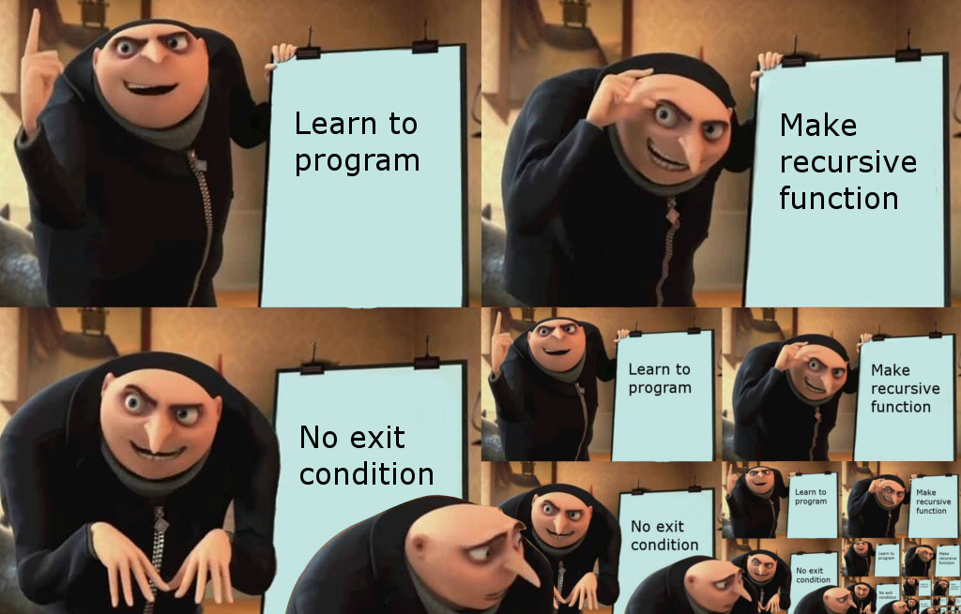

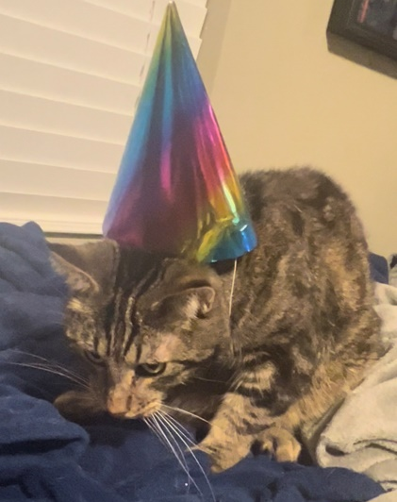
Announcements
No class on Wednesday (4/17)
Program 4 due next Friday
Gianforte Hall Groundbreaking Ceremony: 4/17 @ 2:00 PM

Slide 3
Change Making Problem
Given a set a coin denominations D, how can you represent K cents with the smallest number of coins?

Slide 4
Change Making Problem
Given a set a coin denominations D, how can you represent K cents with the smallest number of coins?
D = [1, 5, 10, 25]
K = 37

Slide 5
Change Making Problem
Given a set a coin denominations D, how can you represent K cents with the smallest number of coins?
D = [1, 5, 10, 25]
K = 37
Answer = 4
(Quarter, dime, two pennies)

Slide 6
Change Making Problem
Given a set a coin denominations D, how can you represent K cents with the smallest number of coins?
D = [1, 5, 10, 25]
K = 37
Answer = 4
(Quarter, dime, two pennies)
Algorithm?

Slide 7
Change Making Problem
Given a set a coin denominations D, how can you represent K cents with the smallest number of coins?
D = [1, 5, 10, 25]
K = 37
Answer = 4
(Quarter, dime, two pennies)
Use as many quarters as possible, then as many dimes as possible, …

Slide 8
Change Making Problem
Given a set a coin denominations D, how can you represent K cents with the smallest number of coins?
D = [1, 5, 10, 25]
K = 37
Answer = 4
(Quarter, dime, two pennies)
Use as many quarters as possible, then as many dimes as possible, …
This is known as the greedy approach

Slide 9
Change Making Problem
Given a set a coin denominations D, how can you represent K cents with the smallest number of coins?
Greedy Algorithm
D = [1, 5, 10, 25]
Use as many quarters as possible, then as many dimes as possible, …
K = 37

Slide 10
Change Making Problem
Given a set a coin denominations D, how can you represent K cents with the smallest number of coins?
Greedy Algorithm
D = [1, 5, 10, 18, 25]
Use as many quarters as possible, then as many 18 cent pieces as possible, then dimes , …
K = 37
What if there were also an 18-cent coin?

Slide 11
Change Making Problem
Given a set a coin denominations D, how can you represent K cents with the smallest number of coins?
Greedy Algorithm
D = [1, 5, 10, 18, 25]
Use as many quarters as possible, then as many 18 cent pieces as possible, then dimes , …
K = 37
25, 10, 1, 1
(4 coins)
What if there were also an 18-cent coin?

Slide 12
Change Making Problem
Given a set a coin denominations D, how can you represent K cents with the smallest number of coins?
Greedy Algorithm
D = [1, 5, 10, 18, 25]
Use as many quarters as possible, then as many 18 cent pieces as possible, then dimes , …
K = 37
25, 10, 1, 1
(4 coins)
What if there were also an 18-cent coin?
Real Answer = 18, 18, 1 (3 coins)

Slide 13
Change Making Problem
Given a set a coin denominations D, how can you represent K cents with the smallest number of coins?
Greedy Algorithm
D = [1, 5, 10, 18, 25]
Use as many quarters as possible, then as many 18 cent pieces as possible, then dimes , …
K = 37
25, 10, 1, 1
(4 coins)
What if there were also an 18-cent coin?
Real Answer = 18, 18, 1 (3 coins)
Lesson Learned: The Greedy approach works for the United States denominations, but not for a general set of denominations

Slide 14
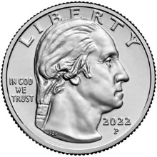
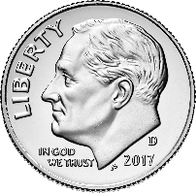
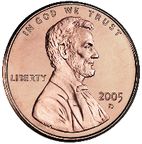
Change Making Problem
Suppose I tell you that 2 quarters, 1 dime, and 3 pennies are the minimum number of coins needed to make 63 cents
(We will assume we have the standard US denominations [1, 5, 10, 25] (NO 50 CENT PIECE)
25 + 25 + 10 + 1 + 1 + 1 = 63
What can you conclude?
Does this provide an answer to any other change making problems?

Slide 15
Change Making Problem
Suppose I tell you that 2 quarters, 1 dime, and 3 pennies are the minimum number of coins needed to make 63 cents
(We will assume we have the standard US denominations [1, 5, 10, 25] (NO 50 CENT PIECE)
25 + 25 + 10 + 1 + 1 + 1 = 63
This is the minimum coins needed to make 38 cents

Slide 16
Change Making Problem
Suppose I tell you that 2 quarters, 1 dime, and 3 pennies are the minimum number of coins needed to make 63 cents
(We will assume we have the standard US denominations [1, 5, 10, 25] (NO 50 CENT PIECE)
25 + 25 + 10 + 1 + 1 + 1 = 63
This is the minimum coins needed to make 13 cents

Slide 17
Change Making Problem
Suppose I tell you that 2 quarters, 1 dime, and 3 pennies are the minimum number of coins needed to make 63 cents
(We will assume we have the standard US denominations [1, 5, 10, 25] (NO 50 CENT PIECE)
25 + 25 + 10 + 1 + 1 + 1 = 63
This is the minimum coins needed to make 3 cents

Slide 18
Change Making Problem
Suppose I tell you that 2 quarters, 1 dime, and 3 pennies are the minimum number of coins needed to make 63 cents
(We will assume we have the standard US denominations [1, 5, 10, 25] (NO 50 CENT PIECE)
25 + 25 + 10 + 1 + 1 + 1 = 63
This is the minimum coins needed to make 2 cents

Slide 19
Change Making Problem
Suppose I tell you that 2 quarters, 1 dime, and 3 pennies are the minimum number of coins needed to make 63 cents
(We will assume we have the standard US denominations [1, 5, 10, 25] (NO 50 CENT PIECE)
25 + 25 + 10 + 1 + 1 + 1 = 63
This is the minimum coins needed to make 1 cent

Slide 20
Change Making Problem
Suppose I tell you that 2 quarters, 1 dime, and 3 pennies are the minimum number of coins needed to make 63 cents
(We will assume we have the standard US denominations [1, 5, 10, 25] (NO 50 CENT PIECE)
25 + 25 + 10 + 1 + 1 + 1 = 63
The solution to the change making problems consists of solutions to smaller change making problems
We can use recursion to solve this problem

Slide 21
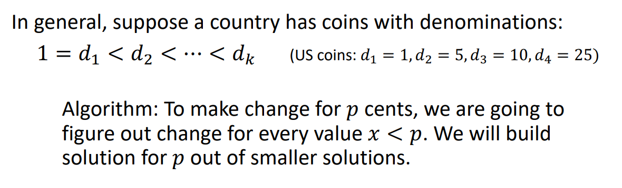
Change Making Problem

Slide 22
Change Making Problem

Slide 23

Change Making Problem
C(37) = 1 + C(12)
Now find the minimum number of coins needed to make 12 cents
We used one quarter

Slide 24
Change Making Problem
Now find the minimum number of coins needed to make 2 cents
C(37) = 1 + C(12)
We used one dime
C(12) = 1 + C(2)

Slide 25
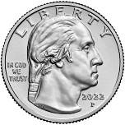
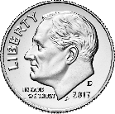
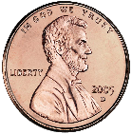
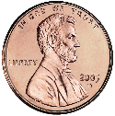
Change Making Problem
C(37) = 1 + C(12)
C(12) = 1 + C(2)
C(2) = 1 + C(1)
C(1) = 1 + C(0)

Slide 26
Change Making Problem
C(37) = 1 + C(12)
C(12) = 1 + C(2)
C(2) = 1 + C(1)
C(1) = 1

Slide 27
Change Making Problem
C(37) = 1 + C(12)
C(12) = 1 + C(2)
C(2) = 1 + 1

Slide 28
Change Making Problem
C(37) = 1 + C(12)
C(12) = 1 + C(2)
C(2) = 2

Slide 29
Change Making Problem
C(37) = 1 + C(12)
C(12) = 1 + 2

Slide 30
Change Making Problem
C(37) = 1 + C(12)
C(12) = 3

Slide 31
Change Making Problem
C(37) = 1 + 3

Slide 32
Change Making Problem
C(37) = 4
The minimum number of coins needed to make 37 cents is 4

Slide 33
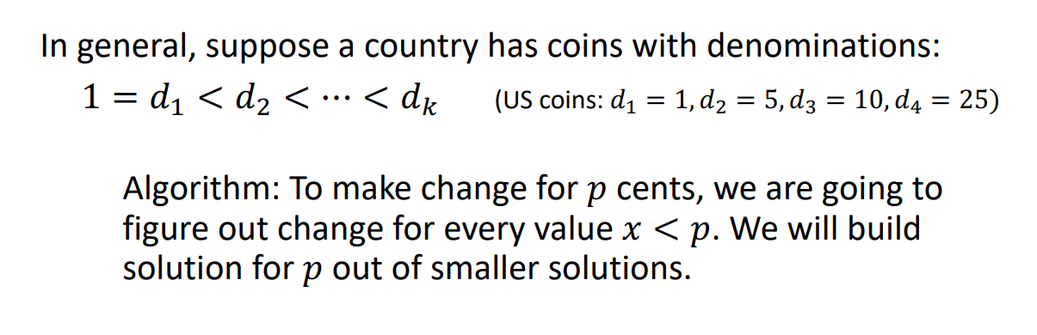
Change Making Problem
(This algorithm must work for ALL denominations)

Slide 34
Change Making Problem
Make $0.19 with $0.01, $0.05, $0.10
19

Slide 35
Change Making Problem
Make $0.19 with $0.01, $0.05, $0.10
19
1
10
5

Slide 36
Change Making Problem
Make $0.19 with $0.01, $0.05, $0.10
k = # denominations
19
1
10
5
18
14
9
Find minimum coins needed to make 18 cents
Find minimum coins needed to make 14 cents
Find minimum coins needed to make 9 cents
To find the minimum number of coins needed to create 19 cents, we generate k subproblems

Slide 37
Change Making Problem
Make $0.19 with $0.01, $0.05, $0.10
k = # denominations
19
1
10
5
18
14
9
Find minimum coins needed to make 18 cents
Find minimum coins needed to make 14 cents
Find minimum coins needed to make 9 cents
We want to select the minimum solution of these three subproblems

Slide 38
Change Making Problem
Make $0.19 with $0.01, $0.05, $0.10
k = # denominations
19
1
10
5
18
14
9
Find minimum coins needed to make 18 cents
Find minimum coins needed to make 14 cents
Find minimum coins needed to make 9 cents
5
5
4
For the solution of our original problem (19), we want to select this branch (one dime used)

Slide 39
Change Making Problem
Make $0.19 with $0.01, $0.05, $0.10
k = # denominations
19
1
10
5
18
14
9
1
10
5
17
13
8
Find minimum coins needed to make 17 cents
Find minimum coins needed to make 13 cents
Find minimum coins needed to make 8 cents

Slide 40
Change Making Problem
Make $0.19 with $0.01, $0.05, $0.10
k = # denominations
19
1
10
5
18
14
9
1
10
5
17
13
8

Slide 41
Change Making Problem
Make $0.19 with $0.01, $0.05, $0.10
k = # denominations
19
1
10
5
18
14
9
1
10
5
17
13
8
1
10
5
16
12
7

Slide 42
Change Making Problem
Make $0.19 with $0.01, $0.05, $0.10
k = # denominations
19
1
10
5
18
14
9
1
10
5
17
13
8
1
10
5
16
12
7
0
Eventually, we reach our base case, the minimum number of coins needed to make 0 cents

Slide 43
Change Making Problem
Make $0.19 with $0.01, $0.05, $0.10
k = # denominations
19
1
10
5
When C(9), we cant use a 10 cent piece…
18
14
9
1
10
1
10
1
5
5
5
8
13
9
8
8
4
17
13
1
10
5
For each change making problem we solve, we must solve at most 3 smaller change making problems
Once we solve the smaller problems, we must select the branch that has the minimum value
16
12
7

Slide 44
Change Making Problem
Make $0.19 with $0.01, $0.05, $0.10
k = # denominations
19
1
10
5
When C(9), we cant use a 10 cent piece…
18
14
9
1
10
1
10
1
5
5
5
8
13
9
8
8
4
17
13
1
10
5
For each change making problem we solve, we must solve at most 3 smaller change making problems
Once we solve the smaller problems, we must select the branch that has the minimum value
16
12
7

Slide 45
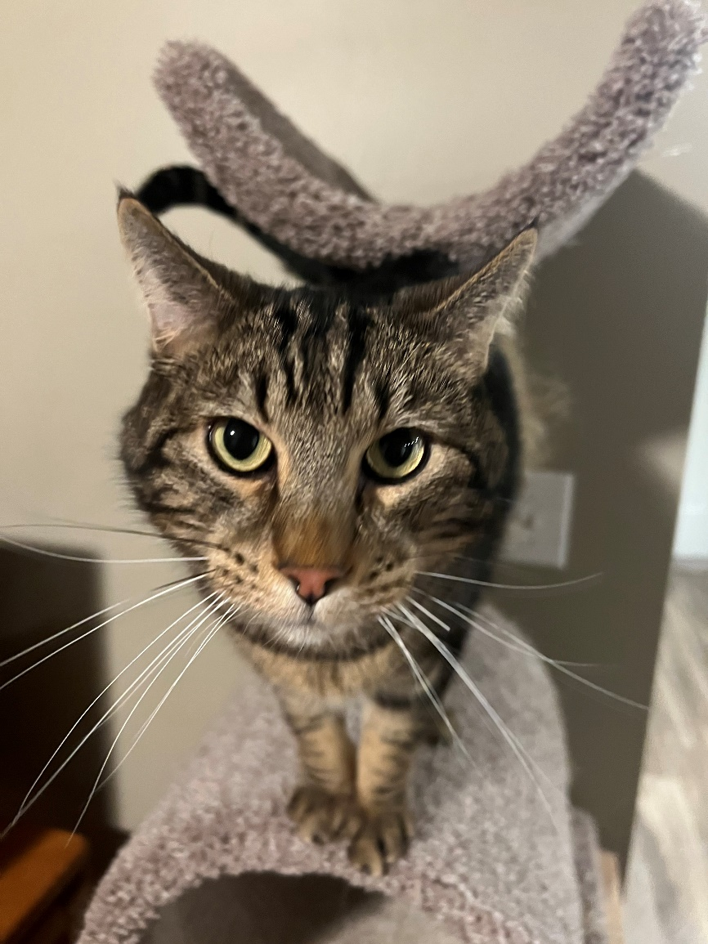

Slide 46
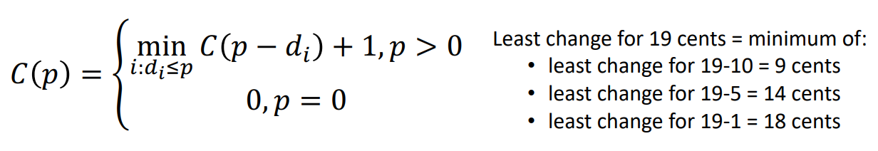

Change Making Problem
For each problem P, we will solve the problem for (P – d), where d represents each possible denomination

Slide 47

Change Making Problem
For each problem P, we will solve the problem for (P – d), where d represents each possible denomination
We want to select only the branch the yields the minimum value

Slide 48

Change Making Problem
For each problem P, we will solve the problem for (P – d), where d represents each possible denomination
If we ever need to make change for 0 cents, return 0
We want to select only the branch the yields the minimum value

Slide 49
Change Making Problem
For each problem P, we will solve the problem for (P – d), where d represents each possible denomination
If we ever need to make change for 0 cents, return 0
We want to select only the branch the yields the minimum value

Slide 50
Change Making Problem
D = array of denominations [1, 5, 10, 18, 25]
p = desired change (37)
min_coins(D, p)

Slide 51
Change Making Problem
D = array of denominations [1, 5, 10, 18, 25]
p = desired change (37)
min_coins(D, p)
if p == 0
return 0;
Base Case

Slide 52

Change Making Problem
D = array of denominations [1, 5, 10, 18, 25]
p = desired change (37)
min_coins(D, p)
if p == 0
return 0;
else
min = ∞
a = ∞
Base Case

Slide 53
Change Making Problem
D = array of denominations [1, 5, 10, 18, 25]
p = desired change (37)
min_coins(D, p)
if p == 0
return 0;
else
min = ∞
a = ∞
for each d_{i} in D
if (p – d_{i}) >= 0
a = min_coins(D, p – d_{i} )
Base Case
Recurse, and find the minimum number of coins needed using each valid denomination

Slide 54
Change Making Problem
D = array of denominations [1, 5, 10, 18, 25]
p = desired change (37)
min_coins(D, p)
if p == 0
return 0;
else
min = ∞
a = ∞
for each d_{i} in D
if (p – d_{i}) >= 0
a = min_coins(D, p – d_{i} )
if a < min
min = a
Base Case
Recurse, and find the minimum number of coins needed using each valid denomination
Select the branch that has the minimum value

Slide 55
Change Making Problem
D = array of denominations [1, 5, 10, 18, 25]
p = desired change (37)
min_coins(D, p)
if p == 0
return 0;
else
min = ∞
a = ∞
for each d_{i} in D
if (p – d_{i}) >= 0
a = min_coins(D, p – d_{i} )
if a < min
min = a
Base Case
Recurse, and find the minimum number of coins needed using each valid denomination
Select the branch that has the minimum value

Slide 56
Change Making Problem
D = array of denominations [1, 5, 10, 18, 25]
p = desired change (37)
min_coins(D, p)
if p == 0
return 0;
else
min = ∞
a = ∞
for each d_{i} in D
if (p – d_{i}) >= 0
a = min_coins(D, p – d_{i} )
if a < min
min = a
return 1 + min
Base Case
Recurse, and find the minimum number of coins needed using each valid denomination
Select the branch that has the minimum value
Once, our for loop finishes, we should know the branch that had the minimum, so return (1 + min), 1 because one coin was used in the current method call

Slide 57
Change Making Problem
min_coins(D, p)
if p == 0
return 0;
else
min = ∞
a = ∞
for each d_{i} in D
if (p – d_{i}) >= 0
a = min_coins(D, p – d_{i} )
if a < min
min = a
return 1 + min

Slide 58
Change Making Problem
min_coins(D, p)
if p == 0
return 0;
else
min = ∞
a = ∞
for each d_{i} in D
if (p – d_{i}) >= 0
a = min_coins(D, p – d_{i} )
if a < min
min = a
return 1 + min
Running time?

Slide 59
Change Making Problem
Make $0.19 with $0.01, $0.05, $0.10
k = # denominations
p = value to make change for
19
1
10
5
18
14
9
1
10
1
10
1
5
5
5
8
13
9
8
8
4
17
13
1
10
5
For sufficiently large p, every permutation of denominations is included.
16
12
7

Slide 60
Change Making Problem
Make $0.19 with $0.01, $0.05, $0.10
k = # denominations
p = value to make change for
19
1
10
5
18
14
9
k
1
10
1
10
1
5
5
5
8
13
9
8
8
4
17
13
1
10
5
16
12
7

Slide 61
Change Making Problem
Make $0.19 with $0.01, $0.05, $0.10
k = # denominations
p = value to make change for
19
1
10
5
18
14
9
k
1
10
1
10
1
5
5
5
13
9
8
k²
17
13
8
8
4
1
10
5
16
12
7

Slide 62
Change Making Problem
Make $0.19 with $0.01, $0.05, $0.10
k = # denominations
p = value to make change for
19
1
10
5
18
14
9
k
1
10
1
10
1
5
5
5
13
9
8
k²
17
13
8
8
4
1
10
5
k³
16
12
7

Slide 63
Change Making Problem
Make $0.19 with $0.01, $0.05, $0.10
k = # denominations
p = value to make change for
19
1
10
5
18
14
9
k
1
10
1
10
1
5
5
5
13
9
8
k²
17
13
8
8
4
1
10
5
k³
16
12
7
k^{p}

Slide 64
Change Making Problem
Make $0.19 with $0.01, $0.05, $0.10
k = # denominations
p = value to make change for
19
As k and p both grow, the number of recursive calls being made will grow exponentially
If we have a lot of coin denominations, we will have a lot of branching
1
10
5
18
14
9
k
1
10
1
10
1
5
5
5
13
9
8
k²
17
13
8
8
4
1
10
5
k³
16
12
7
k^{p}

Slide 65

Change Making Problem
Make $0.19 with $0.01, $0.05, $0.10
k = # denominations
p = value to make change for
19
As k and p both grow, the number of recursive calls being made will grow exponentially
Running time: O( )
1
10
5
18
14
9
k
1
10
1
10
1
5
5
5
13
9
8
k²
17
13
8
8
4
1
10
5
k³
16
12
7
k^{p}

Slide 66
Change Making Problem
Make $0.19 with $0.01, $0.05, $0.10
k = # denominations
p = value to make change for
19
As k and p both grow, the number of recursive calls being made will grow exponentially
Running time: probably O(k^{p}) or O(k!)
For a large set of denominations, or a large p, this algorithm will take a long time to run
1
10
5
18
14
9
k
1
10
1
10
1
5
5
5
13
9
8
k²
17
13
8
8
4
1
10
5
k³
16
12
7
k^{p}

Slide 67
Change Making Problem
Combinations for 7 cents
Using D = [1, 5, 10]
Permutations for 7 cents
Using D = [1, 5, 10]
[1, 1, 5]
[5, 1, 1]
[1, 5, 1]
…
[1, 1, 1, 1, 1, 1, 1]
[1, 1, 5]
[1, 1, 1, 1, 1, 1, 1]
[1, 1, 5] and [5, 1, 1] is the same combination…
Order does not matter.
[1, 1, 5] and [5, 1, 1] are considered different solutions
In our change making algorithm, we are calculating every possible permutation (bad)

Slide 68

Let’s try 81 cents!

Slide 69
Change Making Problem
This algorithm returns the minimum number of coins needed (ie 4), but it does not tell us what coins were used in that solution

Slide 70
Change Making Problem
This algorithm returns the minimum number of coins needed (ie 4), but it does not tell us what coins were used in that solution
D = Array of coin denominations [1, 5, 10, 25]
p = value to make change for
n = minimum number of coins used to make p cents
Goal: Find an n-length combination of coins from D that were used to make p

Slide 71
Change Making Problem
This algorithm returns the minimum number of coins needed (ie 4), but it does not tell us what coins were used in that solution
D = Array of coin denominations [1, 5, 10, 25]
p = value to make change for
n = minimum number of coins used to make p cents
Goal: Find an n-length combination of coins from D that were used to make p
To do this, we will compute all n-length combinations, but only return the combinations that add up to be p (not very efficient)

Slide 72
Generating Combinations for finding coins
Denominations (D) = [1, 5, 10]
For n=3, these are the combinations to be generated:
[1, 1, 1]
[1, 1, 5]
[1, 1, 10]
[1, 5, 5]
[1, 5, 10]
[1, 10, 10]
[5, 5, 5]
[5, 5, 10]
[5, 10, 10]
[10, 10, 10]
Note:
[5, 1, 1] is not a “valid” combination, because it is the same thing as [1, 1, 5]

Slide 73
Generating Combinations for finding coins
Denominations (D) = [1, 5, 10]
n = 3
[ __, __, __, ]

Slide 74
Generating Combinations for finding coins
Denominations (D) = [1, 5, 10]
n = 3
[ __, __, __, ]
[ 1, __, __, ]
[ 5, __, __, ]
[ 10, __, __, ]

Slide 75

Generating Combinations for finding coins
Denominations (D) = [1, 5, 10]
n = 3
[ __, __, __, ]
D = [1, 5, 10]
D = [5, 10]
D = [10]
[ 1, __, __, ]
[ 5, __, __, ]
[ 10, __, __, ]
This branch does not get 1 included in the denomination set, because all the combinations involving 1 will be handled by the left tree

Slide 76
Generating Combinations for finding coins
Denominations (D) = [1, 5, 10]
n = 3
[ __, __, __, ]
D = [1, 5, 10]
D = [5, 10]
D = [10]
[ 1, __, __, ]
[ 5, __, __, ]
[ 10, __, __, ]
[ 1, 1, __, ]
[ 1, 5, __, ]
[ 1, 10, __, ]

Slide 77
Generating Combinations for finding coins
Denominations (D) = [1, 5, 10]
n = 3
[ __, __, __, ]
D = [1, 5, 10]
D = [5, 10]
D = [10]
[ 1, __, __, ]
[ 5, __, __, ]
[ 10, __, __, ]
[ 1, 1, __, ]
[ 1, 5, __, ]
[ 1, 10, __, ]
[ 1, 1, 1, ]
[ 1, 1, 5, ]
[ 1, 1, 10, ]
(Base case) When are combinations reach a length of 3, we will stop recursing
[1, 1, 1] [1, 1, 5] [1, 1, 10]

Slide 78
Generating Combinations for finding coins
Denominations (D) = [1, 5, 10]
n = 3
[ __, __, __, ]
D = [10]
D = [1, 5, 10]
D = [5, 10]
D = [1, 5, 10]
D = [5, 10]
D = [10]
[ 1, __, __, ]
[ 5, __, __, ]
[ 10, __, __, ]
[ 1, 1, __, ]
[ 1, 5, __, ]
[ 1, 10, __, ]
[1, 1, 1] [1, 1, 5] [1, 1, 10]

Slide 79
Generating Combinations for finding coins
Denominations (D) = [1, 5, 10]
n = 3
[ __, __, __, ]
D = [10]
D = [1, 5, 10]
D = [5, 10]
D = [1, 5, 10]
D = [5, 10]
D = [10]
[ 1, __, __, ]
[ 5, __, __, ]
[ 10, __, __, ]
[ 1, 1, __, ]
[ 1, 5, __, ]
[ 1, 10, __, ]
[ 1, 5, 5]
[ 1, 5, 10, ]
[1, 1, 1] [1, 1, 5] [1, 1, 10]

Slide 80
Generating Combinations for finding coins
Denominations (D) = [1, 5, 10]
n = 3
[ __, __, __, ]
D = [10]
D = [1, 5, 10]
D = [5, 10]
D = [1, 5, 10]
D = [5, 10]
D = [10]
[ 1, __, __, ]
[ 5, __, __, ]
[ 10, __, __, ]
[ 1, 1, __, ]
[ 1, 5, __, ]
[ 1, 10, __, ]
[ 1, 5, 5]
[ 1, 5, 10, ]
[1, 1, 1] [1, 1, 5] [1, 1, 10] [1, 5, 5] [1, 5, 10]

Slide 81
Generating Combinations for finding coins
Denominations (D) = [1, 5, 10]
n = 3
[ __, __, __, ]
D = [10]
D = [1, 5, 10]
D = [5, 10]
D = [1, 5, 10]
D = [5, 10]
D = [10]
[ 1, __, __, ]
[ 5, __, __, ]
[ 10, __, __, ]
[ 1, 1, __, ]
[ 1, 5, __, ]
[ 1, 10, __, ]
[ 1, 10, 10]
[1, 1, 1] [1, 1, 5] [1, 1, 10] [1, 5, 5] [1, 5, 10]

Slide 82
Generating Combinations for finding coins
Denominations (D) = [1, 5, 10]
n = 3
[ __, __, __, ]
D = [10]
D = [1, 5, 10]
D = [5, 10]
D = [1, 5, 10]
D = [5, 10]
D = [10]
[ 1, __, __, ]
[ 5, __, __, ]
[ 10, __, __, ]
[ 1, 1, __, ]
[ 1, 5, __, ]
[ 1, 10, __, ]
[ 1, 10, 10]
[1, 1, 1] [1, 1, 5] [1, 1, 10] [1, 5, 5] [1, 5, 10] [1, 10, 10]

Slide 83
Generating Combinations for finding coins
Denominations (D) = [1, 5, 10]
n = 3
[ __, __, __, ]
D = [10]
D = [5, 10]
D = [1, 5, 10]
D = [5, 10]
D = [10]
[ 1, __, __, ]
[ 5, __, __, ]
[ 10, __, __, ]
[ 5, 5, __, ]
[ 5, 10, __, ]
[1, 1, 1] [1, 1, 5] [1, 1, 10] [1, 5, 5] [1, 5, 10] [1, 10, 10]

Slide 84
Generating Combinations for finding coins
Denominations (D) = [1, 5, 10]
n = 3
[ __, __, __, ]
D = [10]
D = [5, 10]
D = [1, 5, 10]
D = [5, 10]
D = [10]
[ 1, __, __, ]
[ 5, __, __, ]
[ 10, __, __, ]
[ 5, 5, __, ]
[ 5, 10, __, ]
[ 5, 5, 5, ]
[ 5, 5, 10, ]
[1, 1, 1] [1, 1, 5] [1, 1, 10] [1, 5, 5] [1, 5, 10] [1, 10, 10]

Slide 85
Generating Combinations for finding coins
Denominations (D) = [1, 5, 10]
n = 3
[ __, __, __, ]
D = [10]
D = [5, 10]
D = [1, 5, 10]
D = [5, 10]
D = [10]
[ 1, __, __, ]
[ 5, __, __, ]
[ 10, __, __, ]
[ 5, 5, __, ]
[ 5, 10, __, ]
[ 5, 5, 5, ]
[ 5, 5, 10, ]
[1, 1, 1] [1, 1, 5] [1, 1, 10] [1, 5, 5] [1, 5, 10] [1, 10, 10] [5, 5, 5] [5, 5, 10]

Slide 86
Generating Combinations for finding coins
Denominations (D) = [1, 5, 10]
n = 3
[ __, __, __, ]
D = [10]
D = [5, 10]
D = [1, 5, 10]
D = [5, 10]
D = [10]
[ 1, __, __, ]
[ 5, __, __, ]
[ 10, __, __, ]
[ 5, 5, __, ]
[ 5, 10, __, ]
[ 5, 10, 10, ]
[1, 1, 1] [1, 1, 5] [1, 1, 10] [1, 5, 5] [1, 5, 10] [1, 10, 10] [5, 5, 5] [5, 5, 10]

Slide 87
Generating Combinations for finding coins
Denominations (D) = [1, 5, 10]
n = 3
[ __, __, __, ]
D = [10]
D = [5, 10]
D = [1, 5, 10]
D = [5, 10]
D = [10]
[ 1, __, __, ]
[ 5, __, __, ]
[ 10, __, __, ]
[ 5, 5, __, ]
[ 5, 10, __, ]
[ 5, 10, 10, ]
[1, 1, 1] [1, 1, 5] [1, 1, 10] [1, 5, 5] [1, 5, 10] [1, 10, 10] [5, 5, 5] [5, 5, 10] [5, 10, 10]

Slide 88
Generating Combinations for finding coins
Denominations (D) = [1, 5, 10]
n = 3
[ __, __, __, ]
D = [10]
D = [1, 5, 10]
D = [5, 10]
D = [10]
[ 1, __, __, ]
[ 5, __, __, ]
[ 10, __, __, ]
[ 10, 10, __, ]
[1, 1, 1] [1, 1, 5] [1, 1, 10] [1, 5, 5] [1, 5, 10] [1, 10, 10] [5, 5, 5] [5, 5, 10] [5, 10, 10]

Slide 89
Generating Combinations for finding coins
Denominations (D) = [1, 5, 10]
n = 3
[ __, __, __, ]
D = [10]
D = [1, 5, 10]
D = [5, 10]
D = [10]
[ 1, __, __, ]
[ 5, __, __, ]
[ 10, __, __, ]
[ 10, 10, __, ]
[ 10, 10, 10, ]
[1, 1, 1] [1, 1, 5] [1, 1, 10] [1, 5, 5] [1, 5, 10] [1, 10, 10] [5, 5, 5] [5, 5, 10] [5, 10, 10]

Slide 90
Generating Combinations for finding coins
Denominations (D) = [1, 5, 10]
n = 3
[ __, __, __, ]
D = [10]
D = [1, 5, 10]
D = [5, 10]
D = [10]
[ 1, __, __, ]
[ 5, __, __, ]
[ 10, __, __, ]
[ 10, 10, __, ]
[ 10, 10, 10, ]
[1, 1, 1] [1, 1, 5] [1, 1, 10] [1, 5, 5] [1, 5, 10] [1, 10, 10] [5, 5, 5] [5, 5, 10] [5, 10, 10] [10, 10, 10]

Slide 91

Generating Combinations for finding coins
Denominations (D) = [1, 5, 10]
n = 3
[1, 1, 1]
[1, 1, 5]
[1, 1, 10]
[1, 5, 5]
[1, 5, 10]
[1, 10, 10]
[5, 5, 5]
[5, 5, 10]
[5, 10, 10]
[10, 10, 10]
We’ve generated all combinations of length 3

Slide 92

Generating Combinations for finding coins
Denominations (D) = [1, 5, 10]
n = 3
[1, 1, 1]
[1, 1, 5]
[1, 1, 10]
[1, 5, 5]
[1, 5, 10]
[1, 10, 10]
[5, 5, 5]
[5, 5, 10]
[5, 10, 10]
[10, 10, 10]
We’ve generated all combinations of length 3
Now, we only want to print out the combinations that add up to K

Slide 93
Generating Combinations for finding coins
Denominations (D) = [1, 5, 10]
n = 3
K = 16
[1, 1, 1]
[1, 1, 5]
[1, 1, 10]
[1, 5, 5]
[1, 5, 10]
[1, 10, 10]
[5, 5, 5]
[5, 5, 10]
[5, 10, 10]
[10, 10, 10]
We’ve generated all combinations of length 3
Now, we only want to print out the combinations that add up to K
Suppose K = 16 (a minimum of 3 coins is needed to make 16 cents)

Slide 94

Generating Combinations for finding coins
Denominations (D) = [1, 5, 10]
n = 3
K = 16
[1, 1, 1]
[1, 1, 5]
[1, 1, 10]
[1, 5, 5]
[1, 5, 10]
[1, 10, 10]
[5, 5, 5]
[5, 5, 10]
[5, 10, 10]
[10, 10, 10]
We’ve generated all combinations of length 3
Now, we only want to print out the combinations that add up to K
Suppose K = 16 (a minimum of 3 coins is needed to make 16 cents)
Answer = [1, 5, 10]

Slide 95

Generating Combinations for finding coins
Denominations (D) = [1, 5, 10]
n = 3
K = 16
LET’S CODE THIS!!
If you don’t fully understand this code, that is fine.
[1, 1, 1]
[1, 1, 5]
[1, 1, 10]
[1, 5, 5]
[1, 5, 10]
[1, 10, 10]
[5, 5, 5]
[5, 5, 10]
[5, 10, 10]
[10, 10, 10]
We’ve generated all combinations of length 3
Now, we only want to print out the combinations that add up to K
Suppose K = 16 (a minimum of 3 coins is needed to make 16 cents)
Answer = [1, 5, 10]

Slide 96
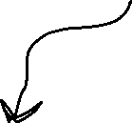
private static void find_coins(int[] d, int k, int n) {
int chosen[] = new int[n + 1];
calculate_combinations(chosen, d, 0, n, 0, d.length - 1, k);
}
void calculate_combinations(int[] chosen, int[] arr, int index, int r, int start, int end, int target) {
Array that we build up over time. Holds indices of currently selected denominations for some combination
[1,__, __ ]
[1,1, __ ]
[1,1, 5 ]

Slide 97




private static void find_coins(int[] d, int k, int n) {
int chosen[] = new int[n + 1];
calculate_combinations(chosen, d, 0, n, 0, d.length - 1, k);
}
void calculate_combinations(int[] chosen, int[] arr, int index, int r, int start, int end, int target) {
Array of denominations we pass for each recursive call
[ __, __, __, ]
D = [1, 5, 10]
D = [5, 10]
D = [10]
[ 1, __, __, ]
[ 5, __, __, ]
[ 10, __, __, ]

Slide 98

private static void find_coins(int[] d, int k, int n) {
int chosen[] = new int[n + 1];
calculate_combinations(chosen, d, 0, n, 0, d.length - 1, k);
}
void calculate_combinations(int[] chosen, int[] arr, int index, int r, int start, int end, int target) {
The next index that we need to insert at for chosen array
[ __,__, __ ]
[1,__, __ ]
[1,1, __ ]
[1,1, 5 ]
index
index
index

Slide 99
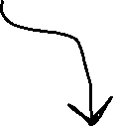
private static void find_coins(int[] d, int k, int n) {
int chosen[] = new int[n + 1];
calculate_combinations(chosen, d, 0, n, 0, d.length - 1, k);
}
void calculate_combinations(int[] chosen, int[] arr, int index, int r, int start, int end, int target) {
The desired size of the combination. When index == r, we have reached the desired combination size
[ __,__, __ ]
[1,__, __ ]
[1,1, __ ]
[1,1, 5 ]
We’ve hit our desired size!
index = 0
index = 1
index = 2
index = 3

Slide 100
void calculate_combinations(int[] chosen, int[] arr, int index, int r, int start, int end, int target) {
if (index == r) {
int counter = 0;
ArrayList<Integer> coins = new ArrayList<Integer>();
for (int i = 0; i < r; i++) {
counter += arr[chosen[i]];
coins.add(arr[chosen[i]]);
}
if(counter == target) {
System.out.println(coins);
}
return;
}
for (int i = start; i <= end; i++) {
chosen[index] = i;
calculate_combinations(chosen, arr, index + 1, r, i, end, target);
}
return;
}

Slide 101

void calculate_combinations(int[] chosen, int[] arr, int index, int r, int start, int end, int target) {
if (index == r) {
int counter = 0;
ArrayList<Integer> coins = new ArrayList<Integer>();
for (int i = 0; i < r; i++) {
counter += arr[chosen[i]];
coins.add(arr[chosen[i]]);
}
if(counter == target) {
System.out.println(coins);
}
return;
}
for (int i = start; i <= end; i++) {
chosen[index] = i;
calculate_combinations(chosen, arr, index + 1, r, i, end, target);
}
return;
}
If we hit our base case, we know we have N things, so put them in an ArrayList and add them up
Base case
Only print out the combination if it adds up to target

Slide 102





void calculate_combinations(int[] chosen, int[] arr, int index, int r, int start, int end, int target) {
if (index == r) {
int counter = 0;
ArrayList<Integer> coins = new ArrayList<Integer>();
for (int i = 0; i < r; i++) {
counter += arr[chosen[i]];
coins.add(arr[chosen[i]]);
}
if(counter == target) {
System.out.println(coins);
}
return;
}
for (int i = start; i <= end; i++) {
chosen[index] = i;
calculate_combinations(chosen, arr, index + 1, r, i, end, target);
}
return;
}
Recursive Case
Otherwise, insert selected coin into the chosen array
create (end-start) branches, and give it a smaller section of D

Slide 103
[ __, __, __, ]
D = [1, 5, 10]
D = [5, 10]
[ 1, __, __, ]
[ 5, __, __, ]
[ 10, __, __, ]
[ 1, 1, __, ]
[ 1, 5, __, ]
[ 1, 10, __, ]
[ 1, 1, 1, ]
[ 1, 1, 5, ]
[ 1, 1, 10, ]

