Slide 1

CSCI 132: Basic Data Structures and Algorithms
Sorting (Part 4)
Reese Pearsall
Spring 2024
https://www.cs.montana.edu/pearsall/classes/spring2024/132/main.html
*All images are stolen from the internet

Slide 2
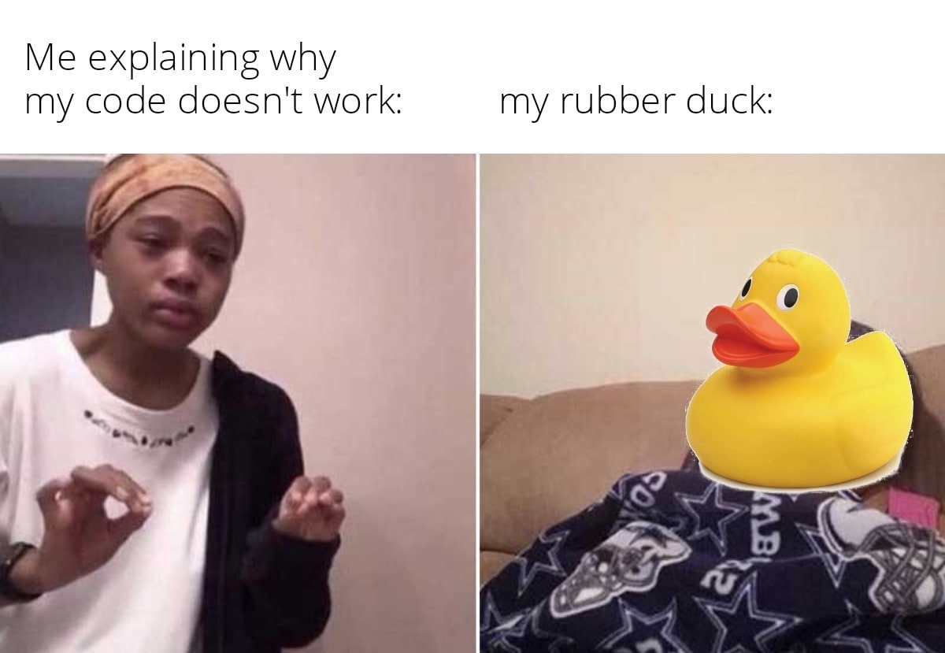
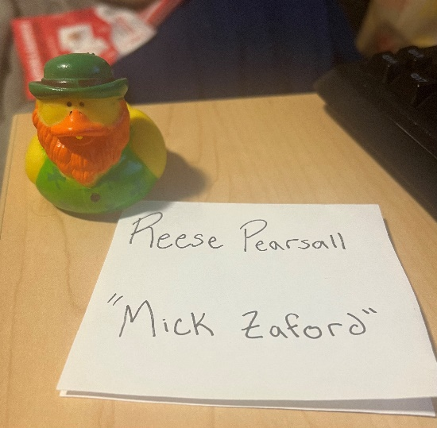
Announcements
Program 5 due Sunday May 5th
Lab 12 → Fill out the course evaluation
Rubber Duck Extra Credit Posted
Next Wednesday (5/1) is an optional help session for program 5 (no lecture)

Slide 3
private static int binary_search(int[] array, int n) {
int low = 0;
int high = array.length - 1;
while(low <= high) {
int mid = (low + high) / 2;
if(n == array[mid]) {
return mid;
}
else if(n > array[mid]) {
low = mid + 1;
}
else {
high = mid - 1;
}
}
return -1;
}
O(1)
O(1)
O(log n)
O(1)
O(1)
O(1)
O(1)
O(1)
O(1)
O(1)
Running time?
O(log n)

Slide 4
Why O(log n) ?
1 | 2 | 9 | 10 | 11 | 15 | 18 | 21 | 27 | 31 | 41 | 43 | 50
low
high
1 | 2 | 9 | 10 | 11 | 15 | 18 | 21 | 27 | 31 | 41 | 43 | 50
low
high
1 | 2 | 9 | 10 | 11 | 15 | 18 | 21 | 27 | 31 | 41 | 43 | 50
low
high
1 | 2 | 9 | 10 | 11 | 15 | 18 | 21 | 27 | 31 | 41 | 43 | 50
low
high

Slide 5
Every time that we loop, we eliminate half the array. We will never check all n elements of the array; therefore, it can’t be O(n).
Whenever we reduce the amount of work done by half, that generally gives us O(logn) running time
Why O(log n) ?
1 | 2 | 9 | 10 | 11 | 15 | 18 | 21 | 27 | 31 | 41 | 43 | 50
low
high
1 | 2 | 9 | 10 | 11 | 15 | 18 | 21 | 27 | 31 | 41 | 43 | 50
low
high
1 | 2 | 9 | 10 | 11 | 15 | 18 | 21 | 27 | 31 | 41 | 43 | 50
low
high
1 | 2 | 9 | 10 | 11 | 15 | 18 | 21 | 27 | 31 | 41 | 43 | 50
low
high

Slide 6
private static int binary_search(????????????) {
if(low <= high) {
int mid = (low + high) / 2;
if(n == array[mid]) {
return mid;
}
else if(n > array[mid]) {
return binary_search(?????????);
}
else {
return binary_search(?????????);
}
}
else {
return -1;
}
}
Binary Search can also be implemented using recursion

Slide 7
private static int binary_search_recursive(int[] array, int n, int high, int low) {
if(low <= high) {
int mid = (low + high) / 2;
if(n == array[mid]) {
return mid;
}
else if(n > array[mid]) {
return binary_search_recursive(array, n, high, mid+1);
}
else {
return binary_search_recursive(array, n, mid-1, low);
}
}
else {
return -1;
}
}
Binary Search can also be implemented using recursion

Slide 8
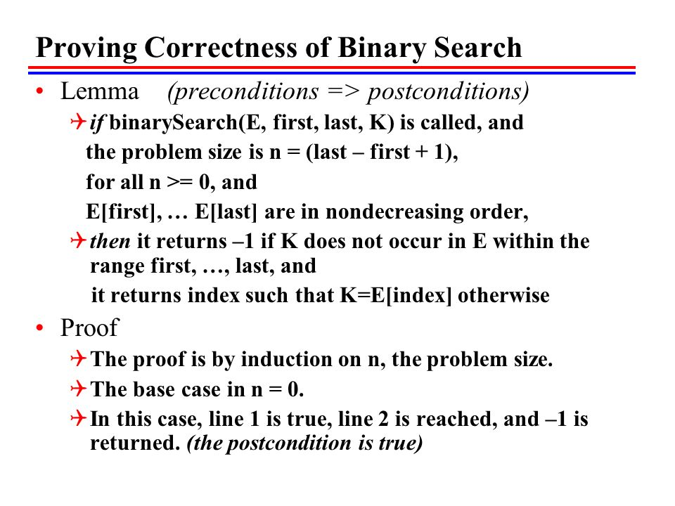
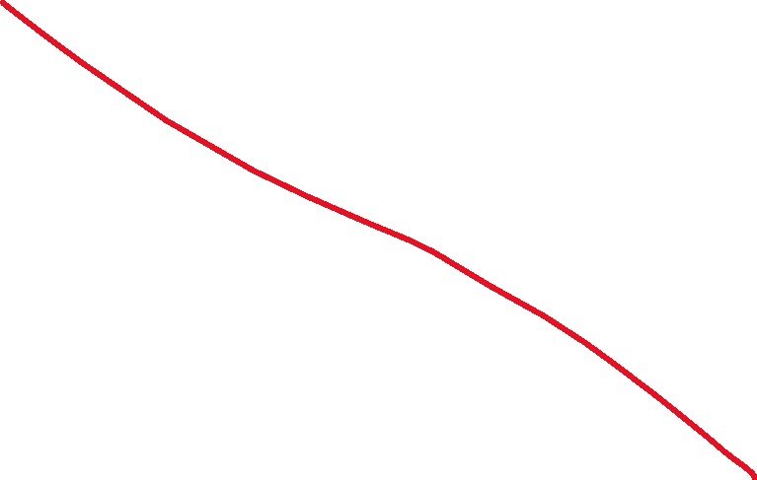
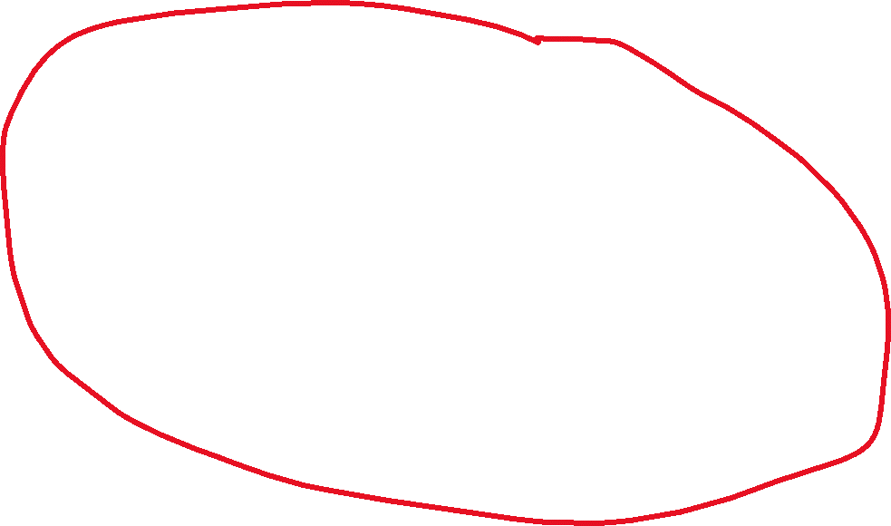

Slide 9
Running Time of Sorting Algorithms
Brief Description
Running Time
Bubble Sort | ??? | ???
Selection Sort | ??? | ???
Merge Sort | ??? | ???
Quick Sort | ??? | ???

Slide 10
public int[] selectionSort(int[] array) {
int n = array.length;
for(int i = 0; i < n -1; i++) {
int min_index_so_far = i;
for (int j = i + 1; j < n; j++) {
if(array[j] < array[min_index_so_far]) {
min_index_so_far = j;
}
}
int temp = array[i];
array[i] = array[min_index_so_far];
array[min_index_so_far] = temp;
}
return array;
}

Slide 11
You will not be tested about today’s sorting algorithms.

Slide 12
Insertion Sort
We divide our array into two sections. A sorted section, and an unsorted section. We iterate through the array, and for each iteration, we move one element from the unsorted section to the sorted section
38 | 27 | 43 | 3 | 9 | 82 | 10 | 14

Slide 13
Insertion Sort
We divide our array into two sections. A sorted section, and an unsorted section. We iterate through the array, and for each iteration, we move one element from the unsorted section to the sorted section
38 | 27 | 43 | 3 | 9 | 82 | 10 | 14
38 | 27 | 43 | 3 | 9 | 82 | 10 | 14

Slide 14

Insertion Sort
We divide our array into two sections. A sorted section, and an unsorted section. We iterate through the array, and for each iteration, we move one element from the unsorted section to the sorted section
38 | 27 | 43 | 3 | 9 | 82 | 10 | 14
38 | 27 | 43 | 3 | 9 | 82 | 10 | 14
38 | 27 | 43 | 3 | 9 | 82 | 10 | 14
27 | 38 | 43 | 3 | 9 | 82 | 10 | 14

Slide 15

Insertion Sort
We divide our array into two sections. A sorted section, and an unsorted section. We iterate through the array, and for each iteration, we move one element from the unsorted section to the sorted section
38 | 27 | 43 | 3 | 9 | 82 | 10 | 14
38 | 27 | 43 | 3 | 9 | 82 | 10 | 14
38 | 27 | 43 | 3 | 9 | 82 | 10 | 14
27 | 38 | 43 | 3 | 9 | 82 | 10 | 14
27 | 38 | 43 | 3 | 9 | 82 | 10 | 14

Slide 16

Insertion Sort
We divide our array into two sections. A sorted section, and an unsorted section. We iterate through the array, and for each iteration, we move one element from the unsorted section to the sorted section
38 | 27 | 43 | 3 | 9 | 82 | 10 | 14
38 | 27 | 43 | 3 | 9 | 82 | 10 | 14
38 | 27 | 43 | 3 | 9 | 82 | 10 | 14
27 | 38 | 43 | 3 | 9 | 82 | 10 | 14
27 | 38 | 43 | 3 | 9 | 82 | 10 | 14

Slide 17
Insertion Sort
We divide our array into two sections. A sorted section, and an unsorted section. We iterate through the array, and for each iteration, we move one element from the unsorted section to the sorted section
38 | 27 | 43 | 3 | 9 | 82 | 10 | 14
38 | 27 | 43 | 3 | 9 | 82 | 10 | 14
38 | 27 | 43 | 3 | 9 | 82 | 10 | 14
27 | 38 | 43 | 3 | 9 | 82 | 10 | 14
3 | 27 | 38 | 43 | 9 | 82 | 10 | 14

Slide 18
Insertion Sort
We divide our array into two sections. A sorted section, and an unsorted section. We iterate through the array, and for each iteration, we move one element from the unsorted section to the sorted section
38 | 27 | 43 | 3 | 9 | 82 | 10 | 14
38 | 27 | 43 | 3 | 9 | 82 | 10 | 14
38 | 27 | 43 | 3 | 9 | 82 | 10 | 14
27 | 38 | 43 | 3 | 9 | 82 | 10 | 14
3 | 27 | 38 | 43 | 9 | 82 | 10 | 14
3 | 9 | 27 | 38 | 43 | 82 | 10 | 14

Slide 19
Insertion Sort
We divide our array into two sections. A sorted section, and an unsorted section. We iterate through the array, and for each iteration, we move one element from the unsorted section to the sorted section
3 | 9 | 27 | 38 | 43 | 82 | 10 | 14

Slide 20
Insertion Sort
We divide our array into two sections. A sorted section, and an unsorted section. We iterate through the array, and for each iteration, we move one element from the unsorted section to the sorted section
3 | 9 | 27 | 38 | 43 | 82 | 10 | 14

Slide 21

Insertion Sort
We divide our array into two sections. A sorted section, and an unsorted section. We iterate through the array, and for each iteration, we move one element from the unsorted section to the sorted section
3 | 9 | 27 | 38 | 43 | 82 | 10 | 14
3 | 9 | 10 | 27 | 38 | 43 | 82 | 14

Slide 22


Insertion Sort
We divide our array into two sections. A sorted section, and an unsorted section. We iterate through the array, and for each iteration, we move one element from the unsorted section to the sorted section
3 | 9 | 27 | 38 | 43 | 82 | 10 | 14
3 | 9 | 10 | 27 | 38 | 43 | 82 | 14

Slide 23

Insertion Sort
We divide our array into two sections. A sorted section, and an unsorted section. We iterate through the array, and for each iteration, we move one element from the unsorted section to the sorted section
3 | 9 | 27 | 38 | 43 | 82 | 10 | 14
3 | 9 | 10 | 27 | 38 | 43 | 82 | 14
3 | 9 | 10 | 14 | 27 | 38 | 43 | 82

Slide 24

Insertion Sort
We divide our array into two sections. A sorted section, and an unsorted section. We iterate through the array, and for each iteration, we move one element from the unsorted section to the sorted section
3 | 9 | 27 | 38 | 43 | 82 | 10 | 14
3 | 9 | 10 | 27 | 38 | 43 | 82 | 14
3 | 9 | 10 | 14 | 27 | 38 | 43 | 82
Running time: O(n²)

Slide 25
Insertion Sort
void insertionSort(int array[]) {
int size = array.length;
for (int step = 1; step < size; step++) {
int key = array[step];
int j = step - 1;
// Compare key with each element on the left of it until an element smaller than
// it is found.
// For descending order, change key<array[j] to key>array[j].
while (j >= 0 && key < array[j]) {
array[j + 1] = array[j];
--j;
}
// Place key at after the element just smaller than it.
array[j + 1] = key;
}
}

Slide 26
Shell Sort
Compare items that are distant from each other. After each iteration, decrease the gap size.
N = 8
Gap = 4
38 | 27 | 43 | 3 | 9 | 82 | 10 | 14

Slide 27
Shell Sort
Compare items that are distant from each other. After each iteration, decrease the gap size.
N = 8
Gap = 4
38 | 27 | 43 | 3 | 9 | 82 | 10 | 14
4

Slide 28
Shell Sort
Compare items that are distant from each other. After each iteration, decrease the gap size.
N = 8
Gap = 4
9 | 27 | 43 | 3 | 38 | 82 | 10 | 14
4

Slide 29
Shell Sort
Compare items that are distant from each other. After each iteration, decrease the gap size.
N = 8
Gap = 4
9 | 27 | 43 | 3 | 38 | 82 | 10 | 14
4

Slide 30
Shell Sort
Compare items that are distant from each other. After each iteration, decrease the gap size.
N = 8
Gap = 4
9 | 27 | 43 | 3 | 38 | 82 | 10 | 14
4

Slide 31
Shell Sort
Compare items that are distant from each other. After each iteration, decrease the gap size.
N = 8
Gap = 4
9 | 27 | 10 | 3 | 38 | 82 | 43 | 14
4

Slide 32
Shell Sort
Compare items that are distant from each other. After each iteration, decrease the gap size.
N = 8
Gap = 4
9 | 27 | 10 | 3 | 38 | 82 | 43 | 14
4

Slide 33
Shell Sort
Compare items that are distant from each other. After each iteration, decrease the gap size.
N = 8
Gap = 4
Gap = 2
9 | 27 | 10 | 3 | 38 | 82 | 43 | 14
2

Slide 34
Shell Sort
Compare items that are distant from each other. After each iteration, decrease the gap size.
N = 8
Gap = 4
Gap = 2
9 | 27 | 10 | 3 | 38 | 82 | 43 | 14
2

Slide 35
Shell Sort
Compare items that are distant from each other. After each iteration, decrease the gap size.
N = 8
Gap = 4
Gap = 2
9 | 3 | 10 | 27 | 38 | 82 | 43 | 14
2

Slide 36
Shell Sort
Compare items that are distant from each other. After each iteration, decrease the gap size.
N = 8
Gap = 4
Gap = 2
9 | 3 | 10 | 27 | 38 | 82 | 43 | 14
2

Slide 37
Shell Sort
Compare items that are distant from each other. After each iteration, decrease the gap size.
N = 8
Gap = 4
Gap = 2
9 | 3 | 10 | 27 | 38 | 82 | 43 | 14
2

Slide 38
Shell Sort
Compare items that are distant from each other. After each iteration, decrease the gap size.
N = 8
Gap = 4
Gap = 2
9 | 3 | 10 | 27 | 38 | 82 | 43 | 14
2

Slide 39
Shell Sort
Compare items that are distant from each other. After each iteration, decrease the gap size.
N = 8
Gap = 4
Gap = 2
9 | 3 | 10 | 27 | 38 | 82 | 43 | 14
2

Slide 40
Shell Sort
Compare items that are distant from each other. After each iteration, decrease the gap size.
N = 8
Gap = 4
Gap = 2
9 | 3 | 10 | 27 | 38 | 14 | 43 | 82
2

Slide 41
Shell Sort
Compare items that are distant from each other. After each iteration, decrease the gap size.
N = 8
Gap = 4
Gap = 2
9 | 3 | 10 | 27 | 38 | 14 | 43 | 82
2

Slide 42
Shell Sort
Compare items that are distant from each other. After each iteration, decrease the gap size.
N = 8
Gap = 4
Gap = 2
Gap = 1
9 | 3 | 10 | 27 | 38 | 14 | 43 | 82
1

Slide 43
Shell Sort
Compare items that are distant from each other. After each iteration, decrease the gap size.
N = 8
Gap = 4
Gap = 2
Gap = 1
3 | 9 | 10 | 27 | 38 | 14 | 43 | 82
1

Slide 44
Shell Sort
Compare items that are distant from each other. After each iteration, decrease the gap size.
N = 8
Gap = 4
Gap = 2
Gap = 1
3 | 9 | 10 | 27 | 38 | 14 | 43 | 82
1

Slide 45
Shell Sort
Compare items that are distant from each other. After each iteration, decrease the gap size.
N = 8
Gap = 4
Gap = 2
Gap = 1
3 | 9 | 10 | 27 | 38 | 14 | 43 | 82
1

Slide 46
Shell Sort
Compare items that are distant from each other. After each iteration, decrease the gap size.
N = 8
Gap = 4
Gap = 2
Gap = 1
3 | 9 | 10 | 27 | 38 | 14 | 43 | 82
1

Slide 47
Shell Sort
Compare items that are distant from each other. After each iteration, decrease the gap size.
N = 8
Gap = 4
Gap = 2
Gap = 1
3 | 9 | 10 | 27 | 38 | 14 | 43 | 82
1

Slide 48
Shell Sort
Compare items that are distant from each other. After each iteration, decrease the gap size.
N = 8
Gap = 4
Gap = 2
Gap = 1
3 | 9 | 10 | 27 | 14 | 38 | 43 | 82
1

Slide 49
Shell Sort
Compare items that are distant from each other. After each iteration, decrease the gap size.
N = 8
Gap = 4
Gap = 2
Gap = 1
3 | 9 | 10 | 27 | 14 | 38 | 43 | 82
1

Slide 50
Shell Sort
Compare items that are distant from each other. After each iteration, decrease the gap size.
N = 8
Gap = 4
Gap = 2
Gap = 1
3 | 9 | 10 | 27 | 14 | 38 | 43 | 82
1

Slide 51
Shell Sort
Compare items that are distant from each other. After each iteration, decrease the gap size.
N = 8
Gap = 4
Gap = 2
Gap = 1
3 | 9 | 10 | 27 | 14 | 38 | 43 | 82
(do it again ??)

Slide 52
Shell Sort
Compare items that are distant from each other. After each iteration, decrease the gap size.
N = 8
Gap = 4
Gap = 2
Gap = 1
3 | 9 | 10 | 27 | 14 | 38 | 43 | 82
1

Slide 53
Shell Sort
Compare items that are distant from each other. After each iteration, decrease the gap size.
N = 8
Gap = 4
Gap = 2
Gap = 1
3 | 9 | 10 | 27 | 14 | 38 | 43 | 82
1

Slide 54
Shell Sort
Compare items that are distant from each other. After each iteration, decrease the gap size.
N = 8
Gap = 4
Gap = 2
Gap = 1
3 | 9 | 10 | 27 | 14 | 38 | 43 | 82
1

Slide 55
Shell Sort
Compare items that are distant from each other. After each iteration, decrease the gap size.
N = 8
Gap = 4
Gap = 2
Gap = 1
3 | 9 | 10 | 27 | 14 | 38 | 43 | 82
1

Slide 56
Shell Sort
Compare items that are distant from each other. After each iteration, decrease the gap size.
N = 8
Gap = 4
Gap = 2
Gap = 1
3 | 9 | 10 | 14 | 27 | 38 | 43 | 82
1

Slide 57

Shell Sort
Compare items that are distant from each other. After each iteration, decrease the gap size.
N = 8
Gap = 4
Gap = 2
Gap = 1
3 | 9 | 10 | 14 | 27 | 38 | 43 | 82
Running time: O(n²)

Slide 58
Cocktail Shaker Sort
Double Sided Bubble Sort
https://en.wikipedia.org/wiki/Cocktail_shaker_sort
Running time: O(n²)

Slide 59
Does anyone have any ideas for a very bad sorting algorithm, but still works?

Slide 60
Does anyone have any ideas for a very bad sorting algorithm, but still works?
If we are really lucky, our algorithm is insanely fast
If we are really unlucky, our algorithm will never finish

Slide 61
Bogo Sort (stupid sort) randomly shuffles the array until its sorted
while not sorted(array):
shuffle(array)
Running time: O(pain) if we don’t keep track of permutations checked
O(n!) if we keep track of permuations

Slide 62

Bogo Sort (stupid sort) randomly shuffles the array until its sorted
while not sorted(array):
shuffle(array)
Best case scenario, this is the most efficient sorting algorithm!
Running time: O(pain) if we don’t keep track of permutations checked
O(n!) if we keep track of permutations
This sorting algorithm is a joke, please don’t take this one seriously…

Slide 63
Sorting Algorithms Visualized
https://youtu.be/kPRA0W1kECg

