Slide 1

CSCI 232: Data Structures and Algorithms
Java Review
Reese Pearsall
Spring 2024
https://www.cs.montana.edu/pearsall/classes/spring2024/232/main.html

Slide 2

Announcements
Lab 1 due this Friday @ 11:59 PM
Should have it posted within the next 24 hours
Teaching Assistants:
Section 003- Sultan Yarylgassimov
Email: sultanyaril@gmail.com
Office Hours: Mondays 10am - 12pm Barnard Hall 259
Section 004- Muzhou (Peter) Chen
Email: muzhouchen@outlook.com
Office Hours: Thursdays 9am - 11am Barnard Hall 259
Section 005- Sultan Yarylgassimov
Email: sultanyaril@gmail.com
Office Hours: Mondays 10am - 12pm Barnard Hall 259

Slide 3
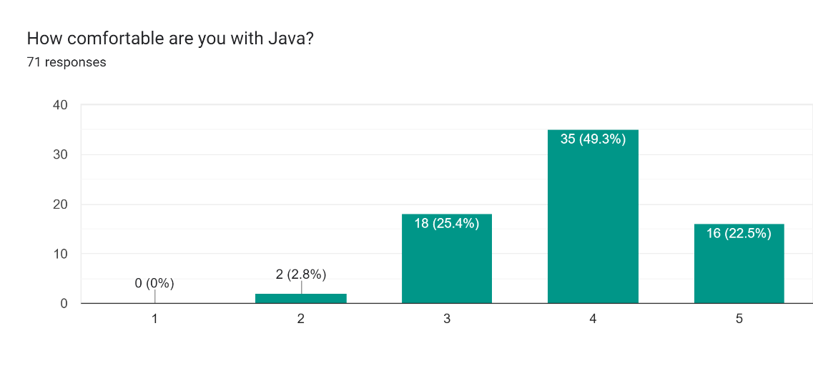
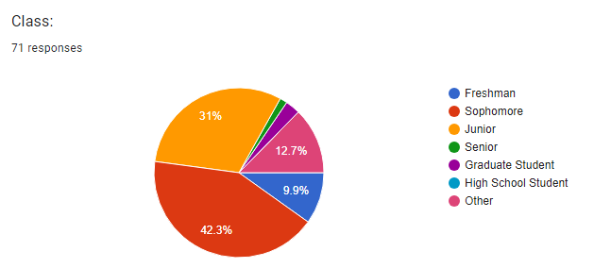

Course Questionnaire Results

Slide 4

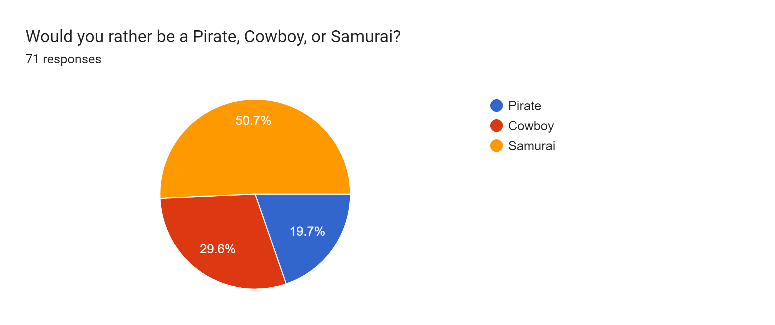
Course Questionnaire Results

Slide 5

We are going to write a program where a user can keep track of their online shopping cart.
Users can add items, remove items, search for items, get the total price of cart, and apply coupons to items

Slide 6
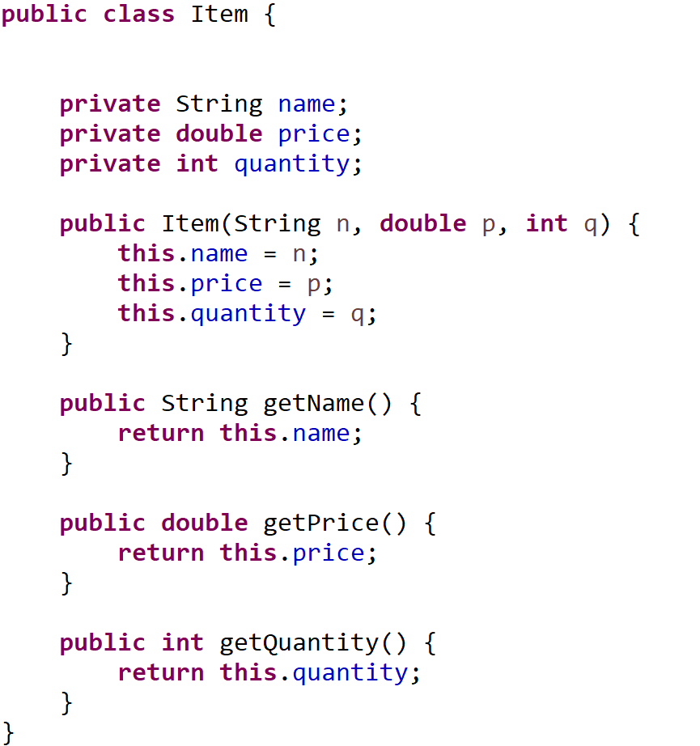
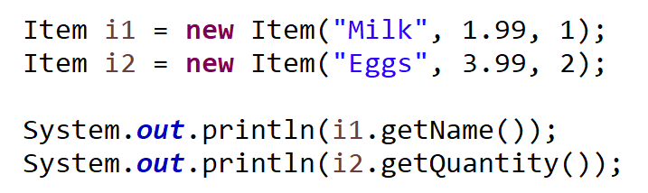
name | “Milk”
price | 1.99
quantity | 1
i1
getName()
getQuantity()
getPrice()
Java Class: Blueprint for an object (i.e. a “thing”)
Java Objects: Instances of classes. Program entities
Instance Field/Attributes
Methods

Slide 7
public void addItem(String name, double price, int quantity) {
Item item = new Item(name, price, quantity);
Item[] tempArray = new Item[this.shoppingCart.length + 1];
for(int i = 0; i < this.shoppingCart.length; i++) {
tempArray[i] = shoppingCart[i];
}
tempArray[shoppingCart.length] = item;
shoppingCart = tempArray;
this.num_of_items++;
}
shoppingCart
Item
Item
Item

Slide 8
public void addItem(String name, double price, int quantity) {
Item item = new Item(name, price, quantity);
Item[] tempArray = new Item[this.shoppingCart.length + 1];
for(int i = 0; i < this.shoppingCart.length; i++) {
tempArray[i] = shoppingCart[i];
}
tempArray[shoppingCart.length] = item;
shoppingCart = tempArray;
this.num_of_items++;
}
shoppingCart
Item
item
Item
Item
Item

Slide 9
public void addItem(String name, double price, int quantity) {
Item item = new Item(name, price, quantity);
Item[] tempArray = new Item[this.shoppingCart.length + 1];
for(int i = 0; i < this.shoppingCart.length; i++) {
tempArray[i] = shoppingCart[i];
}
tempArray[shoppingCart.length] = item;
shoppingCart = tempArray;
this.num_of_items++;
}
shoppingCart
tempArray
Item
item
Item
Item
Item

Slide 10
public void addItem(String name, double price, int quantity) {
Item item = new Item(name, price, quantity);
Item[] tempArray = new Item[this.shoppingCart.length + 1];
for(int i = 0; i < this.shoppingCart.length; i++) {
tempArray[i] = shoppingCart[i];
}
tempArray[shoppingCart.length] = item;
shoppingCart = tempArray;
this.num_of_items++;
}
shoppingCart
Item
tempArray
Item
Item
item
Item
Item
Item
Item

Slide 11
public void addItem(String name, double price, int quantity) {
Item item = new Item(name, price, quantity);
Item[] tempArray = new Item[this.shoppingCart.length + 1];
for(int i = 0; i < this.shoppingCart.length; i++) {
tempArray[i] = shoppingCart[i];
}
tempArray[shoppingCart.length] = item;
shoppingCart = tempArray;
this.num_of_items++;
}
shoppingCart
Item
tempArray
Item
Item
Item
Item
Item
Item

Slide 12
public void addItem(String name, double price, int quantity) {
Item item = new Item(name, price, quantity);
Item[] tempArray = new Item[this.shoppingCart.length + 1];
for(int i = 0; i < this.shoppingCart.length; i++) {
tempArray[i] = shoppingCart[i];
}
tempArray[shoppingCart.length] = item;
shoppingCart = tempArray;
this.num_of_items++;
}
shoppingCart
Item
tempArray
Item
Item
Item
Item
Item
Item

Slide 13
public void addItem(String name, double price, int quantity) {
Item item = new Item(name, price, quantity);
Item[] tempArray = new Item[this.shoppingCart.length + 1];
for(int i = 0; i < this.shoppingCart.length; i++) {
tempArray[i] = shoppingCart[i];
}
tempArray[shoppingCart.length] = item;
shoppingCart = tempArray;
this.num_of_items++;
}
Running time?

Slide 14
public void addItem(String name, double price, int quantity) {
Item item = new Item(name, price, quantity);
Item[] tempArray = new Item[this.shoppingCart.length + 1];
for(int i = 0; i < this.shoppingCart.length; i++) {
tempArray[i] = shoppingCart[i];
}
tempArray[shoppingCart.length] = item;
shoppingCart = tempArray;
this.num_of_items++;
}
Running time: Number of operations required to complete algorithm

Slide 15
public void addItem(String name, double price, int quantity) {
Item item = new Item(name, price, quantity);
Item[] tempArray = new Item[this.shoppingCart.length + 1];
for(int i = 0; i < this.shoppingCart.length; i++) {
tempArray[i] = shoppingCart[i];
}
tempArray[shoppingCart.length] = item;
shoppingCart = tempArray;
this.num_of_items++;
}
Running time: Number of operations required to complete algorithm
Big O Notation: Upper bound on asymptotic growth. I.e. Worst case upper bound of a function

Slide 16
public void addItem(String name, double price, int quantity) {
Item item = new Item(name, price, quantity);
Item[] tempArray = new Item[this.shoppingCart.length + 1];
for(int i = 0; i < this.shoppingCart.length; i++) {
tempArray[i] = shoppingCart[i];
}
tempArray[shoppingCart.length] = item;
shoppingCart = tempArray;
this.num_of_items++;
}
Running time: Number of operations required to complete algorithm
Big O Notation: Upper bound on asymptotic growth. I.e. Worst case upper bound of a function
Big O Notation measures the number of steps needed to complete an algorithm under the worst-case scenario

Slide 17
public void addItem(String name, double price, int quantity) {
Item item = new Item(name, price, quantity);
Item[] tempArray = new Item[this.shoppingCart.length + 1];
for(int i = 0; i < this.shoppingCart.length; i++) {
tempArray[i] = shoppingCart[i];
}
tempArray[shoppingCart.length] = item;
shoppingCart = tempArray;
this.num_of_items++;
}
public int linearSearch(int[] array, int target) {
for(int i = 0; i < array.length; i++) {
if(array[i] == target){
return i;
}
}
return -1;
}
To calculate the running time, we add up the running time of each operation

Slide 18
public void addItem(String name, double price, int quantity) {
Item item = new Item(name, price, quantity);
Item[] tempArray = new Item[this.shoppingCart.length + 1];
for(int i = 0; i < this.shoppingCart.length; i++) {
tempArray[i] = shoppingCart[i];
}
tempArray[shoppingCart.length] = item;
shoppingCart = tempArray;
this.num_of_items++;
}
public int linearSearch(int[] array, int target) {
for(int i = 0; i < array.length; i++) {
if(array[i] == target){
return i;
}
}
return -1;
}
??? →
To calculate the running time, we add up the running time of each operation
Worst case scenario, this for loop will need run n times
O(n) Let n = array.length

Slide 19
public void addItem(String name, double price, int quantity) {
Item item = new Item(name, price, quantity);
Item[] tempArray = new Item[this.shoppingCart.length + 1];
for(int i = 0; i < this.shoppingCart.length; i++) {
tempArray[i] = shoppingCart[i];
}
tempArray[shoppingCart.length] = item;
shoppingCart = tempArray;
this.num_of_items++;
}
public int linearSearch(int[] array, int target) {
for(int i = 0; i < array.length; i++) {
if(array[i] == target){
return i;
}
}
return -1;
}
O(n) →
O(???) →
To calculate the running time, we add up the running time of each operation

Slide 20
public void addItem(String name, double price, int quantity) {
Item item = new Item(name, price, quantity);
Item[] tempArray = new Item[this.shoppingCart.length + 1];
for(int i = 0; i < this.shoppingCart.length; i++) {
tempArray[i] = shoppingCart[i];
}
tempArray[shoppingCart.length] = item;
shoppingCart = tempArray;
this.num_of_items++;
}
public int linearSearch(int[] array, int target) {
for(int i = 0; i < array.length; i++) {
if(array[i] == target){
return i;
}
}
return -1;
}
O(n) →
O(???) →
To calculate the running time, we add up the running time of each operation
Primitive operation – operation that takes constant time (independent of size of the input)

Slide 21
public void addItem(String name, double price, int quantity) {
Item item = new Item(name, price, quantity);
Item[] tempArray = new Item[this.shoppingCart.length + 1];
for(int i = 0; i < this.shoppingCart.length; i++) {
tempArray[i] = shoppingCart[i];
}
tempArray[shoppingCart.length] = item;
shoppingCart = tempArray;
this.num_of_items++;
}
public int linearSearch(int[] array, int target) {
for(int i = 0; i < array.length; i++) {
if(array[i] == target){
return i;
}
}
return -1;
}
O(n) →
O(1) →
To calculate the running time, we add up the running time of each operation
Primitive operation – operation that takes constant time (independent of size of the input)

Slide 22
public void addItem(String name, double price, int quantity) {
Item item = new Item(name, price, quantity);
Item[] tempArray = new Item[this.shoppingCart.length + 1];
for(int i = 0; i < this.shoppingCart.length; i++) {
tempArray[i] = shoppingCart[i];
}
tempArray[shoppingCart.length] = item;
shoppingCart = tempArray;
this.num_of_items++;
}
public int linearSearch(int[] array, int target) {
for(int i = 0; i < array.length; i++) {
if(array[i] == target){
return i;
}
}
return -1;
}
O(n) →
O(1) →
O(1) →
O(1) →
To calculate the running time, we add up the running time of each operation
Primitive operation – operation that takes constant time (independent of size of the input)

Slide 23
public void addItem(String name, double price, int quantity) {
Item item = new Item(name, price, quantity);
Item[] tempArray = new Item[this.shoppingCart.length + 1];
for(int i = 0; i < this.shoppingCart.length; i++) {
tempArray[i] = shoppingCart[i];
}
tempArray[shoppingCart.length] = item;
shoppingCart = tempArray;
this.num_of_items++;
}
public int linearSearch(int[] array, int target) {
for(int i = 0; i < array.length; i++) {
if(array[i] == target){
return i;
}
}
return -1;
}
O(n) →
O(1) →
O(1) →
O(1) →
To calculate the running time, we add up the running time of each operation
Primitive operation – operation that takes constant time (independent of size of the input)
Total running time: O(n * 1 + 1)

Slide 24
public void addItem(String name, double price, int quantity) {
Item item = new Item(name, price, quantity);
Item[] tempArray = new Item[this.shoppingCart.length + 1];
for(int i = 0; i < this.shoppingCart.length; i++) {
tempArray[i] = shoppingCart[i];
}
tempArray[shoppingCart.length] = item;
shoppingCart = tempArray;
this.num_of_items++;
}
public int linearSearch(int[] array, int target) {
for(int i = 0; i < array.length; i++) {
if(array[i] == target){
return i;
}
}
return -1;
}
O(n) →
O(1) →
O(1) →
O(1) →
To calculate the running time, we add up the running time of each operation
Primitive operation – operation that takes constant time (independent of size of the input)
Total running time: O(n * 1 + 1)
In Big O notation:
We can drop non dominant factors
We can drop multiplicative constants (coefficients)

Slide 25
public void addItem(String name, double price, int quantity) {
Item item = new Item(name, price, quantity);
Item[] tempArray = new Item[this.shoppingCart.length + 1];
for(int i = 0; i < this.shoppingCart.length; i++) {
tempArray[i] = shoppingCart[i];
}
tempArray[shoppingCart.length] = item;
shoppingCart = tempArray;
this.num_of_items++;
}
public int linearSearch(int[] array, int target) {
for(int i = 0; i < array.length; i++) {
if(array[i] == target){
return i;
}
}
return -1;
}
O(n) →
O(1) →
O(1) →
O(1) →
To calculate the running time, we add up the running time of each operation
Primitive operation – operation that takes constant time (independent of size of the input)
Total running time: O(n) where n = | array |
In Big O notation:
We can drop non dominant factors
We can drop multiplicative constants (coefficients)

Slide 26
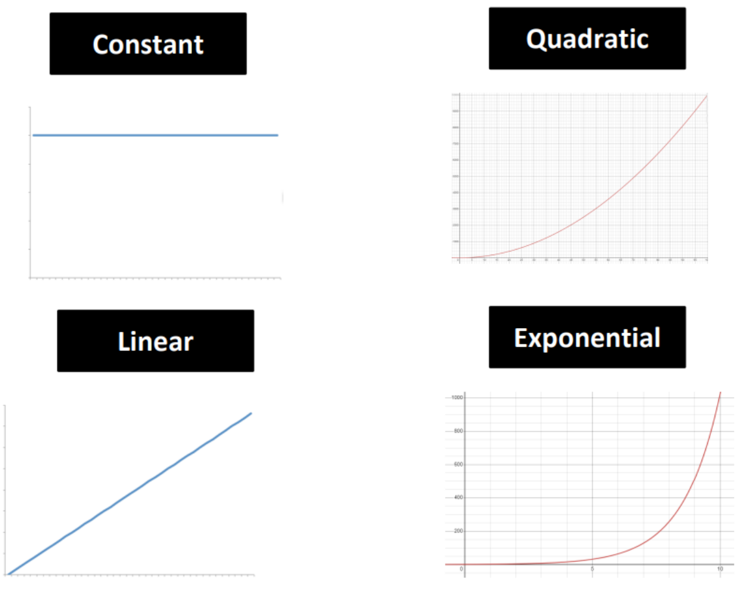
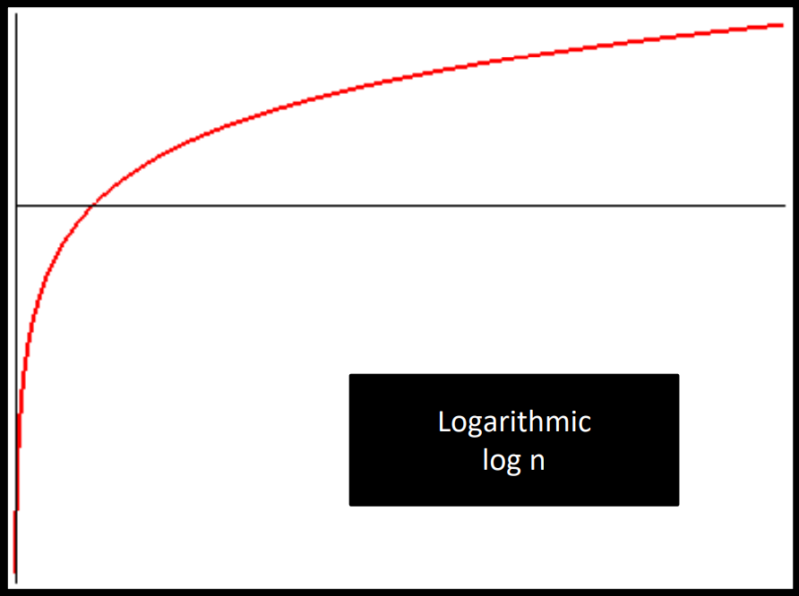
public void addItem(String name, double price, int quantity) {
Item item = new Item(name, price, quantity);
Item[] tempArray = new Item[this.shoppingCart.length + 1];
for(int i = 0; i < this.shoppingCart.length; i++) {
tempArray[i] = shoppingCart[i];
}
tempArray[shoppingCart.length] = item;
shoppingCart = tempArray;
this.num_of_items++;
}

Slide 27
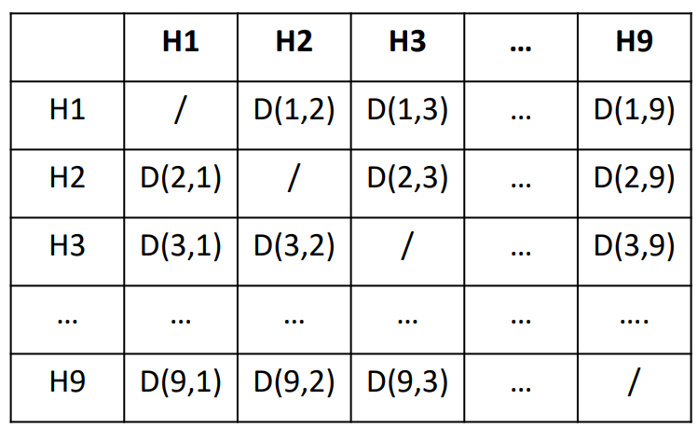
function computeDistanceBetweenHouses():
for each house in neighborhood i;
for each house in neighborhood j;
compute_distance(i, j)

Slide 28
function computeDistanceBetweenHouses():
for each house in neighborhood i;
for each house in neighborhood j;
compute_distance(i, j)
O(n)
O(n-1)
O(1)

Slide 29
function computeDistanceBetweenHouses():
for each house in neighborhood i;
for each house in neighborhood j;
compute_distance(i, j)
O(n)
O(n)
O(1)

Slide 30
function computeDistanceBetweenHouses():
for each house in neighborhood i;
for each house in neighborhood j;
compute_distance(i, j)
O(n)
O(n)
O(1)
Total running time = O(n) * ( O(n) * O(1) )

Slide 31
function computeDistanceBetweenHouses():
for each house in neighborhood i;
for each house in neighborhood j;
compute_distance(i, j)
O(n)
O(n)
O(1)
Total running time = O(n) * ( O(n) * O(1) )
O(n^2)
Where n = # of houses

Slide 32
public void addItem(String name, double price, int quantity) {
Item item = new Item(name, price, quantity);
Item[] tempArray = new Item[this.shoppingCart.length + 1];
for(int i = 0; i < this.shoppingCart.length; i++) {
tempArray[i] = shoppingCart[i];
}
tempArray[shoppingCart.length] = item;
shoppingCart = tempArray;
this.num_of_items++;
}

Slide 33
public void addItem(String name, double price, int quantity) {
Item item = new Item(name, price, quantity);
Item[] tempArray = new Item[this.shoppingCart.length + 1];
for(int i = 0; i < this.shoppingCart.length; i++) {
tempArray[i] = shoppingCart[i];
}
tempArray[shoppingCart.length] = item;
shoppingCart = tempArray;
this.num_of_items++;
}
O(1) →

Slide 34
public void addItem(String name, double price, int quantity) {
Item item = new Item(name, price, quantity);
Item[] tempArray = new Item[this.shoppingCart.length + 1];
for(int i = 0; i < this.shoppingCart.length; i++) {
tempArray[i] = shoppingCart[i];
}
tempArray[shoppingCart.length] = item;
shoppingCart = tempArray;
this.num_of_items++;
}
O(1) →
O(n+1) →

Slide 35
public void addItem(String name, double price, int quantity) {
Item item = new Item(name, price, quantity);
Item[] tempArray = new Item[this.shoppingCart.length + 1];
for(int i = 0; i < this.shoppingCart.length; i++) {
tempArray[i] = shoppingCart[i];
}
tempArray[shoppingCart.length] = item;
shoppingCart = tempArray;
this.num_of_items++;
}
O(1) →
O(n+1) →
O(n) →

Slide 36
public void addItem(String name, double price, int quantity) {
Item item = new Item(name, price, quantity);
Item[] tempArray = new Item[this.shoppingCart.length + 1];
for(int i = 0; i < this.shoppingCart.length; i++) {
tempArray[i] = shoppingCart[i];
}
tempArray[shoppingCart.length] = item;
shoppingCart = tempArray;
this.num_of_items++;
}
O(1) →
O(n+1) →
O(n) →
O(1) →

Slide 37
public void addItem(String name, double price, int quantity) {
Item item = new Item(name, price, quantity);
Item[] tempArray = new Item[this.shoppingCart.length + 1];
for(int i = 0; i < this.shoppingCart.length; i++) {
tempArray[i] = shoppingCart[i];
}
tempArray[shoppingCart.length] = item;
shoppingCart = tempArray;
this.num_of_items++;
}
O(1) →
O(n+1) →
O(n) →
O(1) →
O(1) →
O(1) →
O(1) →

Slide 38
public void addItem(String name, double price, int quantity) {
Item item = new Item(name, price, quantity);
Item[] tempArray = new Item[this.shoppingCart.length + 1];
for(int i = 0; i < this.shoppingCart.length; i++) {
tempArray[i] = shoppingCart[i];
}
tempArray[shoppingCart.length] = item;
shoppingCart = tempArray;
this.num_of_items++;
}
O(1) →
O(n+1) →
O(n) →
O(1) →
O(1) →
O(1) →
O(1) →

Slide 39
public void addItem(String name, double price, int quantity) {
Item item = new Item(name, price, quantity);
Item[] tempArray = new Item[this.shoppingCart.length + 1];
for(int i = 0; i < this.shoppingCart.length; i++) {
tempArray[i] = shoppingCart[i];
}
tempArray[shoppingCart.length] = item;
shoppingCart = tempArray;
this.num_of_items++;
}
O(1) →
O(n) →
O(n) →
O(1) →
O(1) →
O(1) →
O(1) →
Total running time: O(n) + O(n)
O(2n)
O(n) where n = shoppingCart.length

Slide 40
public void addItem(String name, double price, int quantity) {
Item item = new Item(name, price, quantity);
Item[] tempArray = new Item[this.shoppingCart.length + 1];
for(int i = 0; i < this.shoppingCart.length; i++) {
tempArray[i] = shoppingCart[i];
}
tempArray[shoppingCart.length] = item;
shoppingCart = tempArray;
this.num_of_items++;
}
O(1) →
O(n) →
O(n) →
O(1) →
O(1) →
O(1) →
O(1) →
Total running time: O(n) + O(n)
O(2n)
O(n) where n = shoppingCart.length
Takeaway: Adding to a full array takes O(n) time

Slide 41


