Slide 1

CSCI 232: Data Structures and Algorithms
Binary Search Trees (BST) Part 2
Reese Pearsall
Spring 2024
https://www.cs.montana.edu/pearsall/classes/spring2024/232/main.html

Slide 2
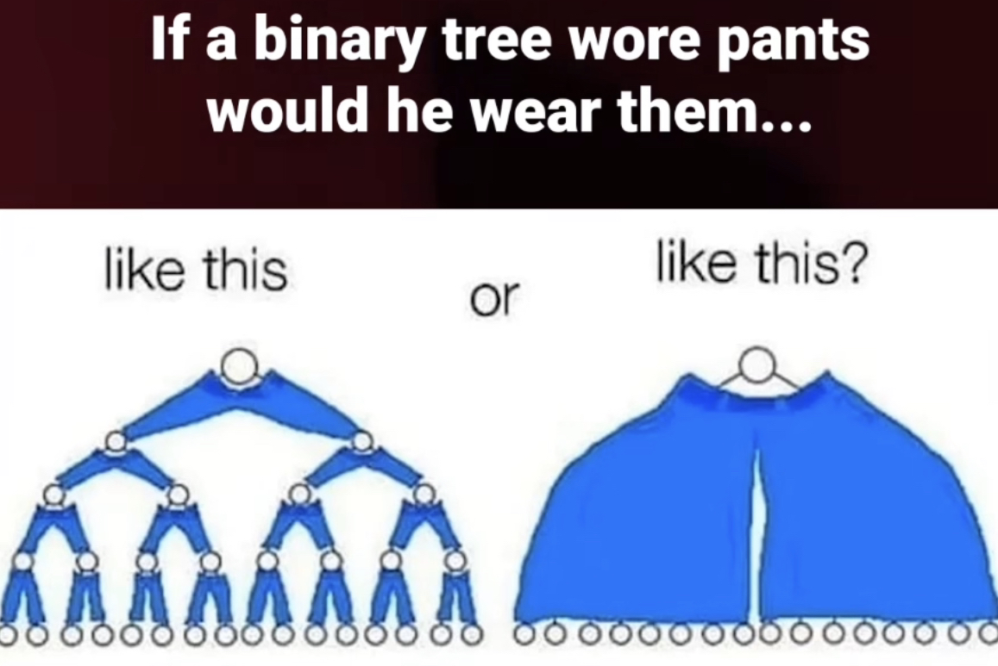
Announcements
Program 1 posted, due Feb 27

Slide 3
Binary Search Tree
44
17
88
Properties of a BST:
Composed of Comparable data elements
Each node as at most two children
For a given node, all left-hand descendants have values that are less than the node
For a given node, all right-hand descendants have values that are greater than the node
No duplicate values
8
32
65
97
27
54
82
93
21
29
76
68
80

Slide 4
Binary Search Tree - Insertion
public void insert(int newValue) {
if(root == null) {
root = new Node(newValue);
}
else {
Node currentNode = root;
boolean placed = false;
while(!placed) {
if(currentNode.getValue() == newValue) {
placed = true;
System.out.println("No duplicate values allowed");
}
else if(newValue < currentNode.getValue()) {
if(currentNode.getLeft() == null) {
currentNode.setLeft(new Node(newValue));
currentNode.getLeft().setParent(currentNode);
placed = true;
}
else {
currentNode = currentNode.getLeft();
}
}
else {
if(currentNode.getRight() == null) {
currentNode.setRight(new Node(newValue));
currentNode.getRight().setParent(currentNode);
placed = true;
}
else {
currentNode = currentNode.getRight();
}
}
}

Slide 5
Binary Search Tree - Insertion
public void insert(int newValue) {
if(root == null) {
root = new Node(newValue);
}
else {
Node currentNode = root;
boolean placed = false;
while(!placed) {
if(currentNode.getValue() == newValue) {
placed = true;
System.out.println("No duplicate values allowed");
}
else if(newValue < currentNode.getValue()) {
if(currentNode.getLeft() == null) {
currentNode.setLeft(new Node(newValue));
currentNode.getLeft().setParent(currentNode);
placed = true;
}
else {
currentNode = currentNode.getLeft();
}
}
else {
if(currentNode.getRight() == null) {
currentNode.setRight(new Node(newValue));
currentNode.getRight().setParent(currentNode);
placed = true;
}
else {
currentNode = currentNode.getRight();
}
}
}
We repeatedly move left or right until we find the correct spot for our new node

Slide 6
Binary Search Tree - Insertion
public void insert(int newValue) {
if(root == null) {
root = new Node(newValue);
}
else {
Node currentNode = root;
boolean placed = false;
while(!placed) {
if(currentNode.getValue() == newValue) {
placed = true;
System.out.println("No duplicate values allowed");
}
else if(newValue < currentNode.getValue()) {
if(currentNode.getLeft() == null) {
currentNode.setLeft(new Node(newValue));
currentNode.getLeft().setParent(currentNode);
placed = true;
}
else {
currentNode = currentNode.getLeft();
}
}
else {
if(currentNode.getRight() == null) {
currentNode.setRight(new Node(newValue));
currentNode.getRight().setParent(currentNode);
placed = true;
}
else {
currentNode = currentNode.getRight();
}
}
}
We repeatedly move left or right until we find the correct spot for our new node
Once we find the correct spot, we update some pointers

Slide 7
Binary Search Tree - Insertion
public void insert(int newValue) {
if(root == null) {
root = new Node(newValue);
}
else {
Node currentNode = root;
boolean placed = false;
while(!placed) {
if(currentNode.getValue() == newValue) {
placed = true;
System.out.println("No duplicate values allowed");
}
else if(newValue < currentNode.getValue()) {
if(currentNode.getLeft() == null) {
currentNode.setLeft(new Node(newValue));
currentNode.getLeft().setParent(currentNode);
placed = true;
}
else {
currentNode = currentNode.getLeft();
}
}
else {
if(currentNode.getRight() == null) {
currentNode.setRight(new Node(newValue));
currentNode.getRight().setParent(currentNode);
placed = true;
}
else {
currentNode = currentNode.getRight();
}
}
}
Running time?

Slide 8
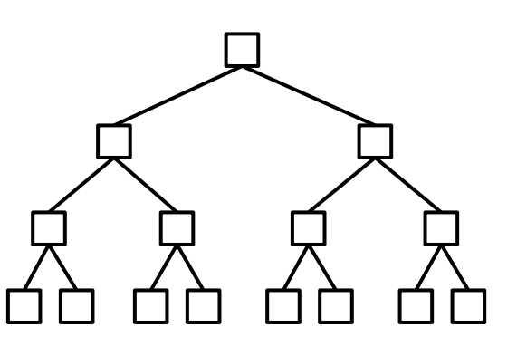
Binary Search Tree - Insertion
public void insert(int newValue) {
if(root == null) {
root = new Node(newValue);
}
else {
Node currentNode = root;
boolean placed = false;
while(!placed) {
if(currentNode.getValue() == newValue) {
placed = true;
System.out.println("No duplicate values allowed");
}
else if(newValue < currentNode.getValue()) {
if(currentNode.getLeft() == null) {
currentNode.setLeft(new Node(newValue));
currentNode.getLeft().setParent(currentNode);
placed = true;
}
else {
currentNode = currentNode.getLeft();
}
}
else {
if(currentNode.getRight() == null) {
currentNode.setRight(new Node(newValue));
currentNode.getRight().setParent(currentNode);
placed = true;
}
else {
currentNode = currentNode.getRight();
}
}
}
Running time?
We will always be inserting a leaf node, so worst cast scenario we will need to travel the height of the tree
If we have a “balanced tree” the height of the tree, is log(n) n = # of nodes

Slide 9
Binary Search Tree - Insertion
public void insert(int newValue) {
if(root == null) {
root = new Node(newValue);
}
else {
Node currentNode = root;
boolean placed = false;
while(!placed) {
if(currentNode.getValue() == newValue) {
placed = true;
System.out.println("No duplicate values allowed");
}
else if(newValue < currentNode.getValue()) {
if(currentNode.getLeft() == null) {
currentNode.setLeft(new Node(newValue));
currentNode.getLeft().setParent(currentNode);
placed = true;
}
else {
currentNode = currentNode.getLeft();
}
}
else {
if(currentNode.getRight() == null) {
currentNode.setRight(new Node(newValue));
currentNode.getRight().setParent(currentNode);
placed = true;
}
else {
currentNode = currentNode.getRight();
}
}
}
Running time?
We will always be inserting a leaf node, so worst cast scenario we will need to travel the height of the tree
If we have a “balanced tree” the height of the tree, is log(n) n = # of nodes
“Good tree” = O(logn)

Slide 10
Binary Search Tree - Insertion
public void insert(int newValue) {
if(root == null) {
root = new Node(newValue);
}
else {
Node currentNode = root;
boolean placed = false;
while(!placed) {
if(currentNode.getValue() == newValue) {
placed = true;
System.out.println("No duplicate values allowed");
}
else if(newValue < currentNode.getValue()) {
if(currentNode.getLeft() == null) {
currentNode.setLeft(new Node(newValue));
currentNode.getLeft().setParent(currentNode);
placed = true;
}
else {
currentNode = currentNode.getLeft();
}
}
else {
if(currentNode.getRight() == null) {
currentNode.setRight(new Node(newValue));
currentNode.getRight().setParent(currentNode);
placed = true;
}
else {
currentNode = currentNode.getRight();
}
}
}
Running time?
We will always be inserting a leaf node, so worst cast scenario we will need to travel the height of the tree
If we have a “bad tree” the height of the tree, is O(n-1) n = # of nodes
50
“bad tree” = O(n)
55
60
72
81

Slide 11

Binary Search Tree - Insertion
public void insert(int newValue) {
if(root == null) {
root = new Node(newValue);
}
else {
Node currentNode = root;
boolean placed = false;
while(!placed) {
if(currentNode.getValue() == newValue) {
placed = true;
System.out.println("No duplicate values allowed");
}
else if(newValue < currentNode.getValue()) {
if(currentNode.getLeft() == null) {
currentNode.setLeft(new Node(newValue));
currentNode.getLeft().setParent(currentNode);
placed = true;
}
else {
currentNode = currentNode.getLeft();
}
}
else {
if(currentNode.getRight() == null) {
currentNode.setRight(new Node(newValue));
currentNode.getRight().setParent(currentNode);
placed = true;
}
else {
currentNode = currentNode.getRight();
}
}
}
Running time?
We will always be inserting a leaf node, so worst cast scenario we will need to travel the height of the tree
“Bad” tree → O(n)
“Good” tree → O(logn)
O(h) → h = height of tree
Running time for adding to an array?
O(n)

Slide 12
Binary Search Tree - Insertion
public void insert(int newValue) {
if(root == null) {
root = new Node(newValue);
}
else {
Node currentNode = root;
boolean placed = false;
while(!placed) {
if(currentNode.getValue() == newValue) {
placed = true;
System.out.println("No duplicate values allowed");
}
else if(newValue < currentNode.getValue()) {
if(currentNode.getLeft() == null) {
currentNode.setLeft(new Node(newValue));
currentNode.getLeft().setParent(currentNode);
placed = true;
}
else {
currentNode = currentNode.getLeft();
}
}
else {
if(currentNode.getRight() == null) {
currentNode.setRight(new Node(newValue));
currentNode.getRight().setParent(currentNode);
placed = true;
}
else {
currentNode = currentNode.getRight();
}
}
}
Running time?
If we can find a way to keep a tree “balanced”, we can achieve O(logn) insertion time, and O(logn) searching time
We will always be inserting a leaf node, so worst cast scenario we will need to travel the height of the tree
“Bad” tree → O(n)
“Good” tree → O(logn)
O(h) → h = height of tree
Running time for adding to an array?
O(n)

Slide 13
Binary Search Tree - Insertion
public void insert(int newValue) {
if(root == null) {
root = new Node(newValue);
}
else {
Node currentNode = root;
boolean placed = false;
while(!placed) {
if(currentNode.getValue() == newValue) {
placed = true;
System.out.println("No duplicate values allowed");
}
else if(newValue < currentNode.getValue()) {
if(currentNode.getLeft() == null) {
currentNode.setLeft(new Node(newValue));
currentNode.getLeft().setParent(currentNode);
placed = true;
}
else {
currentNode = currentNode.getLeft();
}
}
else {
if(currentNode.getRight() == null) {
currentNode.setRight(new Node(newValue));
currentNode.getRight().setParent(currentNode);
placed = true;
}
else {
currentNode = currentNode.getRight();
}
}
}
Running time?
If we can find a way to keep a tree “balanced”, we can achieve O(logn) insertion time, and O(logn) searching time
There is a way! Coming soon
We will always be inserting a leaf node, so worst cast scenario we will need to travel the height of the tree
“Bad” tree → O(n)
“Good” tree → O(logn)
O(h) → h = height of tree
Running time for adding to an array?
O(n)

Slide 14
Binary Search Tree- Removal
44
17
88
remove(68);
8
32
65
97
27
54
82
93
21
29
76
68
80

Slide 15
Binary Search Tree- Removal
44
17
88
remove(68);
8
32
65
97
Step 1: Find the node in the tree
27
54
82
93
21
29
76
68
80

Slide 16
Binary Search Tree- Removal
44
17
88
remove(68);
8
32
65
97
Step 1: Find the node in the tree
27
54
82
93
21
29
76
68
80

Slide 17
Binary Search Tree- Removal
44
17
88
remove(68);
8
32
65
97
Step 1: Find the node in the tree
27
54
82
93
21
29
76
68
80

Slide 18
Binary Search Tree- Removal
44
17
88
remove(68);
8
32
65
97
Step 1: Find the node in the tree
27
54
82
93
21
29
76
68
80

Slide 19
Binary Search Tree- Removal
44
17
88
remove(68);
8
32
65
97
Step 1: Find the node in the tree
27
54
82
93
21
29
76
68
80

Slide 20
Binary Search Tree- Removal
44
17
88
remove(68);
8
32
65
97
Step 1: Find the node in the tree
27
54
82
93
21
29
76
68
80

Slide 21

Binary Search Tree- Removal
44
17
88
remove(68);
8
32
65
97
Step 1: Find the node in the tree
Step 2: Change parent to point to null
27
54
82
93
21
29
76
68
80

Slide 22

Binary Search Tree- Removal
44
17
88
remove(68);
8
32
65
97
Step 1: Find the node in the tree
Step 2: Change parent to point to null
27
54
82
93
Does this always work?
21
29
76
68
80

Slide 23

Binary Search Tree- Removal
44
17
88
remove(32);
8
32
65
97
Step 1: Find the node in the tree
Step 2: Change parent to point to null
27
54
82
93
21
29
76
This does not always work
68
80

Slide 24
Binary Search Tree- Removal
44
Case 1: Node has no children
Case 2: Node has one child
Case 3: Node has two children
17
88
8
32
65
97
27
54
82
93
21
29
76
68
80

Slide 25
Binary Search Tree- Removal
44
Case 1: Node has no children
Case 2: Node has one child
Case 3: Node has two children
17
88
remove(21);
8
32
65
97
27
54
82
93
How do we know it has no children?
21
29
76
68
80

Slide 26
Binary Search Tree- Removal
44
Case 1: Node has no children
Case 2: Node has one child
Case 3: Node has two children
17
88
remove(21);
8
32
65
97
27
54
82
93
How do we know it has no children?
If its left and right child are both null
21
29
76
68
80

Slide 27



Binary Search Tree- Removal
44
Case 1: Node has no children
Case 2: Node has one child
Case 3: Node has two children
17
88
remove(21);
8
32
65
97
27
54
82
93
Update parent’s child to point to null
Update Node’s parent to point to null
21
29
76
68
80

Slide 28



Binary Search Tree- Removal
44
Case 1: Node has no children
Case 2: Node has one child
Case 3: Node has two children
17
88
remove(21);
8
32
65
97
27
54
82
93
Update parent’s child to point to null
Update Node’s parent to point to null
21
29
76
68
80

Slide 29
Binary Search Tree- Removal
44
Case 1: Node has no children
Case 2: Node has one child
Case 3: Node has two children
17
88
remove(32);
8
32
65
97
27
54
82
93
???
21
29
76
68
80

Slide 30




Binary Search Tree- Removal
44
Case 1: Node has no children
Case 2: Node has one child
Case 3: Node has two children
17
88
remove(32);
8
32
65
97
Change the Node’s parent to point to the only child
Update the Node’s only child parent to point to the Node’s Parent
27
54
82
93
21
29
76
68
80

Slide 31
Binary Search Tree- Removal
44
Case 1: Node has no children
Case 2: Node has one child
Case 3: Node has two children
17
88
remove(88);
8
32
65
97
27
54
82
93
21
29
76
96
68
80
95

Slide 32
Binary Search Tree- Removal
44
Case 1: Node has no children
Case 2: Node has one child
Case 3: Node has two children
17
88
remove(88);
8
32
65
97
Which child to use?
27
54
82
93
21
29
76
96
68
80
95

Slide 33
Binary Search Tree- Removal
44
Case 1: Node has no children
Case 2: Node has one child
Case 3: Node has two children
17
65
remove(88);
8
32
54
97
Which child to use?
27
82
93
21
29
76
96
68
80
95

Slide 34



Binary Search Tree- Removal
44
Case 1: Node has no children
Case 2: Node has one child
Case 3: Node has two children
17
65
remove(88);
8
32
54
97
Which child to use?
27
82
93
21
29
76
96
68
80
95

Slide 35
Binary Search Tree- Removal
44
Case 1: Node has no children
Case 2: Node has one child
Case 3: Node has two children
17
88
remove(88);
8
32
65
97
27
54
82
93
21
29
76
96
68
80
95

Slide 36
Binary Search Tree- Removal
44
Case 1: Node has no children
Case 2: Node has one child
Case 3: Node has two children
17
97
remove(88);
8
32
65
93
27
82
96
54
95
21
29
76
68
80

Slide 37

Binary Search Tree- Removal
44
Case 1: Node has no children
Case 2: Node has one child
Case 3: Node has two children
17
97
remove(88);
8
32
65
93
27
82
96
54
95
21
29
76
68
80

Slide 38
Binary Search Tree- Removal
44
Case 1: Node has no children
Case 2: Node has one child
Case 3: Node has two children
17
88
remove(88);
8
32
65
97
Which child descendant to use?
27
54
82
93
21
29
76
96
68
80
95

Slide 39

Binary Search Tree- Removal
44
Case 1: Node has no children
Case 2: Node has one child
Case 3: Node has two children
17
88
remove(88);
8
32
65
97
Which child descendant to use?
27
54
82
93
21
29
76
96
68
80
95

Slide 40

Binary Search Tree- Removal
44
Case 1: Node has no children
Case 2: Node has one child
Case 3: Node has two children
17
82
remove(88);
8
32
65
97
Which child descendant to use?
27
54
76
93
21
29
68
80
96
95

Slide 41
Binary Search Tree- Removal
44
Case 1: Node has no children
Case 2: Node has one child
Case 3: Node has two children
17
88
remove(88);
8
32
65
97
Which child descendant to use?
27
54
82
93
21
29
76
96
68
80
95

Slide 42

Binary Search Tree- Removal
44
Case 1: Node has no children
Case 2: Node has one child
Case 3: Node has two children
17
88
remove(88);
8
32
65
97
Which child descendant to use?
27
54
82
93
21
29
76
96
68
80
95

Slide 43

Binary Search Tree- Removal
44
Case 1: Node has no children
Case 2: Node has one child
Case 3: Node has two children
17
93
remove(88);
8
32
65
97
Which child descendant to use?
27
54
82
96
21
29
76
95
68
80

Slide 44

Binary Search Tree- Removal
44
Case 1: Node has no children
Case 2: Node has one child
Case 3: Node has two children
17
88
remove(88);
8
32
65
97
Which child descendant to use?
27
54
82
93
The lowest value in the right subtree
or the highest value in the left subtree
21
29
76
96
68
80
95

Slide 45

Binary Search Tree- Removal
44
Case 1: Node has no children
Case 2: Node has one child
Case 3: Node has two children
remove node
17
88
remove(88);
8
32
65
97
min
Find smallest node in right sub tree (min)
Update the of remove node to be the value of min
Update the parents of min
Update children on remove node
27
54
82
93
21
29
76
96
68
80
95

Slide 46
Binary Search Tree- Removal
44
Case 1: Node has no children
Case 2: Node has one child
Case 3: Node has two children
remove node
17
88
remove(88);
8
32
65
97
min
27
54
82
93
Running time?
“Bad” tree → O(n)
“Good” tree → O(logn)
21
29
76
96
68
80
95
O(h) → h = height of tree

