Slide 1

CSCI 232: Data Structures and Algorithms
Hashing (Part 1)
Reese Pearsall
Spring 2024
https://www.cs.montana.edu/pearsall/classes/spring2024/232/main.html

Slide 2

Binary Search Tree- Removal
44
replaceMe
replaceMe.setValue(currentNode.getValue());
currentNode.getParent().setLeft(currentNode.getRight());
currentNode.getRight().setParent(currentNode.getParent());
17
88
8
32
65
97
currentNode
27
54
82
93
21
29
76
96
68
80
95

Slide 3
Binary Search Tree- Removal
44
replaceMe
replaceMe.setValue(currentNode.getValue());
currentNode.getParent().setLeft(currentNode.getRight());
currentNode.getRight().setParent(currentNode.getParent());
17
88
8
32
65
97
Always update the left, because we had to have come from the left
currentNode
27
54
82
93
21
29
76
96
68
80
95

Slide 4
Binary Search Tree- Removal
44
replaceMe
replaceMe.setValue(currentNode.getValue());
currentNode.getParent().setLeft(currentNode.getRight());
currentNode.getRight().setParent(currentNode.getParent());
17
88
8
32
65
97
We update the right child, because the left child must be null
currentNode
27
54
82
93
21
29
76
96
68
80
95

Slide 5
Binary Search Tree- Removal
44
replaceMe.setValue(currentNode.getValue());
currentNode.getParent().setLeft(currentNode.getRight());
currentNode.getRight().setParent(currentNode.getParent());
17
88
replaceMe
8
32
65
97
27
54
82
93
21
29
76
96
68
80
95
currentNode

Slide 6
Binary Search Tree- Removal
44
replaceMe.setValue(currentNode.getValue());
currentNode.getParent().setLeft(currentNode.getRight());
currentNode.getRight().setParent(currentNode.getParent());
17
88
replaceMe
8
32
65
97
Null pointer exception
27
54
82
93
21
29
76
96
68
80
95
currentNode

Slide 7
Binary Search Tree- Removal
44
replaceMe.setValue(currentNode.getValue());
currentNode.getParent().setLeft(currentNode.getRight());
if(currentNode.getRight() != null){
currentNode.getRight().setParent(currentNode.getParent());
}
17
88
replaceMe
8
32
65
97
Null pointer exception
27
54
82
93
21
29
76
96
68
80
95
currentNode

Slide 8
Binary Search Tree- Removal
44
replaceMe.setValue(currentNode.getValue());
currentNode.getParent().setLeft(currentNode.getRight());
if(currentNode.getRight() != null){
currentNode.getRight().setParent(currentNode.getParent());
}
17
88
8
32
65
97
replaceMe
27
54
82
93
21
29
76
96
currentNode
19
24
68
80
95

Slide 9
Binary Search Tree- Removal
44
replaceMe.setValue(currentNode.getValue());
currentNode.getParent().setLeft(currentNode.getRight());
if(currentNode.getRight() != null){
currentNode.getRight().setParent(currentNode.getParent());
}
17
88
8
32
65
97
replaceMe
27
54
82
93
This will delete the entire left subtree.
Additionally, we don’t want to update the left child in case
21
29
76
96
currentNode
19
24
68
80
95

Slide 10
Binary Search Tree- Removal
44
replaceMe.setValue(currentNode.getValue());
currentNode.getParent().setLeft(currentNode.getRight());
if(currentNode.getRight() != null){
currentNode.getRight().setParent(currentNode.getParent());
}
17
88
8
32
65
97
replaceMe
27
54
82
93
currentNode
21
29
76
96
19
24
30
68
80
95

Slide 11
Binary Search Tree- Removal
44
replaceMe.setValue(currentNode.getValue());
currentNode.getParent().setLeft(currentNode.getRight());
if(currentNode.getRight() != null){
currentNode.getRight().setParent(currentNode.getParent());
}
17
88
8
32
65
97
replaceMe
27
54
82
93
Same issue here
currentNode
21
29
76
96
19
24
30
68
80
95

Slide 12
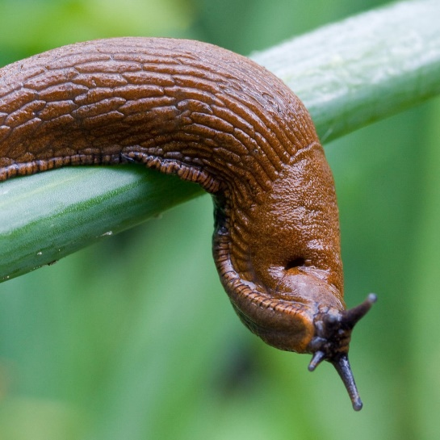
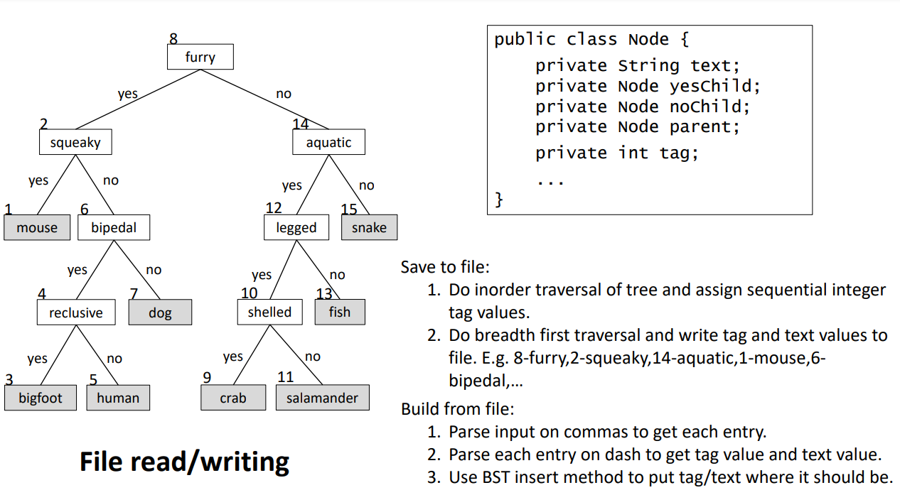
Program 1

Slide 13





Map / Dictionary
A map or dictionary is an unordered collection of key/value pairs.
Maps a key to a value
Keys
Values
Dallas
Chicago
New England
Denver
Pittsburgh
Kansas City
Miami
Tennessee
New York
Buffalo
Atlanta
→
→
→
→
→
→
→
→
→
→
→
Cowboys
Bears
Patriots
Broncos
Steelers
Chiefs
Dolphins
Titans
Giants
Bills
Falcons
General Rules
1. Keys should not be shared
(no duplicate keys)
New York : Jets
New York : Giants
1. Keys should not be mutable
String
int
double
Arrays
Objects

Slide 14





Map / Dictionary
A map or dictionary is an unordered collection of key/value pairs.
Maps a key to a value
Keys
Values
Implementation?
Dallas
Chicago
New England
Denver
Pittsburgh
Kansas City
Miami
Tennessee
New York
Buffalo
Atlanta
→
→
→
→
→
→
→
→
→
→
→
Cowboys
Bears
Patriots
Broncos
Steelers
Chiefs
Dolphins
Titans
Giants
Bills
Falcons
General Rules
1. Keys should not be shared
(no duplicate keys)
New York : Jets
New York : Giants
1. Keys should not be mutable
String
int
double
Arrays
Objects

Slide 15










Map / Dictionary
Miami
Keys
Values
Dallas
Chicago
New England
Denver
Pittsburgh
Kansas City
Miami
Tennessee
New York
Buffalo
Atlanta
→
→
→
→
→
→
→
→
→
→
→
Cowboys
Bears
Patriots
Broncos
Steelers
Chiefs
Dolphins
Titans
Giants
Bills
Falcons
Denver
New York
Chicago
Kansas City
New England
Tennessee
Buffalo
Dallas
Pittsburgh
public class Node{
private Node parent
private Node leftChild
private Node rightChild
private String key;
private String value;
Atlanta

Slide 16










Map / Dictionary
Miami
Keys
Values
Dallas
Chicago
New England
Denver
Pittsburgh
Kansas City
Miami
Tennessee
New York
Buffalo
Atlanta
→
→
→
→
→
→
→
→
→
→
→
Cowboys
Bears
Patriots
Broncos
Steelers
Chiefs
Dolphins
Titans
Giants
Bills
Falcons
Denver
New York
Chicago
Kansas City
New England
Tennessee
Buffalo
Dallas
Pittsburgh
public class Node{
private Node parent
private Node leftChild
private Node rightChild
private String key;
private String value;
Atlanta
1. Build a BST based on Node key

Slide 17



Map / Dictionary
get(“Dallas”)
→ “Cowboys”
Miami
Keys
Values
Dallas
Chicago
New England
Denver
Pittsburgh
Kansas City
Miami
Tennessee
New York
Buffalo
Atlanta
→
→
→
→
→
→
→
→
→
→
→
Cowboys
Bears
Patriots
Broncos
Steelers
Chiefs
Dolphins
Titans
Giants
Bills
Falcons
Denver
New York
Chicago
Kansas City
New England
Tennessee
Buffalo
Dallas
Pittsburgh
public class Node{
private Node parent
private Node leftChild
private Node rightChild
private String key;
private String value;
public class Dictionary{
public void put(key, value)
public String get(key)
public void delete(key)
…
}
Atlanta
Build a BST based on Node key
Search for value using BST, return value of Node

Slide 18



Map / Dictionary
get(“Dallas”)
→ “Cowboys”
Miami
Keys
Values
Dallas
Chicago
New England
Denver
Pittsburgh
Kansas City
Miami
Tennessee
New York
Buffalo
Atlanta
→
→
→
→
→
→
→
→
→
→
→
Cowboys
Bears
Patriots
Broncos
Steelers
Chiefs
Dolphins
Titans
Giants
Bills
Falcons
Denver
New York
Lookup time?
O(log n)
Chicago
Kansas City
New England
Tennessee
Buffalo
Dallas
Pittsburgh
public class Node{
private Node parent
private Node leftChild
private Node rightChild
private String key;
private String value;
public class Dictionary{
public void put(key, value)
public String get(key)
public void delete(key)
…
}
Atlanta
Build a BST based on Node key
Search for value using BST, return value of Node

Slide 19

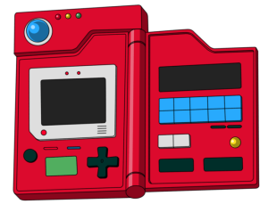

Pokedex
Key
Value
(Pokemon #) (Pokemon)
1
2
3
…
98
99
Bulbasaur
Ivysaur
Venasaur
…
Krabby
Kingler

Slide 20

Pokedex
Key
Value
Index
(Pokemon #) (Pokemon)
0
1
2
3
…
98
99
Bulbasuar
Ivysaur
Venasaur
…
Krabby
Kingler
(null)
1
2
3
…
98
99
Bulbasaur
Ivysaur
Venasaur
…
Krabby
Kingler

Slide 21
Pokedex
Key
Value
Index
(Pokemon #) (Pokemon)
0
1
2
3
…
98
99
Bulbasuar
Ivysaur
Venasaur
…
Krabby
Kingler
(null)
1
2
3
…
98
99
Bulbasaur
Ivysaur
Venasaur
…
Krabby
Kingler
Lookup time?
O(1) !!

Slide 22


Pokedex
Index
0
…
99
100
101
102
103
…
198
199
null
…
null
Voltorb
Electrode
Exeggcute
Exeggutor
…
Murkrow
Slowking
Key
Value
(Pokemon #) (Pokemon)
100
101
102
…
198
199
Voltorb
Electrode
Exeggcute
…
Murkrow
Slowking

Slide 23
Pokedex
Index
Lots of wasted space that won't be used… not ideal
0
…
99
100
101
102
103
…
198
199
null
…
null
Voltorb
Electrode
Exeggcute
Exeggutor
…
Murkrow
Slowking
Key
Value
(Pokemon #) (Pokemon)
100
101
102
…
198
199
Voltorb
Electrode
Exeggcute
…
Murkrow
Slowking

Slide 24
Pokedex
Key
Value
Index
(Pokemon #) (Pokemon)
0
1
2
3
…
98
99
Voltorb
Electrode
Exeggcute
Exeggutor
…
Murkrow
Slowking
100
101
102
…
198
199
Voltorb
Electrode
Exeggcute
…
Murkrow
Slowking

Slide 25
Pokedex
Key
Value
Index
(Pokemon #) (Pokemon)
0
1
2
3
…
98
99
Voltorb
Electrode
Exeggcute
Exeggutor
…
Murkrow
Slowking
100
101
102
…
198
199
Voltorb
Electrode
Exeggcute
…
Murkrow
Slowking
What array index does Pokemon number x go into ?

Slide 26
Pokedex
Key
Value
Index
(Pokemon #) (Pokemon)
0
1
2
3
…
98
99
Voltorb
Electrode
Exeggcute
Exeggutor
…
Murkrow
Slowking
100
101
102
…
198
199
Voltorb
Electrode
Exeggcute
…
Murkrow
Slowking
X % 100
What array index does Pokemon number x go into ?

Slide 27
Pokedex
Key
Value
Index
(Pokemon #) (Pokemon)
% - modulo operator
a % b = remainder when a is divided by b
0
1
2
3
…
98
99
Voltorb
Electrode
Exeggcute
Exeggutor
…
Murkrow
Slowking
100
101
102
…
198
199
Voltorb
Electrode
Exeggcute
…
Murkrow
Slowking
X % 100
What array index does Pokemon number x go into ?

Slide 28
Pokedex
Key
Value
Index
(Pokemon #) (Pokemon)
% - modulo operator
a % b = remainder when a is divided by b
12 % 7 =
0
1
2
3
…
98
99
Voltorb
Electrode
Exeggcute
Exeggutor
…
Murkrow
Slowking
100
101
102
…
198
199
Voltorb
Electrode
Exeggcute
…
Murkrow
Slowking
X % 100
What array index does Pokemon number x go into ?

Slide 29
Pokedex
Key
Value
Index
(Pokemon #) (Pokemon)
% - modulo operator
a % b = remainder when a is divided by b
12 % 7 = 5
7 % 12 =
0
1
2
3
…
98
99
Voltorb
Electrode
Exeggcute
Exeggutor
…
Murkrow
Slowking
100
101
102
…
198
199
Voltorb
Electrode
Exeggcute
…
Murkrow
Slowking
X % 100
What array index does Pokemon number x go into ?

Slide 30
Pokedex
Key
Value
Index
(Pokemon #) (Pokemon)
% - modulo operator
a % b = remainder when a is divided by b
12 % 7 = 5
7 % 12 = 7
132 % 100 =
0
1
2
3
…
98
99
Voltorb
Electrode
Exeggcute
Exeggutor
…
Murkrow
Slowking
100
101
102
…
198
199
Voltorb
Electrode
Exeggcute
…
Murkrow
Slowking
X % 100
What array index does Pokemon number x go into ?

Slide 31
Pokedex
Key
Value
Index
(Pokemon #) (Pokemon)
% - modulo operator
a % b = remainder when a is divided by b
12 % 7 = 5
7 % 12 = 7
132 % 100 = 32
100 % 100 =
0
1
2
3
…
98
99
Voltorb
Electrode
Exeggcute
Exeggutor
…
Murkrow
Slowking
100
101
102
…
198
199
Voltorb
Electrode
Exeggcute
…
Murkrow
Slowking
X % 100
What array index does Pokemon number x go into ?

Slide 32
Pokedex
Key
Value
Index
(Pokemon #) (Pokemon)
% - modulo operator
a % b = remainder when a is divided by b
12 % 7 = 5
7 % 12 = 7
132 % 100 = 32
100 % 100 = 0
0
1
2
3
…
98
99
Voltorb
Electrode
Exeggcute
Exeggutor
…
Murkrow
Slowking
100
101
102
…
198
199
Voltorb
Electrode
Exeggcute
…
Murkrow
Slowking
X % 100
What array index does Pokemon number x go into ?

Slide 33
Pokedex
Key
Value
Index
(Pokemon #) (Pokemon)
% - modulo operator
a % b = remainder when a is divided by b
X % 100
Possible output values?
0
1
2
3
…
98
99
Voltorb
Electrode
Exeggcute
Exeggutor
…
Murkrow
Slowking
100
101
102
…
198
199
Voltorb
Electrode
Exeggcute
…
Murkrow
Slowking
X % 100
What array index does Pokemon number x go into ?

Slide 34
Pokedex
Key
Value
Index
(Pokemon #) (Pokemon)
% - modulo operator
a % b = remainder when a is divided by b
X % 100
Possible output values?
0, 1, 2, 3, … , 98, 99
0
1
2
3
…
98
99
Voltorb
Electrode
Exeggcute
Exeggutor
…
Murkrow
Slowking
100
101
102
…
198
199
Voltorb
Electrode
Exeggcute
…
Murkrow
Slowking
X % 100
What array index does Pokemon number x go into ?

Slide 35
Pokedex
Key
Value
Index
(Pokemon #) (Pokemon)
% - modulo operator
a % b = remainder when a is divided by b
X % 100
Possible output values?
0, 1, 2, 3, … , 98, 99
All array spots are used!
0
1
2
3
…
98
99
Voltorb
Electrode
Exeggcute
Exeggutor
…
Murkrow
Slowking
100
101
102
…
198
199
Voltorb
Electrode
Exeggcute
…
Murkrow
Slowking
X % 100
What array index does Pokemon number x go into ?

Slide 36
Pokedex
Key
Value
Index
(Pokemon #) (Pokemon)
0
1
2
3
…
98
99
Voltorb
Electrode
Exeggcute
Exeggutor
…
Murkrow
Slowking
100
101
102
…
198
199
Voltorb
Electrode
Exeggcute
…
Murkrow
Slowking
Why 100?
X % 100
What array index does Pokemon number x go into ?

Slide 37
Pokedex
Key
Value
Index
(Pokemon #) (Pokemon)
0
1
2
3
…
98
99
Voltorb
Electrode
Exeggcute
Exeggutor
…
Murkrow
Slowking
100
101
102
…
198
199
Voltorb
Electrode
Exeggcute
…
Murkrow
Slowking
X % 100
This is our (simple) hash function
Hash Function: Function that translates keys into array indices (hash values)

Slide 38
Pokedex
Key
Value
Index
(Pokemon #) (Pokemon)
0
1
2
3
…
98
99
Voltorb
Electrode
Exeggcute
Exeggutor
…
Murkrow
Slowking
100
101
102
…
198
199
Voltorb
Electrode
Exeggcute
…
Murkrow
Slowking
X % 100
This is our (simple) hash function
Can accept any arbitrary sized input!
Hash Function: Function that translates keys into array indices (hash values)

Slide 39
Pokedex
Key
Value
Index
(Pokemon #) (Pokemon)
0
1
2
3
…
98
99
Voltorb
Electrode
Exeggcute
Exeggutor
…
Murkrow
Slowking
100
101
102
…
198
199
Voltorb
Electrode
Exeggcute
…
Murkrow
Slowking
Runs in O(1) time
X % 100
This is our (simple) hash function
Can accept any arbitrary sized input!
Hash Function: Function that translates keys into array indices (hash values)

Slide 40
Pokedex
Key
Value
Index
(Pokemon #) (Pokemon)
0
1
2
3
…
98
99
Voltorb
Electrode
Exeggcute
Exeggutor
…
Murkrow
Slowking
100
101
102
…
198
199
Voltorb
Electrode
Exeggcute
…
Murkrow
Slowking
X % 100
What could possibly go wrong?

Slide 41

Pokedex
Key
Value
Index
(Pokemon #) (Pokemon)
0
1
2
3
…
98
99
Voltorb
Electrode
Exeggcute
Exeggutor
…
Murkrow
Slowking
100
101
102
…
198
199
200
Voltorb
Electrode
Exeggcute
…
Murkrow
Slowking
Misdreavus
X % 100

Slide 42


Pokedex
X % 100
Key
Value
Index
(Pokemon #) (Pokemon)
0
1
2
3
…
98
99
Voltorb
Electrode
Exeggcute
Exeggutor
…
Murkrow
Slowking
100
101
102
…
198
199
200
Voltorb
Electrode
Exeggcute
…
Murkrow
Slowking
Misdreavus
We have two keys that map to the same “bucket” (array index)
→ A collision

Slide 43


Pokedex
X % 100
Key
Value
Index
(Pokemon #) (Pokemon)
0
1
2
3
…
98
99
Voltorb Misdreavus
Electrode
Exeggcute
Exeggutor
…
Murkrow
Slowking
100
101
102
…
198
199
200
Voltorb
Electrode
Exeggcute
…
Murkrow
Slowking
Misdreavus
We have two keys that map to the same “bucket” (array index)
→ A collision

Slide 44


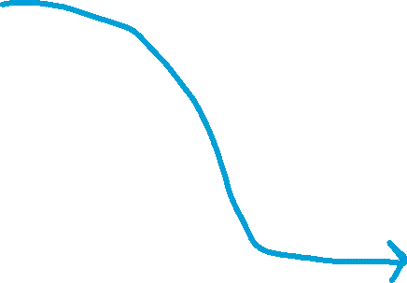



Hash Tables 101
Hash Function
< Key1, Value1 >
0
…
Value3
< Key2, Value2 >
1
Value4
2
Value1
< Key3, Value3 >
3
Value5
< Key4, Value4 >
4
ValueN
…
< Key5, Value5 >

Slide 45






Hash Tables 101
Hash Function
< Key1, Value1 >
0
…
Value3
< Key2, Value2 >
1
Value4
2
Value1
< Key3, Value3 >
3
Value5
< Key4, Value4 >
4
ValueN
…
< Key5, Value5 >
Considerations:
How big to make array?
How to avoid collisions?
How to handle collisions?

Slide 46
Hash Tables 101
Hash Function
< Key1, Value1 >
0
…
Value3
< Key2, Value2 >
1
Value4
2
Value1
< Key3, Value3 >
3
Value5
< Key4, Value4 >
4
ValueN
…
< Key5, Value5 >
Considerations:
How big to make array?
How to avoid collisions?
How to handle collisions?
What’s a good hash function?

Slide 47
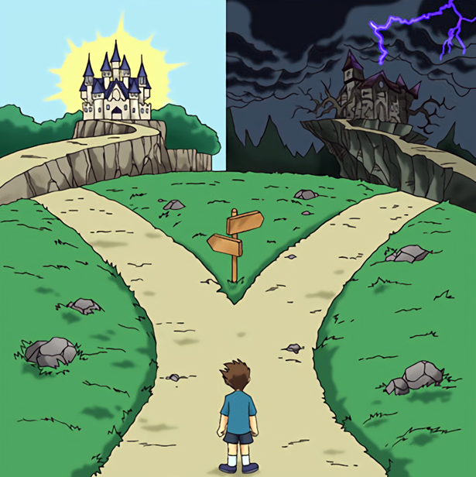
Hash Tables 101

Slide 48


Hash Tables 101
Theory
Inner Workings of Hash Functions
Statistical Likelihood
Expected Performance
Applications
“Tools in hand”
Java Functionality
Hash Tables are probably the most useful thing you learn in this class

Slide 49
Hash Tables 101
I use HashMap, HashTable, and Dictionary interchangeably, but there are very small differences between these
Let’s build a Hash Table for a Student Database
Keys need to be unique, what could we use for a key ?

Slide 50
Hash Tables 101
I use HashMap, HashTable, and Dictionary interchangeably, but there are very small differences between these
Let’s build a Hash Table for a Student Database
Keys need to be unique, what could we use for a key? Student ID!

Slide 51


Hash Tables 101
I use HashMap, HashTable, and Dictionary interchangeably, but there are very small differences between these
Student
Let’s build a Hash Table for a Student Database
null
Keys need to be unique, what could we use for a key? Student ID!
Keys = Student ID
Values = Student Object
null
null
-01561200
null
-12345005
Student

