Slide 1

CSCI 232: Data Structures and Algorithms
Hashing (Part 2)
Reese Pearsall
Spring 2024
https://www.cs.montana.edu/pearsall/classes/spring2024/232/main.html

Slide 2

Announcements
Lab 5 due tomorrow at 11:59 PM
Program 1 due Tuesday at 11:59 PM
No class on Thursday 2/29

Slide 3
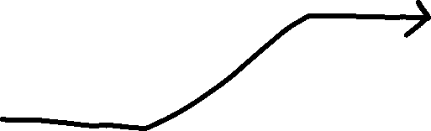

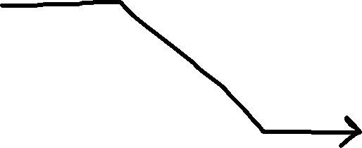
Hash Tables
Student[] Array
Hash Function
0 | null
1 | null
… | null
… | null
12
… | null
… | null
… | null
56
… | null
… | null
… | null
72
… | null
99 | null
Student ID
ID % 100
123456
Sam, Political Science, 2.5
Student Object
121212
Sally, Mathematics, 3.0
Student Object
456672
John, Computer Science, 4.0
Student Object

Slide 4
Hash Tables
Student[] Array
n = 100
Hash Function
0 | null
1 | null
… | null
… | null
12
… | null
… | null
… | null
56
… | null
… | null
… | null
72
… | null
99 | null
Student ID
ID % 100
Lookup time?
O(1) if you have the key
Sam, Political Science, 2.5
Student Object
Sally, Mathematics, 3.0
Student Object
John, Computer Science, 4.0
Student Object

Slide 5
Hash Tables
Student[] Array
n = 100
Hash Function
0 | null
1 | null
… | null
… | null
12
… | null
… | null
… | null
56
… | null
… | null
… | null
72
… | null
99 | null
Student ID
ID % 100
Lookup time?
O(1) if you have the key
O(n) if you don’t have the key
Sam, Political Science, 2.5
Student Object
Sally, Mathematics, 3.0
Student Object
John, Computer Science, 4.0
Student Object

Slide 6
Hash Tables
Student[] Array
n = 100
Hash Function
0 | null
1 | null
… | null
… | null
12
… | null
… | null
… | null
56
… | null
… | null
… | null
72
… | null
99 | null
Student ID
ID % 100
Lookup time?
O(1) if you have the key
O(n) if you don’t have the key
O(k) if you don’t have the key
Sam, Political Science, 2.5
Student Object
Sally, Mathematics, 3.0
Student Object
John, Computer Science, 4.0
Student Object
k = | keyspace |

Slide 7
Hash Tables
Student[] Array
n = 100
Hash Function
0 | null
1 | null
… | null
… | null
12
… | null
… | null
… | null
56
… | null
… | null
… | null
72
… | null
99 | null
Student ID
ID % 100
Lookup time?
O(1) if you have the key*
Array – O(logn)**
BST – O(logn)***
Linked List – O(n)
Sam, Political Science, 2.5
Student Object
Sally, Mathematics, 3.0
Student Object
n = # of elements in data structure
John, Computer Science, 4.0
Student Object
* If we can avoid collisions
**if the array is sorted
***if the tree is balanced

Slide 8
Hash Tables
Student[] Array
n = 100
Hash Function
0 | null
1 | null
… | null
… | null
12
… | null
… | null
… | null
56
… | null
… | null
… | null
72
… | null
99 | null
Student ID
ID % 100
Insertion time?
O(1) *
Array – O(n)
BST – O(logn)**
Linked List – O(1)
Sam, Political Science, 2.5
Student Object
Sally, Mathematics, 3.0
Student Object
n = # of elements in data structure
John, Computer Science, 4.0
Student Object
* If we can avoid collisions
**if the tree is balanced

Slide 9
Hash Tables
Student[] Array
n = 100
Hash Function
0 | null
1 | null
… | null
… | null
12
… | null
… | null
… | null
56
… | null
… | null
… | null
72
… | null
99 | null
Student ID
ID % 100
Removal time?
O(1) *
Array – O(n)
BST – O(logn)**
Linked List – O(1) / O(n)
Sam, Political Science, 2.5
Student Object
Sally, Mathematics, 3.0
Student Object
n = # of elements in data structure
John, Computer Science, 4.0
Student Object
* If we can avoid collisions
**if the tree is balanced

Slide 10
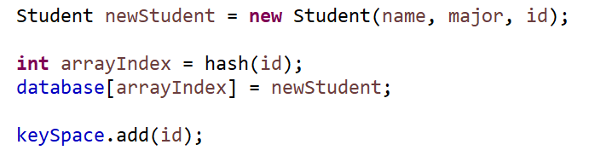
Hash Tables
Student[] Array
n = 100
Hash Function
0 | null
1 | null
… | null
… | null
12
… | null
… | null
… | null
56
… | null
… | null
… | null
72
… | null
99 | null
Student ID
ID % 100
Insertion
Sam, Political Science, 2.5
Student Object
Sally, Mathematics, 3.0
Student Object
John, Computer Science, 4.0
Student Object

Slide 11

Hash Tables
Student[] Array
n = 100
Hash Function
0 | null
1 | null
… | null
… | null
12
… | null
… | null
… | null
56
… | null
… | null
… | null
72
… | null
99 | null
Student ID
ID % 100
Lookup (get)
Sam, Political Science, 2.5
Student Object
O(1)
Sally, Mathematics, 3.0
Student Object
John, Computer Science, 4.0
Student Object

Slide 12
Hash Tables
Student[] Array
n = 100
Hash Function
0 | null
1 | null
… | null
… | null
12
… | null
… | null
… | null
56
… | null
… | null
… | null
72
… | null
99 | null
Student ID
ID % 100
Sam, Political Science, 2.5
Student Object
Remove Method
Sally, Mathematics, 3.0
Student Object
John, Computer Science, 4.0
Student Object

Slide 13
Hash Tables in Java
Typically, we will never have to create our own HashTable class, instead we will import the one that Java provides
import java.util.HashMap;
import java.util.HashSet;

Slide 14
Hash Maps
Hash Maps are a collection of key-values pairs (Map) that uses hashing when inserting, removing, lookup, etc
HashMap<String, String> capitalCities = new HashMap<String, String>();
This is a HashMap that maps Strings (keys) to Strings (values)
Adding a new Key-Value pair
Removing a Value
capitalCities.put("England", "London");
capitalCities.put("Germany", "Berlin");
capitalCities.put("Norway", "Oslo");
capitalCities.put("USA", "Washington DC");
capitalCities.remove("England");
Other Helpful Methods
• keySet() → returns set of keys
• values() → returns set of values
• containsKey()
• containsValue()
• replace()
• size()
Retrieving a Value
capitalCities.get("England");

Slide 15

Hash Sets
Hash Sets is an implementation of the Set interface that uses a Hash Map under the hood
A set is a collection of elements with no duplicate elements
You can think of this as a List, but without the ability to use indices
HashSet<String> candy = new HashSet<String>;
Hash Set that stores Strings
HashCode
HashCode
HashCode
candy.add(“Twix”);
candy.add(“Skittles”);
candy.add(“Snickers”);
candy.contains(“Skittles”);
candy.remove(“Twix”);
Hash Map
Hash Set: ( Twix, Skittles, Snickers )

Slide 16

Hash Sets
Hash Sets is an implementation of the Set interface that uses a Hash Map under the hood
A set is a collection of elements with no duplicate elements
You can think of this as a List, but without the ability to use indices
HashSet<String> candy = new HashSet<String>;
Hash Set that stores Strings
HashCode
HashCode
HashCode
candy.add(“Twix”);
candy.add(“Skittles”);
candy.add(“Snickers”);
candy.contains(“Skittles”);
candy.remove(“Twix”);
Hash Map
Hash Set: ( Twix, Skittles, Snickers )

Slide 17
Today’s Mandatory Fun
Updating our Student Database Class
Replace Array with HashMap
Replace ArrayList with HashSet
Write a method that will compute the number of CS majors, Math Majors, History majors, etc
Add method that will compute which student(s) have a 4.0, 3.0, 3.1, etc
Write a program that will convert an English sentence to sentence in Pirate
“Hello” → “Ahoy”
“Friends” → “Mateys”

