Slide 1

CSCI 232: Data Structures and Algorithms
Hashing (Part 3)
Reese Pearsall
Spring 2024
https://www.cs.montana.edu/pearsall/classes/spring2024/232/main.html

Slide 2


Professor: “THIS CODE DOESN’T EVEN WORK. WHO WROTE THIS AWFUL CODE??”
Announcements
Lab 6 due Friday at 11:59 PM
Program 1 due tonight at 11:59 PM
No class on Thursday
Program 2 posted, due Sunday March 10th
Me, a first year CS student:

Slide 3
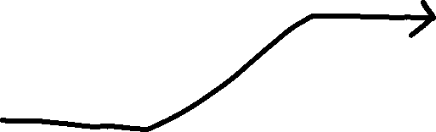

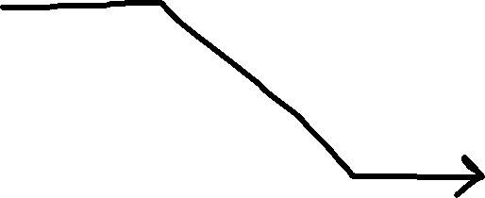
Hash Tables
Student[] Array
Hash Function
0 | null
1 | null
… | null
… | null
12
… | null
… | null
… | null
56
… | null
… | null
… | null
72
… | null
99 | null
Student ID
ID % 100
123456
Sam, Political Science, 2.5
Student Object
121212
Sally, Mathematics, 3.0
Student Object
456672
John, Computer Science, 4.0
Student Object

Slide 4
Hash Tables
Student[] Array
Hash Function
0 | null
1 | null
… | null
… | null
12
… | null
… | null
… | null
56
… | null
… | null
… | null
72
… | null
99 | null
Student ID
ID % 100
123456
Sam, Political Science, 2.5
Student Object
Write method to count number per major
121212
Sally, Mathematics, 3.0
Student Object
456672
John, Computer Science, 4.0
Student Object

Slide 5
Program 2

Slide 6
Hash Tables
Hash Set
Linked List
Array list
O(1) Insertion
O(1) Delete by name
O(1) Contains
Not ordered
No duplicate values
O(1) Insertion*
O(n) Delete by name
O(n) Contains
Ordered
Allow for Duplicate Values
O(n) Insertion
O(n) Delete by name
O(n) Contains
Ordered
Allow for Duplicate Values

Slide 7
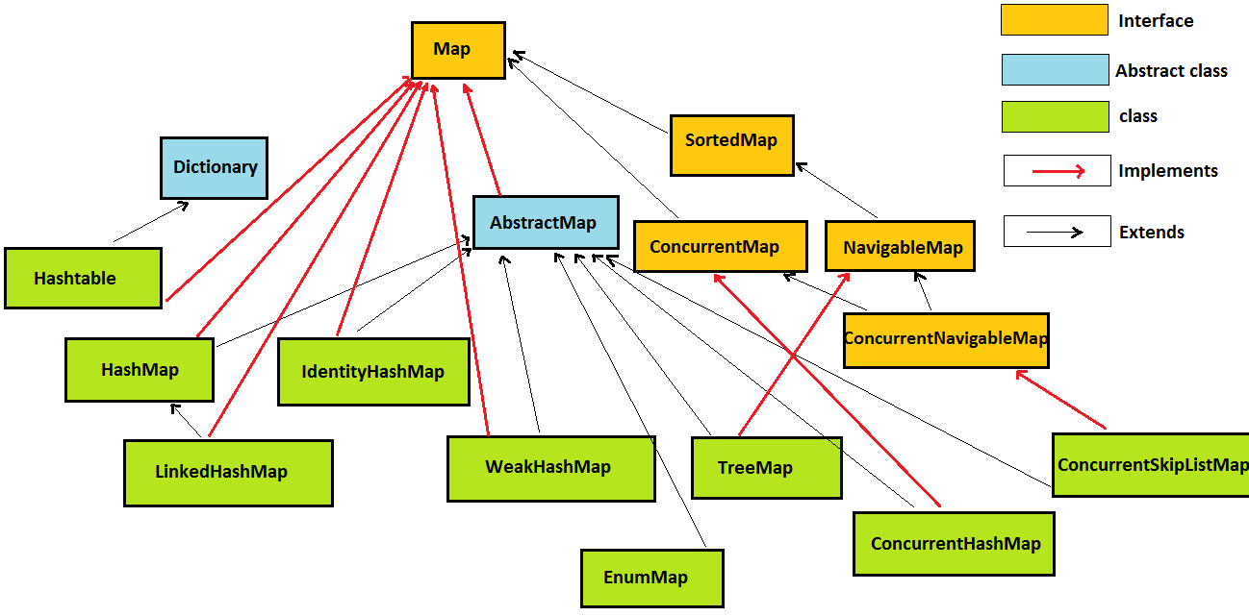

Slide 8

Collection of Key-value pairs implemented by a Balanced BST.
O(logn) operations

Slide 9

This class provides all of the optional Map operations, and permits null elements. Like HashMap, it provides constant-time performance for the basic operations (add, contains and remove), assuming the hash function disperses elements properly among the buckets. Performance is likely to be just slightly below that of HashMap, due to the added expense of maintaining the linked list, with one exception: Iteration over the collection-views of a LinkedHashMap requires time proportional to the size of the map, regardless of its capacity. Iteration over a HashMap is likely to be more expensive, requiring time proportional to its capacity.
Collection of Key-value pairs implemented by a linked list.
O(1) operations*

Slide 10


Collection of Key-value pairs implemented by hashing and an array.
O(1) operations*

Slide 11


HashMap: null is allowed for both key and value
Hashtable: null is not allowed for both key and value
(and some other threading/synchronization differences)

Slide 12

Hash Tables
Student[] Array
Hash Function
0 | null
1 | null
… | null
… | null
12
… | null
… | null
… | null
56
… | null
… | null
… | null
72
… | null
99 | null
Student ID
ID % 100
123456
Sam, Political Science, 2.5
Student Object
121212
Sally, Mathematics, 3.0
Student Object
456672
John, Computer Science, 4.0
Student Object
134712

Slide 13

Hash Tables
Student[] Array
Hash Function
0 | null
1 | null
… | null
… | null
12
… | null
… | null
… | null
56
… | null
… | null
… | null
72
… | null
99 | null
Student ID
ID % 100
Collision
123456
Sam, Political Science, 2.5
Student Object
121212
Sally, Mathematics, 3.0
Student Object
456672
John, Computer Science, 4.0
Student Object
134712

Slide 14
Hash Tables
array
index
hash(key)->
<Key₁, Value₁>
0
1
2
3
4
5
⋮
⋮
<Key₂, Value₂>
<Key₃, Value₃>
<Key₄, Value₄>
Considerations:
How big to make array?
How to avoid collisions?
How to handle collisions?
<Key₅, Value₅>

Slide 15
Hash Tables
array
index
hash(key)->
<Key₁, Value₁>
0
1
2
3
4
5
⋮
⋮
<Key₂, Value₂>
<Key₃, Value₃>
<Key₄, Value₄>
Considerations:
How big to make array?
How to avoid collisions?
How to handle collisions?
<Key₅, Value₅>

Slide 16
Hash Functions
Fact: Every hash function is susceptible to collisions
Hash Function: Function that translates key values to array indices

Slide 17
Hash Functions
Fact: Every hash function is susceptible to collisions
However, if we write a good hash function, we can reduce the number of collisions in our hash table

Slide 18
Hash Functions

Slide 19
Hash Functions
Keys
Hash Value
516-07-0854
516-66-6218
531-01-7352
336-82-2121
517-90-7152
516-98-8002
517-45-0907
531-81-7489
517-07-7312
516-24-6185
669-44-6499
516-16-4236
530-92-1795
611-52-4556
516-34-3352
607-86-0812

Slide 20
Hash Functions
Keys
Hash Value
516-07-0854
516-66-6218
531-01-7352
336-82-2121
517-90-7152
516-98-8002
517-45-0907
531-81-7489
517-07-7312
516-24-6185
669-44-6499
516-16-4236
530-92-1795
611-52-4556
516-34-3352
607-86-0812
Hash Function
Lessons:

Slide 21

Hash Functions
Keys
Hash Value
516-07-0854
516-66-6218
531-01-7352
336-82-2121
517-90-7152
516-98-8002
517-45-0907
531-81-7489
517-07-7312
516-24-6185
669-44-6499
516-16-4236
530-92-1795
611-52-4556
516-34-3352
607-86-0812
….
Hash Function
516070853
F(x) = x
516070854
516070855
….
Lessons:

Slide 22

Hash Functions
Keys
Hash Value
516-07-0854
516-66-6218
531-01-7352
336-82-2121
517-90-7152
516-98-8002
517-45-0907
531-81-7489
517-07-7312
516-24-6185
669-44-6499
516-16-4236
530-92-1795
611-52-4556
516-34-3352
607-86-0812
….
Hash Function
516070853
F(x) = x
516070854
516070855
Not good…
Very big array
Lots of wasted space
….
Lessons:

Slide 23


Hash Functions
Keys
Hash Value
516-07-0854
516-66-6218
531-01-7352
336-82-2121
517-90-7152
516-98-8002
517-45-0907
531-81-7489
517-07-7312
516-24-6185
669-44-6499
516-16-4236
530-92-1795
611-52-4556
516-34-3352
607-86-0812
Hash Function
Size of Array
First three
digits
)
(
$$\% 100$$
(Modular hashing)
Lessons:

Slide 24
Hash Functions
Keys
Hash Value
516-07-0854
516-66-6218
531-01-7352
336-82-2121
517-90-7152
516-98-8002
517-45-0907
531-81-7489
517-07-7312
516-24-6185
669-44-6499
516-16-4236
530-92-1795
611-52-4556
516-34-3352
607-86-0812
16
16
31
36
17
16
17
31
17
16
69
16
30
11
16
07
Hash Function
First three
digits
)
(
$$\% 100$$
Lessons:

Slide 25
Hash Functions
Keys
Hash Value
516-07-0854
516-66-6218
531-01-7352
336-82-2121
517-90-7152
516-98-8002
517-45-0907
531-81-7489
517-07-7312
516-24-6185
669-44-6499
516-16-4236
530-92-1795
611-52-4556
516-34-3352
607-86-0812
16
16
31
36
17
16
17
31
17
16
69
16
30
11
16
07
Hash Function
First three
digits
)
(
$$\% 100$$
Lessons:
What is the problem?

Slide 26
Hash Functions
Keys
Hash Value
16
16
31
36
17
16
17
31
17
16
69
16
30
11
16
07
516-07-0854
516-66-6218
531-01-7352
336-82-2121
517-90-7152
516-98-8002
517-45-0907
531-81-7489
517-07-7312
516-24-6185
669-44-6499
516-16-4236
530-92-1795
611-52-4556
516-34-3352
607-86-0812
Hash Function
First three
digits
)
(
$$\% 100$$
Lessons:
What is the problem?

Slide 27
Hash Functions
Keys
Hash Value
16
16
31
36
17
16
17
31
17
16
69
16
30
11
16
07
516-07-0854
516-66-6218
531-01-7352
336-82-2121
517-90-7152
516-98-8002
517-45-0907
531-81-7489
517-07-7312
516-24-6185
669-44-6499
516-16-4236
530-92-1795
611-52-4556
516-34-3352
607-86-0812
Hash Function
First three
digits
)
(
$$\% 100$$
Lessons:
What is the problem?
Why is the problem occurring?

Slide 28
Hash Functions
Keys
Hash Value
16
16
31
36
17
16
17
31
17
16
69
16
30
11
16
07
516-07-0854
516-66-6218
531-01-7352
336-82-2121
517-90-7152
516-98-8002
517-45-0907
531-81-7489
517-07-7312
516-24-6185
669-44-6499
516-16-4236
530-92-1795
611-52-4556
516-34-3352
607-86-0812
Hash Function
First three
digits
)
(
$$\% 100$$
Lessons:
What is the problem?
Why is the problem occurring?
How can we fix it?

Slide 29
Hash Functions
Keys
Hash Value
516-07-0854
516-66-6218
531-01-7352
336-82-2121
517-90-7152
516-98-8002
517-45-0907
531-81-7489
517-07-7312
516-24-6185
669-44-6499
516-16-4236
530-92-1795
611-52-4556
516-34-3352
607-86-0812
Hash Function
First three
digits
)
(
$$\% 100$$
Lessons:
1. Use as much of the key as possible

Slide 30

Hash Functions
Keys
Hash Value
516-07-0854
516-66-6218
531-01-7352
336-82-2121
517-90-7152
516-98-8002
517-45-0907
531-81-7489
517-07-7312
516-24-6185
669-44-6499
516-16-4236
530-92-1795
611-52-4556
516-34-3352
607-86-0812
Hash Function
(
Nine-Digit
Number
)
$$\% 5$$
Lessons:
1. Use as much of the key as possible

Slide 31
Hash Functions
Keys
Hash Value
4
3
2
1
2
2
2
4
2
0
4
1
0
1
2
2
516-07-0854
516-66-6218
531-01-7352
336-82-2121
517-90-7152
516-98-8002
517-45-0907
531-81-7489
517-07-7312
516-24-6185
669-44-6499
516-16-4236
530-92-1795
611-52-4556
516-34-3352
607-86-0812
Hash Function
(
Nine-Digit
Number
)
$$\% 5$$
Lessons:
1. Use as much of the key as possible

Slide 32
Hash Functions
Keys
Hash Value
4
3
2
1
2
2
2
4
2
0
4
1
0
1
2
2
516-07-0854
516-66-6218
531-01-7352
336-82-2121
517-90-7152
516-98-8002
517-45-0907
531-81-7489
517-07-7312
516-24-6185
669-44-6499
516-16-4236
530-92-1795
611-52-4556
516-34-3352
607-86-0812
Hash Function
(
Nine-Digit
Number
)
$$\% 5$$
Lessons:
1. Use as much of the key as possible

Slide 33
Hash Functions
Keys
Hash Value
4
3
2
1
2
2
2
4
2
0
4
1
0
1
2
2
516-07-0854
516-66-6218
531-01-7352
336-82-2121
517-90-7152
516-98-8002
517-45-0907
531-81-7489
517-07-7312
516-24-6185
669-44-6499
516-16-4236
530-92-1795
611-52-4556
516-34-3352
607-86-0812
Hash Function
(
Nine-Digit
Number
)
$$\% 5$$
Lessons:
Use as much of the key as possible
Make sure your array is big enough

Slide 34

Hash Functions
Keys
Hash Value
516-07-0854
516-66-6218
531-01-7352
336-82-2121
517-90-7152
516-98-8002
517-45-0907
531-81-7489
517-07-7312
516-24-6185
669-44-6499
516-16-4236
530-92-1795
611-52-4556
516-34-3352
607-86-0812
Hash Function
(
Nine-Digit
Number
)
$$\% 500000000000$$
Lessons:
Use as much of the key as possible
Make sure your array is big enough

Slide 35
Hash Functions
Keys
Hash Value
516-07-0854
516-66-6218
531-01-7352
336-82-2121
517-90-7152
516-98-8002
517-45-0907
531-81-7489
517-07-7312
516-24-6185
669-44-6499
516-16-4236
530-92-1795
611-52-4556
516-34-3352
607-86-0812
Hash Function
(
Nine-Digit
Number
)
$$\% 500000000000$$
Lessons:
Use as much of the key as possible
Make sure your array is big enough (but not too big)

Slide 36

Hash Functions
Keys
Hash Value
516-07-0854
516-66-6218
531-01-7352
336-82-2121
517-90-7152
516-98-8002
517-45-0907
531-81-7489
517-07-7312
516-24-6185
669-44-6499
516-16-4236
530-92-1795
611-52-4556
516-34-3352
607-86-0812
Hash Function
(
Nine-Digit
Number
)
$$\% 100$$
Lessons:
Use as much of the key as possible
Make sure your array is big enough (but not too big)

Slide 37
Hash Functions
Keys
Hash Value
516-07-0854
516-66-6218
531-01-7352
336-82-2121
517-90-7152
516-98-8002
517-45-0907
531-81-7489
517-07-7312
516-24-6185
669-44-6499
516-16-4236
530-92-1795
611-52-4556
516-34-3352
607-86-0812
54
18
52
21
52
02
07
89
12
85
99
36
95
56
52
12
Hash Function
(
Nine-Digit
Number
)
$$\% 100$$
Lessons:
Use as much of the key as possible
Make sure your array is big enough (but not too big)

Slide 38
Hash Functions
Keys
Hash Value
516-07-0854
516-66-6218
531-01-7352
336-82-2121
517-90-7152
516-98-8002
517-45-0907
531-81-7489
517-07-7312
516-24-6185
669-44-6499
516-16-4236
530-92-1795
611-52-4556
516-34-3352
607-86-0812
54
18
52
21
52
02
07
89
12
85
99
36
95
56
52
12
Hash Function
(
Nine-Digit
Number
)
$$\% 100$$
Lessons:
Use as much of the key as possible
Make sure your array is big enough (but not too big)

Slide 39
Hash Functions
Keys
Hash Value
516-07-0854
516-66-6218
531-01-7352
336-82-2121
517-90-7152
516-98-8002
517-45-0907
531-81-7489
517-07-7312
516-24-6185
669-44-6499
516-16-4236
530-92-1795
611-52-4556
516-34-3352
607-86-0812
54
18
52
21
52
02
07
89
12
85
99
36
95
56
52
12
Hash Function
(
Nine-Digit
Number
)
$$\% 100$$
Lessons:
Use as much of the key as possible
Make sure your array is big enough (but not too big)
Use a prime number array size

Slide 40

Hash Functions
Keys
Hash Value
516-07-0854
516-66-6218
531-01-7352
336-82-2121
517-90-7152
516-98-8002
517-45-0907
531-81-7489
517-07-7312
516-24-6185
669-44-6499
516-16-4236
530-92-1795
611-52-4556
516-34-3352
607-86-0812
Hash Function
(
Nine-Digit
Number
)
$$\% 97$$
Lessons:
Use as much of the key as possible
Make sure your array is big enough (but not too big)
Use a prime number array size

Slide 41
Hash Functions
Keys
Hash Value
8
83
67
0
96
21
42
51
91
60
29
76
55
84
33
30
516-07-0854
516-66-6218
531-01-7352
336-82-2121
517-90-7152
516-98-8002
517-45-0907
531-81-7489
517-07-7312
516-24-6185
669-44-6499
516-16-4236
530-92-1795
611-52-4556
516-34-3352
607-86-0812
Hash Function
(
Nine-Digit
Number
)
$$\% 97$$
Lessons:
Use as much of the key as possible
Make sure your array is big enough (but not too big)
Use a prime number array size

Slide 42

Hash Functions
Keys
Hash Value
516-07-0854
516-66-6218
531-01-7352
336-82-2121
517-90-7152
516-98-8002
517-45-0907
531-81-7489
517-07-7312
516-24-6185
669-44-6499
516-16-4236
530-92-1795
611-52-4556
516-34-3352
607-86-0812
Hash Function
0
…
(
Nine-Digit
Number
)
$$\% 7753$$
…
99
Lessons:
Use as much of the key as possible
Make sure your array is big enough (but not too big)
Use a prime number array size
???

Slide 43
Hash Functions
Function that translates key values into array indices.
Requirements:
Well defined for all input.
Identical keys map to identical indices.
Maps to a specified range.
Goals:
Easy to compute.
Uniformly distributes keys across range (collision avoidance).

Slide 44
Hash Functions
Function that translates key values into array indices.
Requirements:
Well defined for all input.
Identical keys map to identical indices.
Maps to a specified range.
Goals:
Easy to compute.
Uniformly distributes keys across range (collision avoidance).
Impossible:
0% collision chance
Possible:
0.001% collision chance

Slide 45
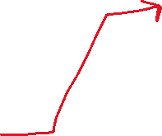

Collision Resolution
We know how to avoid collisions (strong hashing function), but collisions are bound to happen with every hash function
121212
null
null
null
null
null
null
How to deal with collisions?
12
134712

Slide 46
Collision Resolution
Linear Probing – Place value at next, sequential open place
0
0
0
0
0
0
1
1
1
1
1
1
2
2
2
2
2
2
3
3
3
3
3
3
4
4
4
4
4
4
5
5
5
5
5
5
6
6
6
6
6
6

Slide 47
Collision Resolution
Linear Probing – Place value at next, sequential open place
insert(76)
76%7 = 6
76
0
0
0
0
0
0
1
1
1
1
1
1
2
2
2
2
2
2
3
3
3
3
3
3
4
4
4
4
4
4
5
5
5
5
5
5
6
6
6
6
6
6

Slide 48
Collision Resolution
Linear Probing – Place value at next, sequential open place
insert(93)
93%7 = 2
76
93
76
0
0
0
0
0
0
1
1
1
1
1
1
2
2
2
2
2
2
3
3
3
3
3
3
4
4
4
4
4
4
5
5
5
5
5
5
6
6
6
6
6
6

Slide 49
Collision Resolution
Linear Probing – Place value at next, sequential open place
insert(34)
93%7 = 2
Collision!
76
93
76
93
76
0
0
0
0
0
0
1
1
1
1
1
1
2
2
2
2
2
2
3
3
3
3
3
3
4
4
4
4
4
4
5
5
5
5
5
5
6
6
6
6
6
6

Slide 50


Collision Resolution
Linear Probing – Place value at next, sequential open place
insert(34)
93%7 = 2
Collision!
76
93
76
34
93
76
0
0
0
0
0
0
1
1
1
1
1
1
2
2
2
2
2
2
3
3
3
3
3
3
4
4
4
4
4
4
5
5
5
5
5
5
6
6
6
6
6
6

Slide 51
Collision Resolution
Linear Probing – Place value at next, sequential open place
insert(41)
41%7 = 6
Collision!
76
93
76
34
93
76
34
93
76
0
0
0
0
0
0
1
1
1
1
1
1
2
2
2
2
2
2
3
3
3
3
3
3
4
4
4
4
4
4
5
5
5
5
5
5
6
6
6
6
6
6

Slide 52



Collision Resolution
Linear Probing – Place value at next, sequential open place
insert(41)
41%7 = 6
Collision!
76
93
76
34
93
76
34
41
93
76
0
0
0
0
0
0
1
1
1
1
1
1
2
2
2
2
2
2
3
3
3
3
3
3
4
4
4
4
4
4
5
5
5
5
5
5
6
6
6
6
6
6

Slide 53
Collision Resolution
Linear Probing – Place value at next, sequential open place
insert(22)
22%7 = 1
Collision!
76
93
76
34
93
76
34
41
93
76
34
41
93
76
0
0
0
0
0
0
1
1
1
1
1
1
2
2
2
2
2
2
3
3
3
3
3
3
4
4
4
4
4
4
5
5
5
5
5
5
6
6
6
6
6
6

Slide 54


Collision Resolution
Linear Probing – Place value at next, sequential open place
insert(22)
22%7 = 1
Collision!
76
93
76
34
93
76
34
41
93
76
34
41
93
22
76
0
0
0
0
0
0
1
1
1
1
1
1
2
2
2
2
2
2
3
3
3
3
3
3
4
4
4
4
4
4
5
5
5
5
5
5
6
6
6
6
6
6

Slide 55
Collision Resolution
Linear Probing – Place value at next, sequential open place
insert(28)
28%7 = 0
Collision!
76
93
76
34
93
76
34
41
93
76
34
41
93
22
76
34
41
93
22
76
0
0
0
0
0
0
1
1
1
1
1
1
2
2
2
2
2
2
3
3
3
3
3
3
4
4
4
4
4
4
5
5
5
5
5
5
6
6
6
6
6
6

Slide 56




Collision Resolution
Linear Probing – Place value at next, sequential open place
insert(28)
28%7 = 0
Collision!
76
93
76
34
93
76
34
41
93
76
34
41
93
22
76
34
41
93
22
28
76
0
0
0
0
0
0
1
1
1
1
1
1
2
2
2
2
2
2
3
3
3
3
3
3
4
4
4
4
4
4
5
5
5
5
5
5
6
6
6
6
6
6

Slide 57
Collision Resolution
Linear Probing – Place value at next, sequential open place
76
93
76
34
93
76
34
41
93
76
34
41
93
22
76
34
41
93
22
28
76
0
0
0
0
0
0
1
1
1
1
1
1
2
2
2
2
2
2
3
3
3
3
3
3
4
4
4
4
4
4
5
5
5
5
5
5
6
6
6
6
6
6

Slide 58
Collision Resolution
Linear Probing – Place value at next, sequential open place
Something
0
Hash Function:
F(x) = x % 97
1
Something
Something
…
Something
…
93
Something
95
Something
96

Slide 59
Collision Resolution
Linear Probing – Place value at next, sequential open place
Something
0
Hash Function:
F(x) = x % 97
1
Something
Something
…
insert(194)
Something
…
93
Something
95
Something
96

Slide 60
Collision Resolution
Linear Probing – Place value at next, sequential open place
Something
0
Hash Function:
F(x) = x % 97
1
Something
Something
…
insert(194)
Something
…
93
Something
95
Something
96

Slide 61






Collision Resolution
Linear Probing – Place value at next, sequential open place
Something
0
Hash Function:
F(x) = x % 97
1
Something
Something
…
insert(194)
Something
…
93
Something
Worst case scenario, we might have to traverse the entire array before we find an open spot
95
Something
96
That is, insertion becomes O(n)

Slide 62


Collision Resolution
We know how to avoid collisions (strong hashing function), but collisions are bound to happen with every hash function
121212
null
null
null
null
null
null
How to deal with collisions?
12
134712

Slide 63
Collision Resolution
Separate Chaining- Array spots have containers that can hold multiple values
Array Index
Database
0
1
…
…
11
…
30
…
45
…
99

Slide 64
Collision Resolution
Separate Chaining- Array spots have containers that can hold multiple values
Array Index
Database
0 | < >
1 | < >
… | < >
… | < >
11 | < >
… | < >
30 | < >
… | < >
45 | < >
… | < >
99 | < >
Empty Linked List, Array List, Hash Set

Slide 65
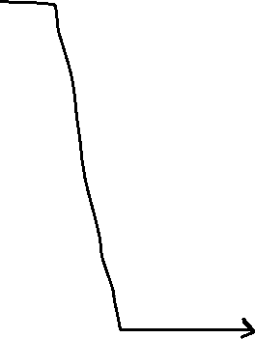
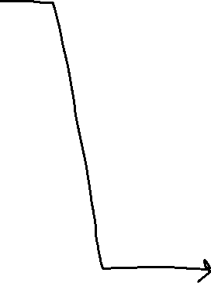

Collision Resolution
Separate Chaining- Array spots have containers that can hold multiple values
X % 100
Array Index
Database
0 | < >
1 | < >
… | < >
… | < >
11 | < >
… | < >
30 | < >
… | < >
45 | < >
… | < >
99 | < >
12345
99899
Student
11111
Student
Student

Slide 66
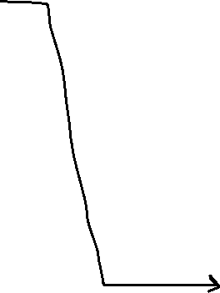
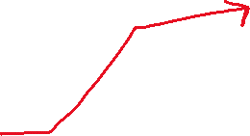
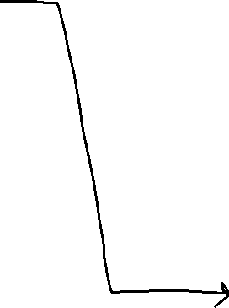

Collision Resolution
Separate Chaining- Array spots have containers that can hold multiple values
X % 100
Array Index
Database
0 | < >
1 | < >
… | < >
… | < >
11 | < >
… | < >
30 | < >
… | < >
45 | < >
… | < >
99 | < >
12345
99899
Student
11111
33411
Student
Student

Slide 67
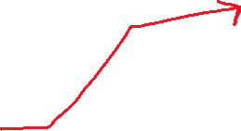
Collision Resolution
Separate Chaining- Array spots have containers that can hold multiple values
X % 100
Array Index
Database
0 | < >
1 | < >
… | < >
… | < >
11 | < >
… | < >
30 | < >
… | < >
45 | < >
… | < >
99 | < >
12345
99899
Student
Student
11111
33411
Student
Student

Slide 68
Collision Resolution
Separate Chaining- Array spots have containers that can hold multiple values
X % 100
Array Index
Database
0 | < >
1 | < >
… | < >
… | < >
11 | < >
… | < >
30 | < >
… | < >
45 | < >
… | < >
99 | < >
12345
99899
Student
Student
11111
33411
69545
Student
Student

Slide 69
Collision Resolution
Separate Chaining- Array spots have containers that can hold multiple values
X % 100
Array Index
Database
0 | < >
1 | < >
… | < >
… | < >
11 | < >
… | < >
30 | < >
… | < >
45 | < >
… | < >
99 | < >
12345
99899
Student
Student
11111
33411
69545
Student
Student
Student

Slide 70
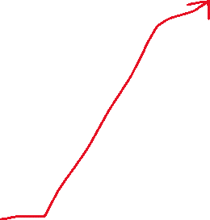
Collision Resolution
Separate Chaining- Array spots have containers that can hold multiple values
X % 100
Array Index
Database
0 | < >
1 | < >
… | < >
… | < >
11 | < >
… | < >
30 | < >
… | < >
45 | < >
… | < >
99 | < >
12345
99899
Student
Student
Student
11111
33411
69545
Student
Student
59311
Student

Slide 71
Collision Resolution
Separate Chaining- Array spots have containers that can hold multiple values
X % 100
Array Index
Database
0 | < >
1 | < >
… | < >
… | < >
11 | < >
… | < >
30 | < >
… | < >
45 | < >
… | < >
99 | < >
insert(87611) ?

Slide 72
Collision Resolution
Separate Chaining- Array spots have containers that can hold multiple values
X % 100
Array Index
Database
0 | < >
1 | < >
… | < >
… | < >
11 | < >
… | < >
30 | < >
… | < >
45 | < >
… | < >
99 | < >
insert(87611) ?
We might have to travel the entire linked list to find our insertion spot
O ( | linked list | )

Slide 73
Collision Resolution
Consequences of collisions?
Our O(1) running time for insertions, deletion, and contains turn into O(n)
Thankfully, the Java libraries use smart, complex hashing mechanisms to ensure the collisions are minimized, so we can get O(1) with HashMaps, HashSets, etc

Slide 74
Lab 6

