Slide 1

CSCI 232: Data Structures and Algorithms
Red Black Trees
Reese Pearsall
Spring 2024
https://www.cs.montana.edu/pearsall/classes/spring2024/232/main.html

Slide 2
Announcements
Lab 7 due Friday at 11:59 PM
Program 2 due Sunday at 11:59 PM
No class next week

Slide 3
Lab 7

Slide 4
















Binary Search Tree – Insertion/Searching/Removing
Running time?
“Good Tree”
“Bad Tree”
O(logn)
O(n)

Slide 5
Balanced BST
A balanced binary tree, is defined as a binary tree in which given n nodes, the height of the tree is O(logn).
Num
Nodes
Depth
0 1
1 2
2 4
3 8

Slide 6
Balanced BST
A balanced binary tree, is defined as a binary tree in which given n nodes, the height of the tree is O(logn).
1
4 nodes
→ If this is a balanced tree, the height should be less than or equal to 2 (log(4))
5
8
10
Height = 3 → not balanced

Slide 7
Balanced BST
A balanced binary tree, is defined as a binary tree in which given n nodes, the height of the tree is O(logn).
40
6 nodes
→ If this is a balanced tree, the height should be less than or equal to 3 ceil(log(6))
36
49
35
38
Height = 3 → balanced
39

Slide 8
Balanced BST
If we are building a BST, there is no guarantee that the tree will be balanced (it depends on the order that we add nodes)
11
44
17
17
88
32
11
32
65
97
44
44, 17, 88, 11, 32, 65, 97
65
44, 17, 32, 88, 11, 97, 65
44, 88, 65, 97, 17, 32, 11
“Bad Tree”
88
O(n)
“Good Tree”
97
O(logn)

Slide 9
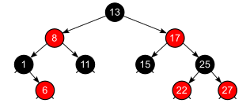
Balanced BST
Red-Black Trees are a type of BST with some more rules, and if we follow the rules, we will be guaranteed a balanced BST
Guaranteed Balanced BST =
O(logn) insertion time
O(logn) deletion time
O(logn) searching time

Slide 10
Balanced BST
Because a RBT is a BST, we still need to make sure
Everything to the left of the node is less than the node
Everything to the right of the node is greater than the node
A node cannot have more than two children
No duplicate nodes
(BST Rules)

Slide 11
Red-Black Tree Rules
Each Node now has a color (red or black)
Every node is either red or black

Slide 12
Red-Black Tree Rules
Each Node now has a color (red or black)
Every node is either red or black
The null children are black
null
null
null
null
null
null
null
null
null
null
null

Slide 13
Red-Black Tree Rules
Each Node now has a color (red or black)
Every node is either red or black
The null children are black
The root node is black
null
null
null
null
null
null
null
null
null
null
null

Slide 14
Red-Black Tree Rules
Each Node now has a color (red or black)
Every node is either red or black
The null children are black
The root node is black
If a node is red, both children must be black
null
null
null
null
null
null
null
null
null
null
null

Slide 15
Red-Black Tree Rules
Each Node now has a color (red or black)
Every node is either red or black
The null children are black
The root node is black
If a node is red, both children must be black
For each node, all paths from the node to descendant leaves contain the same number of black nodes
null
null
null
null
null
null
null
null
null
null
null

Slide 16
Red-Black Tree Rules
10
5. For each node, all paths from the node to descendant leaves contain the same number of black nodes
18
2
null
null
12
50
null
null
null
17
null
null

Slide 17
Red-Black Tree Rules
10
5. For each node, all paths from the node to descendant leaves contain the same number of black nodes
18
2
null
null
12
50
Path 1: 2 black nodes visited
null
null
null
17
null
null

Slide 18
Red-Black Tree Rules
10
5. For each node, all paths from the node to descendant leaves contain the same number of black nodes
18
2
null
null
12
50
Path 1: 2 black nodes visited
Path 2: 2 black nodes visited
null
null
null
17
null
null

Slide 19
Red-Black Tree Rules
10
5. For each node, all paths from the node to descendant leaves contain the same number of black nodes
18
2
null
null
12
50
Path 1: 2 black nodes visited
Path 2: 2 black nodes visited
Path 3: 2 black nodes visited
null
null
null
17
null
null

Slide 20

Red-Black Tree Rules
10
5. For each node, all paths from the node to descendant leaves contain the same number of black nodes
18
2
null
null
12
50
Path 1: 2 black nodes visited
Path 2: 2 black nodes visited
Path 3: 2 black nodes visited
null
null
null
17
null
null

Slide 21
Red-Black Tree Rules
Every node is either red or black
The null children are black
The root node is black
If a node is red, both children must be black
For each node, all paths from the node to descendant leaves contain the same number of black nodes
When we insert or delete something from a Red-Black tree, the new tree may violate one of these rules
null
null
null
null
null
null
null
null
null
null
null

Slide 22
Red-Black Tree Insertion/Deletion
10
insert(15)
2
23
Step 1: Do the normal BST insertion
12
50
17

Slide 23
Red-Black Tree Insertion/Deletion
10
insert(15)
2
23
Step 1: Do the normal BST insertion
12
50
Our tree no longer has log(n) height, so we need to do some operations to reduce the height of the tree
17
15

Slide 24
Red-Black Tree Insertion/Deletion
10
insert(15)
2
23
Step 1: Do the normal BST insertion
12
50
Our tree no longer has log(n) height, so we need to do some operations to reduce the height of the tree
17
15
These operations are known as rotations

Slide 25
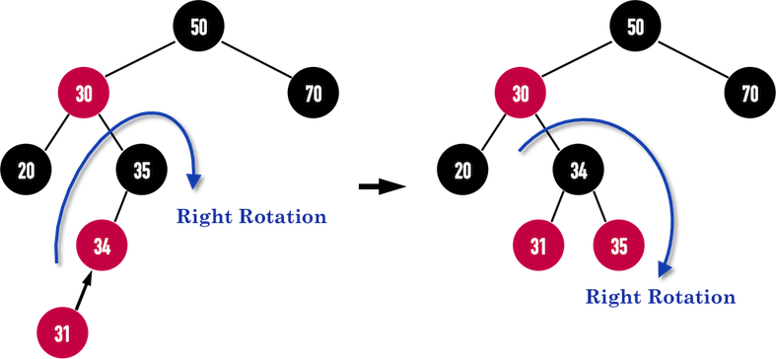
Red-Black Tree Rotation
(We also do some recoloring if needed!)
Local transformation (we rotate just a section– not the entire tree)

Slide 26
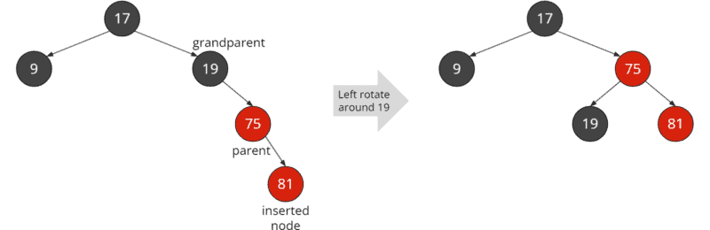
Red-Black Tree Rotation
Local transformation (we rotate just a section– not the entire tree)

Slide 27
Red-Black Tree Insertion/Deletion
10
insert(15)
2
23
Step 1: Do the normal BST insertion
12
50
Our tree no longer has log(n) height, so we need to do some operations to reduce the height of the tree
17
15
These operations are known as rotations

Slide 28
Red-Black Tree Insertion/Deletion
Step 1: Do the normal BST insertion
Step 2: Do rotation(s)
insert(15)
10
10
2
2
23
23
50
12
50
12
17
15
(Rotate Right around 17)
15
17

Slide 29
Red-Black Tree Insertion/Deletion
Step 1: Do the normal BST insertion
Step 2: Do rotation(s)
insert(15)
10
2
23
12
50
15
17

Slide 30
Red-Black Tree Insertion/Deletion
Step 1: Do the normal BST insertion
Step 2: Do rotation(s)
insert(15)
10
10
2
2
23
23
50
15
50
12
12
15
17
(Rotate left around 12)
17

Slide 31
Red-Black Tree Insertion/Deletion
Step 1: Do the normal BST insertion
Step 2: Do rotation(s)
Step 3: Recolor
insert(15)
10
2
23
15
50
12
17

Slide 32
Red-Black Tree Insertion/Deletion
Step 1: Do the normal BST insertion
Step 2: Do rotation(s)
Step 3: Recolor
insert(15)
10
2
23
15 has to be black because….
15
50
12
17

Slide 33
Red-Black Tree Insertion/Deletion
Step 1: Do the normal BST insertion
Step 2: Do rotation(s)
Step 3: Recolor
insert(15)
10
3. If a node is red, both children must be black
2
23
15 has to be black because 23 is red
15
50
12
17

Slide 34
Red-Black Tree Insertion/Deletion
Step 1: Do the normal BST insertion
Step 2: Do rotation(s)
Step 3: Recolor
insert(15)
10
Is this a Red-Black tree?
2
23
15
50
12
17

Slide 35
Red-Black Tree Insertion/Deletion
Step 1: Do the normal BST insertion
Step 2: Do rotation(s)
Step 3: Recolor
insert(15)
10
Is this a Red-Black tree?
2
23
5. For each node, all paths from the node to descendant leaves contain the same number of black nodes
15
50
Path 1: 3 black nodes (including null nodes)
12
17

Slide 36
Red-Black Tree Insertion/Deletion
Step 1: Do the normal BST insertion
Step 2: Do rotation(s)
Step 3: Recolor
insert(15)
10
Is this a Red-Black tree?
2
23
5. For each node, all paths from the node to descendant leaves contain the same number of black nodes
15
50
Path 1: 3 black nodes (including null nodes)
12
Path 2: 2 black nodes (including null nodes)
17

Slide 37




Red-Black Tree Insertion/Deletion
Step 1: Do the normal BST insertion
Step 2: Do rotation(s)
Step 3: Recolor
insert(15)
10
Is this a Red-Black tree?
2
23
5. For each node, all paths from the node to descendant leaves contain the same number of black nodes
15
50
Path 1: 3 black nodes (including null nodes)
12
Path 2: 2 black nodes (including null nodes)
17

Slide 38
Red-Black Tree Insertion/Deletion
Step 1: Do the normal BST insertion
Step 2: Do rotation(s)
Step 3: Recolor
insert(15)
(A lot more needs to be done here)
10
Every node is either red or black
The null children are black
The root node is black
If a node is red, both children must be black
For each node, all paths from the node to descendant leaves contain the same number of black nodes
2
23
15
50
12
17

Slide 39







Red-Black Tree Insertion/Deletion
Step 1: Do the normal BST insertion
Step 2: Do rotation(s)
Step 3: Recolor
insert(15)
Every node is either red or black
The null children are black
The root node is black
If a node is red, both children must be black
For each node, all paths from the node to descendant leaves contain the same number of black nodes
10
2
15
12
23
17
50

Slide 40
https://www.cs.usfca.edu/~galles/visualization/RedBlack.html

Slide 41
Red-Black Tree Insertion/Deletion
Step 1: Do the normal BST insertion
Step 2: Do rotation(s)
Step 3: Recolor
insert(15)
10
Fact:
There will at most 3 rotations needed, and each rotation happens in O(1) time
So, maintaining a Red/Black try happens in O(1) time
2
15
12
23
17
50

Slide 42
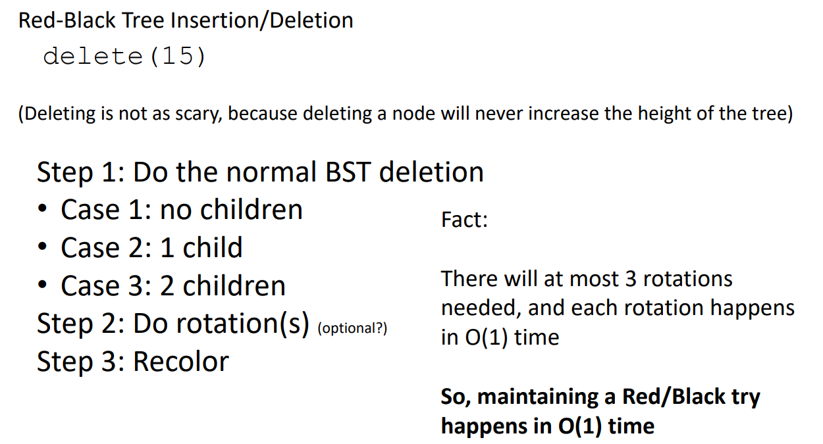

Slide 43
Takeaways
We can add a color (red or black) instance field to our nodes to create a Red Black Tree
If we follow the rules of a Red Black Tree, and follow the proper rotations/recoloring steps, we can guarantee that our tree will be balanced
Guaranteed Balanced BST =
O(logn) insertion
O(logn) deletion
O(logn) Searching/Contains
Adding Red/Black functionality to a BST does not affect the running time
There are also BSTs called AVL tree and 2-3 trees that serve the same purpose of RB trees
You will never have to write code for a red black tree, but you should know the purpose of red black trees, and be able to verify if a red black tree is valid or not

Slide 44
10
18
2
null
null
12
50
null
null
null
17
null
null

Slide 45
10
5. For each node, all paths from the node to descendant leaves contain the same number of black nodes
18
2
null
null
12
50
null
null
null
17
null
null

Slide 46
10
5. For each node, all paths from the node to descendant leaves contain the same number of black nodes
18
2
1. Get Leaf Nodes from starting node
null
null
12
50
null
null
null
17
null
null

Slide 47
10
5. For each node, all paths from the node to descendant leaves contain the same number of black nodes
18
2
1. Get Leaf Nodes from starting node
leaves = [ 2, 17, 50 ]
null
null
12
50
null
null
null
17
null
null

Slide 48
10
5. For each node, all paths from the node to descendant leaves contain the same number of black nodes
18
2
1. Get Leaf Nodes from starting node
leaves = [ 2, 17, 50 ]
null
null
12
2. Calculate the path from leaf to root, and count the number of black nodes visited
50
null
null
null
2 : 3
17: 3
50: 3
17
null
null

Slide 49
10
5. For each node, all paths from the node to descendant leaves contain the same number of black nodes
18
2
1. Get Leaf Nodes from starting node
leaves = [ 2, 17, 50 ]
null
null
12
2. Calculate the path from leaf to root, and count the number of black nodes visited
50
null
null
null
2 : 3
17: 3
50: 3
17
null
null

Slide 50

10
5. For each node, all paths from the node to descendant leaves contain the same number of black nodes
18
2
1. Get Leaf Nodes from starting node
leaves = [ 2, 17, 50 ]
null
null
12
2. Calculate the path from leaf to root, and count the number of black nodes visited
50
null
null
null
2 : 3
17: 3
50: 3
This node is not calculated, but I don’t think it matters ☺
17
3. Make sure all these numbers are the same
null
null

