Slide 1

CSCI 232: Data Structures and Algorithms
Midterm Review
Reese Pearsall
Spring 2024
https://www.cs.montana.edu/pearsall/classes/spring2024/232/main.html

Slide 2
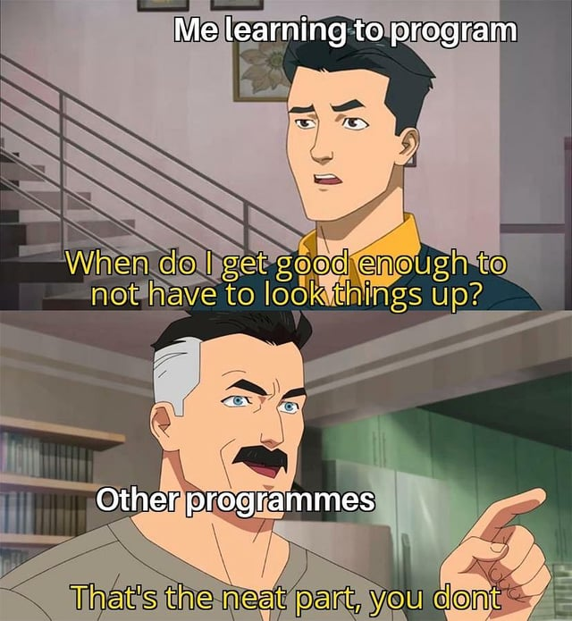
Announcements
No lab this week
Midterm exam on Thursday (normal class time + location)

Slide 3


Slide 4
Class Registration

Slide 5
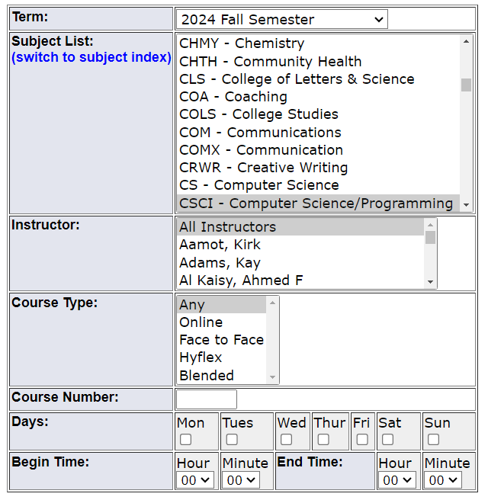
If you have not already:
CSCI 246 – Discrete Structures
CSCI 112- Programming in C
CS 145- Web Design
Next Classes (You can register for these anytime in the next couple years):
CSCI 366- Computer Systems
ESOF 322 – Software Engineering
CSCI 305 – Concepts of Programming Languages
CSCI 338 – Computer Science Theory
Other Classes that may be of interest
CSCI 291- Intro to Data Science
CSCI 331- Web Development
CSCI 351 – System Administration
CSCI 440 – Database Systems
CSCI 443 – User Interface Design
CSCI 447 – Machine Learning*
CSCI 460 – Operating Systems
CSCI 466 – Networks
CSCI 476 – Computer Security

Slide 6
Lab 6

Slide 7
Resources Available to you:
CS Tutoring Center
Smarty Cats Tutoring
Peter and Sultan’s Office Hours + email
My office hours + email

Slide 8
Exam Logistics
Thursday March 21st @ 10:50 in Barnard Hall 103
75 minutes
Open Notes: You can use laptop, notes, lecture slides, previous assignments, your IDE, and Java Documentation. This exam can be completed without a laptop
The midterm will consist of different types of questions, such as
Multiple Choice
True/False
Short Answer
Describe an algorithm (no code) that does X
Compare and Contrast different data structures
Given some code, critique the code, or describe what it prints out
Do some operation on a data structure

Slide 9
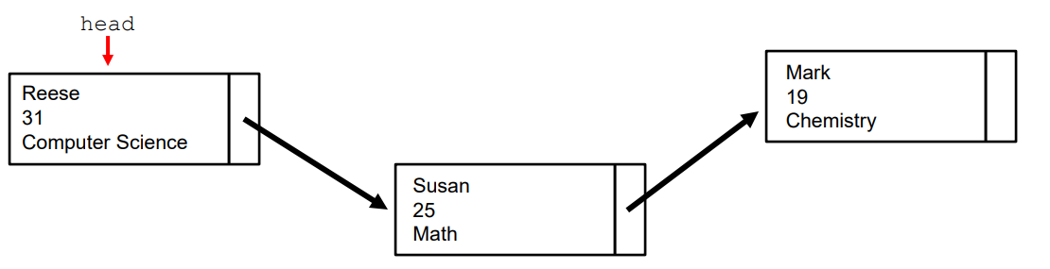
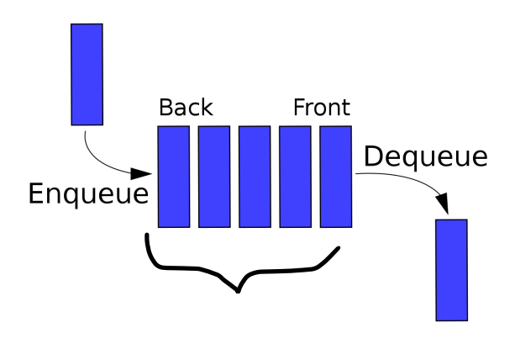
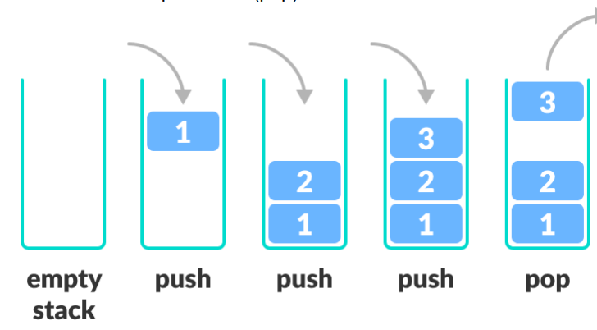
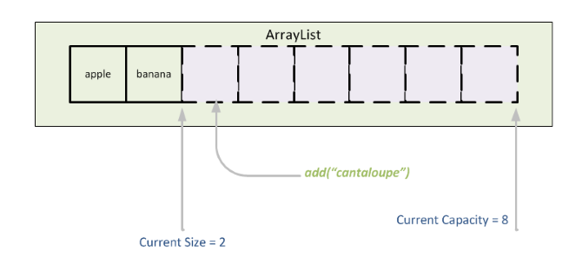
Linked Lists
Queue
Important Operations:
Add()
Remove()
Contains()
Stack
ArrayList

Slide 10
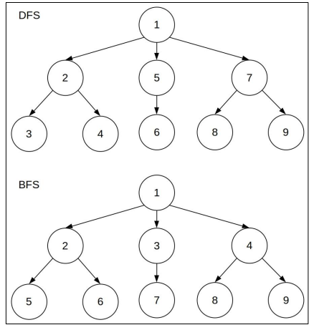
Trees
Desktop
School
Pictures
Work
Documents
CSCI476
CSCI232
Pets
Memes
Paystubs
Tree Vocabulary
Tree Traversal (Depth First, Breadth First)
Programs
Labs
Meatball
Tater
2023
2024

Slide 11
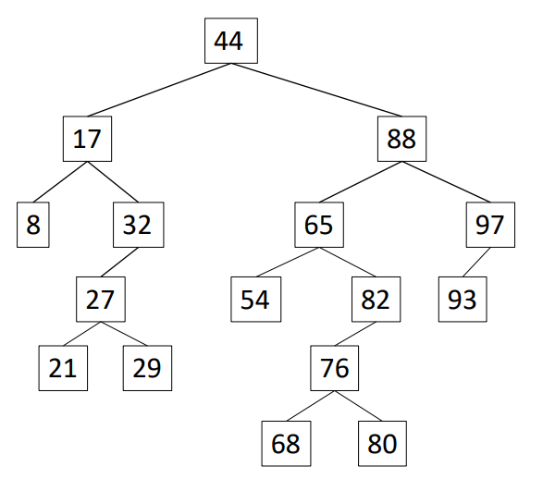
Binary Search Trees
Rules of BST
How to add and remove in a BST
Running time of add(), remove(), contains()
BST Navigation (preorder, post order, in order)
“Good tree” and “Bad tree”
Why are BST helpful

Slide 12
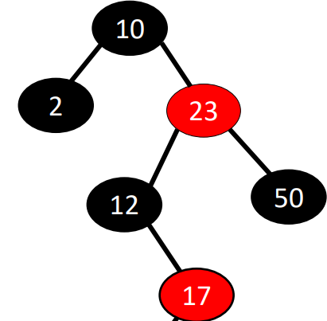
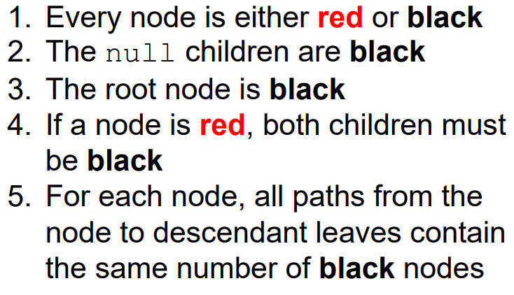
Red Black Trees
-Rules of RB tree
-Purpose of RB tree
-Verify a RB tree
-Explain why something is not an RB tree and how to fix it

Slide 13
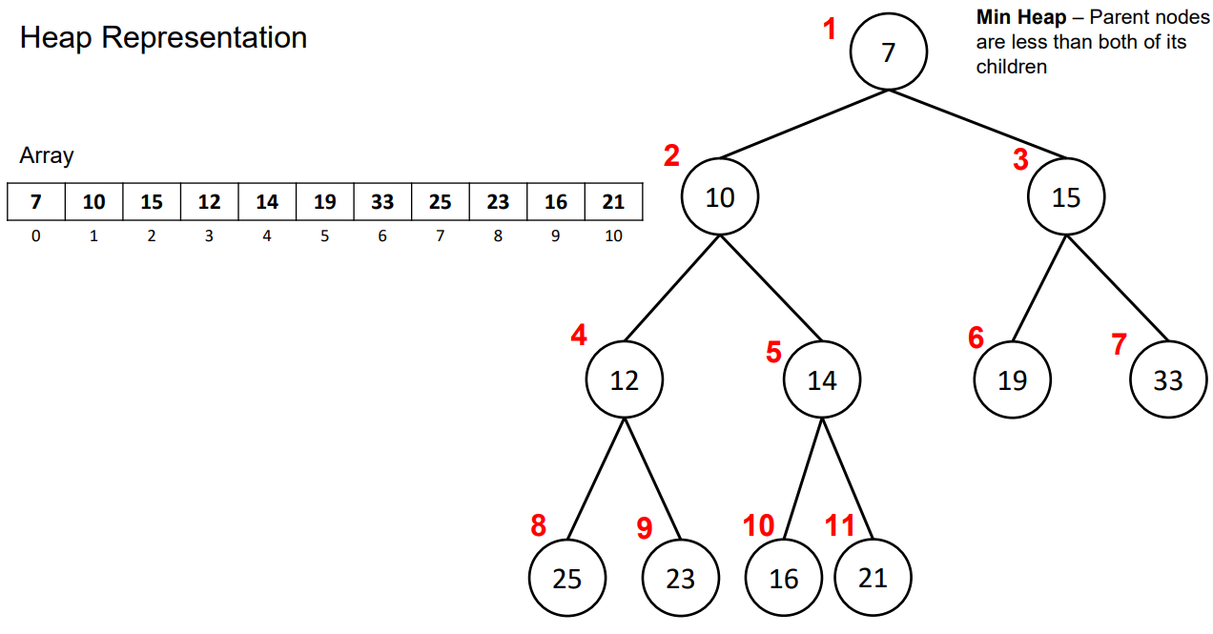
Heaps
Heap
(priority queue)
What a heap is
How to add or remove something from a heap
Heapify
Representation via an array (how to get parent and children)
What is the purpose of heap? What does it do well?
Running time of maintaining, adding, removing, and searching a heap

Slide 14
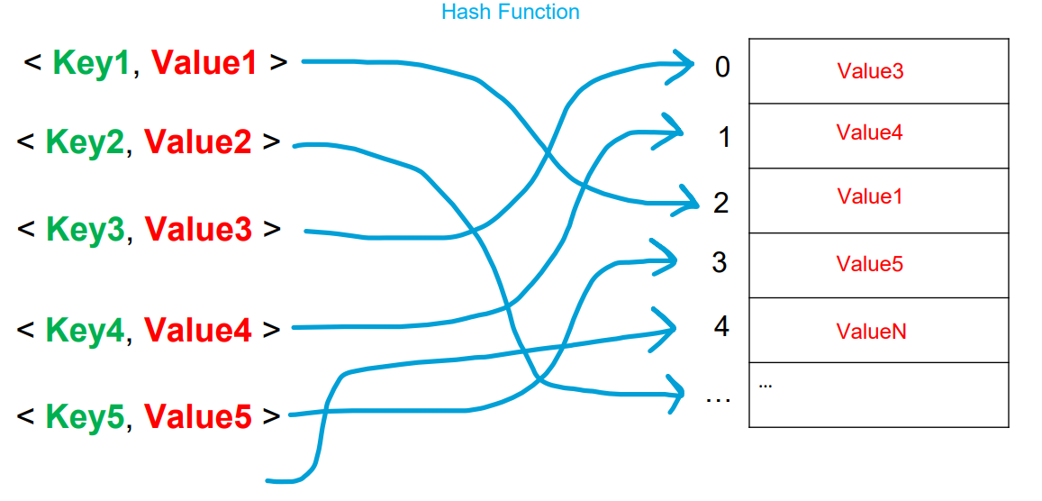

Hash Tables / HashMaps / HashSets/ Dictionaries
Heap
Rules for a Hash Table
How to insert, remove, lookup, and search in a Hash Table
Running time of adding, removing, and contains
Why are hash tables helpful?
How to reduce and deal with collisions (separate chaining and linear probing)
Java HashMaps and HashSets
Hashing Functions

