Slide 1

CSCI 232: Data Structures and Algorithms
Minimum Spanning Tree (MST) Part 2
Reese Pearsall
Spring 2024
https://www.cs.montana.edu/pearsall/classes/spring2024/232/main.html

Slide 2
Announcements
Lab 9 due tomorrow
Fill out survey if you haven’t already for lab 8
All of program 3 has been posted

Slide 3
Lab 9

Slide 4
Graphs
G = (V, E)
Adjacency List
1
3
0
1
2
3
4
5
{1,2}
{0,2,3}
0
5
{0,1,4}
{1,4,5}
2
4
{2,3,5}
{3,4}
4

Slide 5
Minimum Spanning Tree
7
3
0
3
4
2
5
1
1
2
4
1
2
5
3
2
Edge-weighted graph: A graph where each edge has a weight (cost).
MST Goal: Connect all vertices to each other with a minimum weight subset of edges.
5

Slide 6
Minimum Spanning Tree
✓
✗
Tree – connected graph with no loops.
6

Slide 7
Minimum Spanning Tree
✓
✗
Tree – connected graph with no loops.
Spanning tree – tree that includes all vertices in a graph.
7

Slide 8
Minimum Spanning Tree
✓
✗
Tree – connected graph with no loops.
Spanning tree – tree that includes all vertices in a graph.
Minimum spanning tree – spanning tree whose sum of edge costs is the minimum possible value.
1
1
1
1
1
100
1
100
8

Slide 9
Minimum Spanning Tree
7
3
0
3
4
2
Does it ever make sense to have a cycle?
5
1
1
2
4
1
2
5
3
2
No!
Must be a tree!
MST Goal: Connect all vertices to each other with a minimum weight subset of edges.
9

Slide 10
Minimum Spanning Tree
7
3
0
3
4
2
5
1
1
2
4
1
2
5
3
2
How to find MSTs?
10

Slide 11
Kruskal’s MST Algorithm
At each iteration, add the edge with smallest weight, that does not create a cycle.
7
3
0
3
4
2
5
1
1
2
4
1
2
5
3
2
11

Slide 12
Kruskal’s MST Algorithm
At each iteration, add the edge with smallest weight, that does not create a cycle.
7
3
0
3
4
2
5
1
1
2
4
1
2
5
3
2
12

Slide 13
Kruskal’s MST Algorithm
At each iteration, add the edge with smallest weight, that does not create a cycle.
7
3
0
3
4
2
5
1
1
2
4
1
2
5
3
2
13

Slide 14
Kruskal’s MST Algorithm
At each iteration, add the edge with smallest weight, that does not create a cycle.
7
3
0
3
4
2
5
1
1
2
4
1
2
5
3
2
14

Slide 15
Kruskal’s MST Algorithm
At each iteration, add the edge with smallest weight, that does not create a cycle.
7
3
0
3
4
2
5
1
1
2
4
1
2
5
3
2
15

Slide 16
Kruskal’s MST Algorithm
At each iteration, add the edge with smallest weight, that does not create a cycle.
7
3
0
3
4
2
5
1
1
2
4
1
2
5
3
2
16

Slide 17
Kruskal’s MST Algorithm
At each iteration, add the edge with smallest weight, that does not create a cycle.
7
3
0
3
4
2
5
1
1
2
4
1
2
5
3
2
17

Slide 18
Kruskal’s MST Algorithm
At each iteration, add the edge with smallest weight, that does not create a cycle.
MST = [0, 1], [0, 2], [2,3], [3,5], [3,4]
Total Cost = 9
3
0
3
4
2
1
1
2
1
2
5
18

Slide 19
public kruskalsAlgorithm(WeightedGraph graph) {
}
19

Slide 20
public kruskalsAlgorithm(WeightedGraph graph) {
HashSet<Edge> mst = new HashSet<>();
}
20

Slide 21
public kruskalsAlgorithm(WeightedGraph graph) {
HashSet<Edge> mst = new HashSet<>();
// Get the set of edges.
}
21

Slide 22
public kruskalsAlgorithm(WeightedGraph graph) {
HashSet<Edge> mst = new HashSet<>();
// Get the set of edges.
HashSet<Edge> Edges = graph.getEdges();
}
22

Slide 23
public kruskalsAlgorithm(WeightedGraph graph) {
HashSet<Edge> mst = new HashSet<>();
// Get the set of edges, in order of increasing weight.
HashSet<Edge> Edges = graph.getEdges();
}
23

Slide 24
public kruskalsAlgorithm(WeightedGraph graph) {
HashSet<Edge> mst = new HashSet<>();
// Get the set of edges, in order of increasing weight.
PriorityQueue<Edge> edgeQueue = new PriorityQueue<>();
}
24

Slide 25
public kruskalsAlgorithm(WeightedGraph graph) {
HashSet<Edge> mst = new HashSet<>();
// Get the set of edges, in order of increasing weight.
PriorityQueue<Edge> edgeQueue = new PriorityQueue<>();
for (Edge edge : graph.getEdges()) {
edgeQueue.add(edge);
}
}
25

Slide 26
public kruskalsAlgorithm(WeightedGraph graph) {
HashSet<Edge> mst = new HashSet<>();
PriorityQueue<Edge> edgeQueue = new PriorityQueue<>();
for (Edge edge : graph.getEdges()) {
edgeQueue.add(edge);
}
// Run Kruskal’s algorithm.
}
26

Slide 27
public kruskalsAlgorithm(WeightedGraph graph) {
HashSet<Edge> mst = new HashSet<>();
PriorityQueue<Edge> edgeQueue = new PriorityQueue<>();
for (Edge edge : graph.getEdges()) {
edgeQueue.add(edge);
}
while (!edgeQueue.isEmpty()) {
} }
27

Slide 28
public kruskalsAlgorithm(WeightedGraph graph) {
HashSet<Edge> mst = new HashSet<>();
PriorityQueue<Edge> edgeQueue = new PriorityQueue<>();
for (Edge edge : graph.getEdges()) {
edgeQueue.add(edge);
}
while (!edgeQueue.isEmpty()) {
Edge edge = edgeQueue.poll();
} }
28

Slide 29
public kruskalsAlgorithm(WeightedGraph graph) {
HashSet<Edge> mst = new HashSet<>();
PriorityQueue<Edge> edgeQueue = new PriorityQueue<>();
for (Edge edge : graph.getEdges()) {
edgeQueue.add(edge);
}
while (!edgeQueue.isEmpty()) {
Edge edge = edgeQueue.poll();
mst.add(edge);
} }
29

Slide 30
public kruskalsAlgorithm(WeightedGraph graph) {
HashSet<Edge> mst = new HashSet<>();
PriorityQueue<Edge> edgeQueue = new PriorityQueue<>();
for (Edge edge : graph.getEdges()) {
edgeQueue.add(edge);
}
while (!edgeQueue.isEmpty()) {
Edge edge = edgeQueue.poll();
mst.add(edge);
} }
Need to check if adding edge adds a loop!
30

Slide 31
public kruskalsAlgorithm(WeightedGraph graph) {
HashSet<Edge> mst = new HashSet<>();
PriorityQueue<Edge> edgeQueue = new PriorityQueue<>();
for (Edge edge : graph.getEdges()) {
edgeQueue.add(edge);
}
while (!edgeQueue.isEmpty()) {
Edge edge = edgeQueue.poll();
mst.add(edge);
} }
Need to check if adding edge adds a loop!
How?
31

Slide 32
Cycle Finding
7
3
0
3
4
2
5
1
1
2
4
1
2
5
3
2
How can we determine if adding an edge puts in a cycle?
32

Slide 33
Cycle Finding
0
3
4
7
3
0
3
4
2
5
1
1
2
4
1
2
5
1
3
2
5
2
Only add edge if vertices have different connected component markers.
Rules:
Connected component
(in the tree) marker.
33

Slide 34
Cycle Finding
0
3
4
7
3
0
3
4
2
5
1
1
2
4
1
2
5
1
3
2
5
2
Only add edge if vertices have different connected component markers.
To add edge, pick one vertex’s marker and change all vertices with the other marker.
Rules:
Connected component
(in the tree) marker.
34

Slide 35
Cycle Finding
0
3
4
7
3
0
3
4
2
5
1
1
2
4
1
2
5
1
3
2
5
2
Only add edge if vertices have different connected component markers.
To add edge, pick one vertex’s marker and change all vertices with the other marker.
Rules:
Connected component
(in the tree) marker.
35

Slide 36
Cycle Finding
0
3
4
7
3
0
3
4
2
5
1
1
2
4
1
2
5
0
3
2
5
2
Only add edge if vertices have different connected component markers.
To add edge, pick one vertex’s marker and change all vertices with the other marker.
Rules:
Connected component
(in the tree) marker.
36

Slide 37
Cycle Finding
0
3
4
7
3
0
3
4
2
5
1
1
2
4
1
2
5
0
3
2
5
2
Only add edge if vertices have different connected component markers.
To add edge, pick one vertex’s marker and change all vertices with the other marker.
Rules:
Connected component
(in the tree) marker.
37

Slide 38
Cycle Finding
0
5
4
7
3
0
3
4
2
5
1
1
2
4
1
2
5
0
3
2
5
2
Only add edge if vertices have different connected component markers.
To add edge, pick one vertex’s marker and change all vertices with the other marker.
Rules:
Connected component
(in the tree) marker.
38

Slide 39
Cycle Finding
0
5
4
7
3
0
3
4
2
5
1
1
2
4
1
2
5
0
3
2
5
2
Only add edge if vertices have different connected component markers.
To add edge, pick one vertex’s marker and change all vertices with the other marker.
Rules:
Connected component
(in the tree) marker.
39

Slide 40
Cycle Finding
2
5
4
7
3
0
3
4
2
5
1
1
2
4
1
2
5
2
3
2
5
2
Only add edge if vertices have different connected component markers.
To add edge, pick one vertex’s marker and change all vertices with the other marker.
Rules:
Connected component
(in the tree) marker.
40

Slide 41
Cycle Finding
2
5
4
7
3
0
3
4
2
5
1
1
2
4
1
2
5
2
3
2
5
2
Only add edge if vertices have different connected component markers.
To add edge, pick one vertex’s marker and change all vertices with the other marker.
Rules:
Connected component
(in the tree) marker.
41

Slide 42
Cycle Finding
5
5
4
7
3
0
3
4
2
5
1
1
2
4
1
2
5
5
3
2
5
5
Only add edge if vertices have different connected component markers.
To add edge, pick one vertex’s marker and change all vertices with the other marker.
Rules:
Connected component
(in the tree) marker.
42

Slide 43
Cycle Finding
5
5
4
7
3
0
3
4
2
Why is adding this edge a bad idea?
5
1
1
2
4
1
2
5
5
3
2
5
5
Only add edge if vertices have different connected component markers.
To add edge, pick one vertex’s marker and change all vertices with the other marker.
Rules:
Connected component
(in the tree) marker.
43

Slide 44
Cycle Finding
5
5
4
7
3
0
3
4
2
5
1
1
2
4
1
2
5
5
3
2
5
5
Only add edge if vertices have different connected component markers.
To add edge, pick one vertex’s marker and change all vertices with the other marker.
Rules:
Connected component
(in the tree) marker.
44

Slide 45
Cycle Finding
4
4
4
7
3
0
3
4
2
5
1
1
2
4
1
2
5
4
3
2
4
4
Only add edge if vertices have different connected component markers.
To add edge, pick one vertex’s marker and change all vertices with the other marker.
Rules:
Connected component
(in the tree) marker.
45

Slide 46
public kruskalsAlgorithm(WeightedGraph graph) {
HashSet<Edge> mst = new HashSet<>();
PriorityQueue<Edge> edgeQueue = new PriorityQueue<>();
for (Edge edge : graph.getEdges()) {
edgeQueue.add(edge);
}
while (!edgeQueue.isEmpty()) {
Edge edge = edgeQueue.poll();
mst.add(edge);
} }
Need to check if adding edge adds a loop!
46

Slide 47
public kruskalsAlgorithm(WeightedGraph graph) {
HashSet<Edge> mst = new HashSet<>();
PriorityQueue<Edge> edgeQueue = new PriorityQueue<>();
for (Edge edge : graph.getEdges()) {
edgeQueue.add(edge);
}
while (!edgeQueue.isEmpty()) {
Edge edge = edgeQueue.poll();
// Need to check if adding edge adds a loop.
} }
47

Slide 48
public kruskalsAlgorithm(WeightedGraph graph) {
HashSet<Edge> mst = new HashSet<>();
int[] connectedComponentMarker = new int[graph.getNumVertices()];
PriorityQueue<Edge> edgeQueue = new PriorityQueue<>();
for (Edge edge : graph.getEdges()) {
edgeQueue.add(edge);
}
while (!edgeQueue.isEmpty()) {
Edge edge = edgeQueue.poll();
// Need to check if adding edge adds a loop.
} }
48

Slide 49
public kruskalsAlgorithm(WeightedGraph graph) {
HashSet<Edge> mst = new HashSet<>();
int[] connectedComponentMarker = new int[graph.getNumVertices()];
for (int i = 0; i < connectedComponentMarker.length; i++) {
connectedComponentMarker[i] = i;
}
PriorityQueue<Edge> edgeQueue = new PriorityQueue<>();
for (Edge edge : graph.getEdges()) {
edgeQueue.add(edge);
}
while (!edgeQueue.isEmpty()) {
Edge edge = edgeQueue.poll();
// Need to check if adding edge adds a loop.
} }
49

Slide 50
public kruskalsAlgorithm(WeightedGraph graph) {
HashSet<Edge> mst = new HashSet<>();
int[] connectedComponentMarker = new int[graph.getNumVertices()];
for (int i = 0; i < connectedComponentMarker.length; i++) {
connectedComponentMarker[i] = i;
}
PriorityQueue<Edge> edgeQueue = new PriorityQueue<>();
for (Edge edge : graph.getEdges()) {
edgeQueue.add(edge);
}
while (!edgeQueue.isEmpty()) {
Edge edge = edgeQueue.poll();
if (connectedComponentMarker[edge.getVertices()[0]]
!= connectedComponentMarker[edge.getVertices()[1]]) {
} } }
50

Slide 51
public kruskalsAlgorithm(WeightedGraph graph) {
HashSet<Edge> mst = new HashSet<>();
int[] connectedComponentMarker = new int[graph.getNumVertices()];
for (int i = 0; i < connectedComponentMarker.length; i++) {
connectedComponentMarker[i] = i;
}
PriorityQueue<Edge> edgeQueue = new PriorityQueue<>();
for (Edge edge : graph.getEdges()) {
edgeQueue.add(edge);
}
while (!edgeQueue.isEmpty()) {
Edge edge = edgeQueue.poll();
if (connectedComponentMarker[edge.getVertices()[0]]
!= connectedComponentMarker[edge.getVertices()[1]]) {
mst.add(edge);
} } }
51

Slide 52
Cycle Finding
4
4
4
7
3
0
3
4
2
5
1
1
2
4
1
2
5
4
3
2
4
4
Only add edge if vertices have different connected component markers.
To add edge, pick one vertex’s marker and change all vertices with the other marker.
Rules:
Connected component
(in the tree) marker.
52

Slide 53
public kruskalsAlgorithm(WeightedGraph graph) {
HashSet<Edge> mst = new HashSet<>();
int[] connectedComponentMarker = new int[graph.getNumVertices()];
for (int i = 0; i < connectedComponentMarker.length; i++) {
connectedComponentMarker[i] = i;
}
PriorityQueue<Edge> edgeQueue = new PriorityQueue<>();
for (Edge edge : graph.getEdges()) {
edgeQueue.add(edge);
}
while (!edgeQueue.isEmpty()) {
Edge edge = edgeQueue.poll();
if (connectedComponentMarker[edge.getVertices()[0]]
!= connectedComponentMarker[edge.getVertices()[1]]) {
mst.add(edge);
} } }
53

Slide 54
public kruskalsAlgorithm(WeightedGraph graph) {
HashSet<Edge> mst = new HashSet<>();
int[] connectedComponentMarker = new int[graph.getNumVertices()];
for (int i = 0; i < connectedComponentMarker.length; i++) {
connectedComponentMarker[i] = i;
}
PriorityQueue<Edge> edgeQueue = new PriorityQueue<>();
for (Edge edge : graph.getEdges()) {
edgeQueue.add(edge);
}
while (!edgeQueue.isEmpty()) {
Edge edge = edgeQueue.poll();
if (connectedComponentMarker[edge.getVertices()[0]]
!= connectedComponentMarker[edge.getVertices()[1]]) {
mst.add(edge);
int newMarker = connectedComponentMarker[edge.getVertices()[0]];
int oldMarker = connectedComponentMarker[edge.getVertices()[1]];
} } }
54

Slide 55
public kruskalsAlgorithm(WeightedGraph graph) {
HashSet<Edge> mst = new HashSet<>();
int[] connectedComponentMarker = new int[graph.getNumVertices()];
for (int i = 0; i < connectedComponentMarker.length; i++) {
connectedComponentMarker[i] = i;
}
PriorityQueue<Edge> edgeQueue = new PriorityQueue<>();
for (Edge edge : graph.getEdges()) {
edgeQueue.add(edge);
}
while (!edgeQueue.isEmpty()) {
Edge edge = edgeQueue.poll();
if (connectedComponentMarker[edge.getVertices()[0]]
!= connectedComponentMarker[edge.getVertices()[1]]) {
mst.add(edge);
int newMarker = connectedComponentMarker[edge.getVertices()[0]];
int oldMarker = connectedComponentMarker[edge.getVertices()[1]];
for (int i = 0; i < connectedComponentMarker.length; i++) {
} } } }
55

Slide 56
public kruskalsAlgorithm(WeightedGraph graph) {
HashSet<Edge> mst = new HashSet<>();
int[] connectedComponentMarker = new int[graph.getNumVertices()];
for (int i = 0; i < connectedComponentMarker.length; i++) {
connectedComponentMarker[i] = i;
}
PriorityQueue<Edge> edgeQueue = new PriorityQueue<>();
for (Edge edge : graph.getEdges()) {
edgeQueue.add(edge);
}
while (!edgeQueue.isEmpty()) {
Edge edge = edgeQueue.poll();
if (connectedComponentMarker[edge.getVertices()[0]]
!= connectedComponentMarker[edge.getVertices()[1]]) {
mst.add(edge);
int newMarker = connectedComponentMarker[edge.getVertices()[0]];
int oldMarker = connectedComponentMarker[edge.getVertices()[1]];
for (int i = 0; i < connectedComponentMarker.length; i++) {
if (connectedComponentMarker[i] == oldMarker) {
connectedComponentMarker[i] = newMarker;
} } } } }
56

Slide 57
Kruskal’s MST Algorithm
At each iteration, add smallest weight edge that doesn’t create a cycle.
7
3
0
3
4
2
5
1
1
2
4
1
2
5
3
2
Is the solution valid (i.e., is the output a spanning tree)?
Is the solution optimal (i.e., is the output a minimum spanning tree)?
57

Slide 58

Kruskal’s MST Algorithm
At each iteration, add smallest weight edge that doesn’t create a cycle.
Proof of validity: Let $G=(V,E)$ be connected, and $T⊆E$ be the set of edges resulting from Kruskal’s algorithm.
58

Slide 59

Kruskal’s MST Algorithm
At each iteration, add smallest weight edge that doesn’t create a cycle.
Proof of validity: Let $G=(V,E)$ be connected, and $T⊆E$ be the set of edges resulting from Kruskal’s algorithm.
$T$ is a tree because…?
59

Slide 60

Kruskal’s MST Algorithm
At each iteration, add smallest weight edge that doesn’t create a cycle.
Proof of validity: Let $G=(V,E)$ be connected, and $T⊆E$ be the set of edges resulting from Kruskal’s algorithm.
$T$ is a tree because it is connected (otherwise we could have added more edges without creating cycles) and there are no cycles.
60

Slide 61
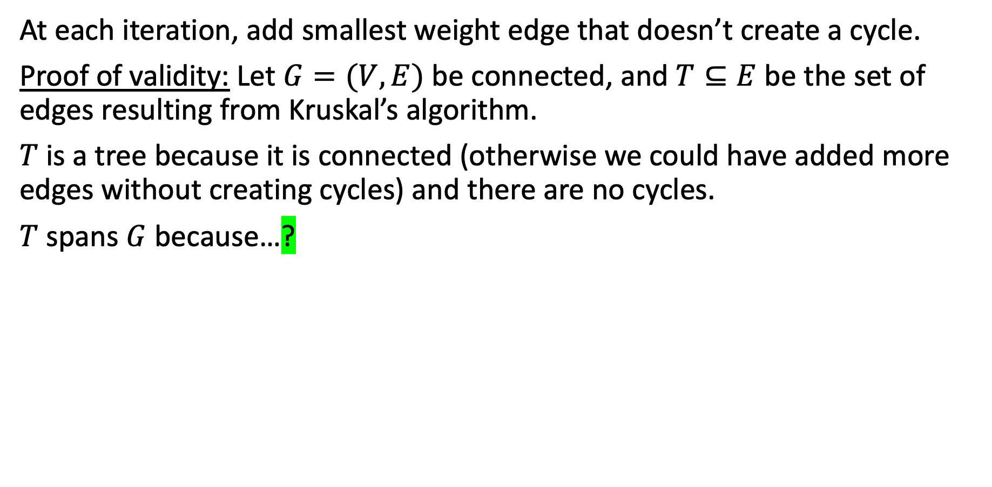
Kruskal’s MST Algorithm
At each iteration, add smallest weight edge that doesn’t create a cycle.
Proof of validity: Let $G=(V,E)$ be connected, and $T⊆E$ be the set of edges resulting from Kruskal’s algorithm.
$T$ is a tree because it is connected (otherwise we could have added more edges without creating cycles) and there are no cycles.
$T$ spans $G$ because…?
61

Slide 62
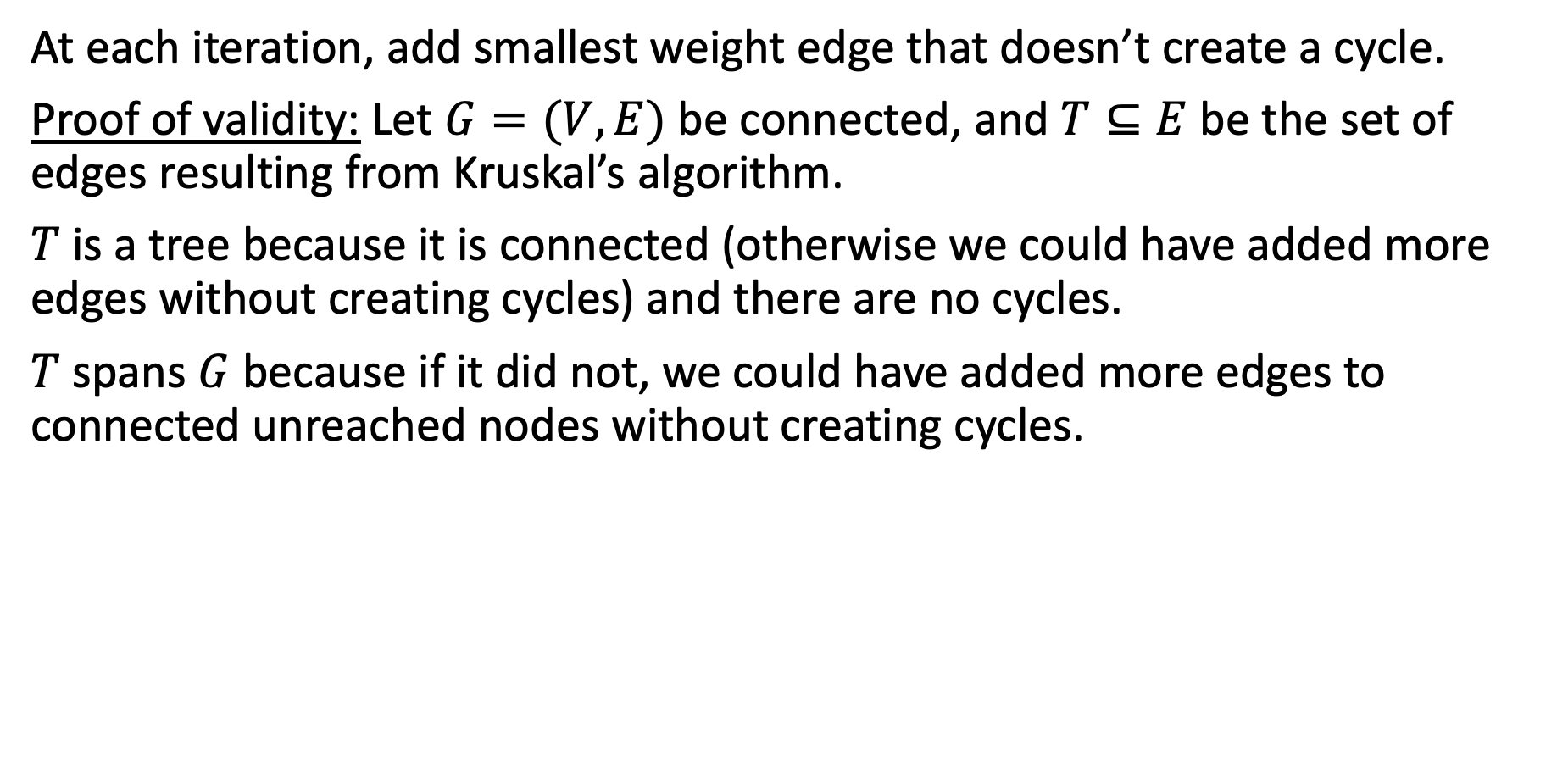
Kruskal’s MST Algorithm
At each iteration, add smallest weight edge that doesn’t create a cycle.
Proof of validity: Let $G=(V,E)$ be connected, and $T⊆E$ be the set of edges resulting from Kruskal’s algorithm.
$T$ is a tree because it is connected (otherwise we could have added more edges without creating cycles) and there are no cycles.
$T$ spans $G$ because if it did not, we could have added more edges to connected unreached nodes without creating cycles.
62

Slide 63
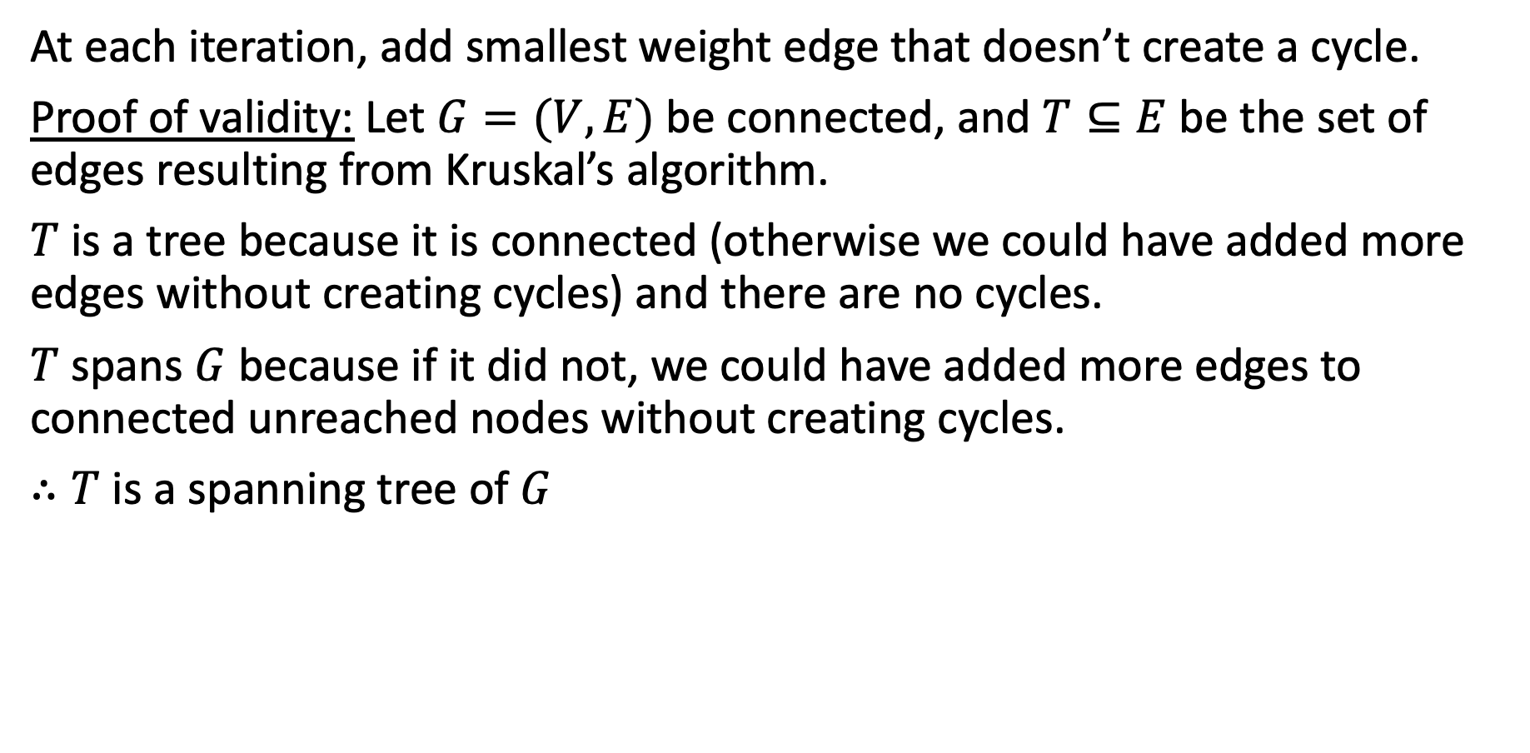
Kruskal’s MST Algorithm
At each iteration, add smallest weight edge that doesn’t create a cycle.
Proof of validity: Let $G=(V,E)$ be connected, and $T⊆E$ be the set of edges resulting from Kruskal’s algorithm.
$T$ is a tree because it is connected (otherwise we could have added more edges without creating cycles) and there are no cycles.
$T$ spans $G$ because if it did not, we could have added more edges to connected unreached nodes without creating cycles.
$∴T$ is a spanning tree of $G$
63

Slide 64

Kruskal’s MST Algorithm
At each iteration, add smallest weight edge that doesn’t create a cycle.
Proof of optimality: Let $G=(V,E)$ be connected, and $T⊆E$ be the set of edges resulting from Kruskal’s algorithm.
$T$ is an MST because???
64

Slide 65
MST Cut Property
Lemma: Suppose that $S$ is a subset of nodes from $G=(V,E)$. Then, the cheapest edge $e$ between $S$ and $V\backslash S$ is part of every MST.
Proof:
$$S$$
65

Slide 66
MST Cut Property
Lemma: Suppose that $S$ is a subset of nodes from $G=(V,E)$. Then, the cheapest edge $e$ between $S$ and $V\backslash S$ is part of every MST.
Proof:
$$S$$
$$V\backslash S$$
66

Slide 67
MST Cut Property
Lemma: Suppose that $S$ is a subset of nodes from $G=(V,E)$. Then, the cheapest edge $e$ between $S$ and $V\backslash S$ is part of every MST.
Proof: Any MST of $G$ must include some edge between $S$ and $V\backslash S$ (otherwise it would not be a tree).
Let $e$ be the cheapest edge between $S$ and $V\backslash S$.
Suppose $T$ is a ST that does not include $e$. $T∪\{e\}$ must have a cycle and that cycle must have another edge $e′$ between $S$ and $V\backslash S$.
Remove $e′$ to form $T′=T∪\{e\}\backslash \{e’\}$.
$T′$ is a tree (removing edge from cycle cannot disconnect graph)
$T′$ spans $V$ (same number of edges as ST $T$)
weight($T′$) = weight($T$) + weight($e$) – weight($e′$).
$⇒$ weight($T′$) < weight($T$), since weight($e$) < weight($e′$).
$⇒ T′$ is a cheaper ST.
So, $e$ is part of every MST.
$$e′$$
$$u$$
$$S$$
$$e$$
$$v$$
$$V\backslash S$$
67

Slide 68
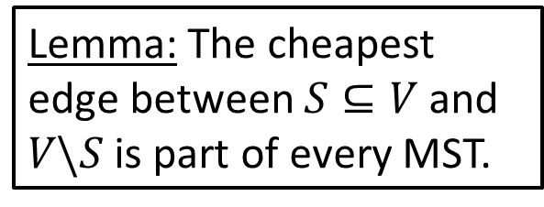
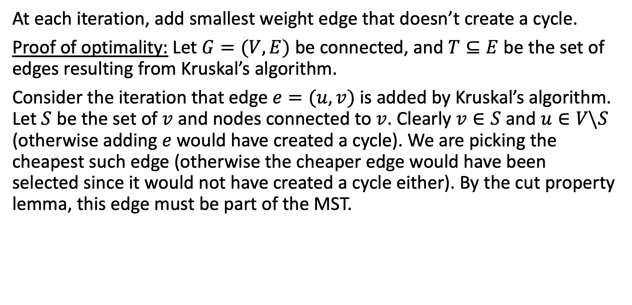
Kruskal’s MST Algorithm
At each iteration, add smallest weight edge that doesn’t create a cycle.
Proof of optimality: Let $G=(V,E)$ be connected, and $T⊆E$ be the set of edges resulting from Kruskal’s algorithm.
Consider the iteration that edge $e=(u,v)$ is added by Kruskal’s algorithm. Let $S$ be the set of $v$ and nodes connected to $v$. Clearly $v∈S$ and $u∈V\backslash S$ (otherwise adding $e$ would have created a cycle). We are picking the cheapest such edge (otherwise the cheaper edge would have been selected since it would not have created a cycle either). By the cut property lemma, this edge must be part of the MST.
$$u$$
7
3
5
Lemma: The cheapest edge between $S⊆V$ and $V\backslash S$ is part of every MST.
2
1
2
1
4
$$v$$
3
3
68

Slide 69
public kruskalsAlgorithm(WeightedGraph graph) {
HashSet<Edge> mst = new HashSet<>();
int[] connectedComponentMarker = new int[graph.getNumVertices()];
for (int i = 0; i < connectedComponentMarker.length; i++) {
connectedComponentMarker[i] = i;
}
PriorityQueue<Edge> edgeQueue = new PriorityQueue<>();
for (Edge edge : graph.getEdges()) {
edgeQueue.add(edge);
}
while (!edgeQueue.isEmpty()) {
Edge edge = edgeQueue.poll();
if (connectedComponentMarker[edge.getVertices()[0]]
!= connectedComponentMarker[edge.getVertices()[1]]) {
mst.add(edge);
int newMarker = connectedComponentMarker[edge.getVertices()[0]];
int oldMarker = connectedComponentMarker[edge.getVertices()[1]];
for (int i = 0; i < connectedComponentMarker.length; i++) {
if (connectedComponentMarker[i] == oldMarker) {
connectedComponentMarker[i] = newMarker;
69

Slide 70
public kruskalsAlgorithm(WeightedGraph graph) {
HashSet<Edge> mst = new HashSet<>();
int[] connectedComponentMarker = new int[graph.getNumVertices()];
for (int i = 0; i < connectedComponentMarker.length; i++) {
connectedComponentMarker[i] = i;
}
PriorityQueue<Edge> edgeQueue = new PriorityQueue<>();
for (Edge edge : graph.getEdges()) {
edgeQueue.add(edge);
}
while (!edgeQueue.isEmpty()) {
Edge edge = edgeQueue.poll();
if (connectedComponentMarker[edge.getVertices()[0]]
!= connectedComponentMarker[edge.getVertices()[1]]) {
mst.add(edge);
int newMarker = connectedComponentMarker[edge.getVertices()[0]];
int oldMarker = connectedComponentMarker[edge.getVertices()[1]];
for (int i = 0; i < connectedComponentMarker.length; i++) {
if (connectedComponentMarker[i] == oldMarker) {
connectedComponentMarker[i] = newMarker;
V = # of vertices
O(1)
O(V)
70

Slide 71

public kruskalsAlgorithm(WeightedGraph graph) {
HashSet<Edge> mst = new HashSet<>();
int[] connectedComponentMarker = new int[graph.getNumVertices()];
for (int i = 0; i < connectedComponentMarker.length; i++) {
connectedComponentMarker[i] = i;
}
PriorityQueue<Edge> edgeQueue = new PriorityQueue<>();
for (Edge edge : graph.getEdges()) {
edgeQueue.add(edge);
}
while (!edgeQueue.isEmpty()) {
Edge edge = edgeQueue.poll();
if (connectedComponentMarker[edge.getVertices()[0]]
!= connectedComponentMarker[edge.getVertices()[1]]) {
mst.add(edge);
int newMarker = connectedComponentMarker[edge.getVertices()[0]];
int oldMarker = connectedComponentMarker[edge.getVertices()[1]];
for (int i = 0; i < connectedComponentMarker.length; i++) {
if (connectedComponentMarker[i] == oldMarker) {
connectedComponentMarker[i] = newMarker;
V = # of vertices
O(1)
O(V)
O(V)
71

Slide 72

public kruskalsAlgorithm(WeightedGraph graph) {
HashSet<Edge> mst = new HashSet<>();
int[] connectedComponentMarker = new int[graph.getNumVertices()];
for (int i = 0; i < connectedComponentMarker.length; i++) {
connectedComponentMarker[i] = i;
}
PriorityQueue<Edge> edgeQueue = new PriorityQueue<>();
for (Edge edge : graph.getEdges()) {
edgeQueue.add(edge);
}
while (!edgeQueue.isEmpty()) {
Edge edge = edgeQueue.poll();
if (connectedComponentMarker[edge.getVertices()[0]]
!= connectedComponentMarker[edge.getVertices()[1]]) {
mst.add(edge);
int newMarker = connectedComponentMarker[edge.getVertices()[0]];
int oldMarker = connectedComponentMarker[edge.getVertices()[1]];
for (int i = 0; i < connectedComponentMarker.length; i++) {
if (connectedComponentMarker[i] == oldMarker) {
connectedComponentMarker[i] = newMarker;
V = # of vertices E = # of edges
O(1)
O(V)
O(V)
O(1)
72

Slide 73

public kruskalsAlgorithm(WeightedGraph graph) {
HashSet<Edge> mst = new HashSet<>();
int[] connectedComponentMarker = new int[graph.getNumVertices()];
for (int i = 0; i < connectedComponentMarker.length; i++) {
connectedComponentMarker[i] = i;
}
PriorityQueue<Edge> edgeQueue = new PriorityQueue<>();
for (Edge edge : graph.getEdges()) {
edgeQueue.add(edge);
}
while (!edgeQueue.isEmpty()) {
Edge edge = edgeQueue.poll();
if (connectedComponentMarker[edge.getVertices()[0]]
!= connectedComponentMarker[edge.getVertices()[1]]) {
mst.add(edge);
int newMarker = connectedComponentMarker[edge.getVertices()[0]];
int oldMarker = connectedComponentMarker[edge.getVertices()[1]];
for (int i = 0; i < connectedComponentMarker.length; i++) {
if (connectedComponentMarker[i] == oldMarker) {
connectedComponentMarker[i] = newMarker;
V = # of vertices E = # of edges
O(1)
O(V)
O(V)
O(1)
O(E log E)
73

Slide 74

public kruskalsAlgorithm(WeightedGraph graph) {
HashSet<Edge> mst = new HashSet<>();
int[] connectedComponentMarker = new int[graph.getNumVertices()];
for (int i = 0; i < connectedComponentMarker.length; i++) {
connectedComponentMarker[i] = i;
}
PriorityQueue<Edge> edgeQueue = new PriorityQueue<>();
for (Edge edge : graph.getEdges()) {
edgeQueue.add(edge);
}
while (!edgeQueue.isEmpty()) {
Edge edge = edgeQueue.poll();
if (connectedComponentMarker[edge.getVertices()[0]]
!= connectedComponentMarker[edge.getVertices()[1]]) {
mst.add(edge);
int newMarker = connectedComponentMarker[edge.getVertices()[0]];
int oldMarker = connectedComponentMarker[edge.getVertices()[1]];
for (int i = 0; i < connectedComponentMarker.length; i++) {
if (connectedComponentMarker[i] == oldMarker) {
connectedComponentMarker[i] = newMarker;
V = # of vertices E = # of edges
O(1)
O(V)
O(V)
O(1)
O(E log E)
O(E)
74

Slide 75
public kruskalsAlgorithm(WeightedGraph graph) {
HashSet<Edge> mst = new HashSet<>();
int[] connectedComponentMarker = new int[graph.getNumVertices()];
for (int i = 0; i < connectedComponentMarker.length; i++) {
connectedComponentMarker[i] = i;
}
PriorityQueue<Edge> edgeQueue = new PriorityQueue<>();
for (Edge edge : graph.getEdges()) {
edgeQueue.add(edge);
}
while (!edgeQueue.isEmpty()) {
Edge edge = edgeQueue.poll();
if (connectedComponentMarker[edge.getVertices()[0]]
!= connectedComponentMarker[edge.getVertices()[1]]) {
mst.add(edge);
int newMarker = connectedComponentMarker[edge.getVertices()[0]];
int oldMarker = connectedComponentMarker[edge.getVertices()[1]];
for (int i = 0; i < connectedComponentMarker.length; i++) {
if (connectedComponentMarker[i] == oldMarker) {
connectedComponentMarker[i] = newMarker;
V = # of vertices E = # of edges
O(1)
O(V)
O(V)
O(1)
O(E log E)
O(E)
O(1)*
75

Slide 76
public kruskalsAlgorithm(WeightedGraph graph) {
HashSet<Edge> mst = new HashSet<>();
int[] connectedComponentMarker = new int[graph.getNumVertices()];
for (int i = 0; i < connectedComponentMarker.length; i++) {
connectedComponentMarker[i] = i;
}
PriorityQueue<Edge> edgeQueue = new PriorityQueue<>();
for (Edge edge : graph.getEdges()) {
edgeQueue.add(edge);
}
while (!edgeQueue.isEmpty()) {
Edge edge = edgeQueue.poll();
if (connectedComponentMarker[edge.getVertices()[0]]
!= connectedComponentMarker[edge.getVertices()[1]]) {
mst.add(edge);
int newMarker = connectedComponentMarker[edge.getVertices()[0]];
int oldMarker = connectedComponentMarker[edge.getVertices()[1]];
for (int i = 0; i < connectedComponentMarker.length; i++) {
if (connectedComponentMarker[i] == oldMarker) {
connectedComponentMarker[i] = newMarker;
V = # of vertices E = # of edges
O(1)
O(V)
O(V)
O(1)
O(E log E)
O(E)
O(1)*
O(1)
76

Slide 77
public kruskalsAlgorithm(WeightedGraph graph) {
HashSet<Edge> mst = new HashSet<>();
int[] connectedComponentMarker = new int[graph.getNumVertices()];
for (int i = 0; i < connectedComponentMarker.length; i++) {
connectedComponentMarker[i] = i;
}
PriorityQueue<Edge> edgeQueue = new PriorityQueue<>();
for (Edge edge : graph.getEdges()) {
edgeQueue.add(edge);
}
while (!edgeQueue.isEmpty()) {
Edge edge = edgeQueue.poll();
if (connectedComponentMarker[edge.getVertices()[0]]
!= connectedComponentMarker[edge.getVertices()[1]]) {
mst.add(edge);
int newMarker = connectedComponentMarker[edge.getVertices()[0]];
int oldMarker = connectedComponentMarker[edge.getVertices()[1]];
for (int i = 0; i < connectedComponentMarker.length; i++) {
if (connectedComponentMarker[i] == oldMarker) {
connectedComponentMarker[i] = newMarker;
V = # of vertices E = # of edges
O(1)
O(V)
O(V)
O(1)
O(E log E)
O(E)
O(1)*
O(1)
O(1)
77

Slide 78
public kruskalsAlgorithm(WeightedGraph graph) {
HashSet<Edge> mst = new HashSet<>();
int[] connectedComponentMarker = new int[graph.getNumVertices()];
for (int i = 0; i < connectedComponentMarker.length; i++) {
connectedComponentMarker[i] = i;
}
PriorityQueue<Edge> edgeQueue = new PriorityQueue<>();
for (Edge edge : graph.getEdges()) {
edgeQueue.add(edge);
}
while (!edgeQueue.isEmpty()) {
Edge edge = edgeQueue.poll();
if (connectedComponentMarker[edge.getVertices()[0]]
!= connectedComponentMarker[edge.getVertices()[1]]) {
mst.add(edge);
int newMarker = connectedComponentMarker[edge.getVertices()[0]];
int oldMarker = connectedComponentMarker[edge.getVertices()[1]];
for (int i = 0; i < connectedComponentMarker.length; i++) {
if (connectedComponentMarker[i] == oldMarker) {
connectedComponentMarker[i] = newMarker;
V = # of vertices E = # of edges
O(1)
O(V)
O(V)
O(1)
O(E log E)
O(E)
O(1)*
O(1)
O(1)
O(1)
O(1)
78

Slide 79
public kruskalsAlgorithm(WeightedGraph graph) {
HashSet<Edge> mst = new HashSet<>();
int[] connectedComponentMarker = new int[graph.getNumVertices()];
for (int i = 0; i < connectedComponentMarker.length; i++) {
connectedComponentMarker[i] = i;
}
PriorityQueue<Edge> edgeQueue = new PriorityQueue<>();
for (Edge edge : graph.getEdges()) {
edgeQueue.add(edge);
}
while (!edgeQueue.isEmpty()) {
Edge edge = edgeQueue.poll();
if (connectedComponentMarker[edge.getVertices()[0]]
!= connectedComponentMarker[edge.getVertices()[1]]) {
mst.add(edge);
int newMarker = connectedComponentMarker[edge.getVertices()[0]];
int oldMarker = connectedComponentMarker[edge.getVertices()[1]];
for (int i = 0; i < connectedComponentMarker.length; i++) {
if (connectedComponentMarker[i] == oldMarker) {
connectedComponentMarker[i] = newMarker;
V = # of vertices E = # of edges
O(1)
O(V)
O(V)
O(1)
O(E log E)
O(E)
O(1)*
O(1)
O(1)
O(1)
O(1)
O(V)
O(1)
O(1)
79

Slide 80
public kruskalsAlgorithm(WeightedGraph graph) {
HashSet<Edge> mst = new HashSet<>();
int[] connectedComponentMarker = new int[graph.getNumVertices()];
for (int i = 0; i < connectedComponentMarker.length; i++) {
connectedComponentMarker[i] = i;
}
PriorityQueue<Edge> edgeQueue = new PriorityQueue<>();
for (Edge edge : graph.getEdges()) {
edgeQueue.add(edge);
}
while (!edgeQueue.isEmpty()) {
Edge edge = edgeQueue.poll();
if (connectedComponentMarker[edge.getVertices()[0]]
!= connectedComponentMarker[edge.getVertices()[1]]) {
mst.add(edge);
int newMarker = connectedComponentMarker[edge.getVertices()[0]];
int oldMarker = connectedComponentMarker[edge.getVertices()[1]];
for (int i = 0; i < connectedComponentMarker.length; i++) {
if (connectedComponentMarker[i] == oldMarker) {
connectedComponentMarker[i] = newMarker;
V = # of vertices E = # of edges
O(1)
O(V)
O(V)
O(1)
O(E log E)
O(E)
O(E * V)
O(1)*
O(1)
O(1)
O(1)
O(1)
O(V)
O(1)
O(1)
80

Slide 81
public kruskalsAlgorithm(WeightedGraph graph) {
HashSet<Edge> mst = new HashSet<>();
int[] connectedComponentMarker = new int[graph.getNumVertices()];
for (int i = 0; i < connectedComponentMarker.length; i++) {
connectedComponentMarker[i] = i;
}
PriorityQueue<Edge> edgeQueue = new PriorityQueue<>();
for (Edge edge : graph.getEdges()) {
edgeQueue.add(edge);
}
while (!edgeQueue.isEmpty()) {
Edge edge = edgeQueue.poll();
if (connectedComponentMarker[edge.getVertices()[0]]
!= connectedComponentMarker[edge.getVertices()[1]]) {
mst.add(edge);
int newMarker = connectedComponentMarker[edge.getVertices()[0]];
int oldMarker = connectedComponentMarker[edge.getVertices()[1]];
for (int i = 0; i < connectedComponentMarker.length; i++) {
if (connectedComponentMarker[i] == oldMarker) {
connectedComponentMarker[i] = newMarker;
V = # of vertices E = # of edges
O(1)
O(V)
O(V)
O(1)
O(E log E) )
O(E log E)
O(E)
O(E * V)
O(1)*
O(1)
O(1)
O(1)
O(1)
O(V)
O(1)
O(1)
81

Slide 82
public kruskalsAlgorithm(WeightedGraph graph) {
HashSet<Edge> mst = new HashSet<>();
int[] connectedComponentMarker = new int[graph.getNumVertices()];
for (int i = 0; i < connectedComponentMarker.length; i++) {
connectedComponentMarker[i] = i;
}
PriorityQueue<Edge> edgeQueue = new PriorityQueue<>();
for (Edge edge : graph.getEdges()) {
edgeQueue.add(edge);
}
while (!edgeQueue.isEmpty()) {
Edge edge = edgeQueue.poll();
if (connectedComponentMarker[edge.getVertices()[0]]
!= connectedComponentMarker[edge.getVertices()[1]]) {
mst.add(edge);
int newMarker = connectedComponentMarker[edge.getVertices()[0]];
int oldMarker = connectedComponentMarker[edge.getVertices()[1]];
for (int i = 0; i < connectedComponentMarker.length; i++) {
if (connectedComponentMarker[i] == oldMarker) {
connectedComponentMarker[i] = newMarker;
V = # of vertices E = # of edges
O(1)
O(V)
O(V)
O(V)
O(1)
O(E log E) )
O(E log E)
O(E)
O(E * V)
O(1)*
O(1)
O(1)
O(1)
O(1)
O(V)
O(1)
O(1)
82

Slide 83
public kruskalsAlgorithm(WeightedGraph graph) {
HashSet<Edge> mst = new HashSet<>();
int[] connectedComponentMarker = new int[graph.getNumVertices()];
for (int i = 0; i < connectedComponentMarker.length; i++) {
connectedComponentMarker[i] = i;
}
PriorityQueue<Edge> edgeQueue = new PriorityQueue<>();
for (Edge edge : graph.getEdges()) {
edgeQueue.add(edge);
}
while (!edgeQueue.isEmpty()) {
Edge edge = edgeQueue.poll();
if (connectedComponentMarker[edge.getVertices()[0]]
!= connectedComponentMarker[edge.getVertices()[1]]) {
mst.add(edge);
int newMarker = connectedComponentMarker[edge.getVertices()[0]];
int oldMarker = connectedComponentMarker[edge.getVertices()[1]];
for (int i = 0; i < connectedComponentMarker.length; i++) {
if (connectedComponentMarker[i] == oldMarker) {
connectedComponentMarker[i] = newMarker;
V = # of vertices E = # of edges
O(1)
O(V)
O(V)
O(V)
O(V)
O(1)
O(E log E) )
O(E log E)
O(E)
O(E * V)
O(1)*
O(1)
O(1)
O(1)
O(1)
O(V)
O(1)
O(1)
83

Slide 84
public kruskalsAlgorithm(WeightedGraph graph) {
HashSet<Edge> mst = new HashSet<>();
int[] connectedComponentMarker = new int[graph.getNumVertices()];
for (int i = 0; i < connectedComponentMarker.length; i++) {
connectedComponentMarker[i] = i;
}
PriorityQueue<Edge> edgeQueue = new PriorityQueue<>();
for (Edge edge : graph.getEdges()) {
edgeQueue.add(edge);
}
while (!edgeQueue.isEmpty()) {
Edge edge = edgeQueue.poll();
if (connectedComponentMarker[edge.getVertices()[0]]
!= connectedComponentMarker[edge.getVertices()[1]]) {
mst.add(edge);
int newMarker = connectedComponentMarker[edge.getVertices()[0]];
int oldMarker = connectedComponentMarker[edge.getVertices()[1]];
for (int i = 0; i < connectedComponentMarker.length; i++) {
if (connectedComponentMarker[i] == oldMarker) {
connectedComponentMarker[i] = newMarker;
V = # of vertices E = # of edges
O(1)
O(1)
O(V)
O(V)
O(V)
O(V)
O(1)
O(E log E) )
O(E log E)
O(E)
O(E * V)
O(1)*
O(1)
O(1)
O(1)
O(1)
O(V)
O(1)
O(1)
84

Slide 85

public kruskalsAlgorithm(WeightedGraph graph) {
HashSet<Edge> mst = new HashSet<>();
int[] connectedComponentMarker = new int[graph.getNumVertices()];
for (int i = 0; i < connectedComponentMarker.length; i++) {
connectedComponentMarker[i] = i;
}
PriorityQueue<Edge> edgeQueue = new PriorityQueue<>();
for (Edge edge : graph.getEdges()) {
edgeQueue.add(edge);
}
while (!edgeQueue.isEmpty()) {
Edge edge = edgeQueue.poll();
if (connectedComponentMarker[edge.getVertices()[0]]
!= connectedComponentMarker[edge.getVertices()[1]]) {
mst.add(edge);
int newMarker = connectedComponentMarker[edge.getVertices()[0]];
int oldMarker = connectedComponentMarker[edge.getVertices()[1]];
for (int i = 0; i < connectedComponentMarker.length; i++) {
if (connectedComponentMarker[i] == oldMarker) {
connectedComponentMarker[i] = newMarker;
V = # of vertices E = # of edges
O(1)
O(1)
O(V)
O(V)
O(V)
O(V)
O(1)
O(E log E) )
O(E log E)
O(E)
O(E * V)
O(1)*
O(1)
O(1)
O(1)
O(1)
O(V)
O(1)
O(1)
85

Slide 86
O(E * V)
O(E log E) )
O(V)
O(V)
O(1)
86

Slide 87

O(E * V)
O(E log E) )
O(V)
O(V)
O(1)
Dominant Factor
87

Slide 88

O(E * V)
Dominant Factor
At most, how many edges are in an undirected graph with n vertices?
What graph has the most number of edges?
88

Slide 89
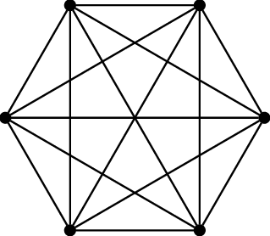
O(E * V)
Dominant Factor
At most, how many edges are in an undirected graph with n vertices?
What graph has the most number of edges?
A complete graph
89

Slide 90
O(E * V)
Dominant Factor
At most, how many edges are in an undirected graph with n vertices?
What graph has the most number of edges?
A complete graph
How many edges does a complete graph with n vertices have?
90

Slide 91
O(E * V)
Dominant Factor
At most, how many edges are in an undirected graph with n vertices?
What graph has the most number of edges?
A complete graph
How many edges does a complete graph with n vertices have?
How many edges leave each vertex? n-1
91

Slide 92
O(E * V)
Dominant Factor
At most, how many edges are in an undirected graph with n vertices?
What graph has the most number of edges?
A complete graph
How many edges does a complete graph with n vertices have?
How many edges leave each vertex? n-1
How much does that all add up to? n * (n-1)
92

Slide 93
O(E * V)
Dominant Factor
At most, how many edges are in an undirected graph with n vertices?
What graph has the most number of edges?
A complete graph
How many edges does a complete graph with n vertices have?
How many edges leave each vertex? n-1
How much does that all add up to? n * (n-1)
Did we double count any edges? Yes
93

Slide 94
O(E * V)
Dominant Factor
At most, how many edges are in an undirected graph with n vertices?
What graph has the most number of edges?
A complete graph
How many edges does a complete graph with n vertices have?
How many edges leave each vertex? n-1
How much does that all add up to? n * (n-1)
Did we double count any edges? Yes
So how many edges are there?
94

Slide 95

O(E * V)
Dominant Factor
At most, how many edges are in an undirected graph with n vertices?
What graph has the most number of edges?
A complete graph
How many edges does a complete graph with n vertices have?
How many edges leave each vertex? n-1
How much does that all add up to? n * (n-1)
Did we double count any edges? Yes
So how many edges are there?
95

Slide 96


O(E * V)
Dominant Factor
At most, how many edges are in an undirected graph with n vertices?
What graph has the most number of edges?
A complete graph
How many edges does a complete graph with n vertices have?
How many edges leave each vertex? n-1
How much does that all add up to? n * (n-1)
Did we double count any edges? Yes
So how many edges are there?
∈ O(n²)
96

Slide 97


O(E * V)
O(n² * n)
Running time of our Kruskal's algorithm
O(n³)
Dominant Factor
At most, how many edges are in an undirected graph with n vertices?
What graph has the most number of edges?
A complete graph
How many edges does a complete graph with n vertices have?
How many edges leave each vertex? n-1
How much does that all add up to? n * (n-1)
Did we double count any edges? Yes
So how many edges are there?
∈ O(n²)
97

Slide 98
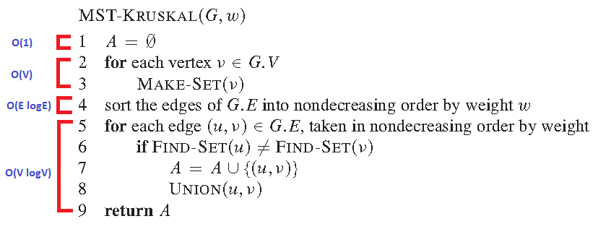

There are many ways to write Kruskal’s algorithm
Running time of finding an MST: O(E log E)
E > V in a complete graph (worst case), so we can get Kruskal’s algorithm to run in O(E log E) time
98

Slide 99

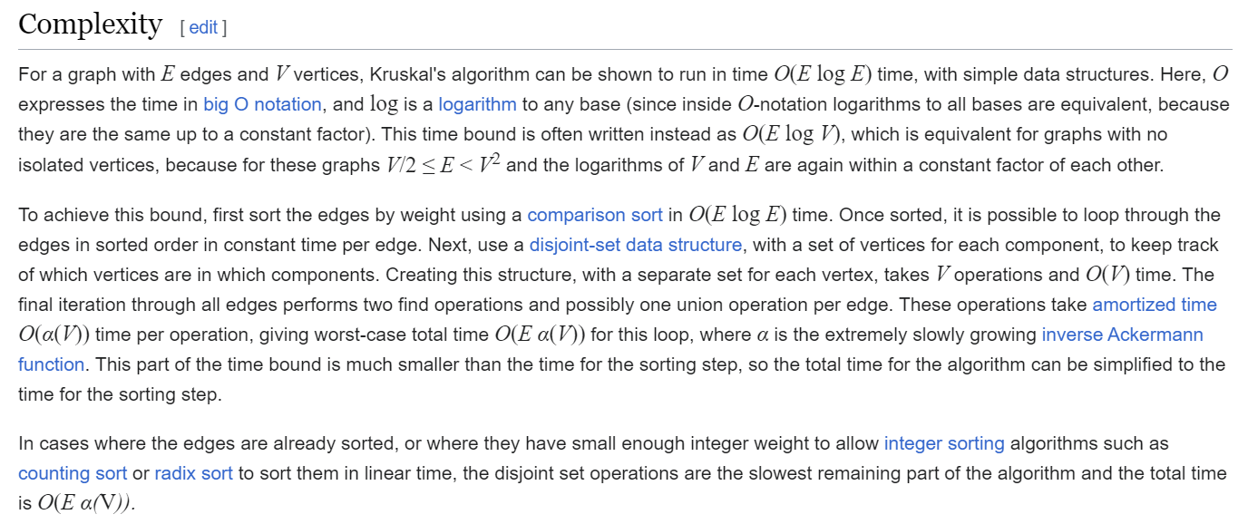
Ok, take a deep breath, the analysis is over
99

Slide 100
There is another prominent algorithm that can also compute an MST
100

Slide 101
Prim’s MST Algorithm
Beginning at any node, add the node that can be connected as cheaply as possible to the tree we are building.
7
3
2
5
1
1
2
4
3
2
101

Slide 102
Prim’s MST Algorithm
Beginning at any node, add the node that can be connected as cheaply as possible to the tree we are building.
7
3
2
5
1
1
2
4
3
2
102

Slide 103
Prim’s MST Algorithm
Beginning at any node, add the node that can be connected as cheaply as possible to the tree we are building.
7
3
2
5
1
1
2
4
3
2
103

Slide 104
Prim’s MST Algorithm
Beginning at any node, add the node that can be connected as cheaply as possible to the tree we are building.
7
3
2
5
1
1
2
4
3
2
104

Slide 105
Prim’s MST Algorithm
Beginning at any node, add the node that can be connected as cheaply as possible to the tree we are building.
7
3
2
5
1
1
2
4
3
2
105

Slide 106
Prim’s MST Algorithm
Beginning at any node, add the node that can be connected as cheaply as possible to the tree we are building.
7
3
2
5
1
1
2
4
3
2
106

Slide 107
Prim’s MST Algorithm
Beginning at any node, add the node that can be connected as cheaply as possible to the tree we are building.
7
3
2
5
1
1
2
4
3
2
107

Slide 108
Prim’s MST Algorithm
Beginning at any node, add the node that can be connected as cheaply as possible to the tree we are building.
7
3
We will use Kruskal’s algorithm in this class, but you should at least be aware of what Prim’s is
2
5
1
1
2
4
3
2
Prim’s Algorithm has the same running time
108

Slide 109
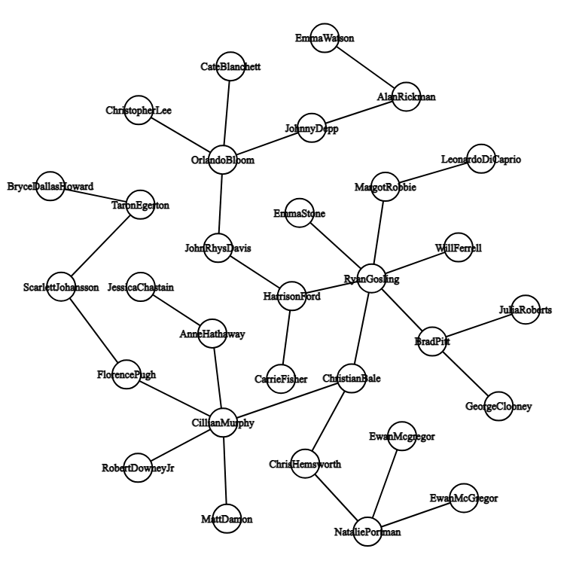
Program 3
(Edge weights for program 3)
109

