Slide 1

CSCI 232: Data Structures and Algorithms
Dynamic Programming (Part 1)
Reese Pearsall
Spring 2024
https://www.cs.montana.edu/pearsall/classes/spring2024/232/main.html
1

Slide 2
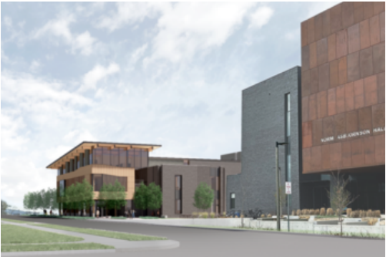
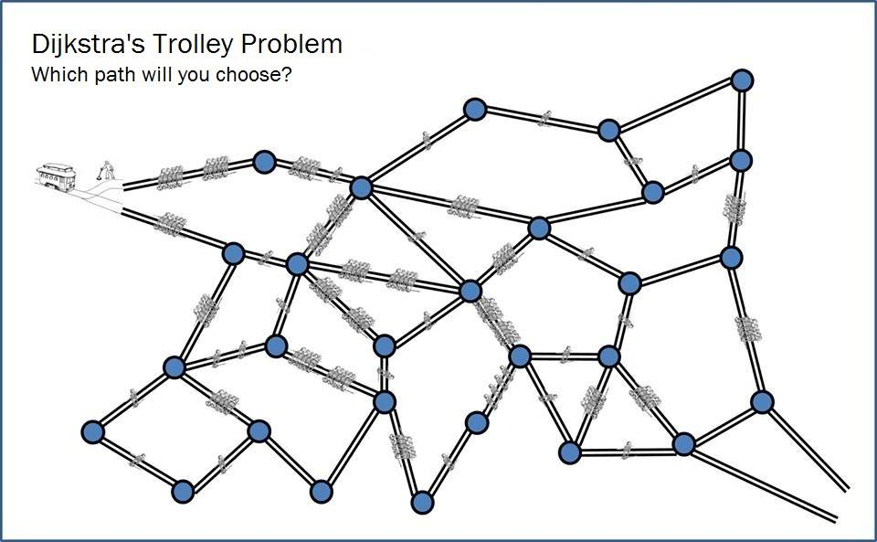
Announcements
Program 3 Due one week from today (4/23)
Tuesday April 23 will be an optional help session for Program 3 (no lecture)
Lab 11 due on Sunday (4/21)
→ After today, you can finish it
Gianforte Hall Groundbreaking Ceremony: Tomorrow @ 2:00 PM
2

Slide 3
Program 3 MST
3

Slide 4
Change Making Problem
Given a set a coin denominations D, how can you represent K cents with the smallest number of coins?
4

Slide 5
Change Making Problem
Given a set a coin denominations D, how can you represent K cents with the smallest number of coins?
D = [1, 5, 10, 25]
K = 37
5

Slide 6
Change Making Problem
Given a set a coin denominations D, how can you represent K cents with the smallest number of coins?
D = [1, 5, 10, 25]
K = 37
Answer = 4
(Quarter, dime, two pennies)
6

Slide 7
Change Making Problem
Given a set a coin denominations D, how can you represent K cents with the smallest number of coins?
D = [1, 5, 10, 25]
K = 37
Answer = 4
(Quarter, dime, two pennies)
Algorithm?
7

Slide 8
Change Making Problem
Given a set a coin denominations D, how can you represent K cents with the smallest number of coins?
D = [1, 5, 10, 25]
K = 37
Answer = 4
(Quarter, dime, two pennies)
Use as many quarters as possible, then as many dimes as possible, …
8

Slide 9
Change Making Problem
Given a set a coin denominations D, how can you represent K cents with the smallest number of coins?
D = [1, 5, 10, 25]
K = 37
Answer = 4
(Quarter, dime, two pennies)
Use as many quarters as possible, then as many dimes as possible, …
This is known as the greedy approach
9

Slide 10
Change Making Problem
Given a set a coin denominations D, how can you represent K cents with the smallest number of coins?
Greedy Algorithm
D = [1, 5, 10, 25]
Use as many quarters as possible, then as many dimes as possible, …
K = 37
10

Slide 11
Change Making Problem
Given a set a coin denominations D, how can you represent K cents with the smallest number of coins?
Greedy Algorithm
D = [1, 5, 10, 18, 25]
Use as many quarters as possible, then as many 18 cent pieces as possible, then dimes , …
K = 37
What if there were also an 18-cent coin?
11

Slide 12
Change Making Problem
Given a set a coin denominations D, how can you represent K cents with the smallest number of coins?
Greedy Algorithm
D = [1, 5, 10, 18, 25]
Use as many quarters as possible, then as many 18 cent pieces as possible, then dimes , …
K = 37
25, 10, 1, 1
(4 coins)
What if there were also an 18-cent coin?
12

Slide 13
Change Making Problem
Given a set a coin denominations D, how can you represent K cents with the smallest number of coins?
Greedy Algorithm
D = [1, 5, 10, 18, 25]
Use as many quarters as possible, then as many 18 cent pieces as possible, then dimes , …
K = 37
25, 10, 1, 1
(4 coins)
What if there were also an 18-cent coin?
Real Answer = 18, 18, 1 (3 coins)
13

Slide 14
Change Making Problem
Given a set a coin denominations D, how can you represent K cents with the smallest number of coins?
Greedy Algorithm
D = [1, 5, 10, 18, 25]
Use as many quarters as possible, then as many 18 cent pieces as possible, then dimes , …
K = 37
25, 10, 1, 1
(4 coins)
What if there were also an 18-cent coin?
Real Answer = 18, 18, 1 (3 coins)
Lesson Learned: The Greedy approach works for the United States denominations, but not for a general set of denominations
14

Slide 15
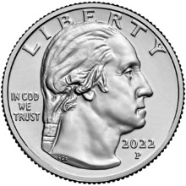
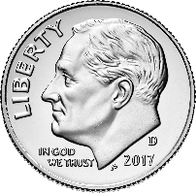
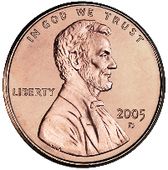
Change Making Problem
Suppose I tell you that 2 quarters, 1 dime, and 3 pennies are the minimum number of coins needed to make 63 cents
(We will assume we have the standard US denominations [1, 5, 10, 25] (NO 50 CENT PIECE)
25 + 25 + 10 + 1 + 1 + 1 = 63
What can you conclude?
Does this provide an answer to any other change making problems?
15

Slide 16
Change Making Problem
Suppose I tell you that 2 quarters, 1 dime, and 3 pennies are the minimum number of coins needed to make 63 cents
(We will assume we have the standard US denominations [1, 5, 10, 25] (NO 50 CENT PIECE)
25 + 25 + 10 + 1 + 1 + 1 = 63
This is the minimum coins needed to make 38 cents
16

Slide 17
Change Making Problem
Suppose I tell you that 2 quarters, 1 dime, and 3 pennies are the minimum number of coins needed to make 63 cents
(We will assume we have the standard US denominations [1, 5, 10, 25] (NO 50 CENT PIECE)
25 + 25 + 10 + 1 + 1 + 1 = 63
This is the minimum coins needed to make 13 cents
17

Slide 18
Change Making Problem
Suppose I tell you that 2 quarters, 1 dime, and 3 pennies are the minimum number of coins needed to make 63 cents
(We will assume we have the standard US denominations [1, 5, 10, 25] (NO 50 CENT PIECE)
25 + 25 + 10 + 1 + 1 + 1 = 63
This is the minimum coins needed to make 3 cents
18

Slide 19
Change Making Problem
Suppose I tell you that 2 quarters, 1 dime, and 3 pennies are the minimum number of coins needed to make 63 cents
(We will assume we have the standard US denominations [1, 5, 10, 25] (NO 50 CENT PIECE)
25 + 25 + 10 + 1 + 1 + 1 = 63
This is the minimum coins needed to make 2 cents
19

Slide 20
Change Making Problem
Suppose I tell you that 2 quarters, 1 dime, and 3 pennies are the minimum number of coins needed to make 63 cents
(We will assume we have the standard US denominations [1, 5, 10, 25] (NO 50 CENT PIECE)
25 + 25 + 10 + 1 + 1 + 1 = 63
This is the minimum coins needed to make 1 cent
20

Slide 21
Change Making Problem
Suppose I tell you that 2 quarters, 1 dime, and 3 pennies are the minimum number of coins needed to make 63 cents
(We will assume we have the standard US denominations [1, 5, 10, 25] (NO 50 CENT PIECE)
25 + 25 + 10 + 1 + 1 + 1 = 63
The solution to the change making problems consists of solutions to smaller change making problems
We can use recursion to solve this problem
21

Slide 22
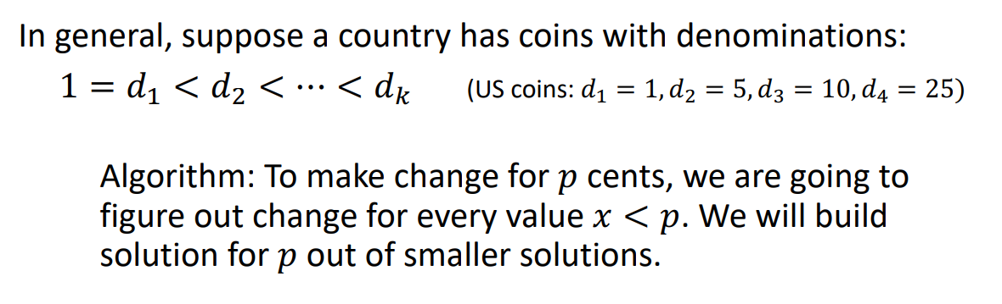
Change Making Problem
22

Slide 23
Change Making Problem
23

Slide 24

Change Making Problem
C(37) = 1 + C(12)
Now find the minimum number of coins needed to make 12 cents
We used one quarter
24

Slide 25
Change Making Problem
Now find the minimum number of coins needed to make 2 cents
C(37) = 1 + C(12)
We used one dime
C(12) = 1 + C(2)
25

Slide 26
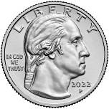
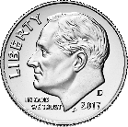
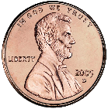
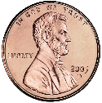
Change Making Problem
C(37) = 1 + C(12)
C(12) = 1 + C(2)
C(2) = 1 + C(1)
C(1) = 1 + C(0)
26

Slide 27
Change Making Problem
C(37) = 1 + C(12)
C(12) = 1 + C(2)
C(2) = 1 + C(1)
C(1) = 1
27

Slide 28
Change Making Problem
C(37) = 1 + C(12)
C(12) = 1 + C(2)
C(2) = 1 + 1
28

Slide 29
Change Making Problem
C(37) = 1 + C(12)
C(12) = 1 + C(2)
C(2) = 2
29

Slide 30
Change Making Problem
C(37) = 1 + C(12)
C(12) = 1 + 2
30

Slide 31
Change Making Problem
C(37) = 1 + C(12)
C(12) = 3
31

Slide 32
Change Making Problem
C(37) = 1 + 3
32

Slide 33
Change Making Problem
C(37) = 4
The minimum number of coins needed to make 37 cents is 4
33

Slide 34
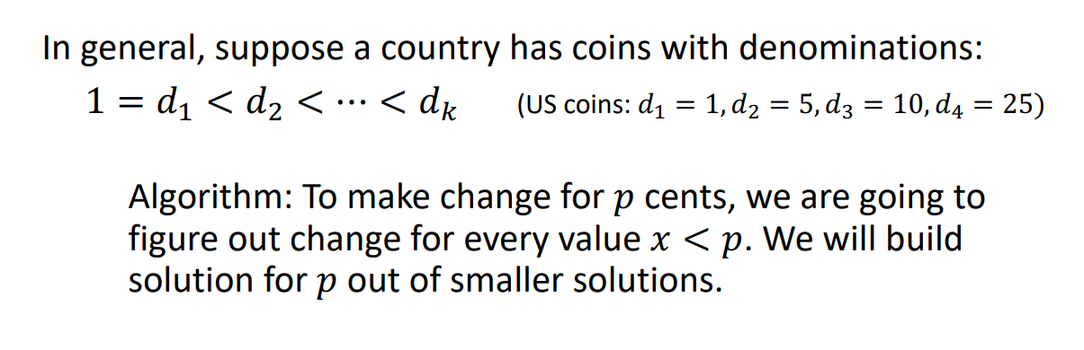
Change Making Problem
(This algorithm must work for ALL denominations)
34

Slide 35
Change Making Problem
Make $0.19 with $0.01, $0.05, $0.10
19
35

Slide 36
Change Making Problem
Make $0.19 with $0.01, $0.05, $0.10
19
1
10
5
36

Slide 37
Change Making Problem
Make $0.19 with $0.01, $0.05, $0.10
k = # denominations
19
1
10
5
18
14
9
Find minimum coins needed to make 18 cents
Find minimum coins needed to make 14 cents
Find minimum coins needed to make 9 cents
To find the minimum number of coins needed to create 19 cents, we generate k subproblems
37

Slide 38
Change Making Problem
Make $0.19 with $0.01, $0.05, $0.10
k = # denominations
19
1
10
5
18
14
9
Find minimum coins needed to make 18 cents
Find minimum coins needed to make 14 cents
Find minimum coins needed to make 9 cents
We want to select the minimum solution of these three subproblems

Slide 39
Change Making Problem
Make $0.19 with $0.01, $0.05, $0.10
k = # denominations
19
1
10
5
18
14
9
Find minimum coins needed to make 18 cents
Find minimum coins needed to make 14 cents
Find minimum coins needed to make 9 cents
5
5
4
For the solution of our original problem (19), we want to select this branch (one dime used)
39

Slide 40
Change Making Problem
Make $0.19 with $0.01, $0.05, $0.10
k = # denominations
19
1
10
5
18
14
9
1
10
5
17
13
8
Find minimum coins needed to make 17 cents
Find minimum coins needed to make 13 cents
Find minimum coins needed to make 8 cents
40

Slide 41
Change Making Problem
Make $0.19 with $0.01, $0.05, $0.10
k = # denominations
19
1
10
5
18
14
9
1
10
5
17
13
8
41

Slide 42
Change Making Problem
Make $0.19 with $0.01, $0.05, $0.10
k = # denominations
19
1
10
5
18
14
9
1
10
5
17
13
8
1
10
5
16
12
7
42

Slide 43
Change Making Problem
Make $0.19 with $0.01, $0.05, $0.10
k = # denominations
19
1
10
5
18
14
9
1
10
5
17
13
8
1
10
5
16
12
7
0
Eventually, we reach our base case, the minimum number of coins needed to make 0 cents
43

Slide 44
Change Making Problem
Make $0.19 with $0.01, $0.05, $0.10
k = # denominations
19
1
10
5
When C(9), we cant use a 10 cent piece…
18
14
9
1
10
1
10
1
5
5
5
8
13
9
8
8
4
17
13
1
10
5
For each change making problem we solve, we must solve at most 3 smaller change making problems
Once we solve the smaller problems, we must select the branch that has the minimum value
16
12
7
44

Slide 45
Change Making Problem
Make $0.19 with $0.01, $0.05, $0.10
k = # denominations
19
1
10
5
When C(9), we cant use a 10 cent piece…
18
14
9
1
10
1
10
1
5
5
5
8
13
9
8
8
4
17
13
1
10
5
For each change making problem we solve, we must solve at most 3 smaller change making problems
Once we solve the smaller problems, we must select the branch that has the minimum value
16
12
7
45

Slide 46

46

Slide 47
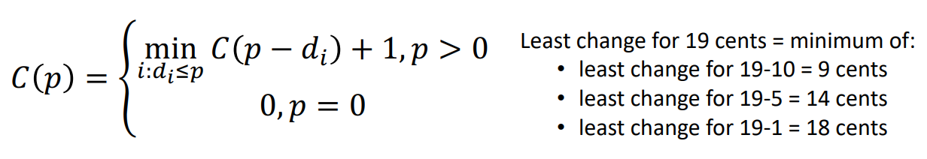

Change Making Problem
For each problem P, we will solve the problem for (P – d), where d represents each possible denomination
47

Slide 48

Change Making Problem
For each problem P, we will solve the problem for (P – d), where d represents each possible denomination
We want to select only the branch the yields the minimum value
48

Slide 49

Change Making Problem
For each problem P, we will solve the problem for (P – d), where d represents each possible denomination
If we ever need to make change for 0 cents, return 0
We want to select only the branch the yields the minimum value
49

Slide 50
Change Making Problem
For each problem P, we will solve the problem for (P – d), where d represents each possible denomination
If we ever need to make change for 0 cents, return 0
We want to select only the branch the yields the minimum value
50

Slide 51
Change Making Problem
D = array of denominations [1, 5, 10, 18, 25]
p = desired change (37)
min_coins(D, p)
51

Slide 52
Change Making Problem
D = array of denominations [1, 5, 10, 18, 25]
p = desired change (37)
min_coins(D, p)
if p == 0
return 0;
Base Case
52

Slide 53

Change Making Problem
D = array of denominations [1, 5, 10, 18, 25]
p = desired change (37)
min_coins(D, p)
if p == 0
return 0;
else
min = ∞
a = ∞
Base Case
53

Slide 54
Change Making Problem
D = array of denominations [1, 5, 10, 18, 25]
p = desired change (37)
min_coins(D, p)
if p == 0
return 0;
else
min = ∞
a = ∞
for each d_{i} in D
if (p – d_{i}) >= 0
a = min_coins(D, p – d_{i} )
Base Case
Recurse, and find the minimum number of coins needed using each valid denomination
54

Slide 55
Change Making Problem
D = array of denominations [1, 5, 10, 18, 25]
p = desired change (37)
min_coins(D, p)
if p == 0
return 0;
else
min = ∞
a = ∞
for each d_{i} in D
if (p – d_{i}) >= 0
a = min_coins(D, p – d_{i} )
if a < min
min = a
Base Case
Recurse, and find the minimum number of coins needed using each valid denomination
Select the branch that has the minimum value
55

Slide 56
Change Making Problem
D = array of denominations [1, 5, 10, 18, 25]
p = desired change (37)
min_coins(D, p)
if p == 0
return 0;
else
min = ∞
a = ∞
for each d_{i} in D
if (p – d_{i}) >= 0
a = min_coins(D, p – d_{i} )
if a < min
min = a
Base Case
Recurse, and find the minimum number of coins needed using each valid denomination
Select the branch that has the minimum value
56

Slide 57
Change Making Problem
D = array of denominations [1, 5, 10, 18, 25]
p = desired change (37)
min_coins(D, p)
if p == 0
return 0;
else
min = ∞
a = ∞
for each d_{i} in D
if (p – d_{i}) >= 0
a = min_coins(D, p – d_{i} )
if a < min
min = a
return 1 + min
Base Case
Recurse, and find the minimum number of coins needed using each valid denomination
Select the branch that has the minimum value
Once, our for loop finishes, we should know the branch that had the minimum, so return (1 + min), 1 because one coin was used in the current method call
57

Slide 58
Change Making Problem
min_coins(D, p)
if p == 0
return 0;
else
min = ∞
a = ∞
for each d_{i} in D
if (p – d_{i}) >= 0
a = min_coins(D, p – d_{i} )
if a < min
min = a
return 1 + min
58

Slide 59
Change Making Problem
min_coins(D, p)
if p == 0
return 0;
else
min = ∞
a = ∞
for each d_{i} in D
if (p – d_{i}) >= 0
a = min_coins(D, p – d_{i} )
if a < min
min = a
return 1 + min
Running time?
59

Slide 60
Change Making Problem
Make $0.19 with $0.01, $0.05, $0.10
k = # denominations
p = value to make change for
19
1
10
5
18
14
9
1
10
1
10
1
5
5
5
8
13
9
8
8
4
17
13
1
10
5
For sufficiently large p, every permutation of denominations is included.
16
12
7
60

Slide 61
Change Making Problem
Make $0.19 with $0.01, $0.05, $0.10
k = # denominations
p = value to make change for
19
1
10
5
18
14
9
k
1
10
1
10
1
5
5
5
8
13
9
8
8
4
17
13
1
10
5
16
12
7
61

Slide 62
Change Making Problem
Make $0.19 with $0.01, $0.05, $0.10
k = # denominations
p = value to make change for
19
1
10
5
18
14
9
k
1
10
1
10
1
5
5
5
13
9
8
k²
17
13
8
8
4
1
10
5
16
12
7
62

Slide 63
Change Making Problem
Make $0.19 with $0.01, $0.05, $0.10
k = # denominations
p = value to make change for
19
1
10
5
18
14
9
k
1
10
1
10
1
5
5
5
13
9
8
k²
17
13
8
8
4
1
10
5
k³
16
12
7
63

Slide 64
Change Making Problem
Make $0.19 with $0.01, $0.05, $0.10
k = # denominations
p = value to make change for
19
1
10
5
18
14
9
k
1
10
1
10
1
5
5
5
13
9
8
k²
17
13
8
8
4
1
10
5
k³
16
12
7
k^{p}
64

Slide 65
Change Making Problem
Make $0.19 with $0.01, $0.05, $0.10
k = # denominations
p = value to make change for
19
As k and p both grow, the number of recursive calls being made will grow exponentially
If we have a lot of coin denominations, we will have a lot of branching
1
10
5
18
14
9
k
1
10
1
10
1
5
5
5
13
9
8
k²
17
13
8
8
4
1
10
5
k³
16
12
7
k^{p}
65

Slide 66

Change Making Problem
Make $0.19 with $0.01, $0.05, $0.10
k = # denominations
p = value to make change for
19
As k and p both grow, the number of recursive calls being made will grow exponentially
Running time: O( )
1
10
5
18
14
9
k
1
10
1
10
1
5
5
5
13
9
8
k²
17
13
8
8
4
1
10
5
k³
16
12
7
k^{p}
66

Slide 67
Change Making Problem
Make $0.19 with $0.01, $0.05, $0.10
k = # denominations
p = value to make change for
19
As k and p both grow, the number of recursive calls being made will grow exponentially
Running time: probably O(k^{p}) or O(k!)
For a large set of denominations, or a large p, this algorithm will take a long time to run
1
10
5
18
14
9
k
1
10
1
10
1
5
5
5
13
9
8
k²
17
13
8
8
4
1
10
5
k³
16
12
7
k^{p}
67

Slide 68

Let’s try 81 cents!
68

Slide 69
Change Making Problem
19
1
10
5
18
14
9
1
10
1
10
1
5
5
5
8
13
9
8
8
4
17
13
1
10
5
Why does our algorithm suck?
16
12
7
69

Slide 70




Change Making Problem
19
1
10
5
18
14
9
1
10
1
10
1
5
5
5
8
13
9
8
8
4
17
13
1
10
5
Why does our algorithm suck?
16
12
7
We frequently re-compute the solution to the sub problems we have already solved
…
8
70

Slide 71




Change Making Problem
19
1
10
5
We can fix this by utilizing some “smart recursion” AKA Dynamic Programming
18
14
9
1
10
1
10
1
5
5
5
8
13
9
8
8
4
17
13
1
10
5
Why does our algorithm suck?
16
12
7
We frequently re-compute the solution to the sub problems we have already solved
…
8
71

Slide 72
Dynamic Programming
Dynamic Programming is an algorithm technique used for optimization problems that involves smartly using recursion to solve a problem with many overlapping subproblems
72

Slide 73
Dynamic Programming
Dynamic Programming is an algorithm technique used for optimization problems that involves smartly using recursion to solve a problem with many overlapping subproblems
To use dynamic programming, we must first identify two characteristics of some problem
(If it has these two characteristics, we can use DP to solve it)
73

Slide 74

Dynamic Programming
Dynamic Programming is an algorithm technique used for optimization problems that involves smartly using recursion to solve a problem with many overlapping subproblems
To use dynamic programming, we must first identify two characteristics of some problem
(If it has these two characteristics, we can use DP to solve it)
Optimal substructure- an optimal solution can be constructed from optimal solutions of its sub problems
74

Slide 75



Dynamic Programming
Dynamic Programming is an algorithm technique used for optimization problems that involves smartly using recursion to solve a problem with many overlapping subproblems
To use dynamic programming, we must first identify two characteristics of some problem
(If it has these two characteristics, we can use DP to solve it)
Optimal substructure- an optimal solution can be constructed from optimal solutions of its sub problems
Overlapping Subproblems- we solve the same subproblem several times during the algorithm
75

Slide 76




Dynamic Programming
Optimal substructure- an optimal solution can be constructed from optimal solutions of its sub problems
The solution to the change making problem consists of solution to smaller change making problems
Overlapping Subproblems- we solve the same subproblem several times during the algorithm
We frequently recompute the same subproblem throughout the algorithm
We satisfy these two conditions, which means we can leverage Dynamic Programming
76

Slide 77
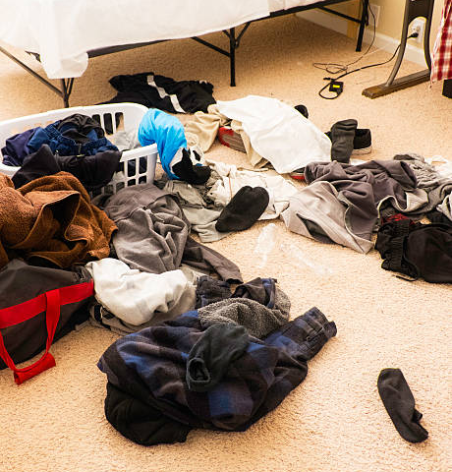


Dynamic Programming
Big idea of dynamic programming:
Use memoization to store solutions of sub problems we have already solved, and don’t re compute them
(Yes, it’s “memoization” and not “memorization”)
77

Slide 78
Dynamic Programming
7
Memoization Table
1
5
3
0
1
2
3
4
5
6
7
6
4
2
1
5
3
5
3
1
1
5
3
4
2
0
1
3
3
1
1
2
1
1
1
0
78

Slide 79

Dynamic Programming
7
Memoization Table
1
5
3
0
1
2
3
4
5
6
7
6
4
2
1
5
3
5
3
1
1
5
3
We eventually hit our base case, and solve that the optimal way to make 0 cents is with zero coins
4
2
0
1
3
3
1
1
2
1
1
1
0
79

Slide 80

Dynamic Programming
7
Memoization Table
1
5
3
0 | 0
1
2
3
4
5
6
7
6
4
2
1
5
3
5
3
1
1
5
3
We eventually hit our base case, and solve that the optimal way to make 0 cents is with zero coins
4
2
0
1
3
3
1
1
2
1
1
1
0
80

Slide 81
Dynamic Programming
7
Memoization Table
1
5
3
0 | 0
1 | 1
2
3
4
5
6
7
6
4
2
1
5
3
5
3
1
1
5
3
4
2
0
1
3
We then see that the optimal way to make 1 cent is with one coin
3
1
1
2
1
1
81

Slide 82
Dynamic Programming
7
Memoization Table
1
5
3
0 | 0
1 | 1
2 | 2
3
4
5
6
7
6
4
2
1
5
3
5
3
1
1
5
3
4
2
0
1
3
The optimal way to make two cents is with 2 coins
3
1
1
2
82

Slide 83
Dynamic Programming
7
Memoization Table
1
5
3
0 | 0
1 | 1
2 | 2
3
4
5
6
7
6
4
2
1
5
3
5
3
1
1
5
3
4
2
0
1
3
Using a 3 cent piece is more optimal than 3 pennies, so we place 1 in memoization table for 3
3
1
1
3
2
0
83

Slide 84
Dynamic Programming
7
Memoization Table
1
5
3
0 | 0
1 | 1
2 | 2
3 | 1
4
5
6
7
6
4
2
1
5
3
5
3
1
1
5
3
4
2
0
1
3
Using a 3 cent piece is more optimal than 3 pennies, so we place 1 in memoization table for 3
3
1
84

Slide 85
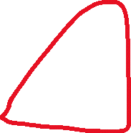
Dynamic Programming
7
Memoization Table
1
5
3
0 | 0
1 | 1
2 | 2
3 | 1
4
5
6
7
6
4
2
1
5
3
5
3
1
1
5
3
4
2
0
1
3
The optimal way to make 4 cents is with 2 coins
3
1
85

Slide 86
Dynamic Programming
7
Memoization Table
1
5
3
0 | 0
1 | 1
2 | 2
3 | 1
4 | 2
5
6
7
6
4
2
1
5
3
5
3
1
1
5
3
4
2
0
86

Slide 87


Dynamic Programming
7
Memoization Table
1
5
3
0 | 0
1 | 1
2 | 2
3 | 1
4 | 2
5
6
7
6
4
2
1
5
3
5
3
1
1
5
3
4
2
0
1
We no longer need to branch here, because we already know the optimal way to make 2 cents!
1
87

Slide 88
Dynamic Programming
7
Memoization Table
1
5
3
0 | 0
1 | 1
2 | 2
3 | 1
4 | 2
5
6
7
6
4
2
1
5
3
5
3
1
1
5
3
4
2
0
We learn the optimal way to make five cents is with one coin
88

Slide 89
Dynamic Programming
7
Memoization Table
1
5
3
0 | 0
1 | 1
2 | 2
3 | 1
4 | 2
5 | 1
6
7
6
4
2
1
5
3
5
3
1
89

Slide 90
Dynamic Programming
7
Memoization Table
1
5
3
0 | 0
1 | 1
2 | 2
3 | 1
4 | 2
5 | 1
6
7
6
4
2
1
5
3
5
3
1
All three of these branches have the same cost, so making 6 cents requires 2 coint
90

Slide 91
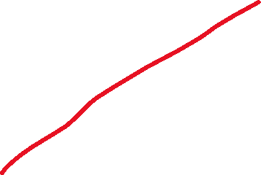
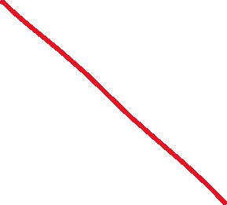
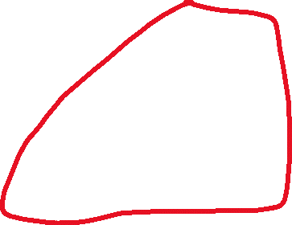
Dynamic Programming
7
Memoization Table
1
5
3
0 | 0
1 | 1
2 | 2
3 | 1
4 | 2
5 | 1
6 | 2
7
6
4
2
1
3
3
1
1
1
2
0
1
1
1
0
We no longer need to branch here, because we already know the optimal solution for 4, so just check our memoization table!
91

Slide 92
Dynamic Programming
7
Memoization Table
1
5
3
0 | 0
1 | 1
2 | 2
3 | 1
4 | 2
5 | 1
6 | 2
7
6
4
2
2
2
2
92

Slide 93
Dynamic Programming
7
Memoization Table
0 | 0
1 | 1
2 | 2
3 | 1
4 | 2
5 | 1
6 | 2
7 | 3
The optimal way to make 7 cents is with 3 coins:
[1, 1, 5]
[3, 1, 3]
Code
93

Slide 94
Dynamic Programming
7
Memoization Table
0 | 0
1 | 1
2 | 2
3 | 1
4 | 2
5 | 1
6 | 2
7 | 3
Top – Bottom Dynamic Programming (Memoization)
(Use Recurison)
94

Slide 95

Dynamic Programming (Bottom to Top)
0 | 0
1 | 1
2 | 2
3 | 1
4 | 2
5 | 1
6 | 2
7 | 3
If we don’t want to use recursion, we can use a for loop to fill out this entire array (tabulation)
95

Slide 96
Dynamic Programming (Bottom to Top)
Cache
0 | 0
1 | ∞
2 | ∞
3 | ∞
4 | ∞
5 | ∞
6 | ∞
7 | ∞
cache[0] = 0 //base case
For each cent value, i, in our array (0 – P):
For each coin in our denomination set c:
if(c – cache[i] >= 0):
x = cache[i – c];
if x is smaller than what is currently in the cache:
update cache to be x + 1
(1)
96

Slide 97
Dynamic Programming (Bottom to Top)
Cache
0 | 0
1 | 1
2 | ∞
3 | ∞
4 | ∞
5 | ∞
6 | ∞
7 | ∞
cache[0] = 0 //base case
For each cent value, i, in our array (0 – P):
For each coin in our denomination set c:
if(c – cache[i] >= 0):
x = cache[i – c];
if x is smaller than what is currently in the cache:
update cache to be x + 1
(1)
97

Slide 98
Dynamic Programming (Bottom to Top)
Cache
0 | 0
1 | 1
2 | 2
3 | ∞
4 | ∞
5 | ∞
6 | ∞
7 | ∞
cache[0] = 0 //base case
For each cent value, i, in our array (0 – P):
For each coin in our denomination set c:
if(c – cache[i] >= 0):
x = cache[i – c];
if x is smaller than what is currently in the cache:
update cache to be x + 1
(1, 3)
98

Slide 99
Dynamic Programming (Bottom to Top)
Cache
0 | 0
1 | 1
2 | 2
3 | 1
4 | ∞
5 | ∞
6 | ∞
7 | ∞
cache[0] = 0 //base case
For each cent value, i, in our array (0 – P):
For each coin in our denomination set c:
if(c – cache[i] >= 0):
x = cache[i – c];
if x is smaller than what is currently in the cache:
update cache to be x + 1
(1, 3)
99

Slide 100
Dynamic Programming (Bottom to Top)
Cache
0 | 0
1 | 1
2 | 2
3 | 1
4 | 2
5 | ∞
6 | ∞
7 | ∞
cache[0] = 0 //base case
For each cent value, i, in our array (0 – P):
For each coin in our denomination set c:
if(c – cache[i] >= 0):
x = cache[i – c];
if x is smaller than what is currently in the cache:
update cache to be x + 1
(1, 3)
100

Slide 101

Dynamic Programming (Bottom to Top)
Cache
0 | 0
1 | 1
2 | 2
3 | 1
4 | 2
5 | ∞
6 | ∞
7 | ∞
cache[0] = 0 //base case
For each cent value, i, in our array (0 – P):
For each coin in our denomination set c:
if(c – cache[i] >= 0):
x = cache[i – c];
if x is smaller than what is currently in the cache:
update cache to be x + 1
(1, 3, 5)
101

Slide 102
Dynamic Programming (Bottom to Top)
Cache
0 | 0
1 | 1
2 | 2
3 | 1
4 | 2
5 | 1
6 | ∞
7 | ∞
cache[0] = 0 //base case
For each cent value, i, in our array (0 – P):
For each coin in our denomination set c:
if(c – cache[i] >= 0):
x = cache[i – c];
if x is smaller than what is currently in the cache:
update cache to be x + 1
(1, 3, 5)
102

Slide 103
Dynamic Programming (Bottom to Top)
Cache
0 | 0
1 | 1
2 | 2
3 | 1
4 | 2
5 | 1
6 | ∞
7 | ∞
cache[0] = 0 //base case
For each cent value, i, in our array (0 – P):
For each coin in our denomination set c:
if(c – cache[i] >= 0):
x = cache[i – c];
if x is smaller than what is currently in the cache:
update cache to be x + 1
(1, 3, 5)
103

Slide 104
Dynamic Programming (Bottom to Top)
Cache
0 | 0
1 | 1
2 | 2
3 | 1
4 | 2
5 | 1
6 | 2
7 | ∞
cache[0] = 0 //base case
For each cent value, i, in our array (0 – P):
For each coin in our denomination set c:
if(c – cache[i] >= 0):
x = cache[i – c];
if x is smaller than what is currently in the cache:
update cache to be x + 1
(1, 3, 5)
104

Slide 105
Dynamic Programming (Bottom to Top)
Cache
0 | 0
1 | 1
2 | 2
3 | 1
4 | 2
5 | 1
6 | 2
7 | ∞
cache[0] = 0 //base case
For each cent value, i, in our array (0 – P):
For each coin in our denomination set c:
if(c – cache[i] >= 0):
x = cache[i – c];
if x is smaller than what is currently in the cache:
update cache to be x + 1
(1, 3, 5)
105

Slide 106
Dynamic Programming (Bottom to Top)
Cache
0 | 0
1 | 1
2 | 2
3 | 1
4 | 2
5 | 1
6 | 2
7 | 3
cache[0] = 0 //base case
For each cent value, i, in our array (0 – P):
For each coin in our denomination set c:
if(c – cache[i] >= 0):
x = cache[i – c];
if x is smaller than what is currently in the cache:
update cache to be x + 1
(1, 3, 5)
106

Slide 107
Dynamic Programming (Bottom to Top)
Cache
0 | 0
1 | 1
2 | 2
3 | 1
4 | 2
5 | 1
6 | 2
7 | 3
cache[0] = 0 //base case
For each cent value, i, in our array (0 – P):
For each coin in our denomination set c:
if(c – cache[i] >= 0):
x = cache[i – c];
if x is smaller than what is currently in the cache:
update cache to be x + 1
(1, 3, 5)
Our table is filled out, we can now query it!
107

Slide 108
Dynamic Programming (Bottom to Top)
Cache
0 | 0
1 | 1
2 | 2
3 | 1
4 | 2
5 | 1
6 | 2
7 | 3
cache[0] = 0 //base case
For each cent value, i, in our array (0 – P):
For each coin in our denomination set c:
if(c – cache[i] >= 0):
x = cache[i – c];
if x is smaller than what is currently in the cache:
update cache to be x + 1
return cache[P]
(1, 3, 5)
Our table is filled out, we can now query it!
108

Slide 109
Dynamic Programming (Bottom to Top)
Cache
0 | 0
1 | 1
2 | 2
3 | 1
4 | 2
5 | 1
6 | 2
7 | 3
cache[0] = 0 //base case
For each cent value, i, in our array (0 – P):
For each coin in our denomination set c:
if(c – cache[i] >= 0):
x = cache[i – c];
if x is smaller than what is currently in the cache:
update cache to be x + 1
return cache[P]
(1, 3, 5)
Bottom-Up Dynamic Programming (Tabulation)
Our table is filled out, we can now query it!
109

Slide 110
Dynamic Programming
start
7
6
…
0
Top to Bottom Dynamic Programming
Use recursion, and fill out a memoization table as you are making recursive calls
Bottom-Up Dynamic Programming
→ Use a for loop to fill out a table (tabulation), then query the table
7
6
…
0
Both have the same running time. But a computer can handle a for loop better than recursion
(I think recursion is easier to understand)
DP improves running time from exponential to O( len(D) * p )
start
110

Slide 111
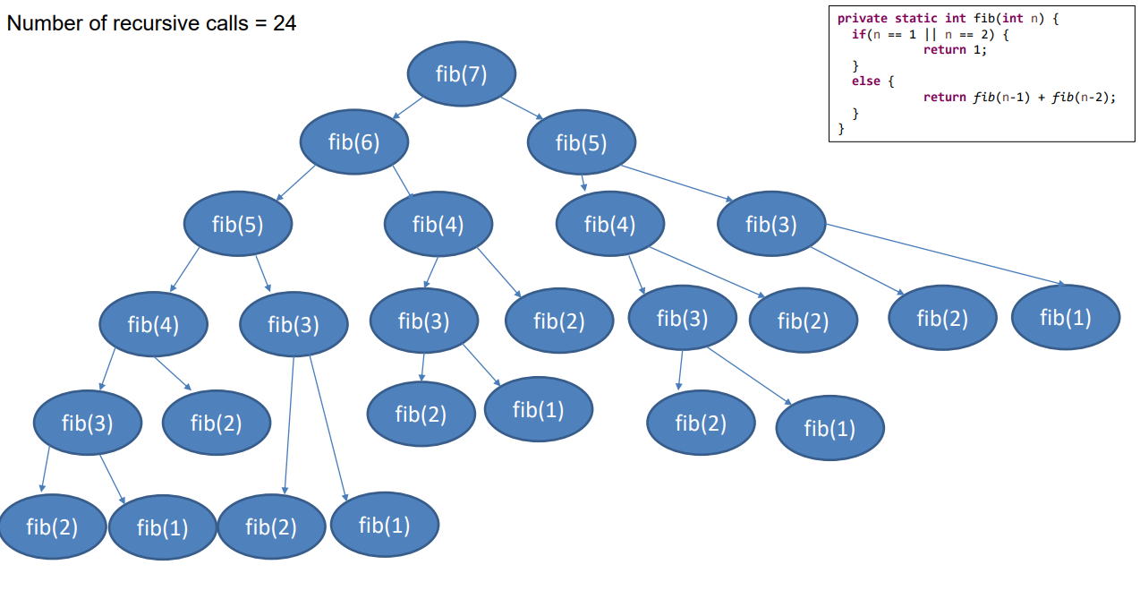
Fibonacci Sequence
Optimal Substructure
Overlapping Subproblems
Rewrite this recursive method using Top-Down DP
111

